Slide 1
Bioinformatics Lab
Spring Quarter 2017
UCSD
Week 5 Session 1
Instructor:
Arturo Medrano
l1medranosoto@ucsd.edu
Instructional Assistant:
Hanbin Lu
hal213@ucsd.edu

Slide 2


Biological Databases
Last week we learned how to use biopython to parse files with genomic information from UniProt.
In addition, we worked with MySQL and learned how to create, modify, load, and query tables. We also defined a preliminary set of fields to generate tables for a realistic database that contains genomic information.
In this session we will continue to work on MySQL and start with the concept of homology where we’ll define and implement computational strategies to detect it and store that information into a our database.
2

Slide 3
Homology
Homology: the relationship of two characters that have descended from a common ancestral character.
Two genes are either homologous or not; 80% identity does not mean 80% homology.
Cenancestor: the most recent common ancestor of the taxa being considered.
Analogy: when characters, although similar, have descended convergently from unrelated ancestral characters. Functionally similar features that have evolved independently are analogous.
For example, the evolution of flight as insects, birds have independently evolved the capacity of flight.
Homoplasy: The complement of analogy. It refers to the relationship of 2 characters in a tree (parallel evolution), whereas analogy is a relationship of 2 characters independently of any tree (convergent evolution).
2000, TIGs 16(5):227-231
3

Slide 4
Homology
There are three disjoint subtypes of homology: orthology, paralogy and Xenology.
Orthology: The relationship where sequence divergence follow speciation. That is, the common ancestor of the two genes lies in the Cenancestor of the taxa from which the two sequences were obtained. This means that the true phylogeny of the genes is identical to the phylogeny of the organisms from which the sequences were obtained. Only orthologous sequences have this property.
Paralogy: the condition where sequences divergence follows gene duplication. Genes diverge while coexisting in the same lineage. Mixing paralogous with orthologous sequences can lead to a tree with the correct phylogeny but not for the taxa from which they derive. A gene tree is not necessarily a species tree.
Xenology: The condition where the history of a gene involves an interspecies transfer of genetic material (horizontal gene transfer). The only form of homology where descent is not from parent to offspring but, rather, from one organism to another.
2000, TIGs 16(5):227-231
4

Slide 5
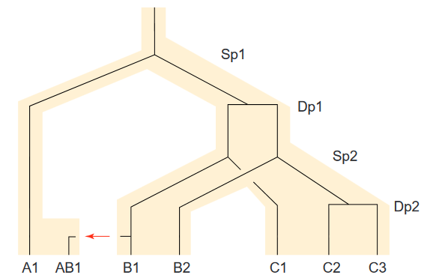
Homology
C2 and C3 are:
Paralogous
B2 is related to C2 and C3 by:
Orthology
B1 is related to C2 and C3 by:
Paralogy
A1 is related to all Bs and Cs by:
Orthology
AB1 and B1 are:
Xenologous
AB1 and A1 are:
Xenologous
AB1 is xenologous to all genes
HGT
2000, TIGs 16(5):227-231
5

Slide 6
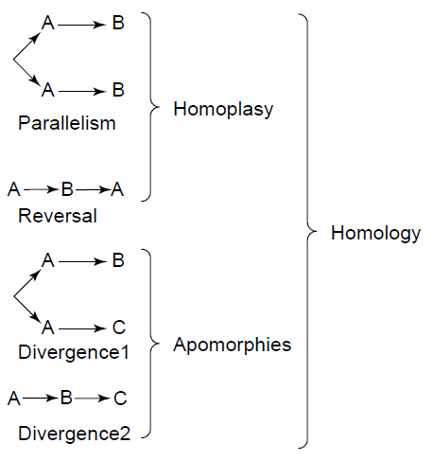
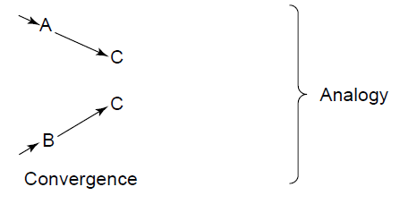
Analogy vs Homoplasy
2000, TIGs 16(5):227-231
6

Slide 7
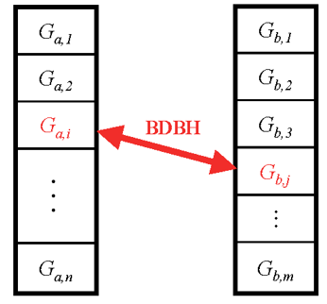
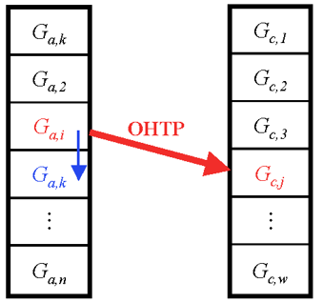

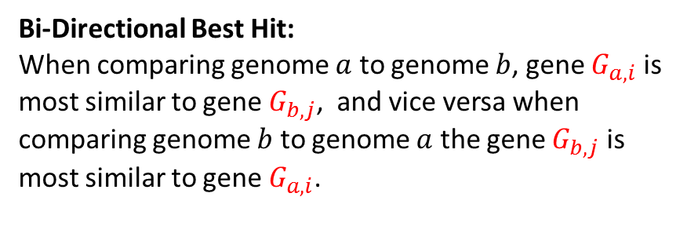



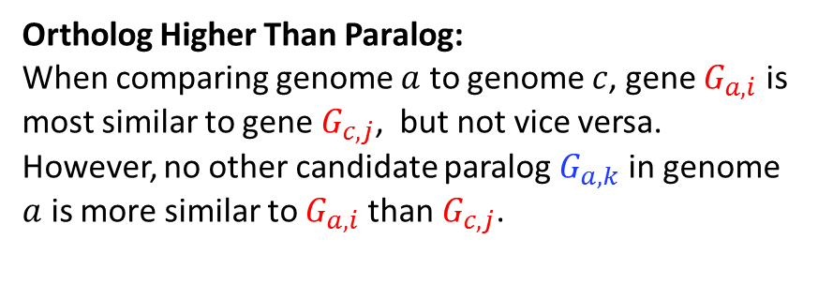
Working definitions of Orthology
Bi-Directional Best Hit:
When comparing genome $a$ to genome $b$, gene $G_{a,i}$ is most similar to gene $G_{b,j}$, and vice versa when comparing genome $b$ to genome $a$ the gene $G_{b,j}$ is most similar to gene $G_{a,i}$.
Ortholog Higher Than Paralog:
When comparing genome $a$ to genome $c$, gene $G_{a,i}$ is most similar to gene $G_{c,j}$, but not vice versa. However, no other candidate paralog $G_{a,k}$ in genome $a$ is more similar to $G_{a,i}$ than $G_{c,j}$.
Genome $a$
Genome $b$
Genome $a$
Genome $c$
7

Slide 8
Amino Acid Substitution Matrices
Model the rate at which one amino acid can change to a different amino acid over time.
Over evolutionary time each amino acid is more or less likely to mutate into other amino acids
For example a hydrophilic residue such as R is more likely to be replaced by another hydrophilic residue such as Q, than it is to be mutated to a hydrophobic residue such as L.
This is primarily due to redundancy of the genetic code, which translates similar codons into similar amino acids.
Mutating an amino acid to another with significantly different physico-chemical properties could affect the folding and activity of the protein.
8

Slide 9

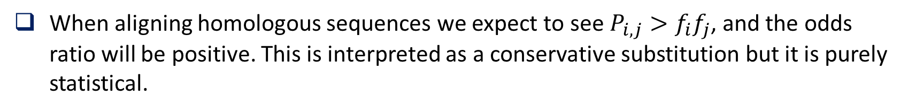
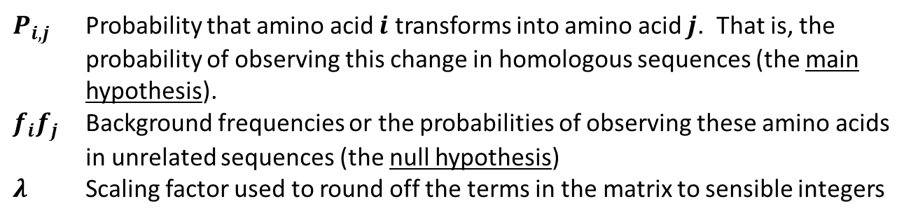
Amino Acid Substitution Matrices
Alignment scores in a substitution matrix are represented with log-odds scores.
They reflect the ratio of likelihoods of two competing hypotheses.
The log-odds score between two residues is determined by:
$P_{i,j}$ Probability that amino acid $i$ transforms into amino acid $j$. That is, the probability of observing this change in homologous sequences (the main hypothesis).
$f_{i}f_{j}$ Background frequencies or the probabilities of observing these amino acids in unrelated sequences (the null hypothesis)
$λ$ Scaling factor used to round off the terms in the matrix to sensible integers
When aligning homologous sequences we expect to see $P_{i,j}>f_{i}f_{j}$, and the odds ratio will be positive. This is interpreted as a conservative substitution but it is purely statistical.
9

Slide 10
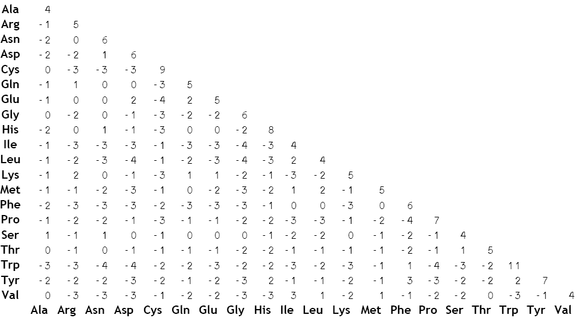
BLOSUM62
10

Slide 11
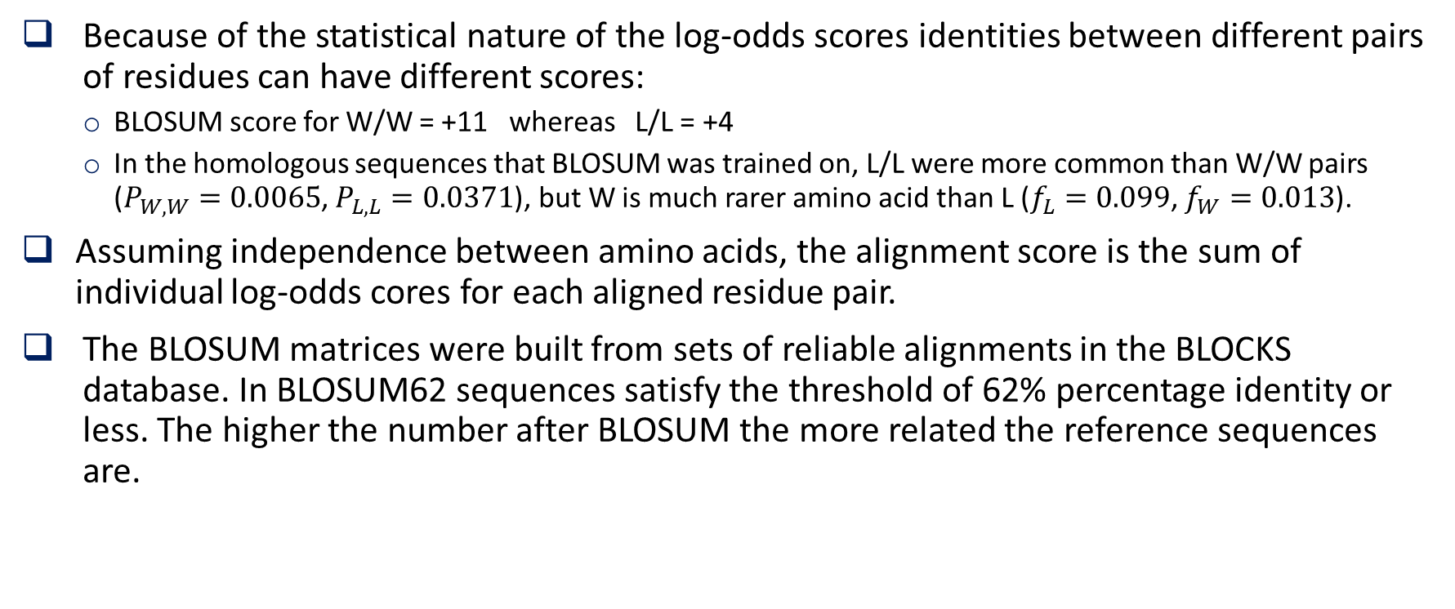
Amino Acid Substitution Matrices
Because of the statistical nature of the log-odds scores identities between different pairs of residues can have different scores:
BLOSUM score for W/W = +11 whereas L/L = +4
In the homologous sequences that BLOSUM was trained on, L/L were more common than W/W pairs ($P_{W,W}=0.0065$, $P_{L,L}=0.0371$), but W is much rarer amino acid than L ($f_{L}=0.099$, $f_{W}=0.013$).
Assuming independence between amino acids, the alignment score is the sum of individual log-odds cores for each aligned residue pair.
The BLOSUM matrices were built from sets of reliable alignments in the BLOCKS database. In BLOSUM62 sequences satisfy the threshold of 62% percentage identity or less. The higher the number after BLOSUM the more related the reference sequences are.
11

Slide 12
BLAST
Basic Local Alignment Search Tool.
A heuristic algorithm that allows comparison of DNA or proteins sequences.
Designed by Stephen Altschul, David J. Lipman and colleagues.
Much faster than calculating an optimal alignment.
It does not guarantee finding the optimal alignments of the query and the sequences in the database.
Compares a query sequence against a database of sequences and identify subject sequences in the database that are similar to the query.
12

Slide 13
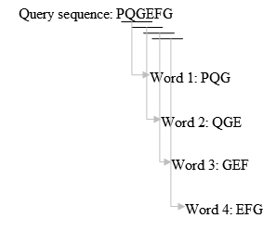
BLAST algorithm
Identify all words of size k (e.g., 3) present in the query
Keep only high scoring words when compared against all 20³ possible words using an amino acid substitution matrix (e.g. BLOSUM62).
Score should be higher then a set threshold T.
13

Slide 14
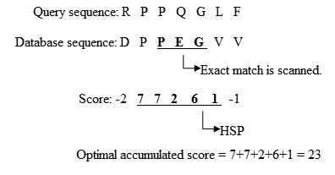
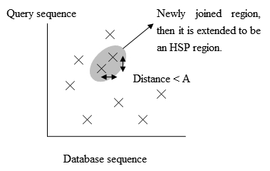
BLAST algorithm
Scan the database sequences for exact matches with the high scoring words obtained from the query sequence.
If a match is found, this match is used to seed possible un-gapped alignments between the query and database sequences.
Extend exact matches to identify high-scoring segment pairs (HSP). Extensions do not stop until the accumulated score of the HSP begins to decrease.
14

Slide 15
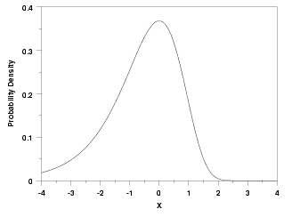







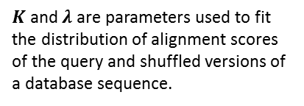
BLAST algorithm
Retrieve all HSPs whose score is high enough to be considered. By examining the distribution of alignment scores modeled by comparing random sequences, a cutoff (raw) score S can be determined such that its value is large enough to guarantee the significance of the remaining HSPs.
The significance of a HSP is calculated based on the Gumbel Extreme Value Distribution (EVD). It is formally proved that optimal local alignment scores between two random sequences follow the Gumbel EVD.
$$p(S≥x)=1−e^{−e^{λ(x−μ)}}$$
$$E(x≥S)=Kmn{ e}^{−λS}=mn{ 2}^{−S^{′}}$$
$$μ=\frac{log(Kmn)}{λ}$$
$$S′=\frac{λS−ln K}{ln 2}$$
$K$ and $λ$ are parameters used to fit the distribution of alignment scores of the query and shuffled versions of a database sequence.
$E$ is the expected value of finding a HSP with as score of at least $S$.
$S′$ Is bit core of the raw score $S$.
$m$ and $n$ are the lengths of the query and database, respectively.
15

Slide 16
Creating a blast database
The blast suit of programs includes the command makeblastdb that allows the definition of custom databases. Assuming that all fasta proteins in E. coli K12 are stored in file E_coli_K12.faa we can create a database with the command:
makeblastdb -in E_coli_K12.faa -dbtype prot –input_type fasta -parse_seqids -hash_index -out /output/dbname -title “ecoli 04/27/2017”
If the file is compressed, we don’t need to decompress it:
zcat E.coli_K12.faa.gz | makeblastdb –input_type fasta –dbtype prot -parse_seqids -hash_index -out /output/dbname -title “ecoli 04/27/2017” -in -
To use the database we need to:
Set the environment variable $BLAST: export BLASTDB=/path/to/blastdb
Or specify the path to the database when we run blast.
16

Slide 17
Running blast
There are multiple commands, but we’ll start with:
blastp -in E_coli_K12.faa -out blast.out -db ecoli -evalue 0.01 -outfmt ‘6 qseqid sseqid evalue pident’
There are many more useful options for -outfmt options 6, 7, 10:
qlen, slen, nident, qcovs, qstart, qend, sstart, send, bitscore, qcovs, etc.
To extract the sequence of a protein:
blastdbcmd -db ecoli –entry NP_517767 –target_only –out NP_517767.faa
See option –entry_batch,
17

Slide 18
Exercise1
Run blast of the whole proteome E. coli K12 vs A. tumefaciens and viceversa:
Generate blast databases for both genomes and put them in the same directory
Run blast giving the full proteome of one genome against the blast database of the other genome.
Produce a tabulated file where you store:
qseqid, sseqid, qlen, slen, bitscore, evalue, pident, nident, length, qcovs, qstat, qend, sstart, send
Calculate the extra field scov (subject coverage) as length/slen
Generate tables in your database to store this information. For each query genome generate a table with the name:
‘blast’ + ‘_’ + genome_id
Fill the blast tables with the blast output.
18

Slide 19
Exercise1
blast_1
gid_1 | gid_2 | evalue | bitscore | identity | alnlen | qcovs | scov | qlen | slen | …
1 | 3 | 4.2e-25 | 153.8 | 0.3 | 150 | 0.42 | 0.6 | 358 | 250 | …
1 | 300 | 7.2e-200 | 333.4 | 0.8 | 300 | 0.9 | 0.8 | 334 | 375 | …
2 | 1200 | 2.3e-5 | 87.3 | 0.24 | 50 | 0.25 | 0.4 | 200 | 125 | …
19

Slide 20
Exercise 2
Identify orthologs between the two genomes using the definitions:
Reciprocal Best Hit or Bidirectional Best Hit
For each genome generate a table with the orthologs:
‘homology’ + ‘_’ + genome_id
20

Slide 21
Exercise 2
homology_1
gid_1 | gid_2 | type | method
1 | 3 | orthology | OHTP
1 | 300 | orthology | BDBH
2 | 1200 | homology | Topblast
50 | 3125 | xenology | Phylogeny
334 | 825 | paralogy | blast
21

Slide 22
Some questions we are ready to answer
What is the set of genes shared between E. coli and A. tumefaciens?
What genes are unique to each of both genomes?
What are the predominant functions of the genes shared?
What are the functions of the genes not shared?
What transport systems are shared and which are not?
What metabolic pathways are share and which are not?
What about transcriptional regulators?
Etc…
22

