Slide 1
Bioinformatics Lab
Spring Quarter 2017
UCSD
Week 6 Session 2
Instructor:
Arturo Medrano
l1medranosoto@ucsd.edu
Instructional Assistant:
Hanbin Lu
hal213@ucsd.edu

Slide 2
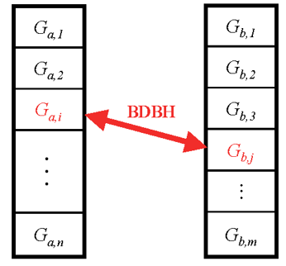
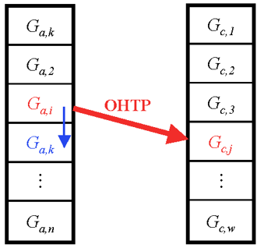

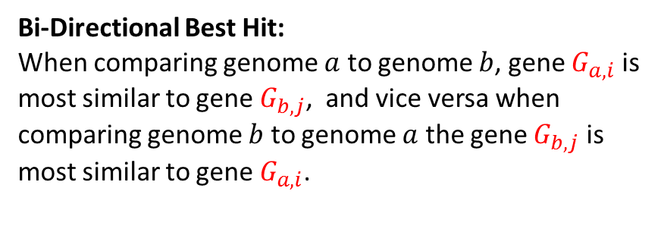



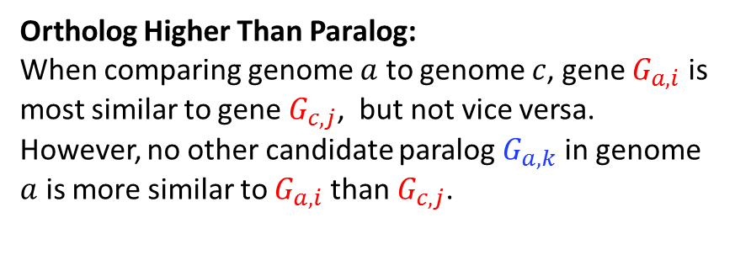
Working definitions of Orthology
Bi-Directional Best Hit:
When comparing genome $a$ to genome $b$, gene $G_{a,i}$ is most similar to gene $G_{b,j}$, and vice versa when comparing genome $b$ to genome $a$ the gene $G_{b,j}$ is most similar to gene $G_{a,i}$.
Ortholog Higher Than Paralog:
When comparing genome $a$ to genome $c$, gene $G_{a,i}$ is most similar to gene $G_{c,j}$, but not vice versa. However, no other candidate paralog $G_{a,k}$ in genome $a$ is more similar to $G_{a,i}$ than $G_{c,j}$.
Genome $a$
Genome $b$
Genome $a$
Genome $c$
2

Slide 3
Exercise 1
blast_1
pid_1 | pid_2 | evalue | bitscore | identity | alnlen | qcovs | scov | qlen | slen | …
NP_XX | WP_XX | 4.2e-25 | 153.8 | 0.3 | 150 | 0.42 | 0.6 | 358 | 250 | …
NP_YY | WP_YY | 7.2e-200 | 333.4 | 0.8 | 300 | 0.9 | 0.8 | 334 | 375 | …
NP_ZZ | WP_ZZ | 2.3e-5 | 87.3 | 0.24 | 50 | 0.25 | 0.4 | 200 | 125 | …
3

Slide 4
Exercise 2
homology_1
gid_1 | gid_2 | type | method
1 | 3 | orthology | OHTP
1 | 300 | orthology | BDBH
2 | 1200 | homology | Topblast
50 | 3125 | xenology | Phylogeny
334 | 825 | paralogy | blast
(just an example, we have not seen this method yet)
4

Slide 5
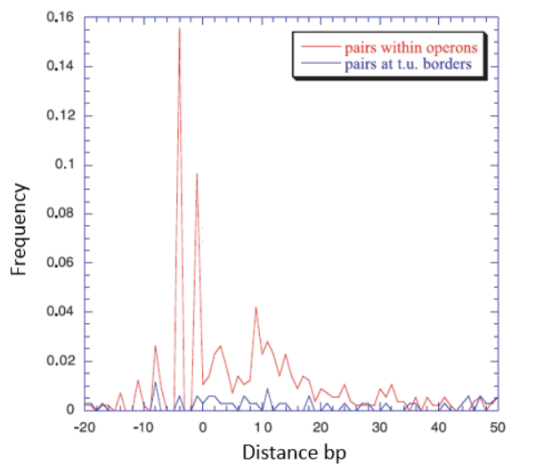
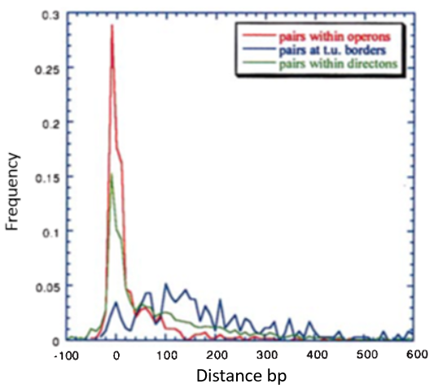
How predictive can intergenic distances be?
2000, PNAS 97(12): 6652-57
5

Slide 6






Log-Likelihood model
Distances between adjacent genes
Same directon
Operon
Not operon
$$LL\left(dist\right):$$
Log-likelihood of the distance between 2 adjacent genes in in the same strand.
$$N_{op}\left(dist\right):$$
Number of pairs of genes in operons at a specific distance.
$$N_{nop}\left(dist\right):$$
Number of pairs of genes not in operons at a specific distance.
The interpretation of LL is not intuitive.
We still need to find a critical value of LL to discriminate operons from other transcription units.
$${TN}_{op}:$$
Total number of adjacent pairs of genes in operons
$${TN}_{nop}:$$
Total number of adjacent pairs of genes NOT in operons
2000, PNAS 97(12): 6652-57
6

Slide 7

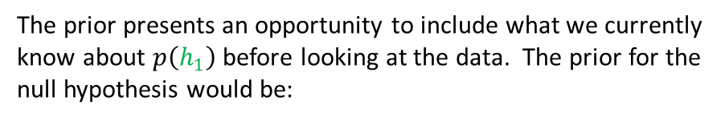

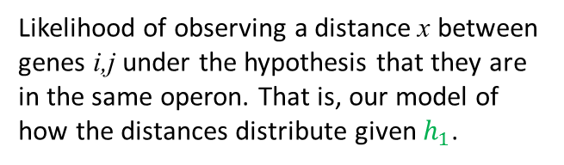




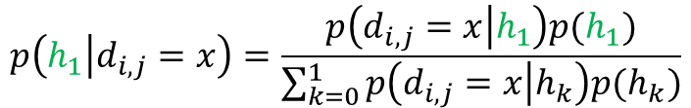




Our Bayesian model
Distances between adjacent genes i, j
The competing hypotheses
$$h_{1}={OP}_{i,j}$$
Adjacent genes i,j are in the same operon
Same directon
$$h_{0}={NOP}_{i,j}$$
Adjacent genes i,j are NOT in the same operon.
Operon
Not operon
$$h_{1}$$
RegulonDB
$$h_{0}$$
What we want to know:
TP
TN
$$p(h_{1}|d_{i,j}=x)$$
Posterior probability that genes i and j are in the same operons given that they have intergenic distance x.
Applying the Bayes theorem:
Now back to reality: we don’t know the operon partition! Therefore we must work with samples and assume they are representative of the genomic distribution of distances in operons. We’ll take this sample from RegulonDB.
$$p\left(h_{1} | d_{i,j}=x\right)=\frac{p\left(d_{i,j}=x | h_{1}\right)p(h_{1})}{\sum_{k=0}^{1}{p\left(d_{i,j}=x | h_{k}\right)p(h_{k})}}$$
$p\left(d_{i,j}=x | h_{1}\right)$:
Likelihood of observing a distance x between genes i,j under the hypothesis that they are in the same operon. That is, our model of how the distances distribute given $h_{1}$.
What about the prior $p\left(h_{1}\right)$?
The prior presents an opportunity to include what we currently know about $p\left(h_{1}\right)$ before looking at the data. The prior for the null hypothesis would be:
$$p\left(h_{1}\right):$$
Prior probability of $h_{1}$
$p\left(h_{0}\right)=1−p(h_{1}$)
7

Slide 8
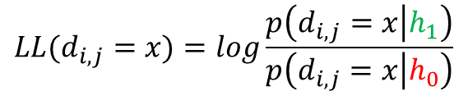
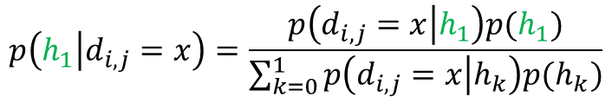
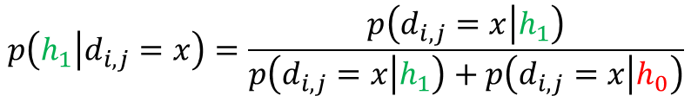

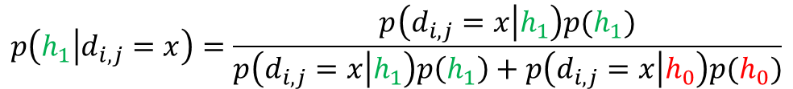
Posterior probability vs log-likelihood
Log-likelihood ratio:
Bayesian model:
$$p\left(h_{1} | d_{i,j}=x\right)=\frac{p\left(d_{i,j}=x | h_{1}\right)p(h_{1})}{\sum_{k=0}^{1}{p\left(d_{i,j}=x | h_{k}\right)p(h_{k})}}$$
We remove now the influence of the priors by making ${p(h}_{1})={p(h}_{0})$:
Applying the summation:
$$p\left(h_{1} | d_{i,j}=x\right)=\frac{p\left(d_{i,j}=x | h_{1}\right)p(h_{1})}{p\left(d_{i,j}=x | h_{1}\right)p\left(h_{1}\right)+p\left(d_{i,j}=x | h_{0}\right)p(h_{0})}$$
$$p\left(h_{1} | d_{i,j}=x\right)=\frac{p\left(d_{i,j}=x | h_{1}\right)}{p\left(d_{i,j}=x | h_{1}\right)+p\left(d_{i,j}=x | h_{0}\right)}$$
We can see that $N_{op}(dist)/{TN}_{op}=p\left(d_{i,j}=x | h_{1}\right)$ and ${ N}_{nop}(dist)/{TN}_{nop}=p\left(d_{i,j}=x | h_{0}\right)$. Thus,
The main disadvantage of the log-likelihood ratio is that it does not inherently incorporate prior knowledge into the model…. and, of course, that it does not give a probability of the main hypothesis.
$$LL(d_{i,j}=x)=log\frac{p\left(d_{i,j}=x | h_{1}\right)}{p\left(d_{i,j}=x | h_{0}\right)}$$
8

Slide 9
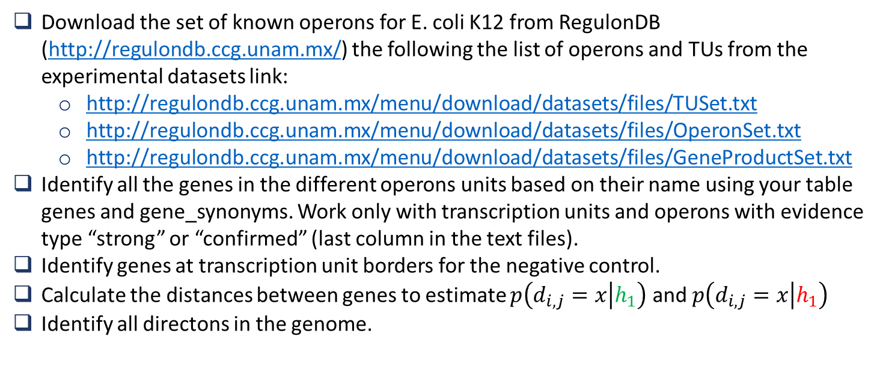
Implementing the model
Download the set of known operons for E. coli K12 from RegulonDB (http://regulondb.ccg.unam.mx/) the following the list of operons and TUs from the experimental datasets link:
http://regulondb.ccg.unam.mx/menu/download/datasets/files/TUSet.txt
http://regulondb.ccg.unam.mx/menu/download/datasets/files/OperonSet.txt
http://regulondb.ccg.unam.mx/menu/download/datasets/files/GeneProductSet.txt
Identify all the genes in the different operons units based on their name using your table genes and gene_synonyms. Work only with transcription units and operons with evidence type “strong” or “confirmed” (last column in the text files).
Identify genes at transcription unit borders for the negative control.
Calculate the distances between genes to estimate $p\left(d_{i,j}=x | h_{1}\right)$ and $p\left(d_{i,j}=x | h_{1}\right)$
Identify all directons in the genome.
9

Slide 10
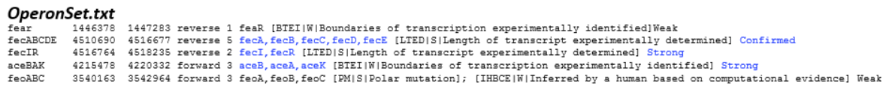
Extracting genes in curated operons
From files TUSet.txt and OperonSet.txt, extract the name of the genes in each transcription unit with evidence “strong” or “confirmed”.
There is an internal promoter aceKp between aceA and aceK.
10

Slide 11
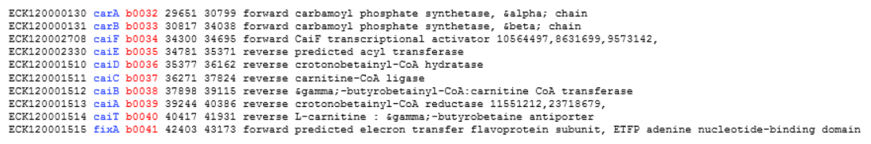
Dealing with missing genes
Just in case there are genes in the files TUSet.txt and OperonSet.txt that are not included in our database, we can use the file GeneProductSet.txt to map the gene name to the locus_tag (b-number), which we will definitely have in our database
GeneProductSet.txt
We can transform all operons to their b-numbers before we query the database for their respective coordinates.
Note that this file contains the coordinates of the gene in the genome. But that implies to trust that that you are using the same version of the genome than RegulonDB and that is not guaranteed until you corroborate it.
11

Slide 12
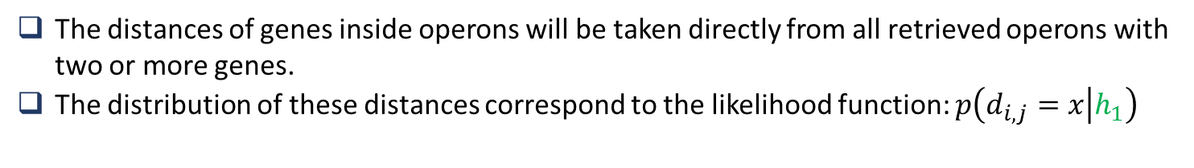
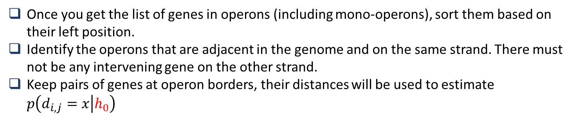
Extracting the data to model h₁ and h₀
h₁
The distances of genes inside operons will be taken directly from all retrieved operons with two or more genes.
The distribution of these distances correspond to the likelihood function: $p\left(d_{i,j}=x | h_{1}\right)$
h₀
Once you get the list of genes in operons (including mono-operons), sort them based on their left position.
Identify the operons that are adjacent in the genome and on the same strand. There must not be any intervening gene on the other strand.
Keep pairs of genes at operon borders, their distances will be used to estimate $p\left(d_{i,j}=x | h_{0}\right)$
d₁
d₂
12

Slide 13
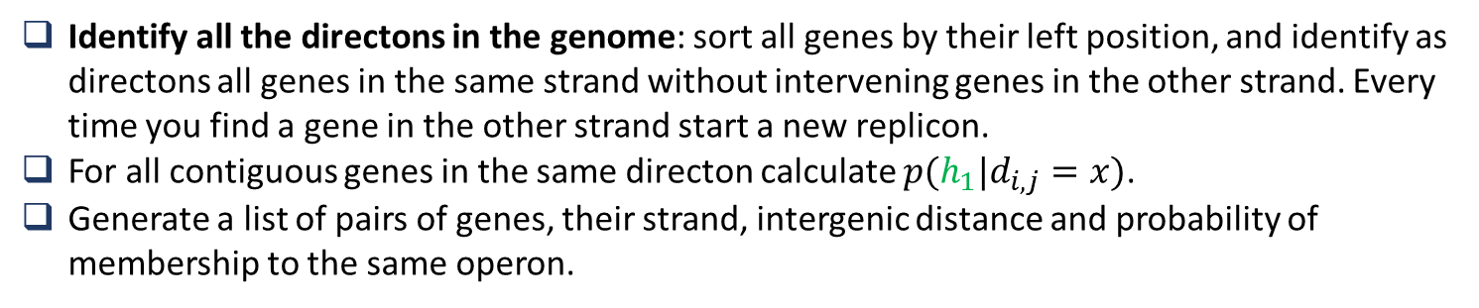
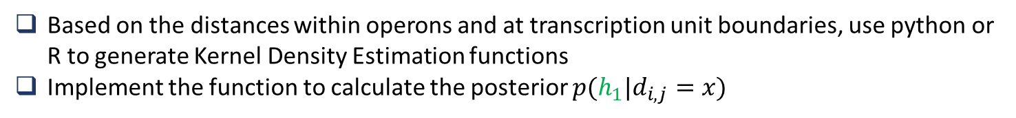
Implementing the model
Based on the distances within operons and at transcription unit boundaries, use python or R to generate Kernel Density Estimation functions
Implement the function to calculate the posterior $p(h_{1}|d_{i,j}=x)$
Predicting Operons for the complete genome
Identify all the directons in the genome: sort all genes by their left position, and identify as directons all genes in the same strand without intervening genes in the other strand. Every time you find a gene in the other strand start a new replicon.
For all contiguous genes in the same directon calculate $p(h_{1}|d_{i,j}=x)$.
Generate a list of pairs of genes, their strand, intergenic distance and probability of membership to the same operon.
13

Slide 15
Exercise 1
Run blast of the whole proteome E. coli K12 vs A. tumefaciens and vice versa:
Generate blast databases for both genomes and put them in the same directory
Run blast giving the full proteome of one genome against the blast database of the other genome.
Produce a tabulated file where you store:
qseqid, sseqid, qlen, slen, bitscore, evalue, pident, nident, length, qcovs, qstart, qend, sstart, send
Calculate the extra field scov (subject coverage) as length/slen*100
Generate tables in your database to store this information. For each query genome generate a table with the name:
‘blast’ + ‘_’ + genome_id
Fill the blast tables with the blast output.
15

Slide 16
Exercise 2
Identify orthologs between the two genomes using the definitions:
Reciprocal Best Hit or Bidirectional Best Hit
For each genome generate a table with the orthologs:
‘homology’ + ‘_’ + genome_id
16

Slide 17
Some questions we are ready to answer
What is the set of genes shared between E. coli and A. tumefaciens?
What genes are unique to each of both genomes?
What are the predominant functions of the genes shared?
What are the functions of the genes not shared?
What transport systems are shared and which are not?
What metabolic pathways are share and which are not?
What about transcriptional regulators?
How many proteins are syntenic?
17

Slide 18
Criteria to infer orthologous genes
At least 60% of the smaller protein should be covered in the alignment.
We need to use the bit score as criterion of significance because the E-value is not reliable as the databases are so small.
Pay attention to the top blast hits because there can be very similar or identical values, in which case one query protein can have more than one reciprocal best hit.
18

Slide 19
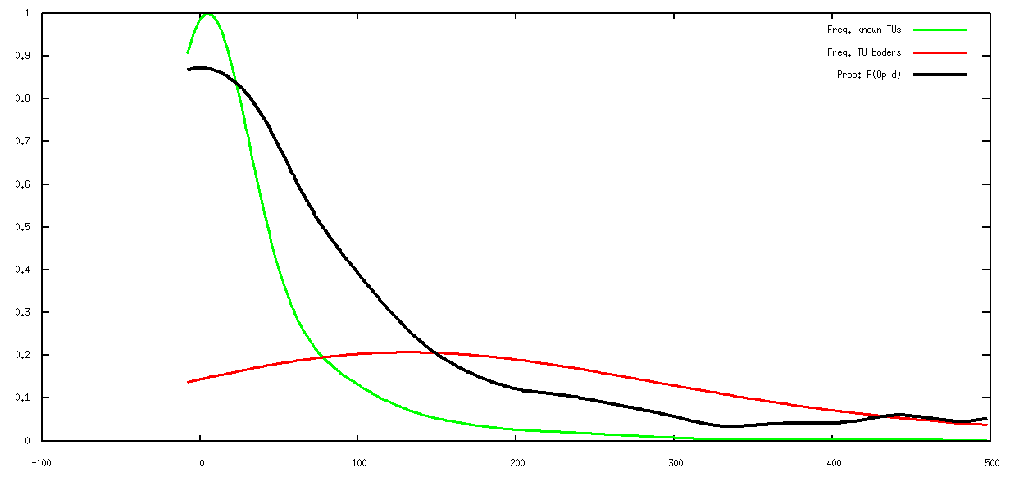
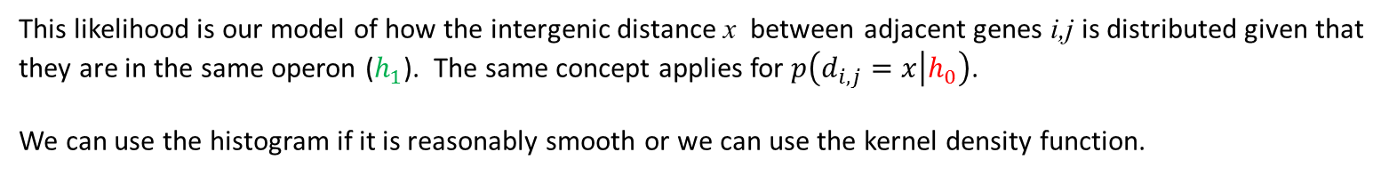




The inference model
$p\left(d_{i,j}=x | h_{1}\right)$:
This likelihood is our model of how the intergenic distance x between adjacent genes i,j is distributed given that they are in the same operon ($h_{1}$). The same concept applies for $p\left(d_{i,j}=x | h_{0}\right)$.
We can use the histogram if it is reasonably smooth or we can use the kernel density function.
$$p\left(d_{i,j}=x | h_{1}\right)$$
$$p\left(d_{i,j}=x | h_{0}\right)$$
$$p(h_{1}|d_{i,j}=x)$$
Posterior
Density
Distance (bp)
19

