Slide 1
Reproducible Research in Document Image Analysis
DivaServices Introduction
Marcel Würsch, Vinay Chandran Pondenkandath, Michele Alberti, Marcus Liwicki, and Rolf Ingold
DIVA Group, University of Fribourg, Switzerland

Slide 2
DivaServices in 30 seconds
Provide DIA methods as Web Services
Currently hosts 25 methods
~1000 executions per month
You should use it if…
You want to quickly integrate existing method
You want to provide stable access to your method
Operate with limited computational power

Slide 3
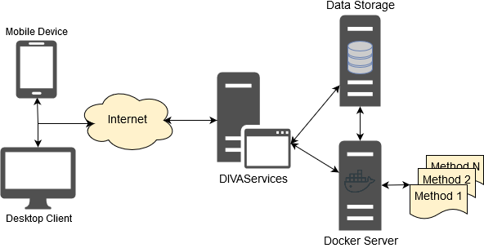
DivaServices – The Framework
Unified API
Docker
Extensible

Slide 4
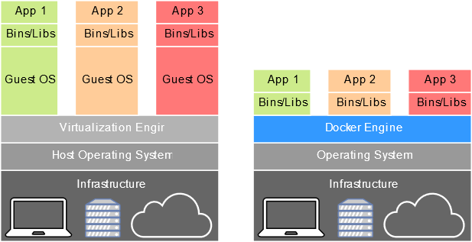
Two words on Docker
Simple
Images provide everything
Secure
Built on top of Linux security
Scalable
Cluster support
Integrates well into research workflow
No more messy environments

Slide 5
Hands-On
Two Tasks
Use methods in a project (easy – medium)
Provide a method to DivaServices (medium+)
Choose one to work on
Step-By-Step guide provided
All material on Github
Ask when you have questions!

Slide 6
Use methods in a project (easy-medium)
OCR Workflow
Website using JavaScript
Modify to apply some methods
Pre-Requisites
Modern Browser
Text Editor

Slide 7
Provide Method to DivaServices (medium+)
Using a local installation of DivaServices
Install your own Binarization method
Pre-Requisites
Java
Docker
Python

Slide 8
Material
Github
https://github.com/lunactic/DAS_2018_Tutorial
USB-Drive
VirtualBox Image with all pre-requisites
User: das2018 / Pwd: das2018
Contains DeepDIVA as well
Have Fun!

