Slide 1

DeepDIVA: A Highly-Functional Python Framework for Reproducible Experiments
{M. Alberti, V. Pondenkandath}*, M. Würsch, R. Ingold, M. Liwicki
*We use an unordered set to reflect how much we care about order of authors
DIVA Group, University of Fribourg, Switzerland

Slide 2
What Is DeepDIVA – Elevator Pitch
Python framework
Built on top of PyTorch
Makes your life easer for:
Reproducing your own experiments
Reproducing other people’s experiments
Additionally, provides boilerplate code for:
Common deep learning scenarios
Handling time consuming everyday problems

Slide 3
Reproducing Your Own Experiments
Short-term,
work in progress

Slide 4
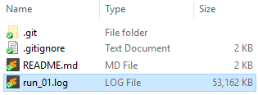
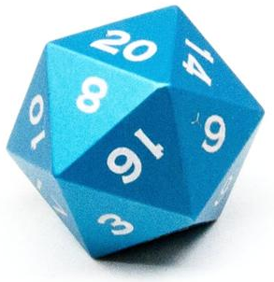

Reproducing Your Own Experiments
Short-term reproducibility is jeopardized by:
Kilometres of poor or incomplete log files
Stochastics runs

Slide 5
Reproducing Your Own Experiments
DeepDIVA ensures short-term reproducibility by:
Meaningful logging
Saving all run parameters and command line args
Providing concise coloured logs
Deterministic runs
Seeding the pseudo-random numbers generators: Python, Numpy and PyTorch.
Disabling CuDNN (NVIDIA Deep Neural Network library) when necessary

Slide 6
Reproducing Your Own Experiments
Long-term,
finished work

Slide 7
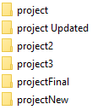

Reproducing Your Own Experiments
Long-term reproducibility is jeopardized by:
Poor (or none!) use of version control
Hard-to-die bad programming habits

Slide 8
Reproducing Your Own Experiments
DeepDIVA ensures long-term reproducibility by:
Git status
Linking every run to a specific commit in Git
Allowing this feature to be disabled for dev purposes
Copy code
Copying the entire running code in the output folder

Slide 9
Reproducing Other People’s Experiments
Given a paper, try to replicate the results and observations

Slide 10
Reproducing Other People’s Experiments
In order to reproduce an experiment one needs:
Git repository URL
Git commit identifier (full SHA)
List of command line arguments used
-> This will be part of the hands-on experience of today ☺

Slide 11
Making Your Life Easier
Do not Reinvent the wheel!

Slide 12
Boilerplate Code: Deep Learning Scenarios
“One click away” deep learning scenarios:
Image classification
Train models for classification of images
Bi-dimensional data classification
Useful for understanding networks or proof of concept
Image similarity
Train models using the triplet-loss metric
Apply a model on new data
Feature extraction using a pre-trained model

Slide 13
Boilerplate Code: Everyday Problems
Major features:
Automatic hyper-parameter optimization (no grid search!)
Data visualization (plots, diagrams, …)
Support for comparing methods (multi-run, …)
Network inspection (histograms of weights, …)
New dataset support (splitting, analytics, … )
DeepDIVA as a web service (DIVA Services)
For a comprehensive list of features visit:
https://github.com/DIVA-DIA/DeepDIVAweb/

Slide 14
Hands On With DeepDIVA
Installation

Slide 15
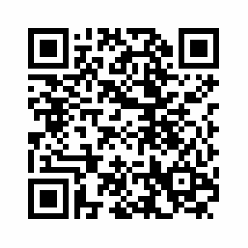
Install DeepDIVA
From source:
Ubuntu (or other flavours of Linux)
Otherwise
Docker
docker run -it --rm -p 6006:6006 divaservices/deepdiva /bin/bash
VirtualBox
DIVAServices virtualbox image
https://diva-dia.github.io/DeepDIVAweb/getting-started.html

Slide 16
Reproduce this experiment
Download MNIST
python util/data/get_me_a_dataset.py mnist --output-folder here
Train a simple convolutional neural network (CNN)
python template/RunMe.py --dataset-folder here/MNIST --seed 42 --ignoregit --no-cuda --epochs 1
Final test score should be: ~19.71%

Slide 17
Reproduce your experiment
Train the same network with a different learning rate
python template/RunMe.py --dataset-folder here/MNIST --seed 42 --ignoregit --no-cuda --epochs 1 --lr 0.1
Re-run the same command one more time with a different experiment name

Slide 18
Visualize the runs
Visualize the different runs:
tensorboard --logdir ./output/
For Ubuntu/VirtualBox people:
Go to the link that Tensorboard suggests
For Docker:
http://localhost:6006
Log folders are organized in format
DeepDIVA/output/experiment_name/param1=val/param2=val/time_stamp/
Only non-default params will be used in directory path

Slide 19
Inspect the logs
Inside the experiment folder, look at:
logs.txt - contains all logged information
args.txt - all arguments used for the run
DeepDIVA.tar.gz - copy of the code used for the run

Slide 20
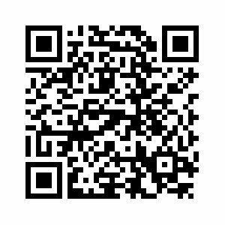
Make your experiment reproducible
https://diva-dia.github.io/DeepDIVAweb/articles/ensure-reproducibility/

