Slide 1
Reproducible Research in Document Image Analysis
Tutorial Introduction
Marcel Würsch, Vinay Chandran Pondenkandath, Michele Alberti, Marcus Liwicki, and Rolf Ingold
DIVA Group, University of Fribourg, Switzerland

Slide 2

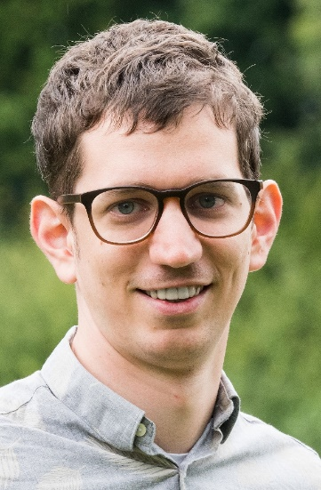
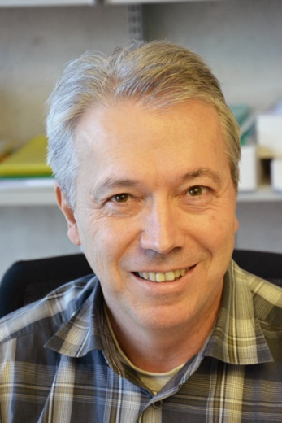
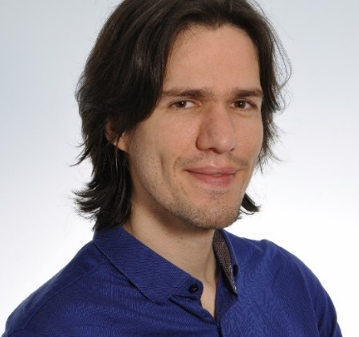

The people behind all of this
Michele Alberti
PhD Student DeepDIVA
Rolf Ingold
Head of DIVA Group
Marcel Würsch
PhD Student
DivaServices
Vinay Chandran Pondenkandath
PhD Student
DeepDIVA
Marcus Liwicki
DIVA, UniFr
MindGarage, TU Kaiserslautern

Slide 3
Overview
What is Reproducible Research?
What are possible solutions?
What are we going to do in this Tutorial?
Part1: DivaServices
Part2: DeepDIVA

Slide 4
The traditional research cycle
Hypothesis
Data
too big to share
restrictive licenses
Publication
Experiment
Missing implementation details
special hardware
hard to replicate
Programming Errors
Results

Slide 5
The Definition of Reproducible Research
Reproducible Research (RR) is the practice of distributing, along with a research publication, all data, software source code, and tools required to reproduce the results discussed in the publication.
(orgmode.org)

Slide 6
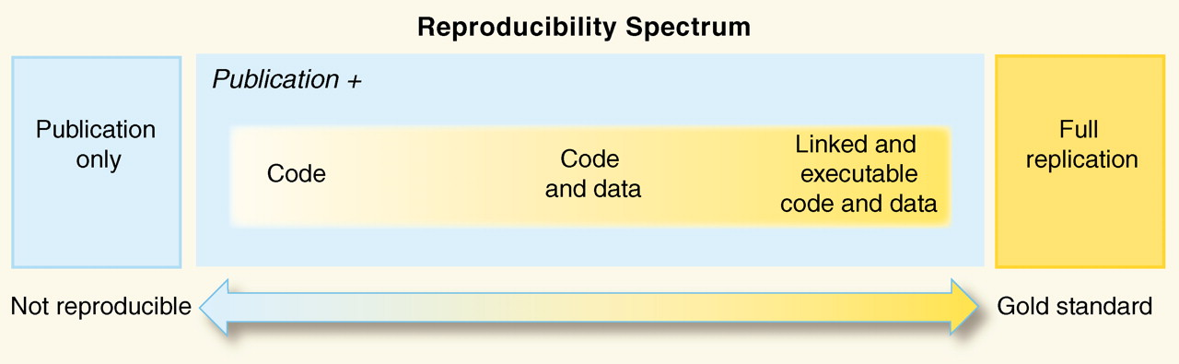
The Reproducibility Spectrum
“Reproducible Research in Computational Science”. R.D Peng, 2011. 334 (6060) pp 1226-1227.

Slide 7
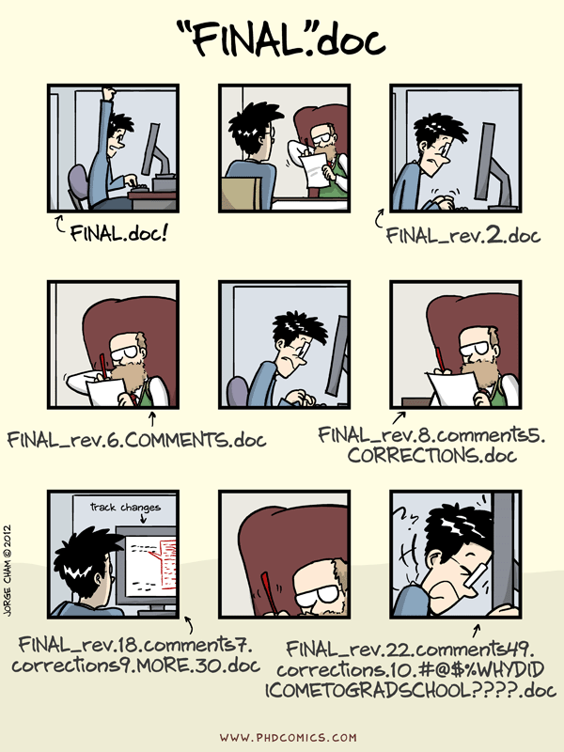
Approaches to Reproducible Research
Document every step of the way
Automate
Don’t do things by hand
Version Controlling
http://phdcomics.com/comics.php?f=1531

Slide 8

Document Every Step of the Way
What software was used
Including version numbers
Create log files!
What is needed to run the experiment?
Computer architecture
Operating System, etc.
External Tools

Slide 9
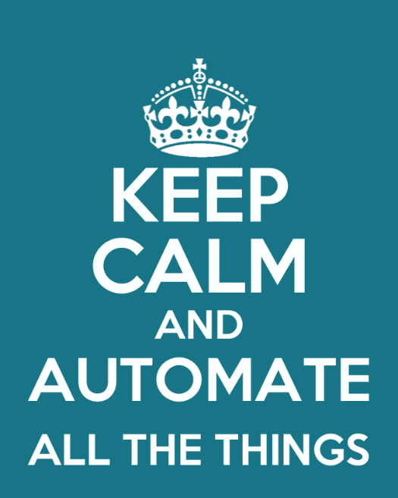
Automate, Automate, Automate
Script as much as possible
No manual data processing!
Re-Use existing tools/software

Slide 10
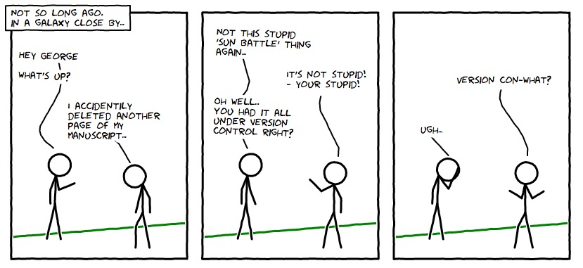
If it is version controlled it can’t be lost
Track on an experiment level
Not just for code

Slide 11
Content of the rest of this Tutorial
Hands-on work
DivaServices
Provide methods as Web Services
Reproduce in the Cloud
DeepDIVA
Deep Learning Framework
Focus on complete reproducibility of experiments
Concepts can be applied in your projects too

