Slide 1
Structural Methods for Handwriting Analysis
Lab Session: Word Spotting
Andreas Fischer (andreas.fischer@unifr.ch)
Marcel Würsch (marcel.wuersch@unifr.ch)

Slide 2
Keyword Spotting
Digitizing historical manuscripts for cultural heritage preservation
Textual content: searching and browsing scanned page images
Widely unsolved for historical handwriting too many writing styles and languages
Keyword spotting is a “shortcut”: identify individual search terms

Slide 3

Query-By-Example
“one-shot learning”: provide one example word image
Goal: find similar word images in the manuscript
Usually constrained to a single-writer scenario (sample from the same manuscript)

Slide 4
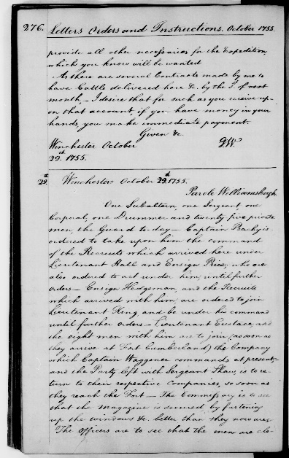
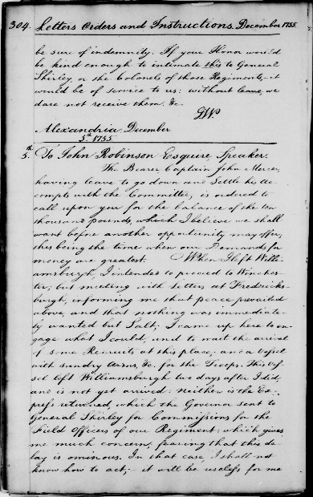
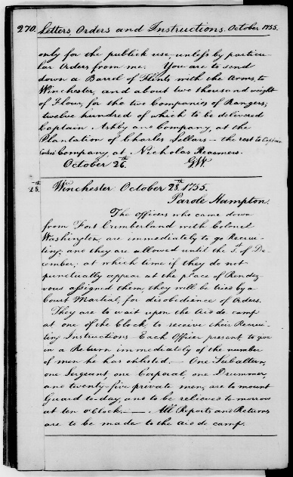
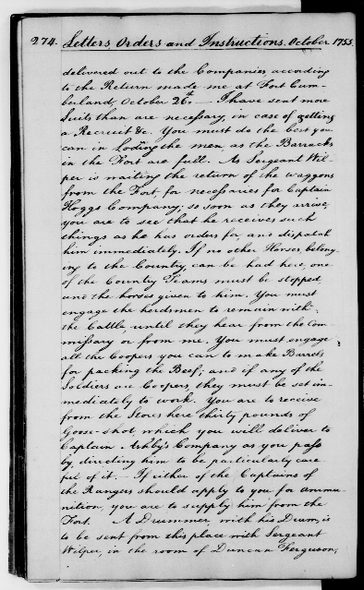
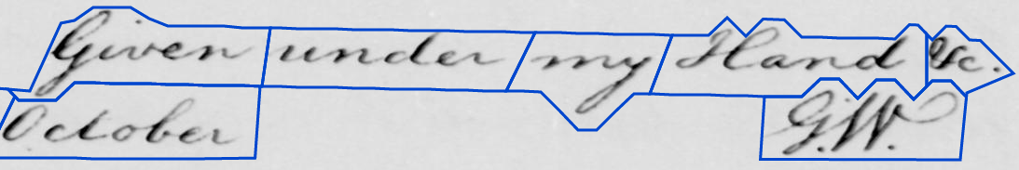
Data Set
WashingtonDB
Letters of George Washington
Library of Congress
18th century, longhand script

Slide 5
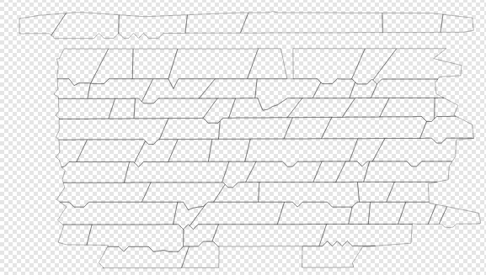
Data
/data/ground-truth/transcription.txt
Character based transcription
/data/ground-truth/locations/*.svg
Polygons of word segments
/data/images/*.jpg
The page images

Slide 6
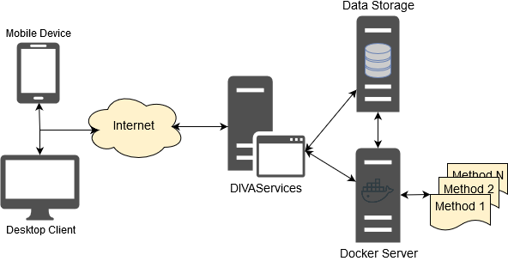
DivaServices – The 1 min rundown
Web Services
Unified API
Extensible

Slide 7
Let’s get started
Download sources from Github
http://bit.ly/SS_LAB_CODE
(all capitals!)

Slide 8
Questions?

