Slide 1
The Multiplier Model
Chapter 10

Slide 2
The Multiplier Model
The multiplier model tells us how much output may change as the AD shifts due to an initial change in expenditures.

Slide 3
The Multiplier Model
The multiplier model assumes that the price level remains constant - and then explores specific questions about expenditures.

Slide 4
The Multiplier Model
The multiplier model gives numerical answers about the effect of changes in aggregate expenditures on aggregate output.

Slide 5
The AS/AD Model When Prices Are Fixed, Fig. 10-1, p 236
Price level
Initial shift
Induced shift
(Multiplier effects)
20
P₀
?
Aggregate supply
AD₀
AD₁
Cumulative shift
Real output

Slide 6
Aggregate Production
Aggregate production (AP) is the total amount of goods and services produced in every industry in an economy.

Slide 7
Aggregate Production
Production creates an equal amount of income.
Thus, actual production and actual income are always equal.

Slide 8
Aggregate Production
Graphically, aggregate production in the multiplier model is represented by a 45° line through the origin.

Slide 9
Aggregate Production
Real production (in dollars) is on the vertical axis, and real income (in dollars) is on the horizontal axis.
At all points on this curve, income equals production.

Slide 10
The Aggregate Production Curve, Fig. 10-2, p 237
Real production
B
Aggregate production
(production = income)
C
A
$4,000
Potential income
45º
0
$4,000
Real income

Slide 11
Aggregate Expenditures
Aggregate expenditures (AE) in the multiplier model consist of:
  Consumption – spending by consumers.
  Investment – spending by business.
  Spending by government.
  Net foreign spending on Canadian goods – the difference between Canadian exports and Canadian imports.

Slide 12
Aggregate Expenditures
The four expenditure components of national income accounting were developed around the multiplier model.
AE = C + I + G + (X - IM)

Slide 13
Autonomous and Induced Expenditures
As income changes, expenditures change, but not as much as income.

Slide 14
Autonomous and Induced Expenditures
Even if income is zero, spending is still taking place.
The money comes from borrowing, or from previous savings.

Slide 15
Autonomous and Induced Expenditures
Autonomous expenditures are those that would exist at a zero level of income.
Autonomous expenditures are independent of income.

Slide 16
Autonomous and Induced Expenditures
Autonomous expenditures change because something other than income changes.

Slide 17
Autonomous and Induced Expenditures
Induced expenditures are those that change as income changes.
Induced expenditures change by less than the change in income.

Slide 18
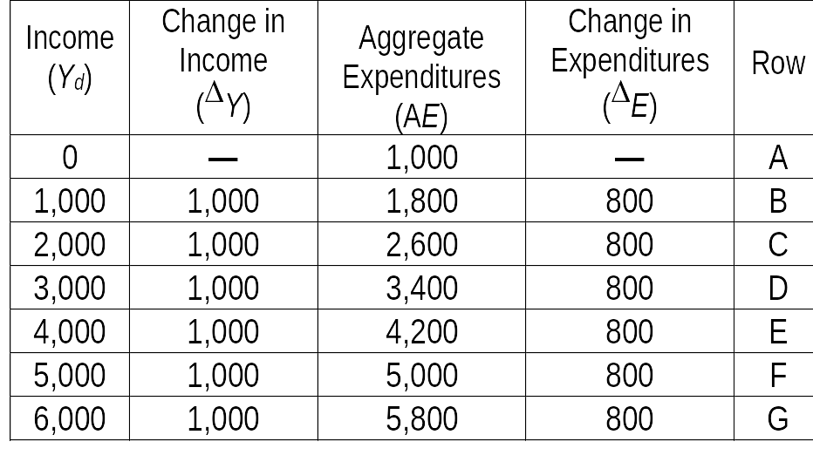
Aggregate Expenditures Related to Income, Table 10-1, p 238

Slide 19
Expenditures Function
The relationship between expenditures and income can be expressed more concisely as an expenditures function.
An expenditures function is a representation of the relationship between aggregate expenditures and income.

Slide 20
Expenditures Function
The expenditures function is expressed as a mathematical function:
AE = AE_{o} + mpcY
  AE = aggregate
  expenditures
  AE_{o} = autonomous expenditures
mpc = marginal propensity to consume
Y = income

Slide 21
The Marginal Propensity to Consume
The marginal propensity to consume (mpc) is the ratio of a change in consumption (^{Δ}C) to a change in income (^{Δ} Y).

Slide 22
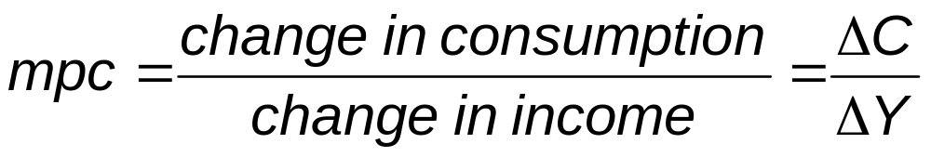
The Marginal Propensity to Consume
The mpc is the fraction spent from an additional dollar of income.

Slide 23
The Marginal Propensity to Consume
The mpc captures the rule of thumb that individuals in aggregate tend to follow:
Their consumption varies with their income, but not by as much as their income varies.

Slide 24
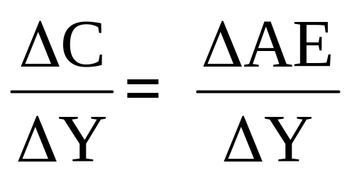
The Marginal Propensity to Consume
Since only consumption expenditures depend on income, in our simple model:

Slide 25
Graphing the Expenditures Function
The graphical representation of the expenditures function is called the aggregate expenditures curve.
The expenditures function's slope tells us how much expenditures change with a particular change in income.

Slide 26
Graphing the Expenditures Function
It is assumed that only consumption changes with income; the other expenditure components – I, G, (X - IM) – are all independent of income.

Slide 27
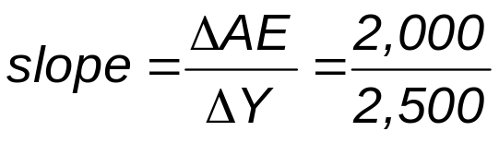
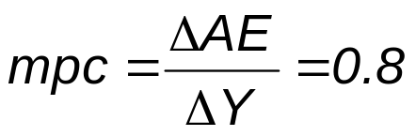
Graphing the Expenditures Function, Fig. 10-3, p 240
Aggregate production
AE = 1,000 + 0.8Y
$12,200
10,000
ΔAE = 2,000
8,000
Real expenditures (AE)
ΔY = 2,500
6,000
5,000
4,000
2,000
1,000
45º
0
$5,000
$8,750
$11,250
$14,000
Real income

Slide 28
Shifts in the Expenditures Function
The expenditure function shifts up and down when autonomous C, I, G, or X - IM change.
The reason that these shifts are so important is that the multiplier model is an historical model in time.

Slide 29
Shifts in the Expenditures Function
The multiplier model can be used to analyze shifts in aggregate expenditures from an historically given level.
It cannot be used to determine income independent of the economy's historical position.

Slide 30
Determining the Level of Aggregate Income
In bringing AP and AE together in one framework, the following is assumed :
  The price level is constant.
  The AP curve is a 45º line until the economy reaches its potential income.
  Expenditures shown on the AE line do not necessarily equal AP or income.

Slide 31
Determining the Level of Aggregate Income
To determine income graphically, you find the income level at which AE equals AP.

Slide 32
Solving for Equilibrium Graphically, Fig. 10-4, p 241
Aggregate production
$14,000
12,200
Aggregate expenditures
10,000
AE = 1,000 + 0.8Y
Real expenditures (AE)
8,000
E
5,000
2,600
AE₀ = $1,000
1,000
45°
0
$2,000
$5,000
$10,000
$14,000
Real income

Slide 33
The Multiplier Equation
The multiplier equation tells us that income equals the multiplier times autonomous expenditures.
Y = (multiplier)(autonomous expenditures)

Slide 34
The Multiplier Equation
The multiplier equation is a useful way to determine the level of income in the multiplier model.

Slide 35
The Multiplier Equation
The multiplier is a number that reveals how much income will change in response to a change in autonomous expenditures.
Multiplier = 1/(1 – mpc)

Slide 36
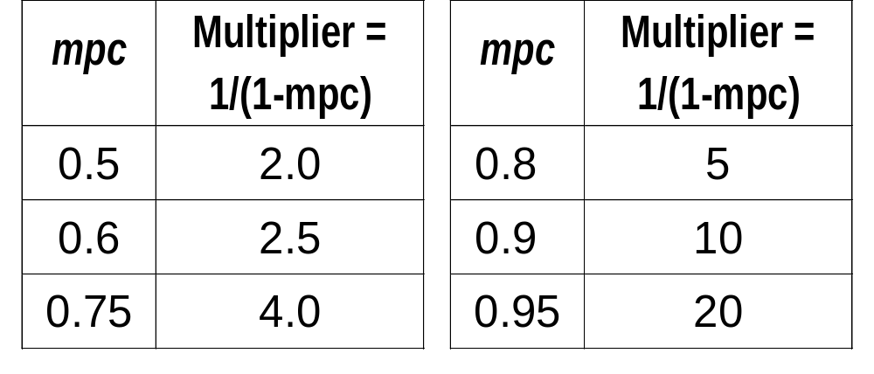
The Multiplier Equation
As the mpc increases, the multiplier increases:

Slide 37
The Multiplier Process
The multiplier process amplifies changes in autonomous expenditures.
What forces are operating to ensure that the income level we determined is actually the equilibrium income level?

Slide 38
The Multiplier Process
When expenditures do not equal current output, business people change planned production:
  Which changes income, which changes expenditures,
  Which changes production, which changes income,
  Which changes . . . etc.

Slide 39
The Multiplier Process, Fig. 10-5, p 244
C, I, G, (X – IM)
A₁
Aggregate production
$14,000
$13,200
Aggregate expenditures
A₂
AE = 1,000 + 0.8Y
10,000
C
Real expenditures (AE)
B₁
6,000
B₂
2,000
45°
0
$2,000
$5,000
$10,000
$14,000
Real income

Slide 40
The Circular Flow Model and the Multiplier Process
The circular flow model provides the intuition behind the multiplier process.

Slide 41
The Circular Flow Model and the Multiplier Process
Expenditures are injections into the circular flow.
The mpc measures the percentage of expenditures that get injected back into the economy each round of the circular flow.
But there are withdrawals.

Slide 42
The Circular Flow Model and the Multiplier Process
Economists use the term the marginal propensity of save (mps) to represent the percentage of income flow that is withdrawn from the economy for each round of the circular flow.

Slide 43
The Circular Flow Model and the Multiplier Process
By definition:
mpc + mps = 1
Alternatively expressed:
mps = 1 - mpc
multiplier = 1/mps

Slide 44
The Circular Flow Model and the Multiplier Process
Aggregate income
Households
Firms
Aggregate expenditures

Slide 45
The Multiplier Model in Action
The first step in understanding the AP/AE analysis is determining the level of income using the multiplier.
This was already explained.

Slide 46
The Multiplier Model in Action
The second step is to modify that analysis to answer a question that is of much more interest to policy makers.
How much would a change in autonomous expenditures change the equilibrium level of income?

Slide 47
The Multiplier Model in Action
Autonomous expenditures are determined outside the model not as a result of changes in income.
Autonomous expenditures can, and do, shift for a number of reasons.
When they do, the multiplier process is called into play.

Slide 48
The Steps of the Multiplier Process
The income adjustment process is directly related to the multiplier.
Any initial shock (a change in autonomous AE) is multiplied in the adjustment process.

Slide 49
The Steps of the Multiplier Process
The multiplier process repeats and repeats until a new equilibrium level is finally reached.

Slide 50
Shifts in the Aggregate Expenditure Curve, Fig. 10-6, p 246
C, I
Aggregate production
E₀
$4,200
AE₀ = 832 + .8Y
AE₁ = 812 + .8Y
D AE_{A} = $20
E₀
$20
4,160
20
$16
D AE_{A} = $16
12.8
D AE_{A} = $12.8
4,100
E₁
4,060
20
E₁
832
812
$100
0
100
$4,060
$4,160
Real income

Slide 51
The First Five Steps of Four Multipliers, Fig. 10-7, p 247
mpc = 0.5
mpc = 0.75
100
100
75
56.25
50
42.19
31.64
25
12.5
6.25
Multiplier = 1/(1-0.5) = 2
Multiplier = 1/(1-0.75) = 4

Slide 52
The First Five Steps of Four Multipliers, Fig. 10-7, p 247
mpc = 0.8
mpc = 0.9
100
100
90
80
81
72.9
64
65.61
51.2
40.96
Multiplier = 1/(1-0.8) = 5
Multiplier = 1/(1-0.9) = 10

Slide 53
The Effect of Shifts in Aggregate Expenditures
Autonomous expenditures can, and do, shift for a number of reasons:
  Natural disasters.
  Sudden climatic changes.
  Changes in consumption caused by changes in consumer choice.

Slide 54
The Effect of Shifts in Aggregate Expenditures
Autonomous expenditures can, and do, shift for a number of reasons:
  Changes in investment caused by technological developments.
  Shifts in government expenditures.
  Shifts in imports and exports.

Slide 55
The Effect of Shifts in Aggregate Expenditures
An understanding of these shifts can be enhanced by tying them to the formula:
AE = C + I + G + (X - IM)

Slide 56
The Effect of Shifts in Aggregate Expenditures
Changes in consumer sentiment affect C.
Major technological breakthroughs affect I.
Changes in government spending affect G.
Changes in exchange rates affect (X - IM).

Slide 57
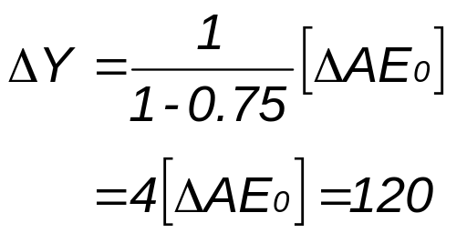
An Upward Shift of AE, Fig. 10-8a, p 248
Real expenditures
Aggregate production
$4,210
AE₁
30
AE₀
4,090
1,052.5
30
1,022.5
$120
0
$4,090
$4,210
Real income

Slide 58
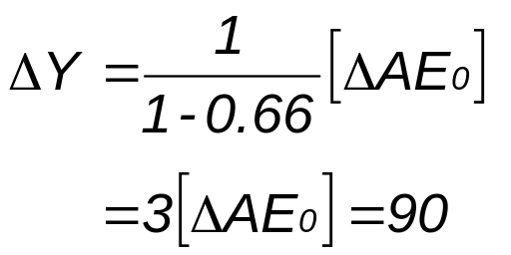
An Downward Shift of AE, Fig. 10-8b, p 248
Real expenditures
Aggregate production
AE₀
$4,152
30
AE₁
4,062
1,412
30
1,382
$90
0
$4,062
$4,152
Real income

Slide 59
Real World Examples
Canada in 2000.
Japan in the 1990s.
The 1930s depression.

Slide 60
Canada in 2000
Consumer confidence rose substantially causing autonomous consumption expenditures to increase more than economists had predicted.
While economists had expected the economy to grow slowly, it boomed.

Slide 61
Japan in the 1990s
A dramatic rise in the value of the yen cut Japanese exports.
Suppliers could not sell all they had produced.
Suppliers laid off workers and decreased output.
Aggregate income (aggregate expenditures) fell causing the multiplier to work in reverse.

Slide 62
The 1930s Depression
The 1929 stock market crash, which continued into 1930, threw the financial markets into chaos.
This resulted in a downward shift of the AE curve.

Slide 63
The 1930s Depression
Frightened business people decreased investment and laid off workers.
Frightened consumers decreased autonomous consumption and increased savings, thereby increasing withdrawals from the system.
Governments cut spending to balance their budgets, as tax revenue declined.

Slide 64
The 1930s Depression
Business people responded by decreasing output, which decreased income, starting a downward cycle, thereby confirming the fears of the businesspeople.

Slide 65
The 1930s Depression
The process continued until the economy settled at a low-level equilibrium, far below the potential level of income.

Slide 66
The 1930s Depression
The process caused the paradox of thrift, whereby individuals attempting to save more, spent less, and caused income to decrease.
They ended up saving not more, but less.

Slide 67
Limitations of the Multiplier Model
On the surface, the multiplier model makes a lot of intuitive sense.
Surface sense can often be misleading.

Slide 68
The Multiplier Model Is Not a Complete Model of the Economy
The multiplier model does not determine income from scratch.
At best, it can estimate the directions and rough sizes of autonomous demand or supply shifts.

Slide 69
Shifts Are Not as Great as Intuition Suggests
The multiplier model leads people to overemphasize the aggregate expenditure shifts that would occur in response to a shift in autonomous expenditures.

Slide 70
The Price Level Will Often Change in Response to Shifts in Demand
The multiplier model assumes that the price level is fixed.
The price level can change in response to changes in aggregate demand.
Price level changes will occur when the SAS is upward sloping.

Slide 71
The Multiplier With a Flexible Price Level, Fig. 10-9, p 251
Price level
increases
AP
LRAS
AE₁
AE₂
SAS
Real expenditures
Price level
AE₀
C
B
SAS
A
AD₁
AD₀
Y₀
Y₂
Y₁
Y₀
Y₂
Y₁
Real income
Real income

Slide 72
The Multiplier With Output Fixed, Fig. 10-10, p 252
AP
LRAS
AE₁
SAS₁
AE₀
B
Real expenditures
Price level
SAS₀
AD₁
A
AD₀
Y₀
Y₀
Real income
Real income

Slide 73
Forward-Looking Expectations Complicate the Adjustment Process
People's forward-looking expectations make the adjustment process much more complicated.
Most people, however, act upon their expectations of the future.

Slide 74
Forward-Looking Expectations Complicate the Adjustment Process
Business people may not automatically cut back production and lay-off workers if they think a fall in sales is temporary.

Slide 75
Forward-Looking Expectations Complicate the Adjustment Process
Some modern economists have put forward a rational expectations model of the economy.
Rational expectations model – all decisions are based upon the expected equilibrium in the economy.

Slide 76
Shifts in Expenditures Might Reflect Desired Shifts in Supply and Demand
Shifts in demand can occur for many reasons.
Many shifts can reflect desired shifts in aggregate production which are accompanied by shifts in aggregate demand.

Slide 77
Shifts in Expenditures Might Reflect Desired Shifts in Supply and Demand
Shifts may be simultaneous shifts in supply and demand that do not necessarily reflect suppliers' responses to changes in demand.

Slide 78
Shifts in Expenditures Might Reflect Desired Shifts in Supply and Demand
Expansion of this line of thought has led to the real business cycle theory of the economy.

Slide 79
Shifts in Expenditures Might Reflect Desired Shifts in Supply and Demand
Real business cycle theory of the economy – fluctuations in the economy reflect real phenomena such as simultaneous shifts in supply and demand, not simply supply responses to demand shifts.

Slide 80
Expenditures Depend on Much More Than Current Income
If people base their spending on lifetime income, not yearly income, the mpc out of changes in current income could be very low, even approaching zero.

Slide 81
Expenditures Depend on Much More Than Current Income
In that case, the expenditures function would essentially by a flat line, and the multiplier would be one, and there would be no secondary effects of an initial shift.

Slide 82
Expenditures Depend on Much More Than Current Income
This set of arguments is called the permanent income hypothesis.
Permanent income hypothesis -- the hypothesis that expenditures are determined by permanent or lifetime income.

Slide 83
The Multiplier Model
End of Chapter 10

