Slide 1

Touching Touch
- An automatic personal information authentication service with a full screen fingerprint scanner
Team 3Mile

Slide 2

Index
I. What Is Touching Touch?
(1) Motivation
(2) Objectives
II. Direction of Progress
(1) Setting the Information
(2) Bringing up Stored Information
III. How Is Touching Touch Used?
(1) Online Shopping
(2) Writing a Review
(3) Food Delivery Service
IV. Conclusion

Slide 3

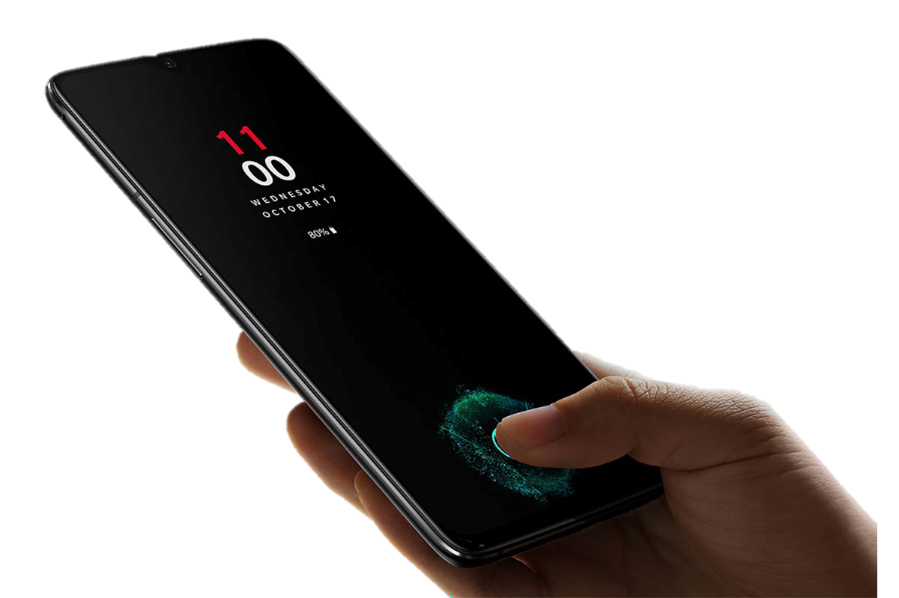
I. What Is Touching Touch?
(1) Motivation
In real life, people show their ‘Thumbs-up’ very often. It has a meaning of showing a positive reaction to someone or something, such as ‘Good job!’, ‘I agree.’ and ‘I like it!’. Its intuitive and emotional purpose has been passed down from generations.
However, when it comes to smartphones, thumb loses its inherent meanings. Rather than a positive reaction, it is just used for a fingerprint recognition. Although it has a same gesture of showing “thumbs-up”, its only purpose is just ‘identification.’
Now, let’s imagine that your favorite football team had just won a league. You are so glad that you want to write a comment on the news article about your team to congratulate them, but you first need to create an account and sign in. You just wanted to write a congratulatory comment but this whole process to write down all your information is annoying. On the other hand, if you are in a face-to-face situation rather than on smartphone, you would just raise your thumb to express how you feel.

Slide 4

Our team thought about how to indicate our emotions on the smartphone in an intuitive way as we do in a face-to-face situation. We come up with one solution, where you can skip all these bothersome gateways for authentication while you can still express your feelings. It is possible on the full-screen fingerprint scanner display.
When you make a nice touch with your “thumbs-up” on the full-screen fingerprint scanner display, this means “I like it.” Moreover, you are showing your fingerprint to authenticate, which is the key to skip those gateways. Compared to the original touch on the display, this “touch” is more advanced in that it can be used both emotionally and pragmatically. Therefore, we call this touch of integrated meaning as “Touching Touch.”
+
Good, Nice!
Identification, Information
=
Touching Touch

Slide 5
(2) Objectives
By using “Touching Touch,” we can achieve some objectives below.
① Maximize the benefit of full-screen fingerprint scanner
Unlike under-display sensors, full-screen fingerprint scanner makes people scan their fingerprints anywhere on the display. Touching Touch contributes to maximizing this benefit. If there is something good or satisfying that you want to tap, wherever it is, you can just touch it with your thumbs. Whether it is on the left or right, top or bottom side of the display, it doesn’t matter. Therefore, Touching Touch is a good chance to utilize the full-screen scanner based on the benefit that fingerprint recognition could be activated at anywhere on the display.
② Expand intuitive function of thumbs
When consumers purchase some products or write a review, they can express their good feeling on the product externally with their “thumbs-up.” It means that people can use emotional function of thumbs not only in real life but also on a smartphone. Expanding this real life function to the smartphone will bring positive effects to the current society, where it lacks human-to-human communication. In addition, consumers feel emotional closeness to the sellers with Touching Touch. It will get buyers to have a friendly relationship with companies, which can lead to a kind of a loyalty to the company.

Slide 6

Express good feeling
Close connection
③ Enhance efficiency through simplification
Generally, customers need to sign in and enter some information to express their good feelings on the product (e.g. writing a review) through their smartphones. However, this complicated process reduces efficiency. People use their time and energy before reaching the original purpose. Touching touch can save this wasted time and energy. Through fingerprints recognition, thumbs verify one’s identification and provide data such as email address, shipping address, and etc. Thus, this simplification of the process will be effective in the aspect of efficiency.
④ Provide a higher level of security
Touching touch will not only provide convenience by skipping some process but also offer a higher level of security on your personal information.
Biometric security including fingerprint is one of the most powerful security systems. If it says your personal information is accessible only by your fingerprint, it means your personal information is protected by fingerprint security.

Slide 7

On many websites and applications, in order to skip repetitive typing, you can decide to save your personal information such as account IDs, passwords, and address automatically. Under this setting, there is a possible security risk that other people could physically take your phone and access your personal information.
However, Touching Touch will not allow other people to access your personal information, as your personal information is only approachable with your fingerprint. So, your personal information could be protected more securely.

Slide 8

II. Direction of Progress
On the smartphones with under-display sensors, a single touch on the fingerprint scanner is not the same one as the other touches on the display anymore. That means the touch has developed to have a function of authentication. And now, on the display with the full-screen fingerprint scanner, the touch takes one more step. ‘Touching Touch’, connecting specific information with fingerprint information, would be the next step of it.
There is the fingerprint information that you have registered on the system of your smartphone. We will connect certain data with your fingerprint information. Then, your smartphone will make a folder linked to the fingerprint information and put those data into the folder. In other words, we will make a folder on your personal data, which is only accessible with your fingerprint. The data stored in the folder could be taken out whenever you need them, as you have nothing but your fingerprint.

Slide 9
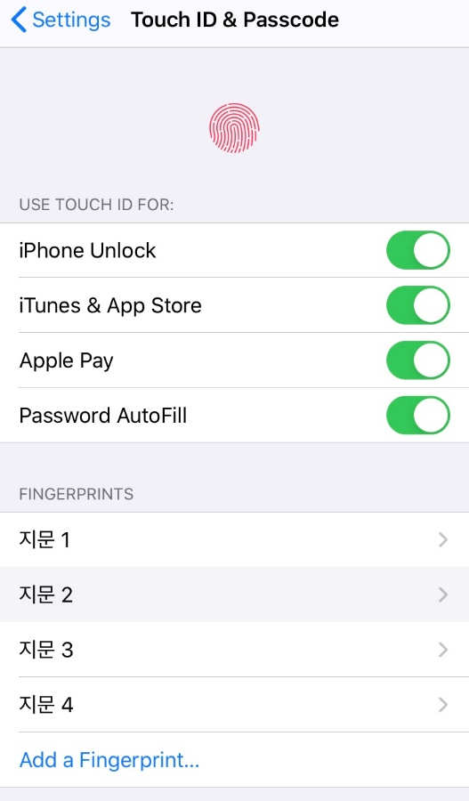
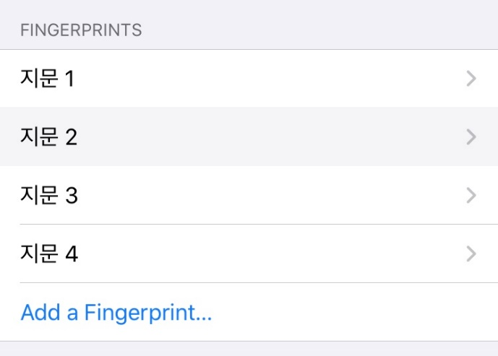
(1) Setting the Information
Most of the smartphones contain settings related to fingerprint, for it is one of the most effective ways to maintain security of the system. So, we register our fingerprint information and set up various usage of it.
Our team will put another option on the setting page, named ‘Offer information by fingerprint recognition’.
Offer information by fingerprint recognition
Touch this function and register your information
This part of the setting would be like a folder storing the data. In this area, we can put in and pull out the data. The data can be your name, birthdate, address, phone number, accounts, and any information that you think needs to be stored.

Slide 10




You can also set the boundary of your data. That is, you can easily use the data that you decide to be open with your fingerprint. On the other hand, the data that you don’t want to reveal would not be pulled out of the folder.
(2) Bringing up Stored Information
After you put the data in the folder on ‘offer information by fingerprint recognition,’ you can simply pull out the data. When you are trying to sign up or pay on your phone, the website or application requires you to provide several personal information.
In this situation, when the necessary information is recorded in the folder and it is set to be open, you can easily bring the information with your fingerprint. As soon as you touch the button ‘sign up’ or ‘pay,’ the full-screen fingerprint scanner recognizes your fingerprint. Then, the system will identify which information is needed, and provide the information from the folder. Touching Touch will let you go into the next step without those bothersome process. You can then simply do what you are going to do.

Slide 11
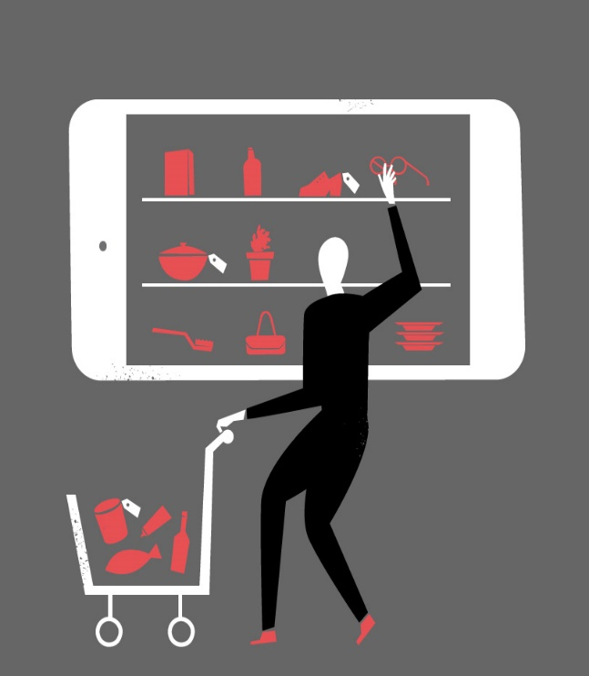
III. How Is Touching Touch
Used?
(1) Online Shopping
① Importance of online shopping
Imagine a situation that you need a certain product. To purchase it, you search this on the Internet. There are both offline shops where you can buy in person and online shop where you can buy the product with some clicks. You want to purchase it online because it saves your time and energy.
Moreover, many people love online shopping because it provides various range of information so that consumers can make more appropriate decisions on which options to select. As the importance of online shopping increases, the size of the online market is getting bigger, even making the word “E-commerce.”
However, we can make current process of online shopping even easier by using the full-screen fingerprint scanner.

Slide 12
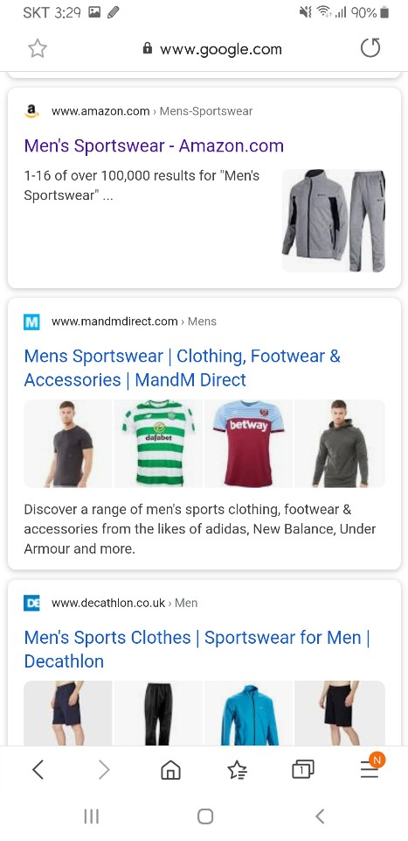
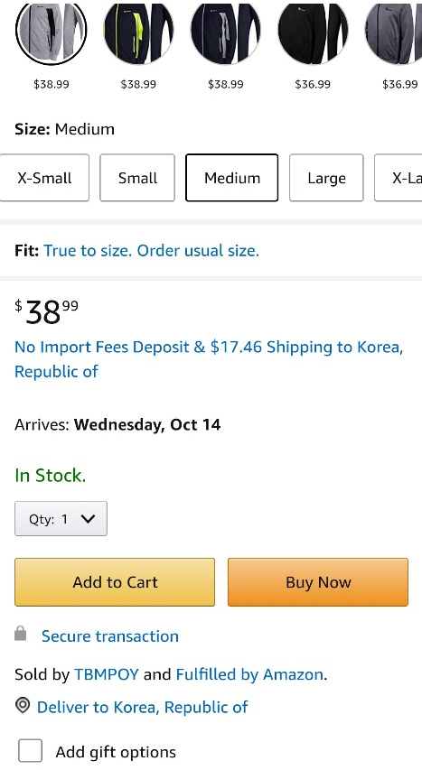
② Existing method
Situation Setting
Your sportswear is old, so you want to purchase new one. As searching on Google, you found a sportswear you are looking for. You really like the design and want to purchase it right now. However, you should first sign in by entering your ID & password and then add your credit card information. Shipping address is also required for the delivery. After entering those things, you will finally be able to buy the product.
Specific Steps
1. Tap the sportswear you want to buy.
2. Choose options, and tap the button ‘Buy now’.

Slide 13
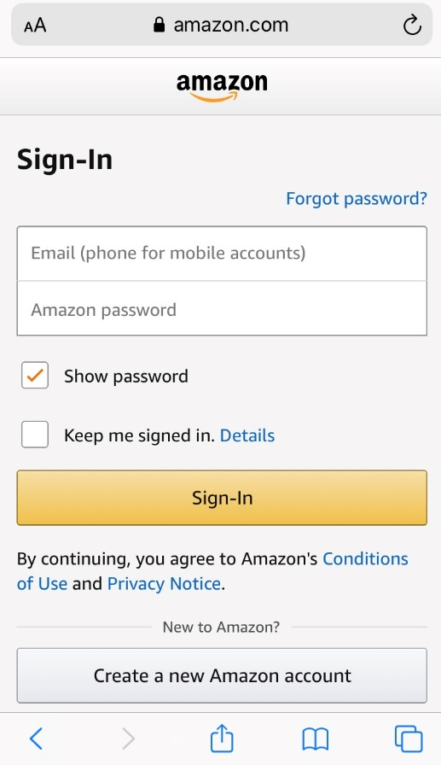
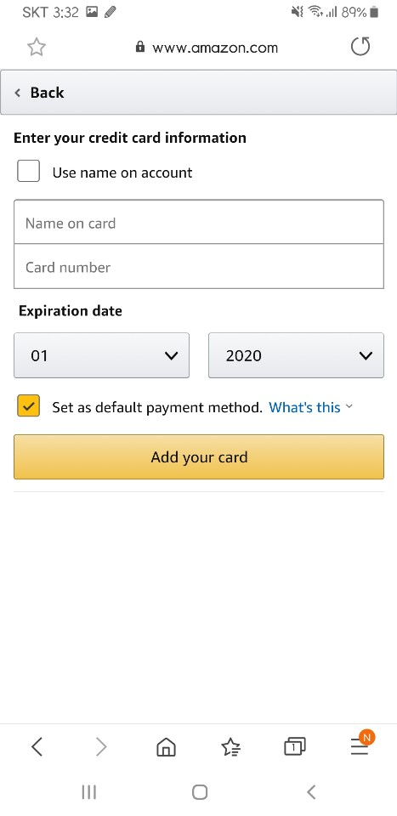
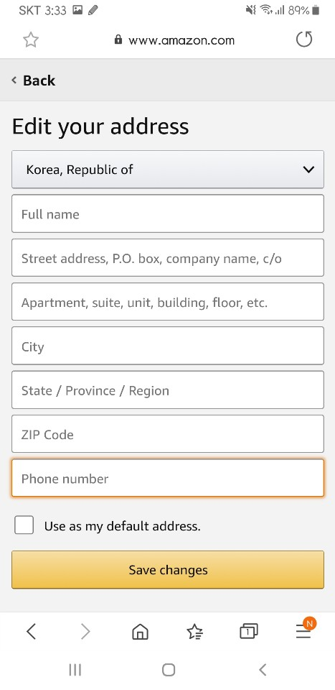
3. Sign in (If you don’t have an account, create one).
4. Add credit card with some card information.
5. Enter shipping address, then you will be able to buy.
③ New method
Situation Setting
Again you want to buy a new sportswear. You’ve just found one on the online shopping mall and you would like to buy it. Even though you are not logged on the website, your thumb can verify yourself. You do not have to enter a credit card information or your shipping address, because your fingerprint provides information about you. With only one touch, you are ready to purchase the product.

Slide 14
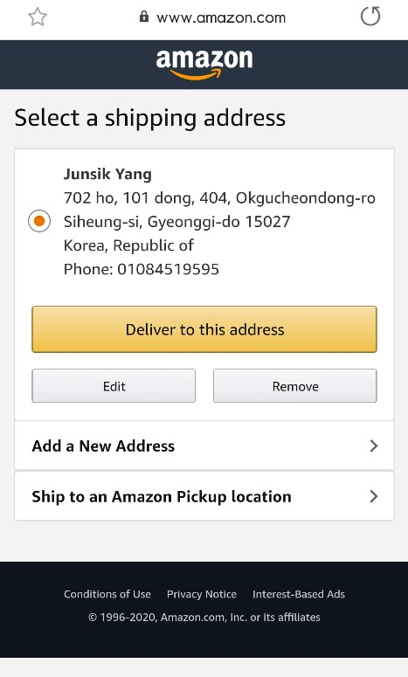
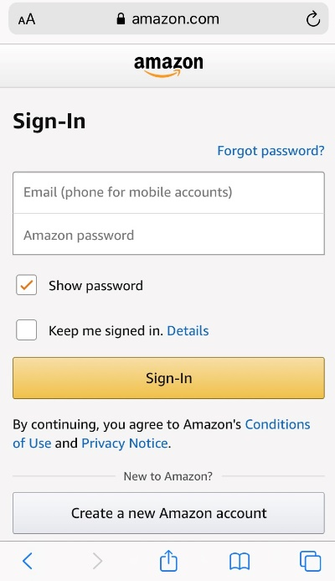

Specific Steps
1. Tap the sportswear you want to buy.
2. Choose option, and touch ‘Buy now’ with ‘thumbs-up’
3. Fingerprint verifies your account, card and address, so you will be able to buy sportswear immediately.

Slide 15
④ Expected effect
By using a full-screen fingerprint scanner, people can tap the products anywhere on the display. Fingerprint verification with ‘thumbs-up’ makes customers emotional, too. They can express their good feeling about the product externally. It will lead consumers to form a close connection with the website, thus creating strong loyalty to the shop.
The efficiency of Touching Touch satisfies the customer’s need as well. People who use online shopping want to save their time and energy more and more. In this aspect, it will help consumers to enjoy shopping more. Simplified process of online shopping can be linked to activating the market, inducing increase in transactions.

Slide 16

(2) Writing an Online Review
① Importance of review
Imagine a situation that you are trying to buy a certain product. It looks pretty good, but you would want to know more objective data related to the product. The easiest way to know is to find the evaluation from actual buyers. Those evaluations may give you practical information because those buyers have actually experienced the product in advance.
In this way, we often look for reviews related to certain things we want to try. Those reviews can influence an individual’s choice. As the importance of the review increases, people who want to write reviews on the product also increase in the same way, to help out people who want to buy the same product.
We can make the complicated process of leaving a review much easier by using the full-screen fingerprint scanner.

Slide 17
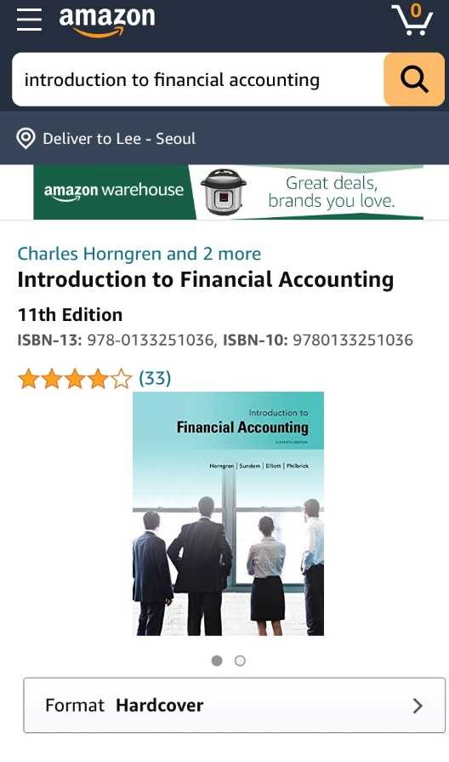
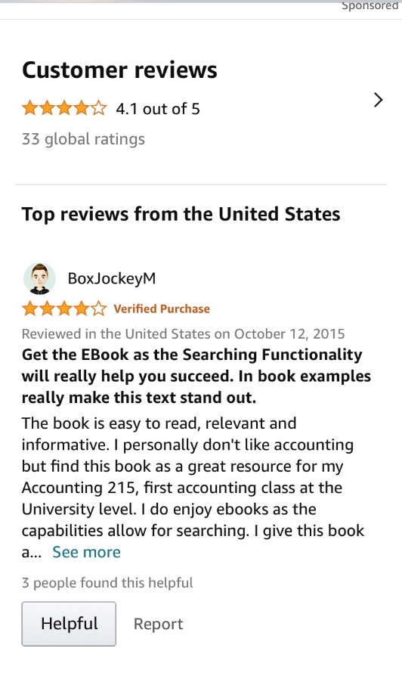
② Existing method
Situation Setting
You bought a textbook from Amazon. You really liked the contents and wanted to recommend this book to other consumers. But to leave a review, you should sign in first by entering your ID & password. After entering those, you will be able to leave a review.
Specific Steps
1. Enter the review page of the textbook you bought.

Slide 18
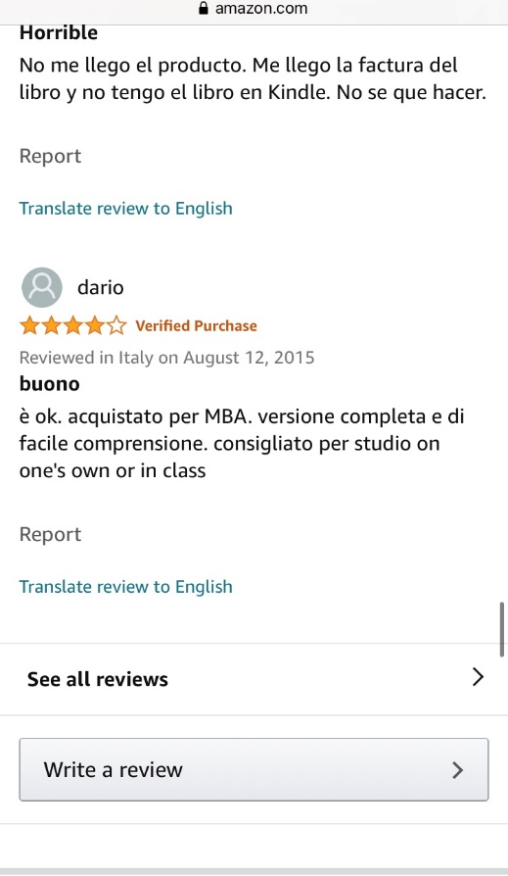
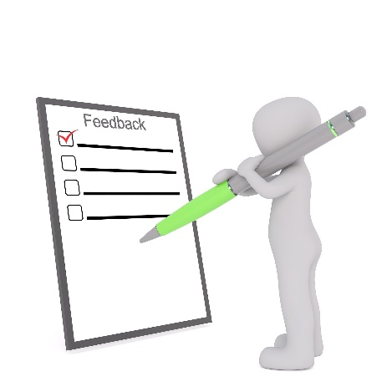
2. Touch ‘Write a review’, sign in, and you will be able to write your review.
③ New method
Situation Setting
Again, you bought a textbook from Amazon, which you evaluate the book positively so that you want to leave a review of it. Even though you are not logged into the Amazon, your thumb can verify yourself to Amazon which will make you possible to leave a review related to the book. With only one touch, you are now ready to leave a review.

Slide 19

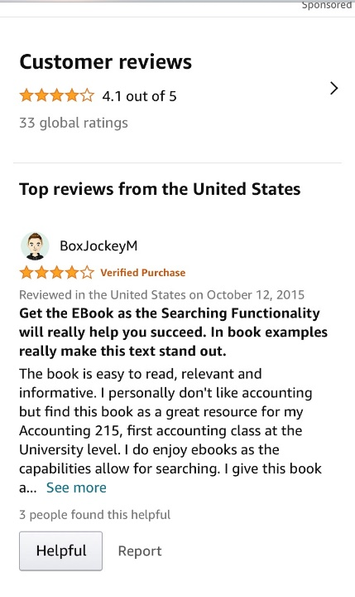
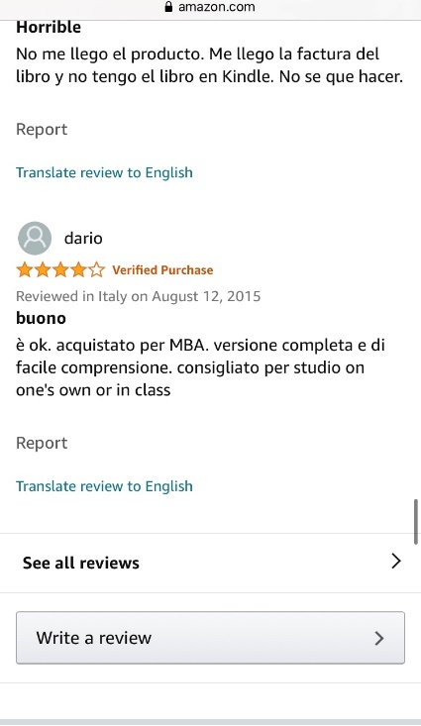



Specific Steps
1. Enter the review page of the textbook you bought
(Same as the existing method)
2. Touch ‘Write a review’ with your thumb, and you will be able to write your review immediately.

Slide 20
④ Expected effect
By simplifying the process of leaving a review, it will eventually lead to easier purchasing procedure. You can leave your comments more easily, and that will help other customers to make their choice.
We can also affect the emotional part. As we said in the opening, thumb represents a good feeling to someone or something. By using a thumb and leaving a friendly review, it can make people experience something new. They can show a favorable impression and further details in review with a single touch. This kind of emotional closeness can lead to additional usage of it.

Slide 21
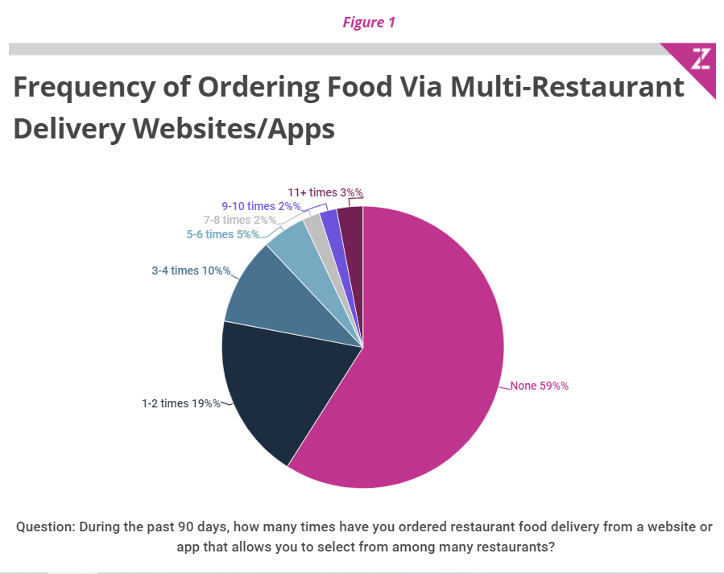
(3) Food Delivery Service
① Importance of food delivery service
Many people around the world order food using food delivery applications. In the US, there are several food delivery apps such as UberEats or Grubhub already. These apps are showing high growth rate annually, for it saves a large amount of time of choosing what to eat, preparing the food or walking or driving to the restaurant you want to go. Moreover, due to COVID-19, people are more likely to order food to their house rather than going our to eat at restaurants in person.
According to the Zion & Zion’s research about multi-restaurant delivery websites/apps on 2,928 U.S. consumers ages over 18, 41% of consumers have used multi-restaurant delivery website/apps at least once within the past 90 days.
Source: https://www.zionandzion.com/research/food-delivery-apps-usage-and-demographics-winners-losers-and-laggards/

Slide 22
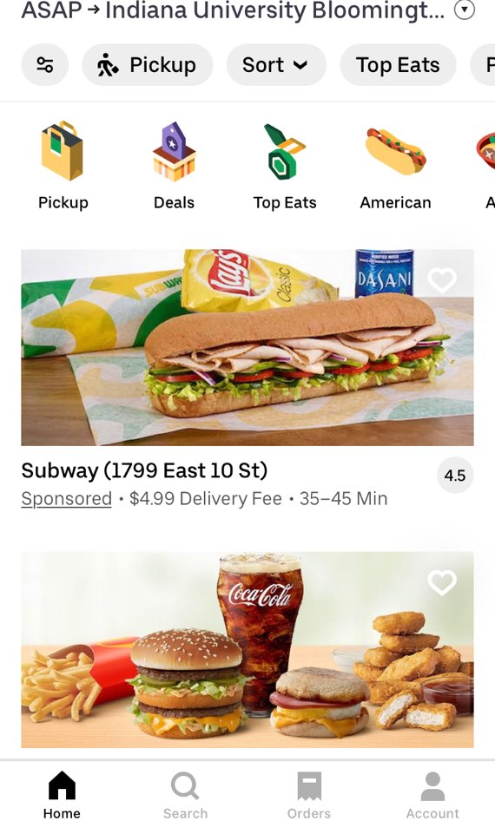
② Existing method
Situation Setting
You would like to order a food for the dinner. You don’t want to prepare for food or go to restaurant because you got so tired today so you decide to use UberEats for delivery.
Specific Steps
Whenever we make an order, we first need to sign in for the app, and then we should type all the personal information necessary for the delivery such as our name, phone number, and address.
The first screen on the right shows the list of restaurants selected by the user through categorized items such as type of food, the popularity of the restaurant, whether we could use coupons for the restaurant, or etc. At this stage, we choose what to eat according to such conditions we select. We tap the image or the title of the restaurants to take the next step to order.
< First Screen >

Slide 23
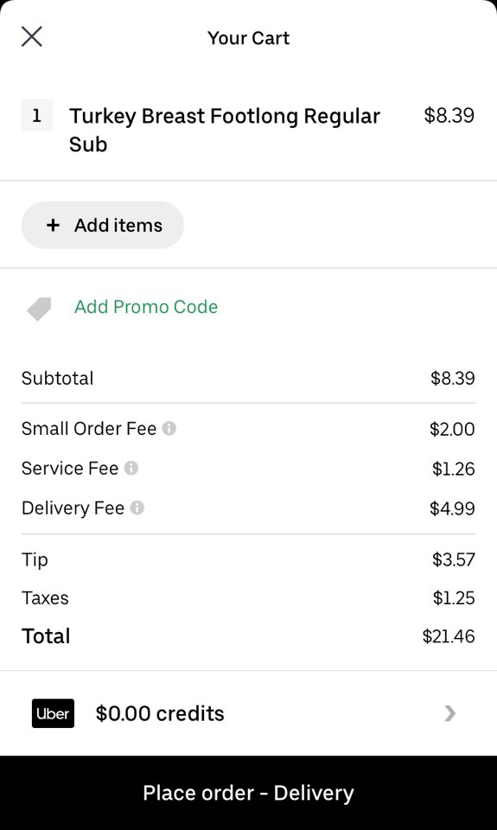
The second screenshot shows the steps we need to take after we choose what to eat, at first signing in (This is not necessary in this case; you still can even without having an account in Ubereats),
and then filling in our personal information that the restaurant needs to deliver like our address, cell number, and verification, and etc.
After writing down all the necessary things, we could then choose how we could pay, such as through credit card or coupon, and as the last step, we could finalize our order.
< Second Screen >
③ New method
Our team, 3Mile, found out by using a full-screen fingerprint scanner, we can reduce the time it takes to go through those steps and promote convenience for the consumer, which is similar to previous examples of online shopping and leaving a review. It cuts down the repetitive process of entering our personal information.

Slide 24


Situation Setting
You would like to order food for dinner. Again, you don’t have enough time to prepare for your food or go to a restaurant so you are using UberEats. But this time, you use UberEats service with a full-screen fingerprint scanner.
Specific Steps
Scanning our fingerprint at the restaurant name as in the first screen, we will see that it automatically signs in, writes down all the personal information. And also, it even chooses the payment method and settling the account.
< First Screen >
As you can see in the second screen, as soon as you scan your fingerprint, you’ll get to the final step for the payment.
< Second Screen >

Slide 25
④ Expected effect
With the service that our team, 3Mile, propose, we could, even more, reduce our time that we actually feel unnecessary because every time we order the food it’s just a repetition of the same process.
By saving the information in our fingerprint, we can easily simplify the steps, considering that using fingerprints can be the condensed way of both selection and verification because our fingerprint is a kind of a proper number unique to us; using the fingerprint means that we agree to share all the information, just like signing for the contract.
This is how we could utilize the full-screen fingerprint scanner on the food delivery apps.

Slide 26


IV. Conclusion
We seek to simplify procedures by providing user information through fingerprint recognition as well as emotional function.
Consumers purchase certain products or services on their smartphones and leave reviews. In this process, they must sign up, log in, and enter various information such as addresses and card numbers. Such complicated procedure is incompatible with expressing their good feelings. Touching Touch simplifies it. Their emotions can be expressed with just one touch with a raised thumb. This ensures both emotion and practicality which is also efficient and secure.
Sign-up
Log
-in
Enter
data
Touching Touch can be used in 3 main ways: online shopping, writing a review, and food delivery. Only single thumbprint makes it easier for customers to do these activities in their daily lives. Because customers don't know where the item they are looking for will be located on the display, Touching touch can take advantages of full-screen fingerprints, which enables fingerprint recognition in any part of the screen.

Slide 27
One small innovation can change many things. The intuitive action of “thumbs-up” of buyers helps to form close connections between buyers and sellers. It will lead to market activation driven by strong loyalty and the increased number of transactions. Touching Touch makes these changes.
Lastly, remember the most important idea that we wanted to highlight throughout this whole proposal. When you press the screen display with your thumbs, it is not only a convenient method, but also a way to express your good feelings on your smartphones.
“Press to Express”

