Slide 1
Spring Framework
팀프로젝트
본 프로젝트는 쌍용교육센터 JAVA 백엔드 개발자 과정 프로젝트 결과물 입니다.
2020년 4월 13일 부터 약 1달 간 Spring Framework를 배우면서 작업했습니다.
4인 팀프로젝트로 제가 맡은 파트는 Controller, MVC, ORM 설계입니다.
데이터베이스 – Oracle 18C, Platform – Spring Boot를 사용하였습니다.
최문정

Slide 2
목차
1. 네트워크 토폴로지, DB명세
2. 각 페이지 소개
3. 로그인 / 회원가입
4. 조회 및 검색
5. 게시판 작성

Slide 3



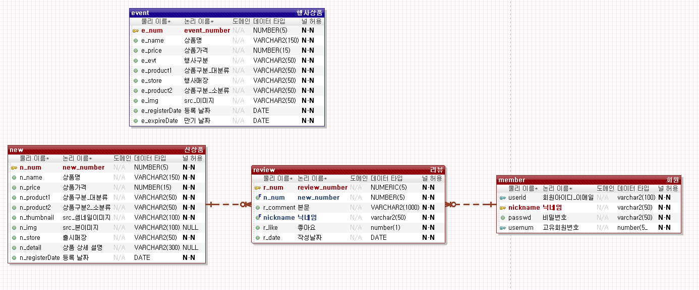
1
Network Topology/DB명세
네트워크 토폴로지(Network Topology)
구현 기능
암호화 로그인/회원가입: Spring Security
검색기능: Mybatis – Procedure 활용
리스트 뷰: Get방식 PathVariable 활용
게시판 작성: uesrDetails 세션 값 활용
CLIENT
WAS:
ubuntu server
Tomcat-9
211.63.89.158
DB SERVER:
CentOS
ORACLE
211.63.89.159
DB명세

Slide 4
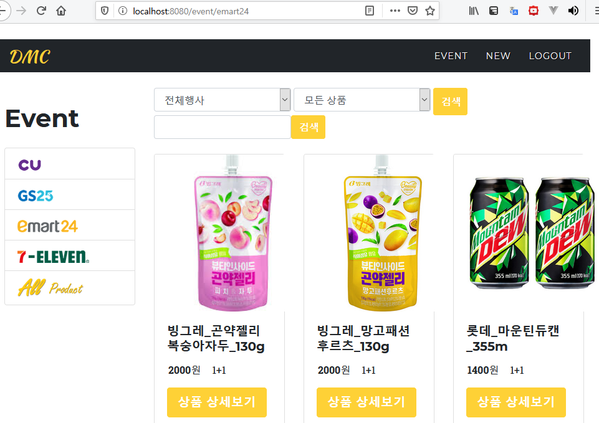
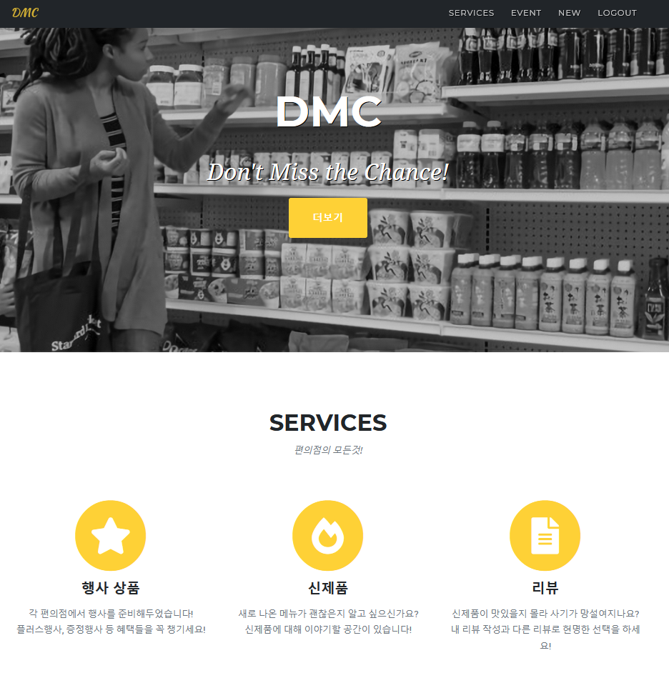
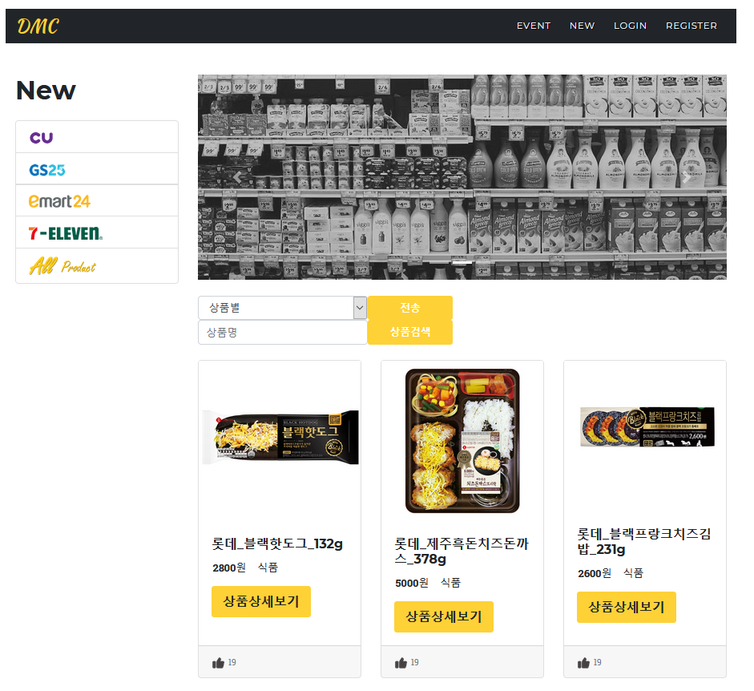
2
페이지 소개
main

Slide 5
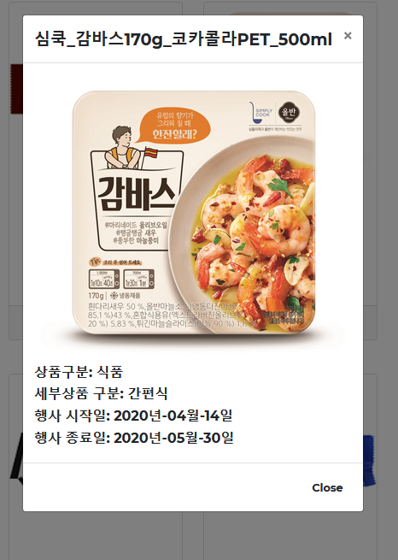
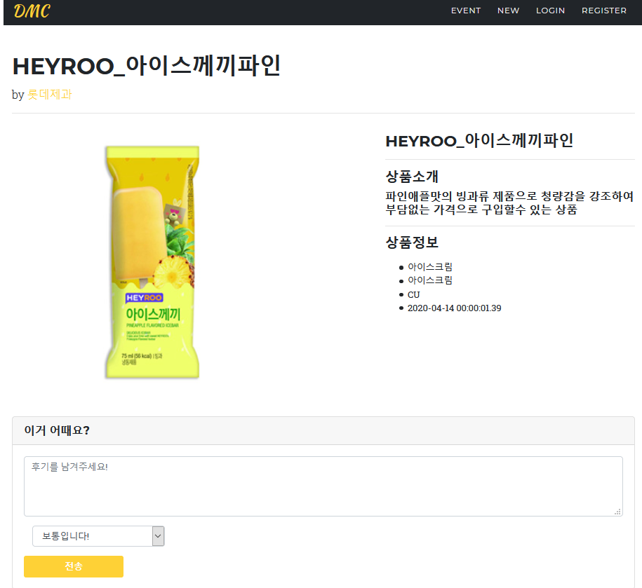
2
페이지 소개
Event- 상품 상세보기
New- 상품 상세보기

Slide 6
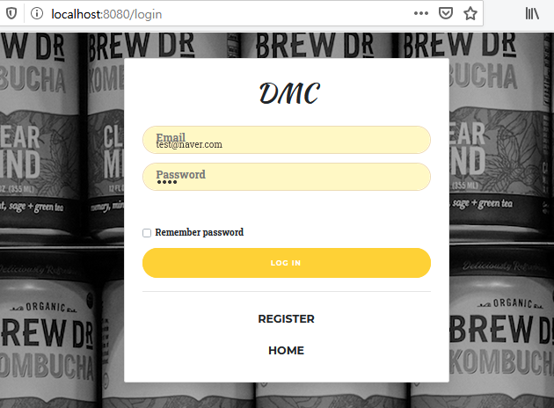
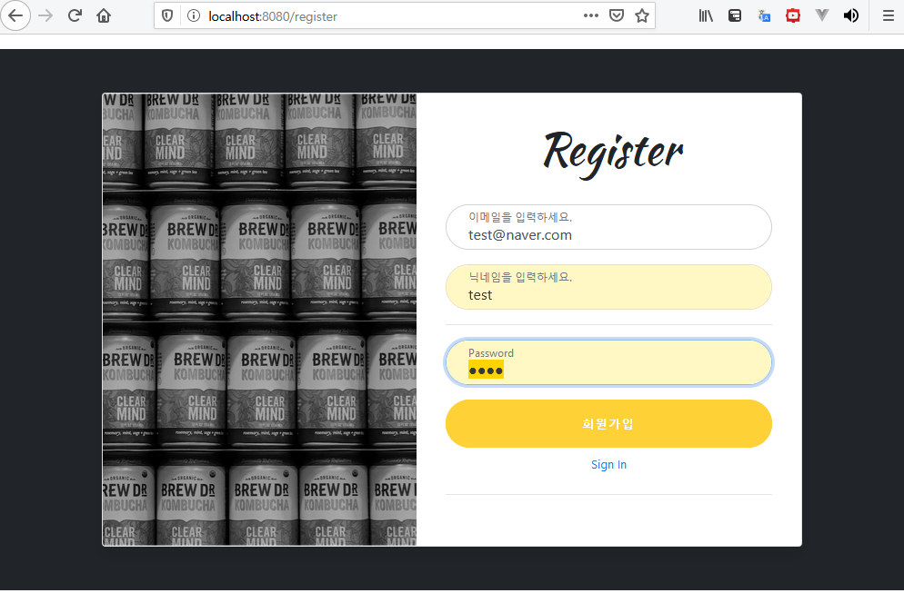
3
로그인/회원가입
JPA(Entity)
myBatis(VO)
@NoArgsConstructor(access = AccessLevel.PROTECTED) @Getter @Table(name = "member") @Entity public class Member { @Id @Column(name = "member_id") private String email; @GeneratedValue private Long id; private String nickname; private String password; @OneToMany(mappedBy = "member") private List<Review> reviews = new ArrayList<>(); @Builder public Member(Long id, String email, String nickname, String password) { this.id = id; this.email = email; this.nickname = nickname; this.password = password; } }
import lombok.*; @Getter @Setter @RequiredArgsConstructor @ToString @NoArgsConstructor public class MemberVO { @NonNull private String userid; @NonNull private String nickname; private String passwd; private String role; private int enabled; }

Slide 7
3
로그인/회원가입
Controller
Service
// 회원가입 페이지 @GetMapping("/register") public String register() { return "register"; // templates/register.html } // 회원가입 처리 @PostMapping("/register") public String execSignup(MemberDto memberDto) { memberService.joinUser(memberDto); return "redirect:/login"; } //login @GetMapping("/login") public void login() { } // 로그인 결과 페이지 @GetMapping("/loginSuccess") public String dispLoginResult() { return "/loginSuccess"; } // 로그아웃 결과 페이지 @GetMapping("/logout") public String dispLogout() { return "/logout"; } // 접근 거부 페이지 @GetMapping("/accessDenied") public String dispDenied() { return "/accessDenied"; }
@Service @Transactional public class MemberService implements UserDetailsService{ @Autowired private MemberRepository memberRepository; @Transactional public String joinUser(MemberDto memberDto) { // 비밀번호 암호화 BCryptPasswordEncoder passwordEncoder = new BCryptPasswordEncoder(); memberDto.setPassword(passwordEncoder.encode(memberDto.getPassword())); return memberRepository.save(memberDto.toEntity()).getEmail(); } @Override public UserDetails loadUserByUsername(String userEmail) throws UsernameNotFoundException { Optional<Member> userEntityWrapper = Optional.ofNullable(memberRepository.findByEmail(userEmail)); Member userEntity = userEntityWrapper.get(); List<GrantedAuthority> authorities = new ArrayList<>(); return new User(userEntity.getEmail(), userEntity.getPassword(), authorities); } }

Slide 8
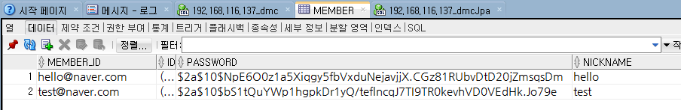
3
로그인/회원가입
SecurityConfig
@Configuration @EnableWebSecurity @AllArgsConstructor public class SecurityConfig extends WebSecurityConfigurerAdapter { private MemberService memberService; @Bean public PasswordEncoder passwordEncoder() { return new BCryptPasswordEncoder(); } @Override public void configure(WebSecurity web) throws Exception { web.ignoring().antMatchers("/css/**", "/js/**", "/img/**", "/lib/**"); } @Override protected void configure(HttpSecurity http) throws Exception { http.authorizeRequests() // 페이지 권한 설정 .antMatchers("/").permitAll() .antMatchers("/new/**").authenticated() .and() // 로그인 설정 .formLogin() .loginPage("/login") .defaultSuccessUrl("/", true) .permitAll() .and() // 로그아웃 설정 .logout() .logoutRequestMatcher(new AntPathRequestMatcher("/logout")) .logoutSuccessUrl("/") .invalidateHttpSession(true) .and() // 403 예외처리 핸들링 .exceptionHandling().accessDeniedPage("/accessDenied"); } @Override public void configure(AuthenticationManagerBuilder auth) throws Exception { auth.userDetailsService(memberService).passwordEncoder(passwordEncoder()); } }
Repository(Spring Data JPA)
public interface MemberRepository extends JpaRepository<Member, Long> { Member findByEmail(String userEmail); Member findByNickname(String nicknamed); Member findById(String memberId); }
암호화된 회원가입 결과물

Slide 9
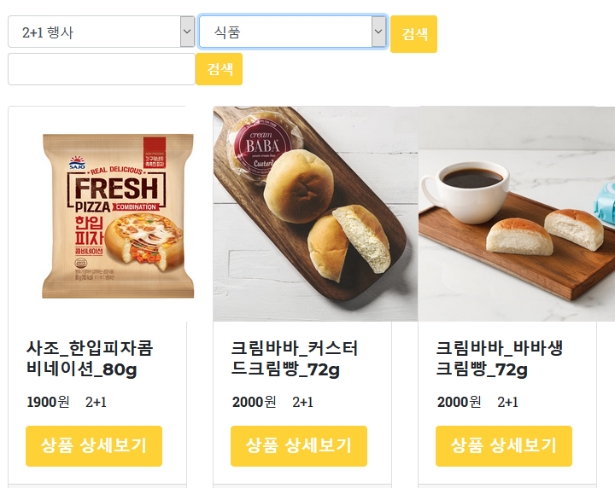
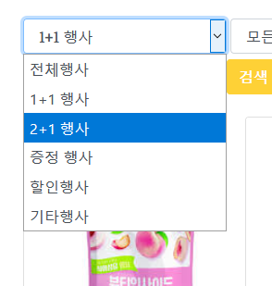
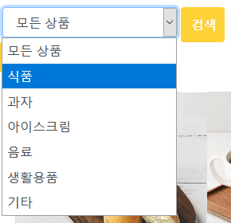
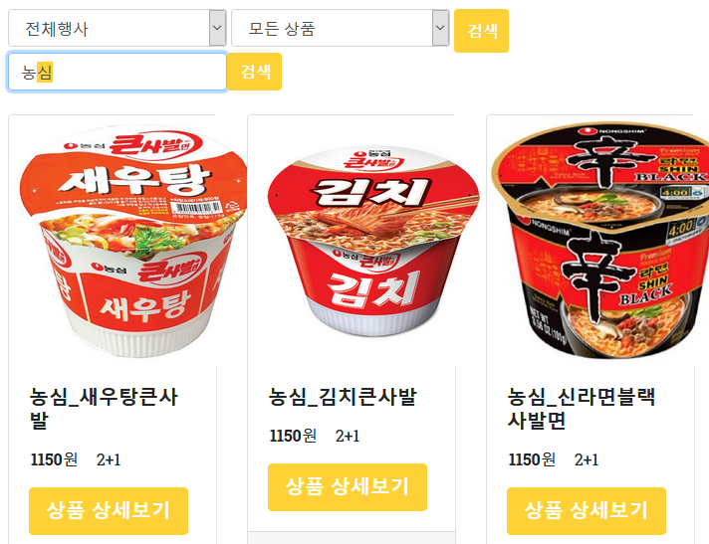
4
조회 및 검색
SelectBox
Text Search

Slide 10
4
조회 및 검색
myBatis_mapper.xml
<!-- event select form store --> <resultMap type="eventVO" id="eventVO_form_ResultMap"> <result property="e_num" column="e_num" javaType="java.lang.Integer" jdbcType="INTEGER"/> <result property="e_name" column="e_name" javaType="java.lang.String" jdbcType="VARCHAR"/> <result property="e_price" column="e_price" javaType="java.lang.Integer" jdbcType="INTEGER"/> <result property="e_evt" column="e_evt" javaType="java.lang.String" jdbcType="VARCHAR"/> <result property="e_product1" column="e_product1" javaType="java.lang.String" jdbcType="VARCHAR"/> <result property="e_store" column="e_store" javaType="java.lang.String" jdbcType="VARCHAR"/> <result property="e_product2" column="e_product2" javaType="java.lang.String" jdbcType="VARCHAR"/> <result property="e_img" column="e_img" javaType="java.lang.String" jdbcType="VARCHAR"/> <result property="e_registerDate" column="e_registerDate" javaType="java.util.Date" jdbcType="DATE"/> <result property="e_expireDate" column="e_expireDate" javaType="java.util.Date" jdbcType="DATE"/> </resultMap> <parameterMap type="hashmap" id="parameterSelect_form_Map"> <parameter property="e_evt" javaType="java.lang.String" mode="IN" jdbcType="VARCHAR"/> <parameter property="e_product1" javaType="java.lang.String" mode="IN" jdbcType="VARCHAR"/> <parameter property="results" javaType="ResultSet" jdbcType="CURSOR" mode="OUT" resultMap="eventVO_form_ResultMap"/> </parameterMap> <select id="event_select_form" parameterMap="parameterSelect_form_Map" statementType="CALLABLE"> { call event_select_form(?,?,?) } </select>
<!-- event textbox store --> <resultMap type="eventVO" id="eventVO_textbox_ResultMap"> <result property="e_num" column="e_num" javaType="java.lang.Integer" jdbcType="INTEGER"/> <result property="e_name" column="e_name" javaType="java.lang.String" jdbcType="VARCHAR"/> <result property="e_price" column="e_price" javaType="java.lang.Integer" jdbcType="INTEGER"/> <result property="e_evt" column="e_evt" javaType="java.lang.String" jdbcType="VARCHAR"/> <result property="e_product1" column="e_product1" javaType="java.lang.String" jdbcType="VARCHAR"/> <result property="e_store" column="e_store" javaType="java.lang.String" jdbcType="VARCHAR"/> <result property="e_product2" column="e_product2" javaType="java.lang.String" jdbcType="VARCHAR"/> <result property="e_img" column="e_img" javaType="java.lang.String" jdbcType="VARCHAR"/> <result property="e_registerDate" column="e_registerDate" javaType="java.util.Date" jdbcType="DATE"/> <result property="e_expireDate" column="e_expireDate" javaType="java.util.Date" jdbcType="DATE"/> </resultMap> <parameterMap type="hashmap" id="parameterTextbox_Map"> <parameter property="e_name" javaType="java.lang.String" mode="IN" jdbcType="VARCHAR"/> <parameter property="results" javaType="ResultSet" jdbcType="CURSOR" mode="OUT" resultMap="eventVO_textbox_ResultMap"/> </parameterMap> <select id="event_textbox" parameterMap="parameterTextbox_Map" statementType="CALLABLE"> { call event_textbox(?,?) } </select>

Slide 11
4
조회 및 검색
Oracle – Procedure_selectBox search
create or replace PROCEDURE event_select_form ( v_e_evt IN event.e_evt%TYPE, v_e_product1 IN event.e_product1%TYPE, event_record OUT SYS_REFCURSOR ) AS BEGIN OPEN event_record FOR SELECT * FROM event where
e_evt like concat(concat('%',v_e_evt),'%’) and
e_product1 like concat(concat('%',v_e_product1),'%'); END;
Oracle – Procedure_text search
create or replace procedure event_textbox ( v_e_name in event.e_name%type, event_record out sys_refcursor ) as begin open event_record for select * from event where e_name like concat(concat('%',v_e_name),'%'); end;

Slide 12
4
조회 및 검색
Controller
@GetMapping("/event/{e_store}") public String event(@PathVariable String e_store, Model model) { Map<String, Object> map = new HashMap<String, Object>(); map.put("e_store", e_store); this.eventService.selectAllEvent_store(map);
List<EventVO> list = (List<EventVO>) map.get("results"); EventVO event = list.get(0); model.addAttribute("events", list); return "event"; }
myBatis_mapper.xml
<resultMap type="eventVO" id="eventVO_store_ResultMap"> <result property="e_num" column="e_num" javaType="java.lang.Integer" jdbcType="INTEGER"/> <result property="e_name" column="e_name" javaType="java.lang.String" jdbcType="VARCHAR"/> <result property="e_price" column="e_price" javaType="java.lang.Integer" jdbcType="INTEGER"/> <result property="e_evt" column="e_evt" javaType="java.lang.String" jdbcType="VARCHAR"/> <result property="e_product1" column="e_product1" javaType="java.lang.String" jdbcType="VARCHAR"/> <result property="e_store" column="e_store" javaType="java.lang.String" jdbcType="VARCHAR"/> <result property="e_product2" column="e_product2" javaType="java.lang.String" jdbcType="VARCHAR"/> <result property="e_img" column="e_img" javaType="java.lang.String" jdbcType="VARCHAR"/> <result property="e_registerDate" column="e_registerDate" javaType="java.util.Date" jdbcType="DATE"/> <result property="e_expireDate" column="e_expireDate" javaType="java.util.Date" jdbcType="DATE"/> </resultMap> <parameterMap type="hashmap" id="parameterSelectAll_store_Map"> <parameter property="e_store" javaType="java.lang.String" mode="IN" jdbcType="VARCHAR"/> <parameter property="results" javaType="ResultSet" jdbcType="CURSOR" mode="OUT" resultMap="eventVO_store_ResultMap"/> </parameterMap> <select id="event_selectAll_store" parameterMap="parameterSelectAll_store_Map" statementType="CALLABLE"> { call event_select_all_store_sp(?,?) } </select>

Slide 13
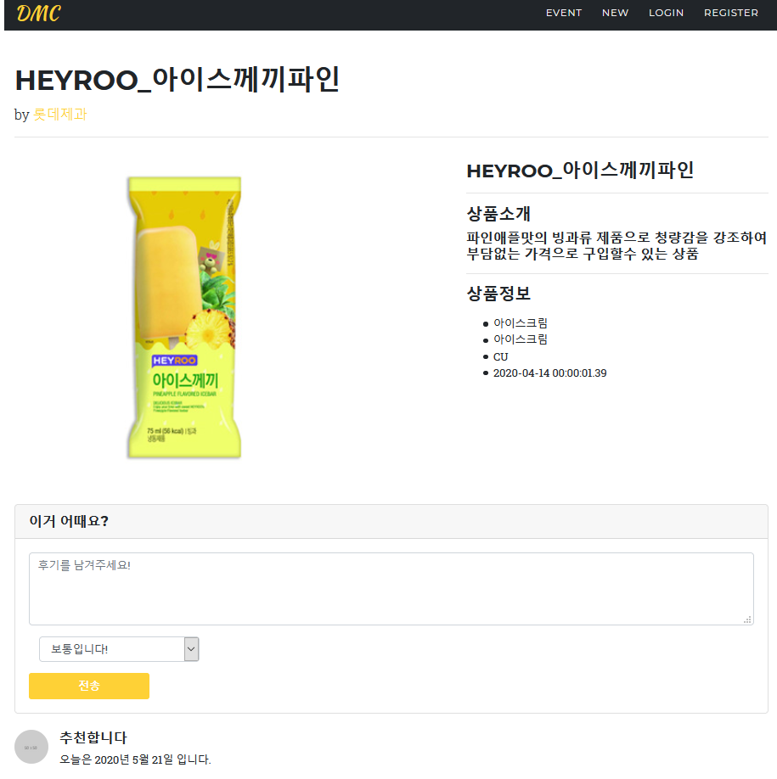
5
게시판 작성
Controller
@GetMapping("/review/{n_num}") public String review(@PathVariable int n_num, @RequestParam(value = "r_comment") String r_comment, @RequestParam(value = "r_like") String r_like, Authentication authentication ) { UserDetails userDetails = (UserDetails) authentication.getPrincipal(); String userid = userDetails.getUsername(); this.detailService.insertReview(n_num,r_comment, userid, r_like); return "redirect:/detail/{n_num}"; }
Service
Service
@Override public void insertReview(int n_num, String r_comment, String userid, String r_like) { this.detailDao.Review_insert(n_num, userid, r_comment, r_like); }
Repository
@Override public void Review_insert(int n_num, String r_comment, String userid, String r_like){ Map<String, Object> map = new HashMap<String, Object>(); map.put("n_num", n_num); map.put("r_comment", r_comment); map.put("userid", userid); map.put("r_like", r_like); this.sqlSession.insert("review_insert",map); }

Slide 14
5
게시판 작성
myBatis_mapper.xml
<parameterMap type="hashmap" id="parameterInsertMap"> <parameter property="n_num" javaType="java.lang.Integer" jdbcType="INTEGER" mode="IN" /> <parameter property="r_comment" javaType="java.lang.String" jdbcType="VARCHAR" mode="IN" /> <parameter property="userid" javaType="java.lang.String" jdbcType="VARCHAR" mode="IN" /> <parameter property="r_like" javaType="java.lang.String" jdbcType="VARCHAR" mode="IN" /> </parameterMap> <insert id="review_insert" parameterType="reviewVO" parameterMap="parameterInsertMap" statementType="CALLABLE"> { call review_insert_sp(?,?,?,?)} </insert>
Oracle – Procedure: review_insert_sp
create or replace PROCEDURE review_insert_sp ( v_n_num IN review.n_num%TYPE, v_r_comment IN review.r_comment%TYPE, v_userid IN review.userid%TYPE, v_r_like IN review.r_like%TYPE ) IS BEGIN insert into review(r_num, n_num, r_comment, userid, r_like, r_date) values(REVIEW_SEQ.NEXTVAL , v_n_num, v_r_comment, v_userid , v_r_like, sysdate); END;

