Slide 1
Kinetex Lab × Notion
Sanchalan
The event command center for student teams — plain-English ops updates become Notion-synced action plans.
Problem ID: KBC-NOTION-03 | Team: larpers | Members: Abhigyan Rai, Aditya Kumar, Akshit Sinha | College: KIIT | Demo link: lunasticgold-hub.github.io/sanchalan | Repo: github.com/lunasticgold-hub/sanchalan
Kaun Banega Codepati 2026

Slide 2
Problem & Users
Problem Understanding (15%)
The problem
Users & roles
Event ops live in WhatsApp groups, spreadsheets and ad-hoc docs — one venue change silently breaks volunteer deployment, speaker timing, equipment and comms.
Who feels it: student organizers, club coordinators, volunteers — at every event, from 50-person meetups to full fests.
Real scenario: 2 hours before showtime the main auditorium is moved. Nobody knows which sessions, volunteers and tasks are hit until things break live.
Cost of the status quo: missed sessions, double-booked volunteers, confused attendees — and zero reusable knowledge after the event.
Role 1: Ops lead — owns the plan; needs the blast radius of any change instantly, and a way to push updates.
Role 2: Volunteer lead — needs a live shift plan; gets auto-flagged the moment their people are affected.
Role 3: Leadership — needs one glance: what is done, blocked, or at risk.
Reference scenario we solve: venue change 2h before the event → impact computed → Notion updated → everyone notified.
Kaun Banega Codepati 2026 | Kinetex Lab × Notion
2

Slide 3
Solution & Workflow
Proposed workflow, end to end
1. Ingest — plain-English ops update
2. Structure (AI) — Gemini extracts change type + params
3. Sync to Notion — read + write 7 linked databases
4. Act / Search — role dashboards + cited Q&A
5. Insights — impact reports, risks, post-event knowledge
What happens at each step
Key features
Input: “Main audi moved to Seminar Hall B, start delayed 1 hr” — typed or pasted ops update.
AI output: structured change {venue_change} + blast radius: 2 sessions moved (Opening Keynote, Panel: Fundraising 101), 3 volunteers flagged, 3 tasks rewritten, 1 P0 capacity risk (Seminar Hall B holds 120 vs ~200 attendees).
Notion write: sessions re-venued and retimed, follow-up tasks created (🤖 AI-generated), comms draft created, Impact Report page linking every affected record.
Mandatory covered: info structuring, Notion knowledge layer (read + write), NL discovery, personalized tasks, relationship mapping (event → session → volunteer → task), 3 roles, analytics dashboard.
Advanced layer: AI extraction from noisy updates, impact analysis, simulate-before-apply, capacity & conflict risk detection, automatic event-lifecycle documentation, explainable answers with source links.
Role-based views: Ops lead (command view), Volunteer lead (shift view), Leadership (status view).
Kaun Banega Codepati 2026 | Kinetex Lab × Notion
3

Slide 4
Architecture & Data Flow
Technical Implementation (20%)
Frontend — React + Vite + Tailwind ops console
Backend / API — Vercel serverless functions (/api/parse, /query, /apply, /ask)
AI layer — Gemini 2.5 Flash extraction + keyword fallback; dependency engine in pure TypeScript
Notion API — 7 databases with relations; reads + writes via integration token
→
→
→
Data model
Reliability
Databases & key relations: Events → Sessions → Volunteers → Tasks; Venues ↔ Sessions; Comms Log; Impact Reports link trigger → affected sessions → new tasks.
Permissions: Notion integration scoped to the Sanchalan page tree; role views are UI filters over the same live data.
AI output labelled: every AI-written record carries Source = “🤖 AI-generated” (amber badge); human-confirmed flips to “✅ Verified” (green).
Sync strategy: simulate-before-apply — blast-radius preview first, then Notion writes; failures reported per record, never half-applied silently.
Source citations / traceability: every impact report links the trigger message, affected sessions and created tasks; Ask answers cite record URLs.
Tech stack & why: Notion as the database (the brief’s knowledge layer), serverless API (zero ops), Gemini (cheap, fast extraction).
Kaun Banega Codepati 2026 | Kinetex Lab × Notion
4

Slide 5
Notion Integration & Innovation
Notion Integration (15%) + Innovation (15%)
How Notion is used
What makes us different
Databases created / synced: Sanchalan · Venues, Events, Sessions, Volunteers, Tasks, Comms Log, Impact Reports — all with live relations.
Read AND write operations: the app queries sessions/tasks/volunteers to compute impact, then writes venue updates, new tasks, comms drafts and impact reports back.
Notion is active in the workflow: the dependency engine runs on live Notion data — not a template, iframe or link.
Live-sync proof: apply a venue change in the app → watch the Sessions database and the new Impact Report page update in Notion side-by-side.
Our unique idea: a dependency engine over your Notion ops graph — every change is simulated for blast radius BEFORE it is applied.
Advanced features built: venue/time impact analysis, capacity-overflow risk detection, volunteer conflict flags, auto comms drafts, one-click post-event knowledge base.
AI output vs verified source: amber 🤖 AI-generated badges vs green ✅ Verified; impact reports always link back to source records.
Compared with existing tools: spreadsheets/WhatsApp have no dependency model; generic PM tools aren’t Notion-native and can’t simulate change impact.
Kaun Banega Codepati 2026 | Kinetex Lab × Notion
5

Slide 6
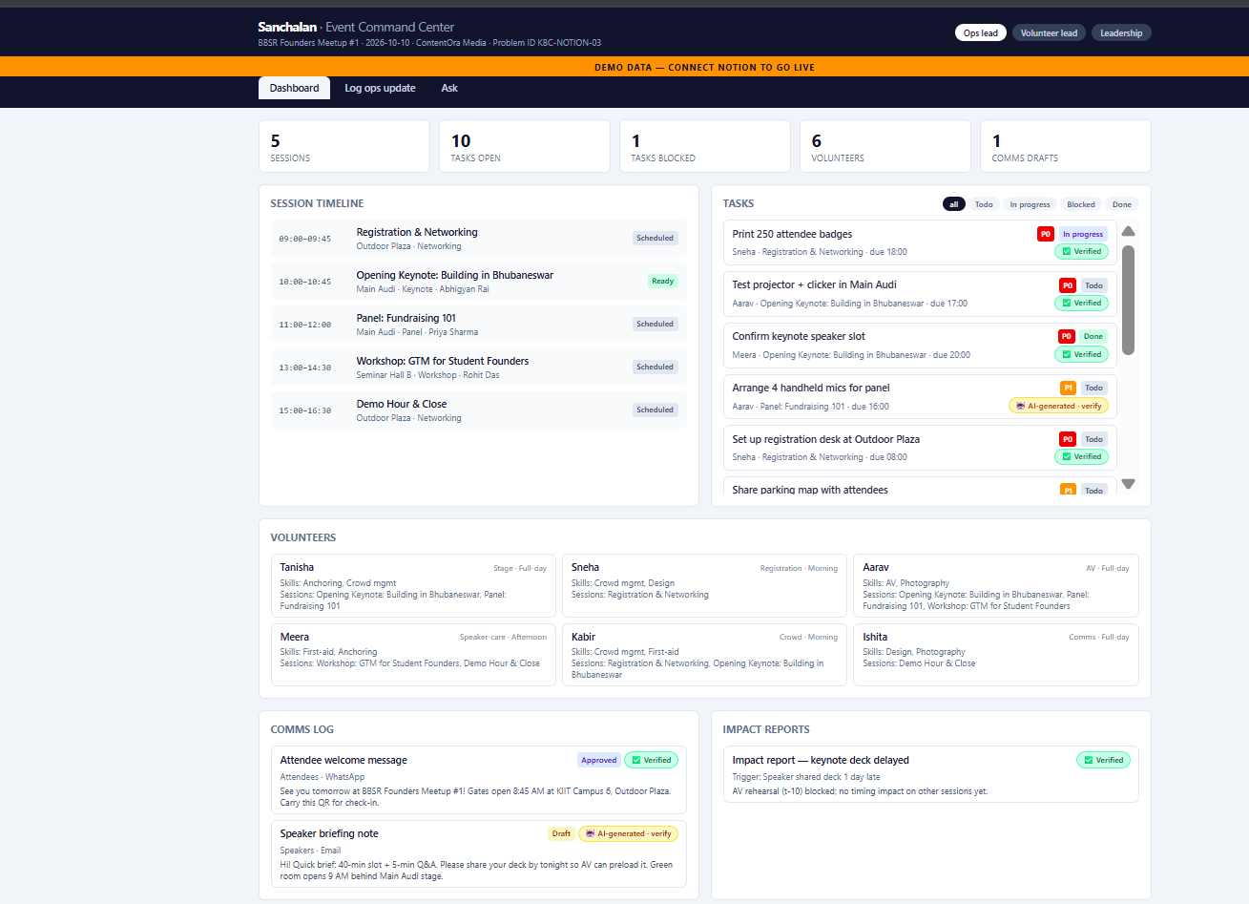
Prototype & Live Demo
Working Prototype (15%) + Presentation & Demo (10%)
Demo script (3–5 min)
1. Input arrives: “Main Audi is under maintenance — move everything to Seminar Hall B.”
2. System parses → simulates: 2 sessions moved, P0 capacity risk (120 < 200), 3 tasks rewritten, 3 volunteers flagged, comms draft created → applies to Notion live.
3. Role A (Ops lead) reviews the Impact Report in Notion and approves.
4. Role B (Volunteer lead) sees the updated shift plan; asks “Which volunteers are affected?” — answered with citations.
5. Insight: P0 overflow risk + auto-created tasks; post-event, one click compiles the knowledge base.
Demo dataset: synthetic BBSR Founders Meetup #1 — 29 records in a real Notion workspace.
Kaun Banega Codepati 2026 | Kinetex Lab × Notion
6

Slide 7
Feasibility, Scalability & Next Steps
Feasibility & Scalability (10%)
Feasibility
Scalability
Roadmap
Works with: any team’s existing Notion workspace — no migration, point it at your databases.
Setup effort: low — create an integration, share one page, paste two keys.
Cost: ~₹0 — Notion API free, Gemini free tier, Vercel hobby tier.
From 1 club to whole campus: one workspace per event; databases scale to thousands of rows.
Multi-team / multi-event: same engine, new database set per event; role views per team.
Performance & rate limits: batched Notion writes, cached reads per session — well within Notion API limits at event scale.
Next 30 days: run the real BBSR Founders Meetup #1 on Sanchalan; WhatsApp bot for ops updates; Hinglish parsing.
Future features: multi-event portfolio view, sponsor & expense tracking, volunteer auto-allocation by skills.
Thank you — questions?
Kaun Banega Codepati 2026 | Kinetex Lab × Notion
7

