Slide 1
C# Language
Working with Data Using Entity Framework Core
Understanding modern databases
Setting up EF Core
Defining EF Core models
Querying EF Core models
Loading patterns with EF Core
Manipulating data with EF Core
Working with transactions
Code First EF Core models
MongoDb
Corso C#

Slide 2
Understanding modern databases
Understanding modern databases
two of the most common places to store data are in
a Relational Database Management System (RDBMS) such as Microsoft SQL Server, PostgreSQL, MySQL, and SQLite
a NoSQL database such as Microsoft Azure Cosmos DB, Redis, MongoDB, AWS DynamoDB, and Apache Cassandra
Corso C#

Slide 3
Understanding modern databases
Legacy Entity Framework
Entity Framework (EF) was first released as part of .NET Framework 3.5 with Service Pack 1 back in late 2008. Since then, Entity Framework has evolved, as Microsoft has observed how programmers use an object-relational mapping (ORM) tool in the real world
ORMs use a mapping definition to associate columns in tables to properties in classes
then, a programmer can interact with objects of different types in a way that they are familiar with, instead of having to deal with knowing how to store the values in a relational table or another structure provided by a NoSQL data store
the version of EF included with .NET Framework is Entity Framework 6 (EF6); it is mature, stable, and supports an EDMX (XML file) way of defining the model as well as complex inheritance models, and a few other advanced features
EF 6.3 and later have been extracted from .NET Framework as a separate package so it can be supported on .NET Core 3.0 and later: this enables existing projects like web applications and services to be ported and run cross-platform
however, EF6 should be considered a legacy technology because it has some limitations when running cross-platform and no new features will be added to it
Corso C#

Slide 4
Understanding modern databases
Using the legacy Entity Framework 6.3 or later
to use the legacy Entity Framework in a .NET Core 3.0 or later project, you must add a package reference to it in your project file, as shown in the following markup:
<PackageReference Include="EntityFramework" Version="6.4.4" />
NOTE: only use legacy EF6 if you have to, for example, when migrating a WPF app that uses it we will only cover the modern Entity Framework Core so you will not need to reference the legacy EF6 package as shown above in the rest of this course
Corso C#

Slide 5
Understanding modern databases
Understanding Entity Framework Core
the truly cross-platform version, EF Core, is different from the legacy Entity Framework. Although EF Core has a similar name, you should be aware of how it varies from EF6. The latest EF Core is version 6.0 to match .NET 6.0.
EF Core 5 and later only support .NET 5 and later. EF Core 3.0 and later only run on platforms that support .NET Standard 2.1, meaning .NET Core 3.0 and later. It does not support .NET Standard 2.0 platforms like .NET Framework 4.8.
as well as traditional RDBMSs, EF Core supports modern cloud-based, nonrelational, schema-less data stores, such as Microsoft Azure Cosmos DB and MongoDB, sometimes with third-party providers
EF Core has so many improvements that we cannot cover them all. We will focus on the fundamentals that all .NET developers should know and some of the cooler new features.
Corso C#

Slide 6
Understanding modern databases
Understanding Entity Framework Core
There are two approaches to working with EF Core:
Database First: A database already exists, so you build a model that matches its structure and features.
Code First: No database exists, so you build a model and then use EF Core to create a database that matches its structure and features.
We will start by using EF Core with an existing database.
Corso C#

Slide 7
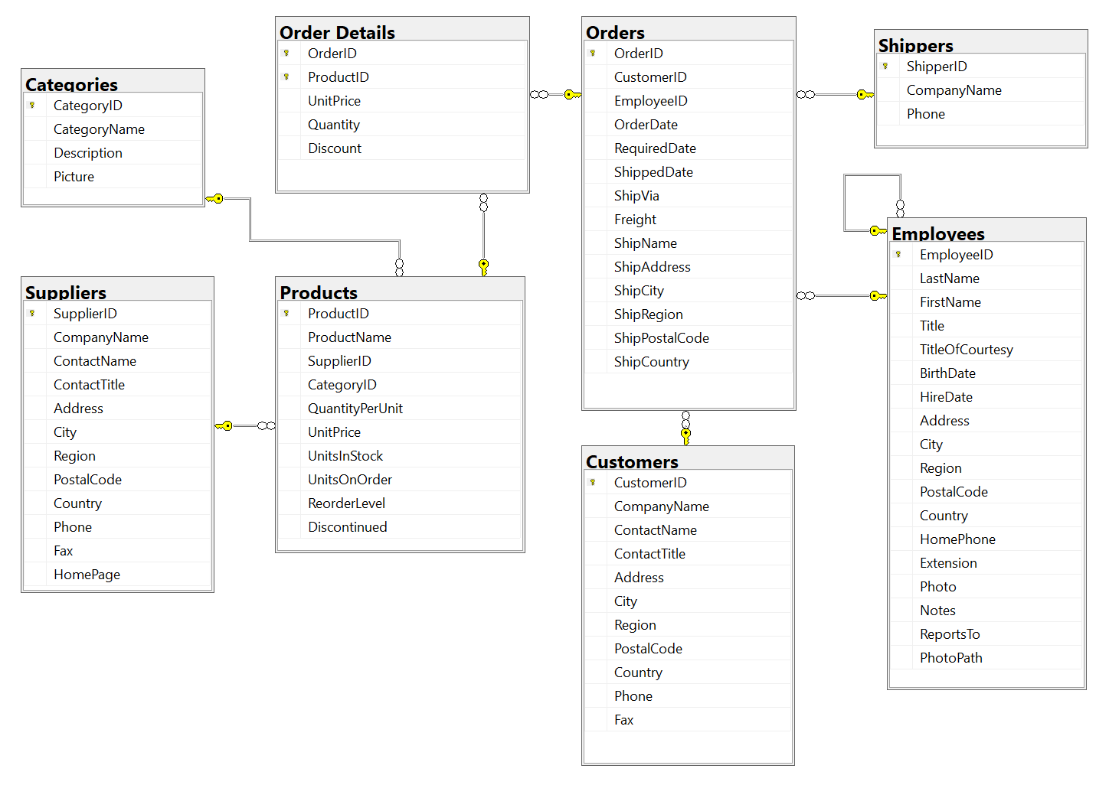
Understanding modern databases
Sample Relational DataBase
we will use a database that was first created in the early 1990s known as Northwind
you will write code to work with the Categories and Products tables later
note that:
each category has a unique identifier, name, description, and picture.
each product has a unique identifier, name, unit price, units in stock, and other fields.
each product is associated with a category by storing the category's unique identifier.
the relationship between Categories and Products is one-to-many, meaning each category can have zero or more products
Corso C#

Slide 8
Understanding modern databases
Example
Example… prepare SQL Server environment
Corso C#

Slide 9
Setting up EF Core
Choosing an EF Core database provider
to manage data in a specific database, we need classes that know how to efficiently talk to that database
EF Core database providers are sets of classes that are optimized for a specific data store
there is even a provider for storing the data in the memory of the current process, which can be useful for high-performance unit testing since it avoids hitting an external system
they are distributed as NuGet packages:
you can install as many EF Core database providers in the same project as you need
each package includes the shared types as well as provider-specific types
data store to manage | NuGet package
Microsoft SQL Server 2012 or later | Microsoft.EntityFrameworkCore.SqlServer
SQLite 3.7 or later | Microsoft.EntityFrameworkCore.SQLite
MySQL | MySQL.Data.EntityFrameworkCore
In-memory | Microsoft.EntityFrameworkCore.InMemory
Azure Cosmos DB SQL API | Microsoft.EntityFrameworkCore.Cosmos
Oracle DB 11.2 | Oracle.EntityFrameworkCore
Corso C#

Slide 10
Setting up EF Core
Connecting to a Database
to connect to an SQLite database, we just need to know the database filename, set using the parameter Filename
to connect to an SQL Server database, we need to know multiple pieces of information:
the name of the server (and the instance if it has one)
the name of the database
security information, such as username and password, or if we should pass the currently logged-on user's credentials automatically
we specify this information in a connection string
Corso C#

Slide 11
Setting up EF Core
Connecting to a Database
for backward compatibility, there are multiple possible keywords we can use in an SQL Server connection string for the various parameters, as shown in the following list:
Data Source or server or addr:These keywords are the name of the server (and an optional instance). You can use a dot . to mean the local server
Initial Catalog or database: These keywords are the name of the database
Integrated Security or trusted_connection: These keywords are set to true or SSPI to pass the thread's current user credentials
MultipleActiveResultSets: This keyword is set to true to enable a single connection to be used to work with multiple tables simultaneously to improve efficiency. It is used for lazy loading rows from related tables.
Corso C#

Slide 12
Setting up EF Core
Connecting to a Database
when you write code to connect to an SQL Server database, you need to know its server name
the server name depends on the edition and version of SQL Server that you will connect to, as shown in the following table:
SQL Server edition | Server name \ Instance name
LocalDB 2012 | (localdb)\v11.0
LocalDB 2016 or later | (localdb)\mssqllocaldb
Express | .\sqlexpress
Full/Developer (default instance) | .
Full/Developer (named instance) | .\mynamedinstance
NOTE: server names for SQL Server are made of two parts: the name of the computer and the name of an SQL Server instance
you provide instance names during custom installation
Corso C#

Slide 13
Setting up EF Core
Defining the database context class
the MyDatabase class will be used to represent the database
to use EF Core, the class must inherit from DbContext
this class understands how to communicate with databases and dynamically generate SQL statements to query and manipulate data
your DbContext-derived class should have an overridden method named OnConfiguring, which will set the database connection string
namespace WorkingWithEFCore;
using Microsoft.EntityFrameworkCore; // DbContext, DbContextOptionsBuilder
// this manages the connection to the database
public class Northwind : DbContext
{
protected override void OnConfiguring(DbContextOptionsBuilder optionsBuilder)
{
string connection = "Data Source=.;" +
"Initial Catalog=Northwind;" +
"Integrated Security=true;" +
"MultipleActiveResultSets=true;";
optionsBuilder.UseSqlServer(connection);
}
}
Corso C#

Slide 14
Setting up EF Core
Defining EF Core models
EF Core uses a combination of conventions, annotation attributes, and Fluent API statements to build an entity model at runtime so that any actions performed on the classes can later be automatically translated into actions performed on the actual database
an entity class represents the structure of a table and an instance of the class represents a row in that table
first, we will review the three ways to define a model, with code examples, and then we will create some classes that implement those techniques
Corso C#

Slide 15
Setting up EF Core
Using EF Core conventions to define the model
the code we will write will use the following conventions:
the name of a table is assumed to match the name of a DbSet<T> property in the DbContext class, for example, Products
the names of the columns are assumed to match the names of properties in the entity model class, for example, ProductId
The string .NET type is assumed to be a nvarchar type in the database
The int .NET type is assumed to be an int type in the database
the primary key is assumed to be a property that is named Id or ID, or when the entity model class is named Product, then the property can be named ProductId or ProductID if this property is an integer type or the Guid type, then it is also assumed to be an IDENTITY column (a column type that automatically assigns a value when inserting)
NOTE: there are many other conventions that you should know, and you can even define your own
you can read about them at the following link: https://docs.microsoft.com/en-us/ef/core/modeling/
Corso C#

Slide 16
Setting up EF Core
Using EF Core annotation attributes to define the model
conventions often aren't enough to completely map the classes to the database objects
a simple way of adding more smarts to your model is to apply annotation attributes.
Some common attributes are shown in the following table:
Attribute | Description
[Required] | ensures the value is not null.
[StringLength(50)] | ensures the value is up to 50 characters in length.
[RegularExpression(expression)] | ensures the value matches the specified regular expression.
[Column(TypeName = "money", Name = "UnitPrice")] | specifies the column type and column name used in the table.
Corso C#

Slide 17
Setting up EF Core
Using EF Core annotation attributes to define the model
i.e., in the database, the maximum length of a product name is 40, and the value cannot be null, as shown highlighted in the following Data Definition Language (DDL) code that defines how to create a table named Products with its columns, data types, keys, and other constraints
CREATE TABLE Products (
ProductId INTEGER PRIMARY KEY,
ProductName NVARCHAR (40) NOT NULL,
SupplierId "INT",
CategoryId "INT",
QuantityPerUnit NVARCHAR (20),
UnitPrice "MONEY" CONSTRAINT DF_Products_UnitPrice DEFAULT (0),
UnitsInStock "SMALLINT" CONSTRAINT DF_Products_UnitsInStock DEFAULT (0),
UnitsOnOrder "SMALLINT" CONSTRAINT DF_Products_UnitsOnOrder DEFAULT (0),
ReorderLevel "SMALLINT" CONSTRAINT DF_Products_ReorderLevel DEFAULT (0),
Discontinued "BIT" NOT NULL
CONSTRAINT DF_Products_Discontinued DEFAULT (0),
CONSTRAINT FK_Products_Categories FOREIGN KEY (
CategoryId
)
REFERENCES Categories (CategoryId),
CONSTRAINT FK_Products_Suppliers FOREIGN KEY (
SupplierId
)
REFERENCES Suppliers (SupplierId),
CONSTRAINT CK_Products_UnitPrice CHECK (UnitPrice >= 0),
CONSTRAINT CK_ReorderLevel CHECK (ReorderLevel >= 0),
CONSTRAINT CK_UnitsInStock CHECK (UnitsInStock >= 0),
CONSTRAINT CK_UnitsOnOrder CHECK (UnitsOnOrder >= 0)
);
Corso C#

Slide 18
Setting up EF Core
Using EF Core annotation attributes to define the model
in a Product class, we could apply attributes to specify this, as shown in the following code
[Required]
[StringLength(40)]
public string ProductName { get; set; }
when there isn't an obvious map between .NET types and database types, an attribute can be used
i.e., in the database, the column type of UnitPrice for the Products table is money
.NET does not have a money type, so it should use decimal instead:
[Column(TypeName = "money")]
public decimal? UnitPrice { get; set; }
Corso C#

Slide 19
Setting up EF Core
Using EF Core annotation attributes to define the model
another example is for the Categories table, as shown in the following DDL code:
CREATE TABLE Categories (
CategoryId INTEGER PRIMARY KEY,
CategoryName NVARCHAR (15) NOT NULL,
Description "NTEXT",
Picture "IMAGE"
);
the Description column can be longer than the maximum 8,000 characters that can be stored in a nvarchar variable, so it needs to map to ntext instead, as shown in the following code:
[Column(TypeName = "ntext")]
public string Description { get; set; }
Corso C#

Slide 20
Setting up EF Core
Using the EF Core Fluent API to define the model
the last way that the model can be defined is by using the Fluent API
this API can be used instead of attributes, as well as being used in addition to them
i.e., to define the ProductName property, instead of decorating the property with two attributes, an equivalent Fluent API statement could be written in the OnModelCreating method of the database context class:
modelBuilder.Entity<Product>()
.Property(product => product.ProductName)
.IsRequired()
.HasMaxLength(40);
this keeps the entity model class simpler and cleaner
Corso C#

Slide 21
Setting up EF Core
Understanding data seeding with the Fluent API
another benefit of the Fluent API is to provide initial data to populate a database
EF Core automatically works out what insert, update, or delete operations must be executed
i.e., if we wanted to make sure that a new database has at least one row in the Product table, then we would call the HasData method, as shown in the following code
modelBuilder.Entity<Product>()
.HasData(new Product
{
ProductId = 1,
ProductName = "Chai",
UnitPrice = 8.99M
});
Corso C#

Slide 22
Setting up EF Core
Building an EF Core model for the Northwind tables
now that we’ve learned about ways to define an EF Core model, let's build a model to represent two tables in the Northwind database
the two entity classes will refer to each other, so to avoid compiler errors, we will create the classes without any members first:
public class Category
{
}
public class Product
{
}
Corso C#

Slide 23
Setting up EF Core
Defining the Category and Product entity classes
the Category class, also known as an entity model, will be used to represent a row in the Categories table
this table has four columns, as shown in the following DDL:
CREATE TABLE Categories (
CategoryId INTEGER PRIMARY KEY,
CategoryName NVARCHAR (15) NOT NULL,
Description "NTEXT",
Picture "IMAGE"
);
We will use conventions to define:
three of the four properties (we will not map the Picture column)
the primary key
the one-to-many relationship to the Products table
to map the Description column to the correct database type, we will need to decorate the string property with the Column attribute.
Later, we will use the Fluent API to define that CategoryName cannot be null and is limited to a maximum of 15 characters.
Corso C#

Slide 24
Setting up EF Core
Defining the Category and Product entity classes
the Product class will be used to represent a row in the Products table, which has ten columns
You do not need to include all columns from a table as properties of a class: we will only map six properties: ProductId, ProductName, UnitPrice, UnitsInStock, Discontinued, and CategoryId
columns that are not mapped to properties cannot be read or set using the class instances
if you use the class to create a new object, then the new row in the table will have NULL or some other default value for the unmapped column values in that row
you must make sure that those missing columns are optional or have default values set by the database or an exception will be thrown at runtime
in this scenario, the rows already have data values and I have decided that I do not need to read those values in this application
we can rename a column by defining a property with a different name, like Cost, and then decorating the property with the [Column] attribute and specifying its column name, like UnitPrice
the final property, CategoryId, is associated with a Category property that will be used to map each product to its parent category
Corso C#

Slide 25
Setting up EF Core
Defining the Category and Product entity classes
note that the two properties that relate the two entities, Category.Products and Product.Category, are both marked as virtual
this allows EF Core to inherit and override the properties to provide extra features, such as lazy loading
public class Category
{
// these properties map to columns in the database
public int CategoryId { get; set; }
public string? CategoryName { get; set; }
[Column(TypeName = "ntext")]
public string? Description { get; set; }
// defines a navigation property for related rows
public virtual ICollection<Product> Products { get; set; }
public Category()
{
// to enable developers to add products to a Category we must
// initialize the navigation property to an empty collection
Products = new HashSet<Product>();
}
}
CREATE TABLE Categories (
CategoryId INTEGER PRIMARY KEY,
CategoryName NVARCHAR (15) NOT NULL,
Description "NTEXT",
Picture "IMAGE"
);
Corso C#

Slide 26
Setting up EF Core
Defining the Category and Product entity classes
CREATE TABLE Products (
ProductId INTEGER PRIMARY KEY,
ProductName NVARCHAR (40) NOT NULL,
SupplierId "INT",
CategoryId "INT",
QuantityPerUnit NVARCHAR (20),
UnitPrice "MONEY" CONSTRAINT DF_Products_UnitPrice DEFAULT (0),
UnitsInStock "SMALLINT" CONSTRAINT DF_Products_UnitsInStock DEFAULT (0),
UnitsOnOrder "SMALLINT" CONSTRAINT DF_Products_UnitsOnOrder DEFAULT (0),
ReorderLevel "SMALLINT" CONSTRAINT DF_Products_ReorderLevel DEFAULT (0),
Discontinued "BIT" NOT NULL
CONSTRAINT DF_Products_Discontinued DEFAULT (0),
CONSTRAINT FK_Products_Categories FOREIGN KEY (
CategoryId
)
REFERENCES Categories (CategoryId),
CONSTRAINT FK_Products_Suppliers FOREIGN KEY (
SupplierId
)
REFERENCES Suppliers (SupplierId),
CONSTRAINT CK_Products_UnitPrice CHECK (UnitPrice >= 0),
CONSTRAINT CK_ReorderLevel CHECK (ReorderLevel >= 0),
CONSTRAINT CK_UnitsInStock CHECK (UnitsInStock >= 0),
CONSTRAINT CK_UnitsOnOrder CHECK (UnitsOnOrder >= 0)
);
public class Product
{
public int ProductId { get; set; } // primary key
[Required]
[StringLength(40)]
public string ProductName { get; set; } = null!;
[Column("UnitPrice", TypeName = "money")]
public decimal? Cost { get; set; } // property name != column name
[Column("UnitsInStock")]
public short? Stock { get; set; }
public bool Discontinued { get; set; }
// these two define the foreign key relationship
// to the Categories table
public int CategoryId { get; set; }
public virtual Category Category { get; set; } = null!;
}
Corso C#

Slide 27
Setting up EF Core
Adding tables to the Northwind database context class
inside your DbContext-derived class, you must define at least one property of the DbSet<T> type: these properties represent the tables
to tell EF Core what columns each table has, the DbSet<T> properties use generics to specify a class that represents a row in the table
that entity model class has properties that represent its columns
The DbContext-derived class can optionally have an overridden method named OnModelCreating
this is where you can write Fluent API statements as an alternative to decorating your entity classes with attributes
Corso C#

Slide 28
Setting up EF Core
Setting up the dotnet-ef tool
instead of defining an entity model manually, there is a tool that can do some of the work for you
.NET has a command-line tool named dotnet that can be extended with capabilities useful for working with EF Core at design-time:
creating and applying migrations from an older model to a newer model
generating code for a model from an existing database
the dotnet ef command-line tool is not automatically installed: you have to install this package as either a global or local tool
if you have already installed an older version of the tool, then you should uninstall any existing version
dotnet tool list –global
Package Id Version Commands
-------------------------------------
dotnet-ef 3.1.0 dotnet-ef
dotnet tool uninstall --global dotnet-ef
dotnet tool install --global dotnet-ef --version 6.0.6
You can invoke the tool using the following command: dotnet-ef
Tool 'dotnet-ef' (version '6.0.0') was successfully installed.
search for installed tools
found older dotnet-ef version
uninstall older version
install new version
Corso C#

Slide 29
Setting up EF Core
Scaffolding models using an existing database
scaffolding is the process of using a tool to create classes that represent the model of an existing database using reverse engineering
a good scaffolding tool allows you to extend the automatically generated classes and then regenerate those classes without losing your extended classes
if you know that you will never regenerate the classes using the tool, then feel free to change the code for the automatically generated classes as much as you want: the code generated by the tool is just the best approximation
dotnet ef dbcontext scaffold "Data Source=.\SQLEXPRESS;Initial Catalog=Northwind;Integrated Security=true;" Microsoft.EntityFrameworkCore.SqlServer --table Categories --table Products --output-dir AutoGenModels --namespace WorkingWithEFCore.AutoGen --data-annotations --context Northwind
Build started...
Build succeeded.
To protect potentially sensitive information in your connection string, you should move it out of source code. You can avoid scaffolding the connection string by using the Name= syntax to read it from configuration - see https://go.microsoft.com/fwlink/?linkid=2131148. For more guidance on storing connection strings, see http://go.microsoft.com/fwlink/?LinkId=723263.
Skipping foreign key 'FK_Products_Suppliers' on table 'dbo.Products' since principal table 'dbo.Suppliers' was not found in the model. This usually happens when the principal table was not included in the selection set.
Corso C#

Slide 30
Setting up EF Core
Configuring preconvention models
one of the new features introduced with EF Core 6 is configuring preconvention models: as models become more complex, relying on conventions to discover entity types and their properties and successfully map them to tables and columns becomes harder
it would be useful if you could configure the conventions themselves before they are used to analyze and build a model
i.e., you might want to define a convention to say that all string properties should have a maximum length of 50 characters as a default, or any property types that implement a custom interface should not be mapped:
protected override void ConfigureConventions(
ModelConfigurationBuilder configurationBuilder)
{
configurationBuilder.Properties<string>().HaveMaxLength(50);
configurationBuilder.IgnoreAny<IDoNotMap>();
}
Corso C#

Slide 31
Querying EF Core models
Querying EF Core models
database context instances are designed for short lifetimes in a unit of work
they should be disposed of as soon as possible so we will wrap it in a using statement
Unit of Work is referred to as a single transaction that involves multiple operations of insert/update/delete and so on
// a query to get all categories and their related products
using (Northwind db = new())
IQueryable<Category>? categories = db.Categories?
.Include(c => c.Products);
// return categories by related filtered products by stock
Using (Northwind db = new())
IQueryable<Category>? categories = db.Categories?
.Include(c => c.Products.Where(p => p.Stock >= stock));
// filter and order products by cost
using (Northwind db = new())
IQueryable<Product>? products = db.Products?
.Where(product => product.Cost > price)
.OrderByDescending(product => product.Cost);
Corso C#

Slide 32
Querying EF Core models
Getting the generated SQL
you might be wondering how well written the SQL statements are that are generated from the C# queries we write
EF Core 5.0 introduced a quick and easy way to see the SQL generated:
WriteLine($"ToQueryString: {categories.ToQueryString()}");
Products that cost more than a price, highest at top.
Enter a product price: 150
ToQueryString: DECLARE @__price_0 decimal(3) = 150.0;
SELECT [p].[ProductId], [p].[CategoryId], [p].[UnitPrice], [p].[Discontinued], [p].[ProductName], [p].[UnitsInStock]
FROM [Products] AS [p]
WHERE [p].[UnitPrice] > @__price_0
ORDER BY [p].[UnitPrice] DESC
38: Côte de Blaye costs $263,50 and has 17 in stock.
the SQL parameter named @_price_0 has been set to 150.0
Corso C#

Slide 33
Querying EF Core models
Logging EF Core using a custom logging provider
To monitor the interaction between EF Core and the database, we can enable logging, this requires the following two tasks:
The registering of a logging provider
The implementation of a logger
ILoggerFactory loggerFactory = db.GetService<ILoggerFactory>();
loggerFactory.AddProvider(new ConsoleLoggerProvider());
public class ConsoleLoggerProvider : ILoggerProvider
{
…
}
public class ConsoleLogger : Ilogger
{
…
}
Corso C#

Slide 34
Querying EF Core models
Logging with query tags
when logging LINQ queries, it can be tricky to correlate log messages in complex scenarios
EF Core 2.2 introduced the query tags feature to help by allowing you to add SQL comments to the log
you can annotate a LINQ query using the TagWith method
IQueryable<Product>? products = db.Products?
.TagWith("Products filtered by price and sorted.")
.Where(product => product.Cost > price)
.OrderByDescending(product => product.Cost);
This will add an SQL comment to the log, as shown in the following output:
-- Products filtered by price and sorted.
Corso C#

Slide 35
Querying EF Core models
Pattern matching with Like
EF Core supports common SQL statements including Like for pattern matching
IQueryable<Product>? products = db.Products?
.Where(p => EF.Functions.Like(p.ProductName, $"%{input}%"));
Defining global filters
Northwind products can be discontinued, so it might be useful to ensure that discontinued products are never returned in results, even if the programmer does not use Where to filter them out in their queries:
protected override void OnModelCreating(ModelBuilder modelBuilder)
{
...
// global filter to remove discontinued products
modelBuilder.Entity<Product>()
.HasQueryFilter(p => !p.Discontinued);
}
Using SQLServer database provider.
Enter part of a product name: che
Level: Debug, Event Id: 20100, State: Executing DbCommand [Parameters=[@__Format_1='?' (Size = 40)], CommandType='Text', CommandTimeout='30']
SELECT [p].[ProductId], [p].[CategoryId], [p].[UnitPrice], [p].[Discontinued], [p].[ProductName], [p].[UnitsInStock]
FROM [Products] AS [p]
WHERE ([p].[Discontinued] = CAST(0 AS bit)) AND ([p].[ProductName] LIKE @__Format_1)
Chef Anton's Cajun Seasoning has 53 units in stock. Discontinued? False
Queso Manchego La Pastora has 86 units in stock. Discontinued? False
Gumbär Gummibärchen has 15 units in stock. Discontinued? False
Corso C#

Slide 36
Loading patterns with EF Core
Loading patterns with EF Core
There are three loading patterns that are commonly used with EF Core:
Eager loading: Load data early – data is loaded from the database as part of the initial query
Lazy loading: Load data automatically just before it is needed - data is transparently loaded from the database when the navigation property is accessed
Explicit loading: Load data manually – data is explicitly loaded from the database at a later time
Corso C#

Slide 37
Loading patterns with EF Core
Eager loading
you can use the Include method to specify related data to be included in query results
here, the blogs that are returned in the results will have their Posts property populated with the related posts:
using (var context = new BloggingContext())
{
var blogs = context.Blogs
.Include(blog => blog.Posts)
.ToList();
}
you can include related data from multiple relationships in a single query
using (var context = new BloggingContext())
{
var blogs = context.Blogs
.Include(blog => blog.Posts)
.Include(blog => blog.Owner)
.ToList();
}
Corso C#

Slide 38
Loading patterns with EF Core
Including multiple levels
you can drill down through relationships to include multiple levels of related data using the ThenInclude method
i.e. an example that loads all blogs, their related posts, and the author of each post.
using (var context = new BloggingContext())
{
var blogs = context.Blogs
.Include(blog => blog.Posts)
.ThenInclude(post => post.Author)
.ToList();
}
you can chain multiple calls to ThenInclude to continue including further levels of related data
using (var context = new BloggingContext())
{
var blogs = context.Blogs
.Include(blog => blog.Posts)
.ThenInclude(post => post.Author)
.ThenInclude(author => author.Photo)
.ToList();
}
eager loading a collection navigation in a single query may cause performance issues
see Single vs split queries https://docs.microsoft.com/en-us/ef/core/querying/single-split-queries
Corso C#

Slide 39
Loading patterns with EF Core
Lazy loading
the simplest way to use lazy-loading is by installing the Microsoft.EntityFrameworkCore.Proxies package and enabling it with a call to UseLazyLoadingProxies inside OnConfiguring method:
protected override void OnConfiguring(DbContextOptionsBuilder optionsBuilder)
{
optionsBuilder.UseLazyLoadingProxies();
…
or when using AddDbContext:
.AddDbContext<BloggingContext>(
b => b.UseLazyLoadingProxies()
.UseSqlServer(myConnectionString));
EF Core will then enable lazy loading for any navigation property that can be overridden (it must be virtual and on a class that can be inherited from)
i.e., the Post.Blog and Blog.Posts navigation properties will be lazy-loaded
public class Blog
{
public int Id { get; set; }
public string Name { get; set; }
public virtual ICollection<Post> Posts { get; set; }
}
public class Post
{
public int Id { get; set; }
public string Title { get; set; }
public string Content { get; set; }
public virtual Blog Blog { get; set; }
}
Corso C#

Slide 40
Loading patterns with EF Core
Explicit loading
it works in a similar way to lazy loading, with the difference being that you are in control of exactly what related data is loaded and when via the DbContext.Entry(...) API
using (var context = new BloggingContext())
{
var blog = context.Blogs
.Single(b => b.BlogId == 1);
context.Entry(blog)
.Collection(b => b.Posts)
.Load();
context.Entry(blog)
.Reference(b => b.Owner)
.Load();
}
Corso C#

Slide 41
Loading patterns with EF Core
Querying related entities
you can also get a LINQ query that represents the contents of a navigation property and filter which related entities are loaded into memory
using (var context = new BloggingContext())
{
var blog = context.Blogs
.Single(b => b.BlogId == 1);
var goodPosts = context
.Entry(blog)
.Collection(b => b.Posts)
.Query()
.Where(p => p.Rating > 3)
.ToList();
}
Corso C#

Slide 42
Manipulating data with EF Core
Intro
inserting, updating, and deleting entities using EF Core is an easy task to accomplish
DbContext maintains change tracking automatically, so the local entities can have multiple changes tracked, including
adding new entities
modifying existing entities
removing entities
when you are ready to send those changes to the underlying database, call the SaveChanges method
the number of entities successfully changed will be returned
Corso C#

Slide 43
Manipulating data with EF Core
Pooling database contexts
DbContext class is disposable and is designed following the single-unit-of-work principle
in the previous code examples, we created all the DbContext-derived Northwind instances in a using block so that Dispose is properly called at the end of each unit of work
a feature of ASP.NET Core that is related to EF Core is that it makes your code more efficient by pooling database contexts when building websites and services
this allows you to create and dispose of as many DbContext-derived objects as you want, knowing that your code is still as efficient as possible
Corso C#

Slide 44
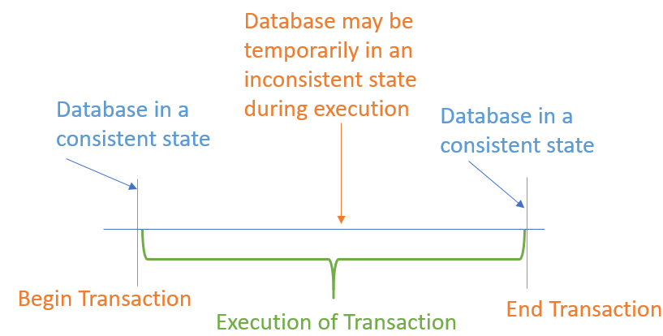
Working with transactions
Intro
every time you call the SaveChanges method, an implicit transaction is started so that if something goes wrong, it will automatically roll back all the changes
if the multiple changes within the transaction succeed, then the transaction and all changes are committed
transactions maintain the integrity of your database by applying locks to prevent reads and writes while a sequence of changes is occurring
Corso C#

Slide 45
Working with transactions
Intro
transactions are ACID, which is an acronym explained in the following list:
A is for atomic: either all the operations in the transaction commit, or none of them do
C is for consistent: the state of the database before and after a transaction is consistent; this is dependent on your code logic; for example, when transferring money between bank accounts, it is up to your business logic to ensure that if you debit $100 in one account, you credit $100 in the other account
I is for isolated: during a transaction, changes are hidden from other processes;
there are multiple isolation levels that you can pick from (refer to the following table)
the stronger the level, the better the integrity of the data
more locks applied will negatively affect other processes
snapshot is a special case because it creates multiple copies of rows to avoid locks, but this will increase the size of your database while transactions occur
D is for durable: if a failure occurs during a transaction, it can be recovered; this is often implemented as a two-phase commit and transaction logs once the transaction is committed it is guaranteed to endure even if there are subsequent errors the opposite of durable is volatile
Corso C#

Slide 46
Working with transactions
Atomicity
Atomicity means that
Transactions execute as a whole
DMBS to guarantee that either all of the operations are performed or none of them
Example
Transfer funds between bank accounts:
Either withdraw and deposit both execute successfully or none of them
In case of failure the DB stays unchanged
Corso C#

Slide 47
Working with transactions
Consistency
Consistency means that
The database is in a legal state when the transaction begins and when it ends
Only valid data will be written in the DB
Transaction cannot break the rules of the database, i.e. integrity constraints (primary keys, foreign keys, alternate keys)
Example
Transaction cannot end with a duplicate primary key in a table
Corso C#

Slide 48
Working with transactions
Isolation
Isolation means that
Multiple transactions running at the same time do not impact each other’s execution
Transaction don’t see other transaction’s uncommitted changes
Isolation level defines how deep transactions isolate from one another
Example
If two or more people try to buy the last copy of a product, just one of them will succeed
Corso C#

Slide 49
Working with transactions
Durability
Durability means that
If a transaction is committed it becomes persistent – cannot be lost or undone
Ensured by use of database transaction logs
Example
After fuds are transferred and committed the power supply at the DB server is lost
Transaction says persistent (no data is lost)
Corso C#

Slide 50
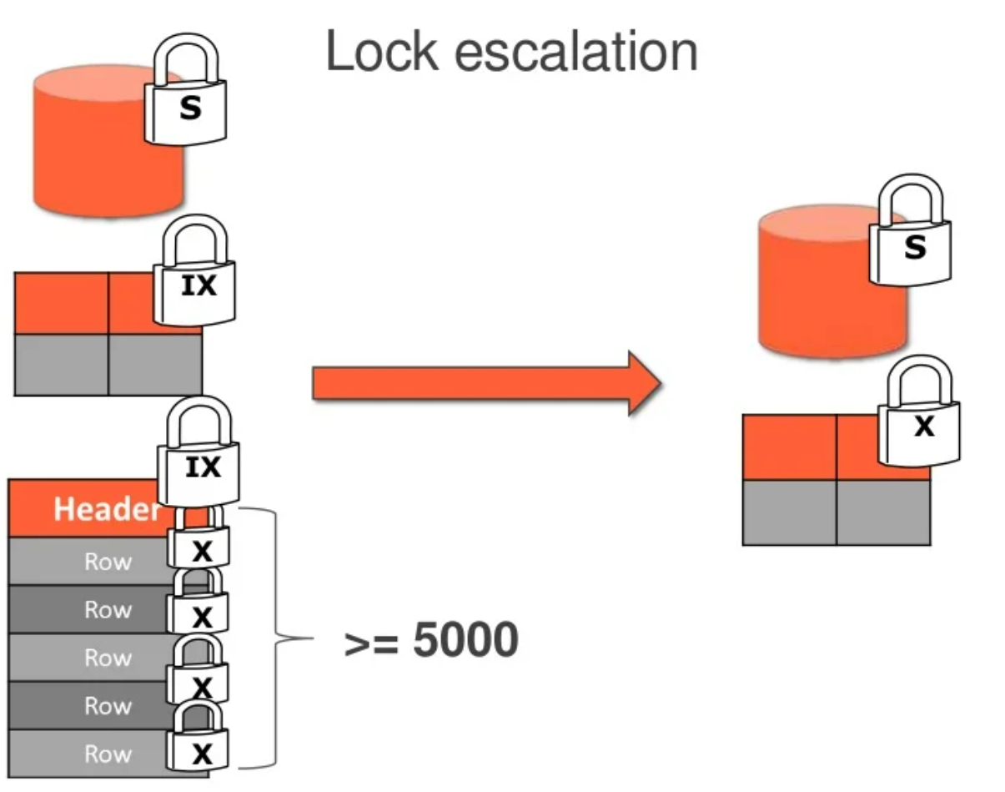
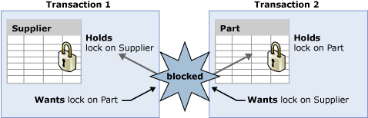
Working with transactions
In SQL Server
Transactions in SQL
BEGIN TRANSACTION
…
-- set of instructions
…
COMMIT TRANSACTION | ROLLBACK TRANSACTION
Lock: internal memory structure that “tells” us what we all do with the resources inside the system
Locking: mechanism to protect the resources and guarantee consistent data
Deadlocks
Lock escalation
more info @ https://docs.microsoft.com/en-us/sql/relational-databases/sql-server-transaction-locking-and-row-versioning-guide?view=sql-server-ver16
Corso C#

Slide 51
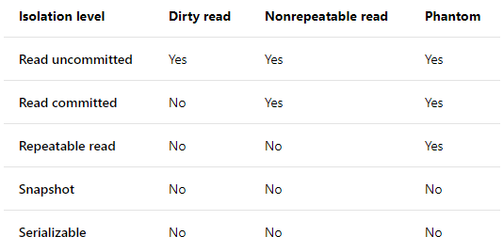
Working with transactions
Controlling transactions using isolation levels
a developer can control transactions by setting an isolation level, as described here:
Isolation level | Lock(s) | Integrity problems allowed
ReadUncommitted | None | Dirty reads, nonrepeatable reads, and phantom read
ReadCommitted | When editing, it applies read lock(s) to block other users from reading the record(s) until the transaction ends | Nonrepeatable reads and phantom read
RepeatableRead | When reading, it applies edit lock(s) to block other users from editing the record(s) until the transaction ends | Phantom read
Serializable | Applies key-range locks to prevent any action that would affect the results, including inserts and deletes | None
Snapshot | None, it specifies that data read within a transaction will never reflect changes made by other simultaneous transactions. The transaction uses the data row versions that exist when the transaction begins. | None
Corso C#

Slide 52
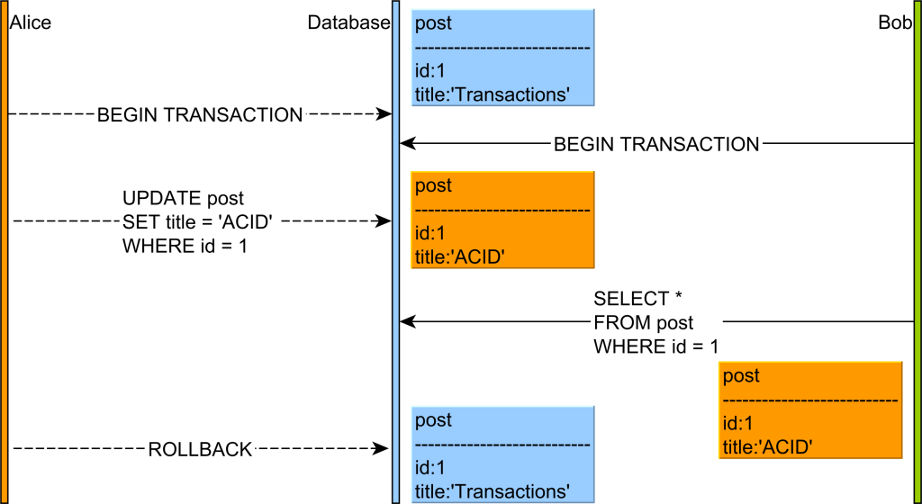
Working with transactions
Dirty read
taking a business decision on a value that has not been committed is risky because uncommitted changes might get rolled back
Alice and Bob start two database transactions.
Alice modifies the title of a given post record.
Bob reads the uncommitted post record.
If Alice commits her transaction, everything is fine. But if Alice rolls back, then Bob will see a record version that no longer exists in the database transaction log
to prevent dirty reads, the database engine must hide uncommitted changes from all other concurrent transactions
each transaction is allowed to see its own changes because otherwise the read-your-own-writes consistency guarantee is compromised
Read Committed, Repeatable Read, Serializable isolation levels use the undo log which already captures the previous version of every uncommitted record
Corso C#

Slide 53
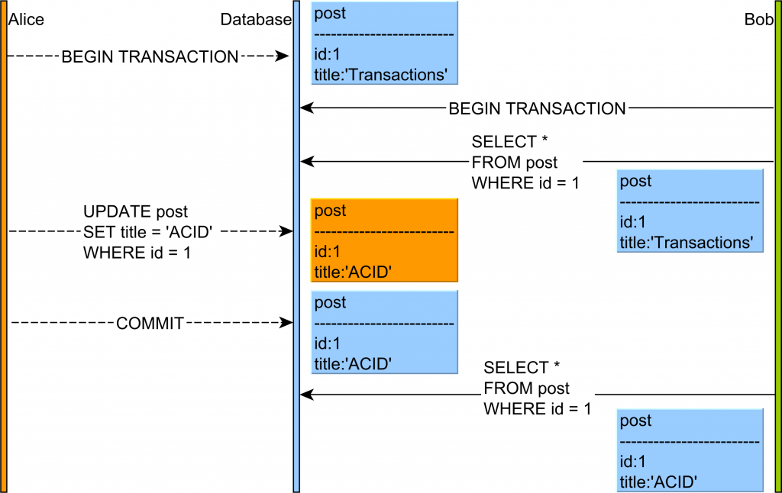
Working with transactions
Non repeatable read
if one transaction reads a database row without applying a shared lock on the newly fetched record, then a concurrent transaction might change this row before the first transaction has ended.
Alice and Bob start two database transactions.
Bob reads the post record and title column value is Transactions.
Alice modifies the title of a given post record to the value of ACID.
Alice commits her database transaction.
If Bob’s re-reads the post record, he will observe a different version of this table row.
preventing this anomaly need to use a higher isolation level like Repeatable Read (which is the default in MySQL) or Serializable
or, you can simply lock the database record using a share(read) lock or an exclusive lock if the underlying database does not support shared locks (e.g. Oracle)
Corso C#

Slide 54
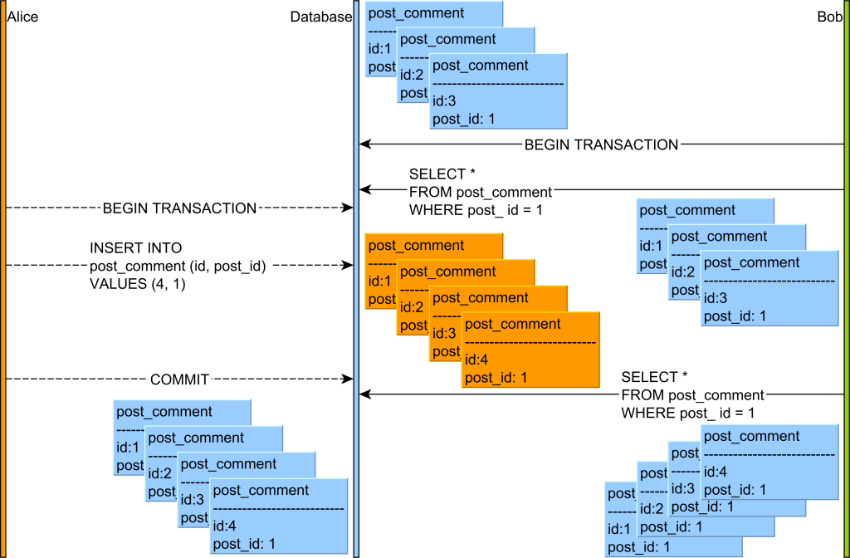
Working with transactions
Phantom read
if a transaction makes a business decision based on a set of rows satisfying a given predicate, without range locks, a concurrent transaction might insert a record matching that particular predicate.
Alice and Bob start two database transactions.
Bob’s reads all the post_comment records associated with the post row with the identifier value of 1.
Alice adds a new post_comment record which is associated with the post row having the identifier value of 1.
Alice commits her database transaction.
If Bob’s re-reads the post_comment records having the post_id column value equal to 1, he will observe a different version of this result set
This phenomenon is typical for both Read Uncommitted, Read Committed and Repeatable Read isolation levels. The default isolation level being either Read Committed (Oracle, SQL Server or PostgreSQL) or Repeatable Read (MySQL) does not prevent this anomaly
preventing this anomaly is fairly simple by using a higher isolation level like Serializable or if the underlying RDBMS supports predicate locks, you can simply lock the range of records using a share (read) lock or an exclusive (write) range lock
Corso C#

Slide 55
Code first EF Core models
Intro
sometimes you will not have an existing database, instead, you define the EF Core model as Code First, and then EF Core can generate a matching database using create and drop APIs
IMPORTANT:
the create and drop APIs should only be used during development
once you release the app, you do not want it to delete a production database!
Corso C#

Slide 56
Code first EF Core models
Understanding migrations
after publishing a project that uses a database, it is likely that you will later need to change your entity data model and therefore the database structure
at that point, you should not use the Ensure methods
instead, you need to use a system that allows you to incrementally update the database schema while preserving any existing data in the database
EF Core migrations are that system
The migrations feature in EF Core provides a way to incrementally update the database schema to keep it in sync with the application's data model while preserving existing data in the database.
Corso C#

Slide 57
Code first EF Core models
Understanding migrations
at a high level, migrations function in the following way:
When a data model change is introduced, the developer uses EF Core tools to add a corresponding migration describing the updates necessary to keep the database schema in sync
EF Core compares the current model against a snapshot of the old model to determine the differences and generates migration source files (the files can be tracked in your project's source control like any other source file)
Once a new migration has been generated, it can be applied to a database in various ways
EF Core records all applied migrations in a special history table, allowing it to know which migrations have been applied and which haven’t
Now… an example…
Corso C#

Slide 58
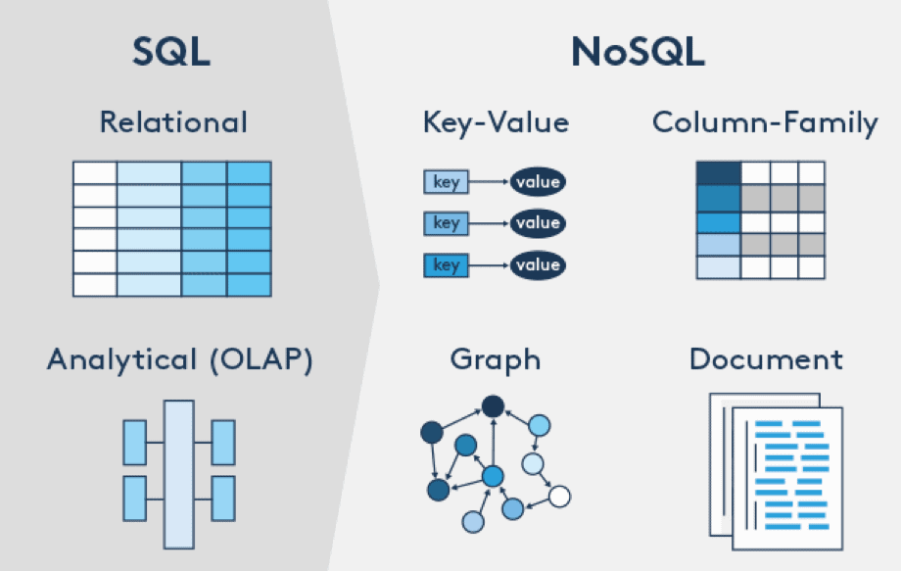
MongoDb
NoSQL Databases
NoSQL databases, unlike SQL, do not require any kind of fixed table schemas
NoSQL database allows storing data of any data type: structured, semi-structured, and unstructured data
Key-value Store (Oracle NoSQL, Redis, Amazon Dynamo)
Document-Based Store (MongoDB and Couchbase)
Column-based Store (Google’s Bigtable, Cassandra, HBase)
Graph databases (Neo4j)
Corso C#

Slide 59
MongoDb
NoSQL Databases
NoSQL is not a replacement for RDBMS
SQL databases are relational, NoSQL databases are non-relational
SQL databases use structured query language and have a predefined schema / NoSQL databases have dynamic schemas for unstructured data
SQL databases are better for multi-row transactions, NoSQL is better for unstructured data like documents or JSON.
Most SQL databases require you to scale-up vertically, NoSQL databases allow you to scale-out horizontally.
Queries in NoSQL databases can be faster than SQL databases.
Data model | Performance | Scalability | Flexibility | Complexity | Functionality
Key–value store | high | high | high | none | variable (none)
Column-oriented store | high | high | moderate | low | minimal
Document-oriented store | high | variable (high) | high | low | variable (low)
Graph database | variable | variable | high | high | graph theory
Relational database | variable | variable | low | moderate | relational algebra
Corso C#

Slide 60
MongoDb
Handling relational data
since most NoSQL databases lack ability for joins in queries, the database schema generally needs to be designed differently
there are three main techniques for handling relational data in a NoSQL database. (MongoDB did not support joining from a sharded collection until version 5.1)
Multiple queries: Instead of retrieving all the data with one query, it is common to do several queries to get the desired data. NoSQL queries are often faster than traditional SQL queries so the cost of additional queries may be acceptable. If an excessive number of queries would be necessary, one of the other two approaches is more appropriate.
Caching, replication and non-normalized data: Instead of only storing foreign keys, it is common to store actual foreign values along with the model's data. For example, each blog comment might include the username in addition to a user id, thus providing easy access to the username without requiring another lookup. When a username changes however, this will now need to be changed in many places in the database. Thus this approach works better when reads are much more common than writes.
Nesting data: With document databases like MongoDB it is common to put more data in a smaller number of collections. For example, in a blogging application, one might choose to store comments within the blog post document so that with a single retrieval one gets all the comments. Thus in this approach a single document contains all the data you need for a specific task.
Corso C#

Slide 61
MongoDb
MongoDb
MongoDB is:
a document-oriented database
a source-available program
cross-platform
uses JSON-like documents with optional schemas
Download it from: https://www.mongodb.com/try/download/community
NOTE: There is no official MongoDb provider implementation for EF core at this time
Corso C#

Slide 62
MongoDb
Features
MongoDb supports
field, range query, and regular-expression searches
indexing: fields in a MongoDB document can be indexed with primary and secondary indices or index
replication: it provides high availability with replica sets (if the replicated MongoDB deployment only has a single secondary member, a separate daemon called an arbiter must be added to the set. It has a single responsibility, which is to resolve the election of the new primary. As a consequence, an idealized distributed MongoDB deployment requires at least three separate servers, even in the case of just one primary and one secondary)
load balancing: MongoDB scales horizontally using sharding; the user chooses a shard key, which determines how the data in a collection will be distributed. The data is split into ranges (based on the shard key) and distributed across multiple shards. (A shard is a master with one or more replicas.) Alternatively, the shard key can be hashed to map to a shard – enabling an even data distribution. MongoDB can run over multiple servers, balancing the load or duplicating data to keep the system up and running in case of hardware failure.
file storage: MongoDB can be used as a file system, called GridFS, with load balancing and data replication features over multiple machines for storing files This function, called grid file system, is included with MongoDB drivers. MongoDB exposes functions for file manipulation and content to developers. GridFS can be accessed using mongofiles utility or plugins for Nginx and lighttpd. GridFS divides a file into parts, or chunks, and stores each of those chunks as a separate document.
Corso C#

Slide 63
MongoDb
Features
MongoDb supports
aggregation: MongoDB provides three ways to perform aggregation: the aggregation pipeline, the map-reduce function, and single-purpose aggregation methods Map-reduce can be used for batch processing of data and aggregation operations. But according to MongoDB's documentation, the Aggregation Pipeline provides better performance for most aggregation operations. The aggregation framework enables users to obtain the kind of results for which the SQL GROUP BY clause is used. Aggregation operators can be strung together to form a pipeline – analogous to Unix pipes. The aggregation framework includes the $lookup operator which can join documents from multiple collections, as well as statistical operators such as standard deviation.
server-side Javascript execution: JavaScript can be used in queries, aggregation functions (such as MapReduce), and sent directly to the database to be executed
capped collections: fixed-size collections called capped collections. This type of collection support high-throughput operations that insert and retrieve documents based on insertion order
transactions: an operation on a single document is atomic; for situations that require atomicity of reads and writes to multiple documents (in a single or multiple collections), MongoDB supports multi-document transactions with distributed transactions, transactions can be used across multiple operations, collections, databases, documents, and shards for transaction better use MongoDB version minimum 4.4
Corso C#

Slide 64
MongoDb
MongoDb / SQL comparison
The following table presents the various SQL terminology and concepts and the corresponding MongoDB terminology and concepts.
SQL Terms/Concepts | MongoDB Terms/Concepts
database | database
table | collection
row | document or BSON document
column | field
index | index
table joins | $lookup, embedded documents
primary key Specify any unique column or column combination as primary key | primary key In MongoDB, the primary key is automatically set to the _id field.
aggregation (e.g. group by) | aggregation pipeline
SELECT INTO NEW_TABLE | $out
MERGE INTO TABLE | $merge (Available starting in MongoDB 4.2)
UNION ALL | $unionWith (Available starting in MongoDB 4.4)
transactions | transactions
Corso C#

Slide 65
MongoDb
MongoDb aggregation pipeline / SQL comparison
The following table presents the various SQL terminology and concepts and the corresponding MongoDB terminology and concepts.
SQL Terms, Functions, and Concepts | MongoDB Aggregation Operators
WHERE | $match
GROUP BY | $group
HAVING | $match
SELECT | $project
ORDER BY | $sort
LIMIT | $limit
SUM() | $sum
COUNT() | $sum $sortByCount
join | $lookup
SELECT INTO NEW_TABLE | $out
MERGE INTO TABLE | $merge (Available starting in MongoDB 4.2)
UNION ALL | $unionWith (Available starting in MongoDB 4.4)
Corso C#

Slide 66
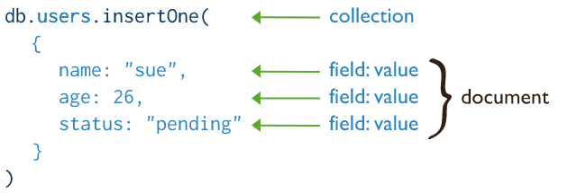
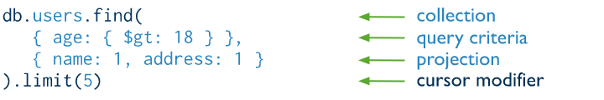
MongoDb
CRUD
Insert
Read
Corso C#

Slide 67
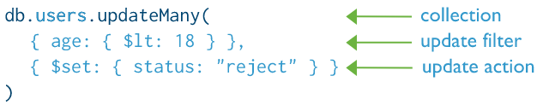
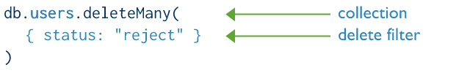
MongoDb
CRUD
Update
Delete
Corso C#

Slide 68
Questions
What type would you use for the property that represents a table, for example, the Products property of a database context?
What type would you use for the property that represents a one-to-many relationship, for example, the Products property of a Category entity?
What is the EF Core convention for primary keys?
When might you use an annotation attribute in an entity class?
Why might you choose the Fluent API in preference to annotation attributes?
What does a transaction isolation level of Serializable mean?
What does the DbContext.SaveChanges() method return?
What is the difference between eager loading and explicit loading?
How should you define an EF Core entity class to match the following table?
What benefit do you get from declaring entity navigation properties as virtual?
CREATE TABLE Employees(
EmpId INT IDENTITY,
FirstName NVARCHAR(40) NOT NULL,
Salary MONEY
)
Corso C#

Slide 69
Summary
how to connect to an existing database
how to execute a simple LINQ query and process the results
how to use filtered includes
how to add, modify, and delete data
how to build entity data models for an existing database, such as Northwind
how to define a Code First model and use it to create a new database and populate it with data
something on NoSQL database
how to use MongoDB
Corso C#

