Slide 1
GIT
About Version Control
Git basics
The command line
Installing Git
First time setup
Getting Help
Corso C#

Slide 2
About Version Control
What is “version control,” and why should you care?
Version control is a system that records changes to a file or set of files over time so that you can recall specific versions later
It allows you:
to revert files to a previous state
revert the entire project to a previous state
compare changes over time
see who last modified something
who introduced an issue and when
and more
You can recover a something you lose…
Corso C#

Slide 3
About Version Control
Local Version Control Systems
Many people’s version-control method of choice is to copy files into another directory
very common because it is simple
error prone (it is easy to forget which directory you’re in and accidentally write to the wrong file or copy over files you don’t mean to)
Corso C#

Slide 4
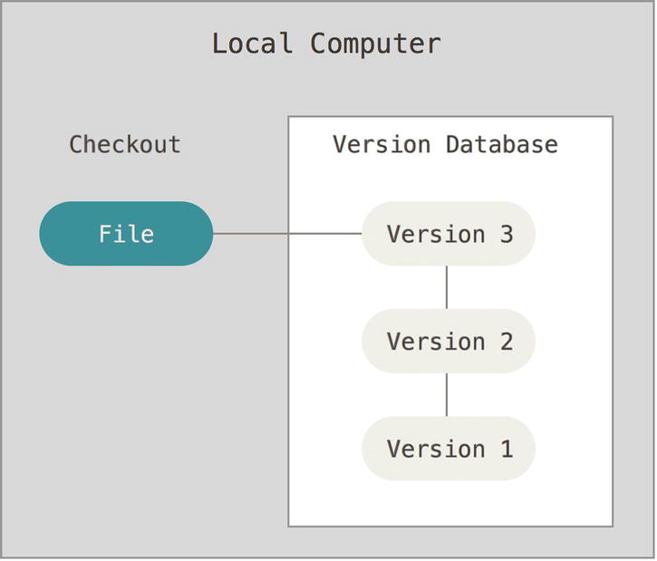
About Version Control
Local Version Control Systems
to deal with this issue, programmers long ago developed local VCSs that had a simple database that kept all the changes to files under revision control
i.e. RCS
Corso C#

Slide 5
About Version Control
Centralized Version Control Systems
Centralized Version Control Systems (CVCSs) were developed to resolve the need to collaborate with developers on other systems
have a single server that contains all the versioned files
clients check out files from that central place
for many years, this has been the standard for version control
i.e. SVN, TFS, CVS
Corso C#

Slide 6
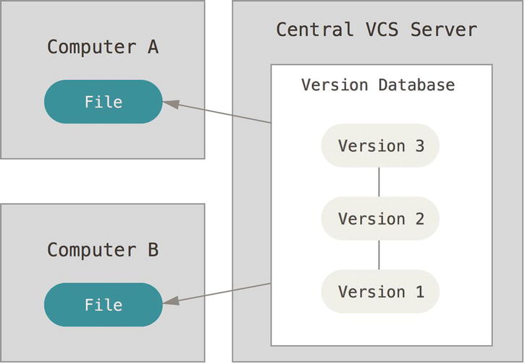
About Version Control
Centralized Version Control Systems
Advantages:
everyone knows to a certain degree what everyone else on the project is doing
Administrators have fine-grained control over who can do what
it’s far easier to administer a CVCS than it is to deal with local databases on every client
Corso C#

Slide 7
About Version Control
Centralized Version Control Systems
Downsides:
single point of failure that the centralized server represents: if that server goes down for an hour, then during that hour nobody can collaborate at all or save versioned changes to anything they’re working on
if the hard disk the central database is on becomes corrupted, and proper backups haven’t been kept, you lose absolutely everything (the entire history of the project except whatever single snapshots people happen to have on their local machines)
Local VCS systems suffer from this same problem—whenever you have the entire history of the project in a single place, you risk losing everything.
Corso C#

Slide 8
About Version Control
Distributed Version Control Systems
clients don’t just check out the latest snapshot of the files: they fully mirror the repository
if any server dies, and these systems were collaborating via it, any of the client repositories can be copied back up to the server to restore it
every checkout is really a full backup of all the data
i.e. Git, Mercurial, bazaar, Darcs
Corso C#

Slide 9
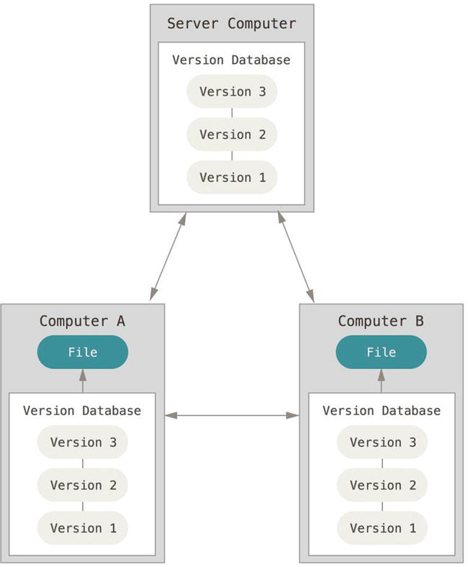
About Version Control
Distributed Version Control Systems
many of these systems deal pretty well with having several remote repositories they can work with
you can collaborate with different groups of people in different ways simultaneously within the same project
distributed VCSs allow you to set up several types of workflows that aren’t possible in centralized systems, such as hierarchical models
Corso C#

Slide 10
Git Basics
What is Git?
Git stores and thinks about information much differently than these other systems
even though the user interface is fairly similar
Corso C#

Slide 11
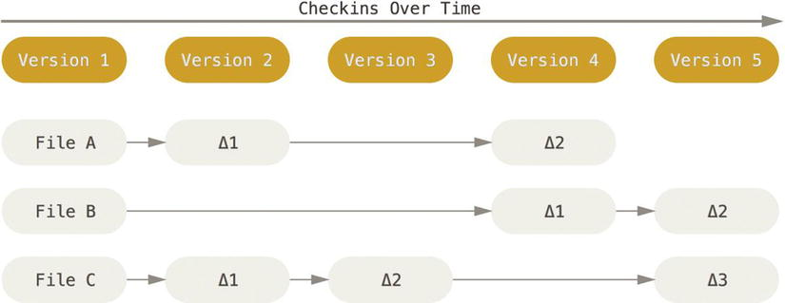
Git Basics
Snapshots – not differences
most other systems store information as a list of file-based changes
they think of the information they keep as a set of files and the changes made to each file over time
Corso C#

Slide 12
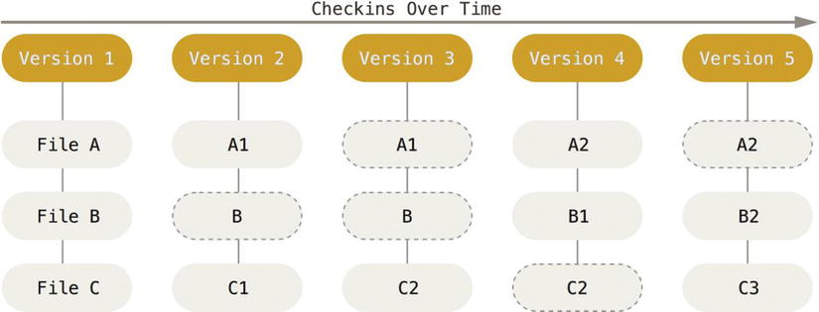
Git Basics
Snapshots – not differences
Git thinks of its data more like a set of snapshots of a miniature filesystem
every time you commit, or save the state of your project in Git, it basically takes a picture of what all your files look like at that moment and stores a reference to that snapshot
to be efficient, if files have not changed, Git doesn’t store the file again, just a link to the previous identical file it has already stored
Git thinks about its data more like a stream of snapshots
Corso C#

Slide 13
Git Basics
Snapshots – not differences
most operations in Git only need local files and resources to operate
no information is needed from another computer on your network
you have the entire history of the project right there on your local disk
you can commit while you are working on a plane
For example
to browse the history of the project, Git doesn’t need to go out to the server to get the history and display it for you:
it simply reads it directly from your local database
Corso C#

Slide 14
Git Basics
Snapshots – not differences
Git has integrity
everything in Git is check-summed before it is stored and is then referred to by that checksum
this means it’s impossible to change the contents of any file or directory without Git knowing about it
it uses SHA-1 hash (a 40-character string composed of hexadecimal characters (0–9 and a–f) and calculated based on the contents of a file or directory structure in Git)
You will see these hash values all over the place in Git because it uses them so much: Git stores everything in its database not by filename but by the hash value of its contents.
24b9da6552252987aa493b52f8696cd6d3b00373
Corso C#

Slide 15
Git Basics
Snapshots – not differences
Git Generally Only Adds Data
as in any VCS, you can lose or mess up changes you haven’t committed yet
but after you commit a snapshot into Git, it is very difficult to lose, especially if you regularly push your database to another repository
we know we can experiment without the danger of severely screwing things up!
Corso C#

Slide 16
Git Basics
The Three states
Git has three main states that your files can reside in:
Committed: the data is safely stored in your local database
Modified: means that you have changed the file but have not committed it to your database yet
Staged: means that you have marked a modified file in its current version to go into your next commit snapshot
This leads us to the three main sections of a Git project:
the Git directory
the working directory
the staging area
Corso C#

Slide 17
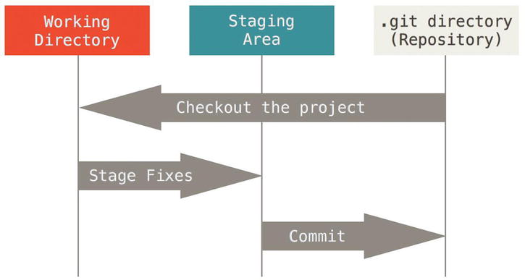
Git Basics
The Three states
The Git directory is where Git stores the metadata and object database for your project
This is the most important part of Git, and it is what is copied when you clone a repository from another computer
Corso C#

Slide 18
Git Basics
The Three states
The working directory is a single checkout of one version of the project
These files are pulled out of the compressed database in the Git directory and placed on disk for you to use or modify
Corso C#

Slide 19
Git Basics
The Three states
The staging area is a file, generally contained in your Git directory, that stores information about what will go into your next commit
It’s sometimes referred to as the “index”, but it’s also common to refer to it as the staging area
Corso C#

Slide 20
Git Basics
The Three states
The basic Git workflow goes something like this:
You modify files in your working directory
You stage the files, adding snapshots of them to your staging area
You do a commit, which takes the files as they are in the staging area and stores that snapshot permanently to your Git directory
Corso C#

Slide 21
Git Basics
The command line
You can use Git by…
Command line
Graphical tools
Corso C#

Slide 22
Git Basics
Installing Git
Git is dowloadable from https://git-scm.com/downloads
Note that this is a project called Git for Windows (also called msysGit), which is separate from Git itself…
Another easy way to get Git installed is by installing GitHub for Windows
the installer includes a command line version of Git as well as the GUI
it also works well with Powershell, and sets up solid credential caching and sane CRLF settings
You can download this from the GitHub for Windows website, at http://windows.github.com
Some people may instead find it useful to install Git from source, because you’ll get the most recent version
Corso C#

Slide 23
Git Basics
First time Git setup
First time setup will remain between upgrades
You can change them at any time by running through the commands again
Git comes with a tool called git config that lets you get and set configuration variables that control all aspects of how Git looks and operates
On Windows systems, Git looks for the .gitconfig file…
in the $HOME directory (C:\Users\$USER for most people)
it looks for /etc/gitconfig, although it’s relative to the MSys root, which is wherever you decide to install Git on your Windows system when you run the installer
Corso C#

Slide 24
Git Basics
First time Git setup
Your Identity
The first thing you should do when you install Git is to set your user name and e-mail address
Git uses this information to mark your commits
$ git config --global user.name "John Doe"
$ git config --global user.email johndoe@example.com
you need to do this only once if you pass the --global option, because then Git will always use that information for anything you do on that system
you can run the command without the --global option when you’re in a project to override the global setting with a different name or e-mail for that project
Corso C#

Slide 25
Git Basics
First time Git setup
Your editor
Using Notepad++ as your editor…
Install Notepad++ from https://notepad-plus-plus.org/. For more information, see "Getting started" in the Notepad++ documentation
Open Git Bash.
Type this command:
$ git config --global core.editor "'C:/Program Files (x86)/Notepad++/notepad++.exe' -multiInst -notabbar -nosession -noPlugin"
Source: https://docs.github.com/en/get-started/getting-started-with-git/associating-text-editors-with-git
Corso C#

Slide 26
Git Basics
First time Git setup
Checking your settings
If you want to check your settings, you can use the git config --list command to list all the settings Git can find at that point
$ git config --list
user.name=John Doe
user.email=johndoe@example.com
color.status=auto
color.branch=auto
color.interactive=auto
color.diff=auto
...
You may see keys more than once, because Git reads the same key from different files (/etc/gitconfig and~/.gitconfig, for example)
Git uses the last value for each unique key it sees
Corso C#

Slide 27
Git Basics
First time Git setup
Checking your settings
You can also check what Git thinks a specific key’s value is by typing git config <key>
$ git config user.name
John Doe
Corso C#

Slide 28
Git Basics
Getting help
manpage
$ git help <verb>
$ git <verb> --help
$ man git-<verb>
i.e.
$ git help config
Corso C#

