Slide 1
C# Language
Improving Performance and Scalability Using Multitasking
Understanding processes, threads, and tasks
Monitoring performance and resource usage
Running tasks asynchronously
Synchronizing access to shared resources
Understanding async and await
Corso C#

Slide 2
Processes, threads, and tasks
Definitions
a PROCESS, with one example being each of the console applications we have created, has resources like memory and threads allocated to it
a THREAD executes your code, statement by statement by default, each process only has one thread, and this can cause problems when we need to do more than one task at the same time threads are also responsible for keeping track of things like the currently authenticated user and any internationalization rules that should be followed for the current language and region
Corso C#

Slide 3
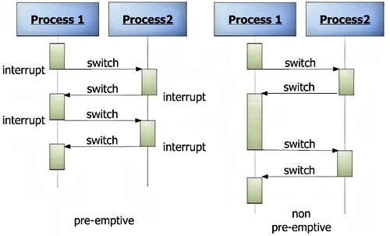
Processes, threads, and tasks
Preemptive multitasking
Windows and most other modern operating systems use preemptive multitasking, which simulates the parallel execution of tasks
It divides the processor time among the threads, allocating a time slice to each thread one after another: the current thread is suspended when its time slice finishes, the processor then allows another thread to run for a time slice
when Windows switches from one thread to another, it saves the context of the thread and reloads the previously saved context of the next thread in the thread queue: this takes both time and resources to complete
Corso C#

Slide 4
Processes, threads, and tasks
Definitions
as a developer, if you have a small number of complex pieces of work and you want complete control over them, then you could create and manage individual Thread instances
having one main thread and multiple small pieces of work that can be executed in the background, can let you use the ThreadPool class to add delegate instances that point to those pieces of work implemented as methods to a queue, and they will be automatically allocated to threads in the thread pool
we will use the Task type to manage threads at a higher abstraction level
Corso C#

Slide 5
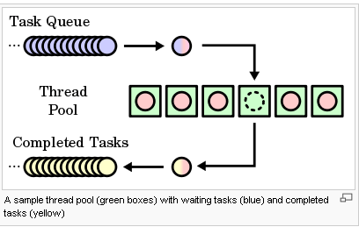
Processes, threads, and tasks
Definitions
What is Task in C#?
.NET framework provides Threading.Tasks class to let you create tasks and run them asynchronously
a task is an object that represents some work that should be done
the task can tell you if the work is completed and if the operation returns a result, the task gives you the result (Task and Task<TResult>)
Corso C#

Slide 6
Processes, threads, and tasks
Differences Between Task And Thread
the Thread class is used for creating and manipulating a thread in Windows
a Task represents some asynchronous operation and is part of the Task Parallel Library, a set of APIs for running tasks asynchronously and in parallel
the task can return a result (Task<TResult>) while there is no direct mechanism to return the result from a thread
Task supports cancellation through the use of cancellation tokens while Thread doesn't
with Task we can easily implement Asynchronous using async and await keywords
a new Thread() is not dealing with Thread pool thread, whereas Task does use thread pool thread
Task is a higher level concept Thread a lower-level implementation
Thread takes resources while a Task does not. It also provides more control than the Task class
Thread should be preferred for any long-running operations, while a Task should be preferred for any other asynchronous operations
Corso C#

Slide 7
Processes, threads, and tasks
Definitions
threads may have to compete for and also wait for access to shared resources, such as variables, files, and database objects: there are types for managing this that you will see in action later
depending on the task, doubling the number of threads (workers) to perform a task does not halve the number of seconds that it will take to complete that task. In fact, it can increase the duration of the task.
never assume that more threads will improve performance!
run performance tests on a baseline code implementation without multiple threads, and then again on a code implementation with multiple threads
you should also perform performance tests in a staging environment that is as close as possible to the production environment
Corso C#

Slide 8
Monitoring performance and resource usage
Evaluating the efficiency of types
before we can improve the performance of any code, we need to be able to monitor its speed and efficiency to record a baseline that we can then measure improvements against
What is the best type to use for a scenario?
to answer this question, we need to carefully consider what we mean by "best", and through this, we should consider the following factors:
Functionality: checking whether the type provides the features you need
Memory size: the number of bytes of memory the type takes up
Performance: how fast the type is
Future needs: this depends on the changes in requirements and maintainability
Corso C#

Slide 9
Monitoring performance and resource usage
Evaluating the efficiency of types
there will be scenarios, such as when storing numbers, where multiple types have the same functionality, so we will need to consider memory and performance to make a choice
if we need to store millions of numbers, then the best type to use would be the one that requires the fewest bytes of memory
if we only need to store a few numbers, yet we need to perform lots of calculations on them, then the best type to use would be the one that runs fastest on a specific CPU
there is an important metric that developers often forget: maintenance
this is a measure of how much effort another programmer would have to put in to understand and modify your code
if you make a nonobvious choice of type without explaining that choice with a helpful documentation, then it might confuse the programmer who comes along later and needs to fix a bug or add a feature
today a short variable might be the best choice, but it might be an even better choice to use an int variable, even though it takes twice as much space in the memory
this is because we might need a wider range of values to be stored in the future
Corso C#

Slide 10
Monitoring performance and resource usage
Evaluating the efficiency of types
System.Diagnostics namespace has lots of useful types for monitoring your code
the first useful type that we will look at is the Stopwatch type
Member | Description
Restart method | resets the elapsed time to zero and then starts the timer
Stop method | stops the timer
Elapsed property | is the elapsed time stored as a TimeSpan format (for example, hours:minutes:seconds)
ElapsedMilliseconds property | is the elapsed time in milliseconds stored as an Int64 value
Corso C#

Slide 11
Monitoring performance and resource usage
Evaluating the efficiency of types
Process type has some useful members
Member | Description
VirtualMemorySize64 | displays the amount of virtual memory, in bytes, allocated for the process
WorkingSet64 | displays the amount of physical memory, in bytes, allocated for the process.
Corso C#

Slide 12
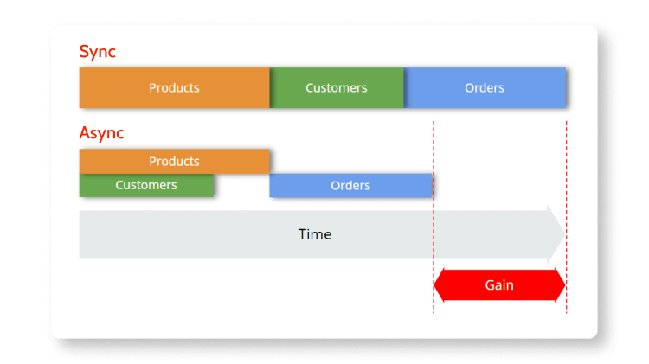
Running tasks asynchronously
Sync vs Async
in synchronous operations tasks are performed one at a time and only when one is completed, the following is unblocked: you need to wait for a task to finish to move to the next one
in asynchronous operations, you can move to another task before the previous one finishes with asynchronous programming you’re able to deal with multiple requests simultaneously, thus completing more tasks in a much shorter period of time
Corso C#

Slide 13
Running tasks asynchronously
Running multiple actions asynchronously using tasks
the Thread class has been available since the first version of .NET and can be used to create new threads and manage them, but it can be tricky to work with directly
.NET Framework 4.0 introduced the Task class in 2010, which is a wrapper around a thread that enables easier creation and management
managing multiple threads wrapped in tasks will allow our code to execute at the same time, aka asynchronously
in particular each Task has:
a Status property
a CreationOptions property
a ContinueWith method that can be customized with the TaskContinuationOptions enum, and can be managed with the TaskFactory class
Corso C#

Slide 14
Running tasks asynchronously
Running multiple actions asynchronously using tasks
the Task asynchronous programming model pattern (TAP) provides an abstraction over asynchronous code
you write code as a sequence of statements, just like always
you can read that code as though each statement completes before the next begins
the compiler performs many transformations because some of those statements may start work and return a Task that represents the ongoing work
Corso C#

Slide 15
Running tasks asynchronously
Create and start a new Task
with the Task Parallel Library TPL (that is part of the BCL), there are several ways to create and start a new task:
one way is to use the constructor for task followed by a call to the Start method
another is by using the StartNew method of TaskFactory
the last is calling the static Run method from Task class, and is a “shortcut” of the previous
new Task(…).Start();
Task.Factory.StartNew(…);
Task.Run(someAction);
//is equivalent to
Task.Factory.StartNew(someAction,
CancellationToken.None, TaskCreationOptions.DenyChildAttach, TaskScheduler.Default);
Corso C#

Slide 16
Running tasks asynchronously
Waiting for tasks
sometimes, you need to wait for a task to complete before continuing
to do this, you can use the Wait method on a Task instance, or the WaitAll or WaitAny static methods on an array of tasks:
Method | Description
t.Wait() | waits for the task instance named t to complete execution
Task.WaitAny(Task[]) | waits for any of the tasks in the array to complete execution
Task.WaitAll(Task[]) | waits for all the tasks in the array to complete execution
Corso C#

Slide 17
Running tasks asynchronously
Continuing with another task
when all tasks can be performed at the same time, then waiting for all tasks to finish will be all we need to do
but when a task is dependent on the output from another task we need to define continuation tasks
Task.ContinueWith creates a continuation that executes asynchronously when the target Task completes
Corso C#

Slide 18
Running tasks asynchronously
Nested and child tasks
as well as defining dependencies between tasks, you can define nested and child tasks
a nested task is a task that is created inside another task
a child task is a nested task that must finish before its parent task is allowed to finish
Corso C#

Slide 19
Running tasks asynchronously
Wrapping tasks around other objects
you might have a method that you want to be asynchronous, but the result to be returned is not itself a task
you can wrap the return value in a successfully completed task, return an exception, or indicate that the task was canceled by using one of the methods:
Method | Description
FromResult<TResult>(TResult) | creates a Task<TResult> object whose Result property is the non-task result and whose Status property is RanToCompletion
FromException<TResult>(Exception) | creates a Task<TResult> that's completed with a specified exception
FromCanceled<TResult>(CancellationToken) | creates a Task<TResult> that's completed due to cancellation with a specified cancellation token
Corso C#

Slide 20
Running tasks asynchronously
Wrapping tasks around other objects
These methods are useful when you need to
implement an interface that has async methods, but your implementation is synchronous (this is common for websites and services)
mock asynchronous implementations during unit testing
// if we had wanted to make our previous XML checker methods conform to an interface that requires a Task<T>:
public static class StringExtensions
{
public static Task<bool> IsValidXmlTagAsync(this string input)
{
if (input == null)
{
return Task.FromException<bool>(
new ArgumentNullException("Missing input parameter"));
}
if (input.Length == 0)
{
return Task.FromException<bool>(
new ArgumentException("input parameter is empty."));
}
return Task.FromResult(Regex.IsMatch(input,
@"^<([a-z]+)([^<]+)*(?:>(.*)<\/\1>|\s+\/>)$"));
}
// other methods
}
NOTE: the only situation you would use Task.FromException is when you're in a method you cannot or won't implement using async and await, and you want the result of the task should be an exception
Corso C#

Slide 21
Running tasks asynchronously
Wrapping tasks around other objects
if the method you need to implement returns a Task (equivalent to void in a synchronous method) then you can return a predefined completed Task object, as shown in the following code:
public Task DeleteCustomerAsync()
{
// ...
return Task.CompletedTask;
}
Corso C#

Slide 22
Synchronizing access to shared resources
Accessing a resource from multiple threads
when you have multiple threads executing at the same time, there is a possibility that two or more of the threads may access the same variable or another resource at the same time, and as a result, may cause a problem
for this reason, you should carefully consider how to make your code thread-safe
the simplest mechanism for implementing thread safety is to use an object variable as a flag or traffic light to indicate when a shared resource has an exclusive lock applied
Corso C#

Slide 23
Synchronizing access to shared resources
Accessing a resource from multiple threads
an object variable can be used for implementing thread-safe code
when a thread has this object variable, no other thread should access the shared resource(s) represented by that object (I say, should because only code that respects this object enables synchronized access, it is not a lock)
Here a couple of types that can be used to synchronize access to shared resources:
Monitor: an object that can be used by multiple threads to check if they should access a shared resource within the same process
Interlocked: an object for manipulating simple numeric types at the CPU level
Corso C#

Slide 24
Synchronizing access to shared resources
Understanding the lock statement
you might wonder what the lock statement does when it "locks" an object variable (hint: it does not lock the object!), as shown in the following code:
lock (SharedObjects.ObjLock)
{
// work with shared resource
}
Corso C#

Slide 25
Synchronizing access to shared resources
Understanding the lock statement
the C# compiler changes the lock statement into a try-finally statement that uses the Monitor class to enter and exit the “lock” object (I like to think of it as take and release the “lock” object), as shown in the following code:
try
{
Monitor.Enter(SharedObjects.Conch);
// work with shared resource
}
finally
{
Monitor.Exit(SharedObjects.Conch);
}
when a thread calls Monitor.Enter on any object, aka reference type, it checks to see if some other thread has already taken the conch:
if it has, the thread waits
if it has not, the thread takes the “lock” object and gets on with its work on the shared resource
once the thread has finished its work, it calls Monitor.Exit, releasing the “lock” object
if another thread was waiting, it can now take the “lock” object and do its work
this requires all threads to respect the “lock” object by calling Monitor.Enter and Monitor.Exit appropriately
Corso C#

Slide 26
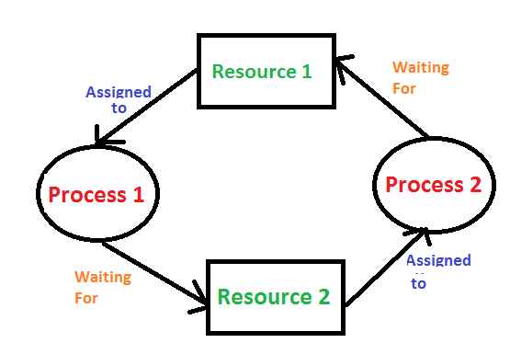
Synchronizing access to shared resources
Avoiding deadlocks
one way to prevent deadlocks is to specify a timeout when attempting to get a lock
to do this, you must manually use the Monitor class instead of using the lock statement
Corso C#

Slide 27
Synchronizing access to shared resources
Avoiding deadlocks
knowing how the lock statement is translated by the compiler to method calls on the Monitor class is also important because using the lock statement can cause a deadlock
deadlocks can occur when there are two or more shared resources (each with a “lock” object to monitor which thread is currently doing work on each shared resource), and the following sequence of events happens:
thread X "locks" lockingobject A and starts working on shared resource A
thread Y "locks" lockingobject B and starts working on shared resource B
while still working on resource A, thread X needs to also work with resource B, and so it attempts to "lock" lockingobject B but is blocked because thread Y already has lockingobject B
while still working on resource B, thread Y needs to also work with resource A, and so it attempts to "lock" lockingobject A but is blocked because thread X already has conch A
Corso C#

Slide 28
Synchronizing access to shared resources
Avoiding deadlocks
NOTE:
only use the lock keyword if you can write your code such that it avoids potential deadlocks
if you cannot avoid potential deadlocks, then always use the Monitor.TryEnter method instead of lock, in combination with a try-finally statement, so that you can supply a timeout and one of the threads will back out of a deadlock if it occurs
use Monitor.IsEntered to determine whether the current thread holds the lock on the specified object in the finally block statement
you can read more about good threading practices at the following link https://docs.microsoft.com/en-us/dotnet/standard/threading/managed-threading-best-practices
Corso C#

Slide 29
Synchronizing access to shared resources
Synchronizing events
we learned how to raise and handle events but…
.NET events are not thread-safe, so you should avoid using them in multithreaded scenarios and follow the standard event raising code
after learning that .NET events are not thread-safe, some developers attempt to use exclusive locks when adding and removing event handlers or when raising an event, as shown here:
// event delegate field
public event EventHandler Shout;
// conch
private object eventLock = new();
// method
public void Poke()
{
lock (eventLock) // bad idea
{
// if something is listening...
if (Shout != null)
{
// ...then call the delegate to raise the event
Shout(this, EventArgs.Empty);
}
}
}
you can read more about events and thread-safety at the following link: https://docs.microsoft.com/en-us/archive/blogs/cburrows/field-like-events-considered-harmful
Corso C#

Slide 30
Synchronizing access to shared resources
Making CPU operations atomic
atomic means undividable and it is important to understand which operations are atomic in multithreading because if they are not atomic, then they could be interrupted by another thread partway through their operation
Is the C# increment operator atomic, as shown in the following code?
int x = 3;
x++; // is this an atomic CPU operation?
Corso C#

Slide 31
Synchronizing access to shared resources
Making CPU operations atomic
It is not atomic! Incrementing an integer requires the following three CPU operations:
load a value from an instance variable into a register
increment the value
store the value in the instance variable
for example:
a thread could be interrupted after executing the first two steps
a second thread could then execute all three steps
when the first thread resumes execution, it will overwrite the value in the variable, and the effect of the increment or decrement performed by the second thread will be lost!
Corso C#

Slide 32
Synchronizing access to shared resources
Making CPU operations atomic
there is a type named Interlocked that can perform atomic actions on value types, such as integers and floats:
Method | Description
Add() | Adds two numbers and replaces the first with the sum, as an atomic operation.
And() | Bitwise "ands" two numbers and replaces the first with the result, as an atomic operation.
CompareExchange<T>(T, T, T) | Compares two instances of the specified reference type T for reference equality and, if they are equal, replaces the first one.
Decrement() | Decrements a specified variable and stores the result, as an atomic operation.
Exchange<T>(T, T) | Sets a variable of the specified type T to a specified value and returns the original value, as an atomic operation.
Increment() | Increments a specified variable and stores the result, as an atomic operation.
MemoryBarrier() | Synchronizes memory access as follows: The processor that executes the current thread cannot reorder instructions in such a way that memory accesses before the call to MemoryBarrier() execute after memory accesses that follow the call to MemoryBarrier()
MemoryBarrierProcessWide() | Provides a process-wide memory barrier that ensures that reads and writes from any CPU cannot move across the barrier.
Or() | Bitwise "ors" two numbers and replaces the first with the result, as an atomic operation.
Read() | Returns a 64-bit (or 64-bit unsigned) value, loaded as an atomic operation.
Corso C#

Slide 33
Synchronizing access to shared resources
Applying other types of synchronization
Monitor and Interlocked are mutually exclusive locks that are simple and effective, but sometimes, you need more advanced options to synchronize access to shared resources, as shown in the following table:
Type | Description
ReaderWriterLock and ReaderWriterLockSlim | these allow multiple threads to be in read mode, one thread to be in write mode with exclusive ownership of the write lock, and one thread that has read access to be in upgradeable read mode, from which the thread can upgrade to write mode without having to relinquish its read access to the resource
Mutex | like Monitor, this provides exclusive access to a shared resource, except it is used for inter-process synchronization
Semaphore and SemaphoreSlim | these limit the number of threads that can access a resource or pool of resources concurrently by defining slots. This is known as resource throttling rather than resource locking
AutoResetEvent and ManualResetEvent | event wait handles allow threads to synchronize activities by signaling each other and by waiting for each other's signals
Corso C#

Slide 34
Async and await
Intro
C# 5 introduced two C# keywords when working with the Task type
they are especially useful for the following:
implementing multitasking for a graphical user interface (GUI)
improving the scalability of web applications and web services
Corso C#

Slide 35
Async and await
Improving responsiveness for GUI apps
life for a programmer gets more complicated when building web applications, web services, and apps with GUIs such as Windows desktop and mobile apps instead of console applications.
One reason for this is that for a GUI app, there is a special thread: the user interface (UI) thread
There are two rules for working in GUIs:
do not perform long-running tasks on the UI thread
do not access UI elements on any thread except the UI thread
to handle these rules, programmers used to have to write complex code to ensure that long- running tasks were executed by a non-UI thread, but once complete, the results of the task were safely passed to the UI thread to present to the user
Corso C#

Slide 36
Async and await
Improving responsiveness for GUI apps
with C# 5 and later, you have the use of async and await
async and await allow you to continue to write your code as if it is synchronous, which keeps your code clean and easy to understand, but underneath, the C# compiler creates a complex state machine and keeps track of running threads
Corso C#

Slide 37
Async and await
Improving scalability for web applications and web services
async and await keywords can also be applied on the server side when building websites, applications, and services
from the client application's point of view, nothing changes (or they might even notice a small increase in the time taken for a request to return) so…
from a single client's point of view, the use of async and await to implement multitasking on the server side makes their experience worse!
Corso C#

Slide 38
Async and await
Improving scalability for web applications and web services
on the server side, additional, cheaper worker threads are created to wait for long-running tasks to finish so that expensive I/O threads can handle other client requests instead of being blocked
this improves the overall scalability of a web application or service
more clients can be supported simultaneously
Corso C#

Slide 39
Async and await
Common types that support multitasking
There are many common types that have asynchronous methods that you can await
Type | Methods
DbContext<T> | AddAsync, AddRangeAsync, FindAsync, and SaveChangesAsync
DbSet<T> | AddAsync, AddRangeAsync, ForEachAsync, SumAsync, ToListAsync, ToDictionaryAsync, AverageAsync, and CountAsync
HttpClient | GetAsync, PostAsync, PutAsync, DeleteAsync, and SendAsync
StreamReader | ReadAsync, ReadLineAsync, and ReadToEndAsync
StreamWriter | WriteAsync, WriteLineAsync, and FlushAsync
NOTE: any time you see a method that ends in the suffix Async, check to see whether it returns Task or Task<T>
if it does, then you could use it instead of the synchronous non-Async suffixed method
Remember to call it using await and decorate your method with async
Corso C#

Slide 40
Async and await
Using await in catch blocks
when async and await were first introduced in C# 5, it was only possible to use the await keyword in a try block, but not in a catch block
in C# 6 and later, it is now possible to use await in both try and catch blocks
Corso C#

Slide 41
Questions
What information can you find out about a process?
How accurate is the Stopwatch class?
By convention, what suffix should be applied to a method that returns Task or Task<T>?
To use the await keyword inside a method, what keyword must be applied to the method declaration?
How do you create a child task?
Why should you avoid the lock keyword?
When should you use the Interlocked class?
When should you use the Mutex class instead of the Monitor class?
What is the benefit of using async and await in a website or web service?
Can you cancel a task? If so, how?
Corso C#

Slide 42
Summary
how to define and start a task
how to wait for one or more tasks to finish
how to control task completion order
how to synchronize access to shared resources
what is behind async and await
Corso C#

