Slide 1
C# Language
Practical Applications of C# and .NET
Understanding app models for C# and .NET
New features in ASP.NET Core
Structuring projects
Using other project templates
Building an entity data model for Northwind
Corso C#

Slide 2
Understanding app models for C# and .NET
Building websites using ASP.NET Core
websites are made up of multiple web pages loaded statically from the filesystem or generated dynamically by a server-side technology such as ASP.NET Core
a web browser makes GET requests using Unique Resource Locators (URLs) that identify each page and can manipulate data stored on the server using POST, PUT, and DELETE requests
with many websites, the web browser is treated as a presentation layer, with almost all the processing performed on the server side
some JavaScript might be used on the client side to implement some presentation features, such as carousels
Corso C#

Slide 3
Understanding app models for C# and .NET
Building websites using ASP.NET Core
ASP.NET Core provides multiple technologies for building websites:
ASP.NET Core Razor Pages and Razor class libraries are ways to dynamically generate HTML for simple websites
ASP.NET Core MVC is an implementation of the Model-View-Controller (MVC) design pattern that is popular for developing complex websites
Blazor lets you build user interface components using C# and .NET instead of a JavaScript-based UI framework like Angular, React, and Vue Blazor WebAssembly runs your code in the browser like a JavaScript-based framework would Blazor Server runs your code on the server and updates the web page dynamically Blazor is not just for building websites; it can also be used to create hybrid mobile and desktop apps
Corso C#

Slide 4
Understanding app models for C# and .NET
Building websites using a content management system
Most websites have a lot of content, and if developers had to be involved every time some content needed to be changed, that would not scale well
a Content Management System (CMS) enables developers to define content structure and templates to provide consistency and good design while making it easy for a non-technical content owner to manage the actual content
they can create new pages or blocks of content, and update existing content, knowing it will look great for visitors with minimal effort
Corso C#

Slide 5
Understanding app models for C# and .NET
Building websites using a content management system
the key benefit of using a CMS is that it provides a friendly content management user interface
content owners log in to the website and manage the content themselves
the content is then rendered and returned to visitors using ASP.NET Core MVC controllers and views, or via web service endpoints, known as a headless CMS, to provide that content to "heads" implemented as mobile or desktop apps, in-store touchpoints, or clients built with JavaScript frameworks or Blazor.
Corso C#

Slide 6
Understanding app models for C# and .NET
Building web applications using SPA frameworks
web applications, also known as Single-Page Applications (SPAs), are made up of a single web page built with a frontend technology such as Blazor WebAssembly, Angular, React, Vue, or a proprietary JavaScript library that can make requests to a backend web service for getting more data when needed and posting updated data using common serialization formats such as XML and JSON
the canonical examples are Google web apps like Gmail, Maps, and Docs
with a web application, the client side uses JavaScript frameworks or Blazor WebAssembly to implement sophisticated user interactions, but most of the important processing and data access still happens on the server side, because the web browser has limited access to local system resources
Corso C#

Slide 7
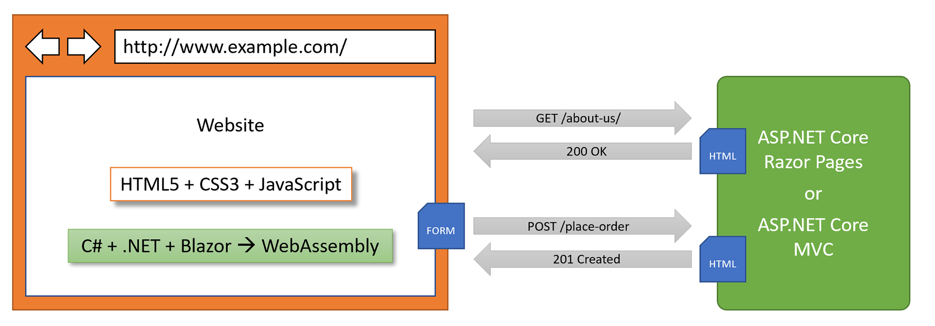
Understanding app models for C# and .NET
Building web applications using SPA frameworks
JavaScript is loosely typed and is not designed for complex projects, so most JavaScript libraries these days use Microsoft TypeScript, which adds strong typing to JavaScript and is designed with many modern language features for handling complex implementations
in summary, C# and .NET can be used on both the server side and the client side to build websites:
Corso C#

Slide 8
Understanding app models for C# and .NET
Building web and other services
we will learn
how to build a web service using the ASP.NET Core Web API, and then
call that web service from the server-side code in our ASP.NET Core websites, and then
we will call that web service from Blazor WebAssembly components and cross-platform mobile and desktop apps
Corso C#

Slide 9
Understanding app models for C# and .NET
Building web and other services
There are no formal definitions, but services are sometimes described based on their complexity:
Service: all functionality needed by a client app in one monolithic service
Microservice: multiple services that each focus on a smaller set of functionalities
Nanoservice: a single function provided as a service unlike services and microservices that are hosted 24/7/365, nanoservices are often inactive until called upon to reduce resources and costs
Corso C#

Slide 10
Understanding app models for C# and .NET
Building web and other services
as well as web services that use HTTP as the underlying communication technology and the design principles of the API, services use also other technologies and design philosophies, like:
gRPC for building highly efficient and performant services with support for almost any platform.
SignalR for building real-time communications between components
OData for wrapping Entity Framework Core and other data models with a web API
GraphQL for letting the client control what data is retrieved across multiple data sources
Azure Functions (Lambda Functions in AWS) for hosting serverless nanoservices in the cloud
Corso C#

Slide 11
Understanding app models for C# and .NET
Building mobile and desktop apps
There are two major mobile platforms: Apple's iOS and Google's Android, each with its own programming languages and platform APIs
There are also two major desktop platforms: Apple's macOS and Microsoft's Windows, each with its own programming languages and platform APIs, as shown in the following list:
iOS: Objective C or Swift and UIkit.
Android: Java or Kotlin and the Android API.
macOS: Objective C or Swift and AppKit or Catalyst.
Windows: C, C++, or many other languages and the Win32 API or Windows App SDK
Cross-platform mobile and desktop apps can be built once for the .NET Multi-platform App User Interfaces (MAUI) platform, and then can run on many mobile and desktop platforms
Corso C#

Slide 12
Understanding app models for C# and .NET
Building mobile and desktop apps
.NET MAUI makes it easy to develop those apps by sharing user interface components as well as business logic
they can target the same .NET APIs as used by console apps, websites, and web services
the app will be executed by the Mono runtime on mobile devices and the CoreCLR runtime on desktop devices
the Mono runtime is better optimized for mobile devices compared to the normal .NET CoreCLR runtime
Blazor WebAssembly also uses the Mono runtime because like a mobile app, it is resource constrained
Corso C#

Slide 13
Understanding app models for C# and .NET
Building mobile and desktop apps
the apps can exist on their own, but they usually call services to provide an experience that spans across all your computing devices, from servers and laptops to phones and gaming systems
future updates to .NET MAUI will support existing MVVM and XAML patterns as well as ones like Model-View-Update (MVU) with C#, which is like Apple's Swift UI.
Corso C#

Slide 14
New features in ASP.NET Core
New features in ASP.NET Core
over the past few years, Microsoft has rapidly expanded the capabilities of ASP.NET Core
you should note which .NET platforms are supported, as shown in the following list:
ASP.NET Core 1.0 to 2.2 runs on either .NET Core or .NET Framework.
ASP.NET Core 3.0 or later only runs on .NET Core 3.0 or later.
Corso C#

Slide 15
New features in ASP.NET Core
New features in ASP.NET Core
ASP.NET Core 1.0 was released in June 2016 and focused on implementing a minimum API suitable for building modern cross-platform web apps and services for Windows, macOS, and Linux
ASP.NET Core 1.1 was released in November 2016 and focused on bug fixes and general improvements to features and performance
ASP.NET Core 2.0 was released in August 2017 and focused on adding new features such as Razor Pages, bundling assemblies into a Microsoft.AspNetCore.All metapackage, targeting .NET Standard 2.0, providing a new authentication model, and performance improvements - the biggest new features introduced with ASP.NET Core 2.0 are ASP.NET Core Razor Pages, and ASP.NET Core OData support
Corso C#

Slide 16
New features in ASP.NET Core
New features in ASP.NET Core
ASP.NET Core 2.1 was released in May 2018 and was a Long Term Support (LTS) release, meaning it was supported for three years until August 21, 2021 (LTS designation was not officially assigned to it until August 2018 with version 2.1.3). It focused on adding new features such as
ASP.NET Core SignalR for real-time communication
Razor class libraries for reusing web components
ASP.NET Core Identity for authentication
better support for HTTPS and the European Union's General Data Protection Regulation (GDPR)
identity UI library and scaffolding
integration tests
[ApiController], ActionResult<T>
IHttpClientFactory
Corso C#

Slide 17
New features in ASP.NET Core
New features in ASP.NET Core
ASP.NET Core 2.2 was released in December 2018 and focused on improving the building of RESTful HTTP APIs, updating the project templates to Bootstrap 4 and Angular 6, an optimized configuration for hosting in Azure, and performance improvements, including
HTTP/2 in Kestrel
In-process hosting model
Endpoint routing
Health check API
Open API Analyzers
Corso C#

Slide 18
New features in ASP.NET Core
New features in ASP.NET Core
ASP.NET Core 3.0 was released in September 2019 and focused on fully leveraging .NET Core 3.0 and .NET Standard 2.1, which meant it could not support .NET Framework, and it added useful refinements, including
Static assets in Razor class libraries
New options for MVC service registration
ASP.NET Core gRPC
Blazor Server
ASP.NET Core 3.1 was released in December 2019 and is an LTS release, meaning it will be supported until December 3, 2022. It focused on refinements like partial class support for Razor components and a new <component> tag helper
Blazor WebAssembly 3.2 was released in May 2020. It was a Current release, meaning that projects had to be upgraded to the .NET 5 version within three months of the .NET 5 release, that is, by February 10, 2021. Microsoft finally delivered on the promise of full-stack web development with .NET: Blazor Server and Blazor WebAssembly
Corso C#

Slide 19
New features in ASP.NET Core
New features in ASP.NET Core
ASP.NET Core 5.0 was released in November 2020 and focused on bug fixes, performance improvements using caching for certificate authentication, HPACK dynamic compression of HTTP/2 response headers in Kestrel, nullable annotations for ASP.NET Core assemblies, and a reduction in container image sizes, including:
Extension method to allow anonymous access to an endpoint
JSON extension methods for HttpRequest and HttpResponse
ASP.NET Core 6.0 was released in November 2021 and focused on productivity improvements like minimizing code to implement basic websites and services, .NET Hot Reload, and new hosting options for Blazor, like hybrid apps using .NET MAUI, including:
New empty web project template
HTTP logging middleware
Minimal APIs
Blazor error boundaries
Blazor WebAssembly AOT
.NET Hot Reload
.NET MAUI Blazor apps
Corso C#

Slide 20
Building Windows-only desktop apps
Building Windows-only desktop apps
Technologies for building Windows-only desktop apps include:
Windows Forms, 2002.
Windows Presentation Foundation (WPF), 2006.
Windows Store apps, 2012.
Universal Windows Platform (UWP) apps, 2015.
Windows App SDK (formerly WinUI 3 and Project Reunion) apps, 2021
The on-disk size of the .NET SDKs for Linux and macOS is about 330 MB. The on-disk size of the .NET SDK for Windows is about 440 MB. This is because it includes the Windows Desktop Runtime, which allows the legacy Windows application platforms Windows Forms and WPF to be run on modern .NET
Corso C#

Slide 21
Building Windows-only desktop apps
Building Windows-only desktop apps
Technologies for building Windows-only desktop apps include:
Windows Forms, 2002.
Windows Presentation Foundation (WPF), 2006.
Windows Store apps, 2012.
Universal Windows Platform (UWP) apps, 2015.
Windows App SDK (formerly WinUI 3 and Project Reunion) apps, 2021
The on-disk size of the .NET SDKs for Linux and macOS is about 330 MB. The on-disk size of the .NET SDK for Windows is about 440 MB. This is because it includes the Windows Desktop Runtime, which allows the legacy Windows application platforms Windows Forms and WPF to be run on modern .NET
Corso C#

Slide 22
Structuring projects
Why
with large, complex solutions, it can be difficult to navigate amongst all the code
the primary reason to structure your projects is to make it easier to find components
it is good to have an overall name for your solution or workspace that reflects the application or solution
there are many ways to structure and name projects and solutions, for example, using a folder hierarchy as well as a naming convention
if you work in a team, make sure you know how your team does it.
Corso C#

Slide 23
Structuring projects
Structuring projects in a solution or workspace
It is good to have a naming convention for your projects in a solution or workspace so that any developer can tell what each one does instantly. A common choice is to use the type of project, for example, class library, console app, website, and so on, as shown in the following table:
Name | Description
Northwind.Common | A class library project for common types like interfaces, enums, classes, records, and structs, used across multiple projects.
Northwind.Common.EntityModels | A class library project for common EF Core entity models. Entity models are often used on both the server and client side, so it is best to separate dependencies on specific database providers.
Northwind.Common.DataContext | A class library project for the EF Core database context with dependencies on specific database providers.
Northwind.Web | An ASP.NET Core project for a simple website that uses a mixture of static HTML files and dynamic Razor Pages.
Northwind.Razor.Component | A class library project for Razor Pages used in multiple projects.
Northwind.Mvc | An ASP.NET Core project for a complex website that uses the MVC pattern and can be more easily unit tested.
Corso C#

Slide 24
Structuring projects
Structuring projects in a solution or workspace
Name | Description
Northwind.WebApi | An ASP.NET Core project for an HTTP API service. A good choice for integrating with websites because they can use any JavaScript library or Blazor to interact with the service.
Northwind.OData | An ASP.NET Core project for an HTTP API service that implements the OData standard to enable a client to control queries.
Northwind.GraphQL | An ASP.NET Core project for an HTTP API service that implements the GraphQL standard to enable a client to control queries.
Northwind.gRPC | An ASP.NET Core project for a gRPC service. A good choice for integrating with apps built with any language and platform since gRPC has wide support and is highly efficient and performant.
Northwind.SignalR | An ASP.NET Core project for real-time communication.
Northwind.AzureFuncs | An ASP.NET Core project for implementing a serverless nanoservice for hosting in Azure Functions.
Corso C#

Slide 25
Structuring projects
Structuring projects in a solution or workspace
Name | Description
Northwind.BlazorServer | An ASP.NET Core Blazor Server project.
Northwind.BlazorWasm.Client | An ASP.NET Core Blazor WebAssembly client-side project.
Northwind.BlazorWasm.Server | An ASP.NET Core Blazor WebAssembly server-side project.
Northwind.Maui | A .NET MAUI project for a cross-platform desktop/mobile app.
Northwind.MauiBlazor | A .NET MAUI project for hosting Blazor components with native integrations with the OS.
Corso C#

Slide 26
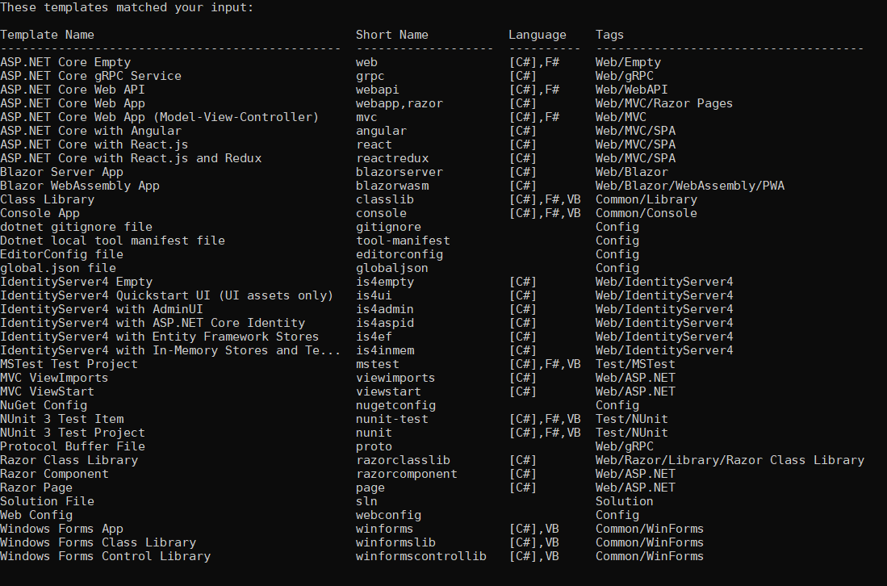
Structuring projects
Using other project templates
When you install the .NET SDK, there are many project templates included
dotnet new --list
note the web-related project templates, including ones for creating SPAs using Blazor, Angular, and React
but another common JavaScript SPA library is missing: Vue
Corso C#

Slide 27
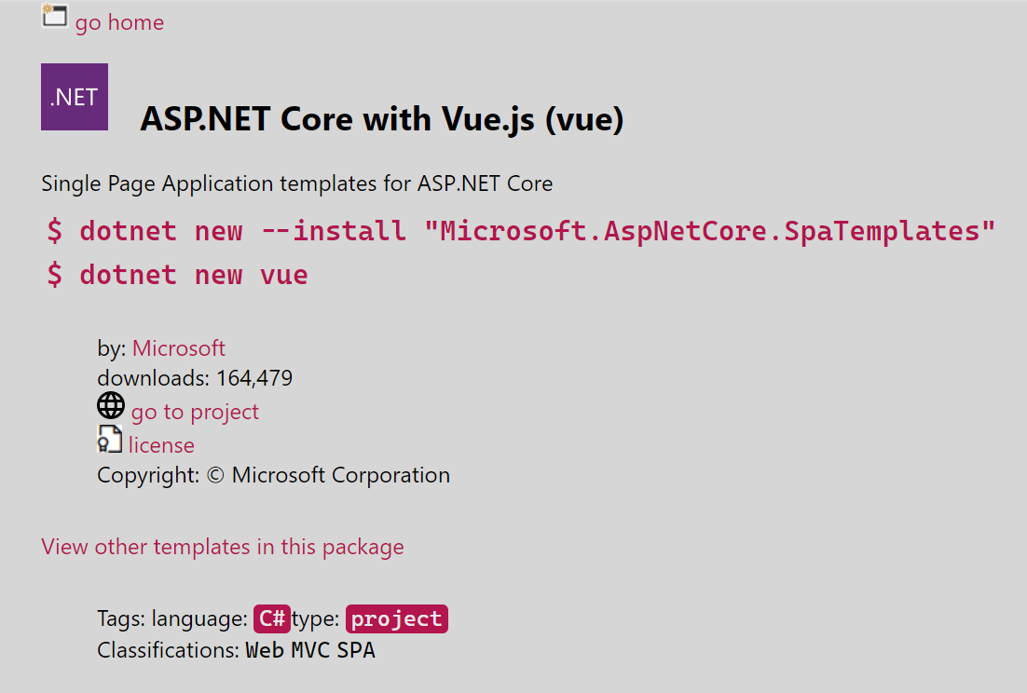
Structuring projects
Installing additional template packs
start a browser and navigate to https://dotnetnew.azurewebsites.net
enter “vue” in the textbox and note the list of available templates for Vue.js, including one published by Microsoft
click on ASP.NET Core with Vue.js by Microsoft, and note the instructions for installing and using this template, as shown in the following commands
click View other templates in this package, and note that as well as a project template for Vue.js, it also has project templates for Aurelia and Knockout.js
dotnet new --install "Microsoft.AspNetCore.SpaTemplates"
dotnet new vue
Corso C#

Slide 28
Building an entity data model for the Northwind database
Creating a class library for entity models using SQL Server
you should create a separate class library project for your entity data models: this allows easier sharing between backend web servers and frontend desktop, mobile, and Blazor WebAssembly clients
Corso C#

