Slide 1
C# Language
Building Websites Using ASP.NET Core Razor Pages
Web development
ASP.NET Core
Exploring ASP.NET Core Razor Pages
Using Entity Framework Core with ASP.NET Core
Using Razor class libraries
Configuring services and the HTTP request pipeline app models for C# and .NET
New features in ASP.NET Core
Structuring projects
Using other project templates
Building an entity data model for Northwind
Corso C#

Slide 2
Web development
HTTP
Developing for the web means developing with Hypertext Transfer Protocol (HTTP)
to communicate with a web server, the client, also known as the user agent, makes calls over the network using HTTP
as such, HTTP is the technical underpinning of the web
when we talk about websites and web services, we mean that they use HTTP to communicate between a client (often a web browser) and a server
Corso C#

Slide 3
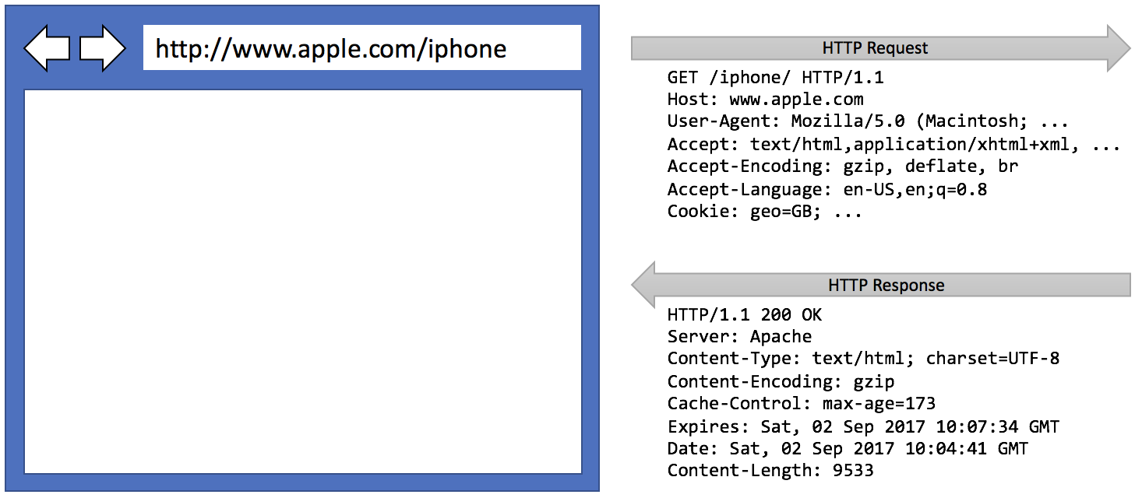
Web development
HTTP
A client makes an HTTP request for a resource, such as a page, uniquely identified by a Uniform Resource Locator (URL), and the server sends back an HTTP response
Corso C#

Slide 4
Web development
Components of a URL
A URL is made up of several components:
scheme: http (clear text) or https (encrypted).
domain: For a production website or service, the top-level domain (TLD) might be com and second level domain might be example.com. You might have subdomains such as www, jobs, or extranet. During development, you typically use localhost for all websites and services.
port number: For a production website or service, 80 for http, 443 for https. These port numbers are usually inferred from the scheme. During development, other port numbers are commonly used, such as 5000, 5001, and so on, to differentiate between websites and services that all use the shared domain localhost.
path: A relative path to a resource, for example, /customers/germany
query string: A way to pass parameter values, for example, ?country=Germany&searchtext=shoes
fragment: A reference to an element on a web page using its ixd, for example, #toc
Corso C#

Slide 5
Web development
Assigning port numbers for projects
when developing multiple services, you use the domain localhost for all websites and services, so you will use port numbers to differentiate projects when multiple need to execute at the same time, as shown in the following table
Project | Description | Port number
Northwind.Web | ASP.NET Core Razor Pages website | 5000 HTTP, 5001 HTTPS
Northwind.Mvc | ASP.NET Core MVC website | 5000 HTTP, 5001 HTTPS
Northwind.WebApi | ASP.NET Core Web API service | 5002 HTTPS, 5008 HTTP
Minimal.WebApi | ASP.NET Core Web API (minimal) | 5003 HTTPS
Northwind.OData | ASP.NET Core OData service | 5004 HTTPS
Northwind.GraphQL | ASP.NET Core GraphQL service | 5005 HTTPS
Northwind.gRPC | ASP.NET Core gRPC service | 5006 HTTPS
Northwind.AzureFuncs | Azure Functions nanoservice | 7071 HTTP
Example using Google Chrome to make HTTP requests with inspector…
Corso C#

Slide 6
Web development
Client-side web development technologies
When building websites, a developer needs to know more than just C# and .NET. On the client (that is, in the web browser), you will use a combination of the following technologies:
HTML5: This is used for the content and structure of a web page
CSS3: This is used for the styles applied to elements on the web page
JavaScript: This is used to code any business logic needed on the web page, for example, validating form input or making calls to a web service to fetch more data needed by the web page
Corso C#

Slide 7
Web development
Client-side web development technologies
HTML5, CSS3, and JavaScript are the fundamental components of frontend web development, but…
there are many additional technologies that can make frontend web development more productive:
Bootstrap, the world's most popular frontend open-source toolkit
CSS preprocessors such as SASS and LESS for styling
Microsoft's TypeScript language for writing more robust code
JavaScript libraries such as jQuery, Angular, React, and Vue
All these higher-level technologies ultimately translate or compile to the underlying three core technologies, so they work across all modern browsers
Corso C#

Slide 8
Web development
Client-side web development technologies
as part of the build and deploy process, you will likely use technologies such as client-side package managers
Node.js; Node Package Manager (npm)
Yarn
and bundling tool
webpack, which is a popular module bundler, a tool for compiling, transforming, and bundling website source files
Corso C#

Slide 9
ASP.NET Core
ASP.NET Core
Microsoft ASP.NET Core is part of a history of Microsoft technologies used to build websites and services that have evolved over the years:
Active Server Pages (ASP) was released in 1996 and was Microsoft's first attempt at a platform for dynamic server-side execution of website code. ASP files contain a mix of HTML and code that executes on the server written in the VBScript language.
ASP.NET Web Forms was released in 2002 with the .NET Framework and was designed to enable non-web developers, such as those familiar with Visual Basic, to quickly create websites by dragging and dropping visual components and writing event-driven code in Visual Basic or C#. Web Forms should be avoided for new .NET Framework web projects in favor of ASP.NET MVC.
Windows Communication Foundation (WCF) was released in 2006 and enables developers to build SOAP and REST services. SOAP is powerful but complex, so it should be avoided unless you need advanced features, such as distributed transactions and complex messaging topologies.
ASP.NET MVC was released in 2009 to cleanly separate the concerns of web developers between the models, which temporarily store the data; the views, which present the data using various formats in the UI; and the controllers, which fetch the model and pass it to a view. This separation enables improved reuse and unit testing.
Corso C#

Slide 10
ASP.NET Core
ASP.NET Core
ASP.NET Web API was released in 2012 and enables developers to create HTTP services (aka REST services) that are simpler and more scalable than SOAP services.
ASP.NET SignalR was released in 2013 and enables real-time communication in websites by abstracting underlying technologies and techniques, such as WebSockets and Long Polling. This enables website features such as live chat or updates to time-sensitive data such as stock prices across a wide variety of web browsers, even when they do not support an underlying technology such as WebSockets.
ASP.NET Core was released in 2016 and combines modern implementations of .NET Framework technologies such as MVC, Web API, and SignalR, with newer technologies such as Razor Pages, gRPC, and Blazor, all running on modern .NET. Therefore, it can execute cross-platform. ASP.NET Core has many project templates to get you started with its supported technologies.
ASP.NET Core 2.0 to 2.2 can run on .NET Framework 4.6.1 or later (Windows only) as well as .NET Core 2.0 or later (cross-platform). ASP.NET Core 3.0 only supports .NET Core 3.0. ASP.NET Core 6.0 only supports .NET 6.0
NOTE: Choose ASP.NET Core to develop websites and services because it includes web-related technologies that are modern and cross-platform
Corso C#

Slide 11
ASP.NET Core
Classic ASP.NET versus modern ASP.NET Core
until now, ASP.NET has been built on top of a large assembly in the .NET Framework named System.Web.dll and it is tightly coupled to Microsoft's Windows-only web server named Internet Information Services (IIS)
over the years, this assembly has accumulated a lot of features, many of which are not suitable for modern cross-platform development
ASP.NET Core is a major redesign of ASP.NET
it removes the dependency on the System.Web.dll assembly and IIS and is composed of modular lightweight packages, just like the rest of modern .NET
using IIS as the web server is still supported by ASP.NET Core but there is a better option
Corso C#

Slide 12
ASP.NET Core
Classic ASP.NET versus modern ASP.NET Core
you can develop and run ASP.NET Core applications cross-platform on Windows, macOS, and Linux
Microsoft has even created a cross-platform, super-performant web server named Kestrel, and the entire stack is open source
ASP.NET Core 2.2 or later projects default to the new in-process hosting model
this gives a 400% performance improvement when hosting in Microsoft IIS, but Microsoft still recommends using Kestrel for even better performance.
Example creating an empty ASP.NET Core Project…
Corso C#

Slide 13
ASP.NET Core
Enabling stronger security and redirect to a secure connection
it is good practice to enable stricter security and automatically redirect requests for HTTP to HTTPS
if needed, while developing, use self-signed SSL certificate then, in terminal enter this command
dotnet dev-certs https --trust
HTTP Strict Transport Security (HSTS) is an opt-in security enhancement that you should always enable. If a website specifies it and a browser supports it, then it forces all communication over HTTPS and prevents the visitor from using untrusted or invalid certificates
// in Program.cs enable HSTS when not in development if (!app.Environment.IsDevelopment())
{
app.UseHsts();
}
// before the call to app.MapGet use this statement to redirect HTTP requests to HTTPS
app.UseHttpsRedirection();
Corso C#

Slide 14
ASP.NET Core
Controlling the hosting environment
the project template - in earlier versions of ASP.NET Core, set a rule to say that while in development mode, any unhandled exceptions will be shown in the browser window for the developer to see the details of the exception, as shown in the following code:
if (app.Environment.IsDevelopment())
{
app.UseDeveloperExceptionPage();
}
with ASP.NET Core 6 and later, this code is executed automatically by default so it is not included in the project template
Corso C#

Slide 15
ASP.NET Core
Controlling the hosting environment
how does ASP.NET Core know when we are running in development mode so that the IsDevelopment method returns true?
ASP.NET Core can read from environment variables to determine what hosting environment to use, for example, DOTNET_ENVIRONMENT or ASPNETCORE_ENVIRONMENT
you can override these settings during local development by setting a different value in file launchSettings.json
Corso C#

Slide 16
ASP.NET Core
Separating configuration for services and pipeline
putting all code to initialize a simple web project in Program.cs can be a good idea only for small projects
for anything more than the most basic web project, you might prefer to separate configuration into a separate Startup class with two methods:
ConfigureServices(IServiceCollection services): to add dependency services to a dependency injection container, such as Razor Pages support, Cross-Origin Resource Sharing (CORS) support, or a database context for working with the Northwind database
Configure(IApplicationBuilder app, IWebHostEnvironment env): to set up the HTTP pipeline through which requests and responses flow Call various Use methods on the app parameter to construct the pipeline in the order the features should be processed
Corso C#

Slide 17
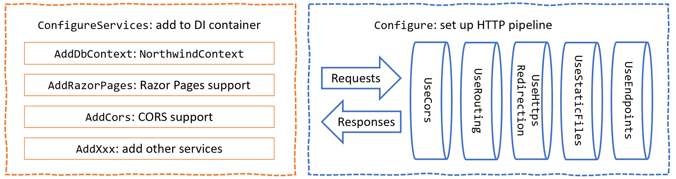
ASP.NET Core
Separating configuration for services and pipeline
here the startup class ConfigureServices and Configure methods diagram
both methods will get called automatically by the runtime
example…
Corso C#

Slide 18
ASP.NET Core Razor Pages
ASP.NET Core Razor Pages
ASP.NET Core Razor Pages allow a developer to easily mix C# code statements with HTML markup to make the generated web page dynamic: that is why they use the .cshtml file extension
by convention, ASP.NET Core looks for Razor Pages in a folder named Pages
then add a statement to add ASP.NET Razor Pages and its related services (model binding, authorization, anti-fogerty, views, tag helpers) to the builder in Startup.cs in the ConfigureServices method
finally, in Startup.cs in the Configure method, in the configuration to use endpoints, add a statement to call the MapRazorPages method
services.AddRazorPages();
app.UseEndpoints(endpoints =>
{
endpoints.MapRazorPages();
endpoints.MapGet("/hello", () => "Hello World!");
});
Corso C#

Slide 19
ASP.NET Core Razor Pages
Adding code to a Razor Page
in the HTML markup of a web page, Razor syntax is indicated by the @ symbol
Razor Pages can be described as follows:
they require the @page directive at the top of the file
they can optionally have an @functions section that defines any of the following:
Properties for storing data values, like in a class definition. An instance of that class is automatically instantiated named Model that can have its properties set in special methods and you can get the property values in the HTML
Methods named OnGet, OnPost, OnDelete, and so on that execute when HTTP requests are made, such as GET, POST, and DELETE
Corso C#

Slide 20
ASP.NET Core Razor Pages
Using shared layouts with Razor Pages
most websites have more than one page…
if every page had to contain all of the boilerplate markup that is currently in index.cshtml, that would become a pain to manage…
ASP.NET Core has a feature named layouts
Corso C#

Slide 21
ASP.NET Core Razor Pages
Using shared layouts with Razor Pages
to use layouts, we must create a Razor file to define the default layout for all Razor Pages (and all MVC views) and store it in a Shared folder so that it can be easily found by convention. The name of this file can be anything, because we will specify it, but _Layout.cshtml is good practice
we must also create a specially named file to set the default layout file for all Razor Pages (and all MVC views): this file must be named _ViewStart.cshtml
@* _ViewStart.cshtml content *@
@{
Layout = "_Layout";
}
Corso C#

Slide 22
ASP.NET Core Razor Pages
Using shared layouts with Razor Pages
ViewData is a dictionary of objects with a string-based key, is a container for data to be passed from the Razor PageModel to the content page
@RenderBody() marks the insertion point for the view being requested
@RenderSection("Scripts", required: false): defines a section named Scripts so that a Razor Page can optionally inject additional scripts that it needs by using, for example, the following code:
@section Scripts {
<script type="text/javascript" src="~/scripts/main.js"></script>
}
Corso C#

Slide 23
ASP.NET Core Razor Pages
Using code-behind files with Razor Pages
sometimes, it is better to separate the HTML markup from the data and executable code, so Razor Pages allows you to do this by putting the C# code in code-behind class files: they have the same name as the .cshtml file but end with .cshtml.cs
@section Scripts {
<script type="text/javascript" src="~/scripts/main.js"></script>
}
Corso C#

Slide 24
ASP.NET Core Razor Pages
Injecting a dependency service into a Razor Page
if you have a .cshtml Razor Page that does not have a code-behind file, then you can inject a dependency service using the @inject directive instead of constructor parameter injection, and then directly reference the injected database context using Razor syntax in the middle of the markup
i.e.
@inject NorthwindContext db
…
<p>
There are @db.Orders.Count() orders in the Northwind database
</p>
Corso C#

Slide 25
Using Razor class libraries
Creating a Razor class library
everything related to a Razor Page can be compiled into a class library for easier reuse in multiple projects
with ASP.NET Core 3.0 and later, this can include static files such as HTML, CSS, JavaScript libraries, and media assets such as image files
a website can either use the Razor Page's view as defined in the class library or override it
just start by using Razor Class Library / razorclasslib Project templates with Support pages and views / -s switches
Corso C#

Slide 26
Using Razor class libraries
Creating a Razor class library
when using a razor library we can create a _Layout.cshtml file with this content:
@{
Layout = "_Layout";
}
and then we do not need to create the _Layout.cshtml file in this project because it will use the one in its host project
Corso C#

Slide 27
Using Razor class libraries
Implementing a Partial View
the <partial> tag helper was introduced in ASP.NET Core 2.1
a partial view is a piece of a Razor file, its code is put in a Razor markup file (.cshtml) without an @page directive that renders HTML output within another markup file's rendered output
Corso C#

Slide 28
Using Razor class libraries
When to use partial views
Partial views are an effective way to:
break up large markup files into smaller components in a large, complex markup file composed of several logical pieces, there's an advantage to working with each piece isolated into a partial view. The code in the markup file is manageable because the markup only contains the overall page structure and references to partial views
Reduce the duplication of common markup content across markup files when the same markup elements are used across markup files, a partial view removes the duplication of markup content into one partial view file. When the markup is changed in the partial view, it updates the rendered output of the markup files that use the partial view.
Corso C#

Slide 29
Using Razor class libraries
When partial views should not be used
Partial Views shouldn't be used:
to maintain common layout elements: common layout elements should be specified in _Layout.cshtml files
where complex rendering logic or code execution is required to render the markup tnstead of a partial view, use a view component
Corso C#

Slide 30
Configuring services and the HTTP request pipeline
Endpoint routing
in earlier versions of ASP.NET Core, the routing system and the extendable middleware system did not always work easily together; for example, if you wanted to implement a policy such as CORS in both middleware and MVC
Microsoft has invested in improving routing with a system named endpoint routing introduced with ASP.NET Core 2.2
endpoint routing replaces the IRouter-based routing used in ASP.NET Core 2.1 and earlier: Microsoft recommends every older ASP.NET Core project migrates to endpoint routing if possible
endpoint routing is designed to enable better interoperability between frameworks that need routing, such as Razor Pages, MVC, or Web APIs, and middleware that needs to understand how routing affects them, such as localization, authorization, CORS, and so on
Corso C#

Slide 31
Configuring services and the HTTP request pipeline
Endpoint routing
endpoint routing gets its name because it represents the route table as a compiled tree of endpoints that can be walked efficiently by the routing system one of the biggest improvements is the performance of routing and action method selection
it is on by default with ASP.NET Core 2.2 or later if compatibility is set to 2.2 or later
traditional routes registered using the MapRoute method or with attributes are mapped to the new system
the new routing system includes a link generation service registered as a dependency service that does not need an HttpContext
Corso C#

Slide 32
Configuring services and the HTTP request pipeline
Configuring endpoint routing
endpoint routing requires a pair of calls to the UseRouting and UseEndpoints methods:
UseRouting marks the pipeline position where a routing decision is made
UseEndpoints marks the pipeline position where the selected endpoint is executed
middleware such as localization that runs in between these methods can see the selected endpoint and can switch to a different endpoint if necessary
Corso C#

Slide 33
Configuring services and the HTTP request pipeline
Configuring endpoint routing
endpoint routing uses the same route template syntax that has been used in ASP.NET MVC since 2010 and the [Route] attribute introduced with ASP.NET MVC 5 in 2013
migration often only requires changes to the Startup configuration
MVC controllers, Razor Pages, and frameworks such as SignalR used to be enabled by a call to UseMvc or similar methods, but they are now added inside the UseEndpoints method call because they are all integrated into the same routing system along with middleware
Corso C#

Slide 34
Configuring services and the HTTP request pipeline
Review Startup.cs
the Startup.cs class file is made of Startup public class
the Startup class has two methods that are called automatically by the host to configure the website
public class Startup
{
public void ConfigureServices(IServiceCollection services)
{ ... }
public void Configure(IApplicationBuilder app, IWebHostEnvironment env)
{ ... }
}
the ConfigureServices method registers services that can then be retrieved when the functionality they provide is needed using dependency injection
the Configure method configures the HTTP request pipeline, which is made up of a connected sequence of delegates that can perform processing and then decide to either return a response themselves or pass processing on to the next delegate in the pipeline. Responses that come back can also be manipulated
Corso C#

Slide 35
Configuring services and the HTTP request pipeline
Registering services in the ConfigureServices method
common methods that register dependency services, including services that combine other method calls that register services, are shown in the following table:
Method | Services that it registers
AddMvcCore | minimum set of services necessary to route requests and invoke controllers most websites will need more configuration than this
AddAuthorization | authentication and authorization services
AddDataAnnotations | MVC data annotations service
AddCacheTagHelper | MVC cache tag helper service
AddRazorPages | Razor Pages service including the Razor view engine. Commonly used in simple website projects. It calls the following additional methods: AddMvcCore AddAuthorization AddDataAnnotations AddCacheTagHelper
AddApiExplorer | Web API explorer service
AddCors | CORS support for enhanced security
Corso C#

Slide 36
Configuring services and the HTTP request pipeline
Registering services in the ConfigureServices method
Method | Services that it registers
AddFormatterMappings | Mappings between a URL format and its corresponding media type
AddControllers | Controller services but not services for views or pages. Commonly used in ASP.NET Core Web API projects. It calls the following additional methods: AddMvcCore AddAuthorization AddDataAnnotations AddCacheTagHelper AddApiExplorer AddCors AddFormatterMappings
AddViews | Support for .cshtml views including default conventions
AddRazorViewEngine | Support for Razor view engine including processing the @ symbol
AddDbContext<T> | Your DbContext type and its optional DbContextOptions<TContext>
Corso C#

Slide 37
Configuring services and the HTTP request pipeline
Registering services in the ConfigureServices method
Method | Services that it registers
AddControllersWithViews | Controller, views, and pages services. Commonly used in ASP.NET Core MVC website projects. It calls the following additional methods: AddMvcCore AddAuthorization AddDataAnnotations AddCacheTagHelper AddApiExplorer AddCors AddFormatterMappings AddViews AddRazorViewEngine
AddMvc | Similar to AddControllersWithViews, but you should only use it for backward compatibility
AddNorthwindContext | a custom extension method we created to make it easier to register the NorthwindContext class for SQL Server
Corso C#

Slide 38
Configuring services and the HTTP request pipeline
Setting up the HTTP request pipeline in the Configure method
delegates define a method signature that a delegate implementation can plug into the delegate for the HTTP request pipeline is simple, as shown in the following code:
public delegate Task RequestDelegate(HttpContext context);
the input parameter is an HttpContext: this provides access to everything you might need to process the incoming HTTP request, including the URL path, query string parameters, cookies, and user agent
these delegates are often called middleware because they sit in between the browser client and the website or service
Corso C#

Slide 39
Configuring services and the HTTP request pipeline
Setting up the HTTP request pipeline in the Configure method
middleware delegates are configured using one of the following methods or a custom method that calls them itself:
Run: adds a middleware delegate that terminates the pipeline by immediately returning a response instead of calling the next middleware delegate
Map: adds a middleware delegate that creates a branch in the pipeline when there is a matching request usually based on a URL path like /hello
Use: adds a middleware delegate that forms part of the pipeline so it can decide if it wants to pass the request to the next delegate in the pipeline and it can modify the request and response before and after the next delegate
Corso C#

Slide 40
Configuring services and the HTTP request pipeline
Setting up the HTTP request pipeline in the Configure method
for convenience, there are many extension methods that make it easier to build the pipeline, for example, UseMiddleware<T>, where T is a class that has:
a constructor with a RequestDelegate parameter that will be passed the next pipeline component
an Invoke method with a HttpContext parameter and returns a Task
Corso C#

Slide 41
Configuring services and the HTTP request pipeline
Summarizing key middleware extension methods
Key middleware extension methods used in our code include the following:
UseDeveloperExceptionPage: captures synchronous and asynchronous System.Exception instances from the pipeline and generates HTML error responses.
UseHsts: adds middleware for using HSTS, which adds the Strict-Transport-Security header.
UseRouting: adds middleware that defines a point in the pipeline where routing decisions are made and must be combined with a call to UseEndpoints where the processing is then executed
this means that for our code, any URL paths that match / or /index or /suppliers will be mapped to Razor Pages and a match on /hello will be mapped to the anonymous delegate
any other URL paths will be passed on to the next delegate for matching, for example, static files
this is why, although it looks like the mapping for Razor Pages and /hello happen after static files in the pipeline, they actually take priority because the call to UseRouting happens before UseStaticFiles
Corso C#

Slide 42
Configuring services and the HTTP request pipeline
Summarizing key middleware extension methods
UseHttpsRedirection: Adds middleware for redirecting HTTP requests to HTTPS, so in our code a request for http://localhost:5000 would be modified to https://localhost:5001
UseDefaultFiles: Adds middleware that enables default file mapping on the current path, so in our code it would identify files such as index.html
UseStaticFiles: Adds middleware that looks in wwwroot for static files to return in the HTTP response
UseEndpoints: Adds middleware to execute to generate responses from decisions made earlier in the pipeline. Two endpoints are added, as shown in the following sub-list:
MapRazorPages: Adds middleware that will map URL paths such as /suppliers to a Razor Page file in the /Pages folder named suppliers.cshtml and return the results as the HTTP response
MapGet: Adds middleware that will map URL paths such as /hello to an inline delegate that writes plain text directly to the HTTP response
Corso C#

Slide 43
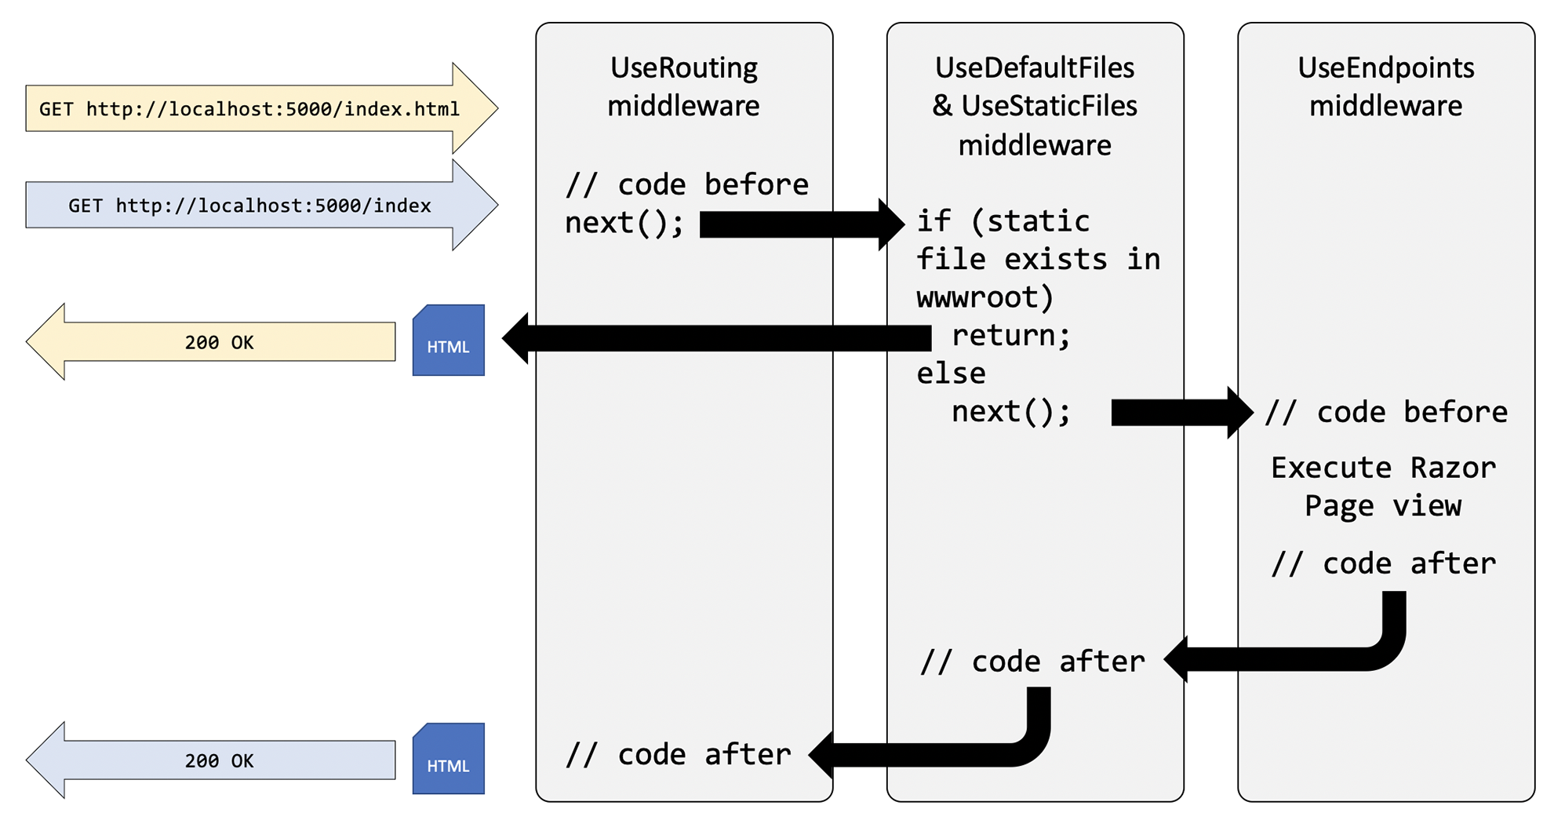
Configuring services and the HTTP request pipeline
Visualizing the HTTP pipeline
the HTTP request and response pipeline can be visualized as a sequence of request delegates, called one after the other, as shown in the following simplified diagram, which excludes some middleware delegates, such as UseHsts
the UseRouting and UseEndpoints methods must be used together
although the code to define the mapped routes such as /hello are written in UseEndpoints, the decision about whether an incoming HTTP request URL path matches and therefore which endpoint to execute is made at the UseRouting point in the pipeline
Corso C#

Slide 44
Questions
List six method names that can be specific in an HTTP request.
List six status codes and their descriptions that can be returned in an HTTP response.
In ASP.NET Core, what is the Startup class used for?
What does the acronym HSTS stand for and what does it do?
How do you enable static HTML pages for a website?
How do you mix C# code into the middle of HTML to create a dynamic page?
How can you define shared layouts for Razor Pages?
How can you separate the markup from the code-behind in a Razor Page?
How do you configure an Entity Framework Core data context for use with an ASP.NET Core website?
How can you reuse Razor Pages with ASP.NET Core 2.2 or later?
Corso C#

Slide 45
Summary
foundations of web development using HTTP
how to build a simple website that returns static files
use ASP.NET Core Razor Pages with Entity Framework Core to create web pages that were dynamically generated from information in a database
HTTP request and response pipeline
what the helper extension methods do, and how you can add your own middleware that affects processing
Corso C#

