Slide 1
Corso C#

Slide 2
Content of this first part:
the grammar and vocabulary of the C# language;
the types available in .NET for building app features;
examples of common cross-platform apps you can build using C# and .NET.
Corso C#

Slide 3
Setting up your development environment
Before you start programming, you'll need a code editor for C#.
Microsoft has a family of code editors and Integrated Development Environments (IDEs), which include:
Visual Studio 2022 for Windows
Visual Studio 2022 for Mac
Visual Studio Code for Windows, Mac, or Linux
GitHub Codespaces
Third parties have created their own C# code editors, for example, JetBrains Rider.
Corso C#

Slide 4
Pros of the .NET Interactive Notebooks extension
easy and safe place to write simple code snippets;
enables you to create a single notebook file that mixes "cells" of Markdown (richly formatted text) and code using C# and other related languages, such as PowerShell, F#, and SQL (for databases).
Cons of the .NET Interactive Notebooks extension
cannot read input from the user, for example, you cannot use ReadLine or ReadKey
cannot have arguments passed to them
do not allow you to define your own namespaces
do not have any debugging tools (but these are coming in the future)
Corso C#

Slide 5
Visual Studio Code
cross-platform development
can run on all common operating systems, including Windows, macOS, and many varieties of Linux, including Red Hat Enterprise Linux (RHEL) and Ubuntu
it has an extensive and growing set of extensions to support many languages beyond C#
can be installed on all platforms that your apps will be deployed to for quick bug fixes and so on
Visual Studio Code has strong support for web development although it currently has weak support for mobile and desktop development
Visual Studio Code is supported on ARM processors so that you can develop on Apple Silicon computers and Raspberry Pi
Visual Studio Code is by far the most popular integrated development environment, with over 70% of professional developers selecting it in the Stack Overflow 2021 survey.
Corso C#

Slide 6
GitHub Codespaces
GitHub Codespaces is a fully configured development environment based on Visual Studio Code
environment hosted in the cloud and accessed through any web browser
supports Git repos, extensions, and a built-in command-line interface so you can edit, run, and test from any device.
Corso C#

Slide 7
Visual Studio for Mac 2022
can create most types of applications, including:
console apps
Websites
web services
Desktop
mobile apps
NOTE: to compile apps for Apple operating systems like iOS to run on devices like the iPhone and iPad you must have Xcode, which only runs on macOS.
Corso C#

Slide 8
Visual Studio for Windows
can create most types of applications, including:
console apps
Websites
web services
Desktop
mobile apps
with its Xamarin extensions to write a cross-platform mobile app (still need macOS and Xcode to compile it)
it only runs on Windows, version 7 SP1 or later
runs it on Windows 10 or Windows 11 to create Universal Windows Platform (UWP) apps that are installed from the Microsoft Store and run in a sandbox to protect your computer.
Corso C#

Slide 9
.NET 6
supports the following platforms for deployment:
Windows: Windows 7 SP1, or later. Windows 10 version 1607, or later, including Windows 11
Windows Server 2012 R2 SP1, or later. Nano Server version 1809, or later.
macOS Mojave (version 10.14), or later
Linux Alpine Linux 3.13, or later. CentOS 7, or later. Debian 10, or later. Fedora 32, or later. openSUSE 15, or later. Red Hat Enterprise Linux (RHEL) 7, or later. SUSE Enterprise Linux 12 SP2, or later. Ubuntu 16.04, 18.04, 20.04, or later.
Android API 21, or later.
iOS: 10, or later.
Windows ARM64 support in .NET 5 and later means you can develop on, and deploy to, Windows ARM devices like Microsoft Surface Pro X.
developing on an Apple M1 Mac using Parallels and a Windows 10 ARM virtual machine is twice as fast!
Corso C#

Slide 10
Shortcuts docs
Visual Studio 2022:
https://docs.microsoft.com/en-us/visualstudio/ide/identifying-and-customizing-keyboard-shortcuts-in-visual-studio?view=vs-2022
Visual Studio Code:
https://code.visualstudio.com/docs/getstarted/keybindings
PDF of keyboard shortcuts for your operating system from the following list:
Windows: https://code.visualstudio.com/shortcuts/keyboard-shortcuts-windows.pdf
macOS: https://code.visualstudio.com/shortcuts/keyboard-shortcuts-macos.pdf
Linux: https://code.visualstudio.com/shortcuts/keyboard-shortcuts-linux.pdf
Corso C#

Slide 11
.NET / .NET Core / .NET Framework
.NET Framework
.NET Framework is a development platform that includes
a Common Language Runtime (CLR), which manages the execution of code
a Base Class Library (BCL), which provides a rich library of classes to build applications from
Microsoft originally designed .NET Framework to have the possibility of being cross-platform, but…
since .NET Framework 4.5.2, it has been an official component of the Windows operating system
components have the same support as their parent products, (follow the life cycle policy of the Windows OS on which it is installed)
.NET Framework is installed on over one billion computers, so it must change as little as possible.
Even bug fixes can cause problems!!! So it is updated infrequently.
For .NET Framework 4.0 or later, all of the apps on a computer written for .NET Framework share the same version of the CLR and libraries
stored in the Global Assembly Cache (GAC), which can lead to issues if some of them need a specific version for compatibility.
Practically speaking…
NET Framework is Windows-only and a legacy platform. Do not create new apps using it.
Corso C#

Slide 12
.NET / .NET Core / .NET Framework
Mono, Xamarin, and Unity projects
Third parties developed a .NET Framework implementation named the Mono project.
Mono is cross-platform, but it fell well behind the official implementation of .NET Framework.
Mono has found a niche as the foundation of the Xamarin mobile platform as well as cross-platform game development platforms like Unity
Microsoft purchased Xamarin in 2016 and now gives away what used to be an expensive Xamarin extension for free with Visual Studio
Microsoft renamed the Xamarin Studio development tool, which could only create mobile apps, to Visual Studio for Mac and gave it the ability to create other types of projects like console apps and web services
With Visual Studio 2022 for Mac, Microsoft has replaced parts of the Xamarin Studio editor with parts from Visual Studio 2022 for Windows to provide closer parity of experience and performance
Visual Studio 2022 for Mac was also rewritten to be a truly native macOS UI app to improve reliability and work with macOS's built-in assistive technologies.
Corso C#

Slide 13
.NET / .NET Core / .NET Framework
.NET Core
cross-platform world (modern mobile and cloud development) have made Windows, as an operating system, much less important
Microsoft have taken the opportunity to refactor and remove major parts that are no longer considered core.
this new product was branded .NET Core and includes:
a cross-platform implementation of the CLR known as CoreCLR
a streamlined BCL (Base Class Library) known as CoreFX
.NET Core is fast-moving, and because it can be deployed side by side with an app, it can change frequently, knowing those changes will not affect other .NET Core apps on the same machine
Most improvements that Microsoft makes to .NET Core and modern .NET cannot be easily added to .NET Framework.
.NET Core has been renamed .NET and the major version number has skipped the number four to avoid confusion with .NET Framework 4.x
Microsoft plans on annual major version releases every November
Corso C#

Slide 14
.NET / .NET Core / .NET Framework
.NET Core journey
Version | Released | Edition | Published
.NET Core RC1 | November 2015 | First | March 2016
.NET Core 1.0 | June 2016
.NET Core 1.1 | November 2016
.NET Core 1.0.4 and .NET Core 1.1.1 | March 2017 | Second | March 2017
.NET Core 2.0 | August 2017
.NET Core for UWP in Windows 10 Fall Creators Update | October 2017 | Third | November 2017
.NET Core 2.1 (LTS) | May 2018
.NET Core 2.2 (Current) | December 2018
.NET Core 3.0 (Current) | September 2019 | Fourth | October 2019
.NET Core 3.1 (LTS) | December 2019
Blazor WebAssembly 3.2 (Current) | May 2020
.NET 5.0 (Current) | November 2020 | Fifth | November 2020
.NET 6.0 (LTS) | November 2021 | Sixth | November 2021
.NET 7.0 (Current) | November 2022 | Seventh | November 2022
.NET 8.0 (LTS) | November 2023 | Eighth | November 2023
Corso C#

Slide 15
.NET / .NET Core / .NET Framework
.NET Support
.NET versions are either Long Term Support (LTS) or Current
LTS releases:
are stable and require fewer updates over their lifetime
good choice for applications that you do not intend to update frequently
LTS releases will be supported for 3 years after general availability, or 1 year after the next LTS release ships, whichever is longer
Current releases:
include features that may change based on feedback
good choice for applications that you are actively developing because they provide access to the latest improvements
After a 6-month maintenance period, or 18 months after general availability, the previous minor version will no longer be supported.
Corso C#

Slide 16
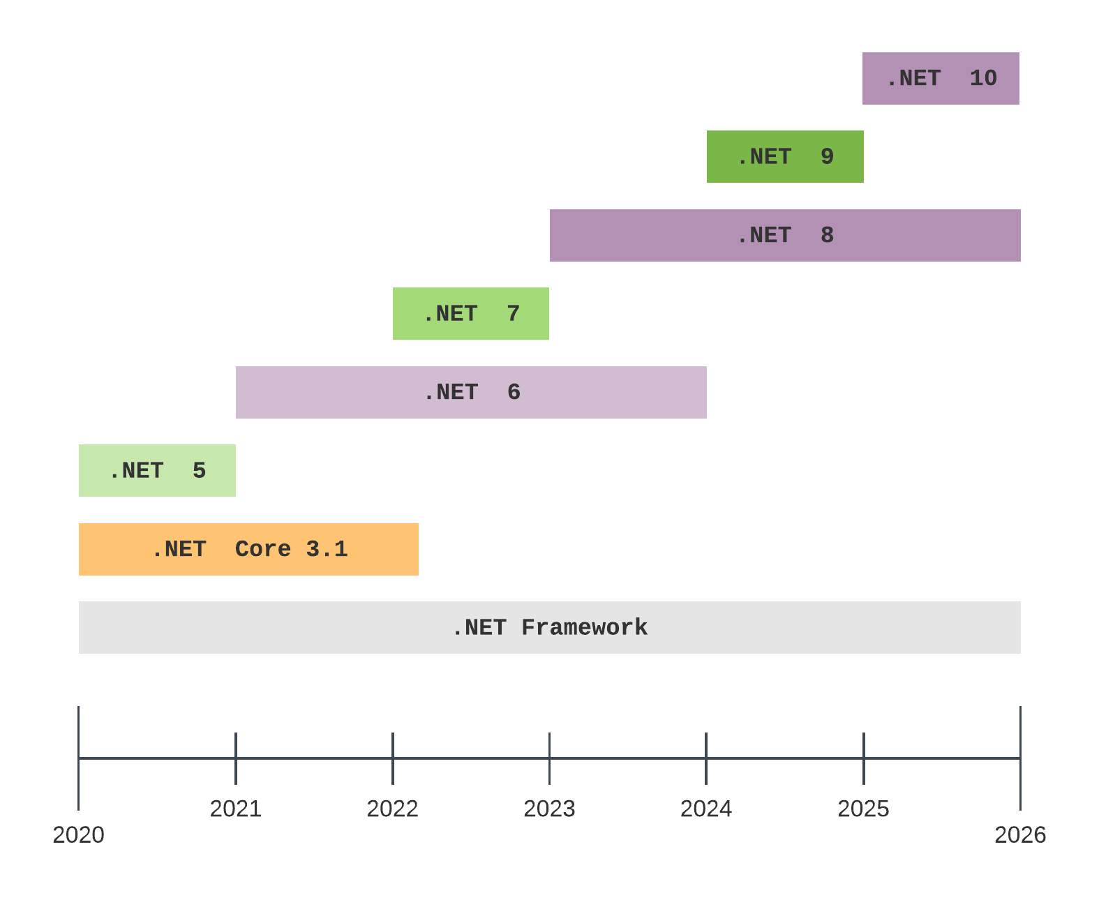
.NET / .NET Core / .NET Framework
.NET Support
Corso C#

Slide 17
.NET / .NET Core / .NET Framework
.NET Runtime and .NET SDK Versions
.NET Runtime follows SEMANTIC versioning:
a major increment indicates breaking changes
minor increments indicate new features
and patch increments indicate bug fixes.
.NET SDK versioning does not follow semantic versioning:
major and minor version numbers are tied to the runtime version it is matched with
patch number follows a convention that indicates the major and minor versions of the SDK
Change | Runtime | SDK
Initial release | 6.0.0 | 6.0.100
SDK bug fix | 6.0.0 | 6.0.101
Runtime and SDK bug fix | 6.0.1 | 6.0.102
SDK new feature | 6.0.1 | 6.0.200
Corso C#

Slide 18
.NET / .NET Core / .NET Framework
Differences
 | .NET | .NET Framework
Generic | modularized | Monolithic
 | open source | closed source
 | smaller without legacy non-cross-platform technologies
Windows development | support for running old Windows Forms and WPF applications using the Windows Desktop Pack that is included with the Windows version of .NET Core 3.1 or later, which is why it is bigger than the SDKs for macOS and Linux.
Web development | ASP.NET Web Forms and Windows Communication Foundation (WCF) have been removed
 | ASP.NET MVC, ASP.NET Web API, SignalR, and gRP have been refactored and combined into a platform that runs on modern .NET, named ASP.NET Core
Database development | the cross-platform API has been slimmed down, has been given support for non-relational databases
Corso C#

Slide 19
.NET / .NET Core / .NET Framework
.NET Standard
The situation with .NET in 2019 was that there were three forked .NET platforms controlled by Microsoft, as shown in the following list:
.NET Core: For cross-platform and new apps
.NET Framework: For legacy apps
Xamarin: For mobile apps
With .NET Standard 2.0 and later, Microsoft made all three platforms converge on a modern minimum standard, which made it much easier for developers to share code between any flavor of .NET.
.NET Standard is just a standard. You are not able to install .NET Standard in the same way that you cannot install HTML5. To use HTML5, you must install a web browser that implements the HTML5 standard.
To use .NET Standard, you must install a .NET platform that implements the .NET Standard specification.
The last .NET Standard, version 2.1, is implemented by .NET Core 3.0, Mono, and Xamarin
Some features of C# 8.0 require .NET Standard 2.1.
.NET Standard 2.1 is not implemented by .NET Framework 4.8…
With the release of .NET 6 in November 2021, the need for .NET Standard has reduced significantly because there is now a single .NET for all platforms, including mobile. .NET 6 has a single BCL and two CLRs: CoreCLR is optimized for server or desktop scenarios like websites and Windows desktop apps, and the Mono runtime is optimized for mobile and web browser apps that have limited resources.
Corso C#

Slide 20
.NET / .NET Core / .NET Framework
Intermediate language
The C# compiler (named Roslyn) used by the dotnet CLI tool converts your C# source code into intermediate language (IL) code and stores the IL in an assembly (a DLL or EXE file)
IL code statements are like assembly language instructions, which are executed by .NET's virtual machine, known as CoreCLR.
At runtime, CoreCLR loads the IL code from the assembly, the just-in-time (JIT) compiler compiles it into native CPU instructions, and then it is executed by the CPU on your machine.
The benefit of this two-step compilation process is that Microsoft can create CLRs for Linux and macOS, as well as for Windows.
The same IL code runs everywhere because of the second compilation step, which generates code for the native operating system and CPU instruction set.
Regardless of which language the source code is written in, for example, C#, Visual Basic, or F#, all .NET applications use IL code for their instructions stored in an assembly.
Corso C#

Slide 21
.NET / .NET Core / .NET Framework
Quick comparison
Technology | Description | Host operating systems
Modern .NET | A modern feature set, full C# 8, 9, and 10 support, used to port existing apps or create new desktop, mobile, and web apps and services | Windows, macOS, Linux, Android, iOS
.NET Framework | A legacy feature set, limited C# 8 support, no C# 9 or 10 support, used to maintain existing applications only | Windows only
Xamarin | Mobile and desktop apps only | Android, iOS, macOS
Corso C#

