Slide 1
C# Language
Writing, Debugging, and Testing Functions
Writing functions
Debugging during development
Logging during runtime
Unit testing
Throwing and catching exceptions in functions
Corso C#

Slide 2
Writing functions
A fundamental principle of programming is Don't Repeat Yourself (DRY)
Why?
When you write code that performs the same tasks over and over again, any modification of one task requires the same change to be made to every single instance of that task!
How to Achieve?
To achieve, divide your system into pieces. Don’t write lengthy methods, divide logic into smaller reusable pieces as much as possible and try to use the existing piece in your method.
Good example for DRY principle
Enterprise libraries, helper class, every piece of code is unique in the libraries and helper classes.
Corso C#

Slide 3
Writing functions
Documenting functions with XML comments
/// <summary>
/// Pass a 32-bit integer and it will be converted into its ordinal equivalent.
/// </summary>
/// <param name="number">Number is a cardinal value e.g. 1, 2, 3, and so on.</param>
/// <returns>Number as an ordinal value e.g. 1st, 2nd, 3rd, and so on.</returns>
Corso C#

Slide 4
Writing functions
Using lambdas in function implementations
F# is Microsoft's strongly typed functional-first programming language that, like C#, compiles to IL to be executed by .NET
Functional languages evolved from lambda calculus; a computational system based only on functions
The code looks more like mathematical functions than steps in a recipe.
Corso C#

Slide 5
Writing functions
Using lambdas in function implementations
Some of the important attributes of functional languages are defined in the following list:
Modularity: The same benefit of defining functions in C# applies to functional languages. Break up a large complex code base into smaller pieces
Immutability: Variables in the C# sense do not exist, any data value inside a function cannot change; instead, a new data value can be created from an existing one: this reduces bugs
Maintainability: Code is cleaner and clearer (for mathematically inclined programmers!)
Corso C#

Slide 6
Writing functions
Using lambdas in function implementations
In C# 6, Microsoft added support for expression-bodied function members
Let’s have a look to the Fibonacci sequence example!
Corso C#

Slide 7
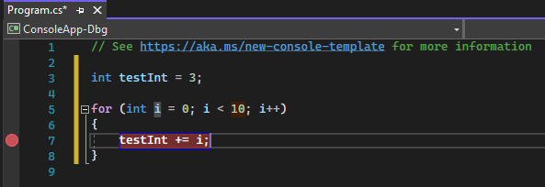
Debugging during development
Setting breakpoints
Debugging: the process of identifying and removing errors from computer hardware or software
Breakpoints allow us to mark a line of code that we want to pause at to inspect the program state and find bugs.
To set a breakpoint in source code, click in the far left margin next to a line of code. You can also select the line and press F9, select Debug > Toggle Breakpoint, or right-click and select Breakpoint > Insert breakpoint. The breakpoint appears as a red dot in the left margin.
Corso C#

Slide 8
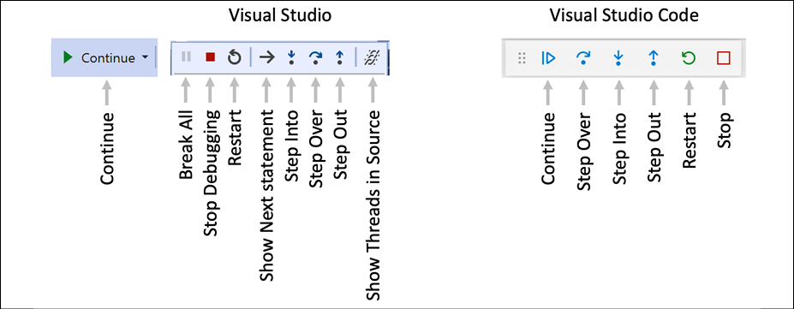
Debugging during development
Navigating with the debugging toolbar
Visual Studio 2022 has one button in its Standard toolbar to start or continue debugging and a separate Debugging toolbar for the rest of the tools. Visual Studio Code shows a floating toolbar with buttons to make it easy to access debugging features.
Continue/F5: This button will continue running the program from the current position until it ends or hits another breakpoint.
Step Over/F10, Step Into/F11, and Step Out/Shift + F11 (blue arrows over dots): These buttons step through the code statements in various ways, as you will see in a moment.
Restart/Ctrl or Cmd + Shift + F5 (circular arrow): This button will stop and then immediately restart the program with the debugger attached again.
Stop/Shift + F5 (red square): This button will stop the debugging session.
Corso C#

Slide 9
Debugging during development
Debugging windows
While debugging, both Visual Studio Code and Visual Studio show extra windows that allow you to monitor useful information, such as variables, while you step through your code. The most useful windows are described in the following list:
VARIABLES, including Locals, which shows the name, value, and type for any local variables automatically. Keep an eye on this window while you step through your code.
WATCH, or Watch 1, which shows the value of variables and expressions that you manually enter.
CALL STACK, which shows the stack of function calls.
BREAKPOINTS, which shows all your breakpoints and allows finer control over them.
Corso C#

Slide 10
Debugging during development
Logging during development and runtime
Once you believe that all the bugs have been removed from your code, you would then compile a release version and deploy the application, so that people can use it.
But no code is ever bug free, and during runtime unexpected errors can occur.
End users are notoriously bad at remembering, admitting to, and then accurately describing what they were doing when an error occurred, so you should not rely on them accurately providing useful information to reproduce the problem to understand what caused the problem and then fix it.
Instead, you can instrument your code, which means logging events of interest.
Corso C#

Slide 11
Debugging during development
Understanding logging options
.NET includes some built-in ways to instrument your code by adding logging capabilities
Third parties created great libraries for logging:
Apache log4net
NLog
Serilog
Corso C#

Slide 12
Debugging during development
Understanding logging options
The Debug class is used to add logging that gets written only during development
The Trace class is used to add logging that gets written during both development and runtime
Console.Writeline
Console
Debug.Writeline
Console, EventLog, File, Debug, etc.
Trace.Writeline
Console, EventLog, File, Debug, etc.
TraceListener
Corso C#

Slide 13
Debugging during development
Switching trace levels
Number | Word | Description
0 | Off | This will output nothing.
1 | Error | This will output only errors.
2 | Warning | This will output errors and warnings.
3 | Info | This will output errors, warnings, and information.
4 | Verbose | This will output all levels.
Corso C#

Slide 14
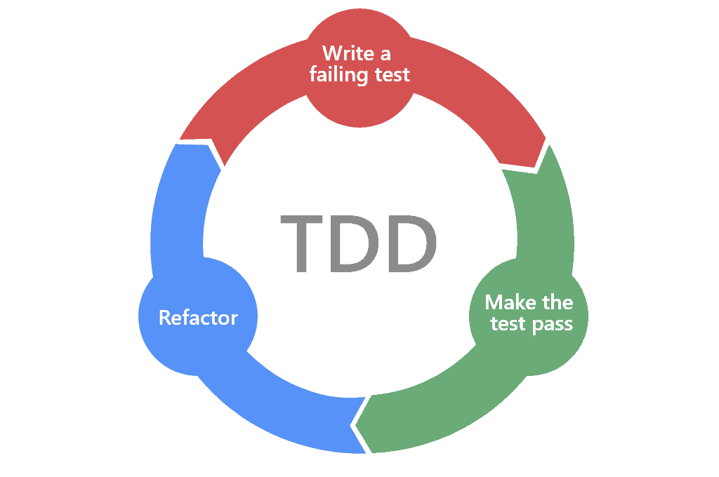
Unit Testing
Intro
Fixing bugs in code is expensive
The earlier that a bug is discovered in the development process, the less expensive it will be to fix
Unit testing is a GOOD way to find bugs early in the development process
Some developers follow the principle that programmers should create unit tests before they write code, and this is called Test-Driven Development (TDD)
Corso C#

Slide 15
Unit Testing
Frameworks
MS Test Microsoft proprietary framework
Nunit Good alternative
xUnit.net Best alternative
Corso C#

Slide 16
Unit Testing
Types of testing
Type of testing | Description
Unit | Tests the smallest unit of code, typically a method or function Unit testing is performed on a unit of code isolated from its dependencies by mocking them if needed Each unit should have multiple tests: some with typical inputs and expected outputs, some with extreme input values to test boundaries, and some with deliberately wrong inputs to test exception handling
Integration | Tests if the smaller units and larger components work together as a single piece of software Sometimes involves integrating with external components that you do not have source code for
Corso C#

Slide 17
Unit Testing
Types of testing
Type of testing | Description
System | Tests the whole system environment in which your software will run.
Performance | Tests the performance of your software; for example, your code must return a web page full of data to a visitor in under 20 milliseconds
Load | Tests how many requests your software can handle simultaneously while maintaining required performance, for example, 10,000 concurrent visitors to a website
User acceptance | Tests if users can happily complete their work using your software
Corso C#

Slide 18
Unit Testing
Writing unit tests
A well written Unit Test will have three parts:
Arrange: This part will declare and instantiate variables for input and output
Act: This part will execute the unit that you are testing. I.e. calling the method that we want to test
Assert: This part will make one or more assertions about the output. An assertion is a belief that, if not true, indicates a failed test. For example, when adding 2 and 2, we would expect the result to be 4.
Corso C#

Slide 19
Unit Testing
Writing unit tests
A well written Unit Test will have three parts:
Arrange: This part will declare and instantiate variables for input and output
Act: This part will execute the unit that you are testing. I.e. calling the method that we want to test
Assert: This part will make one or more assertions about the output. An assertion is a belief that, if not true, indicates a failed test. For example, when adding 2 and 2, we would expect the result to be 4.
Corso C#

Slide 20
Throwing and catching exceptions in functions
try… catch… finally
The try-catch statement consists of a try block followed by one or more catch clauses, which specify handlers for different exceptions
A common usage of catch and finally together is to obtain and use resources in a try block, deal with exceptional circumstances in a catch block, and release the resources in the finally block.
try {
…
}
catch (…)
{
…
}
catch (…)
{
…
}
finally
{
…
}
Corso C#

Slide 21
Throwing and catching exceptions in functions
try… catch… finally
The try block contains the guarded code that may cause the exception. The block is executed until an exception is thrown or it is completed successfully.
When an exception is thrown, the common language runtime (CLR) looks for the catch statement that handles this exception:
if the currently executing method does not contain such a catch block, the CLR looks at the method that called the current method, and so on up the call stack
if no catch block is found, then the CLR displays an unhandled exception message to the user and stops execution of the program
Corso C#

Slide 22
Throwing and catching exceptions in functions
try… catch… finally
You should only catch and handle an exception if you have enough information to mitigate the issue
If you do not, then you should allow the exception to pass up through the call stack to a higher level
Corso C#

Slide 23
Throwing and catching exceptions in functions
Understanding usage errors and execution errors
Usage errors are when a programmer misuses a function, typically bypassing invalid values as parameters
They could be avoided by that programmer changing their code to pass valid values
Usage errors should all be fixed before production runtime
Corso C#

Slide 24
Throwing and catching exceptions in functions
Understanding usage errors and execution errors
Execution errors are when something happens at runtime that cannot be fixed by writing "better" code; execution errors can be split into
program errors - can be programmatically fixed by writing smart code; if you attempt to open a file that does not exist, you might be able to catch that error and handle it programmatically by creating a new file..
system errors – i.e. you attempt to access a network resource but the network is down then you need to be able to handle that system error by logging an exception, and possibly backing off for a time and trying again; some system errors, such as running out of memory, simply cannot be handled; System errors often cannot be fixed programmatically.
Corso C#

Slide 25
Throwing and catching exceptions in functions
Commonly thrown exceptions in functions
Very rarely should you define new types of exceptions to indicate usage errors. .NET already defines many that you should use
When defining your own functions with parameters, your code should check the parameter values and throw exceptions if they have values that will prevent your function from properly functioning
For example, if a parameter should not be null, throw ArgumentNullException
For other problems, throw ArgumentException, NotSupportedException, or InvalidOperationException
For any exception, include a message that describes the problem for whoever will have to read it (typically a developer audience for class libraries and functions, or end users if it is at the highest level of a GUI app)
Corso C#

Slide 26
Throwing and catching exceptions in functions
Commonly thrown exceptions in functions
static void Withdraw(string accountName, decimal amount)
{
if (accountName is null)
{
throw new ArgumentNullException(paramName: nameof(accountName));
}
if (amount < 0)
{
throw new ArgumentException(
message: $"{nameof(amount)} cannot be less than zero.");
}
// process parameters
}
if a function cannot successfully perform its operation, you should consider that a function failure and report it by throwing an exception
Corso C#

Slide 27
Throwing and catching exceptions in functions
Commonly thrown exceptions in functions
never write a try-catch statement to catch these usage type errors (check for null, check for amount): you want the application to terminate!
these exceptions should cause the programmer who is calling the function to fix their code to prevent the problem - they should be fixed before production deployment
that does not mean that your code does not need to throw usage error type exceptions. You should—to force other programmers to call your functions correctly!
Corso C#

Slide 28
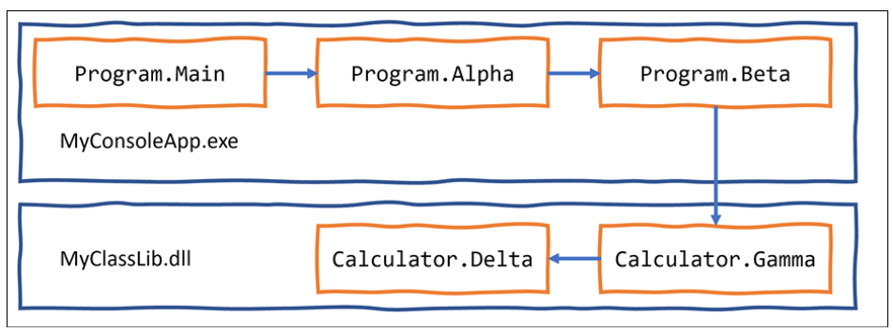
Throwing and catching exceptions in functions
Understanding the call stack
The entry point for a .NET console application is the Main method of the Program class.
The Main method will call other methods, that call other methods, and so on, and these methods could be in the current project or in referenced projects and NuGet packages
A chain of method calls that create a call stack
Corso C#

Slide 29
Throwing and catching exceptions in functions
Understanding the call stack
The entry point for a .NET console application is the Main method of the Program class.
The Main method will call other methods, that call other methods, and so on, and these methods could be in the current project or in referenced projects and NuGet packages
Corso C#

Slide 30
Throwing and catching exceptions in functions
Where to catch exceptions
near the failure point
centralized higher up the call stack: this allows your code to be simplified and standardized.
You might know that calling an exception could throw one or more types of exception, but you do not need to handle any of them at the current point in the call stack.
Sometimes you want to catch an exception, log it, and then rethrow it.
Corso C#

Slide 31
Throwing and catching exceptions in functions
Rethrowing exceptions
To throw the caught exception with its original call stack, call throw.
To throw the caught exception as if it was thrown at the current level in the call stack, call throw with the caught exception, for example, throw ex. This is usually poor practice because you have lost some potentially useful information for debugging.
To wrap the caught exception in another exception that can include more information in a message that might help the caller understand the problem, throw a new exception and pass the caught exception as the innerException parameter.
Corso C#

Slide 32
Throwing and catching exceptions in functions
Implementing the tester-doer pattern
The tester-doer pattern can avoid some thrown exceptions (but not eliminate them completely)
This pattern uses pairs of functions: one to perform a test, the other to perform an action that would fail if the test is not passed.
.NET implements this pattern itself. For example, before adding an item to a collection by calling the Add method, you can test to see if it is read-only, which would cause Add to fail and therefore throw an exception.
Corso C#

Slide 33
Throwing and catching exceptions in functions
Problems with the tester-doer pattern
The tester-doer pattern can add performance overhead, so you can also implement the try pattern, which in effect combines the test and do parts into a single function, as we saw with TryParse.
Another problem with the tester-doer pattern occurs when you are using multiple threads. In this scenario, one thread could call the test function and it returns okay. But then another thread executes that changes the state. Then the original thread continues executing assuming everything is fine, but it is not fine. This is called a race condition.
If you implement your own try pattern function and it fails, remember to set the out parameter to the default value of its type and then return false
Corso C#

Slide 34
Questions
What does the C# keyword void mean?
What are some differences between imperative and functional programming styles?
Where does the Trace.WriteLine method write its output to?
What are the five trace levels?
What is the difference between the Debug and Trace classes?
When writing a unit test, what are the three "A"s?
When writing a unit test using xUnit, what attribute must you decorate the test methods with?
What dotnet command executes xUnit tests?
What statement should you use to rethrow a caught exception named ex without losing the stack trace?
Corso C#

