Slide 1
Collaborating
Pull Requests
Workflows
Corso C#

Slide 2
Pull request
Contributor side
pull requests are a mechanism for a developer to notify team members that they have completed a feature
once their feature branch is ready, the developer fills a pull request via their Github/Bitbucket account
this lets everybody involved know that they need to review the code and merge it into the main branch
after pushing on a branch, a new option appear in the repository reserved area
Corso C#

Slide 3
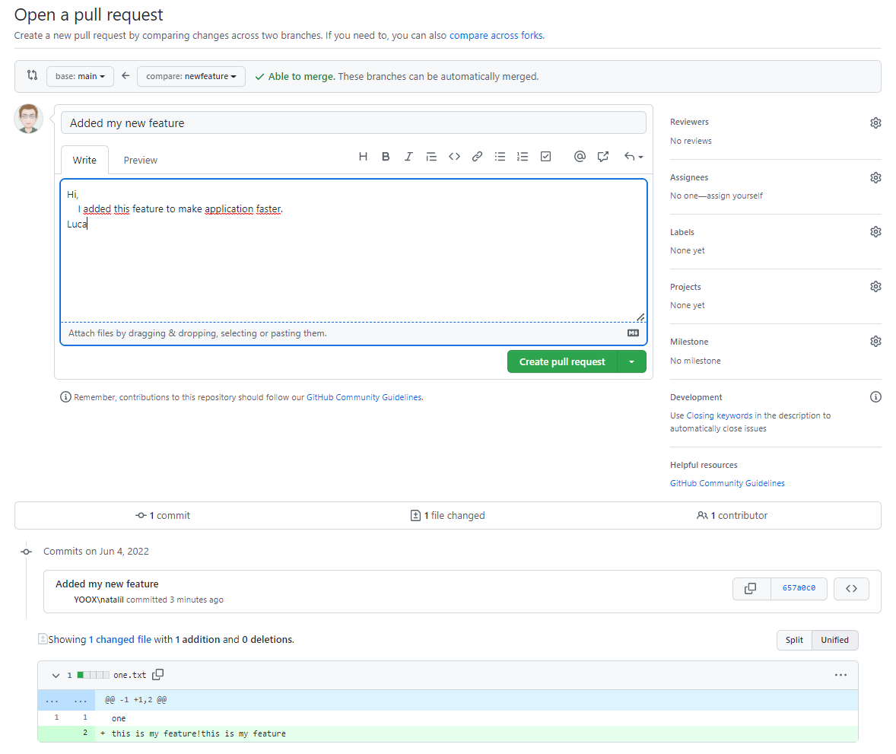
Pull request
Contributor side
the developer must explain its work
then confirm the pull request
Corso C#

Slide 4
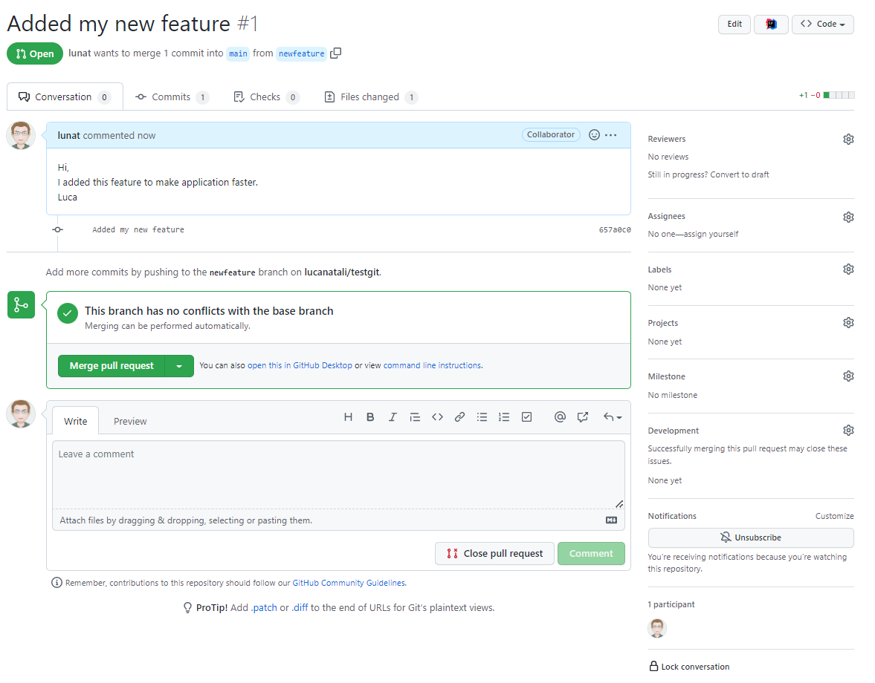
GIT BRANCHING
Contributor side
the contributor can add more comments and, in general, he has a general view on how the pull request is going
Corso C#

Slide 5

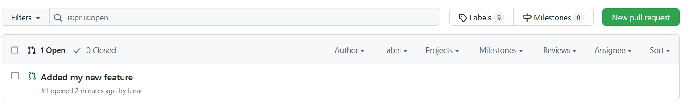
Pull request
Owner side
the repo’s owners (or reviewers, etc) now sees that a new Pull Request is made
by clicking the menu it is possible to navigate through all Pull Requests
Corso C#

Slide 6
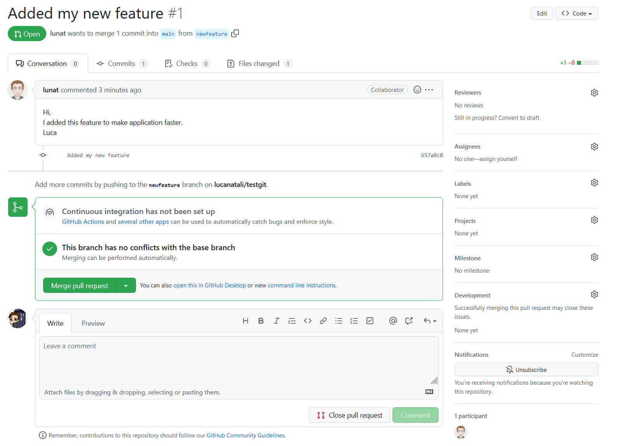
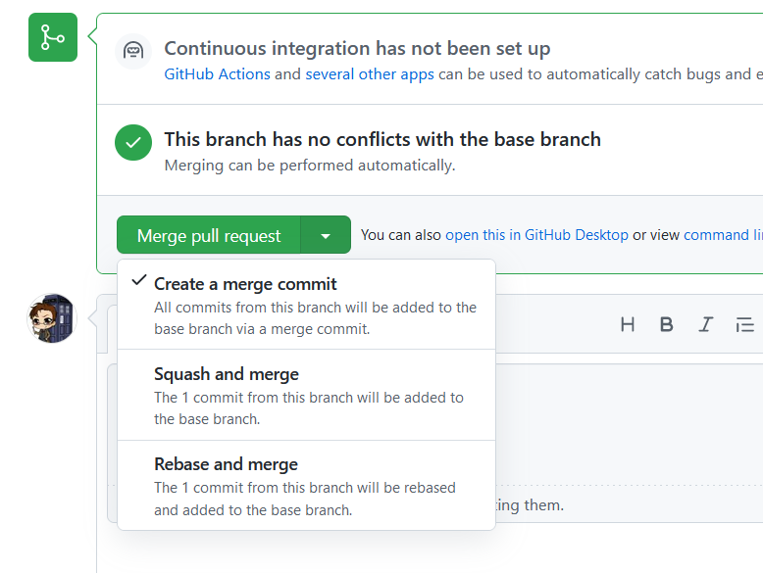
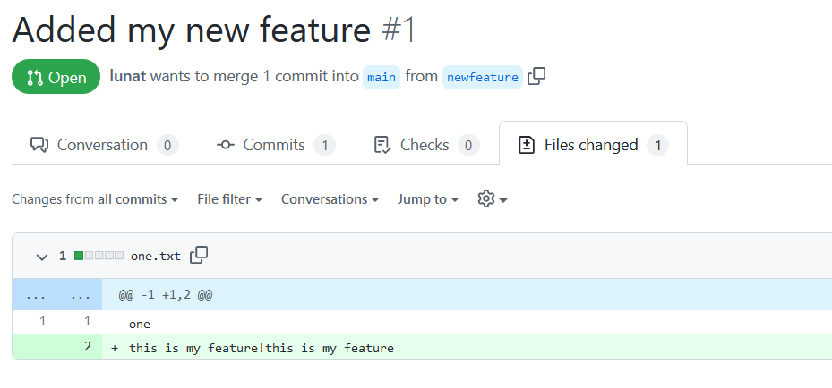
Pull request
Owner side
reviewers can watch the PR, start a discussion and merge the PR directly from the website or, more likely, the will have a look to the code locally
Corso C#

Slide 7
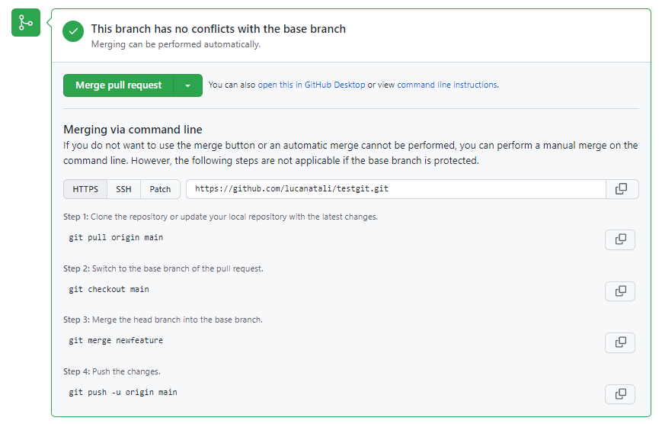
Pull request
Owner side
command line instructions will guide the reviewer to the entire process
Corso C#

Slide 8
Pull request
Owner side
all reviewers can have a closer look to the code before merge
$ git checkout -b newfeature
$ git pull origin newfeature
… have a look to the code on the branch
$ git checkout main
$ git merge newfeature
$ git push origin main
Corso C#

Slide 9
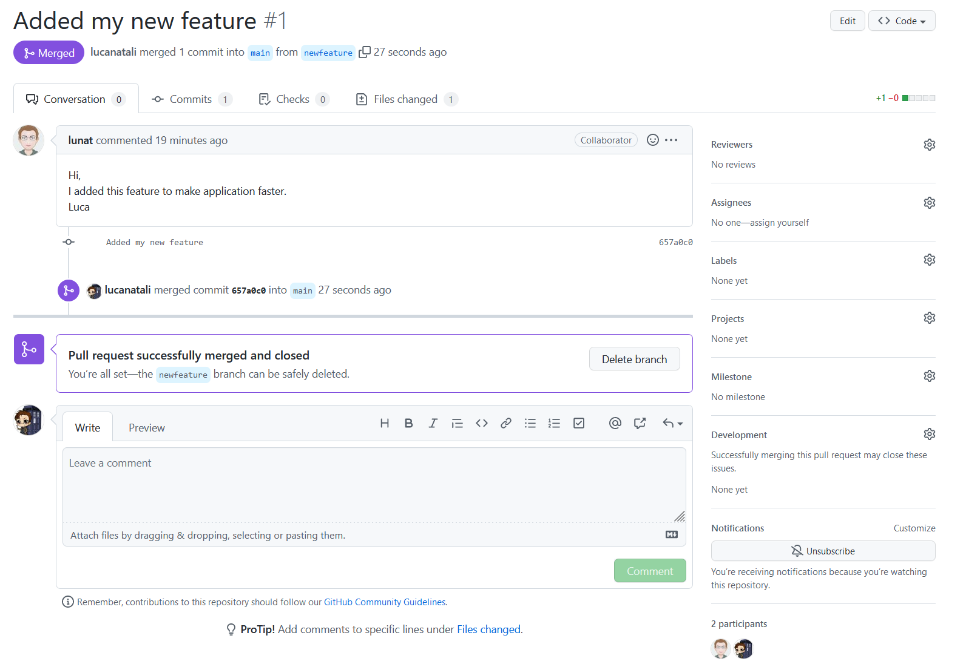
Pull request
Owner side
by merging and pushing the pull request is considered closed
the branch can now be deleted
Corso C#

Slide 10
Pull request
How it works
pull request is more than just a notification, it’s a dedicated forum for discussing the proposed feature
if there are any problems with the changes, teammates can post feedback in the pull request and even tweak the feature by pushing follow-up commits
all of this activity is tracked directly inside of the pull request
Corso C#

Slide 11
Pull request
How it works
pull requests can be used in conjunction with the Feature Branch Workflow, the Gitflow Workflow, or the Forking Workflow
a pull request requires either two distinct branches or two distinct repositories, so they will not work with the Centralized Workflow
using pull requests with each of these workflows is slightly different, but the general process is as follows:
A developer creates the feature in a dedicated branch in their local repo
The developer pushes the branch to a public Bitbucket repository
The developer files a pull request via GitHub/Bitbucket
The rest of the team reviews the code, discusses it, and alters it
The project maintainer merges the feature into the official repository and closes the pull request
The rest of this section describes how pull requests can be leveraged against different collaboration workflows
Corso C#

Slide 12
Workflows
Workflows
Centralized Workflow
Feature Branch
Gitflow Workflow
Forking Workflow
Corso C#

Slide 13
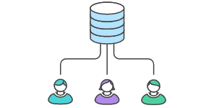
Centralized Workflow
Definition
Centralized Workflow is a great Git workflow for teams transitioning from SVN
Like Subversion, the Centralized Workflow uses a central repository to serve as the single point-of-entry for all changes to the project. Instead of trunk, the default development branch is called main and all changes are committed into this branch. This workflow doesn’t require any other branches besides main
Transitioning to a distributed version control system may seem like a daunting task, but you don’t have to change your existing workflow to take advantage of Git
Your team can develop projects in the exact same way as they do with Subversion
Corso C#

Slide 14
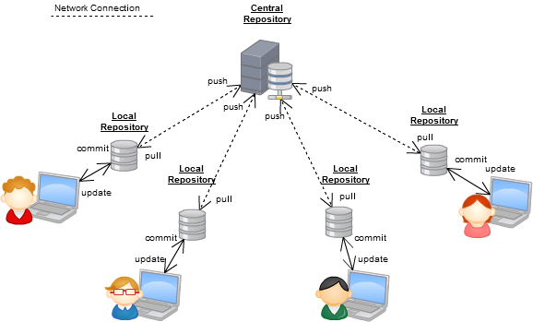
Centralized Workflow
Definition
However, using Git to power your development workflow presents a few advantages over SVN
First, it gives every developer their own local copy of the entire project this isolated environment lets each developer work independently of all other changes to a project - they can add commits to their local repository and completely forget about upstream developments until it's convenient for them
Second, it gives you access to Git’s robust branching and merging model. Unlike SVN, Git branches are designed to be a fail-safe mechanism for integrating code and sharing changes between repositories.
The Centralized Workflow is similar to other workflows in its utilization of a remote server-side hosted repository that developers push and pull form. Compared to other workflows, the Centralized Workflow has no defined pull request or forking patterns. A Centralized Workflow is generally better suited for teams migrating from SVN to Git and smaller size teams.
Corso C#

Slide 15
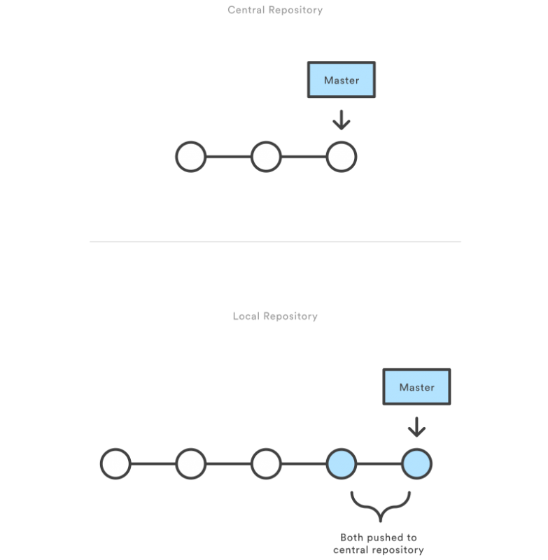
Centralized Workflow
How it works
First, someone needs to create the central repository on a server. If it’s a new project, you can initialize an empty repository; otherwise, you’ll need to import an existing Git or SVN repository
developers start by cloning the central repository
in their own local copies of the project, they edit files and commit changes as they would with SVN; however, these new commits are stored locally - they’re completely isolated from the central repository - this lets developers defer synchronizing upstream until they’re at a convenient break point
to publish changes to the official project, developers "push" their local main branch to the central repository (this is the equivalent of svn commit, except that it adds all of the local commits that aren’t already in the central main branch)
Corso C#

Slide 16
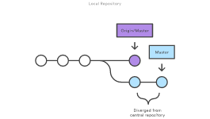
Centralized Workflow
Managing conflicts
The central repository represents the official project, so its commit history should be treated as sacred and immutable. If a developer’s local commits diverge from the central repository, Git will refuse to push their changes because this would overwrite official commits
$ git pull --rebase origin main
or $ git checkout -b newmain origin/main
Corso C#

Slide 17
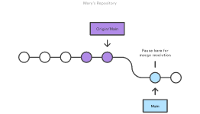
Centralized Workflow
Managing conflicts
before the developer can publish their feature, they need to fetch the updated central commits and rebase their changes on top of them this is like saying, “I want to add my changes to what everyone else has already done.” The result is a perfectly linear history, just like in traditional SVN workflows
if local changes directly conflict with upstream commits, Git will pause the rebasing process and give you a chance to manually resolve the conflicts. The nice thing about Git is that it uses the same git status and git add commands for both generating commits and resolving merge conflicts. This makes it easy for new developers to manage their own merges plus, if they get themselves into trouble, Git makes it very easy to abort the entire rebase and try again (or go find help)
Corso C#

Slide 18
Feature Branch
Definition
the core idea behind the Feature Branch Workflow is that all feature development should take place in a dedicated branch instead of the main branch
this encapsulation makes it easy for multiple developers to work on a particular feature without disturbing the main codebase
it also means the main branch will never contain broken code, which is a huge advantage for continuous integration environments
Corso C#

Slide 19
Feature Branch
Definition
encapsulating feature development also makes it possible to leverage pull requests, which are a way to initiate discussions around a branch
they give other developers the opportunity to sign off on a feature before it gets integrated into the official project
you can open a pull request asking for suggestions from your colleagues
Corso C#

Slide 20
Feature Branch
How it works
Feature Branch Workflow assumes a central repository, and main represents the official project history
instead of committing directly on their local main branch, developers create a new branch every time they start work on a new feature
feature branches should have descriptive names, like animated-menu-items or issue-#1061 or 1061-animated-menu-items: the idea is to give a clear, highly-focused purpose to each branch
Git makes no technical distinction between the main branch and feature branches, so developers can edit, stage, and commit changes to a feature branch
Corso C#

Slide 21
Feature Branch
How it works
feature branches can (and should) be pushed to the central repository this makes it possible:
to share a feature with other developers without touching any official code
since main is the only “special” branch, storing several feature branches on the central repository doesn’t pose any problems
this is also a convenient way to back up everybody’s local commits
Corso C#

Slide 22
Feature Branch
How it works
feature branches can (and should) be pushed to the central repository this makes it possible:
to share a feature with other developers without touching any official code
since main is the only “special” branch, storing several feature branches on the central repository doesn’t pose any problems
this is also a convenient way to back up everybody’s local commits
Corso C#

Slide 23
Feature Branch
Feature branch life-cycle
start with the main branch
all feature branches are created off the latest code state of a project. This guide assumes this is maintained and updated in the main branch
git checkout main git fetch origin git reset --hard origin/main
switches the repo to the main branch
pulls the latest commits
resets the repo's local copy of main to match the latest version
Corso C#

Slide 24
Feature Branch
Feature branch life-cycle
create a new-branch
use a separate branch for each feature or issue you work on
after creating a branch, check it out locally so that any changes you make will be on that branch
git checkout -b new-feature
this checks out a branch called new-feature based on main, and the -b flag tells Git to create the branch if it doesn’t already exist
Corso C#

Slide 25
Feature Branch
Feature branch life-cycle
update, add, commit, and push changes
on this branch, edit, stage, and commit changes in the usual fashion, building up the feature with as many commits as necessary
work on the feature and make commits like you would any time you use Git
when ready, push your commits, updating the feature branch on Git server
git status
git add <some-file>
git commit
Corso C#

Slide 26
Feature Branch
Feature branch life-cycle
push feature branch to remote
it’s a good idea to push the feature branch up to the central repository
this serves as a convenient backup
when collaborating with other developers, this would give them access to view commits to the new branch
git push -u origin new-feature
this command pushes new-feature to the central repository (origin), and the -u flag adds it as a remote tracking branch
after setting up the tracking branch, git push can be invoked without any parameters to automatically push the new-feature branch to the central repository
to get feedback on the new feature branch, create a pull request in a repository management solution
from there, you can add reviewers and make sure everything is good to go before merging
Corso C#

Slide 27
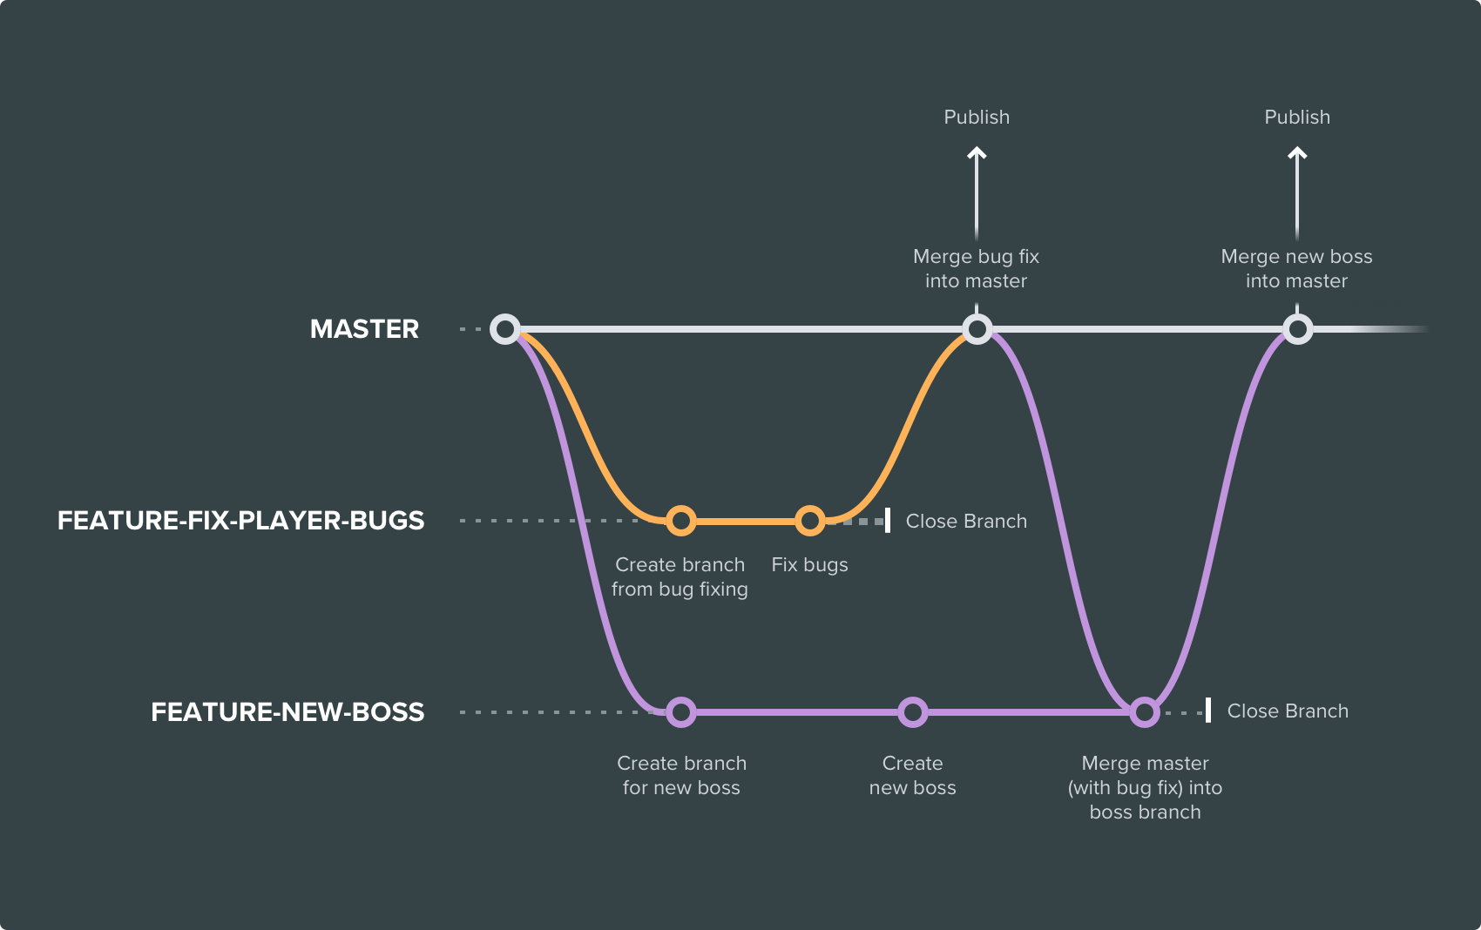
Feature Branch
Feature branch life-cycle
resolve feedback
now teammates comment and approve the pushed commits
resolve their comments locally, commit, and push the suggested changes to Git Server
your updates appear in the pull request.
merge your pull request
before you merge, you may have to resolve merge conflicts if others have made changes to the repo
when your pull request is approved and conflict-free, you can add your code to the main branch
merge from the pull request in Git Server or CLI
Corso C#

Slide 28
Git flow
What is
Giflow is an alternative Git branching model that involves the use of feature branches and multiple primary branches
compared to trunk-based development, Giflow has numerous, longer-lived branches and larger commits
under this model, developers create a feature branch and delay merging it to the main trunk branch until the feature is complete
these long-lived feature branches require more collaboration to merge and have a higher risk of deviating from the trunk branch
they can also introduce conflicting updates
Corso C#

Slide 29
Git flow
What is
Gitflow can be used for projects that have a scheduled release cycle and for the DevOps best practice of continuous delivery
this workflow doesn’t add any new concepts or commands beyond what’s required for the Feature Branch Workflow
instead, it assigns very specific roles to different branches and defines how and when they should interact
in addition to feature branches, it uses individual branches for preparing, maintaining, and recording releases
of course, you also get to leverage all the benefits of the Feature Branch Workflow: pull requests, isolated experiments, and more efficient collaboration
Corso C#

Slide 30
Git flow
How it works
Gitflow is really just an abstract idea of a Git workflow
it dictates what kind of branches to set up and how to merge them together
the git-flow toolset is an actual command line tool that has an installation process
the git flow init command is an extension of the default git init command and doesn't change anything in your repository other than creating branches for you.
git flow init
Initialized empty Git repository in C:/repos/myproject/.git/
No branches exist yet. Base branches must be created now.
Branch name for production releases: [master]
Branch name for "next release" development: [develop]
How to name your supporting branch prefixes?
Feature branches? [feature/]
Bugfix branches? [bugfix/]
Release branches? [release/]
Hotfix branches? [hotfix/]
Support branches? [support/]
Version tag prefix? []
Hooks and filters directory? [C:/_Corso_/todelete/.git/hooks]
Corso C#

Slide 31
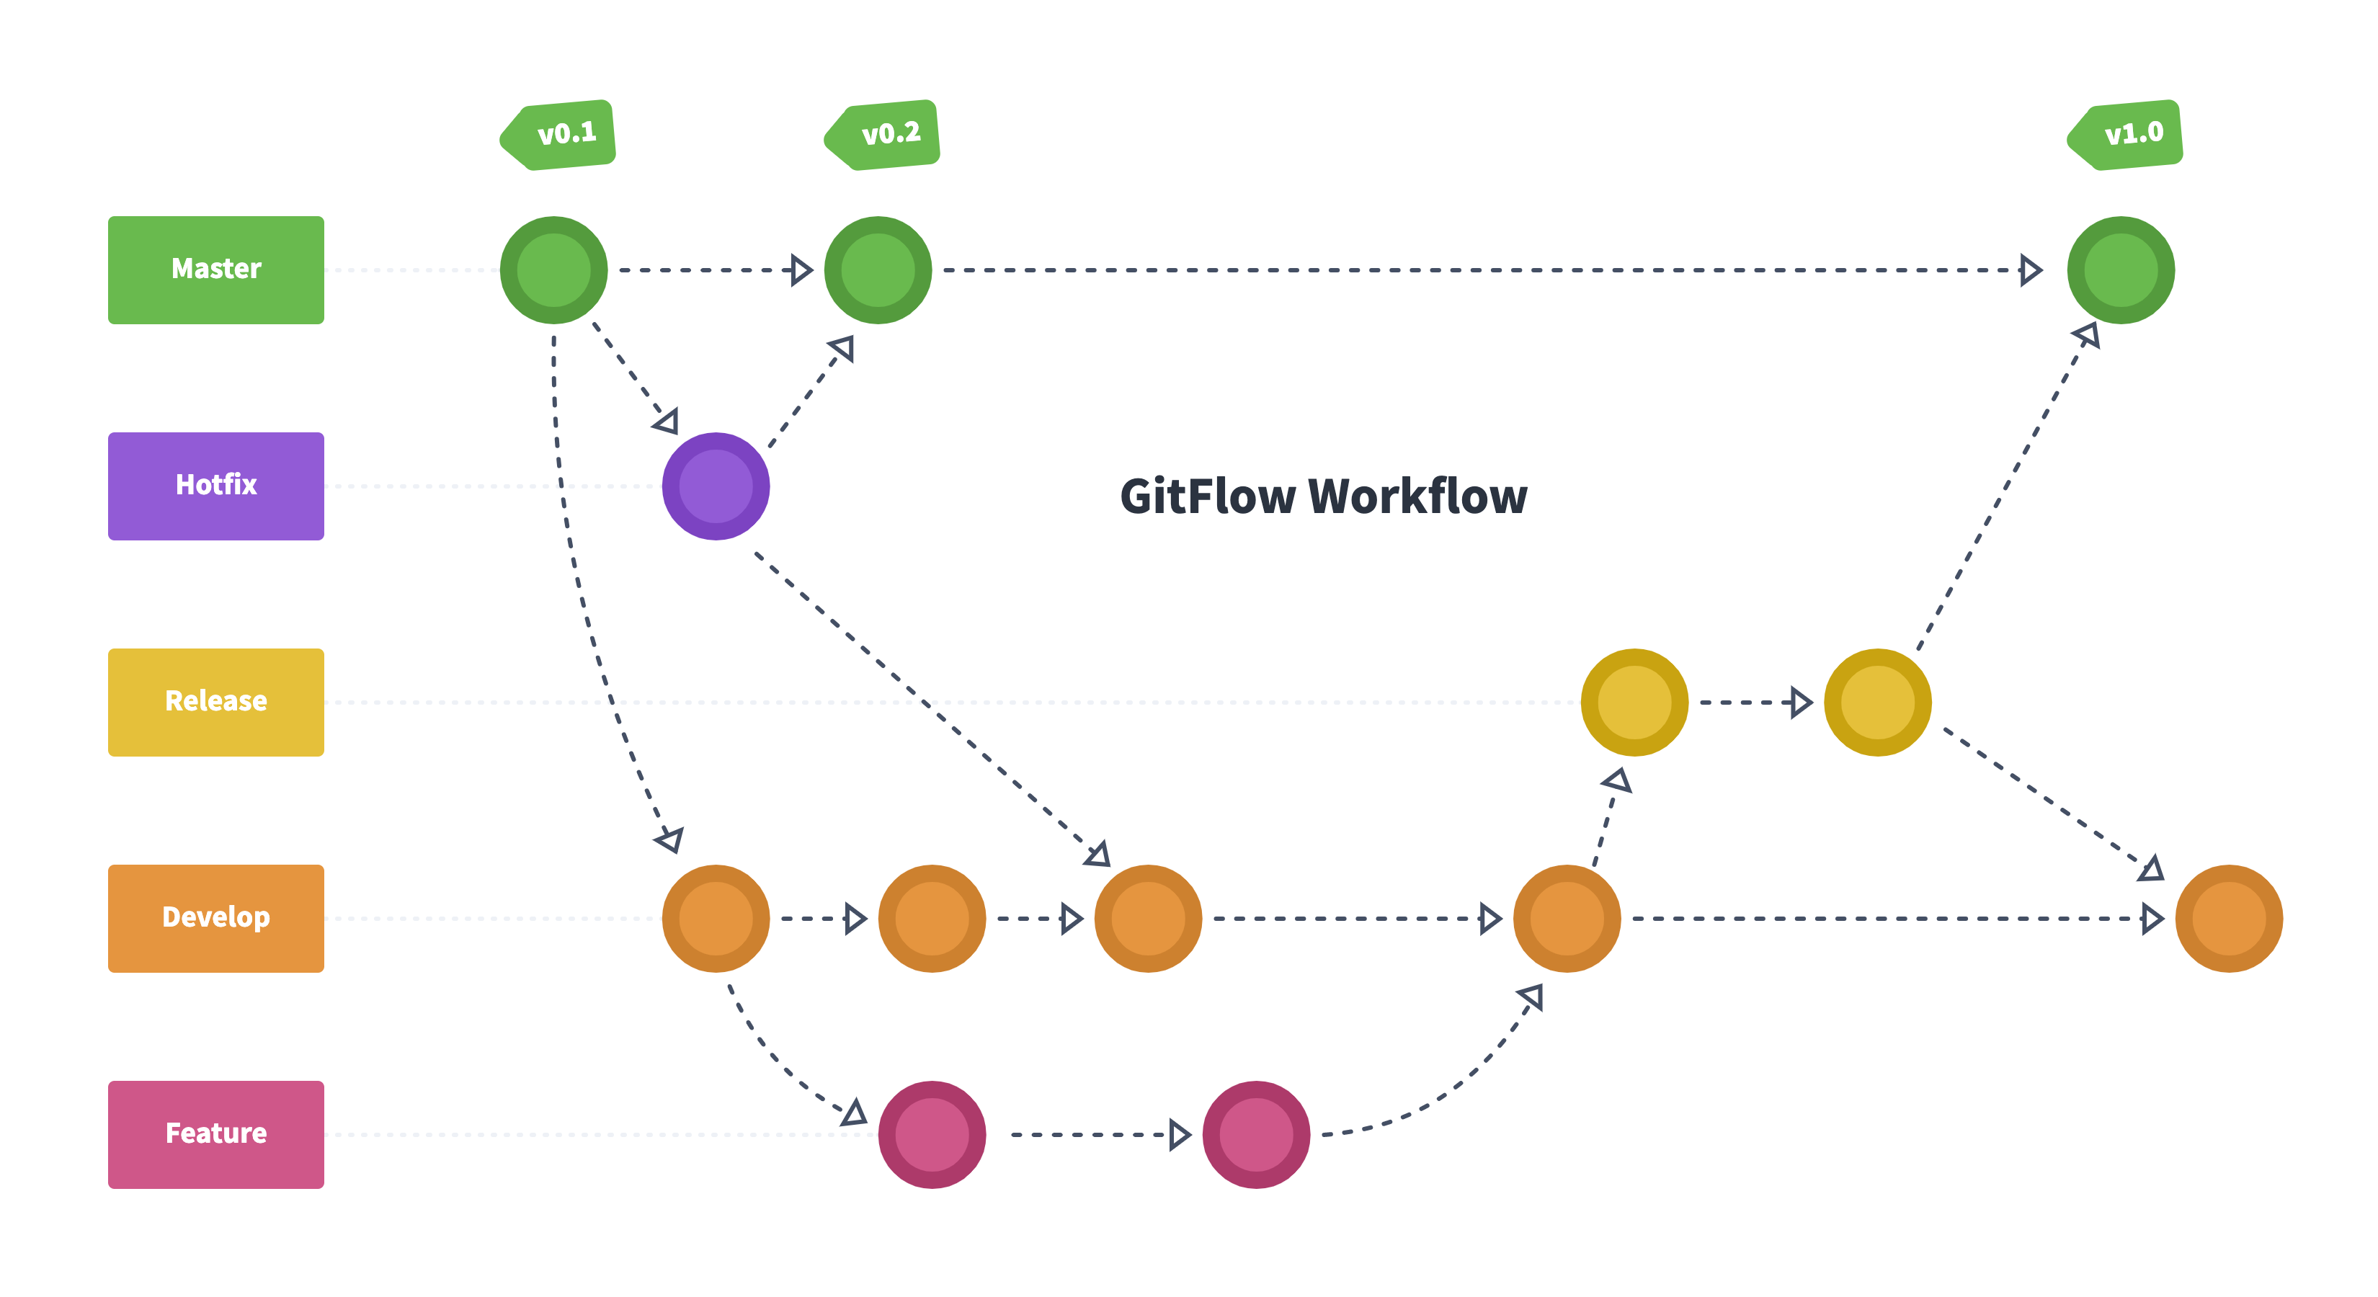
Git flow
How it works
develop and main branches
instead of a single main branch, this workflow uses two branches to record the history of the project
the main branch stores the official release history, and the develop branch serves as an integration branch for features
it's also convenient to tag all commits in the main branch with a version number
Corso C#

Slide 32
Git flow
How it works
the first step is to complement the default main with a develop branch
a simple way to do this is for one developer (other than git flow init) to create an empty develop branch locally and push it to the server
git branch develop git push -u origin develop
develop branch will contain the complete history of the project, whereas main will contain an abridged version
other developers should now clone the central repository and create a tracking branch for develop
Corso C#

Slide 33
Git flow
How it works
Feature branches
each new feature should reside in its own branch
new features can be pushed to the central repository for backup/collaboration
instead of branching off of main, feature branches use develop as their parent branch
when a feature is complete, it gets merged back into develop
features should never interact directly with main
git checkout develop git checkout -b feature_branch
this command creates a feature branch without the git-flow extension
git flow feature start feature_branch
this command creates a feature branch with the git-flow extension
continue your work and use Git like you normally would.
Corso C#

Slide 34
Git flow
How it works
Finishing a feature branch
when you’re done with the development work on the feature, the next step is to merge the feature_branch into develop
git checkout develop
git merge feature_branch
this command merges the feature branch into develop without the git-flow extension
git flow feature finish feature_branch
this command merges the feature branch into develop with the git-flow extension
Corso C#

Slide 35
Git flow
How it works
Release branches
once develop has acquired enough features for a release (or a predetermined release date is approaching), you fork a release branch off of develop
creating this branch starts the next release cycle, so no new features can be added after this point (only bug fixes, documentation generation, and other release-oriented tasks should go in this branch)
once it's ready to ship, the release branch gets merged into main and tagged with a version number
in addition, it should be merged back into develop, which may have progressed since the release was initiated
Corso C#

Slide 36
Git flow
How it works
Release branches
using a dedicated branch to prepare releases makes it possible for one team to polish the current release while another team continues working on features for the next release
it also creates well-defined phases of development (e.g., it's easy to say, “This week we're preparing for version 4.0,” and to actually see it in the structure of the repository)
Corso C#

Slide 37
Git flow
How it works
Release branch
is another straightforward branching operation
like feature branches, release branches are based on the develop branch
a new release branch can be created using the following methods
git checkout develop
git checkout -b release/0.1.0
this command creates a release branch without the git-flow extension
$ git flow release start 0.1.0
Switched to a new branch 'release/0.1.0'
this command creates a release branch with the git-flow extension
once the release is ready to ship, it will get merged it into main and develop, then the release branch will be deleted
it’s important to merge back into develop because critical updates may have been added to the release branch and they need to be accessible to new features
if your organization stresses code review, this would be an ideal place for a pull request
Corso C#

Slide 38
Git flow
How it works
Finishing a release branch
when you’re done with the development work on the feature, the next step is to merge the feature_branch into develop
git checkout main
git merge release/0.1.0
this command merges the release branch into main without the git-flow extension
git flow release finish '0.1.0'
this command merges the release branch into main with the git-flow extension
Corso C#

Slide 39
Git flow
How it works
Hotfix branches
maintenance or “hotfix” branches are used to quickly patch production releases
hotfix branches are a lot like release branches and feature branches except they're based on main instead of develop
this is the only branch that should fork directly off of main
as soon as the fix is complete, it should be merged into both main and develop (or the current release branch)
main should be tagged with an updated version number
Corso C#

Slide 40
Git flow
How it works
Hotfix branches
having a dedicated line of development for bug fixes lets your team address issues without interrupting the rest of the workflow or waiting for the next release cycle
you can think of maintenance branches as ad hoc release branches that work directly with main
Corso C#

Slide 41
Git flow
How it works
Hotfix branches
git checkout main
git checkout -b hotfix_branch
this command creates a hotfix branch without the git-flow extension
$ git flow hotfix start hotfix_branch
this command creates a hotfix branch with the git-flow extension
Similar to finishing a release branch, a hotfix branch gets merged into both main and develop
git checkout main
git merge hotfix_branch
git checkout develop
git merge hotfix_branch
git branch -D hotfix_branch
this command finishes a hotfix branch without the git-flow extension
this command finishes a hotfix branch with the git-flow extension
$ git flow hotfix finish hotfix_branch
Corso C#

Slide 42
Git flow
How it works
The overall flow of Gitflow is:
a develop branch is created from main
a release branch is created from develop
feature branches are created from develop
when a feature is complete it is merged into the develop branch
when the release branch is done it is merged into develop and main
if an issue in main is detected a hotfix branch is created from main
once the hotfix is complete it is merged to both develop and main
Corso C#

Slide 43
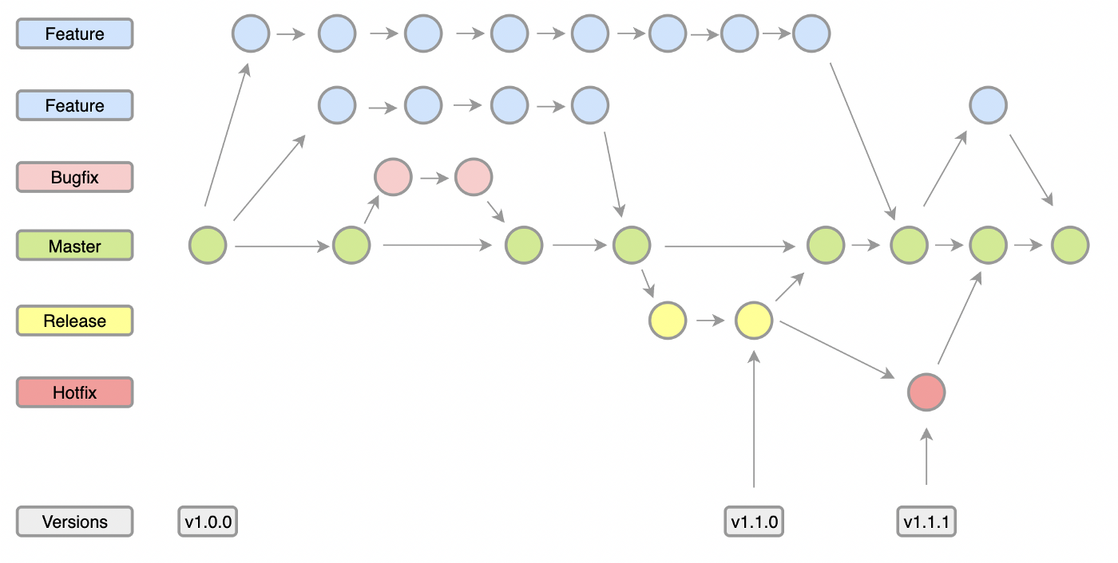
Git flow
How it works
a little Git Flow variant
Corso C#

Slide 44
Forking workflow
Definition
Forking Workflow is fundamentally different than other popular Git workflows
instead of using a single server-side repository to act as the “central” codebase, it gives every developer their own server-side repository
each contributor has not one, but two Git repositories:
a private local one
A public server-side one
the Forking Workflow is most often seen in public open source projects
Corso C#

Slide 45
Forking workflow
Definition
contributions can be integrated without the need for everybody to push to a single central repository
developers push to their own server-side repositories, and only the project maintainer can push to the official repository
this allows the maintainer to accept commits from any developer without giving them write access to the official codebase
typically follows a branching model based on the Gitflow Workflow: complete feature branches will be purposed for merge into the original project maintainer's repository
the result is a distributed workflow that provides a flexible way for large, organic teams (including untrusted third-parties) to collaborate securely
it is the ideal workflow for open source projects
Corso C#

Slide 46
Forking workflow
How it works
as in the other Git workflows, the Forking Workflow begins with an official public repository stored on a server
when a new developer wants to start working on the project, they do not directly clone the official repository, instead, they fork the official repository to create a copy of it on the server
this new copy serves as their personal public repository, no other developers are allowed to push to it, but they can pull changes from it (we’ll see why this is important)
after they have created their server-side copy, the developer performs a git clone to get a copy of it onto their local machine: this serves as their private development environment, just like in the other workflows
when they're ready to publish a local commit, they push the commit to their own public repository—not the official one
then, they file a pull request with the main repository, which lets the project maintainer know that an update is ready to be integrated
the pull request also serves as a convenient discussion thread if there are issues with the contributed code
Corso C#

Slide 47
Forking workflow
How it works - short
A developer 'forks' an 'official' server-side repository. This creates their own server-side copy
The new server-side copy is cloned to their local system
A Git remote path for the 'official' repository is added to the local clone
A new local feature branch is created
The developer makes changes on the new branch
New commits are created for the changes
The branch gets pushed to the developer's own server-side copy
The developer opens a pull request from the new branch to the 'official' repository
The pull request gets approved for merge and is merged into the original server-side repository
Corso C#

Slide 48
Forking workflow
How it works
to integrate the feature into the official codebase, the maintainer pulls the contributor’s changes into their local repository, checks to make sure it doesn’t break the project, merges it into their local main branch, then pushes the main branch to the official repository on the server
the contribution is now part of the project, and other developers should pull from the official repository to synchronize their local repositories
the notion of an “official” repository in the Forking Workflow is merely a convention
the only thing that makes the official repository so official is that it’s the public repository of the project maintainer
Corso C#

Slide 49
Forking workflow
Forking vs Cloning
"forked" repositories and "forking" are not special operations
forked repositories are created using the standard git clone command
forked repositories are generally "server-side clones" and usually managed and hosted by a 3rd party Git service like Bitbucket
there is no unique Git command to create forked repositories, a clone operation is essentially a copy of a repository and its history.
Corso C#

Slide 50
Forking workflow
Branching in the Forking Workflow
all of these personal public repositories are really just a convenient way to share branches with other developers
everybody should still be using branches to isolate individual features, just like in the Feature Branch Workflow and the Gitflow Workflow
the only difference is how those branches get shared:
in the Forking Workflow, they are pulled into another developer’s local repository
in the Feature Branch and Gitflow Workflows they are pushed to the official repository
Corso C#

Slide 51

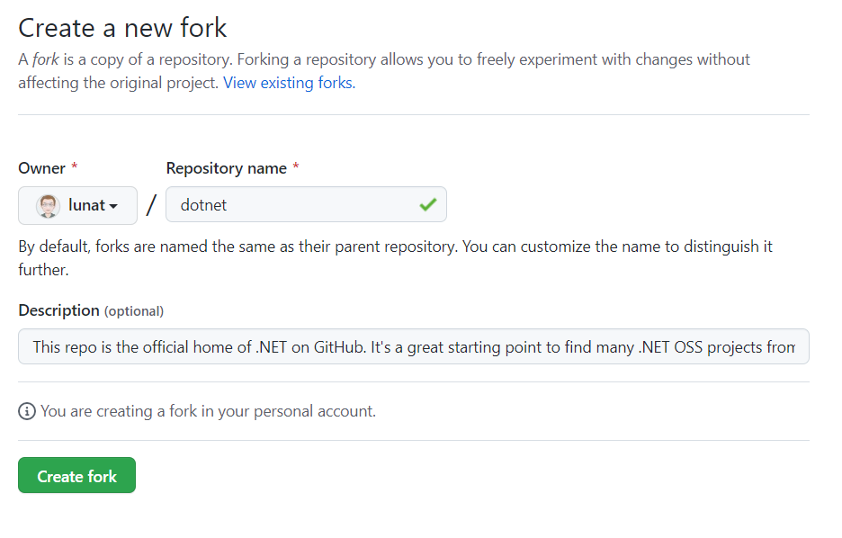
Forking workflow
How it works
all new developers to a Forking Workflow project need to fork the official repository
it’s possible to do this
by SSH’ing into the server and running git clone to copy it to another location on the server
by using some web management interface offered by the Git server
Corso C#

Slide 52
Forking workflow
How it works
Clone your fork
next each developer needs to clone their own public forked repository
they can do this with the familiar git clone command
Assuming the use of Bitbucket to host these repositories, developers on a project should have their own Bitbucket account and they should clone their forked copy of the repository with
git clone https://user@bitbucket.org/user/repo.git
Corso C#

Slide 53
Forking workflow
How it works
Adding a remote
other Git workflows use a single origin remote that points to the central repository, the Forking Workflow requires two remotes:
one for the official repository
one for the developer’s personal server-side repository
while you can call these remotes anything you want, a common convention is to use origin as the remote for your forked repository (this will be created automatically when you run git clone) and upstream for the official repository
the upstream remote will let you easily keep your local repository up-to-date as the official project progresses
git remote add upstream https://bitbucket.org/maintainer/repo
or – with authentication..
git remote add upstream https://user@bitbucket.org/maintainer/repo.git
Corso C#

Slide 54
Forking workflow
Working in a branch: making & pushing changes
In the developer's local copy of the forked repository they can edit code, commit changes, and create branches just like in other Git workflows
git checkout -b some-feature
# Edit some code
git commit -a -m "Add first draft of some feature"
all of their changes will be entirely private until they push it to their public repository
if the official project has moved forward, they can access new commits with git pull:
git pull upstream main
Corso C#

Slide 55
Forking workflow
Making a pull request
you are ready to share their new feature, you need to do two things
make contribution accessible to other developers by pushing it to your public repository
your origin remote should already be set up, so all you should have to do is the following:
git push origin feature-branch
this diverges from the other workflows in that the origin remote points to the developer’s personal server-side repository, not the main codebase
finally you need to notify the project maintainer that you want to merge your feature into the official codebase
many Git server web interface provide a “pull request” button that leads to a form asking you to specify which branch you want to merge into the official repository
typically, you’ll want to integrate your feature branch into the upstream remote’s main branch
Corso C#

Slide 56
Forking workflow
Recap
you want to contribute to an open source library hosted at <gitserver>/userA/open-project
using GitHub/GitLab/Bitbucket you create a fork of the repo to <gitserver>/YourName/open-project
on your local system you execute git clone on https://<gitserver>/YourName/open-project to get a local copy of the repo
you create a new feature branch in your local repo
work is done to complete the new feature and git commit is executed to save the changes
you then push the new feature branch to your remote forked repo
using GitHub/GitLab/Bitbucket you open up a pull request for the new branch against the original repo at bitbucket.org/userA/open-project
Corso C#

