Slide 1
GIT BRANCHING
Branches in a Nutshell
Basic Branching and Merging
Branch Management
Branching Workflows
Remote Branches
Rebasing
Stashing and Cleaning
Corso C#

Slide 2
GIT BRANCHING
Branches in a Nutshell
every VCS has some form of branching support
branching means you diverge from the main line of development and continue to do work without messing with that main line
in many VCS tools, this is a somewhat expensive process, often requiring you to create a new copy of your source code directory, which can take a long time for large projects
Corso C#

Slide 3
Branches in a Nutshell
the killer feature
Git branches is incredibly lightweight, making branching operations nearly instantaneous, and switching back and forth between branches generally just as fast
unlike many other VCSs, Git encourages workflows that branch and merge often, even multiple times in a day
Understanding and mastering this feature gives you a powerful and unique tool and can entirely change the way that you develop
Corso C#

Slide 4
Branches in a Nutshell
How Git stores data
Git doesn’t store data as a series of changesets or differences, but instead as a series of snapshots
When you make a commit, Git stores a commit object that contains a pointer to the snapshot of the content you staged
This object also contains the author’s name and email, the message that you typed, and pointers to the commit or commits that directly came before this commit (its parent or parents):
zero parents for the initial commit
one parent for a normal commit
multiple parents for a commit that results from a merge of two or more branches
Corso C#

Slide 5
Branches in a Nutshell
How Git stores data
To visualize this, let’s assume that you have a directory containing three files, and you stage them all and commit
Staging the files
checksums each one (the SHA-1 hash we mentioned before)
stores that version of the file in the Git repository (Git refers to them as blobs)
adds that checksum to the staging area
$ git add README test.rb LICENSE
$ git commit -m 'initial commit of my project'
Corso C#

Slide 6
Branches in a Nutshell
How Git stores data
When you create the commit by running git commit
Git checksums each subdirectory (in this case, just the root project directory)
stores those tree objects in the Git repository
Git then creates a commit object that has the metadata and a pointer to the root project tree so it can re-create that snapshot when needed
Corso C#

Slide 7
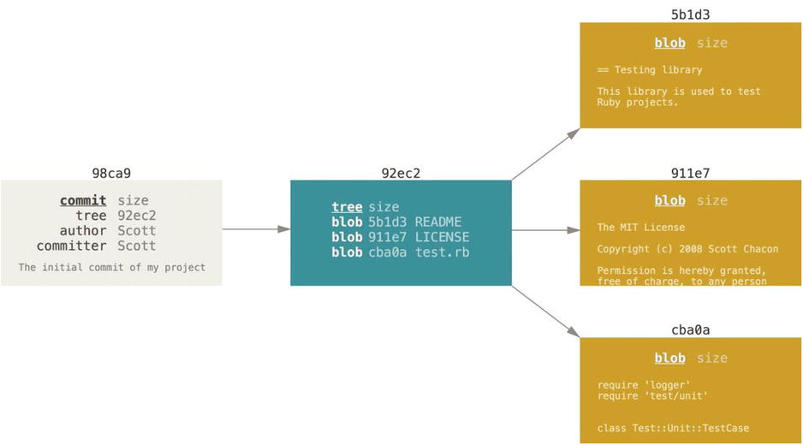
Branches in a Nutshell
How Git stores data
Your Git repository now contains five objects:
one commit with the pointer to the root tree and all the commit metadata
one blob for the contents of each of your three files
one tree that lists the contents of the directory and specifies which file names are stored as which blobs
Corso C#

Slide 8
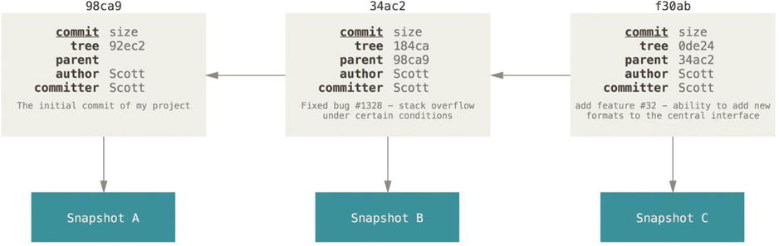
Branches in a Nutshell
How Git stores data
you make some changes and commit again…
the next commit stores a pointer to the commit that came immediately before it
the “main”/“master” branch in Git is not a special branch.
It is exactly like any other branch.
The only reason nearly every repository has one is that the git init command creates it by default and most people don’t bother to change it.
a branch in Git is simply a lightweight movable pointer to one of these commits
the default branch name in Git is main (or master)
as you start making commits, you’re given a main branch that points to the last commit you made
every time you commit, it moves forward automatically.
Corso C#

Slide 9
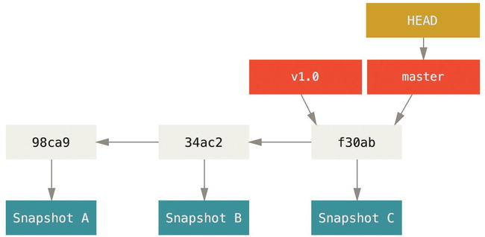
Branches in a Nutshell
How Git stores data
the HEAD points out the last commit in the current checkout branch. It is like a pointer to any reference
the HEAD can be understood as the "current branch“
when you switch branches with 'checkout,' the HEAD is transferred to the new branch
A branch and its commit history
Corso C#

Slide 10
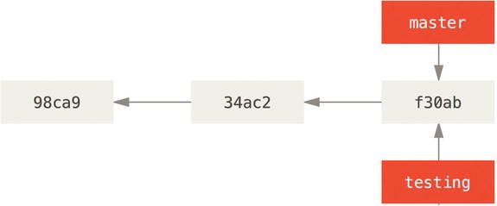
Basic Branching and Merging
Creating a New Branch
what happens if you create a new branch?
it creates a new pointer for you to move around.
you can create a new branch called “testing” with the git branch command
$ git branch testing
this creates a new pointer at the same commit you’re currently on
two branches pointing into the same series of commits
Corso C#

Slide 11
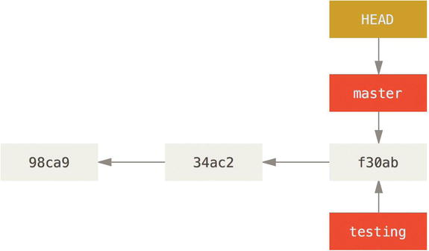
Basic Branching and Merging
Creating a New Branch
how does Git know what branch you’re currently on?
it keeps a special pointer called HEAD
HEAD pointing to a branch
this is a lot different than the concept of HEAD in other VCSs you may be used to, such as Subversion or CVS
in Git, HEAD is a pointer to the local branch you’re currently on
in this case, you’re still on master
the git branch command only created a new branch, it didn’t switch to that branch.
Corso C#

Slide 12
Basic Branching and Merging
Branches in a Nutshell
you can easily see how HEAD behave by running a simple git log command that shows where the branch pointers are pointing
this option is called --decorate
$ git log --oneline --decorate
f30ab (HEAD, master, testing) add feature #32 - ability to add new
34ac2 fixed bug #1328 - stack overflow under certain conditions
98ca9 initial commit of my project
Corso C#

Slide 13
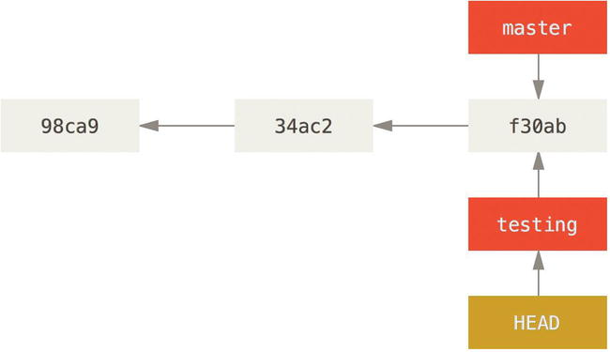
Basic Branching and Merging
Switching branches
to switch to an existing branch, you run the git checkout command
to switch to the new testing branch just run
$ git checkout testing
this moves HEAD to point to the testing branch
Corso C#

Slide 14
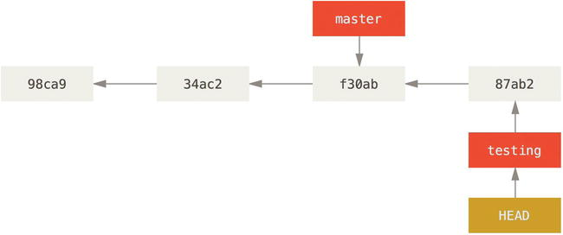
Basic Branching and Merging
Switching branches
what is the significance of that… ? let’s do another commit:
$ echo ‘new test file’ >> test.rb
$ git commit -a -m 'made a change'
The HEAD branch moves forward when a commit is made
Corso C#

Slide 15
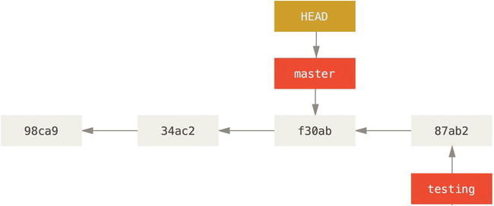
Basic Branching and Merging
Switching branches
now your testing branch has moved forward, but your master branch still points to the commit you were on when you ran git checkout to switch branches
if you switch back to the master branch
$ git checkout master
HEAD moves when you checkout
the HEAD pointer has moved back to point to the master branch
the files in your working directory are reverted to the snapshot that master points to.
the changes you make from this point forward will diverge from an older version of the project. It essentially rewinds the work you’ve done in your testing branch so you can go in a different direction.
Corso C#

Slide 16
Basic Branching and Merging
Switching branches
SWITCHING BRANCHES CHANGES FILES IN YOUR WORKING DIRECTORY
when you switch branches in Git, files in your working directory will change
if you switch to an older branch, your working directory will be reverted to look like it did the last time you committed on that branch
if Git cannot do it cleanly, it will not let you switch at all
Corso C#

Slide 17
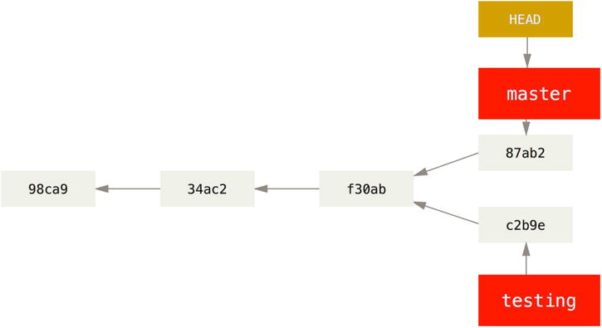
Basic Branching and Merging
Switching branches
Try to make a few changes and commit again
$ vim test.rb
$ git commit -a -m 'made other changes'
now your project history has diverged:
you created and switched to a branch
did some work on it
switched back to your main branch
did other work
both of those changes are isolated in separate branches
you can switch back and forth between the branches and merge them when you’re ready
you did all that with simple branch, checkout, and commit commands.
Divergent history
Corso C#

Slide 18
Basic Branching and Merging
Switching branches
let’s see this easily with the git log command
$ git log --oneline --decorate --graph --all
* c2b9e (HEAD, master) made other changes
| * 87ab2 (testing) made a change
|/
* f30ab add feature #32 - ability to add new formats to the
* 34ac2 fixed bug #1328 - stack overflow under certain conditions
* 98ca9 initial commit of my project
because a branch in Git is in actuality a simple file that contains the 40 character SHA-1 checksum of the commit it points to, branches are cheap to create and destroy
creating a new branch is as quick and simple as writing 41 bytes to a file (40 characters and a newline)
because we’re recording the parents when we commit, finding a proper merge base for merging is automatically done for us and is generally very easy to do
Corso C#

Slide 19
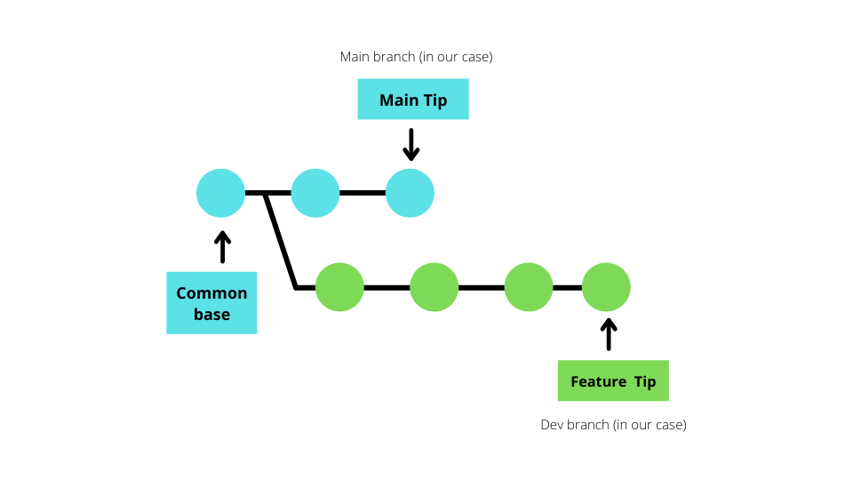
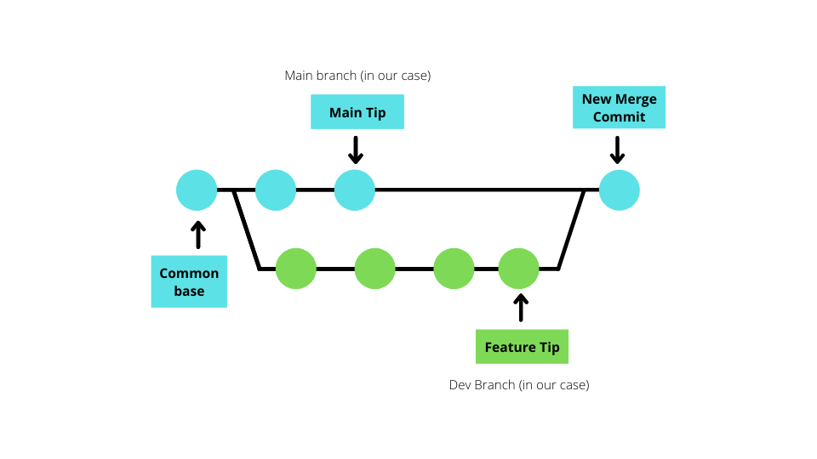
Basic Branching and Merging
Merging
Git merge command incorporates changes from the named commits (since the time their histories diverged from the current branch) into the current branch
this command is used by git pull to incorporate changes from another repository and can be used by hand to merge changes from one branch into another
Corso C#

Slide 20
Basic Branching and Merging
Merging
let’s go through a simple example of branching and merging with a workflow that you might use in the real world.
you’ll follow these steps:
Do work on a web site
Create a branch for a new story you’re working on
Do some work in that branch
at this stage, you’ll receive a call that another issue is critical and you need a hotfix, you’ll do the following:
Switch to your production branch
Create a branch to add the hotfix
After it’s tested, merge the hotfix branch, and push to production
Switch back to your original story and continue working
Corso C#

Slide 21
Basic Branching and Merging
Merging
fast-forward…
when you try to merge one commit with a commit that can be reached by following the first commit’s history, Git simplifies things by moving the pointer forward because there is no divergent work to merge together
Corso C#

Slide 22
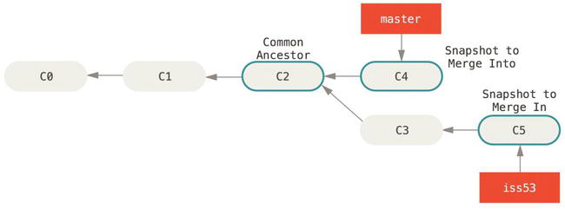
Basic Branching and Merging
Basic Merging
when merging, all you have to do is check out the branch you want to merge into and then run the git merge
$ git checkout master
Switched to branch 'master'
$ git merge iss53
Merge made by the 'recursive' strategy.
README | 1 +
1 file changed, 1 insertion(+)
Instead of just moving the branch pointer forward, Git creates a new snapshot that results from this three-way merge and automatically creates a new commit that points to it
this is referred to as a merge commit
it has more than one parent
Three snapshots used in a typical merge
Corso C#

Slide 23
Basic Branching and Merging
Basic Merging
Git determines the best common ancestor to use for its merge base (this is different than older tools like CVS or Subversion (before version 1.5), where the developer doing the merge had to figure out the best merge base for themselves)
this makes merging a heck of a lot easier in Git than in these other systems
Corso C#

Slide 24
Basic Branching and Merging
Basic Merge conflicts
if you changed the same part of the same file differently in the two branches you’re merging, Git won’t be able to merge them cleanly
if your fix on a branch modified the same part of a file as the other branch, you’ll get a merge conflict that looks something like this
$ git merge iss53
Auto-merging index.html
CONFLICT (content): Merge conflict in index.html
Automatic merge failed; fix conflicts and then commit the result.
Corso C#

Slide 25
Basic Branching and Merging
Basic Merge conflicts
Git hasn’t automatically created a new merge commit. It has paused the process while you resolve the conflict
if you want to see which files are unmerged at any point after a merge conflict, you can run git status
$ git status
On branch master
You have unmerged paths.
(fix conflicts and run "git commit")
Unmerged paths:
(use "git add <file>..." to mark resolution)
both modified: index.html
no changes added to commit (use "git add" and/or "git commit -a")
anything that has merge conflicts and hasn’t been resolved is listed as unmerged
Corso C#

Slide 26
Basic Branching and Merging
Basic Merge conflicts
Git adds standard conflict-resolution markers to the files that have conflicts, so you can open them manually and resolve those conflicts
the version in HEAD (your main branch, because that was what you had checked out when you ran your merge command) is the top part of that block (everything above the =======)
<<<<<<< HEAD:index.html
<div id="footer">contact : email.support@github.com</div>
=======
<div id="footer">
please contact us at support@github.com
</div>
>>>>>>>iss53:index.html
the version in your iss53 branch looks like everything in the bottom part
Corso C#

Slide 27
Basic Branching and Merging
Basic Merge conflicts
To resolve the conflict, you have to either choose
one side
the other
merge the contents yourself
For instance, you might resolve this conflict by replacing the entire block with
<div id="footer">
please contact us at email.support@github.com
</div>
this resolution has a little of each section
the <<<<<<<, =======, and >>>>>>> lines have been completely removed
after you’ve resolved each of these sections in each conflicted file, run git add on each file to mark it as resolved
staging the file marks it as resolved in Git
Corso C#

Slide 28
Basic Branching and Merging
Basic Merge conflicts
If you want to use a graphical tool to resolve these issues, you can run git mergetool, which fires up an appropriate visual merge tool and walks you through the conflicts
$ git mergetool
This message is displayed because 'merge.tool' is not configured.
See 'git mergetool --tool-help' or 'git help config' for more details.
'git mergetool' will now attempt to use one of the following tools:
opendiff kdiff3 tkdiff xxdiff meld tortoisemerge gvimdiff diffuse diffmerge ecmerge p4merge araxis bc3 codecompare vimdiff emerge
Merging:
index.html
Normal merge conflict for 'index.html':
{local}: modified file
{remote}: modified file
Hit return to start merge resolution tool (opendiff):
if you want to use a merge tool other than the default, you can see all the supported tools listed at the top after one of the following tools
just type the name of the tool you want to use
Corso C#

Slide 29
Basic Branching and Merging
Basic Merge conflicts
After you exit the merge tool, Git asks you whether the merge was successful. If you tell the script that it was, it stages the file to mark it as resolved for you. You can run git status again to verify that all conflicts have been resolved
$ git status
On branch master
All conflicts fixed but you are still merging.
(use "git commit" to conclude merge)
Changes to be committed:
modified: index.html
Corso C#

Slide 30
Basic Branching and Merging
Basic Merge conflicts
if you’re happy with that merge conflict resultion
you verify that everything that had conflicts has been staged
you can type git commit to finalize the merge commit
the commit message by default looks something like
Merge branch 'iss53'
Conflicts:
index.html
#
# It looks like you may be committing a merge.
# If this is not correct, please remove the file
# .git/MERGE_HEAD
# and try again.
# Please enter the commit message for your changes. Lines starting
# with '#' will be ignored, and an empty message aborts the commit.
# On branch master
# All conflicts fixed but you are still merging.
#
# Changes to be committed:
# modified: index.html
#
you can modify that message with details about how you resolved the merge if you think it would be helpful to others looking at this merge in the future (why you did what you did, if it’s not obvious)
Corso C#

Slide 31
Branch management
Branch management
The git branch command does more than just create and delete branches. If you run it with no arguments, you get a simple listing of your current branches
$ git branch
iss53
* master
testing
* indicates the branch that you currently have checked out (i.e., the branch that HEAD points to)
if you commit at this point, the master branch will be moved forward with your new work
Corso C#

Slide 32
Branch management
Branch management
To see the last commit on each branch, you can run git branch -v
$ git branch -v
iss53 93b412c fix javascript issue
* master 7a98805 Merge branch 'iss53'
testing 782fd34 add scott to the author list in the readmes
the --merged and --no-merged options can filter this list to branches that you have or have not yet merged into the branch you’re currently on
to see which branches are already merged into the branch you’re on, you can run git branch --merged
$ git branch --merged
iss53
* master
if you already merged in iss53 earlier, you see it in your list
branches on this list without the * in front of them are generally fine to delete with git branch –d
you’ve already incorporated their work into another branch, so you’re not going to lose anything
Corso C#

Slide 33
Branch management
Branch management
to see all the branches that contain work you haven’t yet merged in, you can run git branch --no-merged
$ git branch --no-merged
testing
this shows your other branch
because it contains work that isn’t merged in yet, trying to delete it with git branch –d will fail!
$ git branch -d testing
error: The branch 'testing' is not fully merged.
If you are sure you want to delete it, run 'git branch -D testing'.
if you really do want to delete the branch and lose that work, you can force it with -D, as the helpful message points out
Corso C#

Slide 34
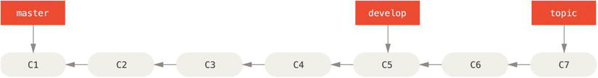
Branching Workflows
Long-Running Branches
many Git developers have a workflow that embraces three-way merge approach, such as
having only code that is entirely stable in their master branch (possibly only code that has been or will be released)
they have another parallel branch named develop or next that they work from or use to test stability (it isn’t necessarily always stable, but whenever it gets to a stable state, it can be merged into master)
it’s used to pull in topic branches (short-lived branches, like your earlier iss53 branch) when they’re ready, to make sure they pass all the tests and don’t introduce bugs
In reality, we are talking about pointers moving up the line of commits you’re making
The stable branches are farther down the line in your commit history, and the bleeding-edge branches are farther up the history.
Corso C#

Slide 35
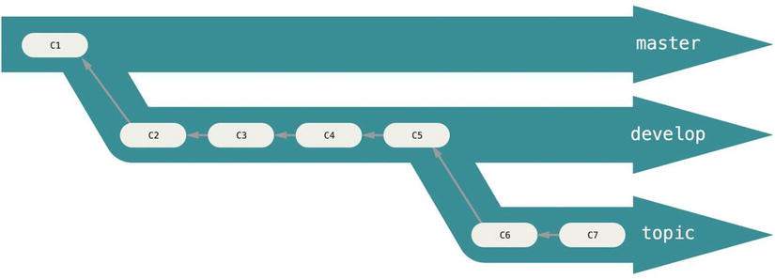
Branching Workflows
Long-Running Branches
another way to think about them is as work silos, where sets of commits graduate to a more stable silo when they’re fully tested
you can keep doing this for several levels of stability
some larger projects also have a proposed or pu (proposed updates) branch that has integrated branches that may not be ready to go into the next or master branch
the idea is that your branches are at various levels of stability; when they reach a more stable level, they’re merged into the branch above them
having multiple long-running branches isn’t necessary, but it’s often helpful, especially when you’re dealing with very large or complex projects
Corso C#

Slide 36
Branching Workflows
Topic Branches
topic branches are useful in projects of any size
a topic branch is a short-lived branch that you create and use for a single particular feature or related work
this is something you’ve likely never done with a VCS before because it’s generally too expensive to create and merge branches but in Git it’s common to create, work on, merge, and delete branches several times a day
this technique allows you to context-switch quickly and completely – because your work is separated into silos where all the changes in that branch have to do with that topic, it’s easier to see what has happened during code review and such
you can keep the changes there for minutes, days, or months, and merge them in when they’re ready, regardless of the order in which they were created or worked on
Corso C#

Slide 37
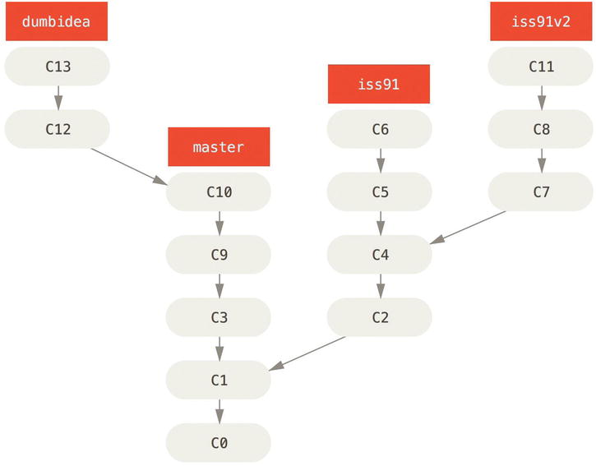
Branching Workflows
Topic Branches
Multiple topic branches
Consider an example of
doing some work (on master)
branching off for an issue (iss91)
working on it for a bit
branching off the second branch to try another way of handling the same thing (iss91v2)
going back to your master branch and working there for a while
then branching off there to do some work that you’re not sure is a good idea (dumbidea branch)
Corso C#

Slide 38
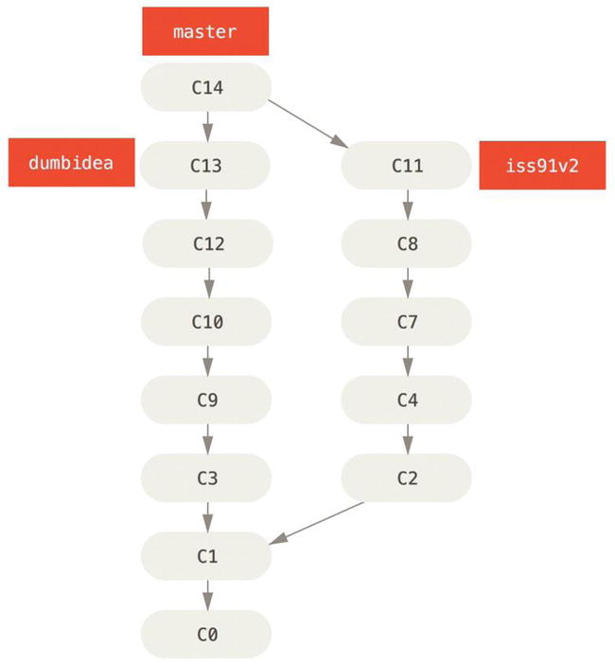
Branching Workflows
Topic Branches
Now, let’s say you decide you like the second solution to your issue best (iss91v2); and you showed the dumbidea branch to your coworkers, and it turns out to be genius
You can throw away the original iss91 branch (losing commits C5 and C6) and merge in the other two
Your history then looks like this
History after merging dumbidea and iss91v2
Corso C#

Slide 39
Remote Branches
Remote Branches
remote branches act as bookmarks to remind you where the branches on your remote repositories were the last time you connected to them
they take the form (remote)/(branch)
for instance, if you wanted to see what the master branch on your origin remote looked like as of the last time you communicated with it, you would check the origin/master branch
if you were working on an issue with a partner and they pushed up an iss53 branch, you might have your own local iss53 branch… but the branch on the server would point to the commit at origin/iss53
Corso C#

Slide 40
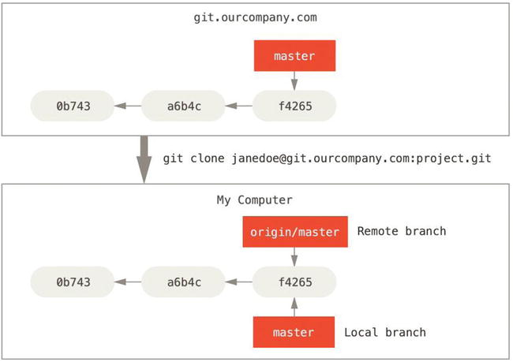
Remote Branches
ORIGIN is not special
Server and local repositories after cloning
just like the branch name “master” (“main”) does not have any special meaning in Git, neither does “origin”
“main” is the default name for a starting branch when you run git init
“origin” is the default name for a remote when you run git clone
If you run git clone -o yeppy instead, then you will have yeppy/main as your default remote branch
Corso C#

Slide 41
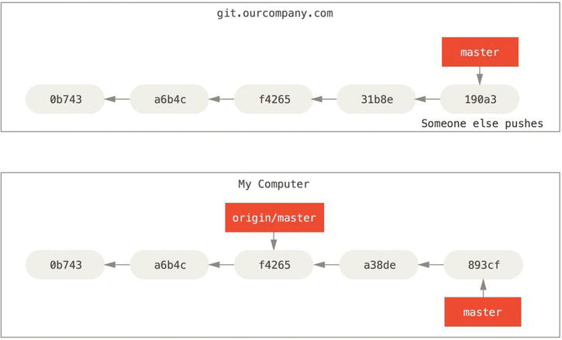
Remote Branches
Local and remote work can diverge
if you do some work on your local master branch, and, in the meantime, someone else pushes to git.ourcompany.com and updates its master branch, then your histories move forward differently
as long as you stay out of contact with your origin server, your origin/master pointer doesn’t move
Corso C#

Slide 42
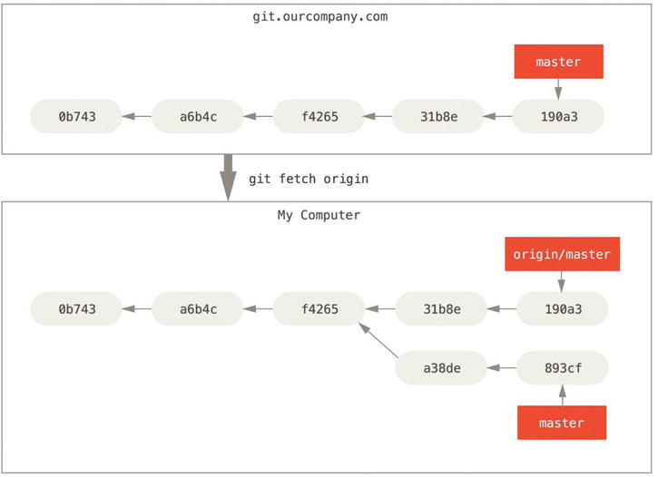
Remote Branches
Git fetch updates your remote references
to synchronize your work, you run a git fetch origin command
this command
looks up which server “origin” is (in this case, it’s git.ourcompany.com)
fetches any data from it that you don’t yet have
updates your local database, moving your origin/master pointer to its new, more up-to-date position.
Corso C#

Slide 43
Remote Branches
Pushing
local branches aren’t automatically synchronized to the remotes you write to
you have to explicitly push the branches you want to share
that way, you can use private branches for work you don’t want to share, and push up only the topic branches you want to collaborate on
If you have a branch named serverfix that you want to work on with others, you can push it up the same way you pushed your first branch. Run git push (remote) (branch)
this is a bit of a shortcut:
Git automatically expands the serverfix branchname out to refs/heads/serverfix:refs/heads/serverfix
it means, “Take my serverfix local branch and push it to update the remote’s serverfix branch.”
$ git push origin serverfix
Counting objects: 24, done.
Delta compression using up to 8 threads.
Compressing objects: 100% (15/15), done.
Writing objects: 100% (24/24), 1.91 KiB | 0 bytes/s, done.
Total 24 (delta 2), reused 0 (delta 0)
To https://github.com/schacon/simplegit
* [new branch] serverfix -> serverfix
Corso C#

Slide 44
Remote Branches
Pushing
the next time one of your collaborators fetches from the server, they will get a reference to where the server’s version of serverfix is under the remote branch origin/serverfix
$ git fetch origin
remote: Counting objects: 7, done.
remote: Compressing objects: 100% (2/2), done.
remote: Total 3 (delta 0), reused 3 (delta 0)
Unpacking objects: 100% (3/3), done.
From https://github.com/schacon/simplegit
* [new branch] serverfix -> origin/serverfix
IMPORTANT: when you do a fetch that brings down new remote branches, you don’t automatically have local, editable copies of them
in other words, in this case, you don’t have a new serverfix branch: you only have an origin/serverfix pointer that you can’t modify
Corso C#

Slide 45
Remote Branches
Pushing
to merge this work into your current working branch, you can run git merge origin/serverfix
if you want your own serverfix branch that you can work on, you can base it off your remote branch
$ git checkout -b serverfix origin/serverfix
Branch serverfix set up to track remote branch serverfix from origin.
Switched to a new branch 'serverfix'
this gives you a local branch that you can work on that starts where origin/serverfix is
Corso C#

Slide 46
Remote Branches
Tracking Branches
checking out a local branch from a remote branch automatically creates what is called a “tracking branch” (or sometimes an “upstream branch”)
tracking branches are local branches that have a direct relationship to a remote branch
if you’re on a tracking branch and type git push, Git automatically knows which server and branch to push To
running git pull while on one of these branches fetches all the remote references and then automatically merges in the corresponding remote branch
Corso C#

Slide 47
Remote Branches
Tracking Branches
when you clone a repository, it generally automatically creates a master branch that tracks origin/master
that’s why git push and git pull work out of the box with no other arguments
if you want you can set up other tracking branches if you wish (ones that track branches on other remotes, or don’t track the master branch)
Corso C#

Slide 48
Remote Branches
Tracking Branches
the simple case is the example you just saw
running git checkout -b [branch] [remotename]/[branch]
this is a common enough operation that git provides the --track shorthand:
$ git checkout --track origin/serverfix
Branch serverfix set up to track remote branch serverfix from origin.
Switched to a new branch 'serverfix'
To set up a local branch with a different name than the remote branch, you can easily use the first version with a different local branch name
$ git checkout -b sf origin/serverfix
Branch sf set up to track remote branch serverfix from origin.
Switched to a new branch 'sf'
now, your local branch sf will automatically push to and pull from origin/serverfix
Corso C#

Slide 49
Remote Branches
Tracking Branches
if you already have a local branch and want to set it to a remote branch you just pulled down, or want to change the upstream branch you’re tracking, you can use the -u or --set-upstream-to option to git branch to explicitly set it at any time
$ git branch -u origin/serverfix
Branch serverfix set up to track remote branch serverfix from origin.
Corso C#

Slide 50
Remote Branches
Tracking Branches
if you want to see what tracking branches you have set up, you can use the -vv option to git branch
this lists your local branches with more information, including what each branch is tracking and whether your local branch is ahead, behind or both
iss53 branch is tracking origin/iss53 and is “ahead” by two, meaning that we have two commits locally that are not pushed to the server
$ git branch -vv
iss53 7e424c3 [origin/iss53: ahead 2] forgot the brackets
master 1ae2a45 [origin/master] deploying index fix
* serverfix f8674d9 [teamone/server-fix-good: ahead 3, behind 1] this should do it
testing 5ea463a trying something new
master branch is tracking origin/master and is up to date
serverfix branch is tracking the server-fix-good branch on our teamone server and is ahead by three and behind by one, meaning that there is one commit on the server we haven’t merged in yet and three commits locally that we haven’t pushed
testing branch is not tracking any remote branch
Corso C#

Slide 51
Remote Branches
Tracking Branches
it’s important to note that these numbers are only since the last time you fetched from each server
this command does not reach out to the servers, it’s telling you about what it has cached from these servers locally
if you want totally up to date ahead and behind numbers, you’ll need to fetch from all your remotes
$ git fetch –all; git branch -vv
Corso C#

Slide 52
Remote Branches
Pulling
git fetch command will fetch down all the changes on the server that you don’t have yet
git fetch will not modify your working directory at all
git fetch will simply get the data for you and let you merge it yourself
git pull is essentially a git fetch immediately followed by a git merge
with a tracking branch set up - either by explicitly setting it or by having it created for you by the clone or checkout commands - git pull will look up what server and branch your current branch is tracking, fetch from that server and then try to merge in that remote branch
Generally it’s better to simply use the fetch and merge commands explicitly as the magic of git pull can often be confusing
Corso C#

Slide 53
Remote Branches
Deleting Remote Branches
when you’re done with a remote branch (you and your collaborators are finished with a feature and have merged it into your remote’s master branch, or whatever branch your stable codeline is in)…
you can delete a remote branch using the --delete option to git push
to delete your serverfix branch from the server run
$ git push origin --delete serverfix
To https://github.com/schacon/simplegit
- [deleted] serverfix
this removes the pointer from the server
the Git server will generally keep the data there for a while until a garbage collection runs, so if it was accidentally deleted, it’s often easy to recover
Corso C#

Slide 54
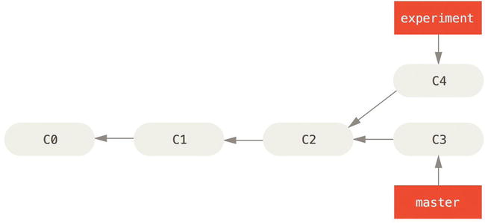
Rebasing
The Basic Rebase
in Git, there are two main ways to integrate changes from one branch into another:
the merge
the rebase
going back to an earlier example from our Basic Merging section, you can see that you diverged your work and made commits on two different branches
Simple divergent history
Corso C#

Slide 55
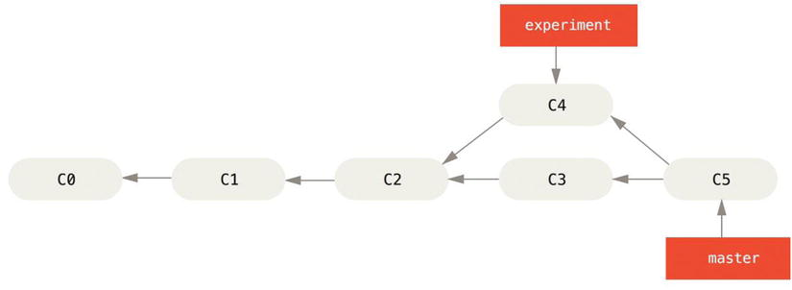
Rebasing
The Basic Rebase
the easiest way to integrate the branches, as we’ve already covered, is the merge command. It performs a three-way merge between the two latest branch snapshots (C3 and C4) and the most recent common ancestor of the two (C2), creating a new snapshot (and commit)
Merging to integrate diverged work history
Corso C#

Slide 56
Rebasing
The Basic Rebase
there is another way!
you can take the patch of the change that was introduced in C4 and reapply it on top of C3
Git calls it rebasing: with the rebase command, you can take all the changes that were committed on one branch and replay them on another one.
$ git checkout experiment
$ git rebase master
First, rewinding head to replay your work on top of it...
Applying: added staged command
Corso C#

Slide 57
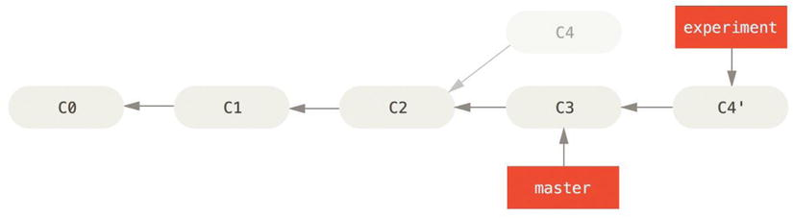
Rebasing
The Basic Rebase
it works by:
going to the common ancestor of the two branches (the one you’re on and the one you’re rebasing onto)
getting the diff introduced by each commit of the branch you’re on
saving those diffs to temporary files
resetting the current branch to the same commit as the branch you are rebasing onto
finally applying each change in turn
Rebasing the change introduced in C3 onto C4
Corso C#

Slide 58
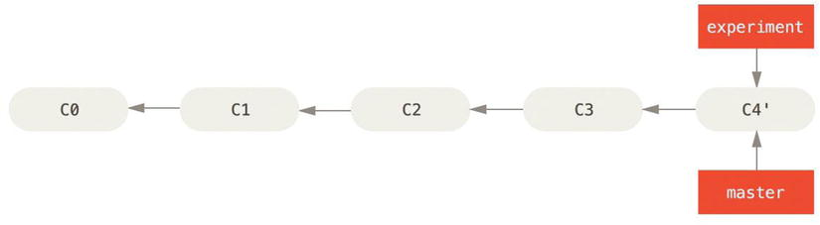
Rebasing
The Basic Rebase
now you can go back to the master branch and do a fast-forward merge.
Now, the snapshot pointed to by C4' is exactly the same as the one that was pointed to by C5 in the merge example.
there is no difference in the end product of the integration, but rebasing makes for a cleaner history
the log of a rebased branch looks like a linear history: it appears that all the work happened in series, even when it originally happened in parallel.
Corso C#

Slide 59
Rebasing
The Basic Rebase
you’ll do this to make sure your commits apply cleanly on a remote branch (i.e. in a project to which you’re trying to contribute but that you don’t maintain)
in this case, you do your work in a branch and then rebase your work onto origin/master when you were ready to submit your patches to the main project
that way, the maintainer doesn’t have to do any integration work: just a fast-forward or a clean apply
NOTE that the snapshot pointed to by the final commit you end up with, whether it’s the last of the rebased commits for a rebase or the final merge commit after a merge, is the same snapshot:
it’s only the history that is different
rebasing replays changes from one line of work onto another in the order they were introduced
merging takes the endpoints and merges them
Corso C#

Slide 60
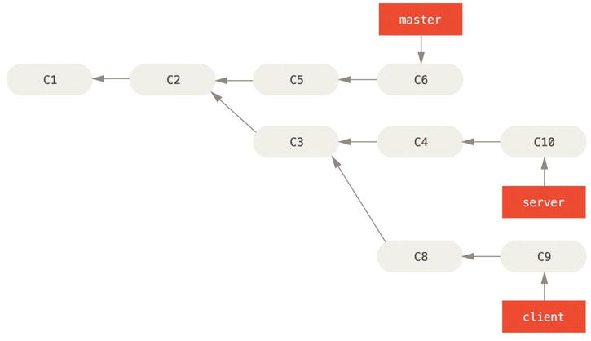
Rebasing
More Interesting Rebases
You can also have your rebase replay on something other than the rebase target branch. Take a history like Figure 3-31, for example. You branched a topic branch (server) to add some server-side functionality to your project, and made a commit. Then, you branched off that to make the client-side changes (client) and committed a few times. Finally, you went back to your server branch and did a few more commits.
you want to merge your client-side changes into your mainline for a release, but you want to hold off on the server-side changes until it’s tested further
Corso C#

Slide 61
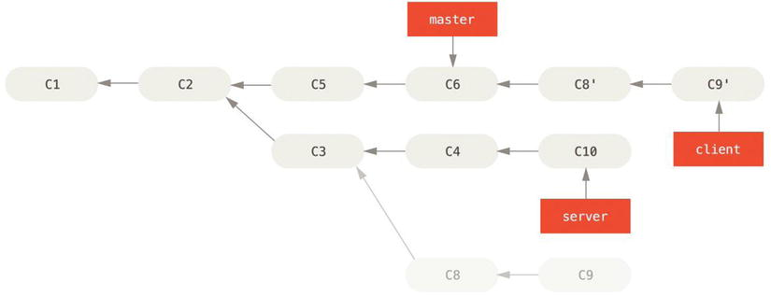
Rebasing
Rebasing a topic branch off another topic branch
you can take the changes on client that aren’t on server (C8 and C9) and replay them on your master branch by using the --onto option of git rebase
$ git rebase --onto master server client
this basically says, “Check out the client branch, figure out the patches from the common ancestor of the client and server branches, and then replay them onto master”
Corso C#

Slide 62
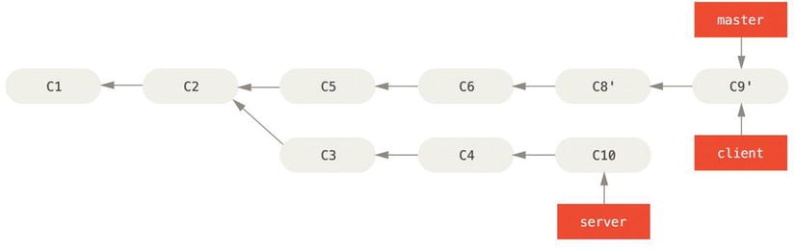
Rebasing
Rebasing a topic branch off another topic branch
finally you can fast-forward your master branch…
$ git checkout master
$ git merge client
Corso C#

Slide 63
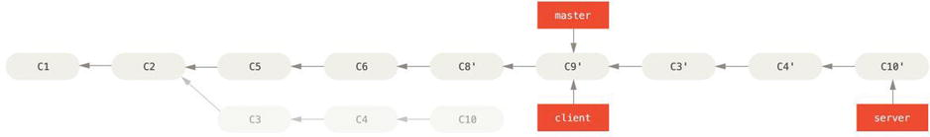
Rebasing
Rebasing a topic branch off another topic branch
now you want to pull your server branch
you can rebase server branch onto the master branch without having to check it out first by running git rebase [basebranch] [topicbranch] which checks out the topic branch (in this case, server) for you and replays it onto the base branch (master)
$ git rebase master server
this replays your server work on top of your master work
Corso C#

Slide 64
Rebasing
Rebasing a topic branch off another topic branch
again you can fast-forward your master branch…
$ git checkout master
$ git merge server
You can remove the client and server branches because all the work is integrated and you don’t need them anymore
$ git branch -d client
$ git branch -d server
Corso C#

Slide 65
Rebasing
Rebasing drawbacks
do not rebase commits that exist outside your repository
when you rebase stuff, you’re abandoning existing commits and creating new ones that are similar but different
if you push commits somewhere and others pull them down and base work on them, and then you rewrite those commits with git rebase and push them up again, your collaborators will have to re-merge their work and things will get messy when you try to pull their work back into yours
Corso C#

Slide 66
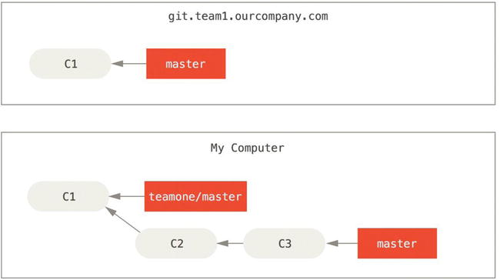
Rebasing
Rebasing drawbacks
suppose you clone from a central server and then do some work off that
Corso C#

Slide 67
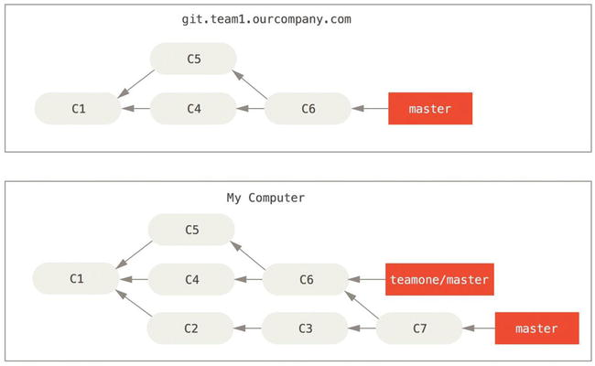
Rebasing
Rebasing drawbacks
someone else does more work that includes a merge, and pushes that work to the central server
you fetch them and merge the new remote branch into your work
Corso C#

Slide 68
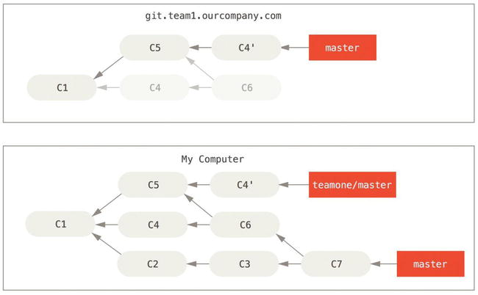
Rebasing
Rebasing drawbacks
the person who pushed the merged work decides to go back and rebase their work instead
they do a git push --force to overwrite the history on the server
you then fetch from that server, bringing down the new commits.
someone pushes rebased commits, abandoning commits you’ve based your work on
Corso C#

Slide 69
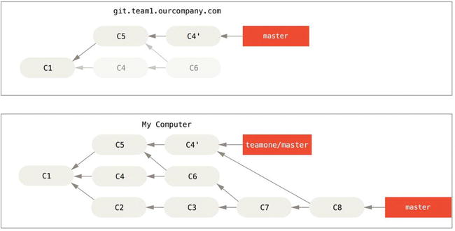
Rebasing
Rebasing drawbacks
now you’re both in trouble
if you do a git pull, you’ll create a merge commit which includes both lines of history.
if you run a git log when your history looks like this, you’ll see two commits that have the same author, date, and message, which will be confusing
furthermore if you push this history back up to the server, you’ll reintroduce all those rebased commits to the central server, which can further confuse people
it’s pretty safe to assume that the other developer doesn’t want C4 and C6 to be in the history; that’s why someone rebased in the first place.
Corso C#

Slide 70
Rebasing
Rebase When You Rebase
in a situation like this, if someone on your team force pushes changes that overwrite work that you’ve based work on, your challenge is to figure out what is yours and what they’ve rewritten
Git helps us:
in addition to the commit SHA checksum, Git also calculate a checksum that is based just on the patch introduced with the commit. This is called a “patch-id.”
if you pull down work that was rewritten and rebase it on top of the new commits from your partner, Git can often successfully figure out what is uniquely yours and apply them back on top of the new branch.
Corso C#

Slide 71
Rebasing
Rebase When You Rebase
i.e. in the previous scenario, if instead of doing a merge when we’re
abandoning commits you’ve based your work on
we run git rebase teamone/master
Git will:
determine what work is unique to our branch (C2, C3, C4, C6, C7)
determine which are not merge commits (C2, C3, C4)
determine which have not been rewritten into the target branch (just C2 and C3, since C4 is the same patch as C4’)
apply those commits to the top of teamone/master
Corso C#

Slide 72
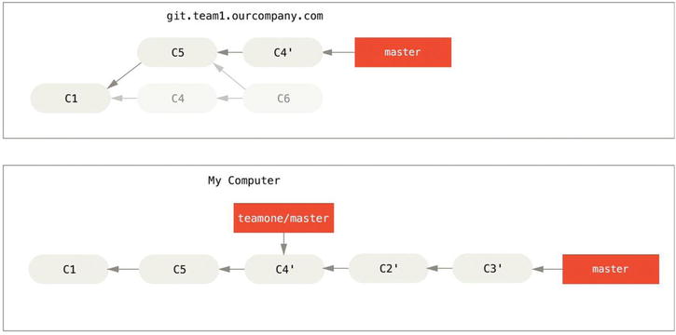
Rebasing
Rebase When You Rebase
the result should be something more like this, a rebase on top of force-pushed rebase work
this only works if C4 and C4' that your partner made are almost exactly the same patch.
otherwise the rebase won’t be able to tell that it’s a duplicate and will add another C4-like patch (which will probably fail to apply cleanly, since the changes would already be at least somewhat there)
Corso C#

Slide 73
Rebasing
Rebase When You Rebase
you can also simplify this by running a git pull --rebase instead of a normal git pull
or you could do it manually with a git fetch followed by a git rebase teamone/master in this case
if you are using git pull and want to make --rebase the default, you can set the pull.rebase config value with something like git config --global pull.rebase true
if you treat rebasing as a way to clean up and work with commits before you push them, and if you only rebase commits that have never been available publicly, then you’ll be fine.
if you rebase commits that have already been pushed publicly, and people may have based work on those commits, then you may be in for some frustrating trouble, and the scorn of your teammates.
if you or a partner does find it necessary at some point… make sure everyone knows to run
git pull --rebase to try to make things easier… if possible
Corso C#

Slide 74
Rebasing
Rebase vs. Merge
one point of view on this is that your repository’s commit history is a record of what actually happened
it’s a historical document, valuable in its own right, and shouldn’t be tampered with
from this angle, changing the commit history is almost blasphemous; you’re lying about what actually transpired
so… what if there was a messy series of merge commits? That’s how it happened, and the repository should preserve that for posterity.
the opposing point of view is that the commit history is the story of how your project was made.
you wouldn’t publish the first draft of a book, and the manual for how to maintain your software deserves careful editing
this is the camp that uses tools like rebase and filter-branch to tell the story in the way that’s best for future readers
Corso C#

Slide 75
Rebasing
Rebase vs. Merge
now, to the question of whether merging or rebasing is better: hopefully you’ll see that it’s not that simple
Git is a powerful tool, it allows you to do many things to and with your history, but every team and every project is different
you know how both of these things work and it’s up to you to decide which one is best for your particular situation.
in general the way to get the best of both worlds is to rebase local changes you’ve made but haven’t shared yet before you push them in order to clean up your story, but never rebase anything you’ve pushed somewhere
Corso C#

Slide 76
Stashing and cleaning
Stashing your work
often, when you’ve been working on part of your project, things are in a messy state and you want to switch branches for a bit to work on something else
the problem is, you don’t want to do a commit of half-done work just so you can get back to this point later
the answer to this issue is the git stash command
stashing takes the dirty state of your working directory (your modified tracked files and staged changes) and saves it on a stack of unfinished changes that you can reapply at any time
Corso C#

Slide 77
Stashing and cleaning
Stashing your work
go into your project and start working on a couple of files and possibly stage one of the changes
if you run git status, you can see your dirty state
$ git status
Changes to be committed:
(use "git reset HEAD <file>..." to unstage)
modified: index.html
Changes not staged for commit:
(use "git add <file>..." to update what will be committed)
(use "git checkout -- <file>..." to discard changes in working directory)
modified: lib/simplegit.rb
Corso C#

Slide 78
Stashing and cleaning
Stashing your work
now you want to switch branches, but you don’t want to commit what you’ve been working on yet
so you’ll stash the changes
to push a new stash onto your stack, run git stash or git stash save
$ git stash
Saved working directory and index state \
"WIP on master: 049d078 added the index file"
HEAD is now at 049d078 added the index file
(To restore them type "git stash apply")
your working directory is clean
$ git status
# On branch master
nothing to commit (working directory clean)
Corso C#

Slide 79
Stashing and cleaning
Stashing your work
At this point, you can easily switch branches and do work elsewhere; your changes are stored on your stack. To see which stashes you’ve stored, you can use git stash list
$ git stash list
stash@{0}: WIP on master: 049d078 added the index file
stash@{1}: WIP on master: c264051... Revert "added file_size"
stash@{2}: WIP on master: 21d80a5... added number to log
in this case, two stashes were done previously, so you have access to three different stashed works
you can reapply the one you just stashed by using the command shown in the help output of the original stash command: git stash apply
if you want to apply one of the older stashes, you can specify it by naming it, like this: git stash apply stash@{2}
if you don’t specify a stash, Git assumes the most recent stash and tries to apply it
$ git stash apply
# On branch master
# Changed but not updated:
# (use "git add <file>..." to update what will be committed)
#
# modified: index.html
# modified: lib/simplegit.rb
#
Corso C#

Slide 80
Stashing and cleaning
Stashing your work
the apply option only tries to apply the stashed work—you continue to have it on your stack
to remove it, you can run git stash drop with the name of the stash to remove
$ git stash list
stash@{0}: WIP on master: 049d078 added the index file
stash@{1}: WIP on master: c264051... Revert "added file_size"
stash@{2}: WIP on master: 21d80a5... added number to log
$ git stash drop stash@{0}
Dropped stash@{0} (364e91f3f268f0900bc3ee613f9f733e82aaed43)
run git stash pop to apply the stash and then immediately drop it from your stack
Corso C#

Slide 81
GIT BRANCHING
Summary
basic branching and merging in Git
creating and switching to new branches
switching between branches
merging local branches
share your branches by pushing them to a shared server
working with others on shared branches
rebasing your branches before they are shared
stashing your work
Corso C#

