Slide 1
Breast Cancer Histopathological Images Segmentation and Classification using Vision Transformer
Soro Bedionita, Tan Ying Hui, Oh Joon Kwon (AI604-2021-SP)
Presenter: SORO Bedionita.

Slide 2
OUTLINE
Introduction
Previous works and motivation
Patch-based image classification and segmentation
Limit of patch-based approaches
Transformer in computer vision
Proposed method
Experiments
Conclusion and discussion

Slide 3
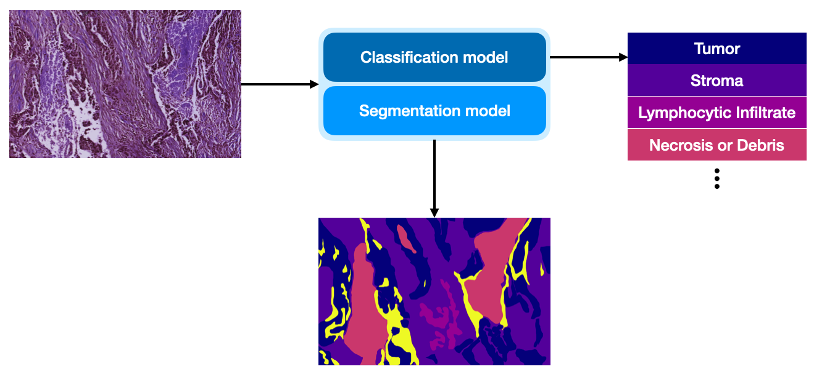
INTRODUCTION
We want to perform Whole Slide Images classification and segmentation
Being able to predict cancer type and subtypes
Why not use CNN (resnet) on raw images?
Images are very large
Resize them!
That does not help a lot. Because performance degrades
What does existing methods do?

Slide 4
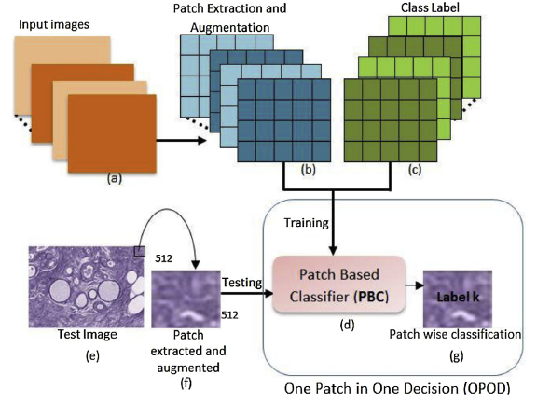
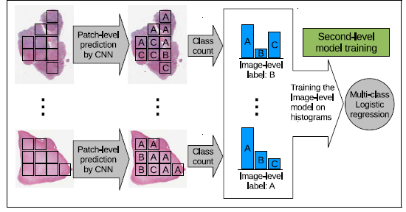
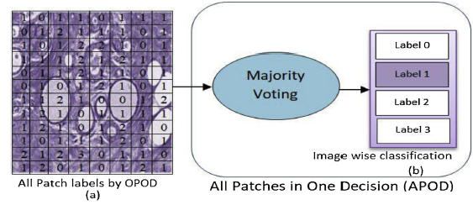
Related work
Kaushiki Roy, et al: Patch-based system for Classification of Breast Histology images using deep learning, 2019
Le Hou, et al:, Patch-based Convolutional Neural Network for Whole Slide Tissue Image
Classification, CVPR 2016
Patch-based approaches can be treated as sequences to sequences approaches

Slide 5
Transformer in computer vision
Encoder-Decoder for Generation:
Image Transformer(2018), Image GPT (2020):
Image segmentation
Jeya Maria Jose Valanarasu et al, Medical Transformer: Gated Axial-Attention for Medical Image Segmentation, 2021
Jieneng Chen et al, TransUNet: Transformers Make Strong Encoders for Medical Image Segmentation, 2021
Enze Xie et al, SegFormer: Simple and Efficient Design for Semantic Segmentation with Transformers,2021

Slide 6
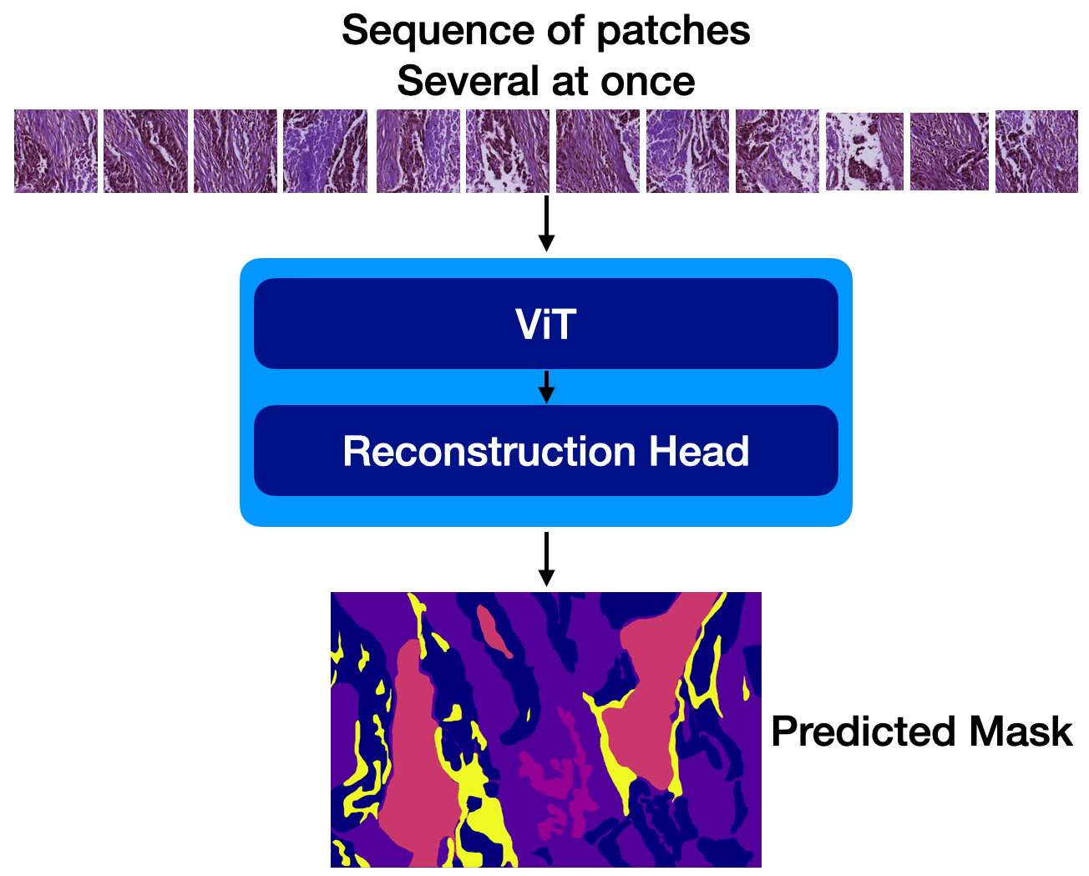
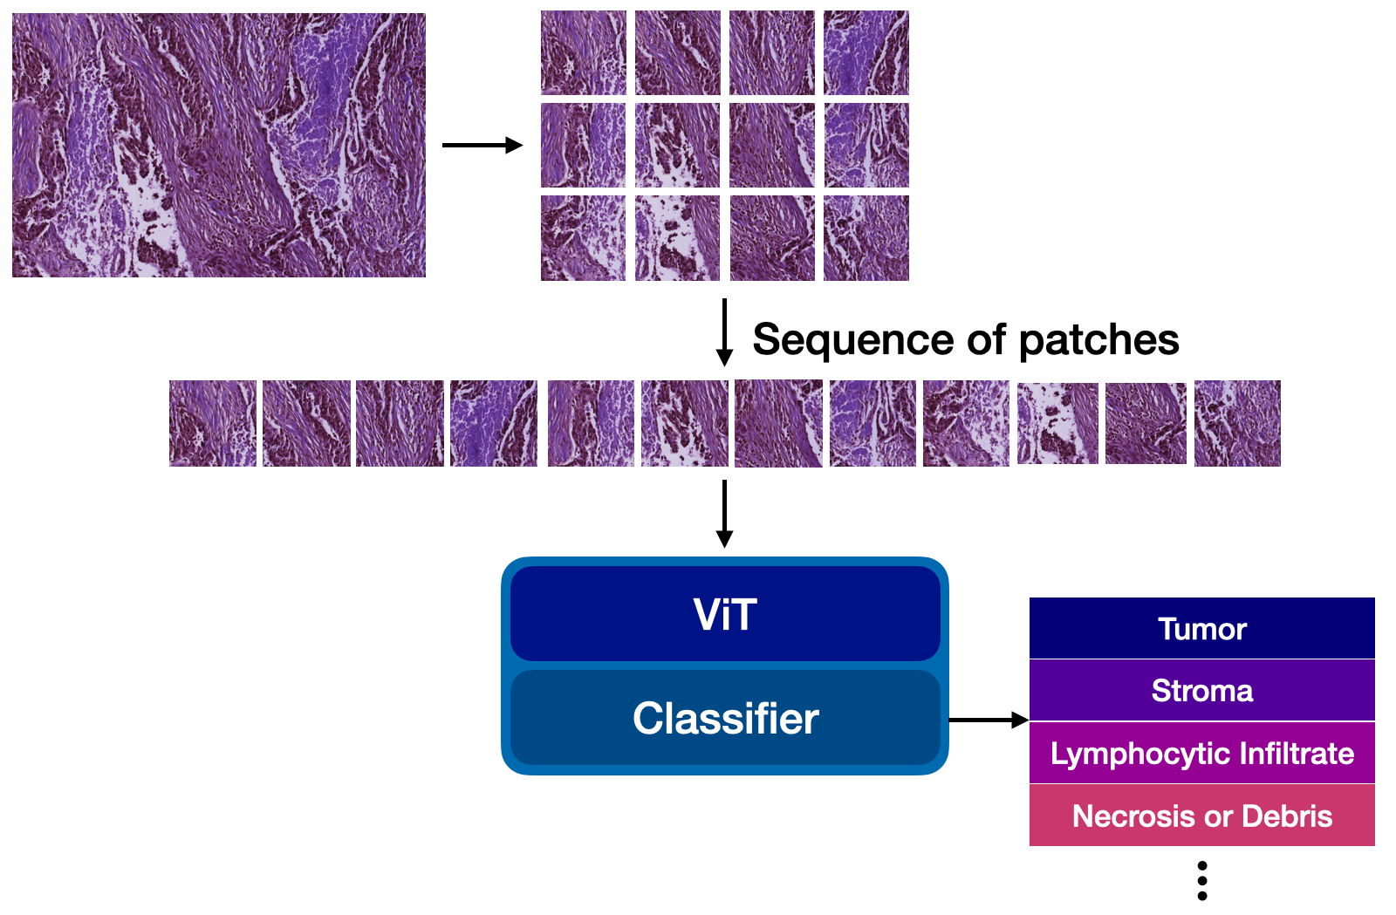
Proposed method
Exploit Vision Transformer as core architecture.
Divide the problem in two. Perform classification then adapt the model to segmentation
Transposed CNN

Slide 7
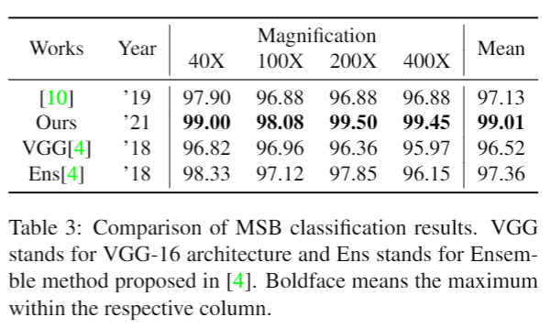
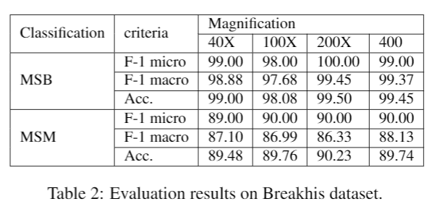
Classification experiments on BreakHis dataset
Setting 70/30 split no increase in number of existing images
Compared to existing state of the art methods with same settings, our method achieved the best performance. Those two existing methods required more data to achieve similar performance than our method. ViT transformer seems more data efficient on this task

Slide 8
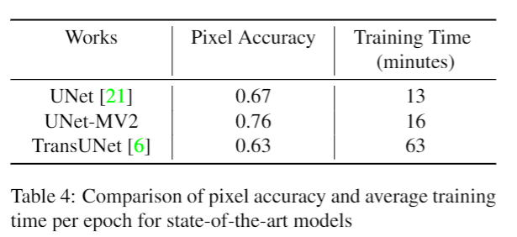
Segmentation experiments
Preliminaries results using existing segmentation models tried on images patches of sizes 512x512x3.
The existing ViT-based medical images segmentation method is hard to train compared to conventional unet
We are currently working on ViT-based approach that can reduce the computation time whlle achieving competitive results compared to unet.
We are also investigating the patch-based unet

Slide 9
contribution
We proposed a whole slide images classification and segmentation method
The proposed method can replace patch-based approach in classification and segmentation tasks.
Our method is the first of applying ViT or transformer to histology images analysis
This method is faster than most existing state-of-the-art deep learning methods for biomedical images analysis

Slide 10
Conclusion and challenges
We proposed a sequence level based whole slide segmentation and classification methods that could mitigate the limitation of patch-base approach.
The proposed method achieves state-of-the art classification performance on breakHis dataset.
However, the segmentation model is still challenging.

Slide 11
Discussion
The reconstruction masks is not smooth as with unet-based approaches
Can patch-to-patch segmentation improve the performance.
Maybe we focus too much on ViT.
What are the possible ways to achieve good segmentation performance?

Slide 12
THANK YOU

