Slide 1



Fresh Life - Personalized Nutrition Assistant
A Modern Approach to Achieving Your Fitness Goals

Slide 2
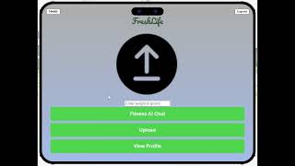
01
01
02
02
03

Slide 3
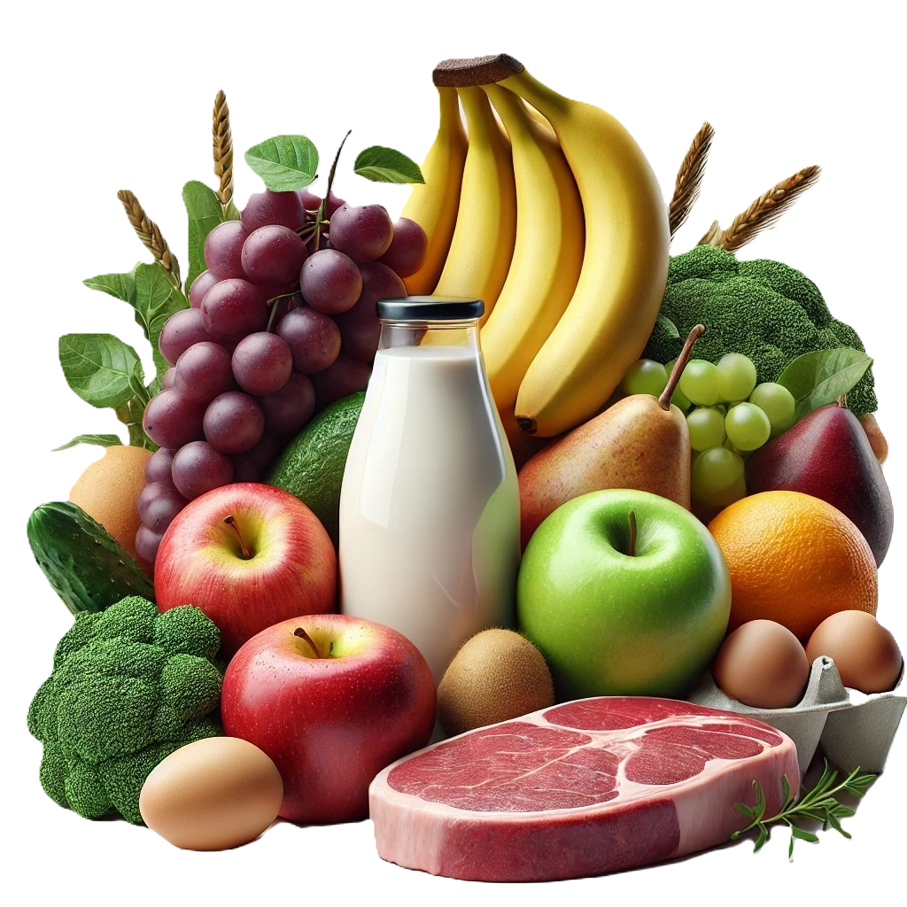
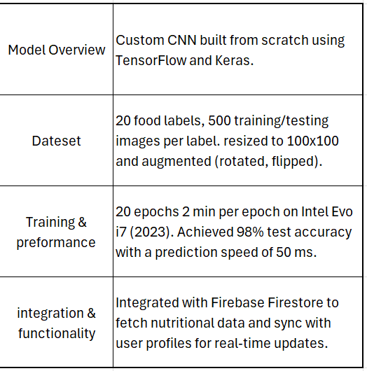

Machine Learning
01
02
03
04
Model

Slide 4
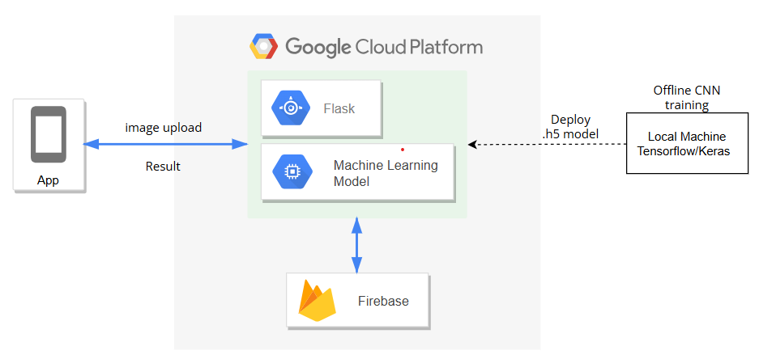
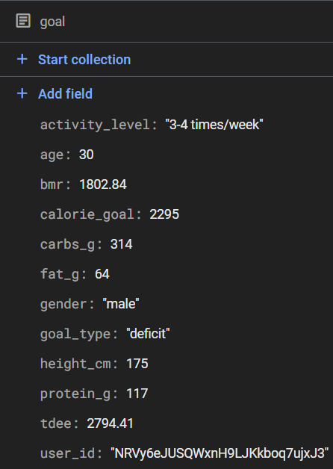
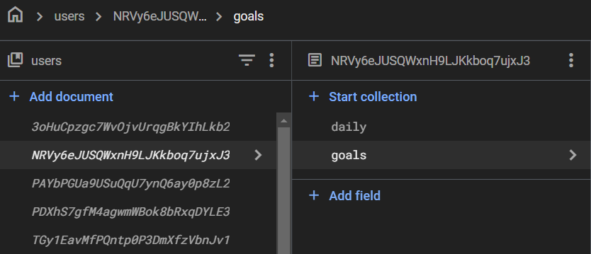
FireStore - Database
NoSQL
01
01
User specific data
(Goals, Daily Consumption)
02
02
Nutritional dataset
03
03
4

Slide 5


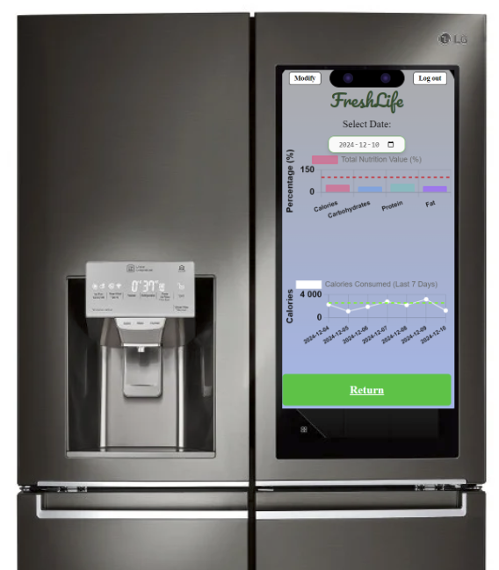
FreshLife
Seamless Smart Appliance Integration
AI-Powered Personalization
Innovative User Experience
Health and Fitness Market Expansion
Future-Ready Scalability

Slide 6
Thank you for your attention

