Slide 1

PENNY / THE PERSON
Calmer
money days.
Busy families lose track of spending.
Money becomes another source of stress.
For parents who want control without studying personal finance.
1/6
Notes:
For a busy family, money is another job after work. Receipts, bank accounts and bills are scattered, and it's hard to know what's left. That can mean stress at the end of the month. We built Penny to help parents feel in control, without having to study personal finance.

Slide 2
PENNY / WHY IT MATTERS
33%
Everyday money
should make sense.
of adults worldwide met the survey's financial-literacy threshold.
2014 survey. Global context, not a Danish statistic.
Source: S&P Global FinLit Survey, 2014 data / 2015 report. Over 150,000 adults in 140+ countries.
2/6
Notes:
In the S&P Global survey, only 33 percent of adults worldwide met the financial-literacy threshold. That's a global finding from 2014, not a Danish statistic. But it raises a useful question: how can AI help people understand everyday money decisions?
Source: https://gflec.org/wp-content/uploads/2015/11/3313-Finlit_Report_FINAL-5.11.16.pdf

Slide 3
PENNY / THE PRODUCT
Ask Penny.
Understand your next step.
Start with your family's plan.
Get an answer you can check.
Set a budget, a buffer and a savings goal.
Ask about money in everyday language.
Claude explains calculated budget and goal cards.
You confirm changes.
Food spending first. Bank and loan insights extend the plan.
Our aim: checks and relevant alerts, with the family in control.
3/6
Notes:
Penny is a friendly AI money coach. You set your family's budget, safety buffer and savings goal, then talk to her in your own words. Claude explains the numbers, and calculated cards let you check the answer. You confirm changes. We start with groceries, with bank and loan insights as the broader direction. Our aim is to let Penny check the finances and contact you when something needs attention. Let us show you.

Slide 4
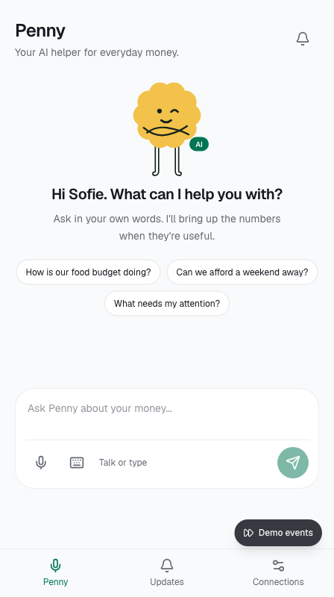
PENNY / LIVE DEMO · 60 SECONDS
"How is our
grocery budget doing?"
Ask Penny by voice.
Hear the answer and see the matching budget card.
Open a budget update.
Penny uses the family's saved plan.
Synthetic data. Connections and events are simulated. No real money moves.
4/6
Notes:
· Demo · 1:10–2:10
Before presenting, sign in, connect the labelled synthetic bank fixtures and save the family plan. Use the browser where the voice and card were verified. Do not spend this minute on onboarding. Check microphone and audio beforehand. Keep the labelled text chat ready.
- 0–8 seconds: switch to the app. Say, "This prototype uses synthetic bank data and simulated connections. No real money moves."
- 8–28 seconds: tap Talk to Penny and ask, "How is our grocery budget doing?" Let the answer finish. Point to the matching budget card. Avoid quoting a fixed balance; the card uses current saved state.
- 28–48 seconds: use Demo events → Budget update, then open the notification. Show that Penny uses the saved family budget and the event's context.
- 48–60 seconds: say, "One question gives the family an understandable answer and the numbers behind it." Switch back to slide 5.
If voice does not respond within roughly eight seconds, use the text field with the same question. If a provider request fails, show the existing card or actual-app screenshot and say that the live request failed. Do not present a screenshot as a fresh answer. End the demo at 60 seconds.

Slide 5
PENNY / THE CHANGE WE WANT
Less stress.
More control.
Understand what's left.
Know what the family can spend and why.
Make progress together.
Choose practical changes toward a trip, home or buffer.
Intended outcomes. Conversation, saved plans and budget cards demonstrated; family impact untested.
5/6
Notes:
The outcome we want is less stress, clearer spending decisions and progress toward something the family cares about. Tonight we demonstrated conversation, saved plans and contextual budget cards. We haven't proved that families save money or feel less stressed yet. That's the next test.

Slide 6
PENNY / 30-DAY IMPACT PLAN · OWNER: JULIA
Test with
real families.
Weeks 1–2 · First real-world test
Set a grocery budget, try simulated receipts and explore a goal. Check understanding and money stress.
5 families
Weeks 3–4 · Improve and decide
Target: at least 3 would use Penny regularly, with evidence of what helps.
Fix confusing suggestions. Compare with the baseline and decide what to build next.
Help us find pilot families and a receipt-integration partner.
6/6
Notes:
Julia owns our next 30 days. We'll test Penny with five Danish families: set a grocery budget, try simulated receipts and explore a savings goal. We'll check what they understand, what helps, and what confuses them. Our target is at least three families saying they would use Penny regularly, backed by examples of useful features. We're looking for pilot families and a technical partner to move beyond simulated receipts.

