Slide 1


Requirements Engineering
Seminar 3:
* Lauesen chapters: 6: Quality Requirements 7: Requirements in the product life cycle 9: Checking and validation 10: Techniques at work
* [QUPER]: Regnell, Björn, Richard Berntsson Svensson, and Thomas Olsson. "Supporting roadmapping of quality requirements." IEEE software 25.2 (2008). doi: 10.1109/MS.2008.48
* [RP]: Ruhe, Gunther, and Moshood Omolade Saliu. "The art and science of software release planning." IEEE software 22.6 (2005): 47-53. doi: 10.1109/MS.2005.164

Slide 2

Funktionella krav:
Vad som görs
Ofta antingen/eller
Indata – Utdata
Funktioner
Kvalitetskrav,
(kallas även
icke-funktionella krav, extrafunktionella krav):
Hur bra det görs
Mäts ofta på en skala
Sätter begränsningar på systemet (eller utvecklingsprocessen)
Kan ofta slå tvärs över många funktioner
Prestanda
Tillförlitlighet
Användbarhet
Säkerhet
Interoperabilitet
Underhållsbarhet
…
Men uppdelningen är inte svartvit…

Slide 3
Functional reqs FR:
What the system shall do
Often intended to be implemented as a whole or else not implemented at all
Often regards input/output data and functions that process the input data to produce the output
Quality Requirements QR,
(also known as:
Non-Functional Reqs (NFR) or Extra-Functional Reqs)
How good the system shall do it
Often measured on a scale
Often put constraints on the system
(or the development process)
Often cross-cutting:
may impact many functions
or even the whole system
Performance
Reliability
Usability
Safety, Security
Interoperability
Maintainability
…
But the division is not black and white...

Slide 4
FR & QR are often tightly coupled
In practice it is often difficult to separate functional and quality requirements as quality requirements often are manifested into extra functionality.
Example: Quality requirement on security requires a log-in function.

Slide 5
Difficult trade-offs among QR
Quality requirements often counteract each other.
Common examples:
  Higher performance
  -> lower maintainability
  Higher security
  -> lower usability
Requires carefully considered trade-offs!

Slide 6
Quality requirements often determine choice of architecture
System Architecture
REQ
GUI
A
B
REQ
REQ
C
D
REQ
L1
L2
DB
Cost?
Value?
Long-term vs short-term?

Slide 7
Paper [QUPER]
Supporting Roadmapping of Quality Requirements
Björn Regnell, Richard Berntsson Svensson, Thomas Olsson,
IEEE Software 25(2) pp 42-47 March-April 2008
https://vimeo.com/10581781

Slide 8
Quality Requirements challenge in market-driven RE
Systematic prioritization of FEATURES
is state-of-art in roadmapping and platform/product scoping
…but…
Prioritisation of QUALITIES is often
handled ad hoc with no specific support for roadmapping
One FR imply many different qualities.
How to scope both FR and QR together?

Slide 9

Improving
Quality Requirements
It’s 3D
Cost &Benefit
&Quality
Problem:
Quality requirements such as performance
are often given without explanation
  Would just a little less still be almost as valuable?
  Would just a little less be very much cheaper?
One proposed solution:
Estimate cost-benefit breakpoints and barriers with
QUPER = Quality Performance reference model

Slide 10
QUPER model views: Benefit, Cost, Roadmap
Benefit view
Cost view
Excessive
Competitive
advantage
Saturation breakpoint
Useful
Differentiation breakpoint
Useless
Utility breakpoint
Quality level
Quality level
barrier
Roadmap view
Competitor B
Competitor A
Target release n₂
Target release n₁
Current
Bad Target
Quality level
(Feature X, Segment Y)‏
Utility
Differentiation
Saturation

Slide 11
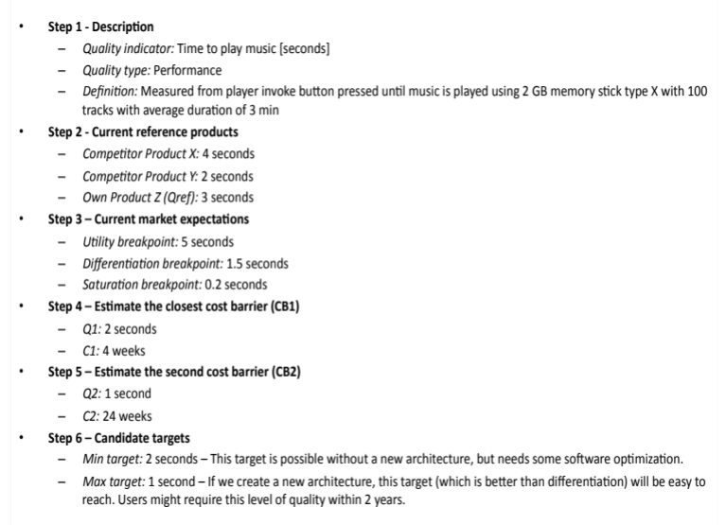
QUPER example steps

Slide 12
reqT QUPER example
Targets represent (candidate) requirements.
The other stuff is there to define what we mean with the targets.
val m = Model(
Quality("mtts") has (
Gist("Mean time to startup"),
Spec("Measured in milliseconds using Test startup"),
Breakpoint("utility") has Value(4000),
Breakpoint("differentiation") has Value(1500),
Breakpoint("saturation") has Value(200),
Target("basic") has (
Value(2000), Comment("Probably possible with existing architecture.")),
Target("strech") has (
Value(1100), Comment("Probably needs new architecture.")),
Barrier("first") has (Min(1900), Max(2100)),
Barrier("second") has Value(1000),
Product("competitorX") has Value(2000),
Product("competitorY") has Value(3000)),
Test("startup") verifies Quality("mtts"),
Test("startup") has (
Spec("Calculate average time in milliseconds of the startup time over 10 executions from start button is pressed to logon screen is shown.")))
[Example modified from "Setting quality targets for coming releases with QUPER: an industrial case study",
R. Berntsson Svensson, Y. Sprockel, B. Regnell, S. Brinkkemper, Requirements Engineering, DOI: 10.1007/s00766-011-0125-0]

Slide 13
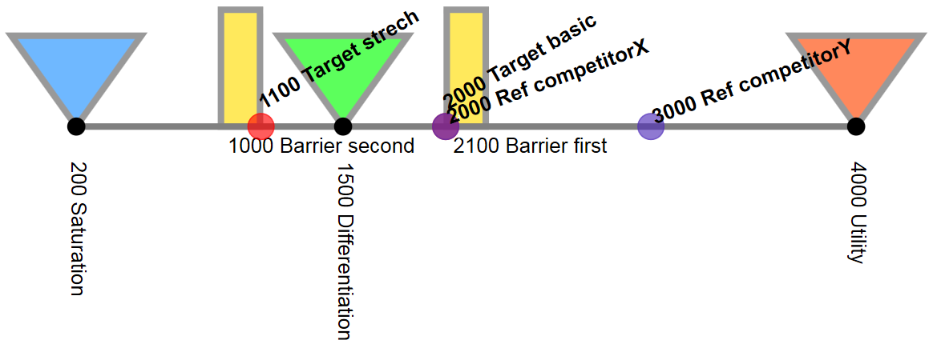
Quper export to svg with reqT
reqT.exporter.toQuperSpec(m).toSvgDoc.save("q.svg")
reqT.desktopOpen("q.svg")

Slide 14


Discussion
QR
What quality features of a word processor do you appreciate?

Slide 15
Fig 6.1 Quality factors
McCall
US Airforce 1980
Operation:
Integrity
Correctness !!
Reliability
Usability
Efficiency
Revision:
Maintainability
Testability
Flexibility
Transition:
Portability
Interoperability
Reusability !!
ISO 9126
Functionality
Accuracy
Security
Interoperability
Suitability !!
Compliance !!
Reliability
Maturity
Fault tolerance !!
Recoverability !!
Usability
Efficiency
Maintainability
Testability
Changeability
Analysability !!
Stability !!
Portability
Adaptability
Installability !!
Conformance !!
Replaceability !!
Use as check lists

Slide 16
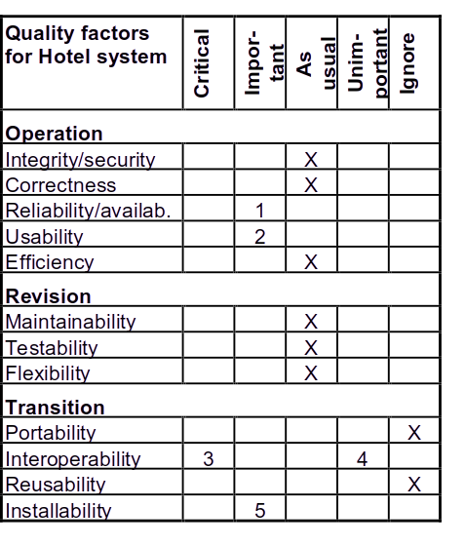
Fig 6.2 Quality grid
Concerns:
1. Hard to run the hotel if system is down. Checking in guests is impossible since room status is not visible.
2. We aim at small hotels too. They have less qualified staff.
3. Customers have many kinds of account systems. They prioritize smooth integration with what they have.
4. Integration with spreadsheet etc. unimportant. Built-in statistics suffice.
5. Must be much easier than present system. Staff in small hotels should ideally do it themselves.
From: Soren Lauesen: Software Requirements
© Pearson / Addison-Wesley 2002
Notes:
Här skulle man kunna använda parvisa jämförelser istället. AHP/Plannig game etc

Slide 17
Fig 6.3A Open metric and open target
Physical
limits
R1: Product shall detect speed violation and take photo within 0.5 seconds.
R2: Product shall compute a room occupation forecast within 2 minutes.
R3: Product shall compute a room occupation forecast within 4 minutes.
R4: Product shall compute a room occupation forecast within ___ minutes.
R5: Product shall compute a room occupation forecast within ___ minutes. (Customer expects one minute.)
R6: Forecast shall be computed with exponential trend smoothing and seasonal adjustments.
R7: The supplier shall specify the forecast accuracy for hotels similar to ours.
Best available
is 4 minutes?
Nobody strives
for 2 minutes
Open target but
how important?
Open target +
expectations
Supplier uses
another approach?
Open metric
Notes:
R6 design level

Slide 18
Fig 6.3C Cost/benefit of response time
$ or ratio
2
Benefit/cost
Benefit
1
Cost
1 2 3 4 min
Response time
From: Soren Lauesen: Software Requirements
© Pearson / Addison-Wesley 2002

Slide 19
Fig 6.4 Capacity and accuracy requirements
Capacity requirements:
R1: The product shall use < 16 MB of memory even if more is available.
R2: Number of simultaneous users < 2000
R3: Database volume:
#guests < 10,000 growing 20% per year
#rooms < 1,000
R4: Guest screen shall be able to show at least 200 rooms booked/occu-pied per day, e.g. for a company event with a single “customer”.
Accuracy requirements:
R5: The name field shall have 150 chars.
R6: Bookings shall be possible at least two years ahead.
R7: Sensor data shall be stored with 14 bit accuracy, expanding to 18 bits in two years.
R8: The product shall correctly recognize spoken letters and digits with factory background noise ___ % of the time. Tape B contains a sample recorded in the factory.
From: Soren Lauesen: Software Requirements
© Pearson / Addison-Wesley 2002
Notes:
Capacity = vilka resurser som behöver utnyttjas (minne, databasutrymme etc)
Accuracy= omfång och noggrannhet hos data, exvis antal tecken

Slide 20
Fig 6.5A Performance requirements
Performance requirements:
R1: Product shall be able to process 100 payment transactions per second in peak load.
R2: Product shall be able to process one alarm in 1 second, 1000 alarms in 5 seconds.
R3: In standard work load, CPU usage shall be less than 50% leaving 50% for background jobs.
R4: Scrolling one page up or down in a 200 page document shall take at most 1 s. Searching for a specific keyword shall take at most 5 s.
R5: When moving to the next field, typing must be possible within 0.2 s.
When switching to the next screen, typing must be possible within 1.3 s. Showing simple report screens, less than 20 s.
(Valid for 95% of the cases in standard load)
R6: A simple report shall take less than 20 s for 95% of the cases. None shall take above 80s. (UNREALISTIC)
Cover all product functions?
From: Soren Lauesen: Software Requirements
© Pearson / Addison-Wesley 2002
Notes:
R2: alarm kommer i skurar; R3 kanske egentligen ett kapacitetskrav

Slide 21
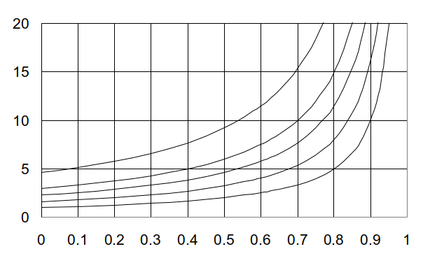
Fig 6.5B Response times, M/M/1
Service time: Exponential distribution
Response factor
99%
90%
80%
95%
Average
System load
Example:
Service time: Time to process one request
Average service time: 8 s (exp. distr.)
Average interarrival time: 10 s (exp. distr.)
System load: 8/10 = 0.8
Average response time:
5 × service time = 40 s
90% responses within:
12 × service time = 96 s
From: Soren Lauesen: Software Requirements
© Pearson / Addison-Wesley 2002

Slide 22
Fig 6.6A Usability
Usability requirements?
R1: System shall be easy to use??
R2: 4 out of 5 new users can book a guest in 5 minutes, check in in 10 minutes, . . . New user means . . . Training . . .
Achieving usability
Prototypes (mockups) before programming.
Usability test the prototype.
Redesign or revise the prototype.
Easier programming. High customer satisfaction.
Defect types
Program error: Not as intended by the programmer.
Missing functionality: Unsupported task or variant.
Usability problem: User cannot figure out . . .
From: Soren Lauesen: Software Requirements
© Pearson / Addison-Wesley 2002

Slide 23
Fig 6.6B Usability problems
Examples of usability problems
P1: User takes long time to start search. Doesn’t notice “Use F10”. Tries many other ways first.
P2: Believes task completed and result saved. Should have used Update before closing.
P3: Cannot figure out which discount code to give customer. Knows which field to use.
P4: Crazy to go through 6 screens to fill 10 fields.
Problem classification
Task failure: Task not completed - or believes it is completed.
Critical problem: Task failure or complaints that it is cumbersome.
Medium problem: Finds out solution after lengthy attempts.
Minor problem: Finds out solution after short attempts
From: Soren Lauesen: Software Requirements
© Pearson / Addison-Wesley 2002

Slide 24

Fig 6.6C Usability test & heuristic evaluation
Usability test
Realistic introduction
Realistic tasks
Note problems
Observe only or
Think aloud & ask
Log keeper
User
Facilitator
Heuristic evaluation
Expert’s predicted problems
≅ Inspection/Review
Heuristic
evaluation
Usability test
findings
Usability test:
Cover all tasks?
Mockups find same problems
as test with final system?
Real
problems
From: Soren Lauesen: Software Requirements
© Pearson / Addison-Wesley 2002

Slide 25
Fig 6.6D Defects & usability factors
Defect correction
Program errors Usability problems
Expected Surprising?
Inspection OK Inspection low hit-rate
Detect in test stage Detect in design stage
Mostly simple Often redesign
Test equipment OK Subjects hard to find
Usability
Fit for use = tasks covered
+
Ease of use =
Ease of learning
Task efficiency
Ease of remembering
Subjective satisfaction
Understandability
Functional
requirements
Usability
factors
From: Soren Lauesen: Software Requirements
© Pearson / Addison-Wesley 2002

Slide 26
Fig 6.7(A) Usability requirements
Risk
Cust.
Suppl
Problem counts
R1: At most 1 of 5 novices shall encounter critical problems during tasks Q and R. At most 5 medium problems on list.
Task time
R2: Novice users shall perform tasks Q and R in 15 minutes. Experienced users tasks Q, R, S in 2 minutes.
Keystroke counts
R3: Recording breakfast shall be possible with 5 keystrokes per guest. No mouse.
Opinion poll
R4: 80% of users shall find system easy to learn. 60% shall recommend system to others.
Score for understanding
R5: Show 5 users 10 common error mesages, e.g. Amount too large. Ask for the cause. 80% of the answers shall be correct.
From: Soren Lauesen: Software Requirements
© Pearson / Addison-Wesley 2002

Slide 27
Fig 6.7(B) Usability requirements
Risk
Cust.
Suppl
Design-level reqs
R6: System shall use screen pictures in app. xx, buttons work as app. yy.
Product-level reqs
R7: For all code fields, user shall be able to select value from drop-down list.
Guideline adherence
R8: System shall follow style guide zz. Menus shall have at most three levels.
Development process reqs
R9: Three prototype versions shall be made and usability tested during design.
From: Soren Lauesen: Software Requirements
© Pearson / Addison-Wesley 2002

Slide 28

Fig 6.8A Threats
Wire tapping
Curious eyes
Product
Payslip
Wire tapping
Disk crash
Threats Violate Prevention, e.g.
Input, e.g.
Mistake Integrity Logical checks
Illegal access Authenticity Signature
Wire tapping Confidentiality Encryption
Storing, e.g.
Disk crash Availability RAID disks
Program error Integrity Test techniques
Virus deletes data Availability Firewall
Output, e.g.
Transmission Availability Multiple lines
Fraud Confidentiality Auditing
Virus sends data Authenticity Encryption
From: Soren Lauesen:
Software Requirements
© Pearson / Addison-Wesley 2002

Slide 29
Fig 6.9 Security requirements
R1: Safeguard against loss of database. Estimated losses to be < 1 per 50 years.
R2: Safeguard against disk crashes. Estimated losses to be < 1 per 100 years.
R3: Product shall use duplicated disks (RAID disks).
R4: Product shall safeguard against viruses that delete files. Remaining risk to be < ______.
R5: Product shall include firewalls for virus detection.
R6: Product shall follow good accounting practices. Supplier shall obtain certification.
R7: Product shall prevent users deleting invoices before transfer to the account system.
R8: The supplier shall as an option offer features for checking and reserving deposits made by credit cards.
R9: The supplier must enclose a risk assessment and suggest optional safeguards.
From: Soren Lauesen: Software Requirements
© Pearson / Addison-Wesley 2002

Slide 30
Examples: Capacity and Performance <=> Usability
Model(
Quality("dbCapacity") has
Spec("#guests < 10,000 growing 20% per year, #rooms < 1,000"),
Quality("calendarAccuracy") has
Spec("Bookings shall be possible at least two years ahead."),
Quality("forecastPerformance") has
Spec("Product shall compute a room occupation forecast within ___ minutes. (Customer expects one minute.)"),
Quality("taskTimeUsability ") has
Spec("Novice users shall perform tasks Q and R in 15 minutes. Experienced users tasks Q, R, S in 2 minutes."),
Quality("taskTimeUsability") requires (Task("Q"), Task("R"), Task("S")),
Quality("peakLoadPerformance") has
Spec("Product shall be able to process 100 payment transactions per second in peak load."))
[Examples modified from Lauesen: "Software Requirements – Styles and Techniques"]

Slide 31
Fig 6.10 Maintainance
Corrective
maintenance
Preventive
maintenance
Product
Perfective
maintenance
New release
Maintenance cycle:
Report: Record and acknowledge.
Analyze: Error, change, usability, mistake?
Cost/benefit?
Decide: Repair? reject? work-around?
next release? train users?
Reply: Report decision to source.
Test: Test solution. Related defects?
Carry out: Install, transfer user data, inform.
From: Soren Lauesen: Software Requirements
© Pearson / Addison-Wesley 2002

Slide 32
Fig 6.11A Maintainability requirements
Risk
Cust.
Suppl
Maintenance performance
R1: Supplier’s hotline shall analyze 95% of reports within 2 work hours. Urgent defects (no work around) shall be repaired within 30 work hours in 95% of the cases.
R2: When reparing a defect, related non-repaired defects shall be less than 0.5 in average.
R3: For a period of two years, supplier shall enhance the product at a cost of ___ per Function Point.
Support features
R4: Installation of a new version shall leave all database contents and personal settings unchanged.
R5: Supplier shall station a qualified developer at the customer’s site.
R6: Supplier shall deposit code and full documentation of every release and correction at ____________.
From: Soren Lauesen: Software Requirements
© Pearson / Addison-Wesley 2002

Slide 33
Fig 6.11B Maintainability requirements
Risk
Cust.
Suppl
Development process requirements
R7: Every program module must be assessed for maintainability according to procedure xx. 70% must obtain “highly maintainable” and none “poor”.
R8: Development must use regression test allowing full re-testing in 12 hours.
Program complexity requirements
R9: The cyclomatic complexity of code may not exceed 7. No method in any object may exceed 200 lines of code.
Product feature requirements
R10: Product shall log all actions and provide remote diagnostic functions.
R11: Product shall provide facilities for tracing any database field to places where it is used.
From: Soren Lauesen: Software Requirements
© Pearson / Addison-Wesley 2002

Slide 34
Fig 6.3B Planguage version of target etc.
Forecast speed [Tag]: How quickly the system completes a forecast report [Gist]
Scale: average number of seconds from pushing button, to report appearing.
Meter: Measured 10 times by a stopwatch during busy hours in hotel reception.
Must: 8 minutes, because the competitive system does it this fast.
Plan: ____ (supplier, please specify).
Wish: 2 minutes.
Past: Done as batch job taking about an hour.
From: Soren Lauesen: Software Requirements
© Pearson / Addison-Wesley 2002

Slide 35
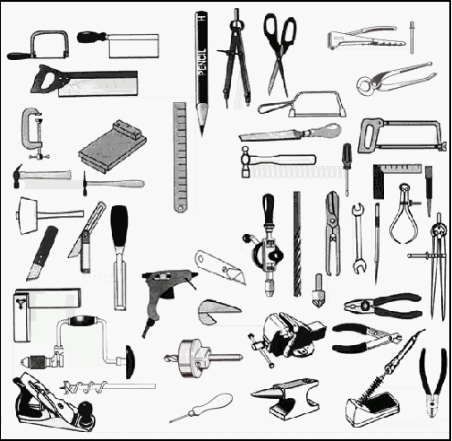
Overview of styles for specifying functional requirements (Swedish terminology)
Datakravstilar:
Datamodell
( =E/R-diagr.)
Dataordlista
Reguljära uttryck
Virtuella fönster
Funktionella kravstilar:
Kontextdiagram
Händelse- & Funktionslistor
Produktegenskapskrav
Skärmbilder & Prototyper
Uppgiftsbeskrivningar
Egenskaper från uppgifter
Uppgifter och stöd
(Levande) Scenarier
Högnivåuppgifter
Användningsfall
Uppgifter med data
Dataflödesdiagram
Standardkrav
Krav på utvecklingsprocessen
Funktionella detaljer:
Enkla och sammansatta funktioner
Tabeller & Beslutstabeller
Textuella processbeskrivningar
Tillståndsdiagram
Övergångsmatriser
Aktivitetsdiagram
Klassdiagram
Samarbetsdiagram
Sekvensdiagram
Speciella gränssnitt
Rapporter
Plattformskrav
Produktintegration
Tekniska gränssnitt

Slide 36
Special interfaces Summary
Platform requirements
  Requirements on what the product shall run on now and in the future
  Dealing with existing and planned platforms
  Can be very complex and technically detailed depending on the product and contracting situation
Technical interfaces
  Requirements on interactions with other systems
  Many different ways to specify technical interfaces
  Performance and capacity requirements can be very difficult to understand and validate
  Prototype and test the communication early

Slide 37
Special interfaces Summary
Platform requirements
  Requirements on what the product shall run on now and in the future
  Dealing with existing and planned platforms
  Can be very complex and technically detailed depending on the product and contracting situation
Technical interfaces
  Requirements on interactions with other systems
  Many different ways to specify technical interfaces
  Performance and capacity requirements can be very difficult to understand and validate
  Prototype and test the communication early
Note that software product line engineering is not covered by Lauesen.

Slide 38
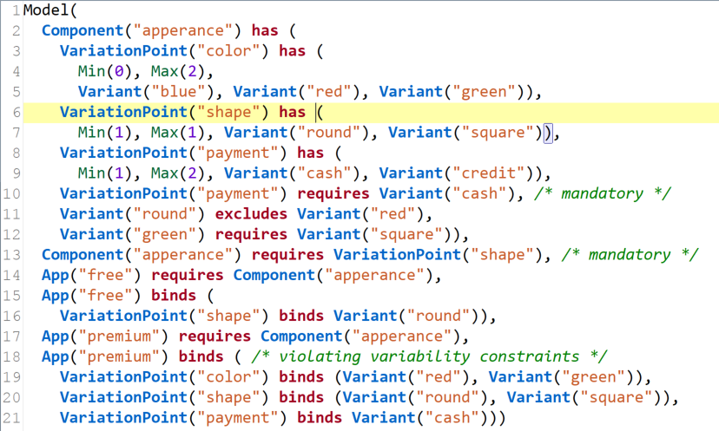
Variability modeling in software product line engineering with reqT

Slide 39
Fig 5.2 Platform requirements
We have a platform
R1: Product shall run on Pentíum PC’s with 128 MB. Many older PC’s still used, so tasks 2.1 to 2.5 must be supported on 80486 with 64 MB.
R2: Our IT staff have expertice in Oracle. Product must use same database platform.
R3: Product shall run on MS Windows release xx.yy. Supplier shall for 3 years port his product to new releases within ___ months from release date.
We want a new platform anyway
R4: Customer expects to switch to client-server running OS zz. Supplier shall specify server memory and server speed needed to obtain capacity and response time for Rxx.
We want software and hardware (maybe)
R5: Supplier shall deliver hardware + software. Supplier shall upgrade if capacity becomes inadequate for the load specified in xx.
R6: Product shall run on Pentium PC’s with 128 MB. As an option, total delivery may include the PC’s and hardware support.
From: Soren Lauesen: Software Requirements
© Pearson / Addison-Wesley 2002
Notes:
R1: standard req + task reference; R2: help for the reader+standard reference; R3: standard req+maintenance req; R4: Standard req+quality req; R5: Delivery req+maintenance req; R6: not decided yet, keep freedom

Slide 40
Fig 5.3A Who can integrate?
Customer
???
Customer’s
IT dept
Hotel
system
Account
system
?
Main
contractor
?
Product
supplier
Notes:
Svårt för en tekniskt okunnig part att ansvara för integration

Slide 41
Fig 5.4 Main contractor
Embedded
3rd party
product
Visible
3rd party
product
Hotel
system
Account
system
DB sys
Telephone
system
Main contractor
Joint design work
The optimal split.
Exists? Willing?
Cost vs. market
Sub-contractor
From: Soren Lauesen: Software Requirements
© Pearson / Addison-Wesley 2002
Notes:
Main contractor måste även göra högniåve design inte bara skriva krav. Krav på och design av gränssnitt med alla underleverantörer.

Slide 42
Fig 5.5 Technical interfaces
Hotel
system
Account
system
Communication channel
Physical channel:
File, TCP/IP, object calls . . .
Message formats:
Data descr, call params
Protocol:
State diagram, sequence diagram
formal data descr, SDL . . .
Semantics: about what?
E/R, tasks, activity diagrams
Verify early:
Functional
prototypes
From: Soren Lauesen: Software Requirements
© Pearson / Addison-Wesley 2002

Slide 43
Fig 7.3 Comparing proposals
Hotel system evaluation Proposals
0 (bad) - 5 (excellent) A B C
Normal requirements 3 4 5
Weakest requirements 3 2 0
Total product points 6 6 5
Understand our problem 1 3 5
Track record 4 1 4
Solidity 5 4 4
Total points 16 14 18
Base price 25 20 15
Option 1: Floor map 10 6 -
Option 2: . . . 8 - 8
From the buyers perspective
If stakeholders
don’t agree?
Ideal evaluation Proposals
A B C
Business value (NPV) 100 100 90
Supplier’s price 25 20 15
Internal investment costs 30 25 10
Net value 45 55 65
Perhaps better to do more systematic prioritization?
From: Soren Lauesen: Software Requirements
© Pearson / Addison-Wesley 2002
Notes:
Om intressenter ej är överens, låt var och en göra sin rankning – här kan man ha nytta av ”ordentlig” prioritering

Slide 44
Fig 7.4 Customer’s rating
Task: 1.2 Checkin Proposal B
Purpose: Give guest a room . . . Rating: 3
Frequency: . . .
Sub-tasks:
1.Find room.
Problem: Guest wants neighbor rooms; price bargain.
2.Record guest as checked in.
3.Deliver key.
Problem: Guests forget to return the key; want two keys.
Variants:
1a. Guest has booked in advance.
Problem: Guest identification fuzzy.
Assessment:
Floor map developed as an option.
Very convenient display of bargain prices.
If guest is not booked, cumbersome to switch to that task.
No support for electronic keys.
Tests show no tolerance for spelling errors.
Very long search time for names.
From: Soren Lauesen: Software Requirements
© Pearson / Addison-Wesley 2002

Slide 45
Fig 7.5 Supplier’s proposal
Task: 1.2 Checkin
Purpose: Give guest a room . . .
Frequency: . . .
Sub-tasks:
1.Find room.
Problem: Guest wants neighboor rooms; price bargain.
2.Record guest as checked in.
3.Deliver key.
Problem: Guests forget to return the key; want two keys.
Variants:
1a. Guest has booked in advance.
Problem: Guest identification fuzzy.
Proposal:
Floor map developed as an option. See outline on page xx.
See room screen p. yy.
See guest screen and check-in screen, p. zz
We provide no support for electronic keys. Planned for release 5 in 1.5 years.
User may search for any field using wild-carding.
From: Soren Lauesen: Software Requirements
© Pearson / Addison-Wesley 2002

Slide 46
High risk requirements
Quality("performance") has Spec("The response time shall be at most 0.5 seconds on average when moving from one screen to another. The response time shall never be above 2 seconds.")
Suppler A: We didn't notice any problems. Our response time is of that magnitude.
Supplier B: We don't care. We'll find a way out later.
Suppler C: We state as an assumption that 95% of the cases will be sufficient.
Supplier D: We fulfill the requirement although it will be expensive.
Supplier E: We tell the customer what it would cost and why, and then offer a reasonable alternative. Eventually, we offer the full solution as an expensive option.
[Lauesen: 7.5, p. 310]

Slide 47
Fig 7. Requirements in product life cycle
Inception
Elicitation
Tender
Formulation
Validation
Writing
proposal
Checking
Verification
Contract
Comparing
proposals
Design &
program
Accept test
Next release
Reqs management
& release planning

Slide 48
Fig 7.6 Design and program
R1: System shall store data according to this data model . . .
R2: Product shall have screen pictures and menus as shown in . . .
R3: Product shall record that a room is under repair . . .
R4: Product shall support check-in according to task description . . .
R5: At most 1 of 5 novices shall have critical usability problems during check-in.
R6: Storing a booking shall take less than 1 second on average.
R7: Pre-calculation of repair orders shall hit within 5% of actual costs.
How to trace and verify
these during development?
From: Soren Lauesen: Software Requirements
© Pearson / Addison-Wesley 2002
Notes:
R1 datakrav Impl:direct verif:simple; R2 designnivåkrav Impl:direct verif:simple; R3 produktegenskapskrav(feauter style) Impl: modest verif: simple; R4 uppgiftsstöd Impl:complex verif simple (men inte bra med ett menyval per task, bättre att kunna komponera enkla funktienr hur man vill) R5 användbarhetskrav Imple: complex, verif:klart R6 prestandakrav Imple. komplex verif:complex; R7 mål-nivåkrav Imple:komplex verification: ej möjligt att verifiera under utvecklingens gång – behöver kollas tidigare (goal domain tracing) och senare

Slide 49

Traceability
Responsibility of requirements fullfilment needs to be linked to system componenets for accountability and impact analysis
Changes in stakeholders’ needs & whishes as well as changed engineering assumptions may require radical re-assessment of requirements' value and cost
Forward
from req to
design/code/test
Forward
from source
to req
Requirements
package samples.simple;
public class Hello1
{
public void printHello()
{
System.out.println( "Hello!" );
}
}
Req A1: Printing
Dependecy
Backward
from req to
source
Backward from
design/code/test
to req
Req F8: Color
Source
Design/
Code/Test
In validation it is essential to have information on how stakeholders contribute to requirements
Fullfillment of requirements needs to be verified and design without supporting requirements (”gold-plating”) should be avoided
Notes:
09/25/98
67
Focal Point AB, Teknikringen 1E, 583 30 Linkˆping, Tel: 013-213705, Fax: 013-213725
Focal Point AB - www.focalpoint.se - info@focalpoint.se

Slide 50
Spårbarhet (Traceability)
Ändringar i intressenternas behov, önskemål och tekniska antaganden kan kräva radikal omvärdering av kravens relevans.
Ansvar för kravuppfyllelse behöver kopplas till systemkomponenter så att ansvarighet och påverkansanalys kan utrönas
Requirements
document
Framåt
från krav
Framåt
till krav
package samples.simple;
public class Hello1
{
public void printHello()
{
System.out.println( "Hello!" );
}
}
Req A1: Printing
Dependecy
Bakåt från
krav
Bakåt till
krav
Req F8: Color
Källa
Design/
Kod/Test
Hur intressenterna medverkat till kraven är viktig information vid validering.
Kravuppfyllelse behöver verifieras och design utan krav (“gold-plating”) behöver undvikas.
Notes:
09/25/98
67
Focal Point AB, Teknikringen 1E, 583 30 Linkˆping, Tel: 013-213705, Fax: 013-213725
Focal Point AB - www.focalpoint.se - info@focalpoint.se

Slide 51
Different methods to detect defects (reading techniques)
Ad hoc
  To your best ability (no specific guidelines)
Checklist
  A list of questions or check items direct the review
Perspective-based reading
  Different reviewers inspect from different perspectives and their findings are combined:
  e.g. user, designer, tester – perspectives,
  or from the perspective of different tasks/use cases
N-fold inspection
  N independent groups run inspection process in parallel
Notes:
09/25/98
108
Focal Point AB, Teknikringen 1E, 583 30 Linkˆping, Tel: 013-213705, Fax: 013-213725
Focal Point AB - www.focalpoint.se - info@focalpoint.se

Slide 52
Different kinds of checks
Content of spec
Structure of spec
Consistency of spec

Slide 53
Fig 9.2A Contents check
Does the spec contain:
Customer, sponsor, background
Business goals + evidence of tracing
Data requirements
(database, i/o formats, comm. state, initialize)
System boundaries & interfaces
Domain-level reqts (events & tasks)
Product-level reqts (events & features)
Design-level reqts (prototype or comm. protocol)
Specification of non-trivial functions
Stress cases & special events & task failures
Quality reqts (performance, usability, security . . .)
Other deliverables (documentation, training . . .)
Glossary (definition of domain terms . . .)
From: Soren Lauesen: Software Requirements
© Pearson / Addison-Wesley 2002
Notes:
382, Lau

Slide 54
Fig 9.2B Structure check
Does the spec contain:
Number or Id for each requirement
Verifiable requirements
Purpose of each requirement
Examples of ways to meet requirement
Plain-text explanation of diagrams, etc.
Importance and stability for each requirement
Cross refs rather than duplicate information
Index
An electronic version
From: Soren Lauesen: Software Requirements
© Pearson / Addison-Wesley 2002

Slide 55
Fig 9.2C Consistency checks
Virtual windows
Tasks
Guest
Support?
Data
exists?
Data exists?
Event
check
CRUD
Event list
1.
2.
. . .
E/R model
CRUD
Event
check
Function list
1.
2.
. . .
From: Soren Lauesen: Software Requirements
© Pearson / Addison-Wesley 2002

Slide 56
Fig 9.2D CRUD+O matrix
Guest
Stay
Room
RoomState
Service
ServiceType
Create, Read, Update, Delete + Overview
SLUT+Ö
Skapa
Läsa
Uppdatera
Ta bort
Översikt
Entity
Task
Book C U O C O U O
CheckinBooked RU U O O U O
CheckinNonbkd C U O C O U O
Checkout U U O R U
ChangeRoom R R O U O
RecordService O C R
PriceChange C UDO C UDO
Missing? D D C?UD? UD
From: Soren Lauesen: Software Requirements
© Pearson / Addison-Wesley 2002

Slide 57
Fig 9.3 Checks against surroundings
Reviews
Review:
Developers and customer review all parts.
Goal-means analysis:
Goals and critical issues covered?
Requirements justified?
Risk assessment:
Customer assesses his risk.
Developers assess their risk.
High-risk areas improved.
Tests
Simulation and walk-through
Follow task descriptions. Correct? Supported?
Prototype test (experiment with prototypes):
Requirements meaningful and realistic?
Prototype used as requirement?
Pilot test (install and operate parts of system):
Cost/benefit?
Requirements meaningful and realistic?
From: Soren Lauesen: Software Requirements
© Pearson / Addison-Wesley 2002

Slide 58
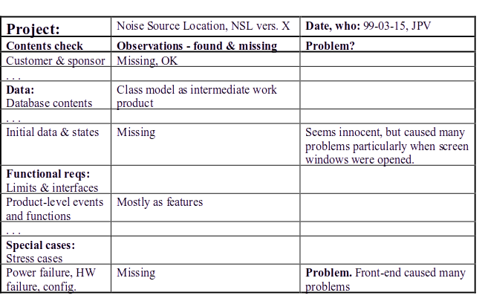
Fig 9.4(A) Check list
From: Soren Lauesen: Software Requirements
© Pearson / Addison-Wesley 2002

Slide 59
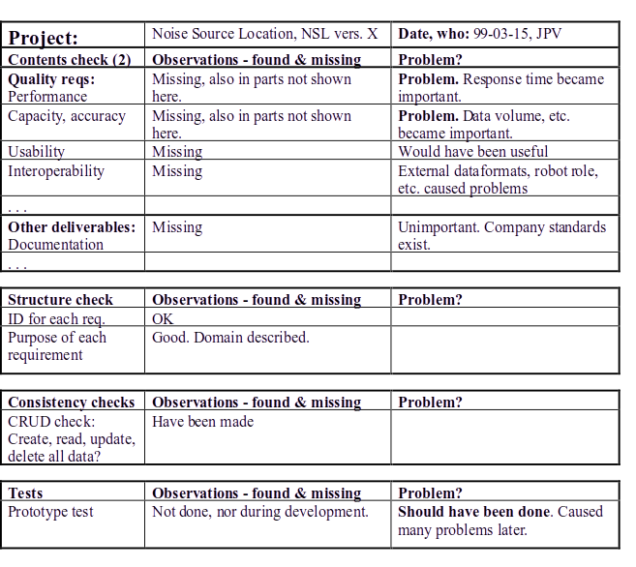

Slide 60
Fig 9.1 Quality criteria for a specification
Classic: A good requirement spec is:
Correct
Each requirement reflects a need.
Complete
All necessary requirements included.
Unambiguous
All parties agree on meaning.
Consistent
All parts match, e.g. E/R and event list.
Ranked for importance and stability
Priority and expected changes per requirement.
Modifiable
Easy to change, maintaining consistency.
Verifiable
Possible to see whether requirement is met.
Traceable
To goals/purposes, to design/code.
Additional:
Traceable from goals to requirements.
Understandable by customer and developer.
Korrekt
Fullständig
Otvetydig
Motsägelsefri
Rankad
Modifierbar
Verifierbar
Spårbar bakåt/framåt
Begriplig
Designoberoende
Motiverad
Koncis
Välorganiserad
...
From: Soren Lauesen: Software Requirements © Pearson / Addison-Wesley 2002

Slide 61
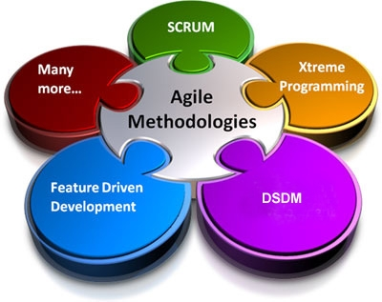

Agile Requirements Engineering
[AGRE]
Notes:
Scrum, XP, Kanban
Lean Development
Crystal
Feature-Driven Dev
DSDM - Dynamic System Development Method

Slide 62
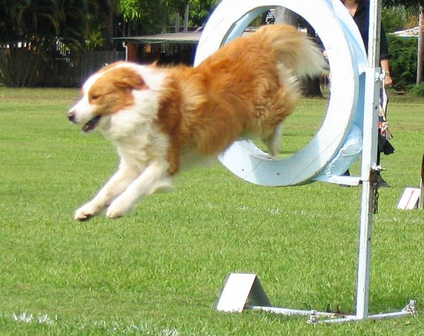
Paper [AGRE]
Agile Requirements Engineering Practices:
An Empirical Study
by Balasubramaniam Ramesh and Lan Cao
In: IEEE Software, pp. 60-67, January/February 2008

Slide 63

RE in Agile Projects [AGRE]
Level of detail at dev start
Practices
Iterative RE: Gradual detailing
Work order
  Extreme prioritization: Just-in-time
  Constant planning
Integrated RE:
Dev roles more involved in RE
  Face-to-face communication
  Reviews & tests
  Prototyping
  Test-driven development
Agile project
Traditional project

Slide 64
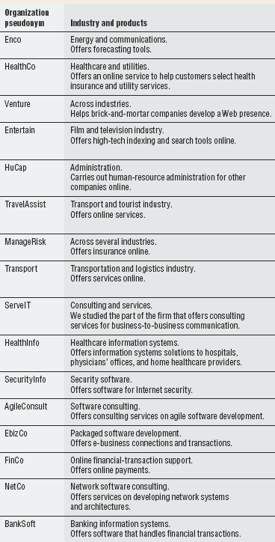
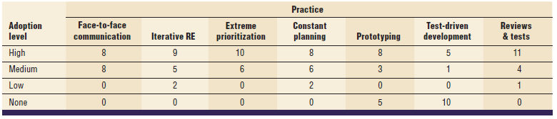
Agile RE practices in 16 companies

Slide 65
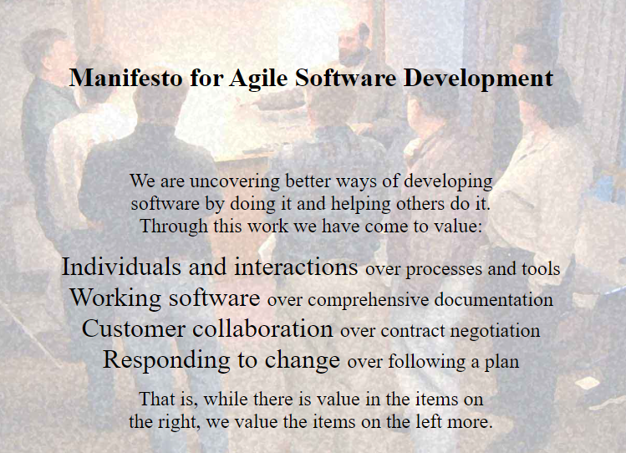
Kent Beck, Mike Beedle, Arie van Bennekum, Alistair Cockburn, Ward Cunningham, Martin Fowler, James Grenning, Jim Highsmith, Andrew Hunt, Ron Jeffries, Jon Kern, Brian Marick, Robert C. Martin, Steve Mellor, Ken Schwaber, Jeff Sutherland, Dave Thomas
The Agile Manifesto, http://agilemanifesto.org/, 2001

Slide 66
Principle-Driven Approach based on Agile Manifesto
More valuable
Valuable
Individuals & interactions
Working software
Customer collaboration
Responding to change
Processes and tools
Comprehensive documentation
Contract negotiation
Following a plan
Kent Beck, Mike Beedle, Arie van Bennekum, Alistair Cockburn, Ward Cunningham, Martin Fowler, James Grenning, Jim Highsmith, Andrew Hunt, Ron Jeffries, Jon Kern, Brian Marick, Robert C. Martin, Steve Mellor, Ken Schwaber, Jeff Sutherland, Dave Thomas
The Agile Manifesto, http://agilemanifesto.org/, 2001

Slide 67
Traditional Development Process
Reqts
Design
Impl
Testing
Agile Development Process – Integrated RE
Reqts
Design
Impl
Testing
Reqts
Design
Impl
Testing
Reqts
Design
Impl
Testing
+ a pre-study phase:
High-level requirements
Same activities, different sizing and timing
→ Different principles and management approach
→ Different people detailing requirements
→ Different documentation formats
Notes:
The application to be delivered is broken down into a number of components each of which will be actually used by the users. Each of these is then developed as a separate ‘mini-project’ or increment.

Slide 68
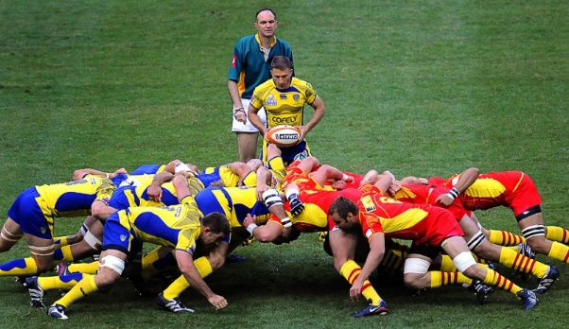
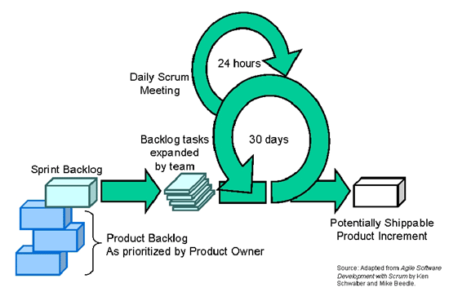
Scrum Development

Slide 69
Requirements in Scrum
Pre-game – Scrum planning & backlog grooming == RE
Requirements in Backlogs
POST-GAME
PRE-GAME

Slide 70
Scrum sprints -
Time boxed iterations
POST-GAME
PRE-GAME
Requirements INTEGRATED in backlog, test cases, design docs etc
Notes:
time-box fixed deadline by which something has to be delivered
Scrum: 30 d prescribed - typically two to six week iterations
XP: 1-4 weeks
Work order
XP: Team strictly works on the most prioritized stories first
Scrum: Team and product owner agree on work order
Changes during iteration
Scrum: not allowed
XP: allowed for non-started work items / stories

Slide 71

Continuous Feedback & Transparency
Business, Management and Development roles involved in
Sprint planning meeting
Daily stand-up meetings
End-of-sprint demo
Sprint retrospective meetings
Notes:
Time-boxes mean that the focus moves from having a fixed set of functional requirements and then extending the planned project completion until they have all been developed. The deadline is fixed and we deliver what we have completed so far even if it is not everything that was originally planned.

Slide 72
Phases of XP
Exploration
Planning
Iterations
Product-
ionizing
Maintenance
Death
Pair programming
Release
Maint.
Release
Final
Release
A
D
Impl
Test
TCs
Code
Pre-study
Planning
Closure
Execution
Kent Beck, eXtreme Programming eXplained, Ch 21, Addison Wesley, 2000
Notes:
XP
Pair programming
Test-driven development

Slide 73
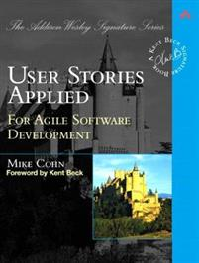
User story & Acceptance Criteria
User story:
As a passenger, I can cancel a flight reservation
Acceptance criteria / test cases
Verify that a premium member can cancel the same day without a fee
Verify that a non-premium member is charged 10% for a same-day cancellation
Verify that an email confirmation is sent
Verify that the hotel is notified of any cancellation
Cohn, Mike. User stories applied: For agile software development. Addison-Wesley Professional, 2004.

Slide 74

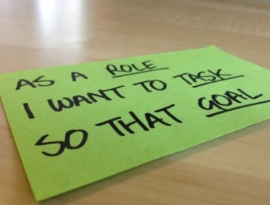
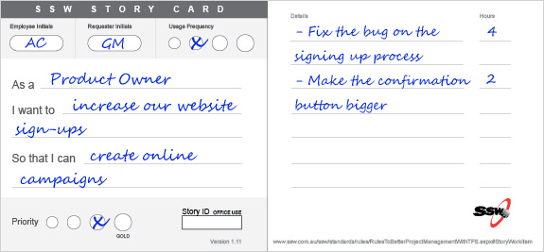
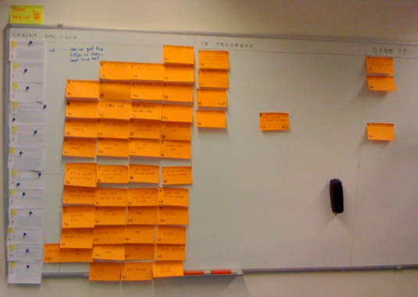
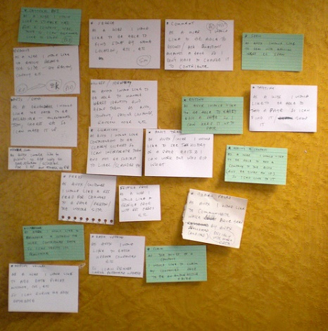
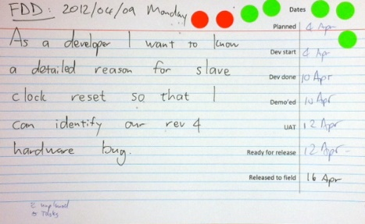
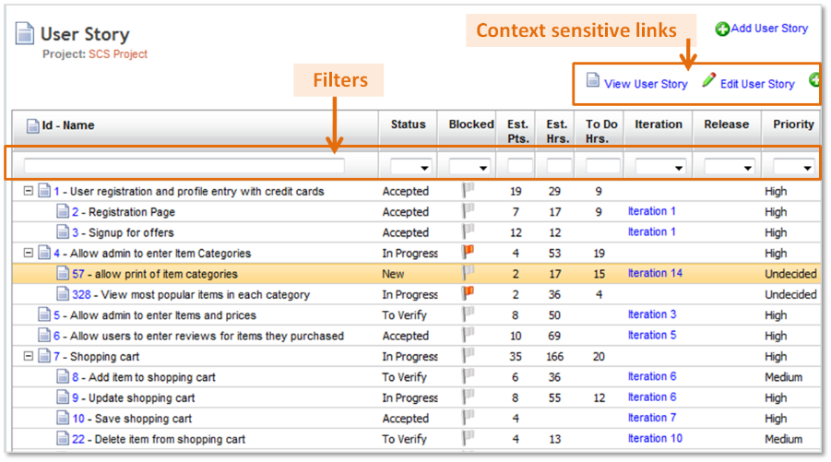
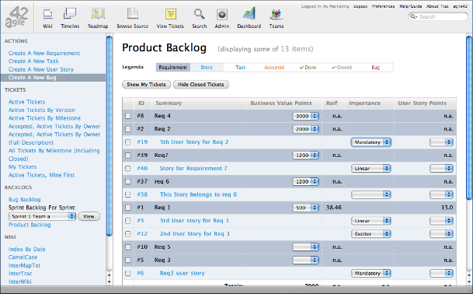
Specification of user stories
1
2
Product Owner/Customer defines & prioritizes
Epics/User stories in product backlog
Team defines details for each user story in sprint backlog
  Tasks
  Acceptance criteria & test cases
Story cards
Backlogs
Notes:
Reqts prior to implementation
Detailing when going to implement

Slide 75
Test cases as Requirements
De facto practice
Company A: Medium-sized, Networking equipment
Tool-supported Behaviour-driven development
Company B: Small, Consultants
Story-test driven / Stand-alone with manual test cases
Company C: Large, Telecom
Bjarnason, Unterkalmsteiner, Borg, & Engström (2016). A multi-case study of agile requirements engineering and the use of test cases as requirements. Information and Software Technology, 77, 61-79.

Slide 76
Test cases as Reqts: Variation points
Documentation time frame
upfront or after-the-fact (during testing)
Requirements format
ranging from natural language to structured
Machine executable specification
automated tests
Tool support for TCR
Bjarnason, Unterkalmsteiner, Borg, & Engström (2016). A multi-case study of agile requirements engineering and the use of test cases as requirements. Information and Software Technology, 77, 61-79.

Slide 77
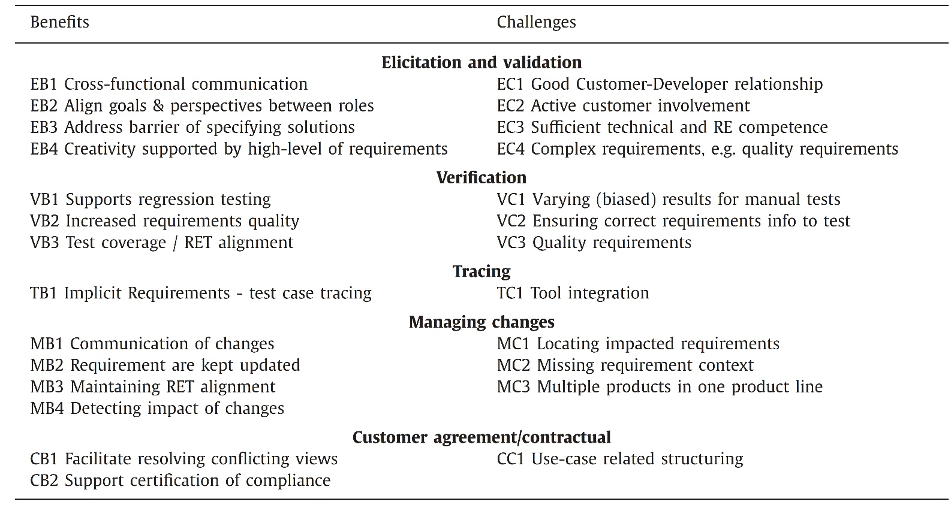
Test Cases as Requirements in Agile practice
Table 7 in ATCR.pdf (optional paper in zip not included in exam)]
Bjarnason, Unterkalmsteiner, Borg, & Engström (2016). A multi-case study of agile requirements engineering and the use of test cases as requirements. Information and Software Technology, 77, 61-79.

Slide 78

Face-to-face communication
Direct communication between customer and development
Techniques
User Stories == high-level requirements spec
Complemented by other artifacts, e.g. "backlog"
Prerequisites
Active involvement of (knowledgeable) customers
Customers can steer project
Avoids time-consuming documentation
Risk of inadequate requirements
On-site customer rep is challenging
Handling more than one customer
Relies on trust rather than agreed requirements
Notes:
Agile software processes prefer face-to-face communication over written specifications.
The focus of RE in an agile environment is to effectively transfer ideas from the customer to the development team, rather than creating extensive requirements documents.
BENEFITS
Customers can steer the project in unanticipated directions, especially when their requirements evolve owing to changes in the environment or their own understanding of the software solution.
Obviates the need for time-consuming documentation and approval processes, which are perceived as unnecessary, especially with evolving requirements.
CHALLENGES
Achieving active on-site customer representation is difficult (even in the form of a surrogate product manager).
risk of wrong or inadequate requirements, If direct communication cannot be established
When more than one customer group is involved, achieving consensus/compromise in the short development cycle is challenging.
Customers used to a traditional development process might not understand or trust the agile RE process, which doesn’t produce detailed requirements.

Slide 79
Face-to-face Communication
Perceived Benefits
Customers can steer the project in unanticipated directions, especially when their requirements evolve owing to changes in the environment or their own understanding of the software solution.
Informal communication obviates the need for time-consuming documentation and approval processes, which are perceived as unnecessary, especially with evolving requirements.
Perceived Challenges
If intensive interaction between customers and developers cannot be established, this approach poses the risk of wrong or inadequate requirements.
Achieving on-site customer representation is difficult (even in the form of a surrogate product manager).
When more than one customer group is involved, achieving consensus/compromise in the short development cycle is challenging.
Customers used to a traditional development process might not understand or trust the agile RE process, which doesn’t produce detailed requirements.
Notes:
Agile software processes prefer face-to-face communication over written specifications.
The focus of RE in an agile environment is to effectively transfer ideas from the customer to the development team, rather than creating extensive requirements documents.
BENEFITS
Customers can steer the project in unanticipated directions, especially when their requirements evolve owing to changes in the environment or their own understanding of the software solution.
Obviates the need for time-consuming documentation and approval processes, which are perceived as unnecessary, especially with evolving requirements.
CHALLENGES
Achieving active on-site customer representation is difficult (even in the form of a surrogate product manager).
risk of wrong or inadequate requirements, If direct communication cannot be established
When more than one customer group is involved, achieving consensus/compromise in the short development cycle is challenging.
Customers used to a traditional development process might not understand or trust the agile RE process, which doesn’t produce detailed requirements.

Slide 80

Iterative RE
Requirements emerge during development based on initial high-level requirements
Techniques
Requirements analysis and detailing for each development cycle
Requirements intertwined with design
Good customer relationship
Clearer and understandable requirements due to direct customer interaction
Accurate cost and scheduling of project
Neglect of quality requirements
Lack of documentation beyond dev team
Notes:
development team acquires a high-level understanding of the critical features of the application, rather than creating a detailed specification of requirements.
Requirements are not intended to be complete or cover all features.
Requirements serve as a starting point to plan the initial release cycle.
Challenges
Cost & Schedule Estimation for entire project: Difficult, since the project scope is subject to constant change. Obtaining management support for such projects could be challenging.
Neglect of quality requirements: Especially during early development cycles, customers often focus on core functionality and ignore quality reqts such as scalability, maintainability, portability, safety, or performance.
Minimal documentation: When a communication breakdown occurs the lack of documentation might cause a variety of problems (e.g., scalability, evolution, introduction of new team members).

Slide 81
Iterative RE
High-level requirement analysis is carried out at beginning of project.
development team acquires a high-level understanding of the critical features of the application, rather than creating a detailed specification of requirements.
Requirements are not intended to be complete or cover all features.
Requirements serve as a starting point to plan the initial release cycle.
As more is getting known, more features/user stories are added.
Techniques:
  Start of development cycle, the customer sits down with the development team to provide detailed information on a set of features that need to be implemented. During this process, requirements are discussed at a greater level of detail.
  Requirements analysis is intertwined with the design activity.

Slide 82
Iterative RE
Perceived Benefits
Iterative RE creates a more satisfactory relationship with the customer.
Requirements are clearer and more understandable because of the immediate access to customers and their involvement in the project when needed.
Perceived Challenges
Cost & Schedule Estimation for entire project: Difficult, since the project scope is subject to constant change. Obtaining management support for such projects could be challenging.
Minimal documentation: When a communication breakdown occurs the lack of documentation might cause a variety of problems (e.g., scalability, evolution, introduction of new team members).
Neglect of quality requirements: Especially during early development cycles, customers often focus on core functionality and ignore quality reqts such as scalability, maintainability, portability, safety, or performance.
Notes:
In agile development, requirements are not pre-defined; instead they emerge during the development process.
Initially, high-level requirement analysis is carried out at the beginning of the project.
At this time, the development team acquires a high-level understanding of the critical features of the application, rather than creating a detailed specification of requirements.
Furthermore, these requirements are not intended to be complete or cover all the features of the system.
Instead, they serve as a starting point to plan the initial release cycle of the project.
As more is known about the product, more features or user stories are added.
Techniques:
Agile requirements analysis continues at each development cycle. At the beginning of each development cycle, the customer sits down with the development team to provide detailed information on a set of features that need to be implemented. During this process, requirements are discussed at a greater level of detail.
Also, very often, requirements analysis is intertwined with the design activity.

Slide 83

Extreme Prioritization
& Constant Planning
Aim to deliver most valuable features first
Responsive to changes in customer demands
Techniques
  Work on most valuable features first
  Continuously revise prioritisation & planning (for each iteration)
  Constant feedback from customer
Customer provides business prio
Re-prioritization supported by dev process
Early validation minimizes need & cost for major changes
Other criteria suffer, e.g. quality
Instability in dev work
Inadequate architecture and
increased costs
Refactoring requires time and experience
Notes:
During development, the customer’s as well as the developer’s understanding of the project improves and new requirements are added, or existing requirements are modified.
To keep priorities up to date, prioritization & Planning is repeated frequently during the entire development process.
BENEFITS
Involved customers can provide business reasons => clear understanding of the customer’s priorities helps the development team better meet customer needs.
agile RE built and provides numerous opportunities for reprioritization.
The early and constant validation of requirements largely minimizes the need for major changes.
Thus, the cost of change request decreases dramatically compared to traditional software development.
CHALLENGES
Only business value prio might cause major problems in the long run (e.g., ‘omitted’ quality reqts).
Continuous reprioritization, when not practiced with caution, may lead to instability
(early) architecture becomes inadequate as requirements change and redesign of the architecture adds significantly to project cost.
Refactoring depends on developers’ experience and schedule pressure.
Refactoring often doesn’t fully address the problem of inadequate/inappropriate architecture.

Slide 84
Extreme Prioritization
  Implement the features with the highest priority early in the project so that the customers can realize most of the potential business value.
  During development, the customer’s as well as the developer’s understanding of the project improves and new requirements are added, or existing requirements are modified.
  To keep priorities up to date, prioritization & Planning is repeated frequently during the entire development process.
Constant Planning
A core principle - adapt / react quickly to changes
a way to better satisfy customer needs.
Before implementing a feature, conversation with customer about needs == requirements

Slide 85
Extreme Prioritization
Perceived Benefits
Involved customers can provide business reasons => clear understanding of the customer’s priorities helps the development team better meet customer needs.
agile RE built and provides numerous opportunities for reprioritization.
Perceived Challenges
Only business value prio might cause major problems in the long run (e.g., ‘omitted’ quality reqts).
Continuous reprioritization, when not practiced with caution, may lead to instability
Constant Planning
Perceived Benefits
The early and constant validation of requirements largely minimizes the need for major changes.
Thus, the cost of change request decreases dramatically compared to traditional software development.
Perceived Challenges
Often, architecture (early cycles) becomes inadequate as requirements change and redesign of the architecture adds significantly to project cost.
Refactoring depends on developers’ experience and schedule pressure.
Refactoring often doesn’t fully address the problem of inadequate/inappropriate architecture.
Notes:
Prioritization is essential in requirements analysis, especially for projects that have limited resources in terms of budget, staff and schedule.
Requirements can be categorized from the standpoint of importance into essential requirements, useful capabilities and desirable capabilities.
Setting priorities early in the project helps deliver the most valuable features as early as possible.
Techniques:
Implement the features with the highest priority early in the project so that the customers can realize most business value.
During development, the customer’s, as well as developer’s, understanding of the project improves and new requirements are added, or existing requirements are modified.
To keep priorities up to date, prioritization is repeated frequently during the entire development process.

Slide 86
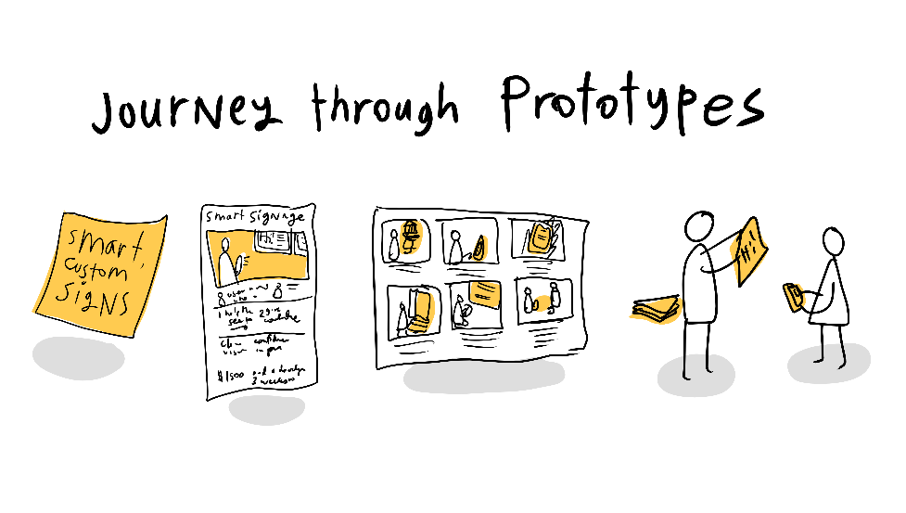
Prototyping &
Reviews & Acc Test
Communicate through prototypes and frequent review meetings
Involves customers, developers and testers
Requirements validation and refinement through feedback
Techniques
End-of-sprint sign-off meeting
Efficient validation
Assess project status
Trust: Customer, Mgmt
Early problem identification
Risks with evolving prototypes in production
Unrealistic expections regarding leadtime
Weak formal validation, consistency checks
Dev of acc tests require access to customers
Notes:
Prototyping used to communicate with customers, validation and elicitation.
End of sprint demo: Sign-off with all stakeholders
BENEFITs
efficient communication wo OH of creating formal reqts docs
Show project status (schedule & quality), builds trust & management support
identify problems early
RISKs of using production software
Create unrealistic expectations
Push to deploy prototypes rather than release quality code
Reviews
CHALLENGE
Weak validation due to lack of stringency: formal modeling, consistency checking
Hard to gain access to customers

Slide 87
Prototyping
way to communicate with their customers.
Validation and elicitation (of details)
Risks of using production software
  Push to deploy prototypes rather than release quality code
Reviews and Acceptance Tests
review meetings / interaction for requirements validation.
Before and during implementation.
End of sprint/iteration: Sign-off with all stakeholders
  demo with feedback
  Show project status (schedule & quality), builds trust

Slide 88
Prototyping
Perceived Benefits
Avoids incurring overhead of creating formal requirements documents.
Perceived Challenges
Risk in production mode may cause problems with features such as scalability, security, and robustness.
Quick deployment of prototypes in the early stages may create unrealistic expectations among customers. unwilling to accept longer development cycles for more scalable and robust implementations
Reviews and Acceptance Tests
Perceived Benefits
ascertain project on target?
increase customer trust and confidence
identify problems early.
obtain management support
Perceived Challenges
Weak validation due to lack of stringency: formal modeling, consistency checking
acceptance testing requires access to the customers
Notes:
Instead of using formal requirements documents, many agile projects use prototyping as a way to communicate with their customers.
Based on customer feedback on the prototypes developed for demonstration and experimentation, requirements are validated and refined.
To a certain extent, the production software itself can be a form of an operational prototype, a refinement of the code created for experimentation with required features.
The rush to market encourages a tendency to deploy these prototypes rather than wait for robust implementations of the desired features.
The ability to quickly deploy newer versions of the product (e.g., enabled by the web architecture for delivery) is another factor promoting this practice.
Risks:
Besides causing problems with issues such as scalability, security and robustness, prototypes may not be easy to maintain or evolve.

Slide 89
Test-Driven Development
Developers create test before writing new code
Tests specify expected behaviour of code
Tests capture complete requirements
Traces to production code facility reqts changes
Requires competence in testing,
requirements understanding and
customer collaboration
Most organizations fail to implement this practice
Notes:
BENEFIT
Tests used to capture complete requirements
Reduced OH for reqts documentation
Traceability to production code facilitates incorporating changes – “säkerhetslina” vid refaktorering
CHALLENGES
consistently following the practice demands a lot of discipline. Only 6 of 16 companies apply the practice
developers aren’t accustomed to writing tests before coding
TDD requires a thorough understanding of the requirements and extensive customer collaboration; involves refining low-level specifications iteratively.
most organizations reported that they’re unable to implement this practice.

Slide 90
RE vs. Product & Project Mgmt
Top-level management
Marketing
Organization
Development
Organization
Business Strategy
Portfolio Mgmt
Product Management
Requriements
Engineering
Project Management

Slide 91
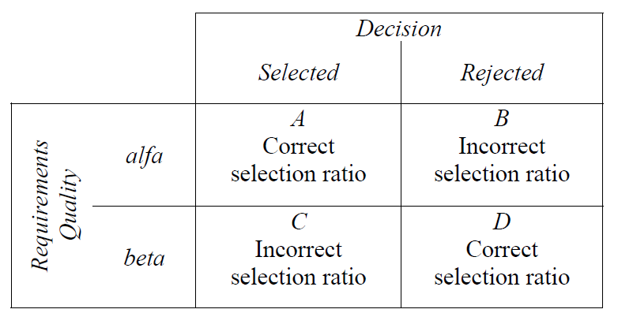


Decisions outcomes in MDRE
Product Quality:
Decision Quality:
[MDRE]
Notes:
För att följa upp hur väl kravhanteringsprocessen fungerar i en organisation kan det vara lämpligt att införa olika kvalitetsmått. Två sådana är produkt och beslutskvalitét.
Produktkvalitetmåttet bygger på antalet korrekt valda krav i ex. en release i förhållande till den totala andelen valda krav i releasen. Korrekt i det här fallet kan till exempel innebära att ett krav medför ett ökat värde för kund och en konkurrensfördel, eller att det behövdes och möjliggjorde för en sådan utgång.
Beslutskvalitetsmåttet bygger på antalet korrekt tagna beslut i samband med ex. en release, det vill säga både inkluderande och avfärdande av krav, i förhållande till alla besluts som tagits.
Att applicera sånna här mått och analysera processkvalitén är väldigt svårt och kan oftast bara göras efter att en release släppts och man har undersökt och analyserat marknadens mottagande av de olika kraven. Oavsett så är det viktigt att följa upp kvalitén på kravprocessen så att dess olika delar som elicietering, prioritering och releaseplanering kan anpassas vid behov.

Slide 92
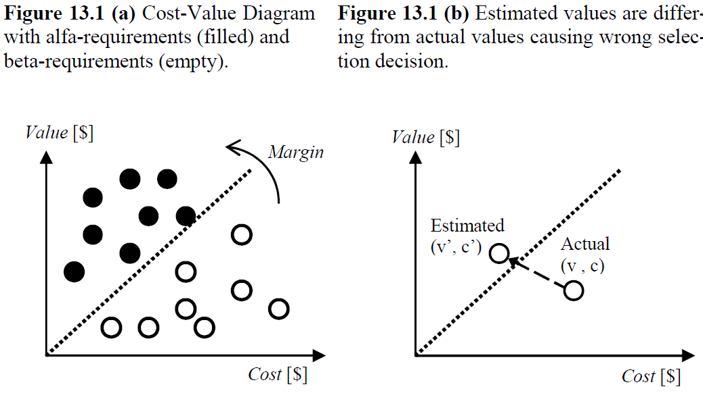
Finding the golden grains despite uncertain cost-value estimates
[MDRE]
Notes:
Alfakraven kan även ses som de med ett högre värde än kostnad och tvärtom för betakraven vilket möjligör en åskådegöring via kostand-värde-diagram som de här.
Det är viktigt att notera att värdekonceptet är kan betyda olika i olika sammanhang. Det kan ha en betydelse för befintliga kunder, en annan för nya. Internt kan utvecklare se ett värde i förhållande till arkitekturen medan marknadsavdelningen ser ett annat i förhållande till företagets branding.

Slide 93



Release Planning

Slide 94
Paper [RP] in compendium
The art and science of software release planning
Ruhe, G., & Saliu, M. O.
IEEE software, 22(6), 47-53. 2005

Slide 95
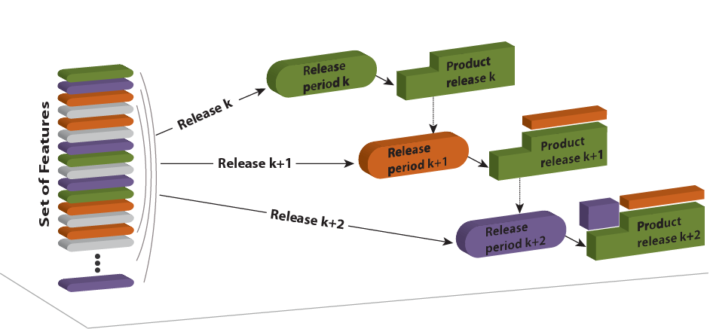
What is Release Planning?
[RP]
Notes:
Release planering är en beslutsprocess gällande tilldelning av features till en av flera efterföljande releaser.

Slide 96
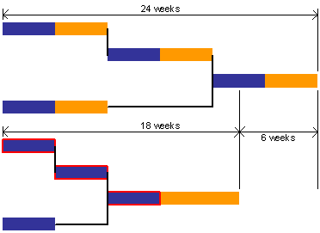
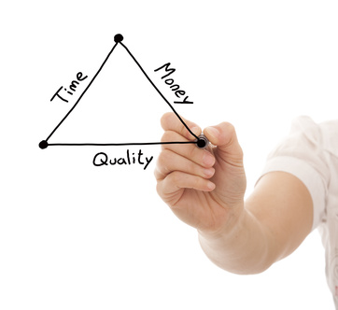

Release Planning involves...
...prioritization + scheduling under various constraints, e.g., resource and precedence constraints
[RP]
Notes:
Det innefattar schemaläggning och prioritering under vissa villkor och begränsningar, t.ex, gällande budget, risk, tekniska eller resursmässiga.

Slide 97
Example planning parameters
Requirements priorities (from prioritization)
Available resources
Delivery time
Requirements dependencies
  Precedence, Coupling, Excludes
System architecture
Dependencies to the code base
[RP]
Notes:
En bra release plan maximerar nyttan/vinsten genom att sätta ihop den kombination av features som ger högst värde enligt prioriteringen, samtidigt som man tillgodoser de begräsningar och bivillkor som finns

Slide 98
What is a good release plan?
A good release plan should
  Provide maximum business value by
    offering the best possible blend of features
    in the right sequence of releases
  satisfy the most important stakeholders involved
  be feasible with available resources, and
  take dependencies among features into account
[RP]
Notes:
Incremental development provides customers with parts of a system early, so they receive both a sense of value and an opportunity to provide feedback early in the process. Each system release is thus a collection of features that the customer values.
Furthermore, each release serves to fix defects detected in former product variants. Release planning (RP) addresses decisions related to selecting and assigning features to create a sequence of consecutive product releases that satisfies important technical, resource, budget, and risk constraints.

Slide 99
Simplistic Release Planning
Informal process
Unclear rationale behind decisions
No systematic management of dependencies
Simplistic greedy allocation is no good
A zillion possibilities already with
20 features and 3 releases:
4²⁰ > 1.000.000.000.000 = 10¹² possibilities
[RP]

Slide 100
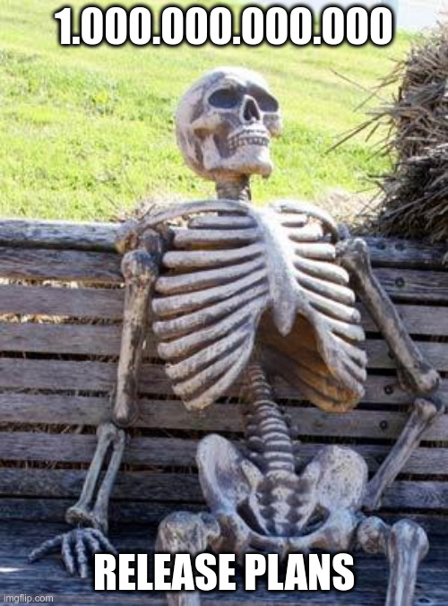

Slide 101
Why greedy allocation is bad
https://gist.github.com/bjornregnell/80897de5b109f36c1b7ae29f43e4aa7b
val m = Model(
Feature("a") has (Benefit(90), Cost(100)),
Feature("b") has (Benefit(85), Cost(90)),
Feature("c") has (Benefit(80), Cost(25)),
Feature("d") has (Benefit(75), Cost(23)),
Feature("e") has (Benefit(70), Cost(22)),
Feature("f") has (Benefit(65), Cost(20)),
Feature("g") has (Benefit(60), Cost(10)),
Feature("h") has (Benefit(55), Cost(30)),
Feature("i") has (Benefit(50), Cost(30)),
Feature("j") has (Benefit(45), Cost(30)),
Release("r1") has Capacity(100),
Release("r2") has Capacity(90))
def plan(input: Model,
pickNext: (Model,Release)=>Option[Feature]): Model = {
var result = input
releases(input).foreach { r =>
var next = pickNext(result, r)
while (next.isDefined) {
result = allocate(result, next.get, r)
next = pickNext(result, r)
}
}
result
}
plan(m, random)
plan(m, greedy)
def features(m: Model): Vector[Feature] = m.tip.collect{case f: Feature => f}
def releases(m: Model): Vector[Release] = m.tip.collect{case r: Release => r}
def allocate(m: Model, f: Feature, r: Release): Model = m + (r has f)
def isAllocated(m: Model, f: Feature): Boolean = releases(m).exists(r => (m/r).contains(f))
def allocatedCost(m: Model, r: Release): Int = (m/r).entities.collect{case f => m/f/Cost}.sum
def isRoom(m: Model, f: Feature, r: Release): Boolean = m/r/Capacity >= allocatedCost(m,r) + m/f/Cost
def featuresInGreedyOrder(m: Model): Vector[Feature] = features(m).sortBy(f => m/f/Benefit).reverse
def random(m: Model, r: Release): Option[Feature] = scala.util.Random.shuffle(features(m)).
filter(f => !isAllocated(m,f) && isRoom(m,f,r)).headOption
def greedy(m: Model, r: Release): Option[Feature] =
featuresInGreedyOrder(m).find(f => !isAllocated(m,f) && isRoom(m,f,r))

Slide 102
Optimal vs. Greedy
val optimal = Model(
Feature("a") has (Benefit(90), Cost(100)),
Feature("b") has (Benefit(85), Cost(90)),
Feature("c") has (Benefit(80), Cost(25)),
Feature("d") has (Benefit(75), Cost(23)),
Feature("e") has (Benefit(70), Cost(22)),
Feature("f") has (Benefit(65), Cost(20)),
Feature("g") has (Benefit(60), Cost(10)),
Feature("h") has (Benefit(55), Cost(30)),
Feature("i") has (Benefit(50), Cost(30)),
Feature("j") has (Benefit(45), Cost(30)),
Release("r1") has (Capacity(100), Feature("c"), Feature("d"), Feature("e"), Feature("f"), Feature("g")),
Release("r2") has (Capacity(90), Feature("h"), Feature("i"), Feature("j")))
def sumAllocatedBenefit(m: Model) =
releases(m).map(r => (m/r).collect{case f: Feature => m/f/Benefit}.sum).sum
val beneftitOptimal = sumAllocatedBenefit(optimal)
val benefitGreedy = sumAllocatedBenefit(plan(m,greedy))
val ratio = benefitGreedy.toDouble / beneftitOptimal

