Slide 1
LargeVis
an effective method for visualizing large-scale and high-dimensional data

Slide 2
Why do we need these methods?

Slide 3
we live in the era of big data
understanding and mining large-scale data sets have created big opportunities for business providers, data scientists, governments, educators, and healthcare practitioners
many computational infrastructures, algorithms, and tools are being constructed for the users to manage, explore, and analyze their data sets
information visualization has been playing a critical role in this pipeline, which facilitates the description, exploration, and sense-making from both the original data and the analysis results
classical visualization techniques have been proved effective for small or intermediate size data; they however face a big challenge when applied to the big data.
compared to the high-dimensional representations, the 2D or 3D layouts not only demonstrate the intrinsic structure of the data intuitively and can also be used as the basis to build many advanced and interactive visualizations.

Slide 4
What is the difference between LargeVis and other methods?

Slide 5
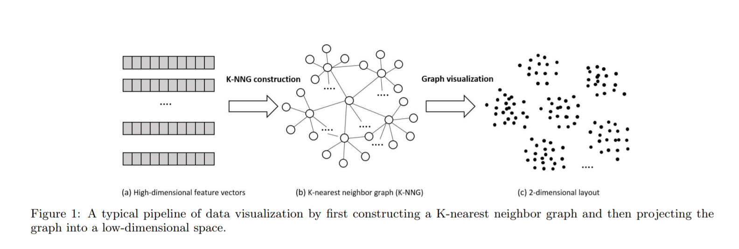
A two-step process

Slide 6
Constructing K-nearest neighbor graph
critical to many applications such as similarity search, collaborative filtering, manifold learning, and network analysis.
the exact computation of a KNN has a complexity of O(N^2 * d) (with N being the number of data points and d being the number of dimensions)
existing approaches use roughly three categories of techniques: space-partitioning trees, locality sensitive hashing techniques and neighbor exploring techniques

Slide 7
Constructing K-nearest neighbor graph - LargeVis
Random projection trees used to approximate the KNN graph
Algorithm starts by partitioning the entire space and building up a tree
For every non-leaf node of the tree, the algorithm selects a random hyperplane to split the subspace corresponding to the non-leaf node into two, which become the children of that node
This process continues until the number of nodes in the subspace reaches a threshold
Once a random projection tree is constructed, every data point can traverse the tree to find a corresponding leaf node. The points in the subspace of that leaf node will be treated as the candidates of the nearest neighbors of the input data point.
In practice multiple trees can be built to improve the accuracy of the nearest neighbors.
Once the nearest neighbors of all the data points are found, the K-nearest neighbor graph is built.

Slide 8
LargeVis’ improvement
Constructing a very accurate KNN graph requires many trees to be built, which significantly hurts the efficiency
Instead of building a large number of trees to obtain a highly accurate KNN graph, we use neighbor exploring techniques to improve the accuracy of a less accurate graph. The basic idea is that “a neighbor of my neighbor is also likely to be my neighbor”
For each node of the graph, we search the neighbors of its neighbors, which are also likely to be candidates of its nearest neighbors. We may repeat this for multiple iterations to improve the accuracy of the graph. In practice, we find that only a few iterations are sufficient to improve the accuracy of the KNN graph to almost 100%.

Slide 9
Graph visualization
principled probabilistic model - idea is to preserve the similarities of the vertices in the low-dimension, we want to keep similar vertices close to each other and dissimilar vertices far apart in the low-dimensional space.
directly maximizing cost function is computationally expensive - randomly sample some negative edges for model optimization
asynchronous stochastic gradient descent for optimization
time complexity - linear to number of nodes

Slide 10
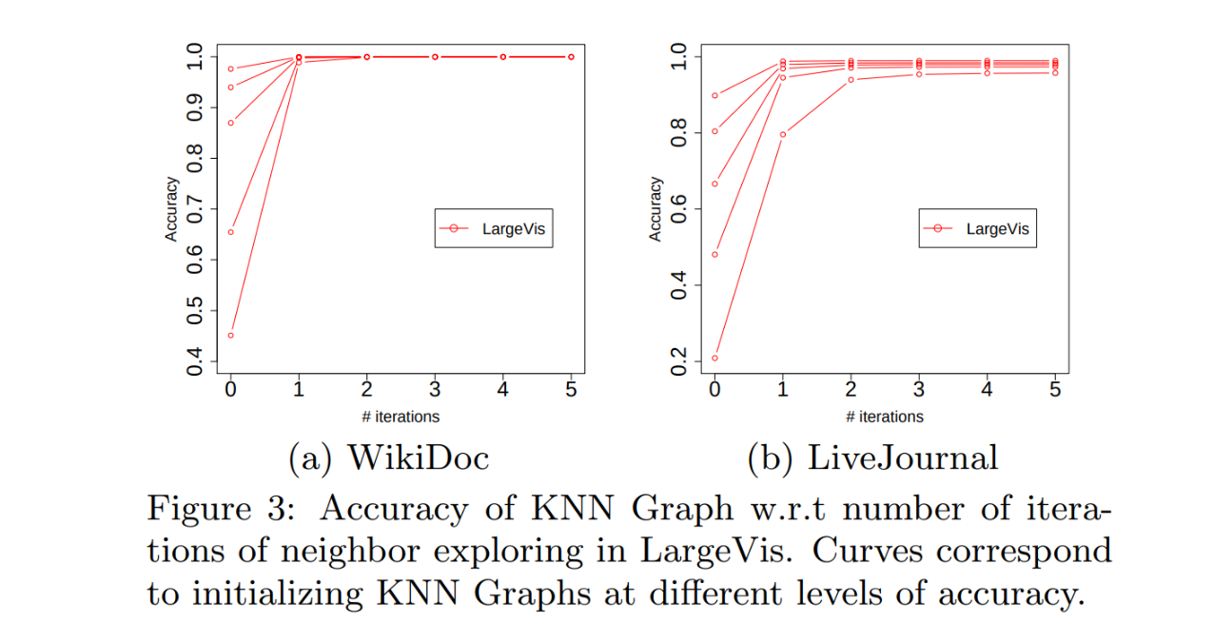

Slide 11
Comparing to t-SNE
Significantly reduces the computational cost of the graph construction step
Employs a principled probabilistic model for the visualization step , the objective of which can be effectively optimized through asynchronous stochastic gradient descent with a linear time complexity.
The whole procedure thus easily scales to millions of high-dimensional data points.
Experimental results on real-world data sets demonstrate that the LargeVis outperforms the state-of-the-art methods in both efficiency and effectiveness.
The hyper-parameters of LargeVis are also much more stable over different data sets.

Slide 12
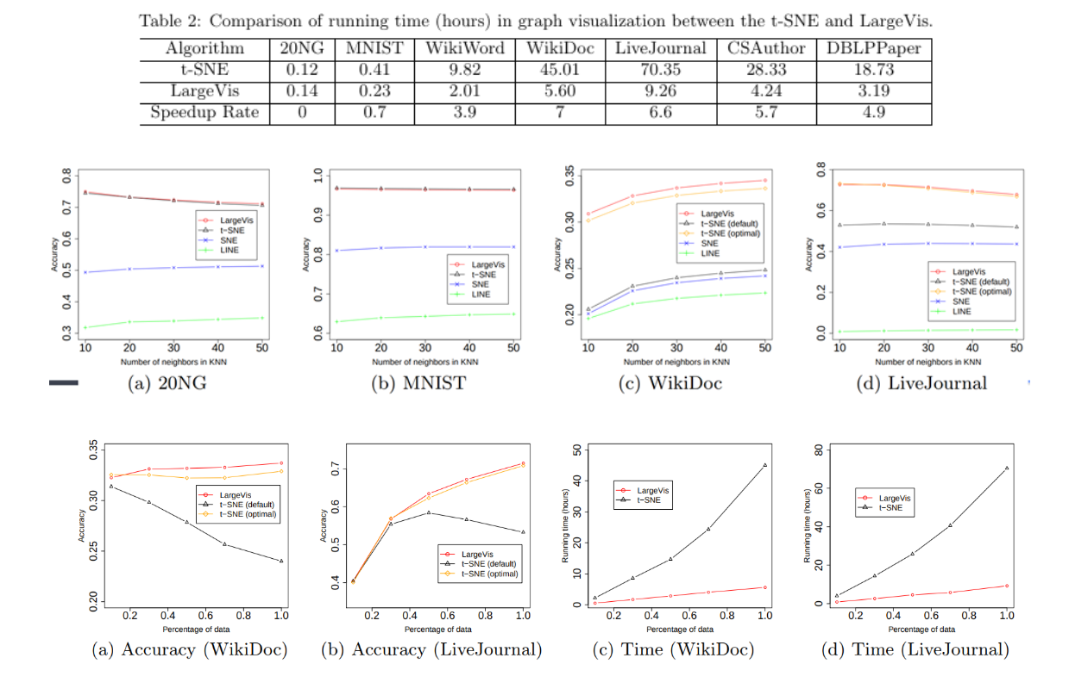

Slide 13
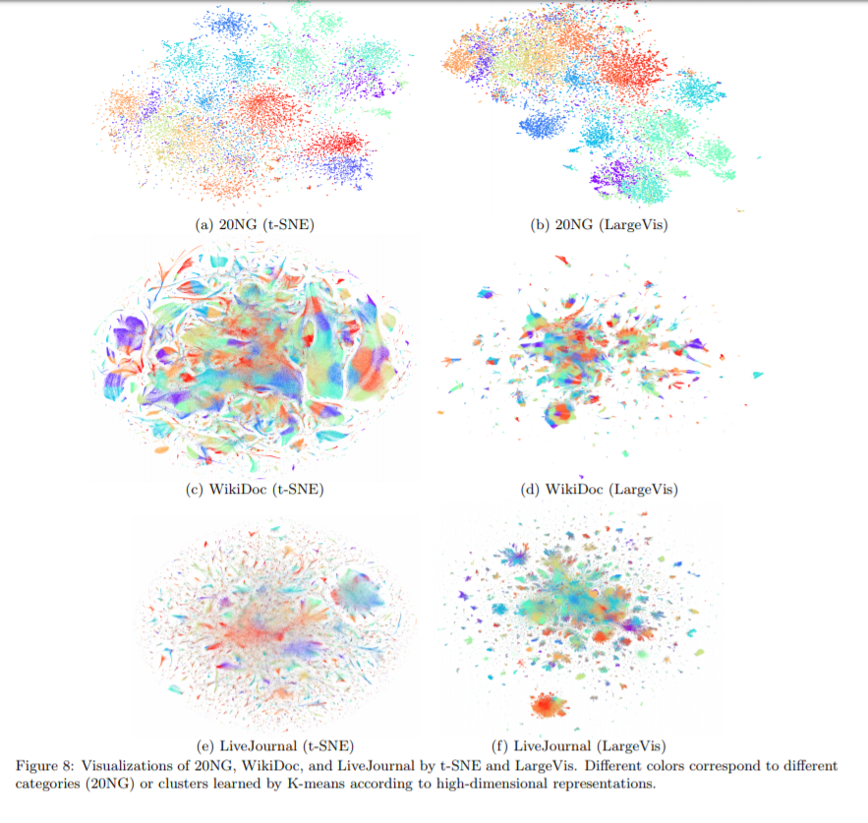

Slide 14
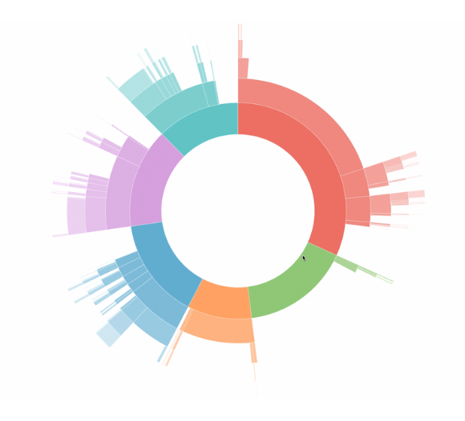
Thank you
Marek Gargas
Wiktor Reczek
References:
https://arxiv.org/pdf/1602.00370.pdf

