Slide 1


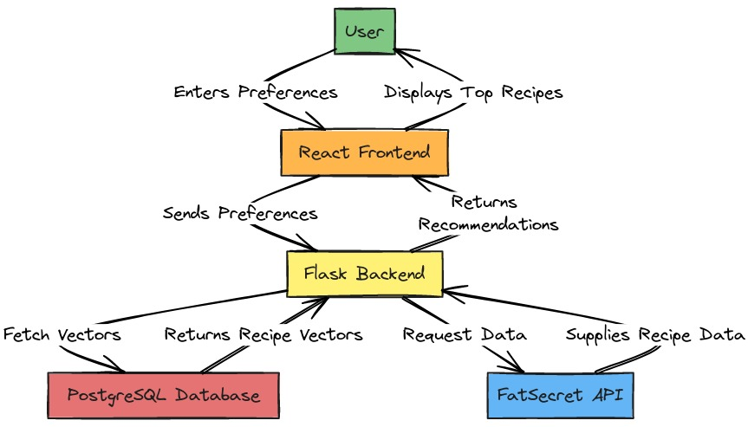
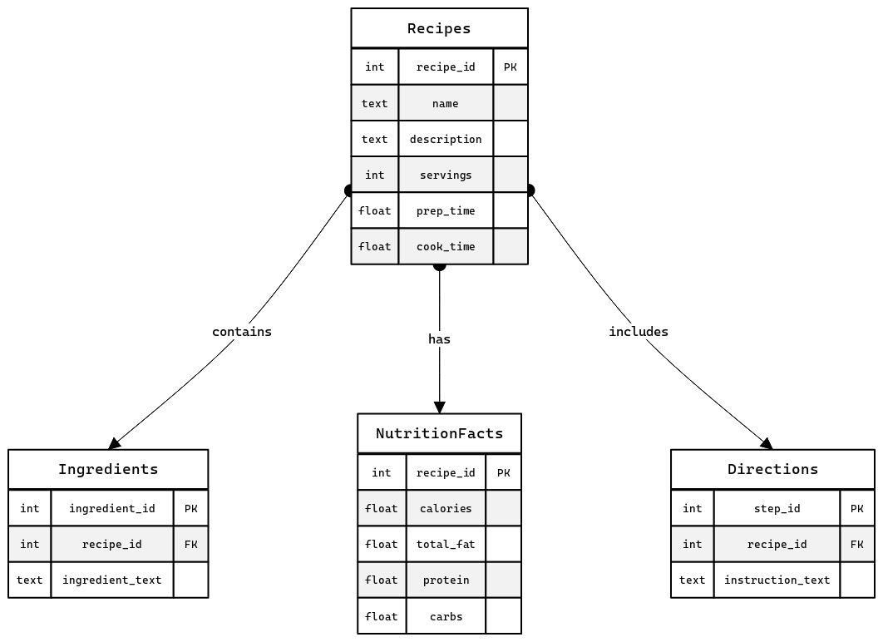
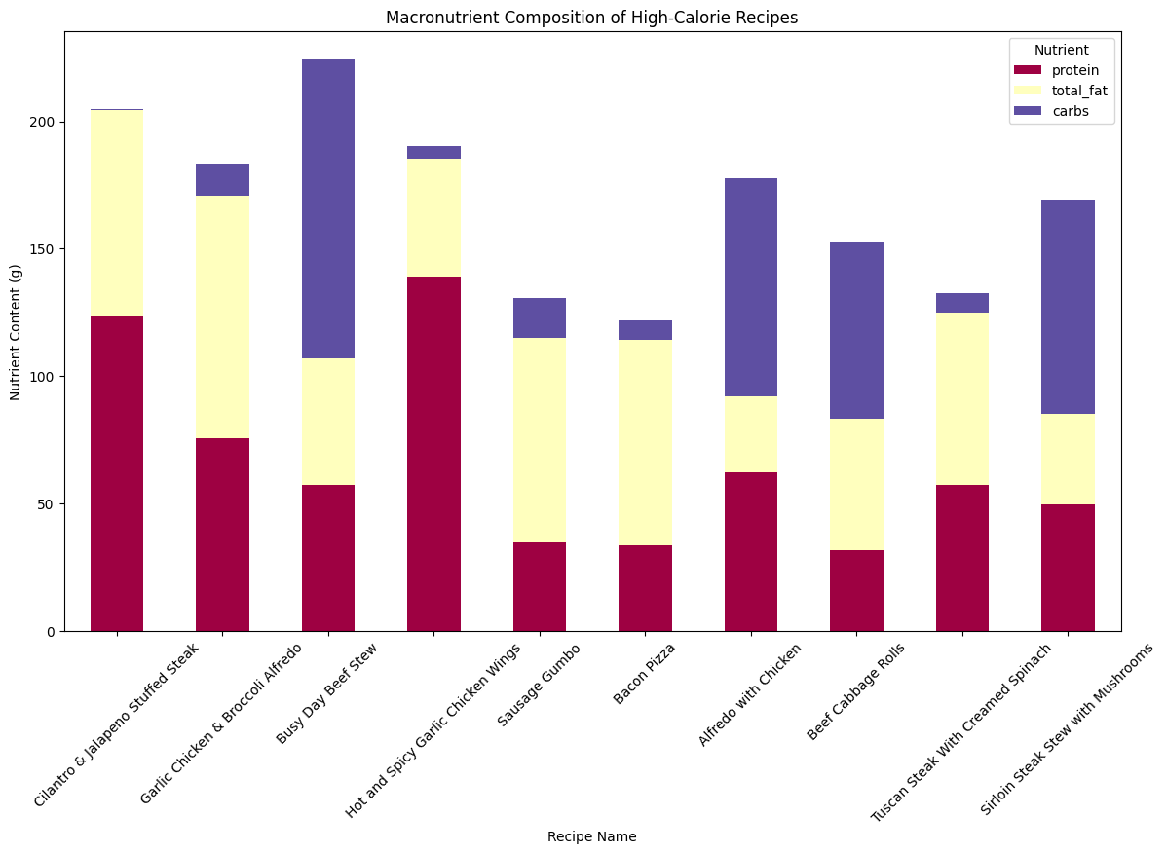
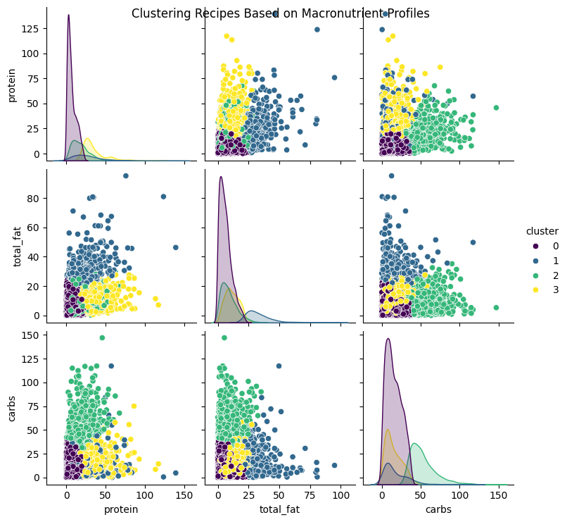
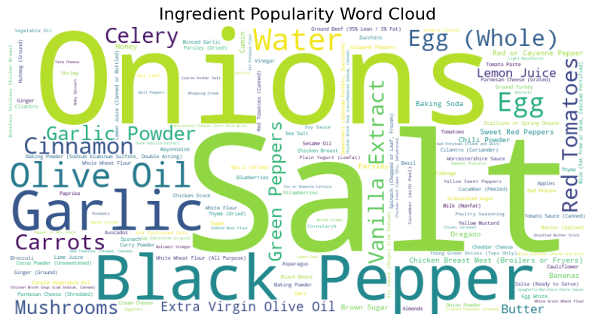
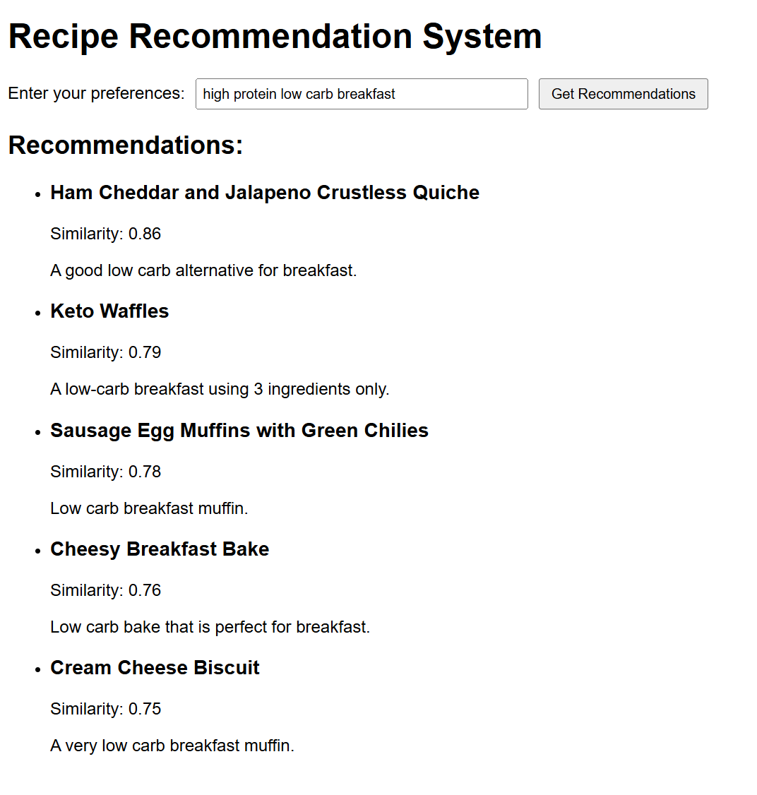
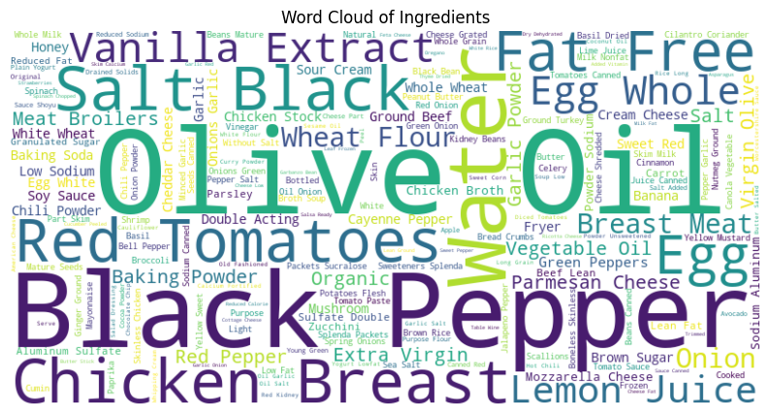
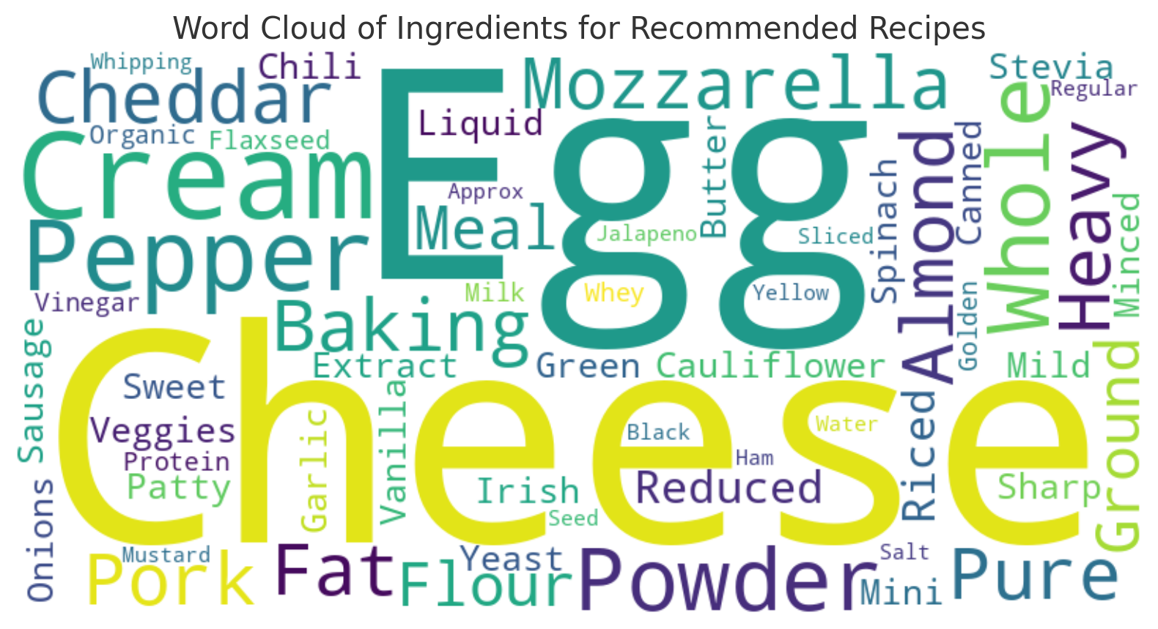
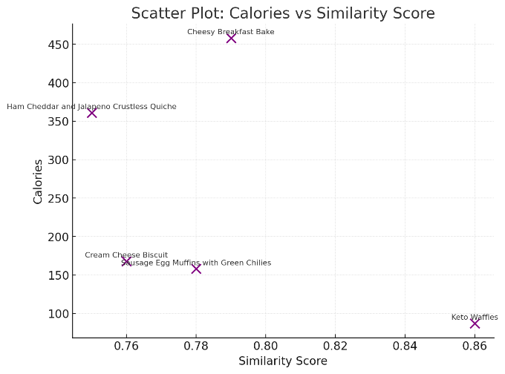
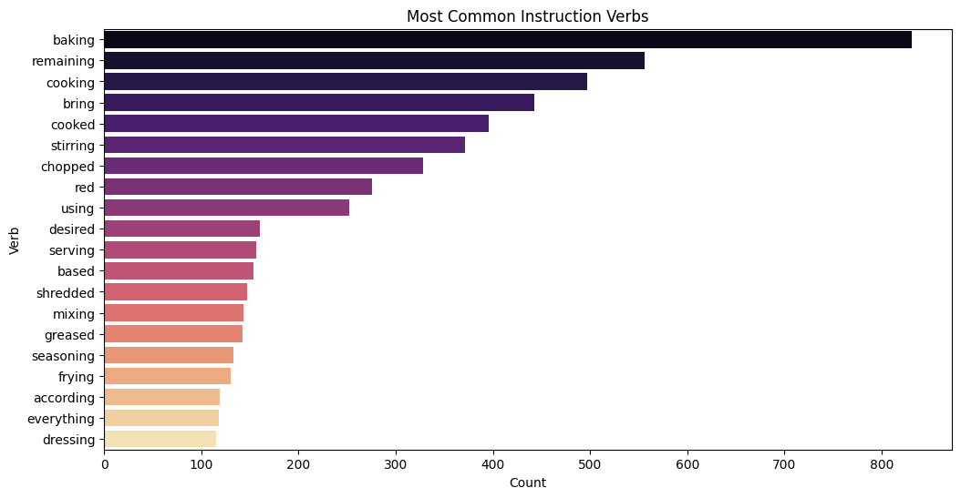
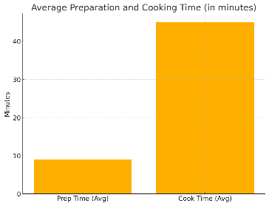
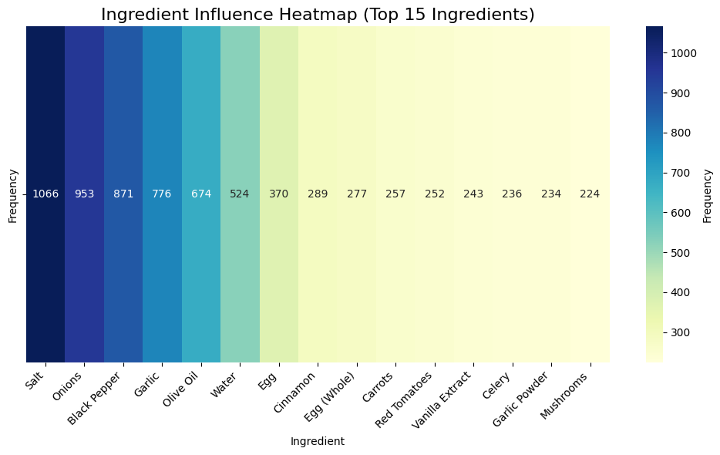
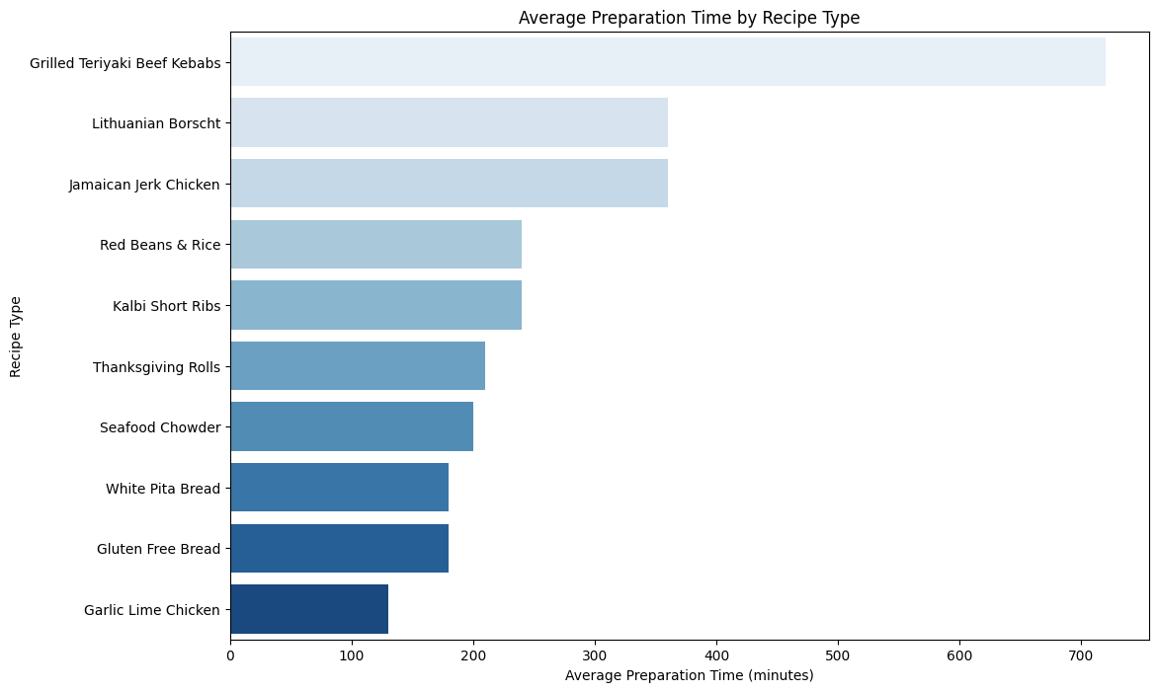
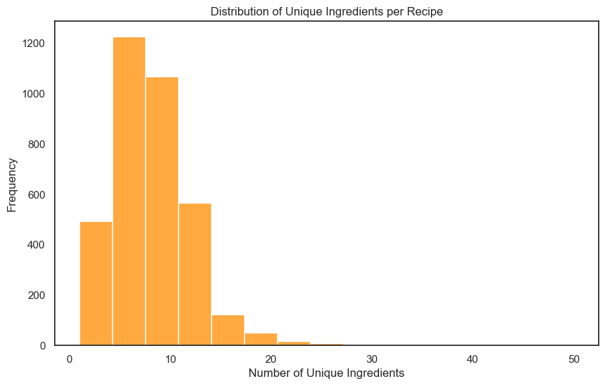
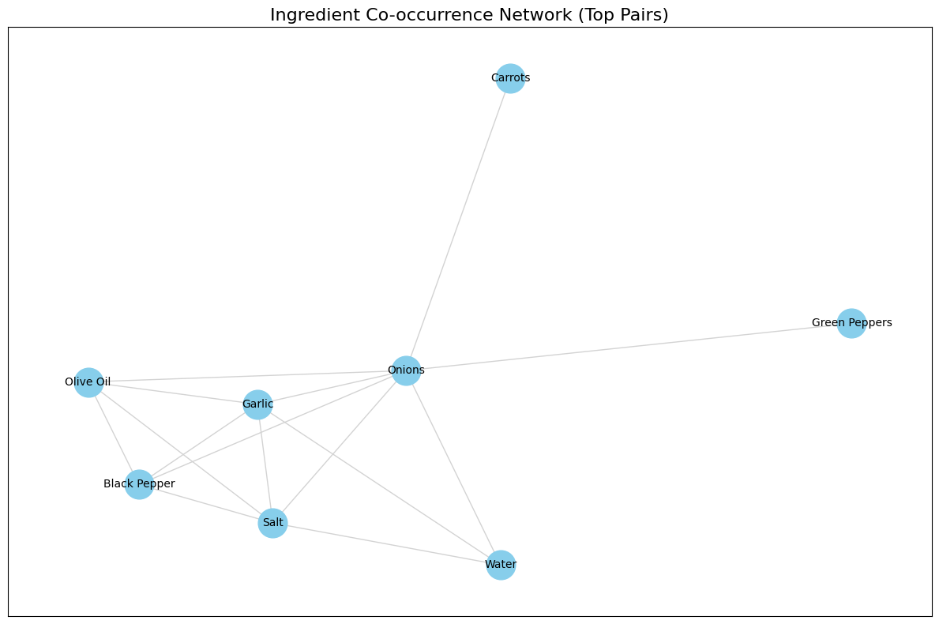
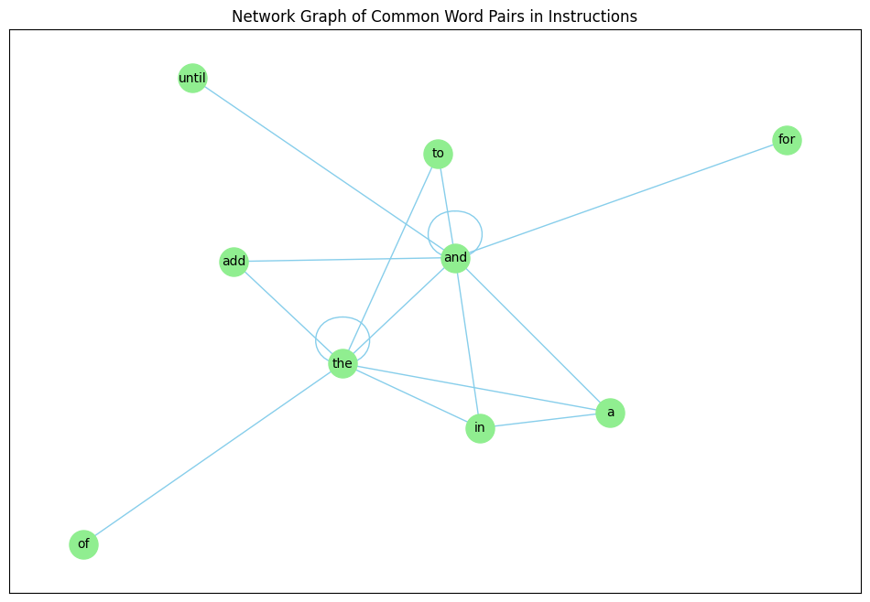
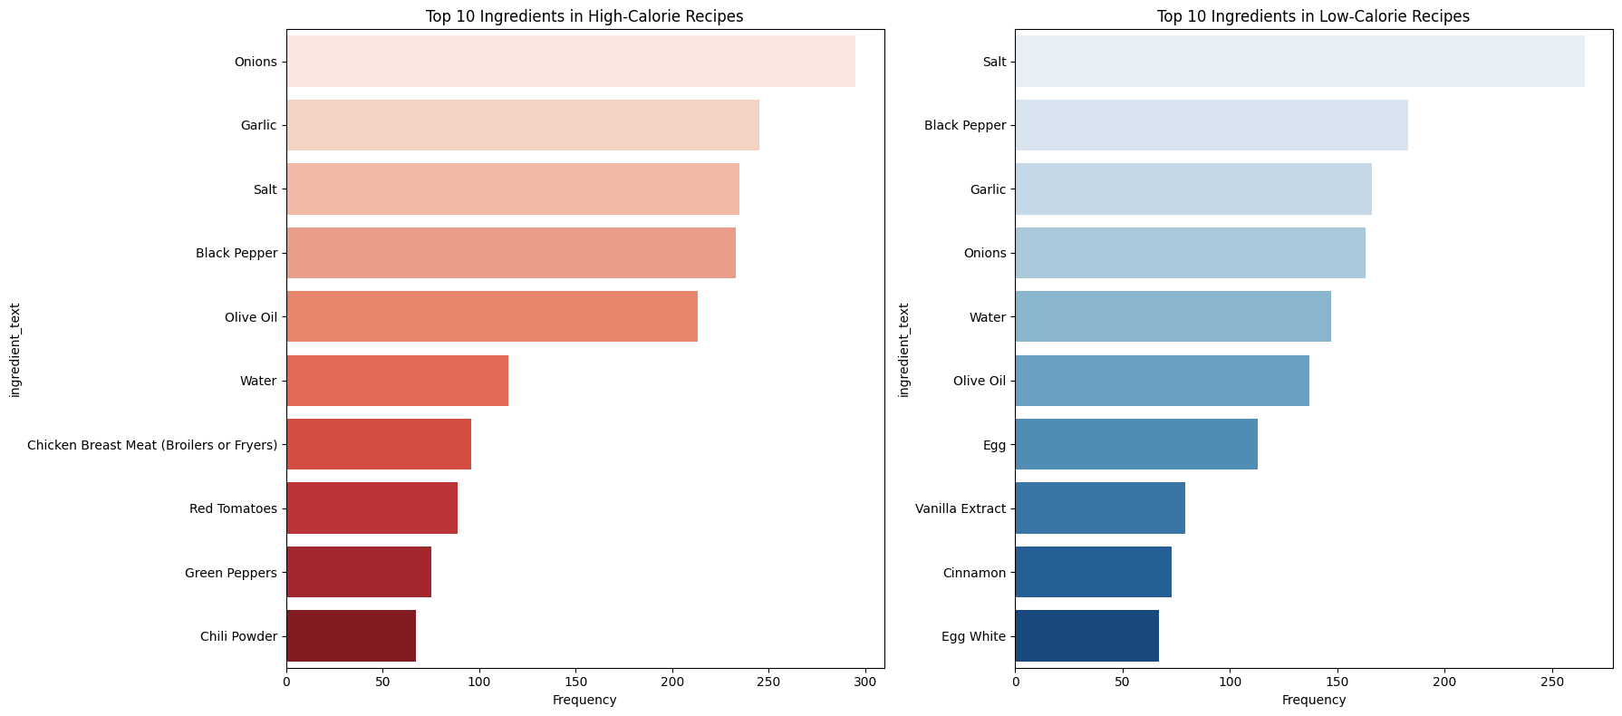
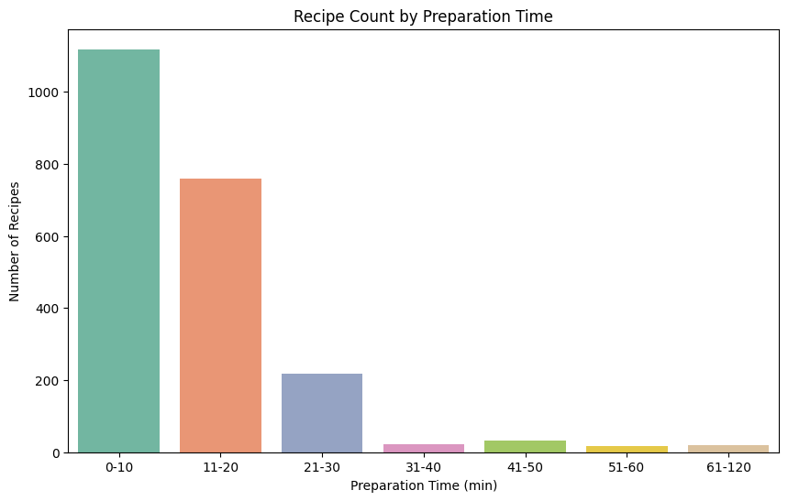
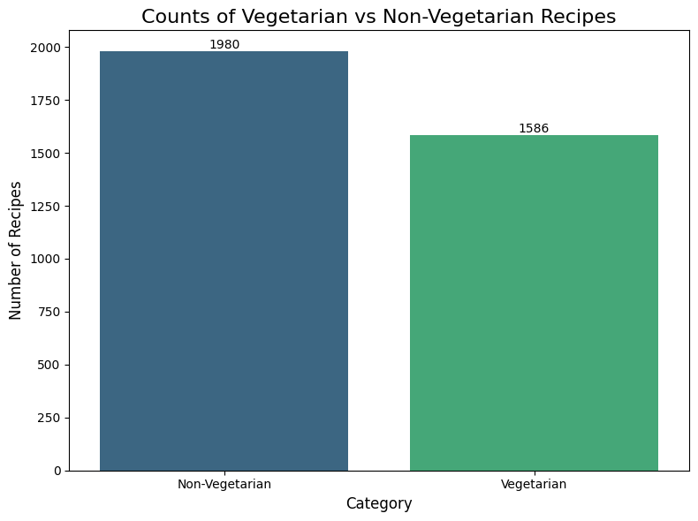
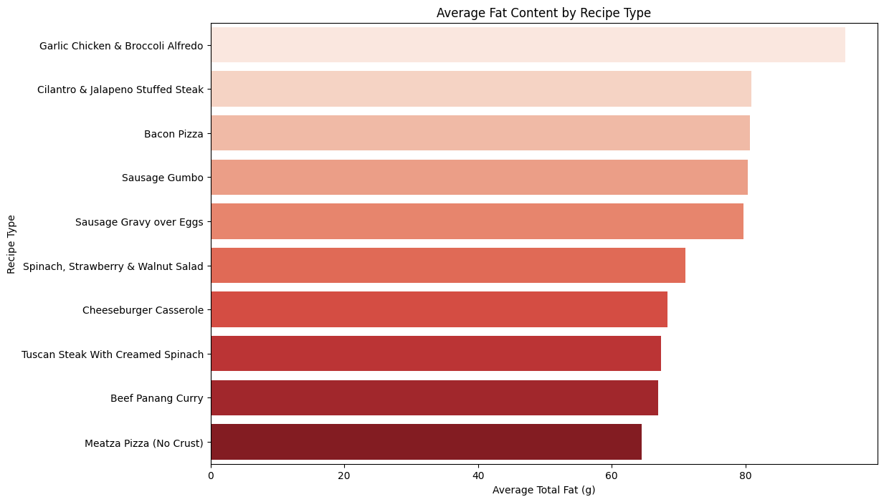
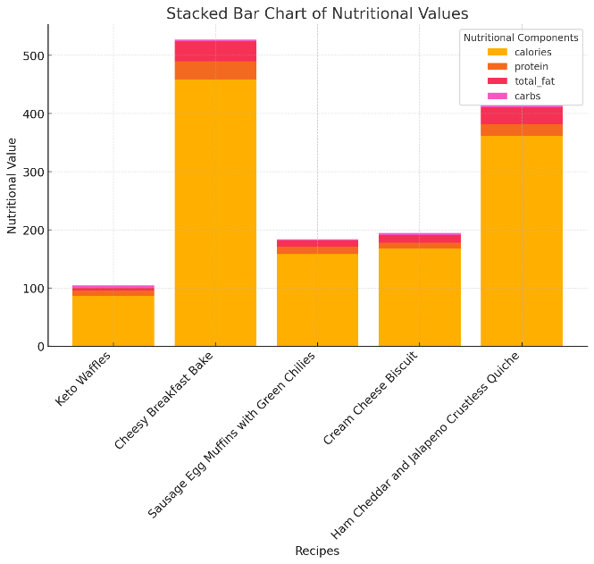
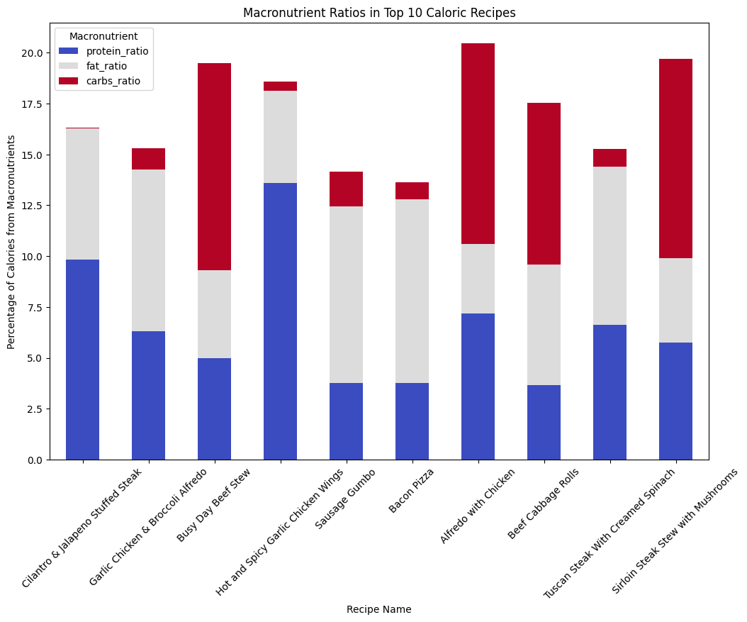
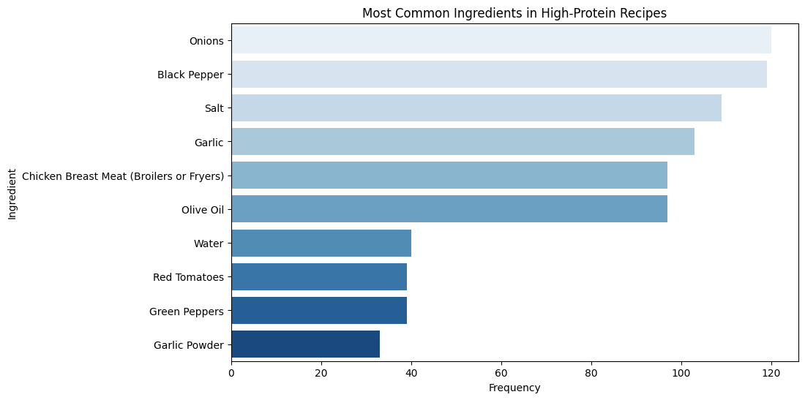
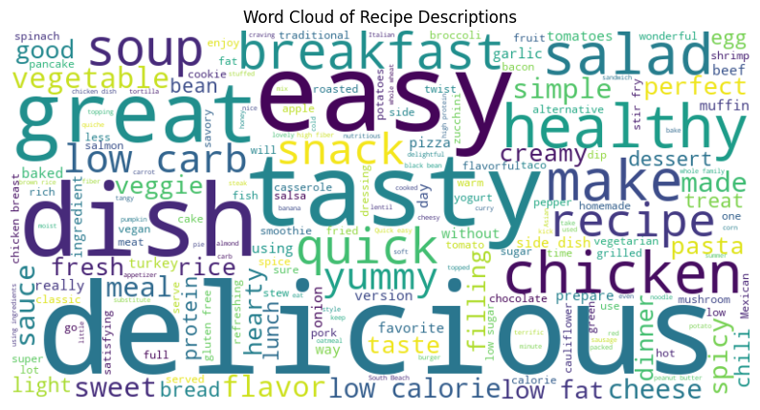
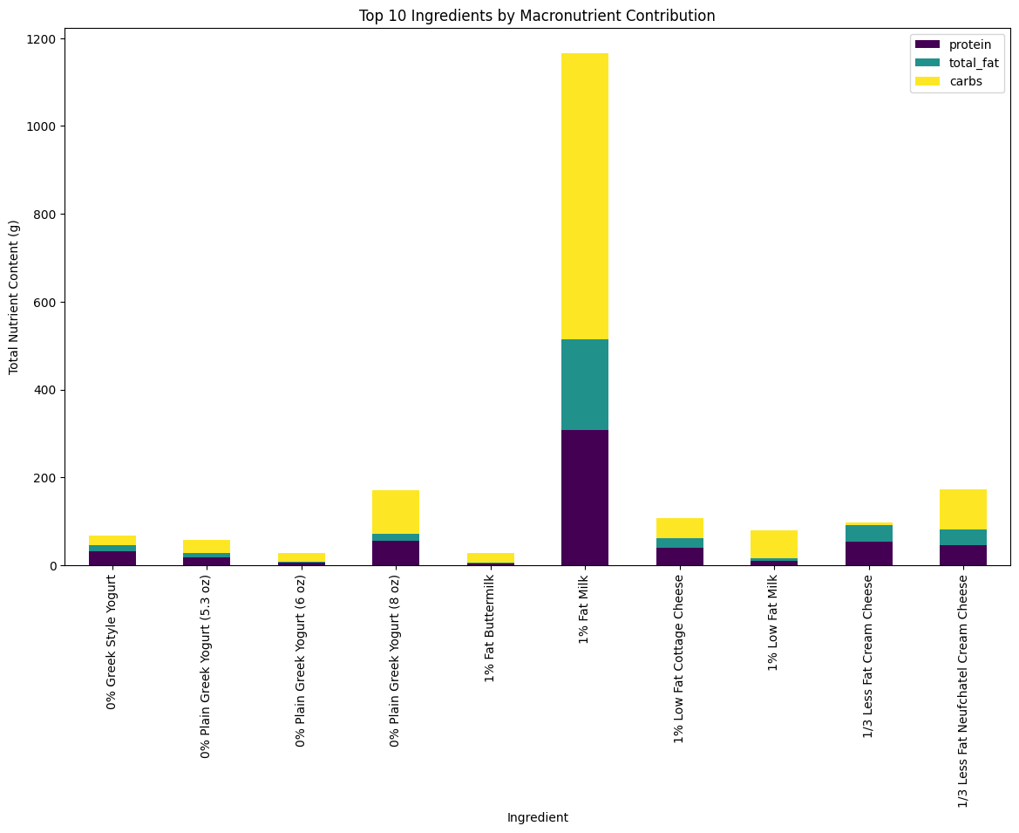
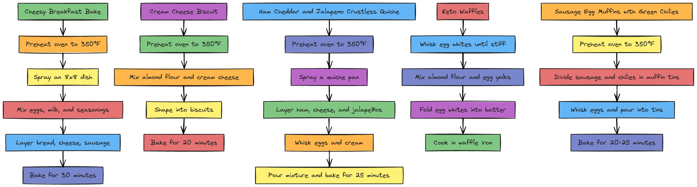
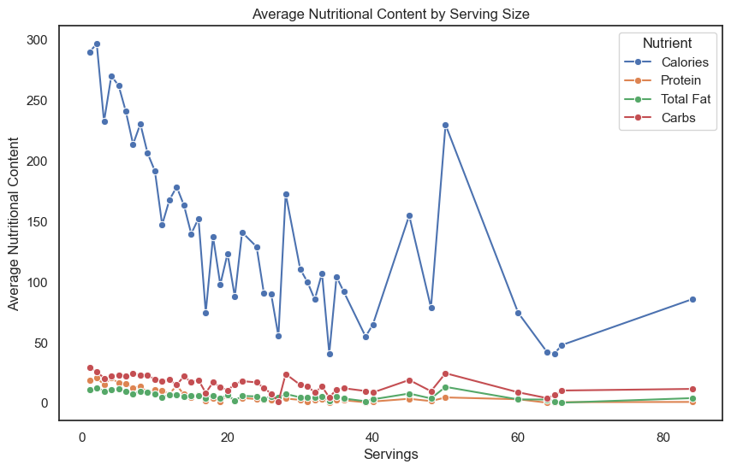
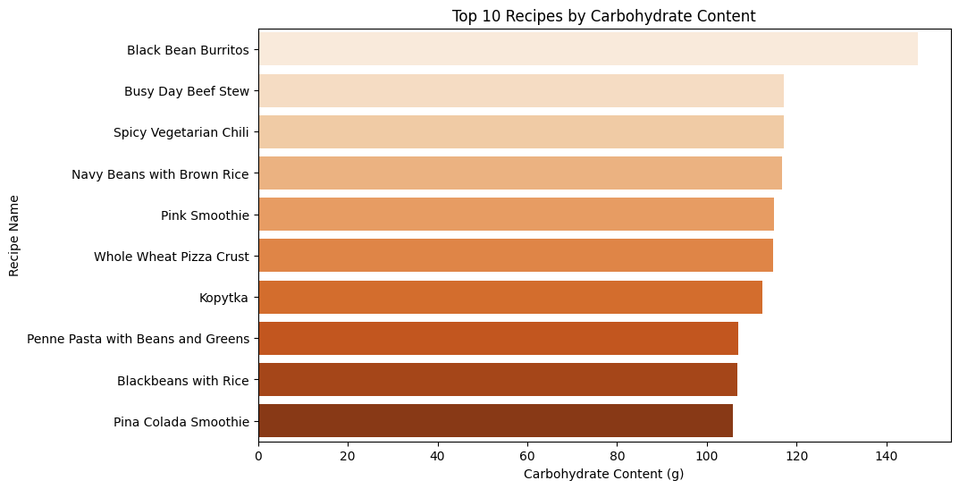
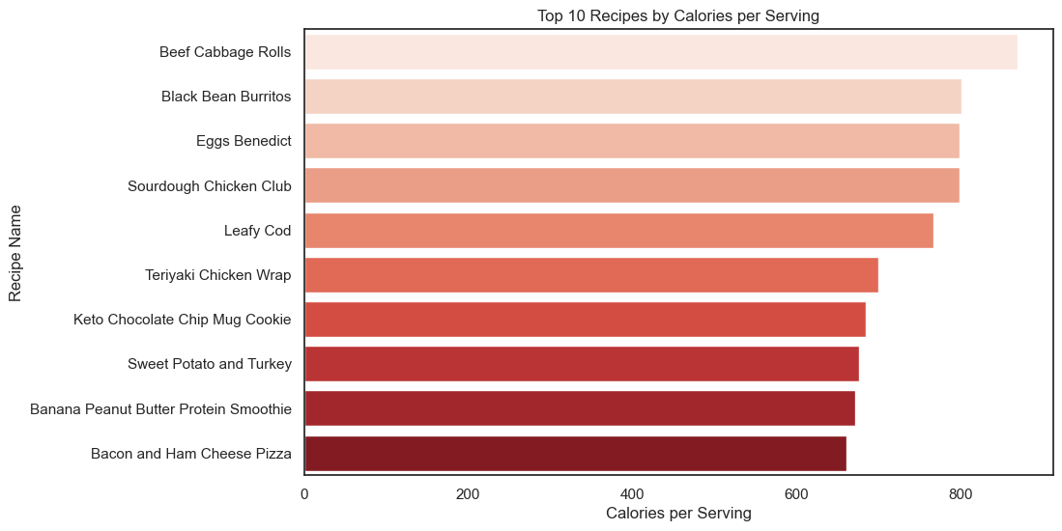
Personalized Recipe Recommendation
Data Visualization Project
By Anchal Kulwal, Elizabeth Wanyonyi, Kevin Gomez, and Vaishnavi Sampara
The University of Texas at Arlington
Introduction
System Architecture
Technologies Used
The Recipe Recommendation System leverages the power of Natural Language Processing (NLP) and Machine Learning (ML) to provide personalized recipe recommendations based on user preferences. The system analyzes similarities between recipes using cosine similarity, which compares textual information like ingredients and descriptions. The recommendations are fetched from a rich dataset of recipes stored in a PostgreSQL database and fetched using the FatSecret API.
Backend: Python (Flask), Psycopg2 (PostgreSQL interaction)
NLP Model: SentenceTransformer (all-MiniLM-L6-v2)
Frontend: React, JavaScript
Database: PostgreSQL
API Integration: FatSecret API for recipe data fetching
Cosine Similarity: Scipy’s cosine function
Objective
Challenges and Learnings
The goal of this project is to recommend recipes based on user-input preferences, such as dietary restrictions or ingredients. By utilizing cosine similarity scores, the system finds the most similar recipes to a user’s preference and presents the top five recommendations.
Data Quality: Ensuring data consistency between the FatSecret API and the PostgreSQL database was crucial for accurate similarity calculations.
Performance Optimization: Efficiently querying and storing high-dimensional recipe vectors required careful database indexing and optimization.
User Experience: Designing a seamless user experience in React and providing timely recommendations in real-time.
Technical Overview
Methodology
User Input Handling:
Users enter text preferences, such as "high-protein low-carb breakfast."
The input is converted into a vector using SentenceTransformer.
Cosine Similarity Calculation:
Recipe vectors stored in the database are compared with the user’s vector.
Cosine similarity measures the angle between two vectors—vectors pointing in the same direction are highly similar.
Recommendations:
Based on similarity scores, the system fetches the top 5 recipes.
Recipes with higher cosine similarity to the user input are ranked higher.
1. Data Collection:
FatSecret API: Recipes are collected using the FatSecret API, which provides detailed recipe information such as name, description, preparation time, cooking time, ingredients, and nutritional facts.
PostgreSQL Database: Recipe data (e.g., name, description, ingredients, nutritional values) is stored in a PostgreSQL database to ensure efficient querying and data management.
2. Data Preprocessing and Feature Extraction:
Textual Embeddings: Recipes' descriptions and ingredients are converted into vectors using the SentenceTransformer model (all-MiniLM-L6-v2). This pre-trained model transforms the textual data into a high-dimensional vector that can be compared.
3. Cosine Similarity:
Cosine Similarity Calculation: The system calculates the similarity between a user’s preferences and the available recipes. The higher the cosine similarity score, the more relevant the recipe is to the user's input preferences.
4. Recipe Recommendation Algorithm:
Backend (Flask): A Flask-based API handles user requests. When a user enters a preference (e.g., "low carb breakfast"), the backend uses the SentenceTransformer to convert the preferences into a vector and compares it to stored recipe vectors using cosine similarity.
Frontend (React): The frontend provides a user-friendly interface where users can input their preferences and receive real-time recipe recommendations. The React app communicates with the Flask backend to fetch and display the top recipe suggestions.
User Input Handling:
Users enter text preferences, such as "high-protein low-carb breakfast."
The input is converted into a vector using SentenceTransformer.
Cosine Similarity Calculation:
Recipe vectors stored in the database are compared with the user’s vector.
Cosine similarity measures the angle between two vectors—vectors pointing in the same direction are highly similar.
Recommendations:
Based on similarity scores, the system fetches the top 5 recipes.
Recipes with higher cosine similarity to the user input are ranked higher.
Add your information, graphs and images to this section.
Add your information, graphs and images to this section.
Conclusion and Future Work
This Recipe Recommendation System offers personalized suggestions based on user preferences, bringing healthier meal options to the forefront. Future work includes expanding the dataset, adding more dietary filters (e.g., vegan, gluten-free), and improving recommendation algorithms by incorporating collaborative filtering techniques.
Dataset Visualizations
Results
User Input Handling:
Users enter text preferences, such as "high-protein low-carb breakfast."
The input is converted into a vector using SentenceTransformer.
Cosine Similarity Calculation:
Recipe vectors stored in the database are compared with the user’s vector.
Cosine similarity measures the angle between two vectors—vectors pointing in the same direction are highly similar.
Recommendations:
Based on similarity scores, the system fetches the top 5 recipes.
Recipes with higher cosine similarity to the user input are ranked higher.

