Slide 1
Intro to
Neural Networks

Slide 2
What is it?
Finding an equation that matches reality
Layers of nodes that take in multiple “activated/not activated” signals and output a single “activated/not activated” signal
Why go on?
Seriously, what more could you want than that?
Demanding, aren’t you!
Fine, it’s also tweaking a giant matrix

Slide 3
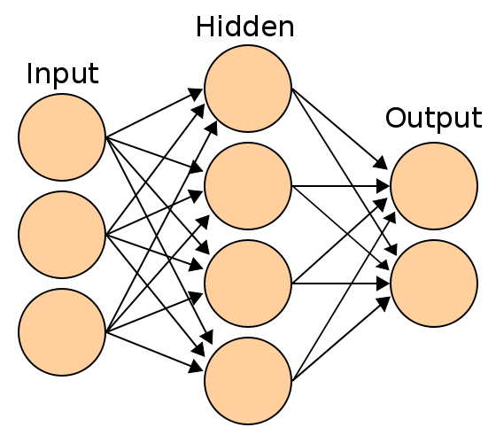
Neural Network
Image from https://en.wikipedia.org/wiki/Artificial_neural_network

Slide 4
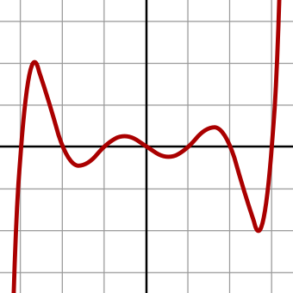
2D Complex Equations
f(x) = x⁷ - 14 x⁵ + 49 x³ - 36 x
Image from https://en.wikipedia.org/wiki/Polynomial

Slide 5
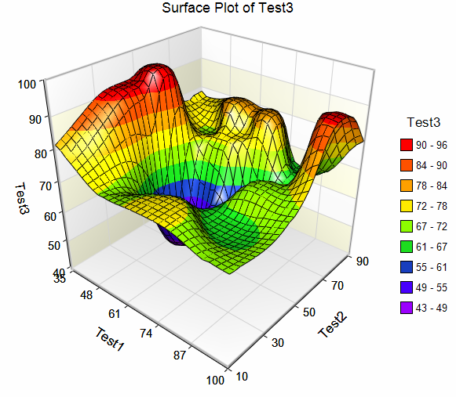
Now 3D Version
Image from ncss.com

Slide 6
Gradient Descent
The actual equation trying to be solved isn’t the equation that gives us the output, we’re trying to minimize the equation that tells us how far we’re from the correct output
Usually that means the mean squared error

Slide 7
General Flow
Start out with default, random, or “these could be right” values in the matrix
Check how far off from the actual values it is
Use gradient descent to tweak the values so the predicted is close to the actual
Repeat until it’s close enough to be useful

Slide 8
How Does It Fit?
Overfitting – the graph you create fits the graph of the training set too well. Means that it’s less likely to match things outside the training set
Underfitting – the graph you create doesn’t fit the training set closely enough. Likely it’s not going to match anything, in or out of the training set

Slide 9
What’s the use?
Image identification – Alpha Go used images of Go boards to learn the difference between good games and bad games
Speech recognition
Art generation
Medical Diagnosis … es

Slide 10
Tools
Python
  TensorFlow
  PyTorch
R
AI::MXNet – written by Sergey Kolychev

