Slide 1
AUA 2026
Advanced & Metastatic
Prostate Cancer
72
advanced-session items
IP38 + PD23 + IP73
6
original posters
Narrative update with abstract digests and original poster appendix
attached as source pack
Washington, DC | May 2026
40
guideline recs
AUA/SUO 2026 amendment
Speaker line
The useful update is not a list of new agents. It is a cleaner way to run an advanced prostate cancer clinic.
Sources: AUA 2026 program; AUA/SUO APC guideline amendment; local AUA abstract/poster corpus.
01

Slide 2
CLAIM SPINE
Not one breakthrough. A new operating model.
AUA 2026 connects treatment intensification, imaging, genomics, and toxicity management into one clinical workflow.
INTENSIFY
SELECT
IMAGE
SUSTAIN
Doublet therapy is no longer exotic; the real question is who needs triplet therapy.
The triplet signal is clinically plausible, but not uniform enough to become an automatic reflex.
PSMA PET is central, yet post-RLT monitoring may need more than one tracer story.
The endpoint is not only response. It is whether the clinic can keep patients safely on therapy.
Talk track
I would present this as a clinic-design update: under-treatment and over-treatment now happen in the same room, and the answer is workflow discipline.
Narrative synthesis from AUA advanced prostate cancer sessions and poster abstracts.
02

Slide 3
OFFICIAL ANCHOR
The guideline update validates the story.
The May 2026 AUA/SUO amendment explicitly expands guidance across imaging, molecular testing, risk stratification, and treatment paradigms.
IMAGING
TESTING
RISK
TREATMENT
Appropriate imaging becomes a treatment-selection tool, not just a staging formality.
Germline and somatic testing move earlier and become part of routine APC counseling.
Risk stratification is needed to choose intensity, de-intensity, and sequencing.
Combination therapy and sequencing are now a guideline-level management problem.
Why this matters
The 040IC course description mirrors the same pattern: genetic counseling, somatic testing, ADT + ARPI + chemotherapy, PSMA PET, PARP inhibitors, CRPC sequencing, and de-intensification.
Sources: AUA/SUO APC Guideline Amendment announcement, May 12 2026; AUA 040IC course page.
03

Slide 4
MHSPC INTENSIFICATION
Routine care has already moved away from ADT alone.
In a Swedish population-based de novo mCSPC cohort, doublet and triplet uptake rose alongside improved 3-year survival.
Upfront doublet
19%
66%
9,294
de novo mCSPC men
Upfront triplet
4%
NPCR Sweden, 2016-2024
17%
3-year OS, all men
51%
INTERPRETATION
61%
The signal is real-world adoption plus survival movement, not randomized proof that every patient needs triplet therapy.
3-year OS, age <65
69%
77%
Source: IP38-12 original poster PDF; values paraphrased from poster results.
04

Slide 5
TRIPLET SELECTION
Triplet therapy needs a gate, not a reflex.
Bayesian and real-world data keep ADT + ARPI as the rational default while identifying a narrower high-volume, fit-patient lane.
Selection gate
OVERALL
HIGH-VOLUME
MEANINGFUL BENEFIT
Consider triplet when high-volume disease, good performance status, chemo-eligible physiology, and patient goals align.
Otherwise, intensify with ADT + ARPI and preserve later-line options.
HR 1.04
HR 0.89
HR <0.8
Pr benefit 36%
Pr benefit 90%
19% in high-volume
YUSHIMA registry: triplet was not clearly superior for time to CRPC; Bayesian borrowing suggested modest RMST benefit that depended on external evidence.
Sources: IP38-13 and IP73-03 original poster PDFs.
05

Slide 6
IMPLEMENTATION GAP
The first ADT decision still varies by pathway.
Ontario data suggest intensification improved over time, but real-world delivery still depends on patient barriers and care-system design.
3,871
332
26.5%
Mean uptake per urologist
patients
urologists
intensified
6%
de novo mHSPC, age >=66
ADT initiated by urologist
ARPI or docetaxel within 6 mo
59%
NARRATIVE POINT
The gap is no longer knowledge alone. It is referral timing, frailty/comorbidity assessment, drug access, documentation, and whether the urology clinic has a default intensification pathway.
Source: IP73-14 original poster PDF.
06

Slide 7
PSMA / RLT MONITORING
After target pressure, PSMA is no longer the whole imaging story.
A Mayo registry analysis suggests 11C-Choline PET/CT may detect post-Lu-177 PSMA progression more often and at lower PSA than PSMA PET/CT.
512
54%
40%
2.0 vs 4.1
PET/CT scans
progression
progression
PSA at progression
235 mCRPC patients
11C-Choline scans
PSMA PET scans
ng/mL, p=0.003
1
2
3
4
Baseline
Therapy
Progression call
Decision
PSMA PET before Lu-177
Lu-177 PSMA exposure
PSMA PET vs 11C-Choline
Biopsy / imaging / treatment response
Source: IP73-16 original poster PDF. Interpret as retrospective registry signal, not definitive imaging standard.
07

Slide 8
MCRPC PRECISION
BRCA is no longer a binary checkbox.
A large Japanese CGP cohort argues for variant-level annotation and treatment interpretation beyond simply 'BRCA altered' or 'not altered'.
CGP landscape
Clinical readout
TP53
- BRCA1 PVs: inferior outcomes vs BRCA2 PVs
- BRCA2 loss: most favorable olaparib response signal
- MTB review shifted earlier in recent cases
- NEPC phenotype remains a separate escape problem
BRCA2
CDK12
ATM
PRACTICE POINT
Order testing early, but read the result deeply: specimen, timing, pathogenicity class, zygosity/loss, CDK12/ATM context, and neuroendocrine phenotype all change the discussion.
Sources: IP73-24 and IP73-27 original poster PDFs.
08

Slide 9
TOXICITY DURABILITY
The hidden endpoint is clinic durability.
AUA 2026 toxicity posters make the same point: intensified therapy fails if adverse effects are handled as afterthoughts.
Supportive-care operating model
270
PC360 enrolled
Cardiometabolic
Bone / dental
INTERPRETATION
5-domain ADT care model
The endpoint is not only response; it is whether patients stay functional, monitored, and able to complete the intended treatment sequence.
Mood / cognition
Anemia / QoL
20.3%
Sexual health / exercise
MRONJ at 3 yr
denosumab cohort signal
Talk track
The modern APC clinic needs standing workflows for bone, metabolic risk, mood, cognition, anemia, sexual health, exercise, dental review, and treatment completion.
Sources: IP38-17, IP73-07, IP73-04, IP38-05 original poster PDFs.
09

Slide 10
PRACTICE TRANSLATION
What I would change after AUA 2026.
A practical APC workflow for the Monday clinic: make the default visible, document the exceptions, and audit the pathway.
01
mHSPC default
Discuss ADT + ARPI early for eligible de novo metastatic patients.
BOTTOM LINE
02
AUA 2026 is a prompt to redesign the advanced prostate cancer clinic around evidence selection, source documentation, and toxicity capacity.
Triplet gate
Document volume, symptoms, fitness, chemo eligibility, and patient preference.
03
PSMA/RLT rule
Predefine how progression will be called after Lu-177 PSMA exposure.
04
Variant read
Capture germline, somatic, specimen, pathogenicity, and zygosity/loss.
05
Toxicity clinic
Build ADT/RLT supportive care into the pathway, not the rescue visit.
Synthesis from AUA/SUO amendment, 040IC objectives, and selected AUA 2026 posters.
10

Slide 11
ABSTRACT DIGEST
IP38-12 is the backbone abstract for the narrative.
Use this when someone asks why the deck says intensification is now routine practice.
IP38-12
Uptake of doublet and triplet therapy for men with de novo metastatic castration-sensitive prostate cancer. Population-based study
Question
How much did upfront doublet/triplet treatment enter routine care, and did survival move in parallel?
Population
9,294 men with de novo mCSPC in Sweden's NPCR, 2016-2024.
Key result
Doublet uptake 19% -> 66%; triplet 4% -> 17%; 3-year OS 51% -> 61%; among age <65, 69% -> 77%.
Take-home
Real-world treatment intensity increased, supporting early intensification while leaving patient selection unresolved.
Source: IP38-12 poster PDF and local fulltext extraction. This slide paraphrases the abstract instead of reproducing it verbatim.
11

Slide 12
ABSTRACT DIGEST
The supporting abstracts make the workflow argument.
These are the source-level pieces that turn a drug update into a clinic-model update.
IP38-13
Triplet selection signal
Overall OS advantage was unclear; high-volume patients had higher probability of benefit, but clinically meaningful benefit remained modest.
IP73-14
Implementation variation
Only 26.5% of older Ontario mHSPC patients received intensification; uptake rose to 59% by 2022, showing pathway improvement but not uniform delivery.
IP73-16
Post-Lu-177 PSMA imaging
11C-Choline detected progression more frequently and at lower PSA than PSMA PET/CT in a retrospective post-RLT registry.
IP73-24
Variant-level CGP
Variant-level BRCA interpretation provided prognostic and predictive information beyond binary BRCA status.
IP38-17
PC360 ADT toxicity pathway
A multidisciplinary ADT care model enrolled 270 men and operationalized five domains of supportive care.
Sources: selected original poster PDFs and local fulltext extraction; text is paraphrased.
12

Slide 13
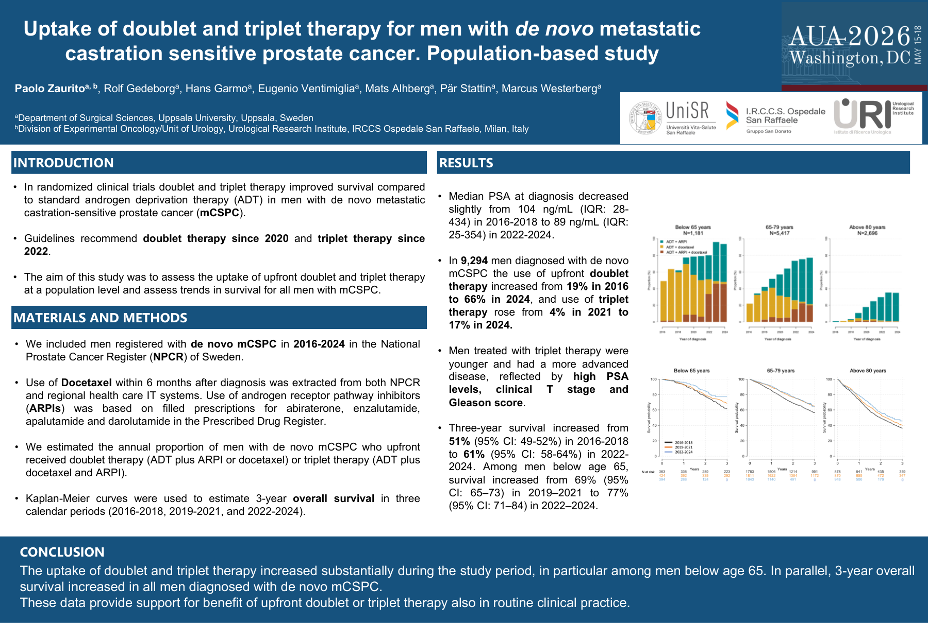
ORIGINAL POSTER APPENDIX
IP38-12: Uptake of doublet and triplet therapy in de novo mCSPC
Rendered from the original local poster PDF; included as source appendix for internal presentation use.
Source: scraper/data/posters/IP38-12.pdf
13

Slide 14
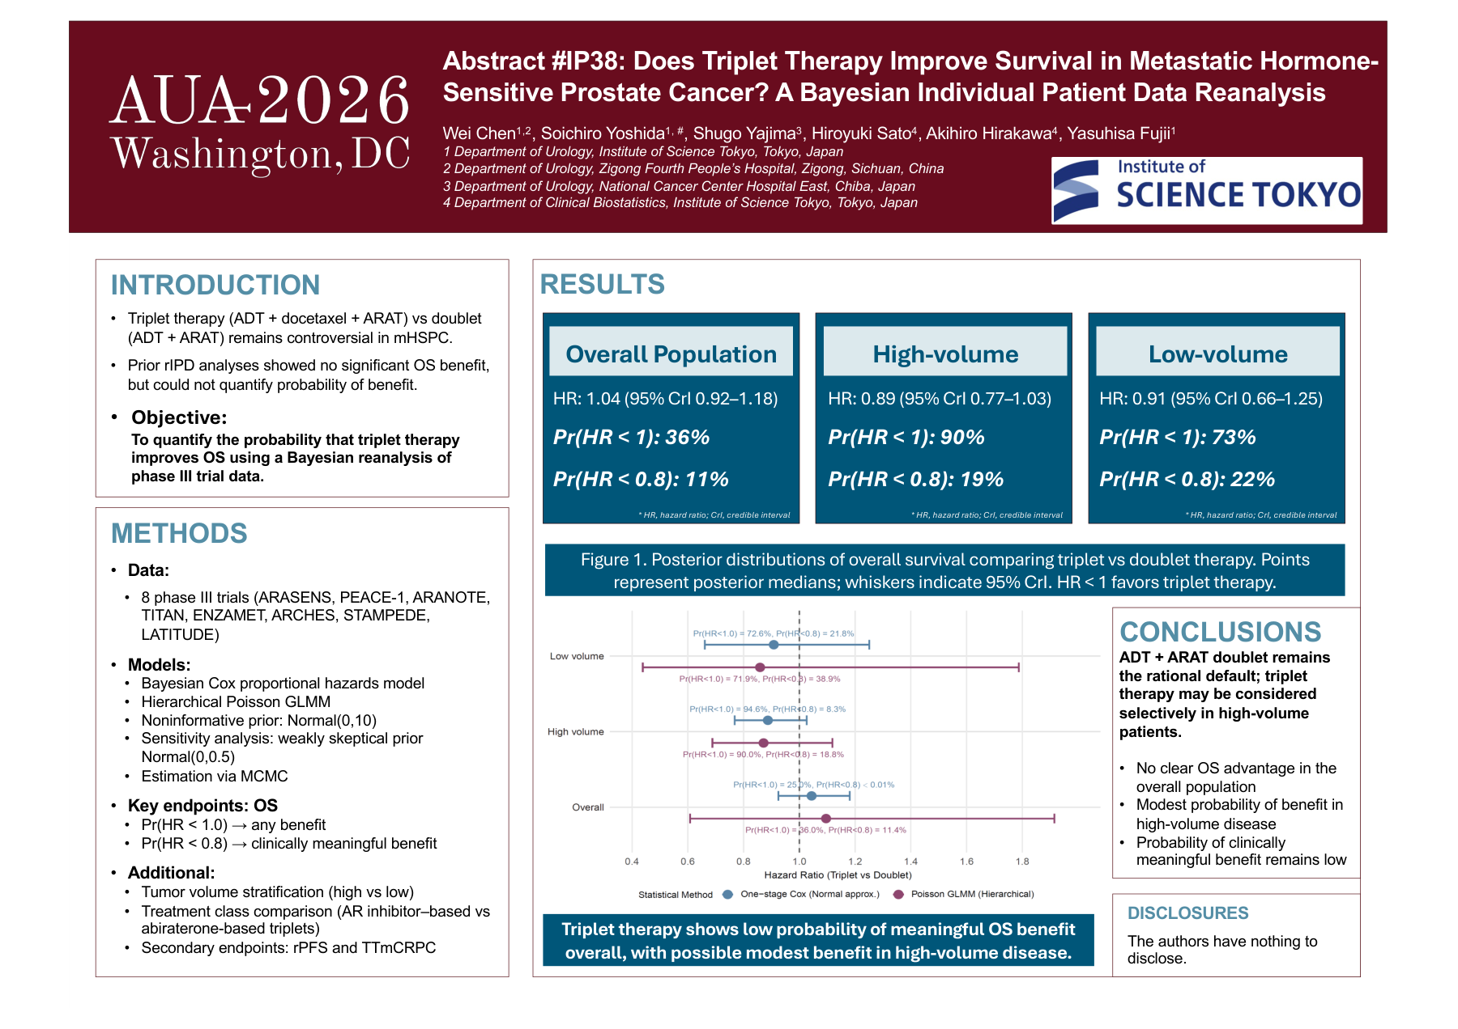
ORIGINAL POSTER APPENDIX
IP38-13: Bayesian reanalysis of triplet vs doublet therapy in mHSPC
Rendered from the original local poster PDF; included as source appendix for internal presentation use.
Source: scraper/data/posters/IP38-13.pdf
14

Slide 15
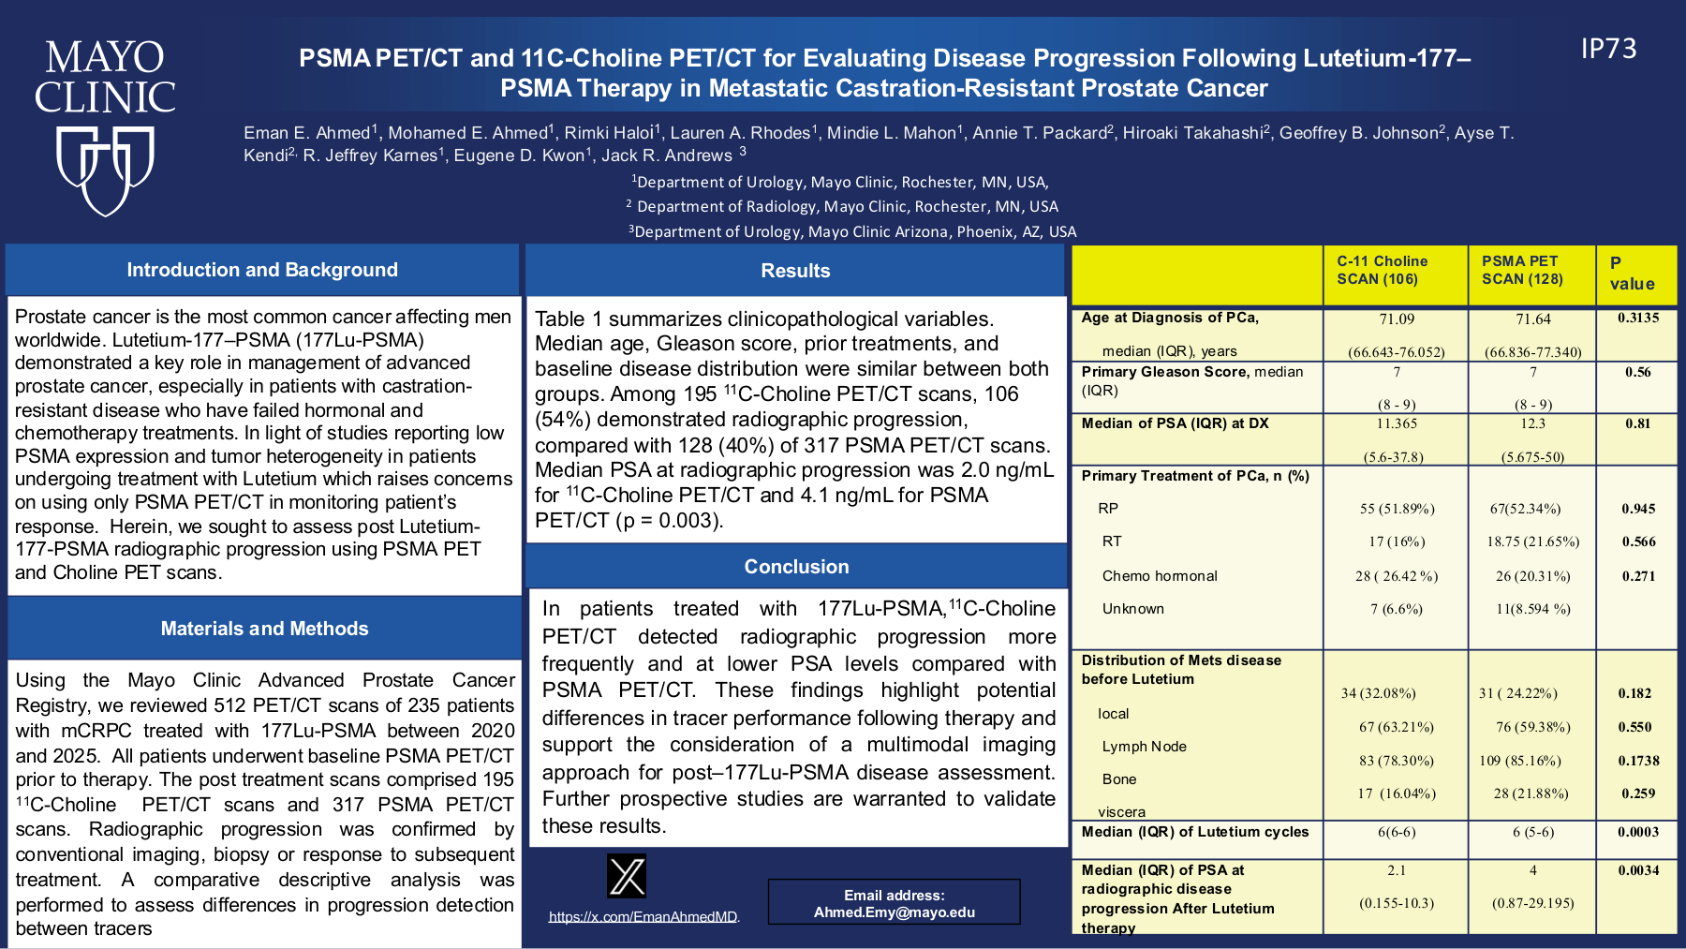
ORIGINAL POSTER APPENDIX
IP73-16: PSMA PET/CT and 11C-Choline after Lu-177 PSMA therapy
Rendered from the original local poster PDF; included as source appendix for internal presentation use.
Source: scraper/data/posters/IP73-16.pdf
15

Slide 16
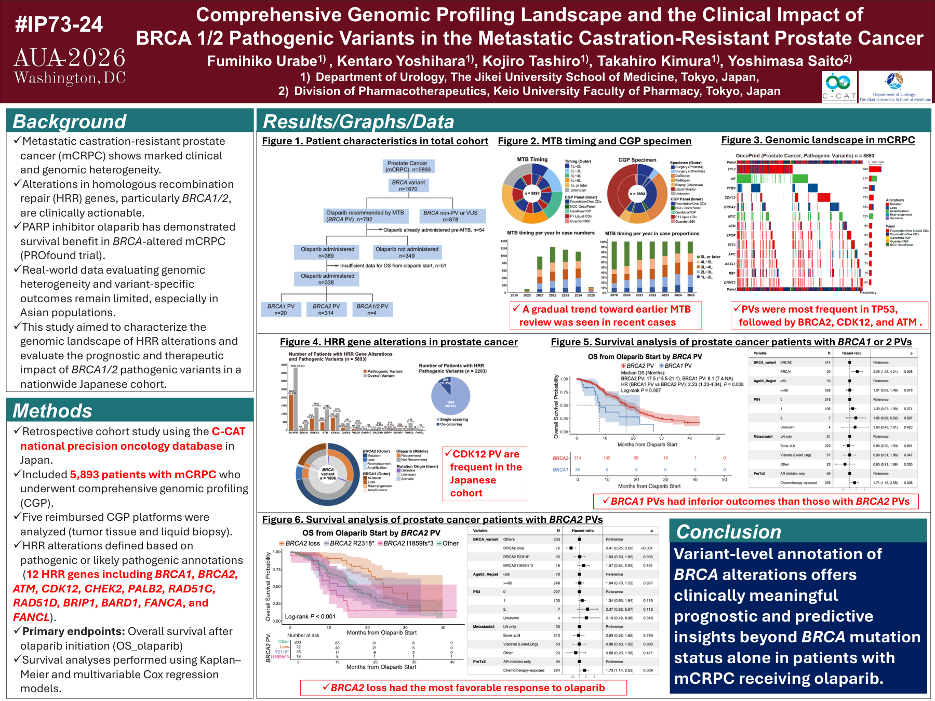
ORIGINAL POSTER APPENDIX
IP73-24: CGP landscape and BRCA1/2 pathogenic variants in mCRPC
Rendered from the original local poster PDF; included as source appendix for internal presentation use.
Source: scraper/data/posters/IP73-24.pdf
16

