Slide 1
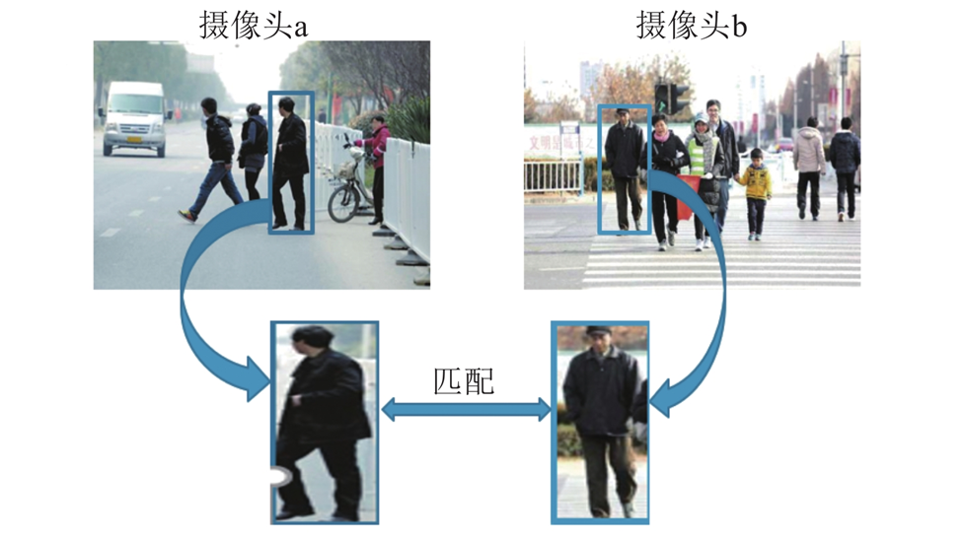
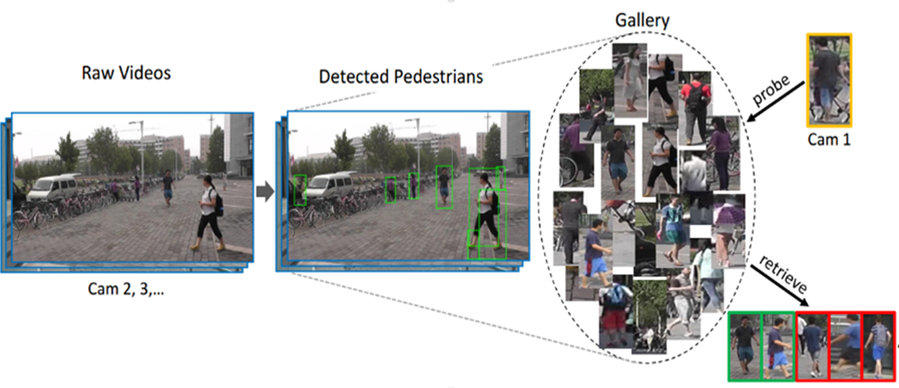
Re-ID（行人重识别）

Slide 2
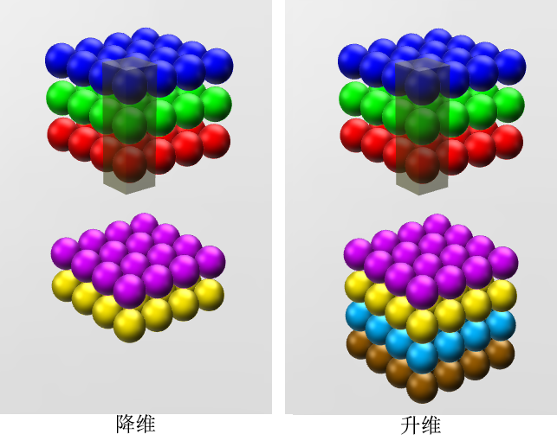
1x1卷积
跨通道信息融合

Slide 3
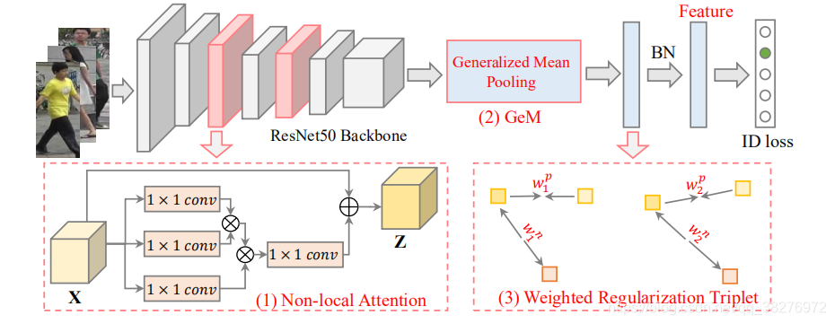
AGW：A New Baseline for Single-/Cross-Modality Re-ID
1x1卷积减少一半的通道后（有助于减少计算量）

Slide 4

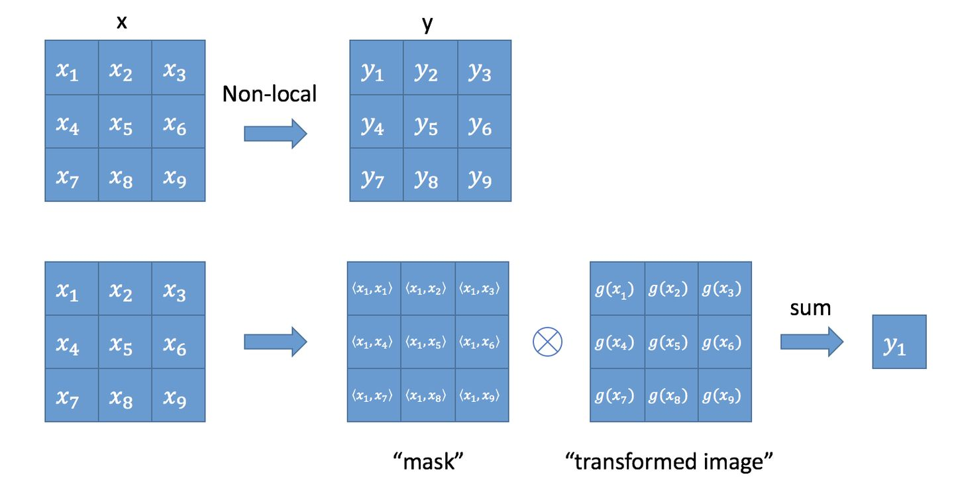
Non-local

Slide 5

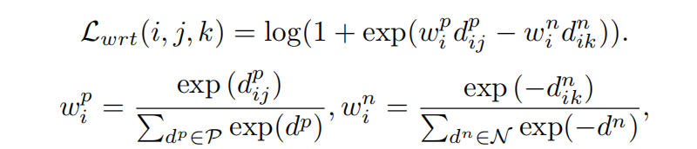
Triplet loss
Weighted Regularization Triplet (WRT) loss

