Slide 1
Abstract Interpretation
© Lunjin Lu

Slide 2
Abstract Interpretation
Simulate computation (of the program) on a non-standard domain

Slide 3
Casting out of nine
Detect errors in calculation of arithmetic expression (+, - ,*)
  Calculate the remainder of sum of digits in an operand divided by 9
  Take module 9 of each intermediate and final results
  The result obtained as above agree with that of normal calculation module 9.

Slide 4
Casting out of nine
Concrete semantics
Domain: Z
n → N(n)
+ → add
- → sub
* → mult
Abstract semantics
Domain: Z₉ ={0,…,8}
n → N(n) mod 9
+ → add₉
- → sub₉
* → mult₉

Slide 5
Casting out of nine
X add₉ Y = (X add Y) mod 9
X sub₉ Y = (X sub Y) mod 9
X mult₉ Y = (X mult Y) mod 9
: Z → Z₉
α(0) = 0
α(8) = 8
…
α(9) = 0
α(10a±b) = α(a±b)

Slide 6
Casting out of nine
Concrete semantics
[ ] : Exp → Z
[n] = N(n)
[ e₁+e₂] = [e₁] add [e₂]
[ e₁-e₂] = [e₁] sub [e₂]
[ e₁*e₂] = [e₁] mult [e₂]
Abstract semantics
[ ]₉ : Exp → Z₉
[n]₉ = α(N(n))
[ e₁+e₂]₉=[e₁]₉ add₉ [e₂]₉
[ e₁-e₂]₉=[e₁]₉ sub₉ [e₂]₉
[ e₁*e₂]₉= [e₁]₉ mult₉ [e₂]₉

Slide 7
Exact Abstraction
[ ]
Z
Z
α
α
=
Z₉
[ ]₉
Z₉

Slide 8
Abstract Interpretation
Key points so far:
  There are two semantics
    Concrete semantics models normal execution;
    Abstract semantics gives analysis;
      Constants in concrete domain is abstracted by constants in abstract domain
      An n-ary operation on concrete domain is abstracted by an n-ary operation on abstract domain
    Correctness is established with respect to a relationship between the abstract and the concrete domains.

Slide 9
Parity Analysis
(Jones & Nielson)
A: while n ≠ 1 do
B: if n is even
then (C: n := n÷2; D:)
else (E: n := 3*n+1; F:)
fi
od
G:

Slide 10
Flowchart
A
n≠1
n even
n := n÷2
B
C
D
G
E
n:=3*n+1
F

Slide 11
Operational semantics
A state is a pair of program point and a store
Each elementary block (test, assignment) defines a transition
  next_{n≠1}(<A, {n→5}>) = <B,{n→5}>
  next_{n≠1}(<A, {n→1}>) = <G,{n→1}>

Slide 12
Collecting semantics
Each program point is associated with the set of stores that may be obtained during execution of the program
acc_{p} = {s | next*(<p₀,s₀>) = <p,s> }

Slide 13
Collecting semantics
Domain: (2^{N},⊆,∪,∩,N,∅)
acc_{A} = S₀
acc_{B} = (acc_{A} ∪ ace_{D} ∪ acc_{F}) ∩ (N\{1})
acc_{C} = acc_{B} ∩ {2m | m ∈ N }
acc_{D} = f_{n÷2} (acc_{C})
acc_{E} = acc_{B} ∩ {2m+1 | m ∈ N }
acc_{F} = f_{3n+1}(acc_{E})
acc_{G} = (acc_{A} ∪ ace_{D} ∪ acc_{F}) ∩ {1}
f_{n÷2} (S) = {n ÷ 2 | n ∈ S}
f_{3n+1}(S) = {3n+1 | n∈ S}

Slide 14
Abstract semantics
Domain: <P,<,∨,∧,Δ,∇) where
P = {odd,even, Δ,∇}
Δ < Δ, Δ < odd, Δ < even, Δ < ∇,
odd < odd, even < even
odd < ∇, even < ∇, ∇< ∇

Slide 15
Abstraction
α(S) = Δ, if S = {}
odd, if S ⊆ {1,3,…}
even, if S ⊆ {0,2,…}
∇, else

Slide 16
Abstract semantics
abs_{A} = α(S₀)
abs_{B} = (abs_{A} ∨ abs_{D} ∨ abs_{F}) ∧ α(N\{1})
abs_{C} = abs_{B} ∧ α({2m | m ∈ N })
abs_{D} = f_{n÷2} (abs_{C})
abs_{E} = abs_{B} ∧ α({2m+1 | m ∈ N })
abs_{F} = f_{3n+1}(abs_{E})
abs_{G} = (abs_{A} ∨ abs_{D} ∨ abs_{F}) ∧ α{1}

Slide 17
Abstract operations
f_{n÷2} (abs) = if abs=Δ then Δ else ∇
f_{3n+1}(abs) = Δ, if abs= Δ
∇, if abs= ∇
even, if abs=odd
odd, if abs=even

Slide 18
Abstract semantics
abs_{A} = α(S₀)
abs_{B} = (abs_{A} ∨ abs_{D} ∨ abs_{F}) ∧ ∇
abs_{C} = abs_{B} ∧ even
abs_{D} = f_{n÷2} (abs_{C})
abs_{E} = abs_{B} ∧ odd
abs_{F} = f_{3n+1}(abs_{E})
abs_{G} = (abs_{A} ∨ abs_{D} ∨ abs_{F}) ∧ odd

Slide 19
Safety
α is not homomorphic, so we could not have exact abstraction as in casting out of nine!
Global safety: α( lfp F_{acc}) < lfp F_{abs}
Local safety: each abstract operation safely abstracts corresponding concrete operation.
  α(S₁ ∪ S₂) < α(S₁) ∨ α(S₂)

Slide 20
Galois connection
Instead of an abstraction function α, another way to relate abstract and concrete domains is via a concretization function γ from the abstract domain to the concrete domain.
γ(abs) = {}, if abs = Δ,
{2m+1 | m∈ N},if abs = odd,
{2m | m∈ N}, if abs = even,
N, if abs = ∇

Slide 21
Galois connection
Functions α and γ satisfy:
S ⊆ γ(α(S))
α(γ(abs)) < abs
This is called a Galois connection

Slide 22
Galois Connection
Let <C,<_{C} > and <A,<_{A} > be posets. The pair α: C→A and γ: A→C is a Galois connection iff
c <_{C} γ(α(c)) for each c in C
α(γ(a)) <_{A} a for each a in A
If α(γ(a)) = a then (α,γ) is a Galois insertion.

Slide 23
Parity Analysis Revisited
(α,γ) is a Galois insertion:
Let S be a set of natural numbers. Then It can be easily verified that S⊆γ(α(S)).
Let P be any parity. Then P = α(γ(P)) follows by simple case analysis.

Slide 24
Alternative Definition
Let <C,<_{C} > and <A,<_{A} > be posets. The pair α: C→A and γ: A→C is a Galois connection iff
  α(c) < a ⇔ c < γ(a)

Slide 25
Galois Connection for Sign Analysis
Let Sign = { top, bot, +, 0, - }
top
+
0
-
bot

Slide 26
Values = (2^{Z},⊆,∪,∩,N,∅)
α_{sign}(X) = bot, if X= ∅
+, if X ⊆ {1,2,…}
0, if X={0}
-, if X ⊆ {…, -2,-1}
top, else
γ_{sign}(S) = ∅, if S = bot
{1,2…} if S = +
{0} if S = 0
{…,-2,-1} if S = -
Z else
(α_{sign,}γ_{sign}) is a Galois connection (insertion).

Slide 27
Properties of Galois connections
αγα = α
γαγ = γ
αγ is a lower closure.
γα is an upper closure.
If <A,<_{A} > is a complete lattice then γ*(A) is a Moore family.
α and γ determines each other:
  γ(a) = ∨_{C}{ c | α(c) <_{A} a }
  α(c) = ∧_{A}{ a | c <_{C} γ(a) }
α preserves l.u.b.
γ preserves g.l.b.
α is onto iff γ is one-to-one (Galois insertion)
Every Galois connection can be reduced into a Galois insertion.
  Independent attribute sign analysis.

Slide 28
Operational semantics - revisited
Each elementary block is a transition function.
  A state is a pair of a program point and a store. s=<p,m> where p is a point and m is a memory store.
  The block maps a state to another state:
    [x:=e] next(<p,m>)=<q,m[x→A[e]m]>
    [skip] next(<p,m>)=<q,m>
    [b] next(<p,m>)=<q_{true},m> if B[b]m=tt
    next(<p,m>)=<q_{false},m> if B[b]m=ff
    Note that p labels the entry of the block while q with/without subscript labels the entry of the block to be executed next.

Slide 29
Properties of memory stores
Many program analyses derive invariants of memory stores for each program point.
An invariant is
  a logic formula that is satisfied by all memory stores that may be obtained;
  a set of memory stores that includes all memory stores that may be obtained
These two views are both useful.

Slide 30
Collecting semantics
Lifting next relation
[x:=e]
Next(<p,M>)=<q, {m[x→A[e]m] | m∈M}>
[skip]
Next(<p,M>)=<q,M>
[b]
Next(<p,M>) = <q_{true}, M∩{m| B[b]m=tt}>
Next(<p,M>) =<q_{false}, M∩{m| B[b]m=ff}>

Slide 31
Collecting semantics
Collecting all states with the same points together:
X_{q} = ∪{X | Next(p,X_{p}) =(q,X) and p→q}
Where X_{q} is a set of memory stores associated with q and p→q indicates that the block labeled q may be executed immediately after that labeled p.

Slide 32
Abstract semantics
Logical view
[x:=e]
next(<p,f>)=<q, sp(x:=e,f)>
[skip]
next(<p,f>)=<q,f>
[b]
next(<p,f>) = <q_{true}, f ∧ b>
next(<p,f>) = <q_{false}, f ∧ ¬b>

Slide 33
Abstract semantics
Group all formulae associated with the same program point:
f_{q} = ∨ { X | next(p,X_{p}) =(q,X) and p→q}

Slide 34
Abstract semantics
Logic formulae without restrict are too general. Analysis requires restriction on logic formulae. This restriction in turn requires operations next, sp, logical connectives to be approximated.
In a sign analysis, formulae are formed of primitive formulae (x is positive), (x is negative) together with logical connectives.
Logic formulae are then represented in an isomorphic domain (abstract domain).

Slide 35
Sign analysis
while (x>0)
do
x := x-1;
z := y*y
od;
z := -z
A logic formula might be x is positive, y negative and z positive.
This can be represented as an abstract state:
{x→+,y→-,z→+}
1
2
3
4
5

Slide 36
Global conditions
Both concrete and abstract semantics are least fixed points.
α(lfp f_{C}) <_{A} lfp f_{A}
lfp f_{C} <_{C} γ(lfp f_{A})
A sufficient (global) condition is f_{C} < γ f_{A} α or equivalently γ f_{C} α < f_{A.}

Slide 37
Local conditions
Often f_{C} and f_{A} are defined in the same way: an operation o_{C} is applied whenever o_{A} is applied.
Global safety condition can be reduced into a set of local safety conditions.

Slide 38
Best abstract operations/analysis
Global -- f_{A} = γ f_{C} α
Local -- o_{A} = γ₀ o_{C} <α₁, …, α_{n}>
Best analysis maybe un-computable.

Slide 39
Independent attribute versus relational analysis
Independent attribute – relationship between variables are not captured.
Relational – keep track of relationship between variables using a power domain construction.
Example
if rand() then (x:=1;y:=1) else (x:=-1;y:=-1)

Slide 40
Disjunctive completion
Analysis precision can be improved by using a more rich domain.
Disjunctive completion of an abstract domain allows disjunction in the concrete domain to be precisely represented as disjunction in the abstract domain.
Example - Sign analysis

Slide 41
Martelli-Montanari unification
Apply following steps until no change
X=X::E → E
X=t::E →
if occurs(X,t) then failure else X=t::E[X/t]
f(t₁,…,t_{n})=X::E → X=f(t₁,…,t_{n})::E
f(t₁,…t_{n})=g(s₁,…s_{m})::E →
if f/n = g/m then t₁=s₁,…t_{n}=s_{n}::E else failure

Slide 42
Basic operation in LP
Unifying an atom θ(A) with another atom H where H and θ(A) do not share variable.
Equivalently, unifying A=H::θ. In general, unifying E ∪ θ

Slide 43
Simple Groundness Analysis
Derive which program variables are definitely ground. Abstract substitution is
  a mapping from the set VI of variable of interest to domain {G,top} with a bot to indicate failure or
  a subset of VI with a bot to indicate failure
  What is Galois connection?

Slide 44
Abstract unification
Computes an output abstract substitution from a set of equations and an input abstract substitution.
Abstract terms: terms with G as a constant

Slide 45
Apply following steps until no change
X=X::E → E
X=t::E →
if occurs(X,t) then failure
else if t is ground then X=G::E
else X=t::E[X/t]
f(t₁,…,t_{n})=X::E → X=f(t₁,…,t_{n})::E
f(t₁,…t_{n})=g(s₁,…s_{m})::E →
if f/n = g/m then t₁=s₁,…t_{n}=s_{n}::E else failure
G=g(s₁,…s_{m})::E →s₁=G ,…s_{n} = G ::E
g(s₁,…s_{m})=G::E →s =G,…s_{n} =G ::E
Retain only equations of the form Y=G.

Slide 46
Example
X=f(a,U)
Y=f(V,b)
X=Y
g(U,W)=g(V,h(Z))

Slide 47
Example
Given the append program
  append([ ], X, X).
  append([X|U],V,[X|W]) ← append(U,V,W).
Construct an SLD tree for the abstract query ← append(G,G,V) using abstract unification instead of concrete unification. Which abstract answers do you get?

Slide 48
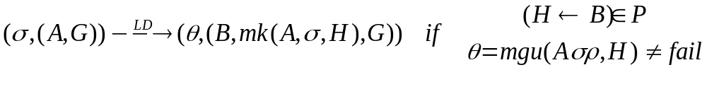
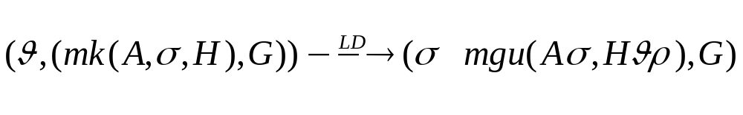
SOS

Slide 49
Observation
A goal in the alternative SOS is of the form
(θ_{n},B_{n}(A_{n-1},θ_{n-1},H_{n})B_{n-1} (A_{n-2},θ_{n-2},H_{n-1})B_{n-2}….(A₁,θ₁,H₂)B₁)
The goal can be re-organized as
(θ_{n},B_{n,} H_{n})(θ_{n-1},A_{n-1},B_{n-1},H_{n-1})…(θ₁, A₁, B_{1,}♦))
where each B_{i} can be and is a suffix of a clause whose head is H_{i}. ♦ is falsity and is the head of the query.

Slide 50
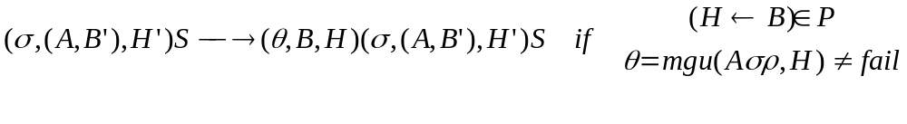
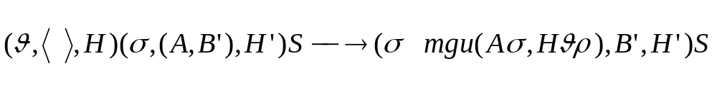
SOS

Slide 51
Example
append([ ], X, X).
append([X|U],V,[X|W]) ← append(U,V,W).
← append([1,2],[a,b,c],L).

Slide 52
Encapsulating procedure-entry and procedure-exit operations

Slide 53
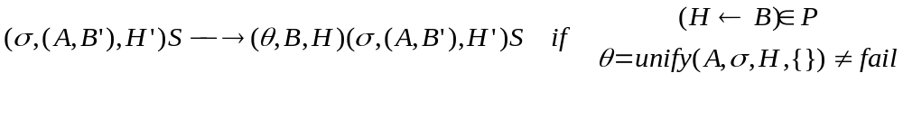
SOS

Slide 54
Program flow graph
Nodes are program points;
Edge p → q indicates that q will be possibly visited immediately after p is visited.
Call edges – models possible procedure-entry operation
Return edges – models possible procedure-exit operation
Let p be a program point in a clause. Then the suffix of the body to the right of p and the head of the clause are determined.

Slide 55
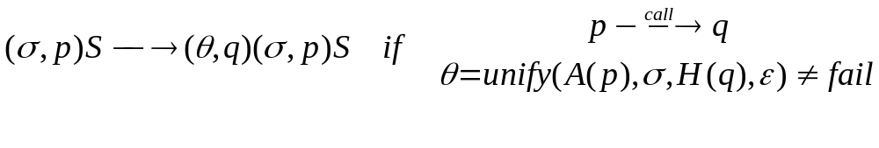
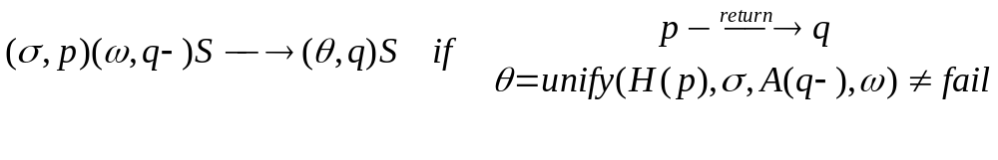
SOS

Slide 56
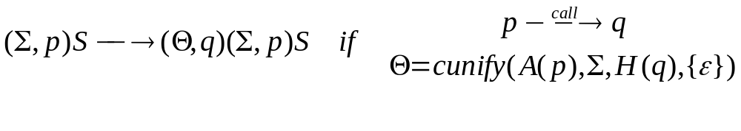
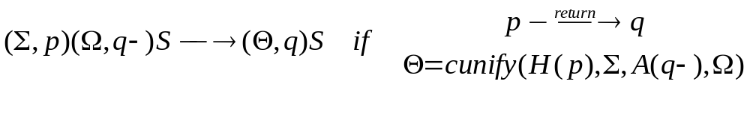
Accumulating substitutions
cunify(a,Θ,b,Ω) = {unify(a,θ,b,ω) | θ∈Θ∧ω∈Ω} \ {fail}

Slide 57
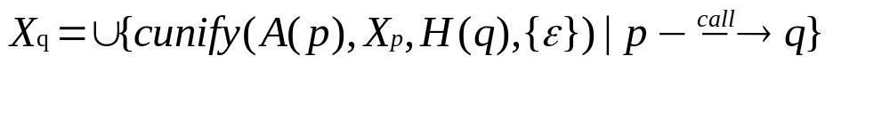
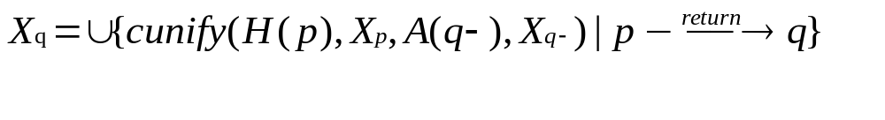
Nilsson’s Collecting semantics
Initial point: X_{ι} = Θ_{ι}
For entry points:
For other points:

Slide 58
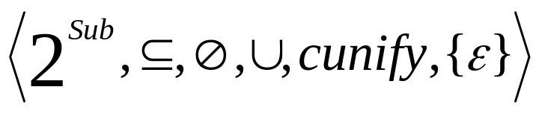
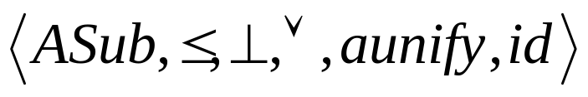
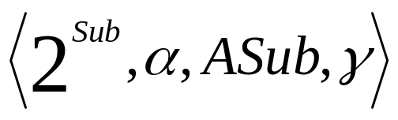
Nilsson’s Abstract semantics
Concrete interpretation:
Abstract interpretation:
Galois connection:

Slide 59
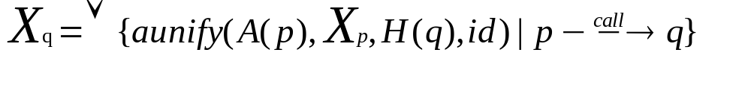
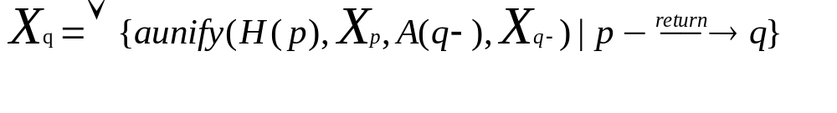
Nilsson’s Abstract semantics
Initial point: X_{ι} = π_{ι}
For entry points:
For other points:

Slide 60
Local Safety Conditions
ε∈γ(id)
cunify(a₁,γ(π₁),a₂, γ(π₂)) ⊆ γ(aunify(a₁,π₁,a₂,π₂)) for any atoms a1 and a2 and any abstract substitutions π₁ and π₂

Slide 61
Groundness Analysis
A variable x is ground in a substitution σ iff xσ contains no variable. Let vars(t) be the set of variables occurring in t. Then x is ground in σ iff vars(xσ)={}
Groundness analysis aims to identify which variables are definitely ground at a given program point.

Slide 62
Abstract domain
To describe a set of substitutions by
  a function from variables of interest to {g,a} ordered g < a augmented with a bottom ⊥
  Abstract domain ASub = (VI → {g,a})⊥
    ≤ π for any π in ASub
    π₁ ≤ π₂ iff π₁(x) ≤ π₂(x) for any x in VI
    γ(⊥ ) = {}
    γ(π) = {θ | ∀x∈VI.(π(x)=g ⇒ vars(xθ)={})}

Slide 63
Abstract domain
To describe a set of substitutions by
  a subset of the set variables of interest augmented with a bottom ⊥
  Abstract domain ASub = 2^{VI}⊥
    ≤ π for any π in ASub
    π₁ ≤ π₂ iff π₁ ⊇ π₂
    γ(⊥ ) = {}
    γ(π) = {θ | ∀x∈VI.(x ∈ π ⇒ vars(xθ)={})}

Slide 64
Abstract operations
id = {}
aunify(a,π₁,b,,π₂) =
    let ψ be a tagging substitution in
    let E = mgu(aψ,b) in
    if E=fail then ⊥
    else up(E,down(E, π₁ψ∪ π₂)) ∩ VI
  up(E, π) = π ∪ { x | ((x→t)∈E) and (vars(t)⊆π)}
  down(E, π) = π ∪ { y | ((x→t)∈E) and (x∈π) and (y∈vars(t))}

Slide 65
append([ ], X, X).
append([X|U],V,[X|W]) ← append(U,V,W).
← append(Xs, Ys, Zs).
1
2
3
4
5

Slide 66
a=append([],X,X) b=append([X|U],V,X|W] c=append(U,V,W) d=append(Xs,Ys,Zs)
X₁ = aunify(d,X₄,a,id) ∨ aunify(c,X₂,a,id)
X₂ = aunify(d,X₄,b,id) ∨ aunify(c,X₂,b,id)
X₃ = aunify(a,X₁,c,X₂) ∨ aunify(b,X₂,c,X₂)
X₄ = π₄
X₅ = aunify(a,X₁,d,X₄) ∨ aunify(b,X₂,d,X₄)
Compute lfp using π₄= {Xs,Ys}

Slide 67
Positive Boolean Formulae
This domain consists of positive Boolean functions over VI – that returns true when all arguments are true augmented with ff.
A truth assignment is a model of a Boolean function if the Boolean function is true when arguments are given the true assignment.
Let assign: Sub→VI→{tt,ff}
  assign σ x = tt iff vars(xσ) ={}
Galois Connection:
  γ_{Pos}(f) = {σ | assign σ |= f for each σ’ < σ}
  α_{Pos}

Slide 68
Abstract operations
id = tt
aunify(a,π₁,b,,π₂) =
    let ψ be a tagging substitution in
    let E = mgu(aψ,b) in
    if E=fail then ff
    else ∃ψ(VI). (α_{Pos}({E}) ∧ π₁ψ ∧ π₂)
Let π₄ = tt. Do the analysis using Pos.

Slide 69
OLDT
OLDT is OLD with tabling. OLD is same as SLD except computational rule always select atom among those that are introduced most recently.
LD is an OLD.
T means tabling or memoization: remember all computations and complete duplicate computations by look-up.

Slide 70
Tabling
Tabling has been known to computer scientists long time ago and has been incorporated into algorithms.
There are programming language systems that implement tabling – XSB Prolog

Slide 71
Tabling
long fib(long n)
{
if ( n==0 || n==1 )
then return 1;
else return fib(n-1) + fib(n-2);
}
Try fib(4)

Slide 72
OLDT
An OLDT structure
Tree
  Each node is labeled with a pair of a goal and a substitution
  Each edge is labeled with a substitution.
  Look-up nodes (processed by table look-up)
  Solution nodes (processed as in a SLD tree)
  Failure nodes
Table
  An entry has a key (an atom) and a solution list (instances of the atom)
Association
  pointers from look-up nodes to solution lists

Slide 73
Initial OLDT structure
For query (G,σ) and program P;
Tree – single node labeled with (G,σ)
Table – empty
Association – empty

Slide 74
OLDT Resolution
Repeat
Process a leaf node with non-empty goal
Process a look-up node
Until no change to the OLDT structure

Slide 75
Process a leaf node ((A,G),σ)
Case -- Aσ is an variant of a key in the table
  Mark the leaf a look-up node
  Create a child node (G, σθ) for ((A,G),σ) (no longer a leaf) for each Aσθ in the solution list for the key and label the edge θ
  make a pointer from ((A,G),σ) to the tail of the solution list

Slide 76
Process a leaf node ((A,G),σ)
Case -- Aσ is not an variant of any key in the table
  Mark the leaf a solution node
  Add to the table an entry with key Aσ and empty solution list
  For each clause (renamed) H ← B such that θ=mgu(H, Aσ) ≠ fail
    Create a child node ((B,G), σθ) for ((A,G),σ) and label the edge θ
    If B is empty then sub-refutations for several atomic calls have been finished, solution lists of these calls must be updated.
  If there is no such clause, create a child node labeled failure for ((A,G),σ)

Slide 77
Updating solution lists
Let Aσ be an atom completed by a unit clause and θ₁…θ_{k} be substitutions that label edges from the node in which Aσ is located to the node that is created after the unit clause is applied. Then Aσθ₁…θ_{k} is added to the rear of the solution list for Aσ.

Slide 78
Process a look-up node ((A,G),σ)
If the pointer for the look-up node points to middle of the solution list for a key
  Add a child node (G, σθ) for ((A,G),σ) for each Aσθ at or after the pointed position in the solution list for the key and label the edge θ
  position the pointer to the tail of the solution list

Slide 79
Example
arc(a,b).
arc(b,c).
arc(c,a).
path(X,Y) ← arc(X,Y).
path(X,Z) ← arc(X,Y),path(Y,Z).

Slide 80
Abstract OLDT
Substitution → abstract substitution/concrete substitution
Key → a pair of an atom and an abstract substitution (restricted to variables in the atom)
Solution → a pair of an atom and an abstract substitution (restricted to variables in the atom)
Unification → abstract unification
Composition → abstract composition

Slide 81
Example
append([ ], X, X).
append([X|U],V,[X|W]) ← append(U,V,W).
← append(Xs,Ys,Zs).

Slide 82
<append(Xs,Ys,Zs), {Xs,Ys}>

Slide 83
<append(Xs,Ys,Zs) ◊, {Xs,Ys}>
{Xs/[],Ys/X,Zs/X}
<◊,{X}>
<append(Xs,Ys,Zs), {Xs,Ys}> | <append(Xs,Ys,Zs), {Xs,Ys,Zs}>

Slide 84
<append(Xs,Ys,Zs) ◊, {Xs,Ys}>
{Xs/[],Ys/X,Zs/X}
{Xs/[X|U],Ys/V,Zs/[X|W]}
<◊,{X}>
<append(U,V,W) ◊,{U,V}>
<◊,{U,V,W}>
<append(Xs,Ys,Zs), {Xs,Ys}> | <append(Xs,Ys,Zs), {Xs,Ys,Zs}>

Slide 85
Top-down/bottom-up analysis
Top-down analysis emulates a top-down execution mechanism, like OLDT or SLD.
Bottom-up analysis emulates a bottom-up execution mechanism such as T_{P}.

Slide 86
Abstract Compilation
Apply abstraction to clauses to obtain an abstract program
Apply T_{P} to compute success set of the abstract program

Slide 87
Normalized programs
append([ ], Ys, Ys).
append([X|Us],Vs,[X|Ws]) ←
append(Us,Vs,Ws).
append(Xs,Ys,Zs) ← Xs = [ ],Ys=Zs.
append(Xs,Ys,Zs) ←
Xs=[X|Us], Zs=[X|Ws],
append(Us,Ys,Ws).

Slide 88
Abstraction α_{Pos}
append(Xs,Ys,Zs) ←
Xs = [ ],
Ys=Zs.
append(Xs,Ys,Zs) ←
Xs=[X|Us], Zs=[X|Ws],
append(Us,Ys,Ws).
append(Xs,Ys,Zs) ←
Xs /\ (Ys↔ Zs).
append(Xs,Ys,Zs) ←
∃{X,Us,Ws}.
Xs ↔ X/\Us /\
Zs ↔ X/\Ws /\
append(Us,Ys,Ws).

Slide 89
Abstract atoms
An abstract atom has the following form:
p(X₁,X₂,…,X_{n}) ← f(X₁,X₂,…X_{n})
where p is a predicate of arity n.

Slide 90
Success set
append(Xs,Ys,Zs) ← Xs /\ (Ys↔ Zs)
  append(Xs,Ys,Zs) ←
  ∃{X,Us,Ws}.
  Xs ↔ X/\Us /\
  Zs ↔ X/\Ws /\
  Us /\ (Ys ↔ Ws)
append(Xs,Ys,Zs) ← (Xs/\Ys↔Zs)

Slide 91
Quicksort
qs(Xs,Ys) ←
Xs=[],Ys=[].
qs(Xs,Ys) ←
Xs=[X|Xs1],
pt(X,Xs1,Ls,Bs),
qs(Ls,Ls1),
qs(Bs,Bs1),
Bs2=[X|Bs1],
append(Ls1,Bs2,Ys).
pt(X,Xs,Ls,Bs) ←
Xs=[],Ls=[],Bs=[].
pt(X,Xs,Ls,Bs) ←
Xs=[X1|Xs1],
X < X1,
pt(X,Xs1,Ls,Bs1),
Bs = [X1|Bs1].
pt(X,Xs,Ls,Bs) ←
Xs=[X1|Xs1],
X >= X1,
pt(X,Xs1,Ls1,Bs),
Ls = [X1|Ls1].

Slide 92
Abstraction of Quicksort
qs(Xs,Ys) ←
Xs /\Ys
qs(Xs,Ys) ←
∃{X,Xs1,Ls,Bs,Ls1,Bs1,Bs2}.
Xs ↔X/\Xs1 /\
pt(X,Xs1,Ls,Bs) /\
qs(Ls,Ls1) /\
qs(Bs,Bs1) /\
Bs2 ↔ X/\Bs1 /\
append(Ls1,Bs2,Ys)
pt(X,Xs,Ls,Bs) ←
Xs/\Ls/\Bs
pt(X,Xs,Ls,Bs) ←
∃{X1,Xs1,Ls,Bs1}.
(Xs ↔X1/\Xs1) /\
X/\ X1 /\
pt(X,Xs1,Ls,Bs1) /\
Bs ↔ X/\Bs1
pt(X,Xs,Ls,Bs) ←
∃{X1,Xs1,Ls1}.
(Xs ↔ X1/\Xs1) /\
X /\X1 /\
pt(X,Xs1,Ls1,Bs),
Ls ↔X1/\Ls1

Slide 93
Simplifying Abstract Quicksort
qs(Xs,Ys) ←
Xs /\Ys
qs(Xs,Ys) ←
∃{X,Xs1,Ls,Bs,Ls1,Bs1,Bs2}.
Xs ↔X/\Xs1 /\
pt(X,Xs1,Ls,Bs) /\
qs(Ls,Ls1) /\
qs(Bs,Bs1) /\
Bs2 ↔ X/\Bs1 /\
append(Ls1,Bs2,Ys)
pt(X,Xs,Ls,Bs) ←
Xs/\Ls/\Bs
pt(X,Xs,Ls,Bs) ←
∃{Xs1,Ls,Bs1}.
(Xs ↔Xs1) /\
X /\
pt(X,Xs1,Ls,Bs1) /\
Bs ↔ Bs1
pt(X,Xs,Ls,Bs) ←
∃{Xs1,Ls,Ls1}.
(Xs ↔ Xs1) /\
X /\
pt(X,Xs1,Ls1,Bs),
Ls ↔Ls1

