Slide 1
More on SLD

Slide 2
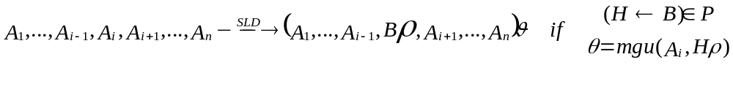
SLD
SLD is a SOS
  States are sequences of atoms
  Program doesn’t change.
SLD derivation, refutation, computed answer, SLD tree, proof tree

Slide 3
Example SLD tree
p(X) :- q(X), r(X), s(X).
p(a).
q(a).
q(b).
q(c).
r(b).
r(c).
s(c).
p(Y)
{X/Y}
{Y/a}
q(Y),r(Y),s(Y)
{Y/a}
{Y/c}
{Y/b}
r(a),s(a)
r(b),s(b)
r(c),s(c)
s(b)
s(c)

Slide 4
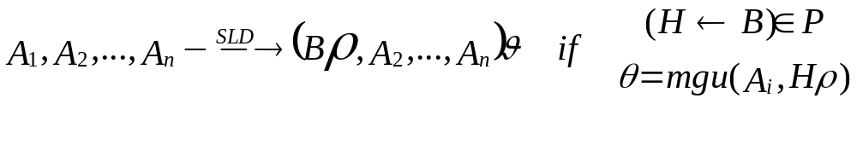
LD
Always select the first atom

Slide 5

Alternative SOS
Substitutions are made explicit.
Substitutions assign terms to variables occurring in the program rather than their renamed incarnations.
State is of the form (θ,G) where θ is a substitution and G is a sequence of atoms and special construct which marks the end of the body of a clause.

Slide 6
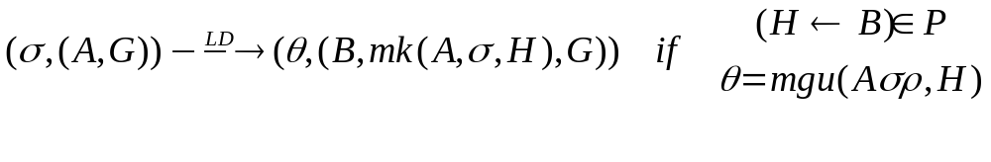
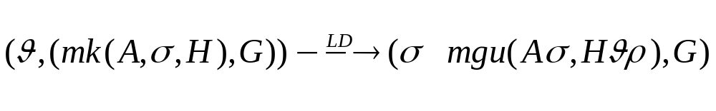
Alternative SOS

Slide 7
Prolog programming

Slide 8
Logic operations
inv(0,1).
inv(1,0).
and(0,0,0).
and(0,1,0).
and(1,0,0).
and(1,1,1).
or(0,0,0).
or(0,1,1).
or(1,0,1).
or(1,1,1).
?- or(X,Y,V1),inv(Z,V2), and(V1,V2,V).

Slide 9
Path
b
d
f
a
c
e
g
edge(a,b).
edge(a,c).
edge(b,d).
edge(c,d).
edge(d,e).
edge(f,g).
path(N1,N2) :-
edge(N1,N2).
path(N1,N3) :-
edge(N1,N2),
path(N2,N3).

Slide 10
List Notation
.
.
a
a
.
b
b
c
[]
c
.(a, .(b, .(c, [])))

Slide 11
More On List Notation
The empty list: []
A non-empty list: .(X,Y) or [X|Y]
Syntactic Sugar:
[b] instead of [b|[]] and .(b, [])
[a,b] instead of [a|[b]] and [a|[b|[]]]
[a,b|X] instead of [a|[b|X]]

Slide 12
List manipulation
list([ ]).
list([X|Xs]) :- list(Xs).
member(X,[X|Xs]).
member(X,[Y|Ys]) :- member(X,Ys).
append([ ],Ys,Ys).
append([X|Xs],Ys,[X|Zs]) :- append(Xs,Ys,Zs).

Slide 13
List Manipulation
% reverse(A, B)
% B is A in reverse order
reverse([ ],[ ]).
reverse([X|Xs],Zs) :- reverse(Xs,Ys), append(Ys,[X],Zs).
% Alternative version
reverse(Xs,Ys) :- reverse(Xs,[ ],Ys).
reverse([ ],Ys,Ys).
reverse([X|Xs],Acc,Ys) :- reverse(Xs,[X|Acc],Ys).

Slide 14
Insertion Sort
% sort(A,B)
% B is a sorted version of A
sort([X|Xs],Ys) :- sort(Xs,Zs), insert(X,Zs,Ys).
sort([ ],[ ]).
% insert(A,B,C)
% if B is a sorted list, then C is sorted
% and contains all elements in B plus A
insert(X,[ ],[X]).
insert(X,[Y|Ys],[Y|Zs]) :- X > Y, insert(X,Ys,Zs).
insert(X,[Y|Ys],[X,Y|Ys]) :- X =< Y.

Slide 15
Circuits I
circuit(1,1).
circuit(0,0).
circuit(and(X,Y),V) :-
circuit(X,V1),
circuit(Y,V2),
and(V1,V2,V).
circuit(or(X,Y),V) :-
circuit(X,V1),
circuit(Y,V2),
or(V1,V2,V).
circuit(inv(X),V) :-
circuit(X,V1),
inv(V1,V).

Slide 16
Circuits II
circuit(1,1).
circuit(0,0).
circuit(C,V) :-
nonvar(C),
C = and(X,Y),
circuit(X,V1),
circuit(Y,V2),
and(V1,V2,V).
circuit(C,V) :-
nonvar(C),
C = or(X,Y),
circuit(X,V1),
circuit(Y,V2),
or(V1,V2,V).
circuit(C,V) :-
nonvar(C),
C = inv(X),
circuit(X,V1),
inv(V1,V).

Slide 17
Circuits III
circuit(X,X) :-
var(X),
!.
circuit(1,1).
circuit(0,0).
circuit(and(X,Y),V) :-
circuit(X,V1),
circuit(Y,V2),
and(V1,V2,V).
circuit(or(X,Y),V) :-
circuit(X,V1),
circuit(Y,V2),
or(V1,V2,V).
circuit(inv(X),V) :-
circuit(X,V1),
inv(V1,V).

Slide 18
Cut
p(X) :- q(X), r(X), !, s(X).
p(a).
q(a).
q(b).
q(c).
r(b).
r(c).
s(c).
p(Y)
{X/Y}
{Y/a}
q(Y),r(Y),!,s(Y)
{Y/a}
{Y/c}
{Y/b}
r(a),!,s(a)
r(b),!,s(b)
r(c),!,s(c)
!,s(b)
s(c)
s(b)

Slide 19
Meta-Programming
Meta-programs: programs that takes other programs as inputs such as interpreters, compilers, partial evaluators and debuggers.
Meta-circular programs: a program in language L that takes programs in L as inputs.
Meta-interpreter: a program that executes input programs.

Slide 20
A meta-interpreter
Representation:
A clause
H :- A₁,…,A_{n}
is represented as a fact pg_clause(H,[A₁,…,A_{n} ]).
solve([]).
solve([A|As]) :-
solve(A),
solve(As).
solve(A) :-
pg_clause(A,B),
solve(B).

Slide 21
A meta-interpreter
Representation:
  A clause
  H :- A₁,…,A_{n}
  is represented as is.
Prolog implementations provides a built-in predicate clause(A,B)
solve(true).
solve((A,As)) :-
solve(A),
solve(As).
solve(A) :-
A \= true,
A \= (_,_),
clause(A,B),
solve(B).

Slide 22
Ground and non-ground representation
Previous meta-interpreters use non-ground representation in which a variable is represented by a variable.
Another variation will be ground representation. The meta-interpreter then needs to do renaming, unification and instantiation explicitly.

Slide 23
Variations
Substitutions can be explicitly represented.
Program can be passed as an argument.
Proof trees can be constructed and returned.
Other execution strategies such as breadth-first search can be programmed.
Other semantics such as OLDT can be programmed.
Program analyses can be developed as an meta-program/interpreter very fast.

Slide 24
Representation of WHILE programs
x := a ➔ assign(x,a)
skip ➔ skip
if b then S₁ else S₂ ➔ if(b, S₁,S₂)
S₁;S₂ ➔ sequent(S₁,S₂)
while b do S ➔ while(b,S)
x ➔ var(x)
n ➔ int(N(n))
e₁ op e₂ ➔ op(e₁,e₂)
op e ➔ op(e)

Slide 25
Interpreter
ae(int(N),State,N).
ae(var(x),State,N) :-
member((x,N),State).
ae(plus(E,F),State,N) :-
ae(E,State,Left),
ae(F,State,Right),
N is Left + Right.
ae(minus(E),State,N) :-
ae(E,State,N1),
N is – N1.
….
be(true, tt).
be(false,ff).
be(lt(E,F),State,Truth) :-
ae(E,State,Lft),
ae(F,State,Rht),
lt_test(Lft,Rht,Truth).
….
lt_test(L,R,tt) :- L < R.
lt_test(L,R,ff) :- R =< L.

Slide 26
Interpreter
interp(assign(var(X),Exp),Si,So) :-
ae(Exp,Si,N), update(Si,X,N,So).
interp(skip,S,S).
interp(sequent(Stm1,Stm2),Si,So) :-
interp(Stm1,Si,Sm), interp(Stm2,Sm,So).
interp(if(BExp,Stm1,Stm2),Si,So) :-
be(BExp,Si,Truth),
cond(Truth,Stm1,Stm2,Si,So).
interp(while(BExp,Stm),Si,So) :-
be(Bexp,Si,Truth),
cond(Truth,skip,sequent(Stm,while(BExp,Stm)),Si,So).

