Slide 1

AI assistants
at work
A hands-on workshop
for academic work
Notes:
Introduce the workshop as an opportunity to delegate academic tasks to an AI assistant and inspect and refine the resulting work. Participants will explore the normal Copilot Chat experience before examining customisation. Slide 2 introduces questions and answers and task delegation as uses of an AI assistant. Slide 3 explains the supporting model-and-harness architecture.
The cover illustration symbolises work with research documents, data and presentations. Any apparent plot or table is decorative and represents no actual dataset.

Slide 2

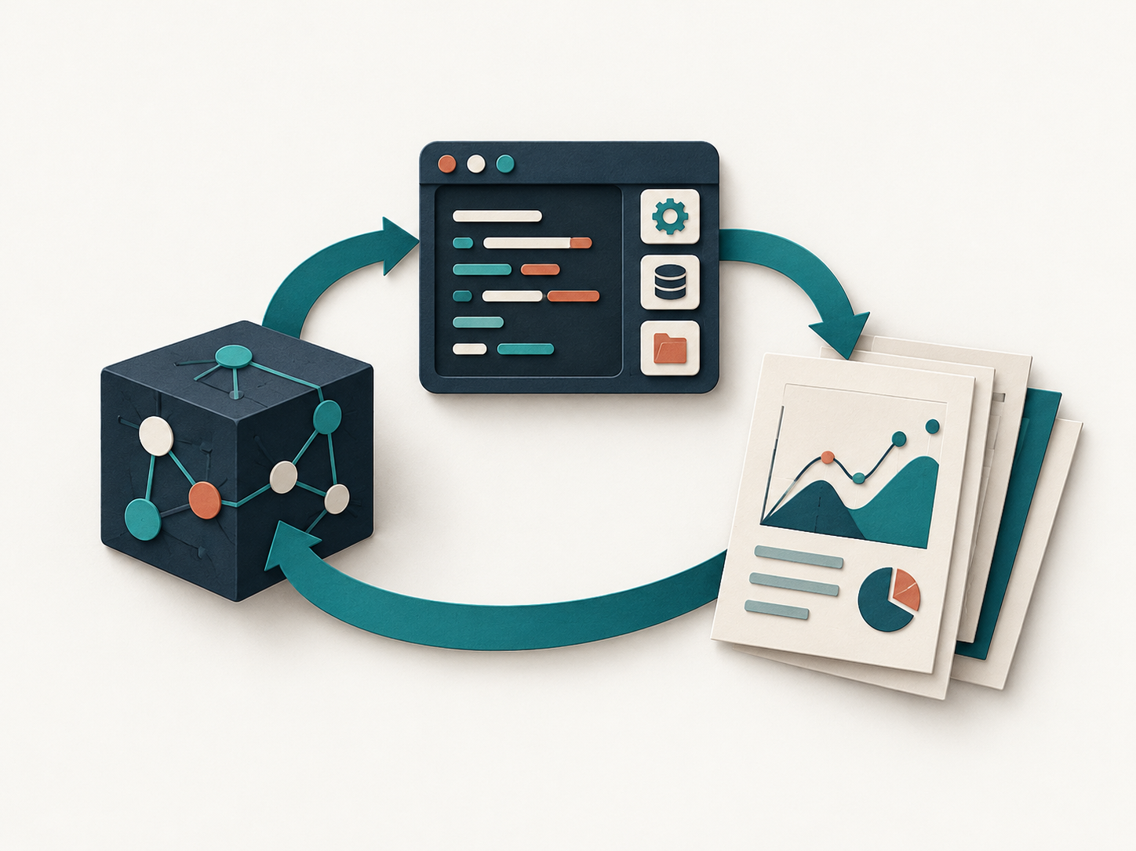
What is an AI assistant?
An AI assistant helps with questions and can carry out delegated tasks.
Questions and answers
Task delegation
Ask for explanations, advice,
or suggestions.
Ask the assistant to carry out work
and produce a result.
“How could these data be analysed?”
“Analyse these data and prepare
a short presentation.”
2
Notes:
This slide introduces what an AI assistant does through two uses: questions and answers, and task delegation. The examples concern the same academic activity. Asking how data could be analysed seeks guidance. Asking the assistant to analyse the data and prepare a presentation delegates work and specifies a result. These uses can be combined within one conversation. A formal distinction between chatbot and agent is unnecessary here. The next slide explains the architecture supporting these uses.
The question-answer illustration represents conversational help. The tool-and-report illustration represents choosing actions, using tools and interpreting intermediate outputs to complete a task. Any apparent chart is decorative and makes no numerical claim.
Customisation is a separate concept: persistent instructions, knowledge and selected tools can tailor an assistant for recurring work, but prior customisation is not required to delegate a task to a general assistant.
Source: https://www.anthropic.com/engineering/building-effective-agents

Slide 3
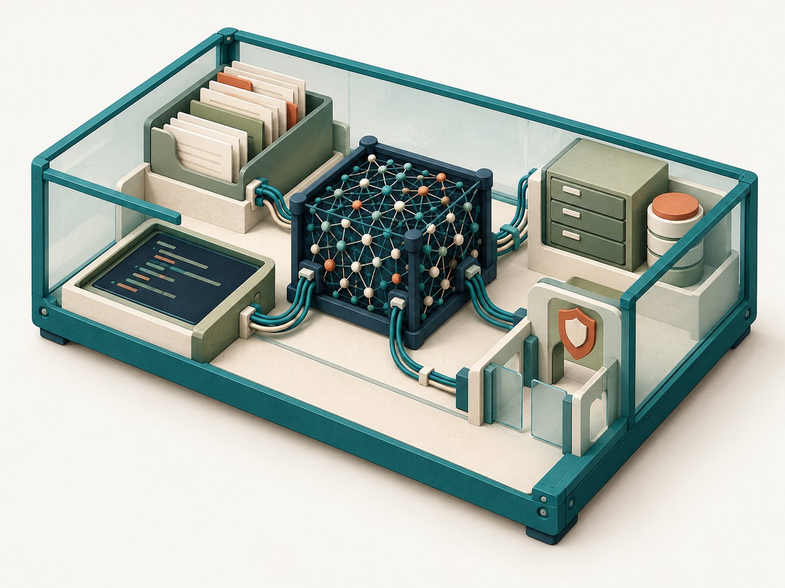
The architecture of an AI assistant
The model and its harness together form the AI assistant.
Model
Interprets requests
and reasons.
Harness
Instructions and context
Tools and resources
Execution and permissions
3
Notes:
The model interprets requests, reasons and generates responses. The harness is the surrounding software environment: it supplies instructions and context, exposes tools and resources, executes tool calls, and applies permissions. Together they form the AI assistant.
The illustration is a workbench metaphor, not a literal system architecture. The central connected network represents the model. The enclosure and surrounding document, code, file and permission modules represent its harness. This makes the distinction between a model and the environment in which it works visible.
Source: https://www.anthropic.com/engineering/building-effective-agents

Slide 4
The model
Model characteristics influence how the assistant processes information and approaches tasks.
Aspect | Practical question
Hosting | Does the model run locally or through a cloud service?
Reasoning capabilities | How well can it reason through complex tasks?
Input and output | Can it work with text, images, audio, or other formats?
Context capacity | How much information can it consider at once?
4
Notes:
This slide follows the architecture overview and considers the model separately from the surrounding working environment. Hosting describes where model inference takes place: locally or through a cloud service. This is distinct from where tools run and where conversations and files are stored.
Reasoning capabilities concern how well the model can work through complex tasks. Available reasoning settings can also affect its approach. Input and output capabilities vary across models and may include text, images, audio or other formats.
Context capacity concerns how much information the model can consider in a request. It is different from session storage or persistent memory. The application manages stored conversations and files and selects the information supplied to the model. What the model can consider is different from what the application stores.
The next slide considers the harness, including execution and storage. A local harness can use a cloud-hosted model, and different components may run in different places.
Framework developed in the workshop planning discussion.

Slide 5
The assistant's working environment
The harness provides the working environment, including tool access, customisation options, and controls over execution.
Aspect | Practical question
Execution and storage | Where are tools run, files kept, and conversations stored?
Capabilities | What tools and resources are available to the assistant?
Customisation | How can we adapt the assistant and its working environment?
Permissions and restrictions | What may it access and execute, and when is approval required?
5
Notes:
The architecture slide introduces the model and its harness. After considering the model, this slide describes execution and storage, capabilities, customisation, and permissions and restrictions. The next slide gives concrete implementations. Model hosting, code execution, and storage can occur in different places.
Cloud execution uses a remote environment with files and resources made available there. Local execution uses the user's computer and its accessible files and installed software, within permissions. Some environments combine local and cloud components. Local execution can still use a cloud-hosted model. The harness or application stores conversations and files and determines what is retrieved or supplied to the model in later requests.
Capabilities describe the tools and resources available. The model also influences how effectively the assistant uses them. Customisation can apply to both the assistant and its harness: reusable instructions, knowledge and skills shape how it works, while plugins and MCP connections can extend its working environment. These aspects are related. Adding an MCP connection is a customisation that can provide additional capabilities.
Permissions and restrictions have two dimensions. Sandboxing determines file and network access, while command rules can further restrict execution. Approval policies determine whether an action is blocked, requires permission, or can proceed without approval. The dimensions can interact: approval may sometimes permit an action beyond default sandbox restrictions, while other restrictions remain absolute. These controls are distinct from the agent choosing its own steps and tools. Introduce customisation briefly here and return to participants' recurring preferences after the exercise.
Framework developed in the workshop planning discussion.

Slide 6
Different harnesses, different possibilities
Tools, execution and customisation vary across implementations.
Harness | Tools and execution environment | Customisation
chatUMCG | Conversation only. | None
Copilot Chat | Python and JavaScript execution in a cloud VM; file processing and generation. | Agents via Agent Builder: instructions and knowledge
Codex / Claude Code (Local setup) | Terminal access, local files, and installed software. | Project instructions Reusable skills
Examples depend on licence, enabled features and organisational settings.
6
Notes:
This slide applies selected aspects of the general harness framework to concrete environments. The middle column describes tools and execution environments consistently, rather than mixing use cases with tool access. The examples are not an exhaustive inventory or a ranking. chatUMCG is described by the workshop organiser as conversation only, with no customisation options.
Copilot Chat is shown on its own because participants use it in this workshop. Microsoft documents Python code execution in isolated Azure virtual machines and the processing and generation of files. JavaScript support is included on the basis of the workshop organiser's successful test of Node.js in the Copilot execution environment. In that test, webR was installed and loaded through JavaScript to run R compiled to WebAssembly; the simulation and analysis were performed in R. This observation describes the tested workshop environment, rather than a claim that every Copilot configuration guarantees Node.js or native R. Microsoft Agents created through Agent Builder package instructions, knowledge sources and selected capabilities. Availability depends on licensing and organisational settings.
The Codex / Claude Code row explicitly describes a local setup: terminal access, local files, and installed software, within permissions. Both also offer cloud execution options. Project instructions and reusable skills support customisation. Code execution can produce analyses and documents as well as software.
Discuss permissions and restrictions verbally in terms of approvals and execution boundaries rather than claiming directly comparable controls across these environments.
Sources: workshop organiser's descriptions of chatUMCG and the tested Copilot Node.js/webR workflow; https://learn.microsoft.com/en-us/microsoft-365/copilot/extensibility/code-interpreter-security; https://learn.microsoft.com/en-us/microsoft-365/copilot/extensibility/code-interpreter; https://learn.microsoft.com/en-us/microsoft-365/copilot/extensibility/agent-builder-build-agents; https://learn.microsoft.com/en-us/microsoft-365/copilot/extensibility/knowledge-sources; https://docs.r-wasm.org/webr/latest/downloading.html; https://developers.openai.com/codex/cli; https://developers.openai.com/codex/quickstart; https://code.claude.com/docs/en/overview; https://code.claude.com/docs/en/claude-code-on-the-web

Slide 7

First exercise: sample size and power
The exercise
Workshop website
Ask Copilot to create a power graph for a hypothetical two-arm trial.
Open “First exercise” for the instructions and prompts.
Start a new Copilot chat.
Follow the exercise on the website.
Try a follow-up and review the changes.
7
Notes:
Ask participants to open the workshop website and select First exercise. Start a new Copilot chat and use the instructions on the page to generate analytical power curves for a hypothetical two-arm trial.
Encourage participants to check whether Copilot generated the requested graph, whether the labels and legend are clear, and whether the explanation is helpful. Then try a follow-up about sample size or a higher standard deviation, or ask Copilot to improve the output.
Exercise instructions: https://luntergroup.github.io/health-in-context-agents-workshop/first-exercise.html

Slide 8
Discussing the results
Did Copilot produce the graph you asked for?
Were the graph, labels and explanation clear?
How did Copilot respond to your follow-up prompts?
What did you ask Copilot to improve?
8
Notes:
Invite two or three participants to show their graphs. Discuss whether the output matched the request, whether it was clear, and how Copilot responded to follow-up prompts. Ask participants to share an instruction that helped improve the result. Use their examples to discuss how to make requests clearer and refine the assistant’s output.

