Slide 1
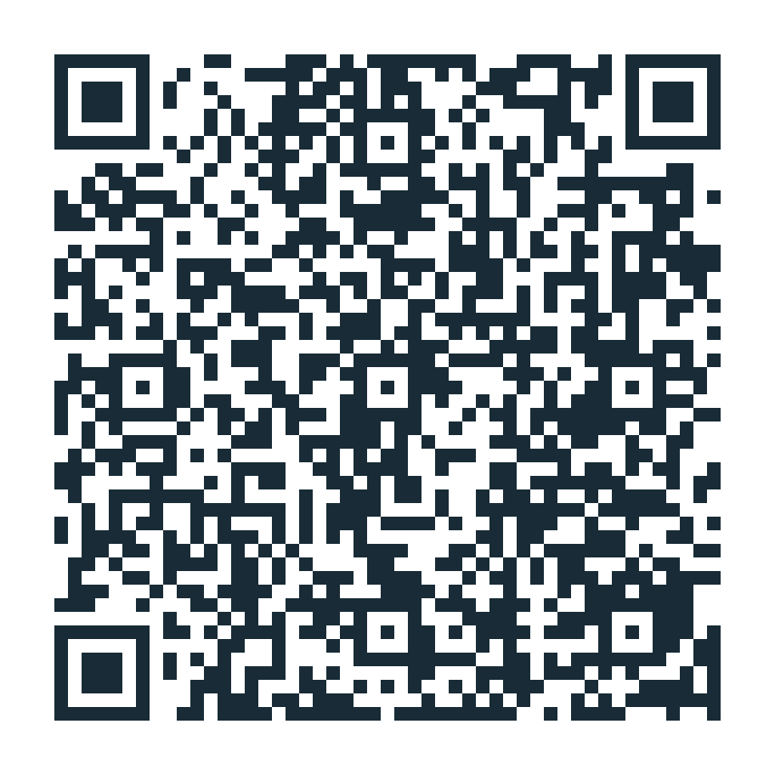
STOP 04 · AGENTS AND SKILLS
Grant preparation
Build a Copilot agent with reusable skills, then use it on a grant proposal: a personnel budget and a project timeline.
Objectives
Learn how to build an agent with skills in Microsoft Copilot.
Understand that agents are good at “changing representations” of content.
Scan to open the exercise
luntergroup.github.io/health-in-context-agents-workshop/grant.html
1

Slide 2
Discuss
Which computer task you think the agent can NOT help you with? Argue!
What surprised you?
What skill would make the agent more useful for your own work?
2

