Slide 1
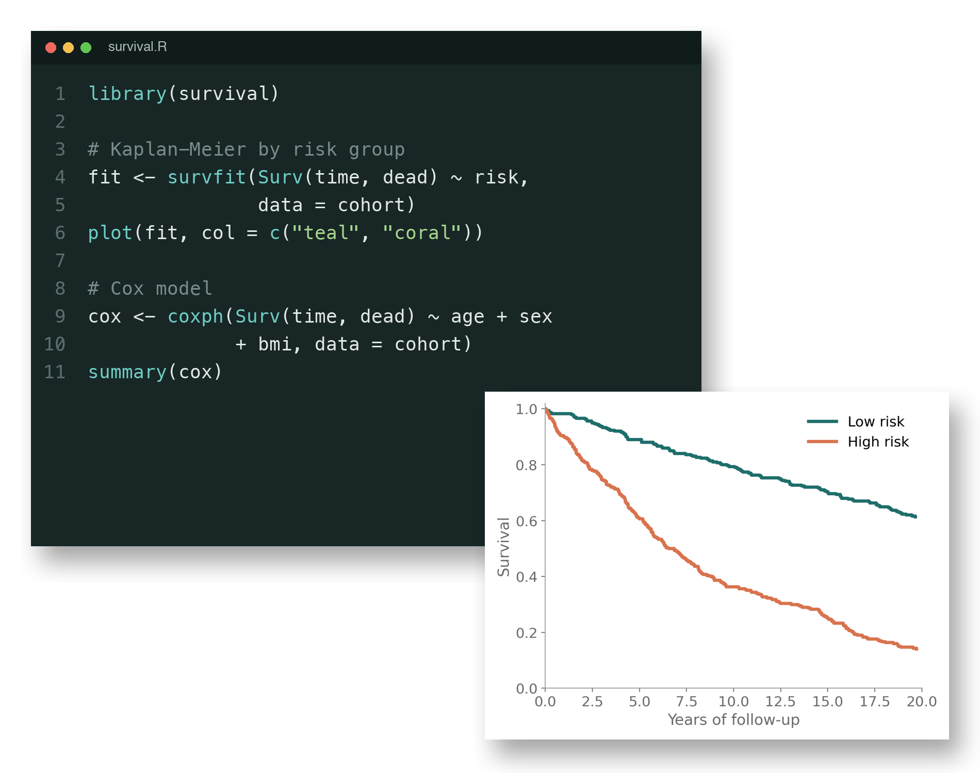
Agentic AI for coding
Why it works so well, and what it can do for your research
Notes:
This short introduction explains why AI assistants are unusually good at writing code, shows the kinds of tasks they can take on, and ends with what this means for reproducible science.
'Agentic' means the AI does not just answer a question: it carries out a task in steps. It writes code, runs it, looks at the result or the error message, and repairs the code until it works.
The illustration (synthetic data) shows a typical result: a short R script and the survival plot it produces.

Slide 2








Why is AI so good at coding?
Everything a language model does well comes together in code
Many examples
Code is text
Attention
Large context
Billions of lines of open code to learn from
And text is what language models process
Links each piece to related pieces far away
Keeps a whole project in view at once
Simple syntax
Uses tools
Testable
This all screams
Few words, strict grammar, no ambiguity
Runs the code, reads errors, tries again
Code runs or it doesn't; tests pass or fail
Coding
Notes:
Seven properties of language models, each of which happens to suit programming:
- Many examples: the internet contains an enormous amount of freely available code, often with explanations and discussion (e.g. GitHub, Stack Overflow).
- Code is text: language models are trained to read and write text, and code is just text.
- Attention: the mechanism inside these models that connects each word to the other words it relates to, even far apart. In code: where a variable was defined, which function is called.
- Large context: modern models can read hundreds of pages at once, so the whole analysis, the data description and the error message fit in view together.
- Simple syntax: a programming language has a small vocabulary and strict rules, much simpler than English.
- Uses tools: an agent can run its own code, read the output or error, and fix the code. This feedback loop is what makes it 'agentic'.
- Testable: unlike an essay, code can be checked objectively. It runs or it does not; the numbers match or they do not. That makes it possible to train models on it, and lets the agent check its own work.
Put together, coding is close to the ideal task for this technology.

Slide 3
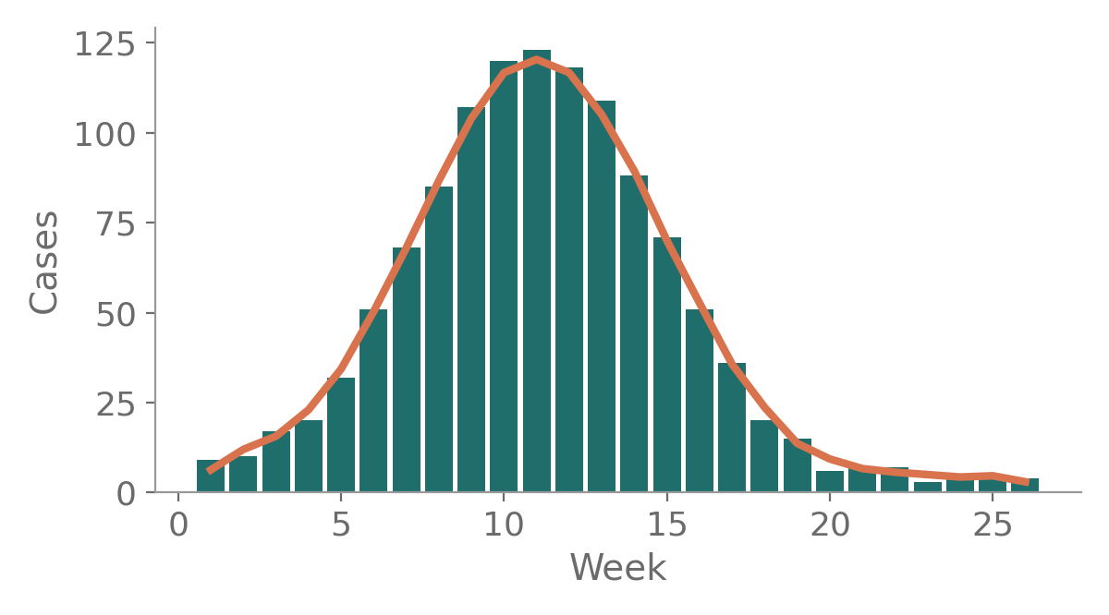
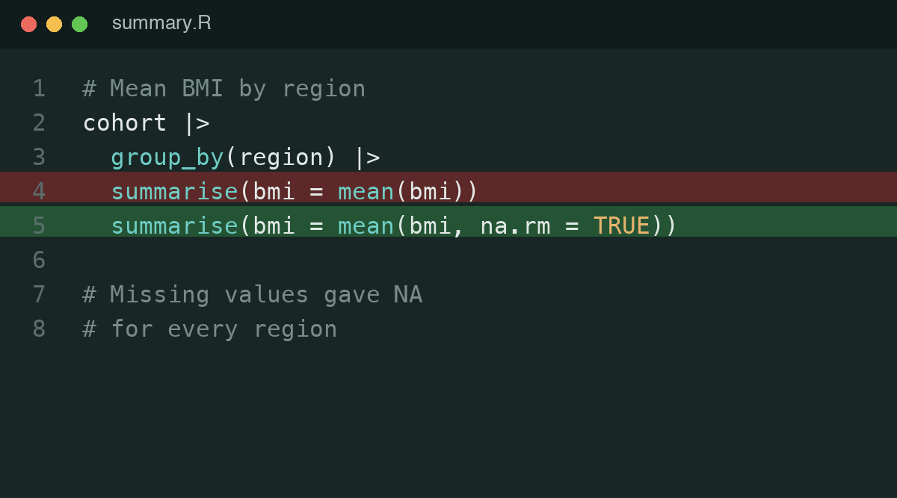
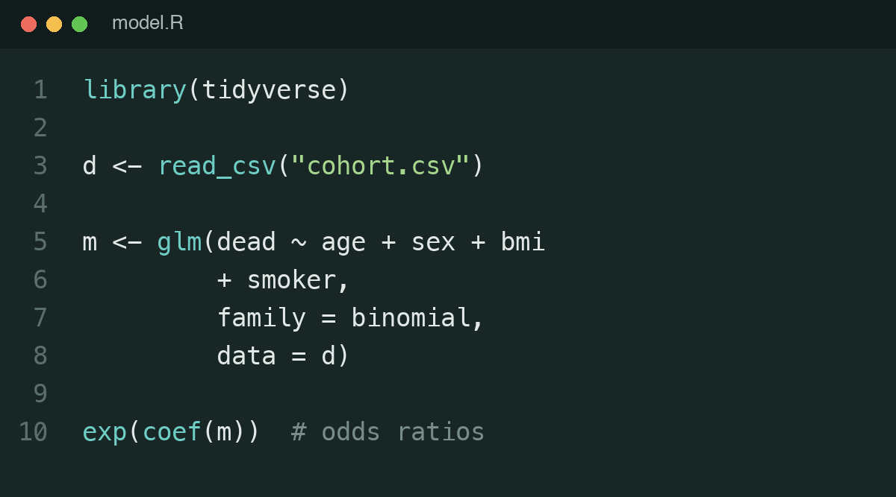

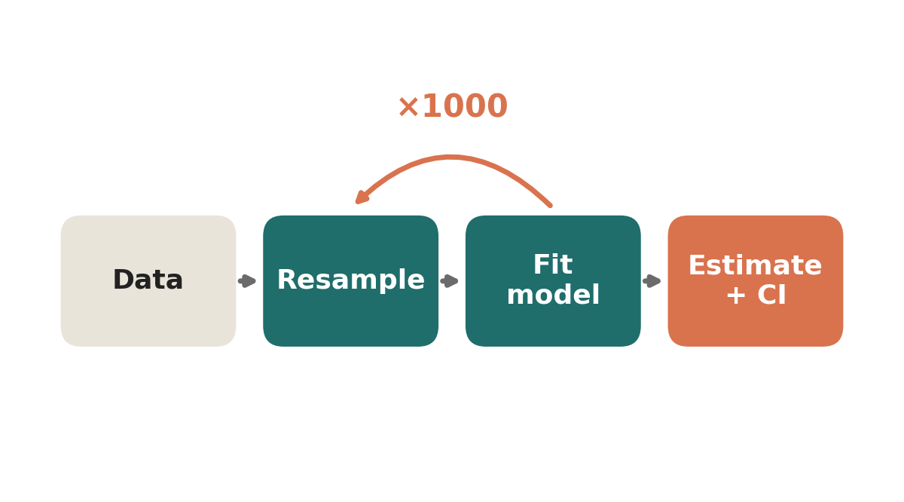

What can it do for you?
You describe what you want; the agent writes, runs and fixes the code
Make plots
Find bugs
Write R scripts
…and much more
Cleaning data, translating Stata to R, documenting code
Build web pages
Develop algorithms
Notes:
Five everyday tasks an agent can do from a plain-language request:
- Make plots: 'plot weekly case counts with a 3-week moving average'.
- Find bugs: here a missing na.rm = TRUE made every group mean NA. The agent spots this by running the code and looking at the output.
- Write R scripts: a complete analysis, from reading the data to fitting a logistic regression and reporting odds ratios.
- Build web pages: for example an interactive dashboard to explore a cohort, or a project website.
- Develop algorithms: for example a bootstrap procedure for confidence intervals, or a simulation for a sample size calculation.
You remain responsible for checking the result, but the agent does the typing, running and debugging.
All images on this slide are illustrations with synthetic data.

Slide 4
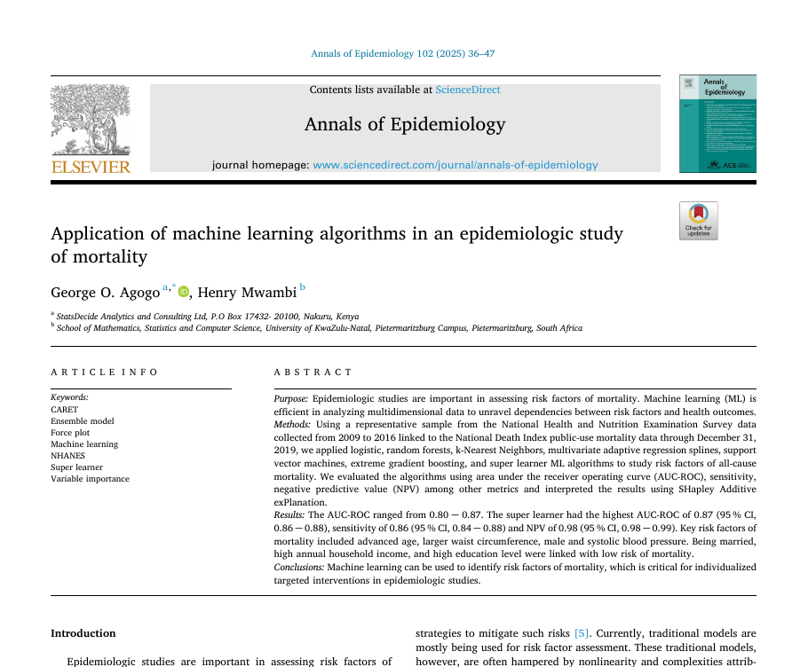
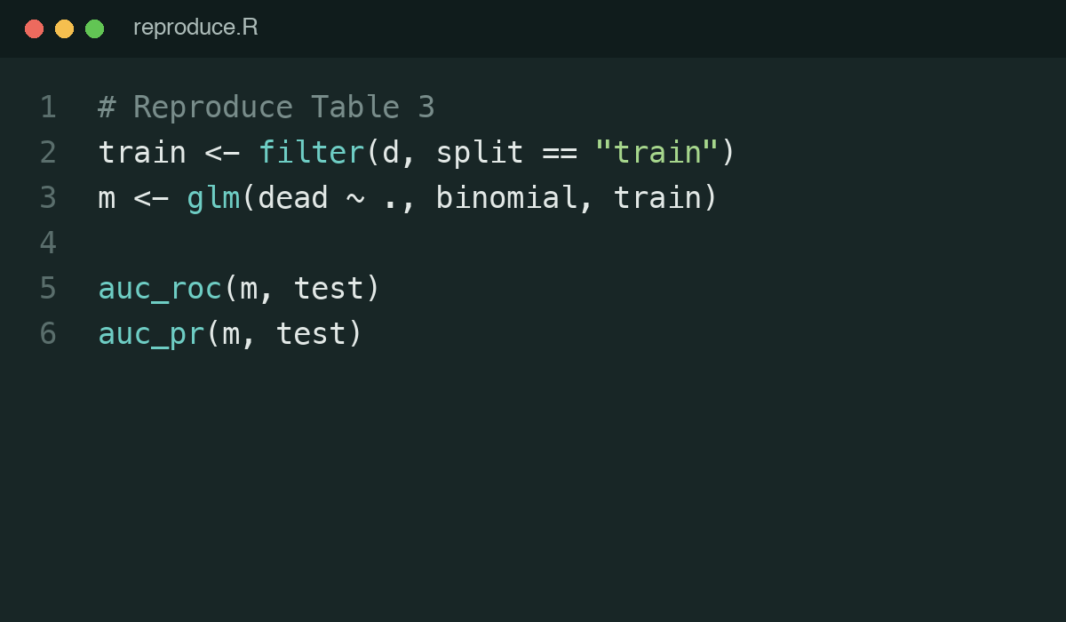

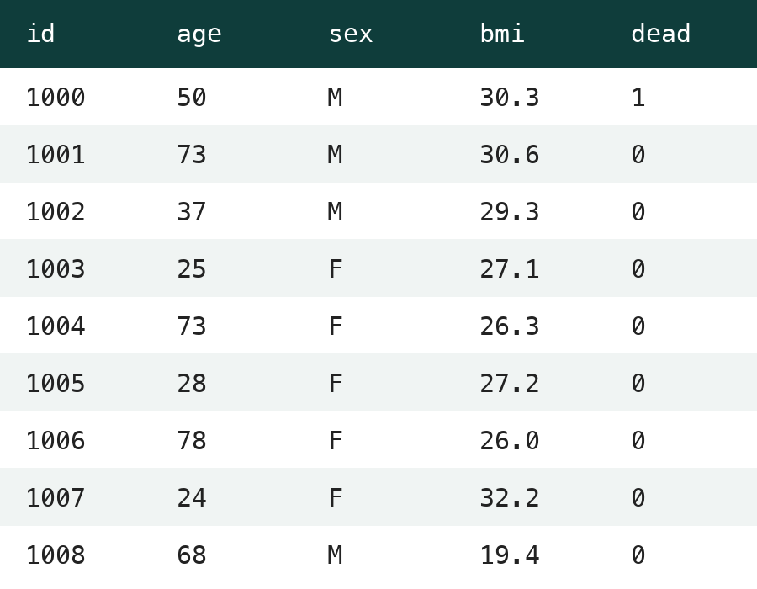



Reproducible science
A paper is a precise description of an analysis, written in natural language
Paper
Data
Reproduces the published results
AI agent
Flags steps the paper leaves out
Suggests better modelling choices
Notes:
A good methods section is a precise specification of an analysis, written in natural language. Language models are good at turning natural language into code. So when the data are available, an AI agent should be able to re-run the analysis described in a paper.
Example used in this workshop: Agogo & Mwambi (2025), Annals of Epidemiology 102:36-47, a mortality prediction model on NHANES 2009-2016 (about 24,000 people with linked mortality follow-up). The data are public.
What happened when we tried:
- The agent re-implemented the logistic regression and obtained results very close to the published ones.
- The paper did not describe a few data-preparation and modelling choices; the agent had to make guesses and said where.
- It also found choices that could be improved: different follow-up windows per survey cycle were ignored, and no imputation was done although missingness was informative. Fixing these barely changed discrimination but clearly improved calibration.
Reproducing a published analysis used to take weeks; now it can be a routine check.

Slide 5
Workshop
> _
Reproducible science

Slide 6











How does an AI agent work?
AI looks at
AI writes
AI runs
The model reads, writes and runs code, in a loop
“Plot survival by age”
You
Data
Skills
Survival analysis
Journal figure style
Making slides
Web
types commands
Plan
> command
output 1
output 2
output 3
...
> _
Language model
e.g. ChatGPT
reads output
Code
Repeats until
the result is right
Where the agent acts
Tools
Program
Notes:
This is what happens when an AI agent works on code.
On the left is the language model, such as ChatGPT. On its own it can only read and write text. You chat with it, and it replies.
What turns it into an agent is the box on the right: a computer it can use. The model types a command, reads the output, and decides on the next command. Through those commands it reaches everything around the computer:
- Data, Skills and Web: things it only looks at. Skills are written instructions and know-how, for example how to do a survival analysis, your group's figure style, or how to make slides.
- Plan and Code: things it both reads and writes. For bigger tasks it first writes a plan and ticks off steps; it reads your code and edits it.
- Program and Tools: things it runs. It runs the program it wrote and reads the results; it can also run other tools, such as R, Python or git.
Teal arrows: what the AI looks at. Thin orange arrows: what it writes. Thick orange arrows: what it runs.
The key is the loop: write code, run it, read the output or error message, fix, and run again, until the result is right.

Slide 7
Strengths and pitfalls
Strengths
Pitfalls
Processing lots of detailed information
Wrong choices in ambiguous situations
Setting up complex but common & well-defined workflows
Need for clear instructions

