Slide 1


英语句子成分

Slide 2
１. This kind of skirt is very _________ (fashion).
2. His suggestions are _________ (reason).
3. It is ________(obviously ) that he won the match.
4. That ‘s really a _________ (science ) method(方法)．
5. there are too many ________ (art ) scenes in the park .
6. We should do something to stop the _________ (globe) warming.
fashionable
reasonable
obvious
scientific
artificial
global

Slide 3
1.With the ___________ (develop) of the science, we improve our living conditions greatly.
2. European ________ (settle) began in 1840 when the British arrived.
3. Have you made an ___________ (arrange) about your trip?
4. Could you give me some _________ (suggest) on our plan?
5. A cinema is a public place of ________ (entertain ).
development
settlement
arrangement
suggestions
entertainment

Slide 4
After sunset, the sky darkened ________ ( rapid )
________ ( fortunate ), they escaped from the big fire.
_________ ( general ) speaking, people in South China live on rice.
His daughter is _______ ( serious ) ill, so he has to ask for leave.
The car which was out of control _________ (violent ) hit the big tree.
The typhoon is ________ (extreme ) strong.
rapidly
Fortunately
Generally
seriously
violently
extremely

Slide 5
句子成分
定义 ：构成句子的各个部分叫做句子成分。句子成分有主要成分和次要成分；
主要成分：主语和谓语
次要成分：表语、宾语、定语、状语、补足语、同位语

Slide 6
1. I met my best friend Tom at the station yesterday.
↓
主语
↓
谓
语
↓
定语
↓
宾
语
↓
同位语
↓
状
语
↓
地点
↓
时间

Slide 7
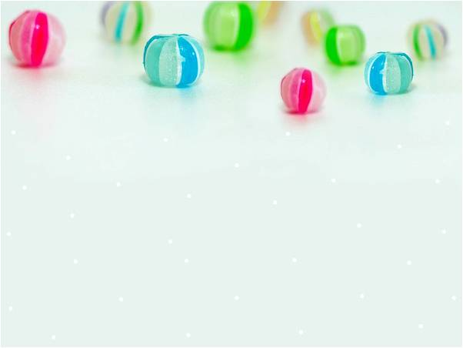
句子成分
定义 ：构成句子的各个部分叫做句子成分。句子成分有主要成分和次要成分；
主要成分：主语和谓语
次要成分：表语、宾语、定语、状语、补足语、同位语

Slide 8
Elements of a sentence:
S --- subject
V --- verb
P --- predicative
O --- object
Attri.---attribute
Adv.--- adverb
Oc --- object complement
主·
谓·
表
宾
定·
状·
宾补

Slide 9

㈠主语（subject）
是一个句子所叙述的主体，说明动作是“谁，什么”发出的，一般位于句首。
Jane is good at playing the piano.
She went out in a hurry.
Four plus four is eight.
To see is to believe.
Smoking is bad for health.
The young should respect the old.
What he has said is true.
（名词）
（代词）
（数词）
（不定式）
（动名词）
（名词化的形容词）
（句子）

Slide 10

找出句中主语
The sun rises in the east.
Twenty years is a short time in history.
The poor are now living in the shelter.
Seeing is believing.
To see is to believe.
He likes dancing.
What he needs is a book.
It is very clear that the elephant is round and tall like a tree.
（名词）
（数词）
(名词化的形容词）
（动名词）
（不定式）
（代词）
（句子）
（It形式主语，主语从句是真正主语）

Slide 11
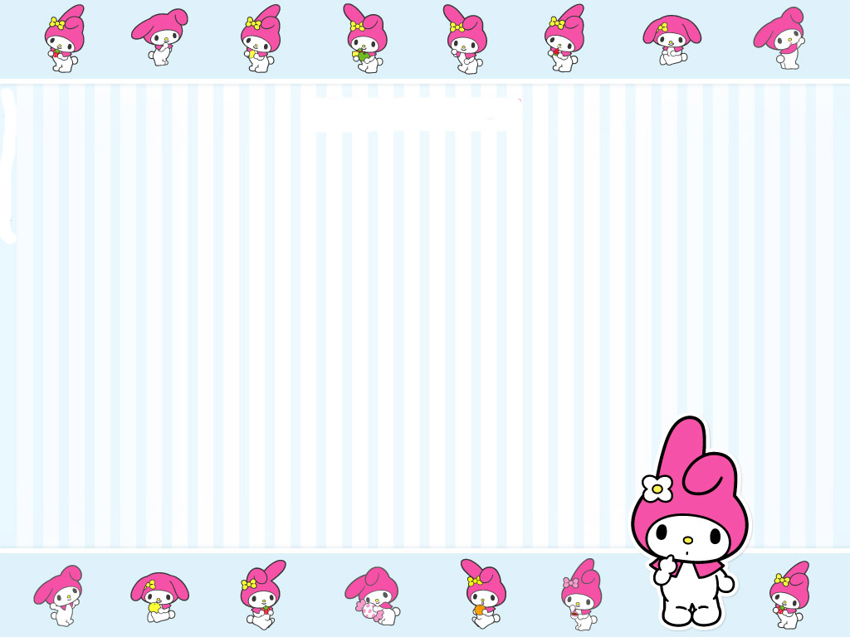
㈡谓语（verb）
是对主语加以陈述，说明主语的动作、状态和特征，一般由V.充当,放在主语之后（英语句子的灵魂）
(1)由单一动词V.做谓语
We are Chinese.
I saw the flag on the top of the hill?
(2)情态V + V原
He can speak English well.
(3)助V +V
She is talking with her sister.
I have seen this man before.

Slide 12


(三)宾语（object）
动作的对象或承受者，一般位于vt.和prep.之后
Show your passport, please.
She didn't say anything.
How many do you want? - I want two.
They sent the injured to hospital.
They asked to see my passport.
I enjoy working with you.
Did you write down what he said?
I succeeded in passing the exam.
（名词 ）
( 代词）
(数词)
(名词化的形容词)
（不定式）
（动名词）
（句子）

Slide 13
宾语分为直接宾语(direct object)
和间接宾语(indirect object).
直接宾语指物,间接宾语指人.
He gave me some books.
↓
间接
宾语
（承受者）
↓
直接
宾语
（对象）
●Please pass me the book.
●He bought his girlfriend some flowers.

Slide 14

（六）宾语补足语
有些及物动词除了有一个直接宾语以外，还要有一个宾语补足语，说明宾语的身份和状态以补充其意义不足，使句子的意义完整。这类常用的及物动词有 ：
make, ask, see, find, call, get, have, let, tell, help, keep
I found the book interesting.
I make my students intertested in my class.
She asked me to lend her a hand.
We made him monitor in our class.
We found him in trouble now.
We found it necessary to study English.
（It形式宾语，to do是真正宾语）

Slide 15
（四）表语(predicative)
在系动词后的部分就是表语,用以说明主语的身份，特征和状态。
The speech is exciting.
They seem to know the truth.
Time is precious.
I’m tired today.
That remains a puzzle.
I don’t feel at ease.
That’ s why he came here.

Slide 16

（四）表语(predicative)
在系动词后的部分就是表语,用以说明主语的身份，特征和状态。
The speech is exciting.
They seem to know the truth.
Time is precious.
I’m tired today.
That remains a puzzle.
I don’t feel at ease.
That’ s why he came here.
(现在分词)
（不定式）
(形容词)
(过去分词)
(名词)
(介短)
(从句)

Slide 17

（五）定语（adjective）
修饰或限制名词或代词的词、词组或从句
单个的定语一般放在所修饰词前– 前置定语
短语，句子一般放在所修饰词前– 后置定语
He is a clever boy.
His father works in a steel work.
There are 54students in our class.
Do you know Betty’s sister?
He bought some sleeping pills.
There is a sleeping baby in bed.
His spoken language is good.
(形容词)
(名词)
(数词)
(名词的所有格)
(动名词)
(现在分词)
(过去分词)

Slide 18

定语后置：
如果定语是由一个单词表示时，通常要前置。而由一个词组或一个句子表示时，通常则后置
The girl in red is his sister.
We have a lot of work to do.
The girl standing under the tree is his daughter.
Do you know the man who spoke just now?

Slide 19
（六）状语（adverbial）
用以修饰adj. /v. /adv.及全句,位置灵活。
修饰adj./adv.时，通常位于被修饰的词之前；
表示时间、地点、目的的状语一般位于句子两头，强调时放在句首，一些表示不确定时间（如：often）或程度（如：almost）的副词状语通常位于be动词、助动词、情态动词之后，动词之前。
说明动作于“何时,何地,如何”发生, 或者说明“adj./adv.”的程度。
状语分为：地点、时间、原因、目的、结果、让步、条件、程度、方式和伴随等状语。
This book is very interesting.
I run fast/quickly.
They are playing on the playground at eight.
I John often came to chat with me．
His parents died, leaving him an orphan.
(副词)
(副词)
(介短)
（不定式）
（V-ing短语）

Slide 20

Please call me if it is necessary.
Suddenly, I heard the bird sing a song.
You probably know more than you think.
（从句）
（副词）
（副词）

Slide 21
(七) 挑出下列句中的状语
① There was a big smile on her face.
② Every night he heard the noise upstairs.
③ He began to learn English when he was eleven.
④ The man on the motorbike was travelling too fast.
⑤ With the medicine box under her arm, Miss Li hurried off.

Slide 22
⑥ She loves the library because she loves books.
⑦ I am afraid that if you've lost it, you must pay for it.
⑧ The students followed Uncle Wang to see the other machine.

Slide 23

同位语
对n.或pron.进行补充说明或进一步解释说明
We young people should respect the old.
He himself will do the experiment.
He told me the news that our team won the game.
名词
代词
从句

Slide 24

系动词
1）状态系动词（be动词）
例如： He is a teacher.
2）持续系动词
keep, rest, remain, stay, lie, stand
例如： He always kept silent at meeting.
他开会时总保持沉默。
3）表像系动词
seem, appear, look,
例如： He looks tired.
他看起来很累。

Slide 25
4）感官系动词
feel, smell, sound, taste, look
例如：This kind of cloth feels very soft.
注意：系动词(除be外)不用于被动语态.
5）变化系动词
become, grow, turn, fall, get, go, come, run.
例如： He became mad after that.
6）终止系动词
prove, turn out, 表达“证实”，“变成”之意
例如： The rumor proved false.

Slide 26
句子成分
定义 ：构成句子的各个部分叫做句子成分。句子成分有主要成分和次要成分；
主要成分：主语和谓语
次要成分：表语、宾语、定语、状语、补足语、同位语

Slide 27
Elements of a sentence:
S --- subject
V --- verb
P --- predicative
O --- object
Attri.---attribute
Adv.--- adverbial
Oc --- object complement
主·
谓·
表
宾
定·
状·
宾补

Slide 28
简单句（即只有一个主谓结构），它是最小的句子单位。按照句子的用途可以分为四种。
作一种陈述（陈述句）
The boy hit the dog. / The dog bit the boy.
提出一个问题 (一般/特殊/选择/反义疑问句)
Does the shop close at 7 tonight?
发出一种命令或请求（祈使句）
Shut/Open the door.
表示一种感叹（感叹句）
What a slow train this is!
简单句
（句子用途）

Slide 29
句 子 结 构 分 类 | 简单句 Simple Sentences | 含有一个主语（或并列主语）和一个谓语（或并列谓语）的句子
 | 并列句 Compound Sentences | 包含两个或两个以上主谓结构的句子且句子之间有并列连词and/but/or /so 等或用分号连接
 | 复合句 Complex Sentences | 包含一个主句和一个从句或一个主句和多个从句的句子，且从句用从属连词that/what/when/if等引导

Slide 30
句子类型
简单句
并列句
复合句

Slide 31
句 子 结 构 分 类 | 简单句 Simple Sentences | 含有一个主语（或并列主语）和一个谓语（或并列谓语）的句子
 | 并列句 Compound Sentences | 包含两个或两个以上主谓结构的句子且句子之间有并列连词and/but/or /so 等或用分号连接
 | 复合句 Complex Sentences | 包含一个主句和一个从句或一个主句和多个从句的句子，且从句用从属连词that/what/when/if等引导

Slide 32
Summary
简 单 句 的 基 本 句 型 | 1.主语+系动词+表语
 | 2.主语+不及物动词
 | 3.主语+及物动词+宾语
 | 4.主语+及物动词+间接宾语 +直接宾语
 | 5.主语+及物动词+宾语 +宾语 补足语

Slide 33
复习简单句：
对下列句子的成份进行划分

Slide 34
Practice
Nobody went.
She became a doctor.
The car caught fire.
I will write you a long letter.
I will let him go.
主 + 谓
主 + 谓 + 表
主 + 谓 + 宾
主 + 谓 + 间接宾语 + 直接宾语
‹ ›
主 + 谓 + 宾 + 宾补

Slide 35
Ⅰ.简单句
1. Things changed.
2. Trees are green.
3. We don’t beat children.
4. He gave his sister the piano.
5. I found the book easy.
主 + 谓
主 + 谓 + 表
主 + 谓 + 宾
主 + 谓 + 间接宾语 + 直接宾语
‹ ›
主 + 谓 + 宾 + 宾补

Slide 36

Exercises:分析句子结构
1）You are a student.
2）He felt happy today.
3）What you said made me happy.
4）You could give me some advice on how to learn English well?
5）We found a man lying on the ground.
6） It is my duty to look after these children.
7） You had better keep the window open.

Slide 37

8）He likes pop music.
9）The sound sounds strange.
10）The food tastes good.
11）He has been learning English for years.
12）We think it a pity that she didn’t
come here.
13）

Slide 38
1. He learns German.
2. Both Tom and Jack enjoy country
music.
3. We sang and danced yesterday
evening.
4. My brother and I go to school at half
past seven in the morning and come
back home at five in the afternoon.
（一个主语和一个谓语）
（并列主语和一个谓语）
（一个主语和并列谓语）
（并列主语和并列谓语）

Slide 39
并列句
常用并列连词
coordinating conjunctions
平行并列连词:
转折并列连词：
因果并列连词:
选择并列连词:
and, both…and, not only…but also, neither…nor, and then
but, however, while, yet
for, so
or, either…or

Slide 40
Ⅱ.并列句
This is me and these are my friends.
They must stay in water, or they will die.
It’s not cheap, but it is very good.
It was late, so I went to bed.
and
or
but
so
He knocked at the door; there was no answer.
You’re alive! And she’s dead.

Slide 41
复合句与简单句：复合句 = 简单句 + 从属连词 +简单句
when he was
leaving for Paris.
that the match had
been cancelled.
He told me
the news.
宾语从句
宾语
that I passed the exam.
that his father
was working in
that school.
what he needs.

Slide 42
复合句与简单句：复合句 = 简单句 + 从属连词 +简单句
that he has finished his work.
whether he has finished his work.
I don’t know
him.
宾语从句
He has finished his work
that he is leaving for Washington.
when he is leaving for Washington.
why he is leaving for Washington.
how he is leaving for Washington.
whether he is leaving for Washington.
He is leaving for Washington.

Slide 43
宾语从句
* I understand that he is well qualified.
* He said that he didn’t like her.
I don’t know if you can help me.
They want to know where you are going .
The students has decided when they
hold the meeting.

Slide 44
复合句与简单句：复合句 = 简单句 + 从属连词 +简单句
What he said
What he did
surprised
the people
in the room.
That
定语
主语
who were sitting in the room.
who were present.
whose sons were at war.
who had signed the contract.
That he didn’t
know the answer

Slide 45
1) 主语从句
* What he said is not known.
* That we shall be late is certain.
* It is certain that we shall be late.
* How strange it is that the children are so quiet!

Slide 46
2) 定语从句
He said he knew the boy who was sitting by the window.
A plane is a machine that can fly.
The picture which is on the wall is drawn by my father.

Slide 47
复合句与简单句：复合句 = 简单句 + 从属连词 +简单句
That
is
表 语
the fact.
what he needs.
what he gave me.
why he was late.
because he was ill.
what has happened.

Slide 48
2）表语从句
* That is what he wants to buy.
* The problem is who can replace her.
* The reason is that he has lied to me several times.

Slide 49
复合句与简单句：复合句 = 简单句 + 从属连词 +简单句
I lived there.
He lived there
three years ago.
where I lived
He worked
in that factory
地点状语
three years ago.
in that factory
时间状语
where his
father worked
when he
lived there
His father worked there.

Slide 50
复合句与简单句：复合句 = 简单句 + 从属连词 +简单句
where it was.
Put the book
on the desk.
地点状语
where you found it.
where you took it.
wherever you like.
You can’t camp
here.
where there are
a lot of trees.

Slide 51
Practice
指出下列各从句的类型
宾语从句
I believe that everything is going on well.
She was reading a novel when I came in.
She is the girl who sings best in my class.
状语从句
定语从句

Slide 52
Practice
用所给连词连接句子。
He has found out. She was late. (why)
He has found out why she was late.
I still remember the day. I first went to York on that day. (when)
I still remember the day when I first
went to York.
将各组句子连接为一个含有状语从句的复合句。
He didn’t come yesterday. He was ill. (原因)
He didn’t come yesterday because he was ill.

Slide 53
I’ll give the letter to him. I see him. （时间）
It is such a big box. Nobody can move it. （结果）
We’ll go to the great wall. It’s fine tomorrow. (条件)
We should not go there all the time. The place is quite pleasant.(让步）
I’ll give the letter to him when I see him.
I’ll give the letter to him as soon as I see him.
I’ll give the letter to him the moment I see him.
It is such a big box that nobody can move it.
We’ll go to the great wall if it’s fine tomorrow.
Although the place is quite pleasant, we should not go there all the time.

Slide 54
状语从句
分为八类：时间、地点、原因、结果、
目的、条件、让步、方式、
1) 时间状语从句
Wait until you are called.
When spring came, leaves turned green.
常用的关联词有：as, after, before, since,
till/ until, when, while, as soon as, whenever等

Slide 55
2) 条件状语从句
If it snows tomorrow, we will build a snowman.
So long as you need me, I’ll stay.
常用的关联词有：if, unless,
as long as , on condition that…
3) 让步状语从句
Though I’m fond of music,I can’t play any instrument.
常用的关联词有：though, although,
even if, even though,

Slide 56
4) 结果状语从句
She was so happy that she didn’t know what
to say .
He is such an honest boy that we all like him.
常用的关联词有：so… that, such… that,
5) 目的状语从句
Come early in order that/so that you may
see him.
Take your rain coat in case it rains.
常用的关联词有： so that, in order that
in case

Slide 57
6) 地点状语从句
Put it where you found it.
Sit down wherever you like.
常用的关联词有：where, wherever, anywhere
7) 原因状语从句
As I didn’t know the way, I asked a policeman
常用的关联词有：because, as, since

Slide 58
8) 方式状语从句
He did just as you told him.
常用的关联词有：as, as if, as though, how

Slide 59
Practice
指出下列各从句的类型
宾语从句
I believe that everything is going on well.
She was reading a novel when I came in.
She is the girl who sings best in my class.
状语从句
定语从句

Slide 60
宾语从句
He has found out why she was late.
I still remember the day when I first went to York.
定语从句
He didn’t come yesterday because he was ill.
状语从句

Slide 61
划出从句，并判断从句的种类。
1. The reason why he was dismissed is that he didn’t work hard.
2. I doubt whether he will succeed. I don’t know if you can help me.
3. That the earth is round is well-known.
4. They believed that they would win the game.
5. When we were at school, we went to the library every day.
6. Do you know the woman who is talking to Mr Green ?
(定语从句）
（表语从句）
（宾语从句）
（宾语从句）
（主语从句）
（宾语从句）
（状语从句）
(定语从句）

Slide 62
7. It all depends on whether they will support us.
8. We will go where the Party directs us.
9. The news that Jim told us is true.
10. He always thinks of how he can work better.
11. You will certainly succeed so long as you keep on trying.
12. The photographs will show you what our village looks like.
13. It is because the tobacco companies want to remain in business.
（宾语从句）
（状语从句）
(定语从句）
（宾语从句）
（状语从句）
（宾语从句）
（表语从句）

Slide 63
有关“跨文化”话题
假设你叫李华，你的外国朋友John想了解中国的春节，请根据以下提纲，给他写一封短信：
1、春节在中国人中的地位
2、春节的时间. 春节前人们……
3、春节期间，人们……
参考词汇：对联couplet 爆竹firecracker
Dear John,
How time flies! Four months have passed since we saw each other last time. I cannot help but miss you. You asked me about Chinese Spring Festival. Now I would like to tell you something about it.________________________________________

Slide 64
写出下列与春节有关的词汇
春节 _____________ 农历______________
正月____________ 除夕______________
初一_____________ 团圆饭_______________
年夜饭____________
爆竹________________
饺子____________ 年糕________________
过年_____________ 传统的______________
张贴_____________ 庆祝________________
聚集____________
节日气氛___________________
吃饭_____________ 看电视___________________
休息_____________ 放松_____________________
风俗习惯_____________________________
Spring Festival
Lunar calendar
Lunar January
New year's Eve
First day
Family reunion dinner
The dinner on New Year's Eve
Firecrackers
Jiaozi
New Year Cake
spend the new year
traditional
put up
celebrate
get together
the atmosphere of the festival
have dinner
watch TV
have a rest
relaxed
customs and habits

Slide 65
与要点有关的句子:
春节是中国的传统节日
春节在农历的第一天
3. 春节是家人聚会的节日
4. 春节前打扫房间, 贴春联, 放鞭炮，吃饺子， 看电视。
5. 结束语
The Spring Festival is a Chinese traditional festival.
The Spring Festival begins on the first day of the first lunar month.
It is when all family members get together
A few days before the festival, houses are cleaned and red couplets are put up on the doors of every household.

Slide 66
参考文章：
How time flies! Four moths have passed since we saw each other last time. I cannot help but miss you. You asked me about Chinese Spring Festival. Now I would like to tell you something about it. The Spring Festival is a Chinese traditional festival. It is the most important festival for the Chinese people and is when all family members get together, just like Christmas in the West. The Spring Festival begins on the first day of the first lunar month. It marks the first day of a new year. A few days before the festival, houses are cleaned and red couplets are put up on the doors of every household. They are said to frighten away the ghosts.

Slide 67
On that day, people are dressed up. Firecrackers ring out in the air, which adds to the atmosphere of the festival. People after a year’s hard work begin to relax and visit one another. Presents and dinners are given to celebrate the happy reunion of friends and relatives. Families get together. They have jiaozi and enjoy the New Year TV show. Customs may vary from place to place, but the same happy atmosphere is to be found everywhere in the country.
Now, I hope you have some idea of Chinese Spring Festival.
Best wishes,

Slide 68
Basic Sentence Patterns
简单句基本句型

Slide 69
在英语中，简单句的基本结构主要有以下5种类型。
1. 主 +谓（S+Vi）
I work. 我工作。

Slide 70
2.主 +谓+ 宾（S + Vt. +O）
She studies English. 她学英语。
3. 主 +谓+ 表（S+V1+P）
John is busy. 约翰忙。

Slide 71
4.主 +谓+ 间宾 + 直宾（S+V+IO+DO）
My mother made me a new dress.
我母亲给我做了一件新衣服。
5. 主 +谓+ 宾 + 补（S+V+O+OC）
I found the book interesting.
我觉得这个书很有趣。

Slide 72

注意：
状语可以出现于以上任何一种简单句的结构中。

Slide 73

Look at the pictures and then read the following story, paying attention to the numbered sentences.

Slide 74
One day, Jimmy stood by a window. 1) He looked out. 2) He saw a bird. 3) The bird was beautiful. The beautiful bird was singing aloud. 4) Suddenly, he heard the bird begin to talk to him. “Hi, I am Jill. Who are you?” Jimmy was very surprised.

Slide 75
He asked the bird. “Are you speaking to me?” The bird, Jill, said, “Yes. I am very hungry. 5) Can you give me something to eat?” Jimmy then put some rice on his palm to feed the bird. As soon as the bird finished eating the rice, Jimmy found himself flying together with the bird in the sky.
Oh, what a wonderful dream!

Slide 76
1. Put the numbered sentences after the correct sentence patterns.
1. 主 +谓（S+V）
He looked out.
2.主 +谓+ 宾（S+V+O）
He saw a bird.
3. 主 +谓+ 表（S+V+P）
The bird was beautiful.

Slide 77
4.主 +谓+ 间宾 + 直宾（S+V+IO+DO）
Can you give me something to eat?
5. 主 +谓+ 宾 + 补（S+V+O+OC）
Suddenly, he heard the bird begin to talk to him.

Slide 78
2. Read the story again and find more sentences which match the five basic sentence patterns.
1. S+V
One day, Jimmy stood by a window.
The beautiful bird was singing aloud.

Slide 79
2. S+V+O
He asked the bird.
Are you speaking to me?
Jimmy then put some rice on his palm to feed the bird.
As soon as the bird finished eating the rice …

Slide 80
3. S+V+P
I am Jill.
Who are you?
Jimmy was very surprised.
I am very hungry.
4. S+V+IO+DO 无。
5. S+V+O+OC
Jimmy found himself flying together with the bird in the sky.

Slide 81
3. Study the chart carefully, and then complete the following sentences.
pronoun and the “- ing” form
Noun, _________________________ can be used to be a subject.
___________________ can be used to be a predicate.
Noun, ____________________________ can be used to be an object.
Verb and verbal phrase
pronoun, the “- ing” form, the infinitive and object clause

Slide 82
Noun, _____________________________
_________can be used to be a predicative.
Noun, ______________________________
_______________________________can be
used to be an object complement.
adverb, adjective and prepositional
phrase
adjective, prepositional phrase,
the infinitive and the “- ing” form

Slide 83
Noun / Pronoun /
the + adj
V-ing / Clause / Infinitive
Vi
英语句子基本成分示意图
宾语
noun
adj. / adv.
Infinitive/
V-ing/
V-ed/
etc.
主语
谓语
Vt
宾语(间)
宾语(直)
宾语
宾补
V-l
表语
Noun / Pronoun/
the + adj/
V-ing / Clause/
Infinitive
Noun/
Pronoun/
adj. / adv./
Infinitive/
V-ing / V-ed/
clause
etc.
be / feel / seem / look
appear / stand / lie
become /get / grow / turn
go / come / remain/ keep
taste / smell etc.

Slide 84
Follow the example and mark the elements of each sentence.
1. I am looking forward to meeting you.
2. We found a man lying on the ground.
S
V
O
O
OC

Slide 85
3. Your boss called and left you a message.
4. I know exactly what they want.
5. It’s my duty to look after these children.
S
V
V
IO
DO
O
S

Slide 86
6. Tom asked whether he could borrow my new dictionary.
7. The speaker raised his voice and finally made himself heard.
8. Do you think it necessary to build a new camp?
O
V
O
V
O
OC
OC
O
（It形式宾语，to do是真正宾语）

Slide 87

Read the following passage and mark the sentence elements of the coloured parts. The first one has been done as an example.

Slide 88
It is the last day of October ( ). Children put on costumes ( ) some children dress like pirates or ghosts. Others ( ) try to look like famous people. On Halloween night, they carry a big sack ( ) and say “trick or treat”( ) outside the door of each house. People give ( ) them ( ) candies or fruits ( ).
P
O
S
O
O
V
IO
DO

Slide 89
The symbols of Halloween are pumpkin lanterns ( ). They are made from pumpkin shells. The favourite drink at Halloween time is apple juice. Americans also call it ( ) cider ( ). Teachers often serve the children ( ) cider ( ) in elementary school on Halloween Day. The boys and girls ( ) wear their costumes to school and the teachers give prizes ( ) to the students ( ) with the best costumes.
P
O
OC
IO
DO
S
DO
IO

Slide 90
Identify the structures of the following sentences.
My head aches.
She likes English.
She makes her mother angry．
She is happy．
She gave John a book．
SV
SVO
SVOC
SVP
SVIODO

Slide 91
Translate the following sentences into English.
你应当努力学习。
他昨天回家很晚。
You should study hard.
He went home very late last night.

Slide 92
3. 昨晚我写了一封信。
4. 今天下午我想同你谈谈。
I wrote a letter last night.
I want to have a talk with you this afternoon.

Slide 93
5. 我的兄弟都是大学生。
6. 十五岁他就成为有名的钢琴家了。
My brothers are all college students.
At the age of fifteen he became a famous pianist.

Slide 94
7. 奶奶昨晚给我们讲了一个有趣的故事。
8. 请把那本字典递给我好吗？
Grandma told me an interesting story last night.
Would you please pass me the dictionary?

Slide 95
9. 他的父母给他起名为John。
10. 我们大家都认为他是诚实的。
His parents named him John.
All of us considered him honest.

Slide 96
Write at least five sentences to describe the picture below.
S+V
The students are having an English class.
2. S+V+O
All the students have put up their hands.
3. S+V+P
The students are very active.

Slide 97
4. S+V+IO+DO
The teacher is showing a newspaper to the students.
5. S+V+O+OC
The teacher will ask a student to answer a question.

Slide 98
Summary
简 单 句 的 基 本 句 型 | 1.主语+系动词+表语
 | 2.主语+不及物动词
 | 3.主语+及物动词+宾语
 | 4.主语+及物动词+间接宾语 +直接宾语
 | 5.主语+及物动词+宾语 +宾语 补足语
Grammar

Slide 99
Unit 2
Grammar

Slide 100


Listen to a song:
Don’t Worry, Be Happy.

Slide 101
Read the sentences.
She works hard.
You are an analytic learner.
You get some useful advice.
She brings me a book.
The teacher lets him study hard.

Slide 102
简单句：由一个主语（或并列主语）和一个
谓语（或并列谓语）构成。
We are living a happy life.
She and her daughter are both teachers.
(并列主语)
They walked and talked along the river.
(并列谓语)

Slide 103
简单句的五种基本句型
S + V
S + V + P
S + V + O
S + V + IO + DO
S + V + O + OC

Slide 104
1、主语+不及物动词： We work.
2、主语+系动词+表语: He is a student.
3、主语+及物动词+宾语：
Henry bought a dictionary.
4、主语+及物动词+双宾语（间接宾语+直接宾语）： My father bought me a car.
5、主语+及物动词+复合宾语（宾语+宾补）：
Tom made the baby laugh.
注：其他各种句子都可由这一种基本句型扩展、变化或省略而构成。

Slide 105
Read the sentences and pay attention to the underlined parts.
Try to find more time to learn and organise the time.
She loves English, but her sister doesn’t.
Study hard, or you will fail the exam.
I want to study English, however, it’s too difficult for me.
Either you or me should go to the party.

Slide 106
并列句: 由并列连词（and, but, or等）或分号（;）把两个或两个以上的简单句连在一起构成。包括两个或两个以上互不依从的主谓结构。并列句由并列连词but, yet, and, or, so, either … or, not only … but (also), both … and, neither … nor …等连接。
You help him and he helps you.
He made a promise, but he didn’t keep it.
Hurry up, or you’ll miss the train.

Slide 107
1、表示连接两个同等概念，常用and, not only … but also …, neither … nor …, then
等连接。
The teacher’s name is Smith, and the student’s name is John.
2、表示选择，常用的连词有or, either … or …, otherwise等。
Hurry up, or you’ll miss the train.

Slide 108
3、表示转折，常用的连词有but, still,
however, yet, while, when等。
He was a little man with thick glasses, but
he had a strange way of making his classes
lively and interesting.
4、表示因果关系，常用的连词有so, for,
therefore等。
August is the time of the year for rice harvest,
so every day I work from dawn until dark.

Slide 109
A
Give me one more minute ____ I’ll be able to finish it.
A. and B. or C. if D. so
B
I’m sorry to have to say this, ____ you forgot to turn off the lights when you left the room last night.
A. and B. but C. so D. because

Slide 110
A
---- Do you feel like going out ____ would you
rather have dinner at home?
---- I’d like to go out.
A. or B. and C. but D. so
B
He lay in bed ____ read something borrowed from library.
A. but B. and C. or D. yet
We are going to the bookstore in John's car. You can come with us ______ you can meet us there
later.
A. but B. and C. or D. then
C

Slide 111
用and, but或or连接句子。
They watch TV. They do their homework.
2. Mary's brothers finish school at half past three. They go home at four o'clock.
3. We get up. We wash our faces.
4. Hurry up. You will miss the bus.
They watch TV and do their homework.
Mary's brothers finish school at half past three and / but they go home at four o'clock.
We get up and wash our faces.
Hurry up or you will miss the bus.

Slide 112
高考真题
A
If you have a job, _________ yourself to it and finally you’ll succeed. （2010四川）
A. do devote B. don't devote
C. devoting D. not devoting
Don’t turn off the computer before closing all programs, _________ you could have problems. （2013北京）
A. or B. and
C. but D. so
A

Slide 113
C
It’s not easy to change habits, ________with awareness and self-control, it is possible.
（2013重庆）
A. for B. or
C. but D. so
Read this story, _______ you will realize that not everything can be bought with money.
（2013四川）
A. or B. and
C. but D. so
B

Slide 114
Read the sentences and pay attention to the underlined parts.
Knowing what learner type you are may help you learn English better.
The fact is that you have your own learning style and habits.
Read the comments to find what learner type you are.
You will become aware of the mistake that you make regularly.
If you score between 9 and 13 points, you are probably a relaxed learner.

Slide 115
复合句：由一个主句和一个或一个以上的从句构成。主句为句子的主体, 从句只用作句子的一个次要成分, 不能独立成为一个句子。
按其在复合句中的作用, 从句可分为：
主语从句
名词性从句
宾语从句
同位语从句
定语从句
状语从句
｛
表语从句

Slide 116
He is one of the professors who are from the south. (含有定语从句)
The manager required that we finish the work
before 10 o’clock.
(含有宾语从句)
What you said yesterday is right.
(含有主语从句)
We will go for a picnic if it doesn’t rain tomorrow. (含有状语从句）

Slide 117
Read and decide the types of the following sentences.
简单句
1. I love books.
2. I love reading books.
3. I love reading books very much.
4. I love reading English books very much.
5. I love reading English books very much but I don’t like this one.
6. I love reading English books very much because it can improve my English.
7. Though I love reading English books very much, I don’t like this one.
简单句
简单句
简单句
并列句
复合句
复合句

Slide 118
判断下列句子的种类，写在横线上。
1. The girl who offered me her seat is called Lucy.
2. There is a chair in this room, isn’t there?
3. My sister and I go to school at half past seven in the morning and come back home at seven in the evening.

Slide 119
4. He was fond of drawing when he was yet a child.
5. Neither has he changed his mind, nor will he do so.
6. He is in Class One and I am in Class Two.
7. The farmer is showing the boy how to plant a tree.
8. It was late, so we went home.

Slide 120
简单句：_____________
并列句：_____________
复合句：_____________
2 3
5 6 8
1 4 7

Slide 121
状语从句
状语从句：在复合句中充当状语的从句。
状语从句可以分为以下几类：
时间、地点、原因、条件、目的、结果、
让步状语从句

Slide 122
一、时间状语从句
常用的关联词有as,
when, whenever, while, before, after, until等。如：
Come and see me whenever it is convenient to you.
二、地点状语从句
常用的关联词有where，wherever等。如：
The famous scientist grew up where he was born, and in 1930, he came to Shanghai.

Slide 123
三、原因状语从句
常用的关联词有because, as, since, now that, for等。如：
The Italian boy was regarded as a hero because he gave his life for his country.
四、结果状语从句
常用的关联词有so … that …, such … that …等。如：
He worried so that he couldn’t sleep.
He’s such a good person that we mustn’t blame him.

Slide 124
五、目的状语从句
常用的关联词有that, so that, in order that, in case等。从句的谓语常由“can / could，may / might + 动词原形”构成。如：
I’m going to take an early bus so that I’ll get there on time.
六、条件状语从句
常用的关联词有if, unless, as / so long as, on condition that等。如：
I will come to see you if I have time.

Slide 125
七、让步状语从句
常用的关联词有though, although, even if / though, whatever, whichever, whether … or, no matter who等。如：
Although he is poor, he’s still happy.
We’ll go even if it rains.

Slide 126
运用状语从句需要注意的问题：
要准确掌握与区别引导词的词义与用法。
2. 掌握两种重要句型。
It is / has been + 时间段 + since…
自从…以来有多长时间了
It is / will be + 时间段 + before…
在…之前有多长时间
It’s ten years since they got married.
他们结婚到现在已经十年了。
It won’t be long before they understand each other.
过不了多久他们就会互相了解的。

Slide 127
3. 一些名词短语可以用作连词，引导时间状语从句，
但是这些名词短语之前不带任何介词。
the moment / instant / minute… 一…就…
every time / each time 每次/当…
the first /second / third …(等序数词) +time 第几次…
He fell love in with that girl the first time he saw her.
Mr. Smith phoned Jim the moment he came home.
4. 状语从句中，常用一般现在时代替一般将来时。
If you are too tired, we’ll not go out for a walk.

Slide 128
Choose the best answer from A, B, C and D.
He would never speak to someone like that
______ they said something unpleasant to him.
A. so that B. even if
C. as if D. ever since
B

Slide 129
2. It will be five years _______ we meet again.
A. since B. until C. before D. when
3. ---Do you think we can get there on time?
---Yes, ______ the car doesn’t break down.
A. even if B. unless
C. until D. so long as
C
D

Slide 130
4. _______ I admit that there are problems, I don’t agree that they cannot be solved.
A. While B. If
C. As D. Unless
5. Dr. Bethune began to work ______ he arrived at the front.
A. at the moment B. for the moment
C. the moment D. in the moment
A
C

Slide 131
高考真题
─ Coach, can I continue with the training?
─ Sorry, you can’t _____ you haven’t recovered from the knee injury. (2012重庆高考)
A. until B. before
C. as D. unless
C
I have a tight budget for the trip, so I'm not going to fly _____ the airlines lower ticket prices. （2012上海高考）
A. once B. if
C. after D. unless
D

Slide 132
The police officers in our city work hard ______ the rest of us can live a safe life. (2011上海)
A. in case B. as if
C. in order that D. only if
C
If a lot of people say a film is not good, I won’t bother to see it, or I’ll wait ______ it comes out on DVD. (2011上海 )
A. whether B. after
C. though D. until
D

Slide 133
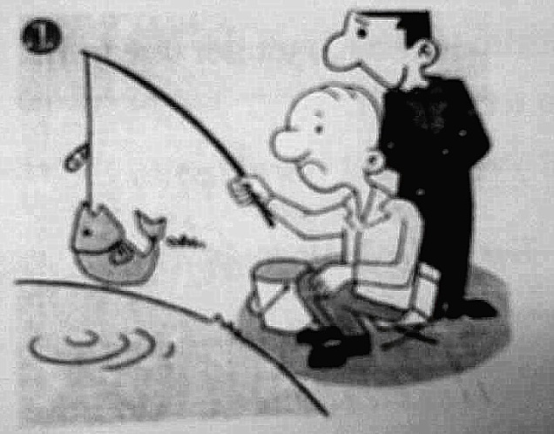
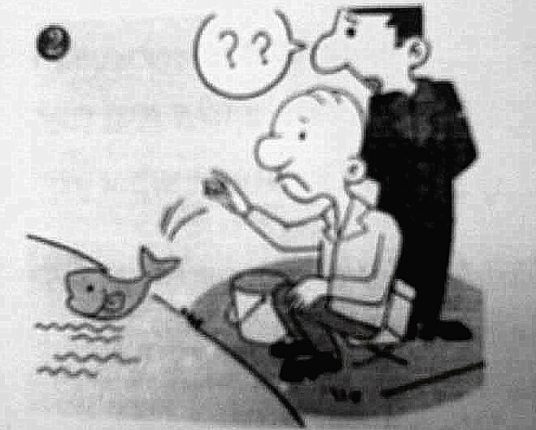
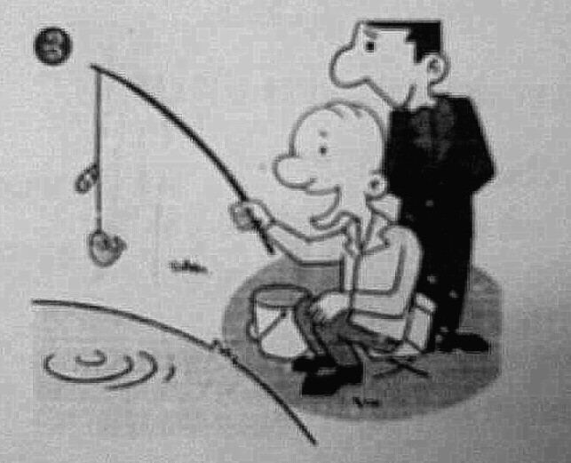
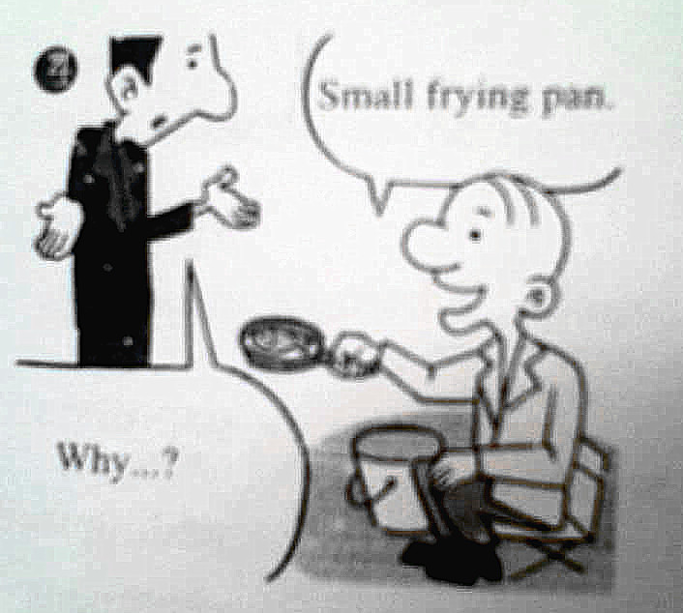
4. Look at the four pictures and then make a story.

Slide 134
Here is a sample and try to complete
the sentences.
A young man walked along a river and ___________________________________. After a while, the old gentleman caught a big fish but __________________________. The young man was greatly surprised when ______________________. He decided to stay and watch the old man.
he found an old man fishing by the river
he threw it back into the river
he saw what happened

Slide 135
Several minutes later, ___________________________ and he put it into his bucket. The young man felt so surprised that _______________________
_______________________________________________. The old man smiled, took out a pan, and said _________________________
__________.
the old man caught a small fish
he asked the old man why
he threw away the big fish and kept the small one
that he only had a small
frying pan

Slide 136

Writing
Talk with your partner about the questions and then write a short passage.

Slide 137
Sample
I have a friend. His name is Congcong. He is a lovely boy with two big bright eyes, a small mouth and a round face. His hair is short and black. My friend does well in his lessons and English is his favorite subject. He usually gets high scores in English exams. Congcong also has many hobbies, such as playing table-tennis, playing computer, reading story-books, and so on. He is always polite to others, especially to his teachers and his parents. We have been friends for a few years and we are getting along very well with each other.

Slide 138
Step Seven
Homework:
Exercise 3

Slide 139

Happy every day in 2014!

