Slide 1
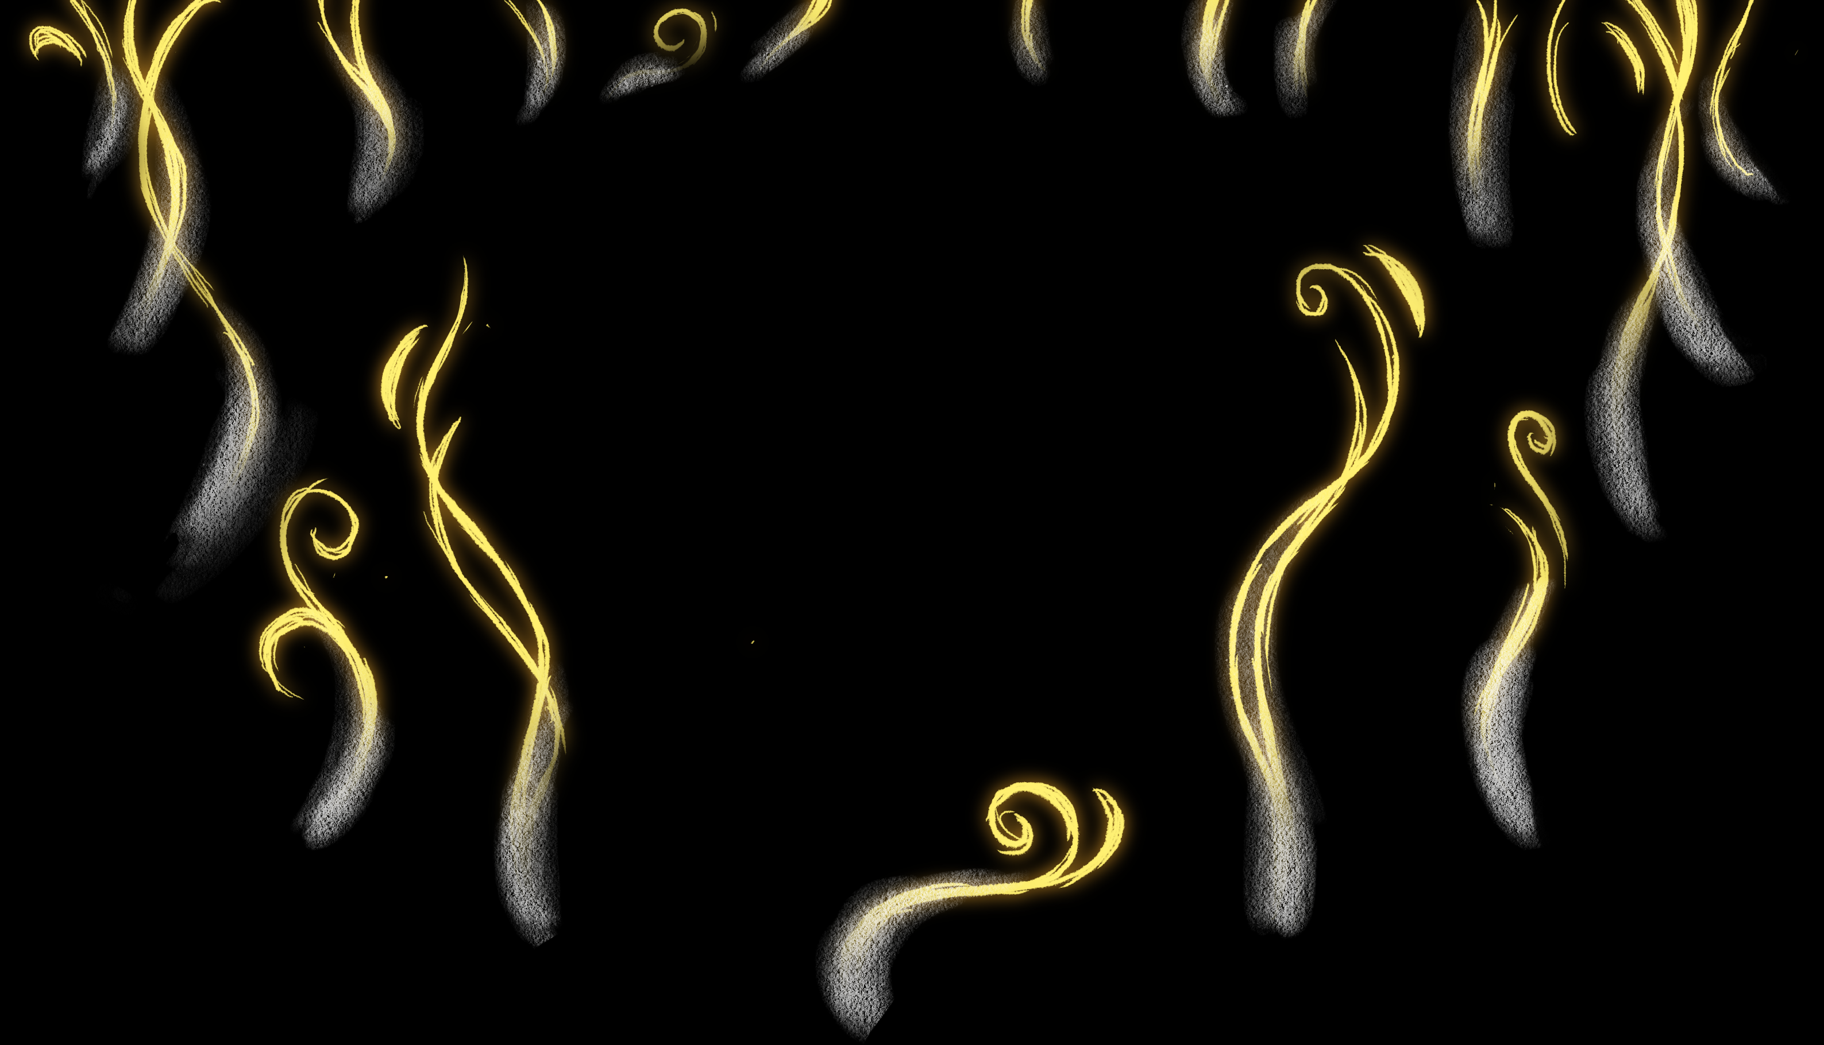
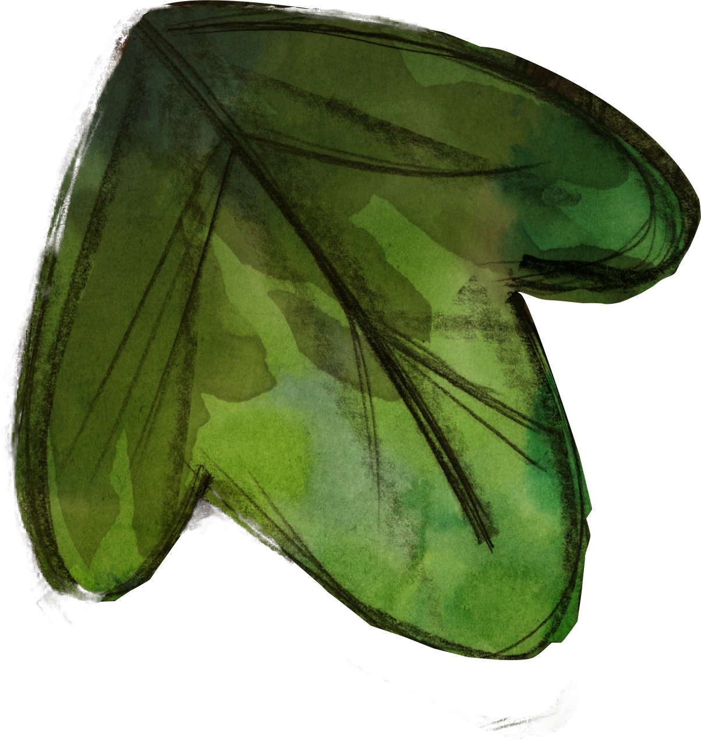
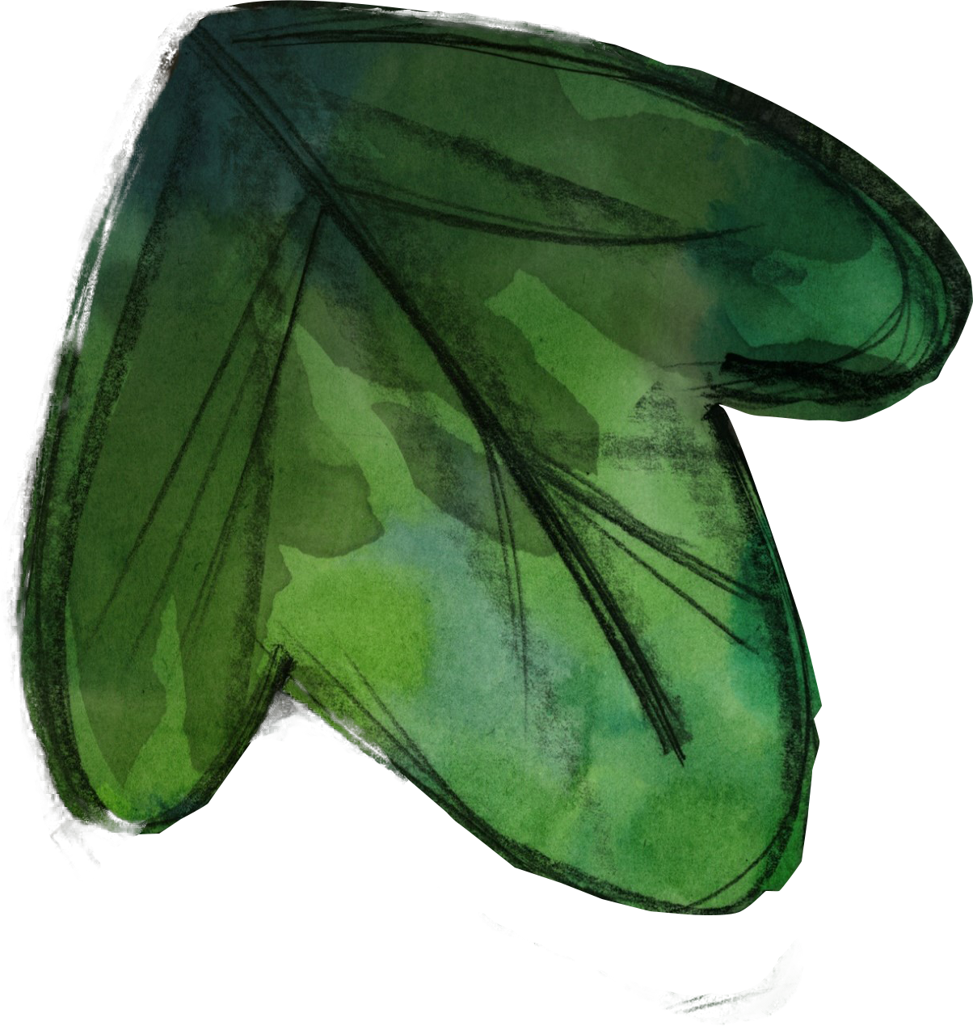
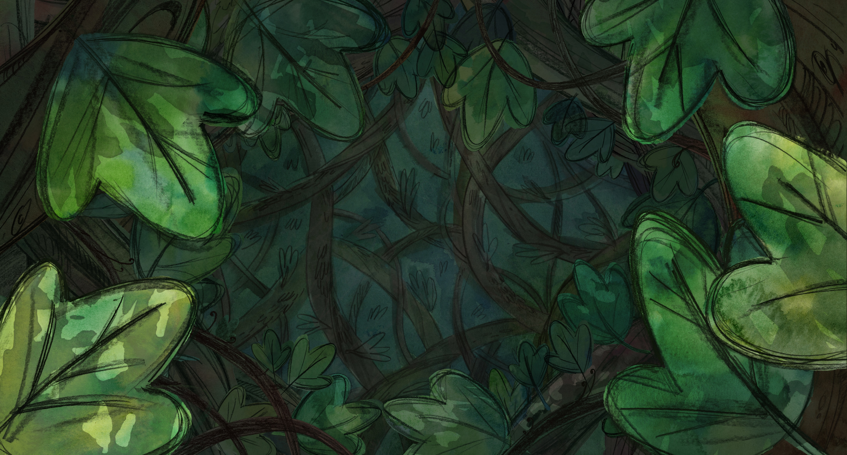
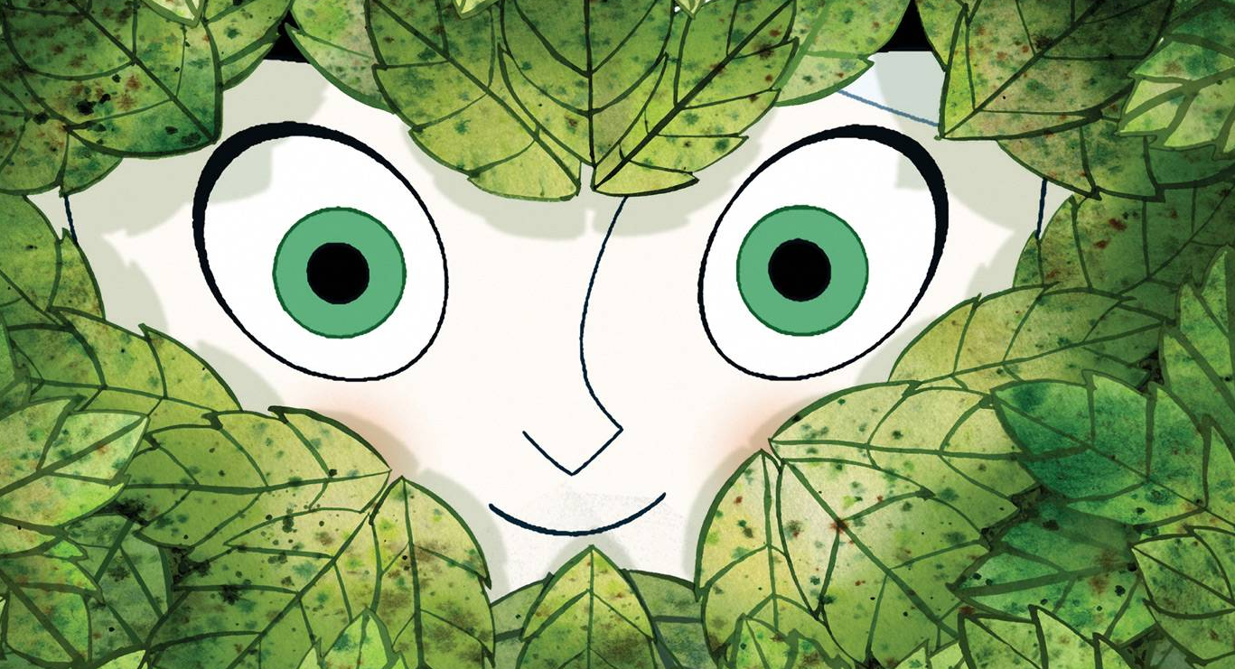

In a time of superstition and magic, a young apprentice hunter, robyn goodfellowe, journeys to ireland with her father to wipe out the last wolf pack. While exploring the forbidden lands outside the city walls, robyn befriends a free-spirited girl, mebh, a member of a mysterious tribe rumored to have the ability to transform into wolves by night.

Slide 2

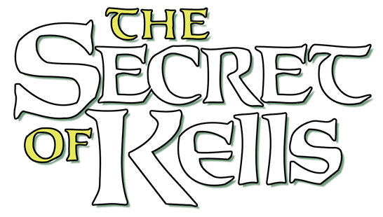
Journeys to ireland with her father to wipe out the last wolf pack. While exploring the forbidden lands

