Slide 1

Children
Happy Children’s Day
Childhood

Slide 2

TO MY ，
DEAR DEAR DEAR…
CHILDHOOD！！！
TO MY
DEAR DEAR CHILDHOOD!!!!
BY Simon

Slide 3

Hi~
THOSE
YEARS
TO MY DEAR CHILDHOOD

Slide 4

YEAH~
TO MY DEAR CHILDHOOD

Slide 5
TRAFFIC LIGHT?
RED
YELLOW
GREEN
TO MY DEAR CHILDHOOD

Slide 6
BBB？
CCC？
AAA？
TO MY DEAR CHILDHOOD

Slide 7
TO MY DEAR CHILDHOOD

Slide 8
COOL~
TO MY DEAR CHILDHOOD

Slide 9
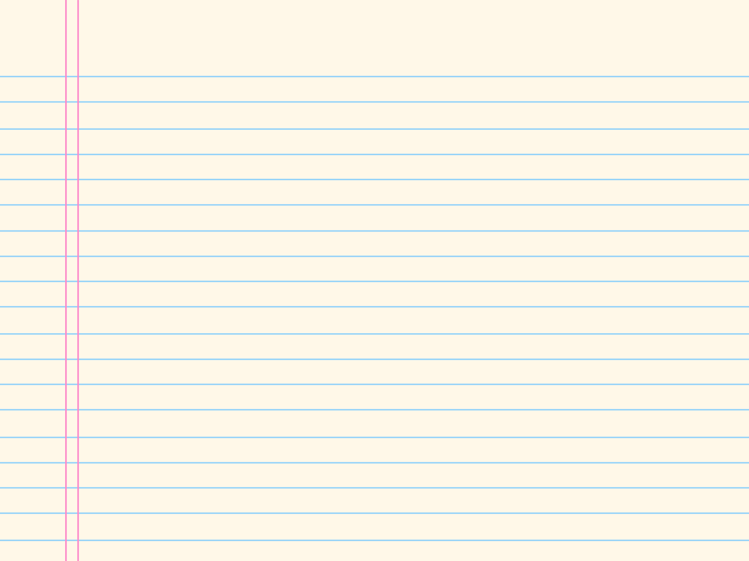
HI
SIMPLE
TO MY DEAR CHILDHOOD

Slide 10

Good
ju
hua
CHRYSANTHEMUM
TO MY DEAR CHILDHOOD

Slide 11
er
bI
CALL ME 2B.
2B
TO MY DEAR CHILDHOOD

Slide 12
WE ARE NOT
GAY
xiong
BROTHER
dI
TO MY DEAR CHILDHOOD

Slide 13
xiao
zhang
HEADMASTER
TO MY DEAR CHILDHOOD
Please…

Slide 14
cang
jIng
kong
TO MY DEAR CHILDHOOD

Slide 15

TO MY DEAR CHILDHOOD

Slide 16
TO MY DEAR CHILDHOOD
TO MY DEAR CHILDHOOD

Slide 17
HAPPY
CHILDREN’S DAY

Slide 18
HAPPY CHILDREN’S DAY

Slide 19
HAPPY CHILDREN’S DAY

Slide 20
HAPPY CHILDREN’S DAY

Slide 21
HAPPY
CHILDREN’S DAY

Slide 22
THANKS
SIMON PPT

