Slide 1

杂志风格模板1
BEIJING STYLE
SIMON PPT 2013.7.13

Slide 2
BEI
JING
此处输入标题标题
A TRIP TO BEIJING

Slide 3
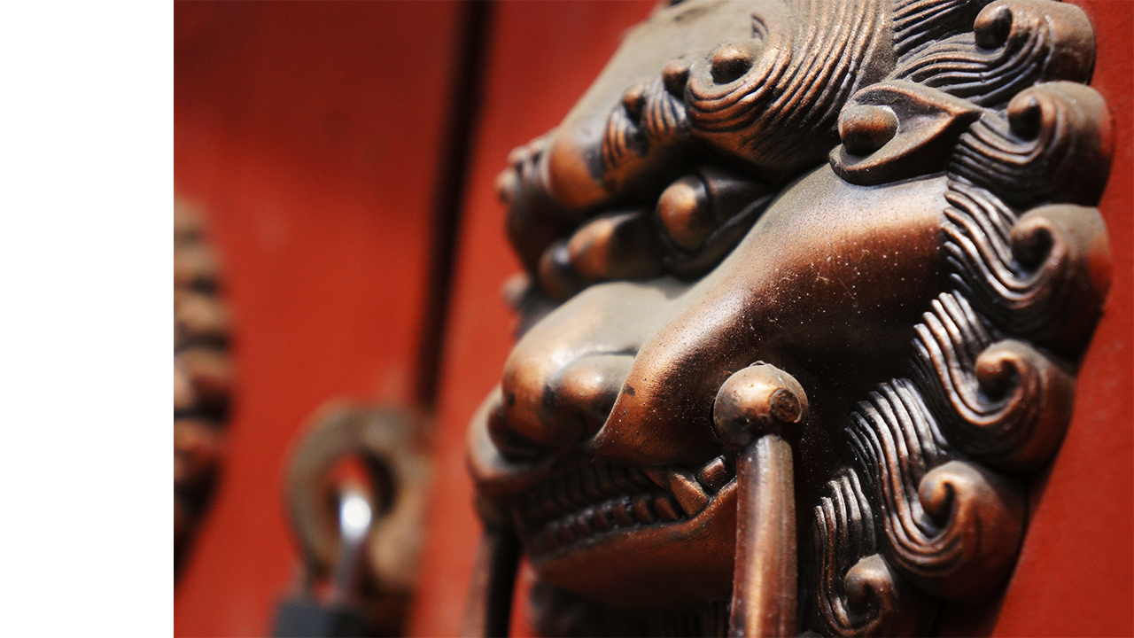
北
Beijing is the second largest Chinese city by urban population after Shanghai and is the nation's political, cultural, and educational center.
京
BEIJING STYLE
It is home to the headquarters of most of China's largest state-owned companies, and is a major hub for the national highway, expressway, railway, and high-speed rail networks.
The Beijing Capital International Airport is the second busiest in the world by passenger traffic.

Slide 4
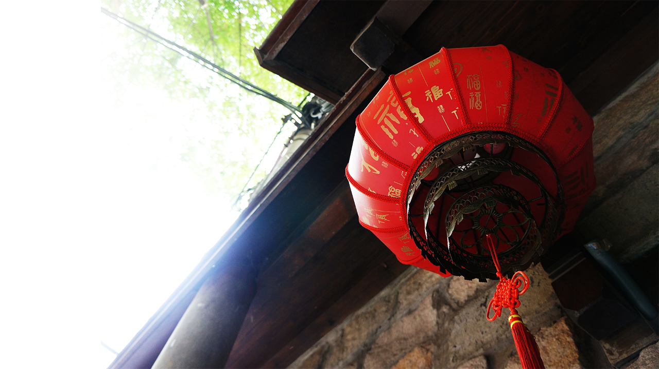
BEIJING
北
京
Beijing is the second largest Chinese city by urban population after Shanghai and is the nation's political, cultural, and educational center.
It is home to the headquarters of most of China's largest state-owned companies, and is a major hub for the national highway, expressway, railway, and high-speed rail networks.
The Beijing Capital International Airport is the second busiest in the world by passenger traffic.

Slide 5
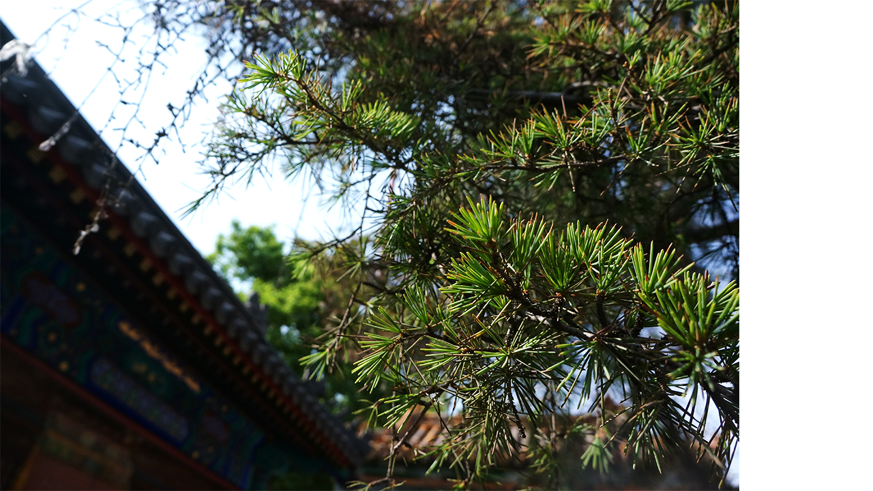
Beijing is the second largest Chinese city by urban population after Shanghai and is the nation's political, cultural, and educational center.
BEI
It is home to the headquarters of most of China's largest state-owned companies, and is a major hub for the national highway, expressway, railway, and high-speed rail networks.
JING
The Beijing Capital International Airport is the second busiest in the world by passenger traffic.

Slide 6
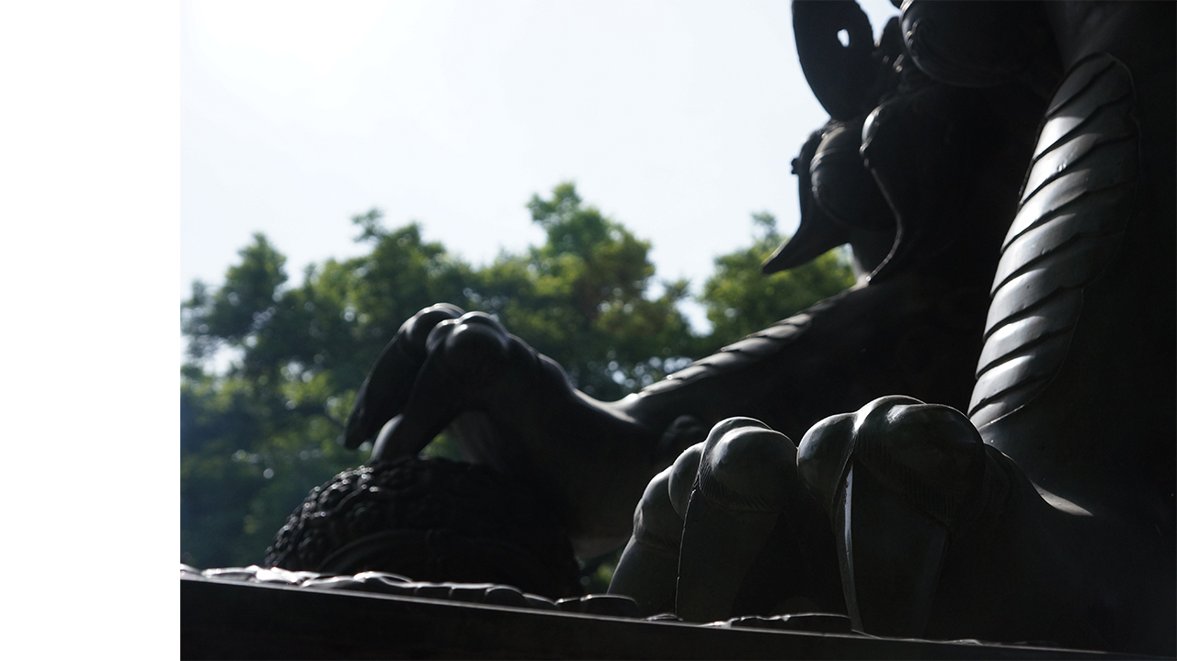
北京
BEIJING
We see good people in the wonderful world.
Beijing is the second largest Chinese city by urban population after Shanghai and is the nation's political, cultural, and educational center.
Beijing is the second largest Chinese city by urban population after Shanghai and is the nation's political, cultural, and educational center.

Slide 7

2
TWO

Slide 8
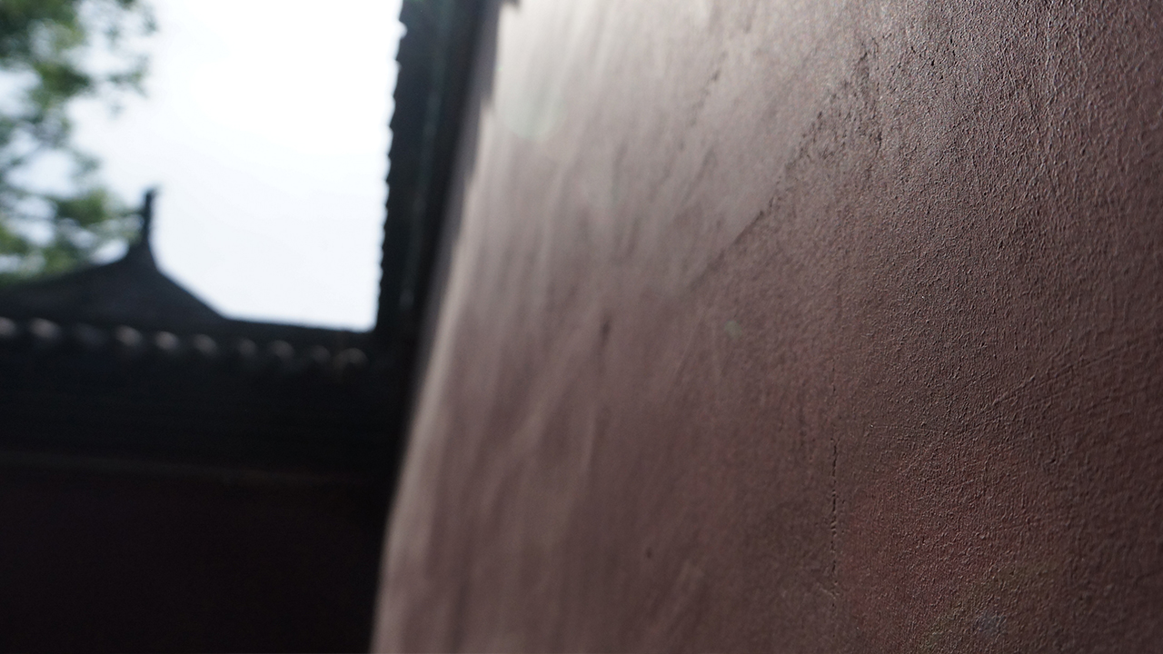
北京
Beijing is the second largest Chinese city by urban population after Shanghai and is the nation's political, cultural, and educational center.
Beijing is the second largest Chinese city by urban population after Shanghai and is the nation's political, cultural, and educational center.
Beijing is the second largest Chinese city by urban population after Shanghai and is the nation's political, cultural, and educational center.
WE SEE GOOD PEOPLE IN THE WONDERFUL WORLD.

Slide 9
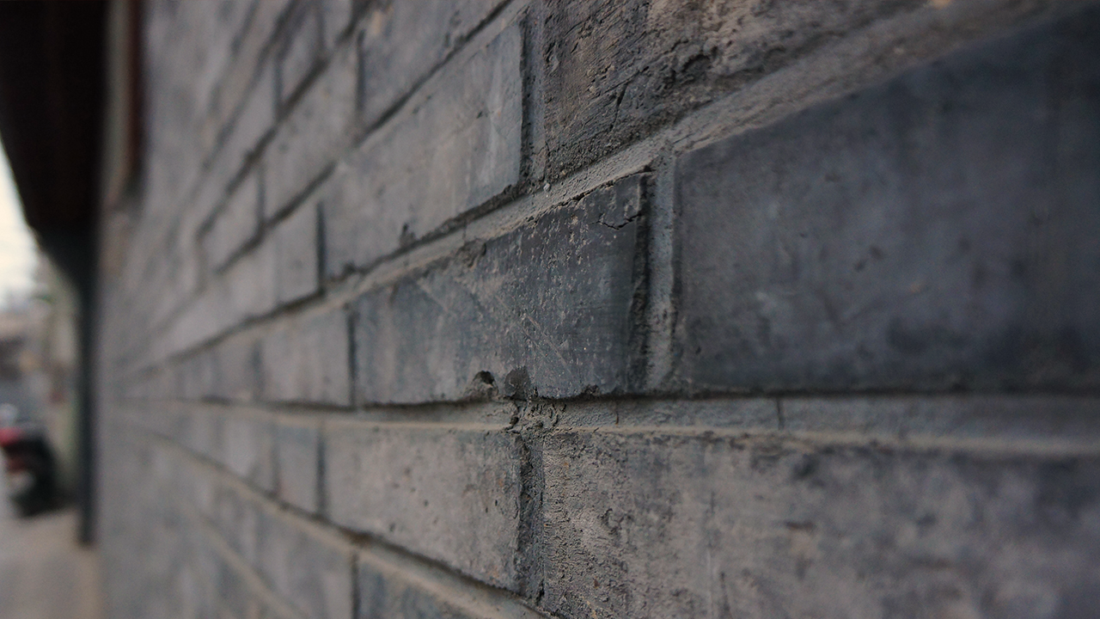
1
2
3
标题
标题
标题
TEXT HERE
TEXT HERE
TEXT HERE
Beijing is the second largest Chinese city by urban population after Shanghai and is the nation's political, cultural, and educational center.

Slide 10
BEI JING
北京
WE SEE GOOD PEOPLE IN THE WONDERFUL WORLD.
1
Beijing is the second largest Chinese city by urban population after Shanghai and is the nation's political, cultural, and educational center.
2
It is home to the headquarters of most of China's largest state-owned companies, and is a major hub for the national highway, expressway, railway, and high-speed rail networks.
3
The Beijing Capital International Airport is the second busiest in the world by passenger traffic.

Slide 11
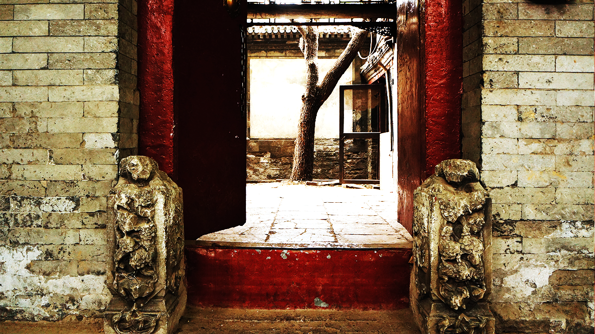
3
THREE

Slide 12
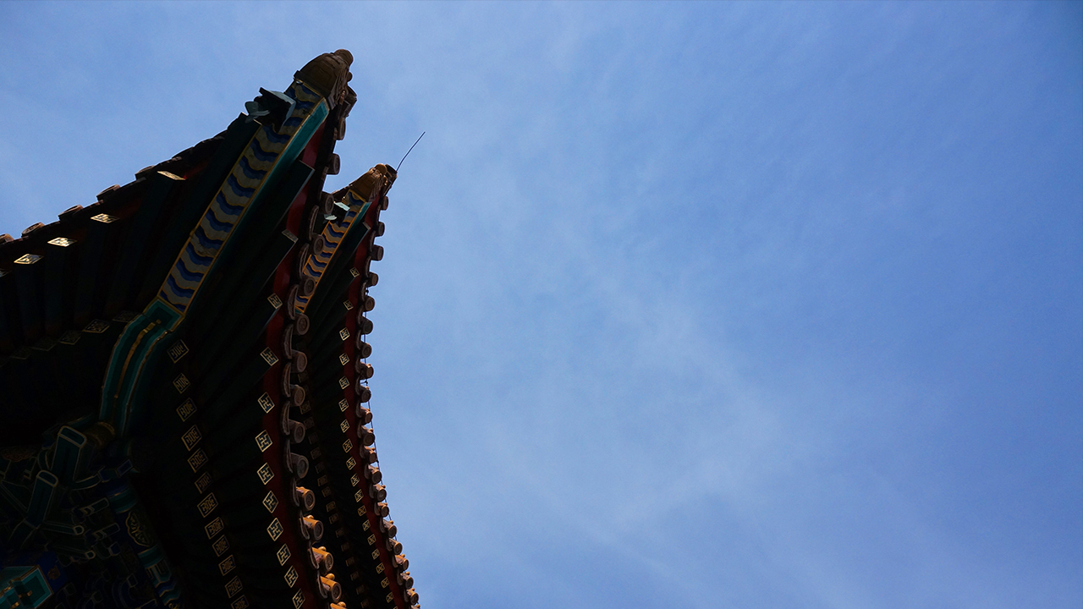
BEI JING
北京
Beijing is the second largest Chinese city by urban population after Shanghai and is the nation's political, cultural, and educational center.
It is home to the headquarters of most of China's largest state-owned companies, and is a major hub for the national highway, expressway, railway, and high-speed rail networks.
The Beijing Capital International Airport is the second busiest in the world by passenger traffic.

Slide 13
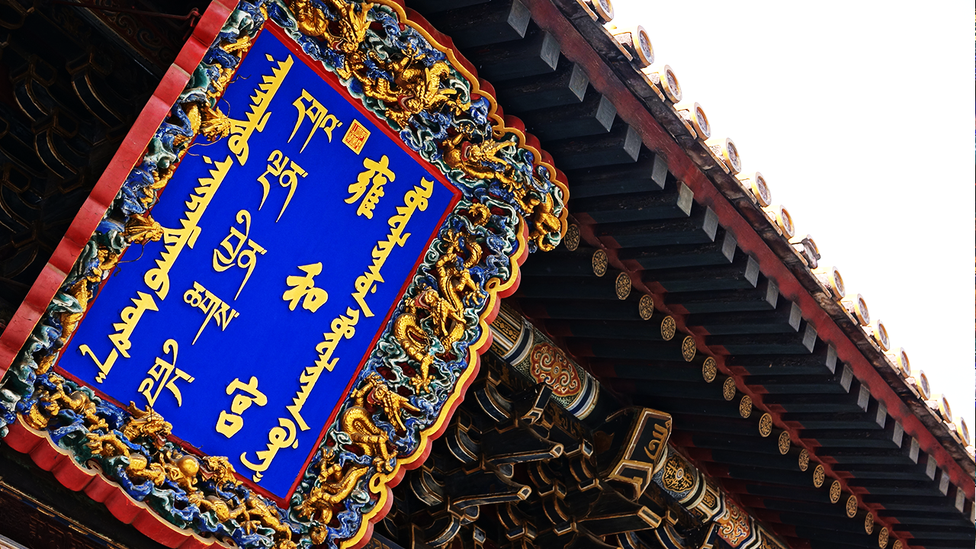
YONG HE
It is home to the headquarters of most of China's largest state-owned companies, and is a major hub for the national highway, expressway, railway, and high-speed rail networks.

Slide 14
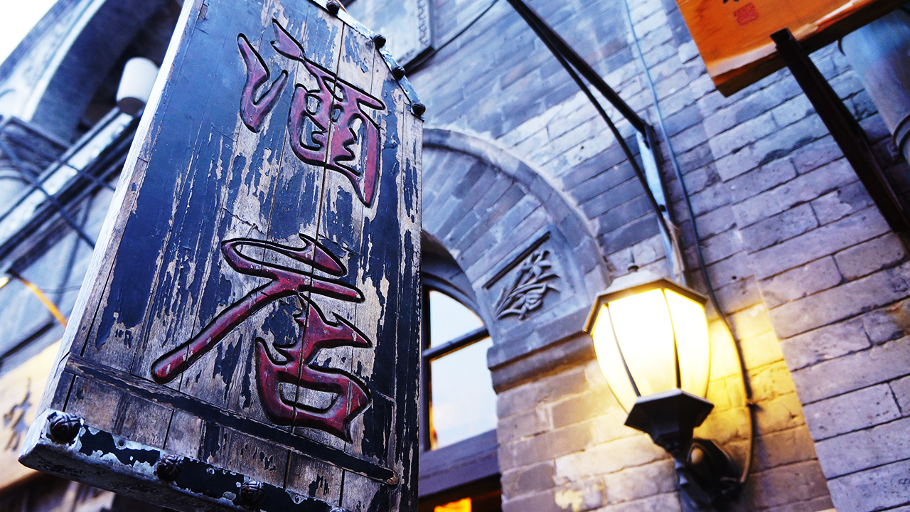
HOTEL
北京
Beijing is the second largest Chinese city by urban population after Shanghai and is the nation's political, cultural, and educational center.
It is home to the headquarters of most of China's largest state-owned companies, and is a major hub for the national highway, expressway, railway, and high-speed rail networks.
The Beijing Capital International Airport is the second busiest in the world by passenger traffic.

Slide 15
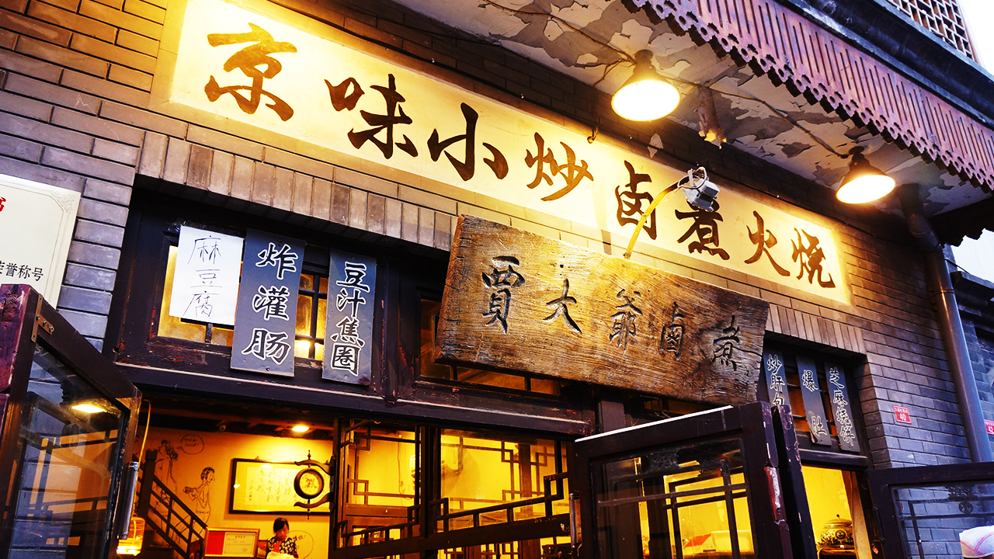
BEIJING
Beijing is the second largest Chinese city by urban population after Shanghai and is the nation's political, cultural, and educational center.
It is home to the headquarters of most of China's largest state-owned companies, and is a major hub for the national highway, expressway, railway, and high-speed rail networks.
The Beijing Capital International Airport is the second busiest in the world by passenger traffic.

Slide 16
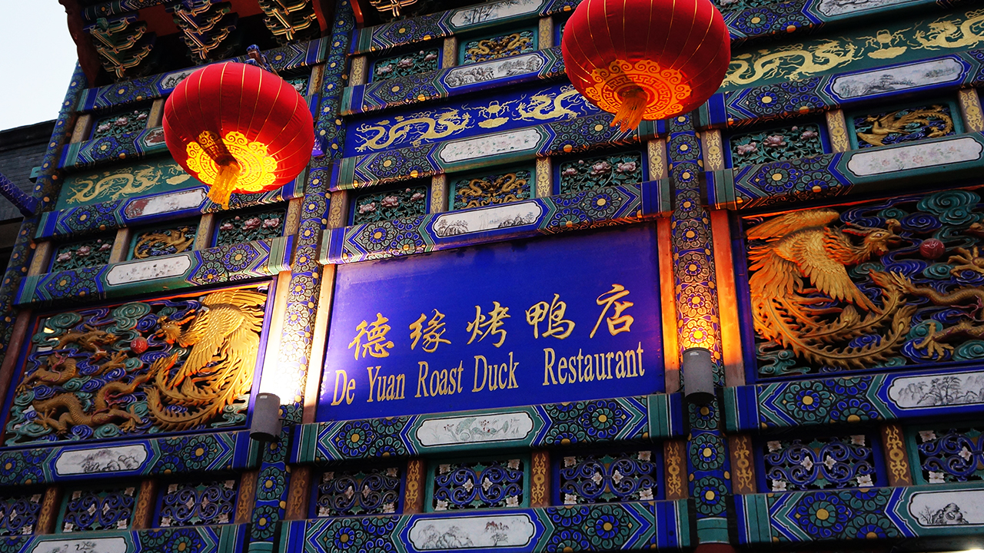
Beijing is the second largest Chinese city by urban population after Shanghai and is the nation's political, cultural, and educational center.
BEI
北京
It is home to the headquarters of most of China's largest state-owned companies, and is a major hub for the national highway, expressway, railway, and high-speed rail networks.
JING

Slide 17
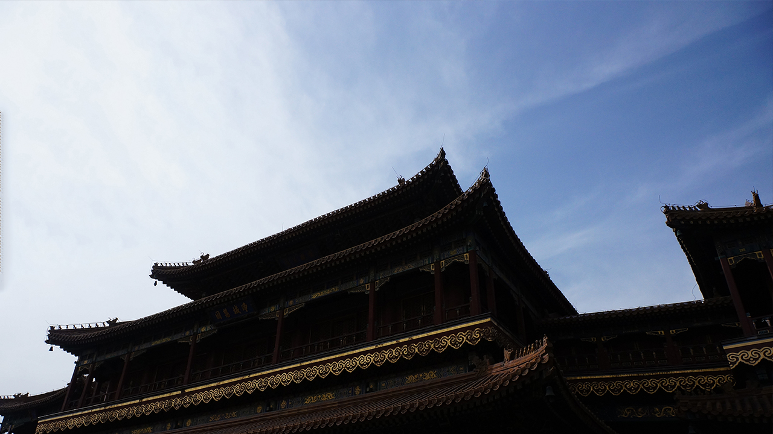
THANKS
SIMON PPT

Slide 18

Notes:
原创PPT发布说明
1、为保护您作品的版权，请将版权声明页对应4:3或者16:9规格插入到原创PPT中。
2、推荐使用2010版本OFFICE制作原创PPT，发布作品存为2003和2007以上版本两个格式，压缩后上传。
3、在上传PPT的截图时，推荐使用2010版本OFFICE另存为jpg图片的功能，第1页为封面，第2页为封面结合缩略图，图片宽度为640像素。
4、上传PPT作品时，可以使用2010版本OFFICE将PPT另存为wmv格式视频，上传到优酷，在PPT STORE添加原创PPT时，嵌入视频地址。

Slide 19


Notes:
原创PPT发布说明
1、为保护您作品的版权，请将版权声明页对应4:3或者16:9规格插入到原创PPT中。
2、推荐使用2010版本OFFICE制作原创PPT，发布作品存为2003和2007以上版本两个格式，压缩后上传。
3、在上传PPT的截图时，推荐使用2010版本OFFICE另存为jpg图片的功能，第1页为封面，第2页为封面结合缩略图，图片宽度为640像素。
4、上传PPT作品时，可以使用2010版本OFFICE将PPT另存为wmv格式视频，上传到优酷，在PPT STORE添加原创PPT时，嵌入视频地址。

