Slide 1

BUSINESS AND CORPORATE
Business Infographic
Template

Slide 2

Hello & welcome to presentation
WELCOME MESSAGE
Presentations are communication tools that can be used as demonstrations, lectures, speeches, reports, and more. It is mostly presented before an audience.
LETS GET STARTED

Slide 3



How to Use This Presentation
GOOGLE SLIDES
POWERPOINT
CANVA
Click on the "Google Slides" button below this presentation preview. Click on "Make a copy." Start editing your presentation. You need to sign in to your Google account.
Click on the "PowerPoint" button below this presentation preview.
Start editing your presentation.
Download and install the fonts used in this presentation as listed on page 21.
Click on the "Canva" button under this presentation preview. Start editing your presentation. You need to sign in to your Canva account.

Slide 4
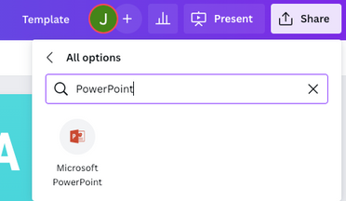
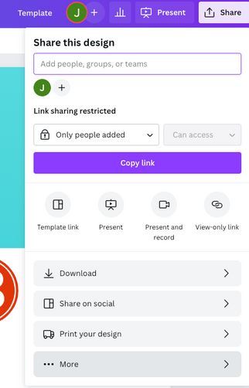
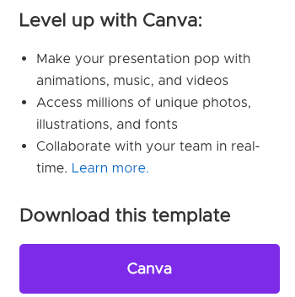
Download this presentation as a powerpoint template in 3 steps
1.
2.
3.
1.
2.
3.
Click on the "Canva" button next to this presentation. Start editing your presentation. You may need to sign in to your Canva account.
Click on the "Share" button on the top right corner in Canva and click on "More" at the bottom of the menu.
Enter "PowerPoint" in the search bar and click on the PowerPoint icon to download.

Slide 5
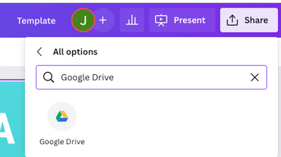
Download this presentation as a google slide template in 3 steps
1.
2.
3.
1.
2.
3.
Click on the "Canva" button next to this presentation. Start editing your presentation. You may need to sign in to your Canva account.
Click on the "Share" button on the top right corner in Canva and click on "More" at the bottom of the menu.
Enter "Google Drive" in the search bar and click on the Google Drive icon to add this design as a Google slide in your G Drive. It will ask you to link your Google account to Canva the first time.

Slide 6



Infographic Slides
OPTION 1
Presentations are communication tools.
OPTION 2
Presentations are communication tools.
OPTION 3
Presentations are communication tools.
Presentations are communication tools that can be used as demonstrations, lectures, speeches, reports, and more. It is mostly presented before an audience.

Slide 7

Infographic
Slide Report
Presentations are communication tools that can be used as demonstrations.
Series 3
Series 4
400
300
200
100
0
0
10
20
30

Slide 8




Infographic Slide Report
Presentations are communication tools that can be used as demonstrations, lectures, speeches, reports, and more. It is mostly presented before an audience.
67%
31%
78%

Slide 9

2 out of 5
Elaborate on the featured statistic.
95%
Elaborate on the featured statistic.
12 million
Elaborate on the featured statistic.

Slide 10





Add an Infographic Page
ELABORATE ON THE DATA YOU WANT TO DISCUSS
STEP 1
STEP 2
STEP 3
STEP 4
STEP 5
Elaborate on the step here
Elaborate on the step here
Elaborate on the step here
Elaborate on the step here
Elaborate on the step here

Slide 11
Infographic
Slide Report
Item 5
20%
Item 1
20%
Presentations are communication tools that can be used as demonstrations, lectures, speeches, reports, and more. It is mostly presented before an audience.
Presentations are communication tools that can be used as demonstrations, lectures, speeches, reports, and more. It is mostly presented before an audience.
Presentations are communication tools that can be used as demonstrations, lectures, speeches, reports, and more. It is mostly presented before an audience.
Presentations are communication tools that can be used as demonstrations, lectures, speeches, reports, and more. It is mostly presented before an audience.
Item 4
20%
Item 2
20%
Item 3
20%

Slide 12

Infographic slide report
Presentations are communication tools that can be used as demonstrations.
EXAMPLE
EXAMPLE
4.3%
9.5%
9.5%
21.3%
31.9%
30.5%
41%
21.3%
21.3%
9.5%

Slide 13

Infographic
Slide Report
Presentations are communication tools that can be used as demonstrations, lectures, speeches, reports, and more. It is mostly presented before an audience.
OPTION 1
Presentations are communication tools.
OPTION 2
Presentations are communication tools.
OPTION 3
Presentations are communication tools.
OPTION 4
Presentations are communication tools.

Slide 14

Infographic slide report
PRODUCTION
Presentations are communication tools that can be used as demonstrations.
PRODUCTION
Presentations are communication tools that can be used as demonstrations.
PRODUCTION
Presentations are communication tools that can be used as demonstrations.
PRODUCTION
Presentations are communication tools that can be used as demonstrations.

Slide 15
Add an Infographic Page
Elaborate on the data you want to discuss.
Elaborate on the data you want to discuss.
Elaborate on the data you want to discuss
Female
50%
Male
50%
80%
Elaborate on the data you want to discuss.
Elaborate on the data you want to discuss.
50%
40
30
Elaborate on the data you want to discuss
Elaborate on the data you want to discuss.
20
10
10%
0
S
M
T
W
TH
F
SA

Slide 16
GRAPHICS
Infographic Slide Report
STEP ONE
STEP TWO
Presentations are
communication tools
Presentations are
communication tools
STEP THREE
STEP FOUR
Presentations are
communication tools
Presentations are
communication tools

Slide 17

S | W | O | T
STRENGTHS | WEAKNESSES | OPPORTUNITIES | THREATS
What are you doing well? What sets you apart? What are your good qualities? | Where do you need to improve? Are resources adequate? What do others do better than you? | What are your goals? Are demands shifting? How can it be improved? | What are the blockers you're facing? What are factors outside of your control?

Slide 18
Add a Timeline Page
ADD A MAIN POINT
ADD A MAIN POINT
ADD A MAIN POINT
ADD A MAIN POINT
Elaborate on what you want to discuss.
Elaborate on what you want to discuss.
Elaborate on what you want to discuss.
Elaborate on what you want to discuss.

Slide 19
Add an Infographic Page
ELABORATE ON THE DATA YOU WANT TO DISCUSS
 | ITEM | ITEM | ITEM | ITEM
ITEM
ITEM
ITEM

Slide 20

37%
67%
26%
Presentations are communication tools that can be used as demonstrations.
Presentations are communication tools that can be used as demonstrations.
Presentations are communication tools that can be used as demonstrations.

Slide 21
Infographic Slide Report
Item 1
PRODUCTION
PRODUCTION
Presentations are communication tools that can be used as demonstrations.
Presentations are communication tools that can be used as demonstrations.
Item 2
Item 3
PRODUCTION
PRODUCTION
Presentations are communication tools that can be used as demonstrations.
Presentations are communication tools that can be used as demonstrations.
Item 4
0
10
20
30
40

Slide 22
Fonts In this Presentation
THIS PRESENTATION TEMPLATE USES THE FOLLOWING FONTS:
Titles: Open Sans Bold
Headers: Noto
Body Copy: Noto
You can find these fonts online too.
Happy designing!

Slide 23
Credits
THIS PRESENTATION TEMPLATE
IS FOR EVERYONE TO USE THANKS
TO THE FOLLOWING:
SlidesCarnival for the presentation template
Pexels for the photos
HAPPY DESIGNING!

Slide 24







































Icons
Resource Page
Use these design resources in your Canva Presentation. Happy designing!
Don't forget to delete this page before presenting.

Slide 25

BUSINESS AND CORPORATE
thanks for
watching
Presentations are communication tools that can be used as demonstrations, lectures, speeches, reports, and more. It is mostly presented before an audience.

