Slide 1
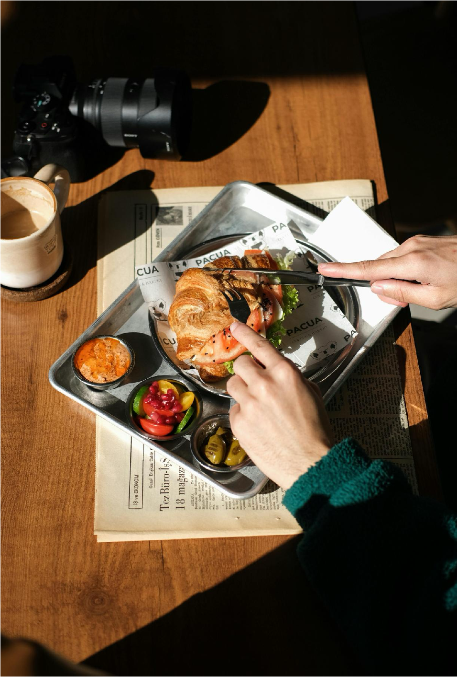

Artsy Cafe
2035 Rebranding
Stellar Studio
PROJECT DEBRIEF

Slide 2



AGENDA
1
2
3
Project
Reflection
Project
Deliverables
Moving
Forward

Slide 3
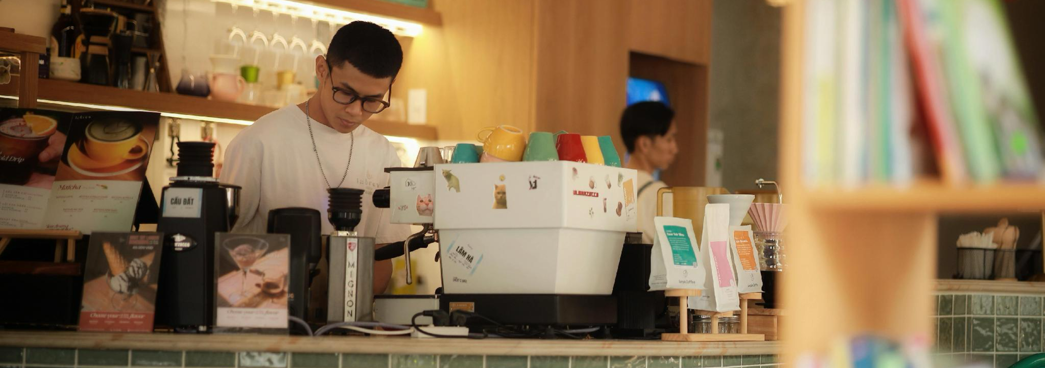
PROJECT REFLECTION
Back to agenda page
The design campaign successfully refreshed Artsy Cafe's visual identity while strengthening its connection with both existing and new customers.

Slide 4
PROJECT OVERVIEW
Back to agenda page
Project goal
Scope
Creative approach
Refresh the restaurant's visual identity and promotional materials to attract new diners while strengthening brand recognition among existing customers.
The project included logo refinements, menu redesign, social media graphics, promotional posters, digital advertisements, and additional in-store marketing collateral.
Designers embraced warm colors, food-focused photography, modern typography, and consistent branding to create a welcoming and memorable customer experience.

Slide 5




PROJECT OUTCOME
Back to agenda page
A cohesive visual identity that elevated the restaurant's brand and improved the overall customer experience both online and in-store.
Increased engagement across social platforms
Refreshed restaurant’s visual identity
Strengthened brand consistency across channels
Delivered all creative assets on schedule

Slide 6
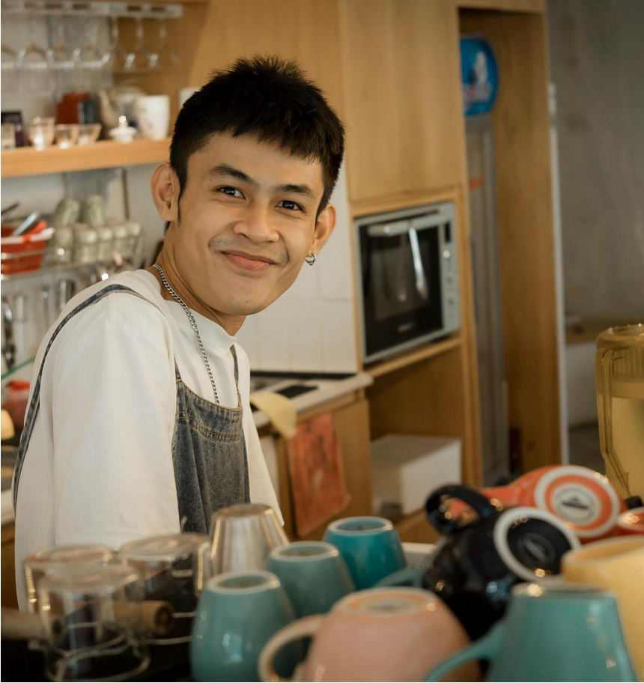
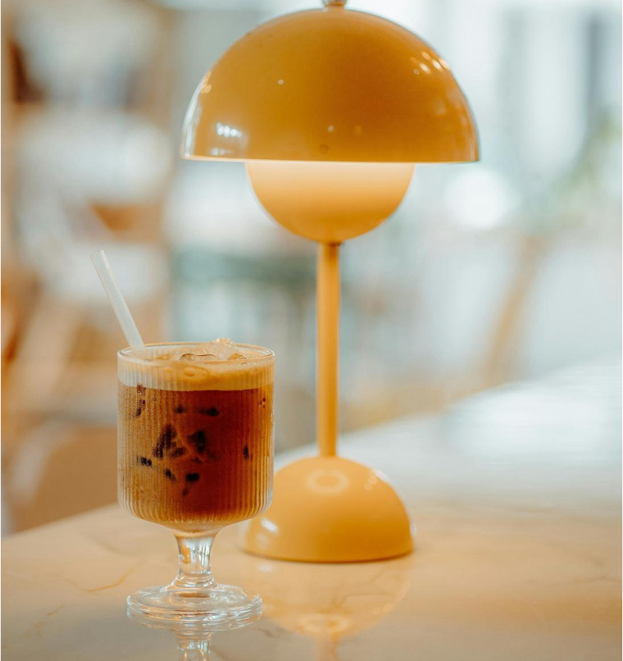
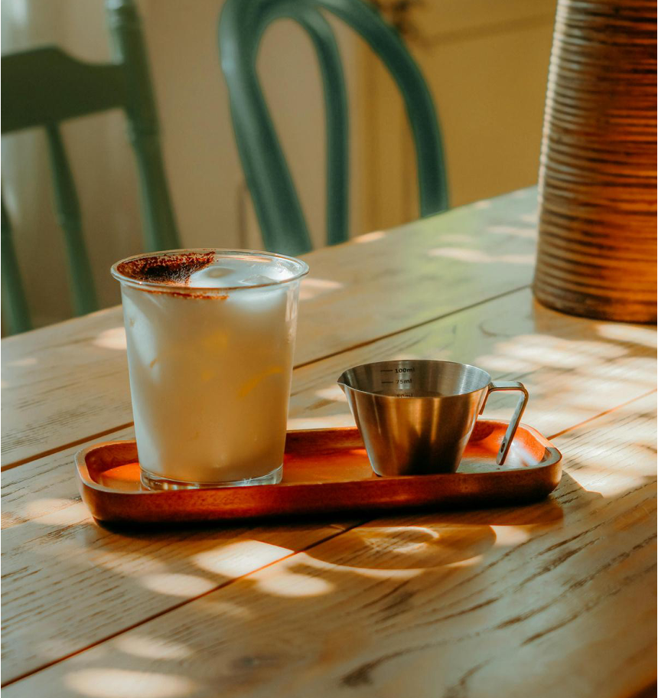
PROJECT DELIVERABLES
Back to agenda page
A snapshot of the campaign's creative output and project delivery.

Slide 7




KEY PROJECT MILESTONES
Back to agenda page
Discovery
Conceptualization
Design production
Launch
  Brand audit
  Competitor research
  Creative brief
  Content planning
  Mood boards
  Visual direction
  Design concepts
  Approval process
  Menus
  Promotional materials
  Digital assets
  Print marketing materials
  Creative assets published across digital and physical channels

Slide 8
CREATIVE DELIVERABLES
Back to agenda page
Key insight
Rank | Deliverable | Share of output
1 | Social media graphics | 35%
2 | Print collateral | 20%
3 | Digital ads | 15%
4 | Menu designs | 10%
5 | In-store signage | 10%
6 | Logo redesign | 10%
The campaign prioritized high-impact digital content, with social media graphics making up the largest share of deliverables (35%), followed by print collateral (20%) and digital ads (15%), while maintaining consistent branding across all customer touchpoints.

Slide 9
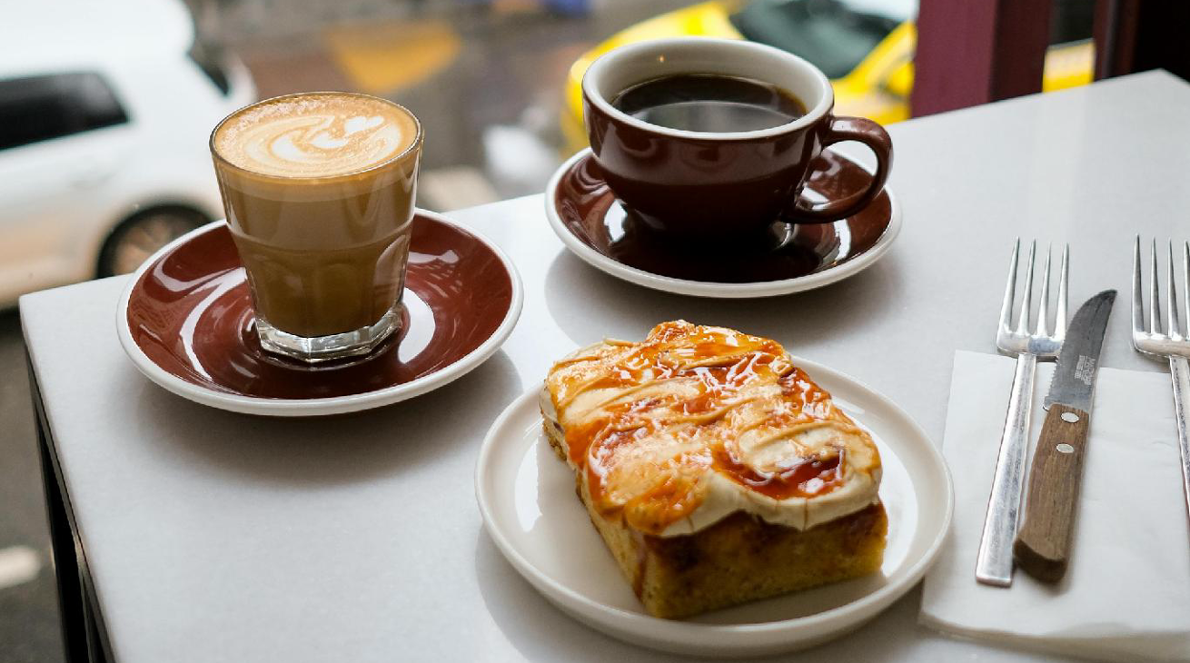
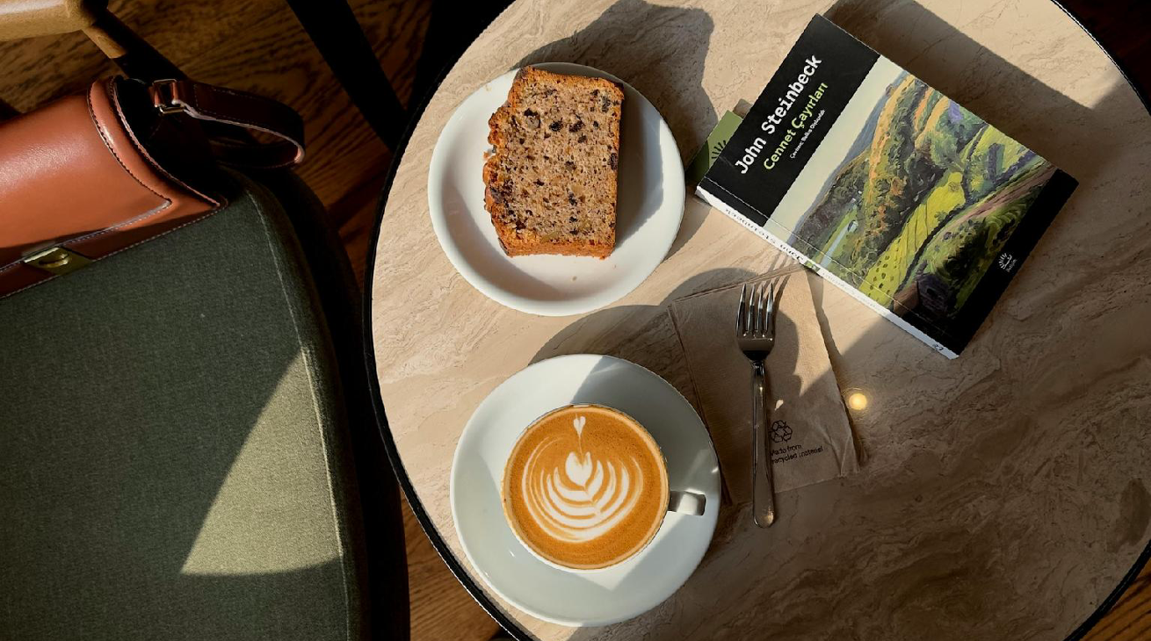
MOVING FORWARD
Back to agenda page
Maintaining design consistency and regularly refreshing promotional content will help keep the brand engaging and relevant.

Slide 10
CHALLENGES
  Balancing modern design with the restaurant's established identity
  Coordinating photography and content production within limited operating hours
  Managing revisions while maintaining project timelines
  Adapting designs for both print and digital formats
LESSONS LEARNED
  Early alignment on creative direction speeds up approvals
  High-quality food photography improves campaign performance
  Consistent branding across every customer touchpoint builds stronger recognition
  Regular progress reviews reduce revision cycles and
  improve efficiency

Slide 11
RECOMMENDATIONS
Back to agenda page
Refresh seasonal promotions
Maintain brand consistency
Expand digital content
Introduce new creative campaigns throughout the year to highlight seasonal menus and special events.
Apply the updated visual identity across
  all future marketing materials and customer touchpoints.
  Invest in more photography, short-form video, and social media campaigns to reach new audiences.

Slide 12

THANK YOU!
Feel free to reach out if you have any questions.
hello@reallygreatsite.com
@reallygreatsite
123-456-7890

Slide 13



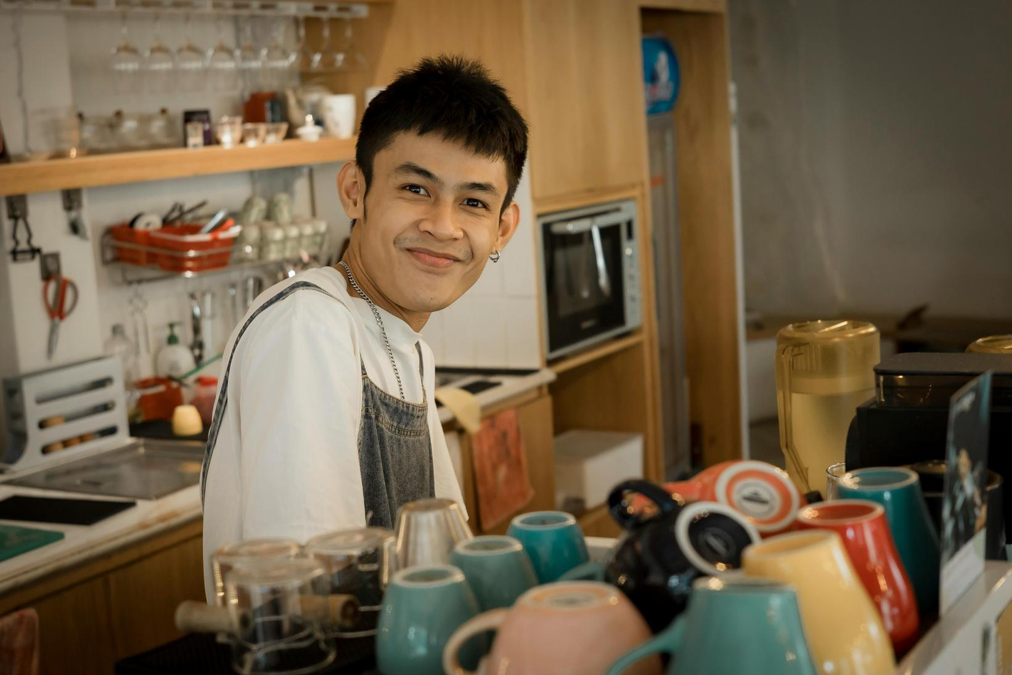
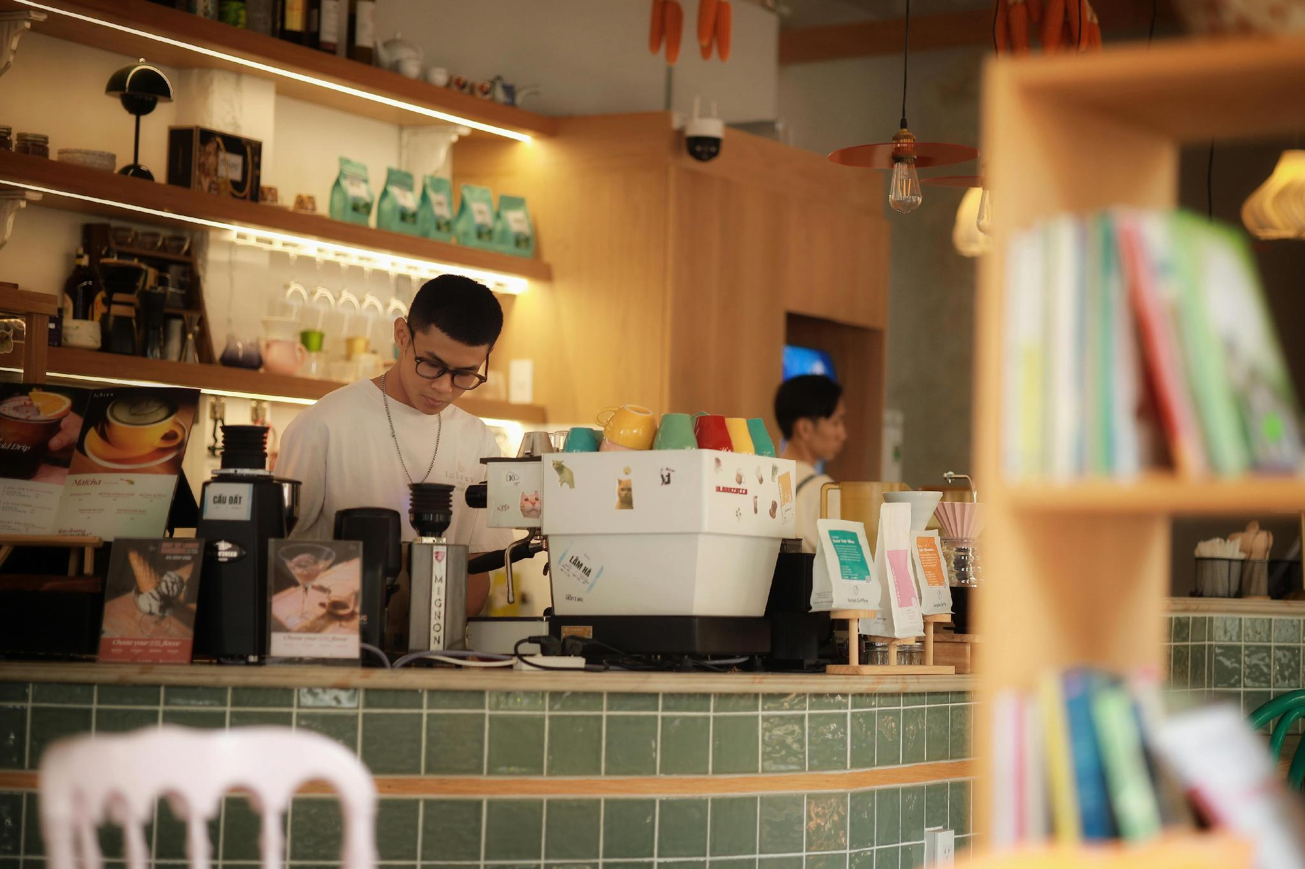
RESOURCE PAGE
Use these in your presentation. Delete or hide this page before presenting.
Fonts
Design Elements / Icons
This presentation template
uses the following free fonts:
Cabin
You can find these fonts online, too.
Colors
#2F1806
#FBE9C5

Slide 14

CREDITS
  This presentation template is free for everyone to use, thanks to the following:
  for this presentation template
Pexels, Pixabay, Sketchify
  for the photos, graphics, and elements
  Happy designing!

