Slide 2
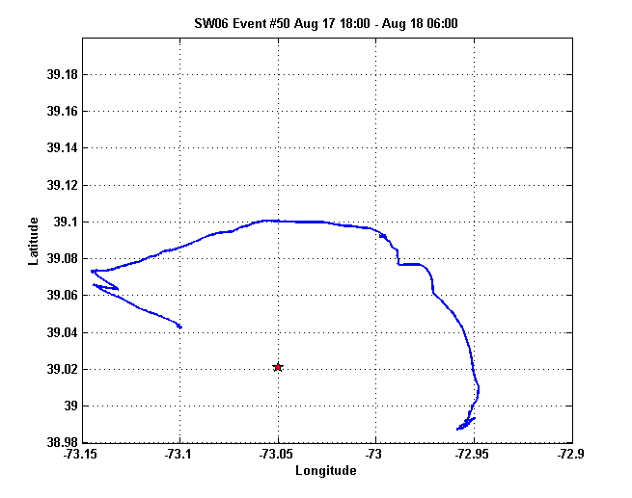
NRL 300
source
Zone 5
Zone 4
Zone 3
Zone 2
Zone 1
Shark array

Slide 3
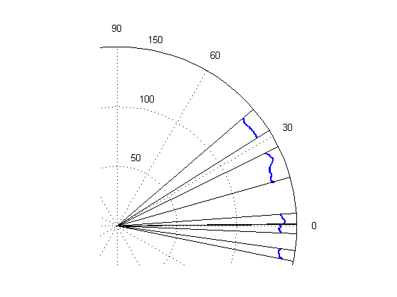
Zone 5
Zone 4
Zone 3
Zone 2
Zone 1

Slide 4
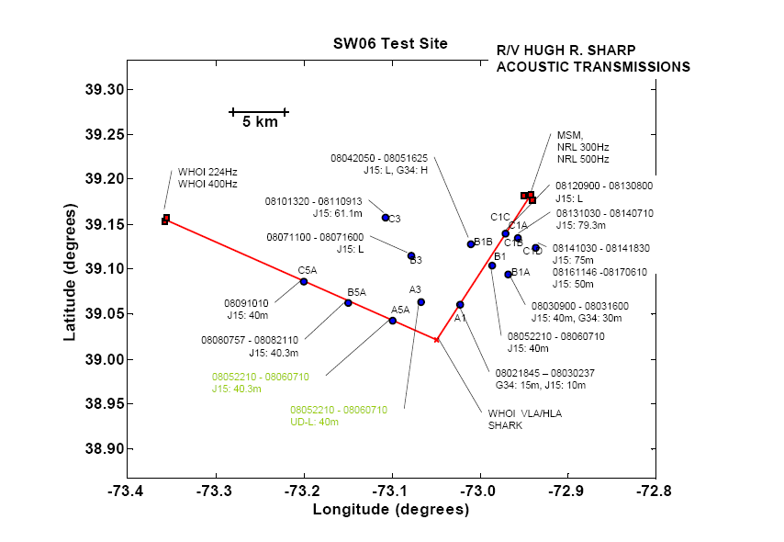
IW

Slide 5
