Slide 2
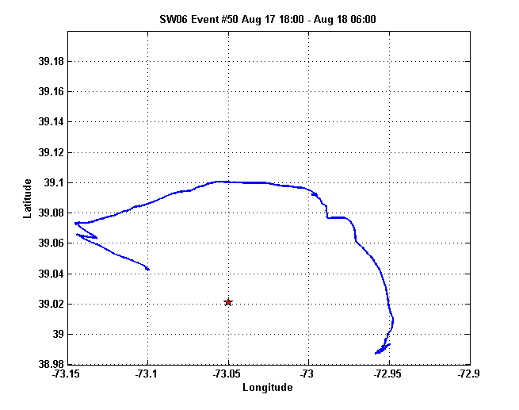
NRL 300
source
Zone 5
Zone 4
Zone 3
Zone 2
Zone 1
Shark array

Slide 3
NRL 300
source
Zone 5
Zone 4
Zone 3
Zone 2
Zone 1
R/V Sharp
Shark VHLA

Slide 4
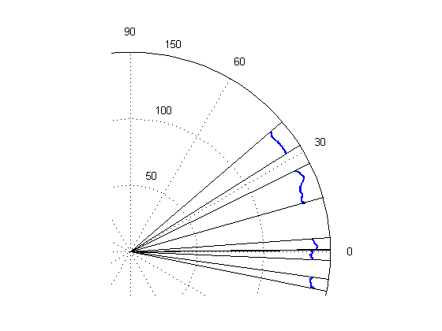
Zone 5
Zone 4
Zone 3
Zone 2
Zone 1

Slide 5
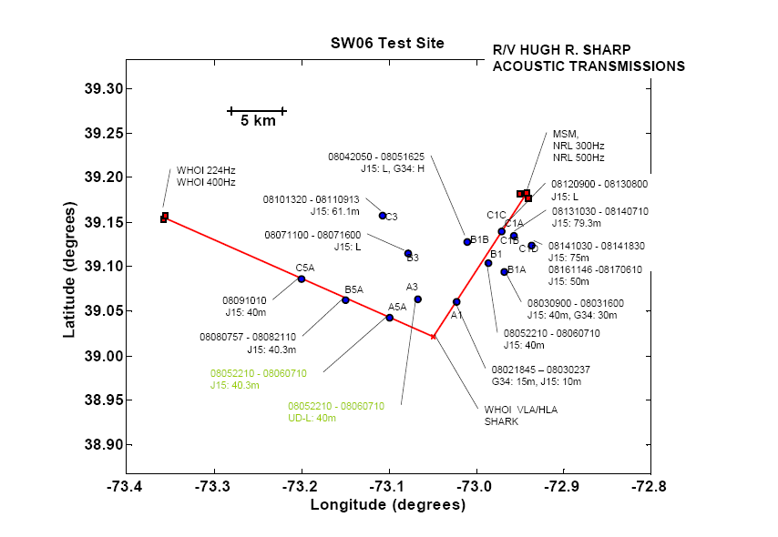
IW

Slide 6
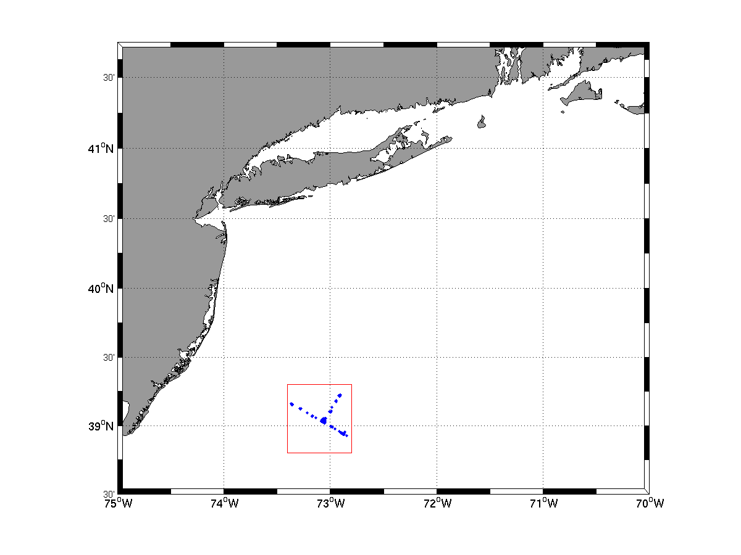
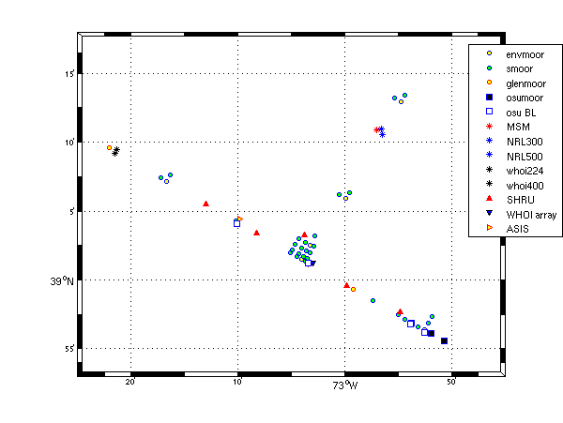

Slide 7
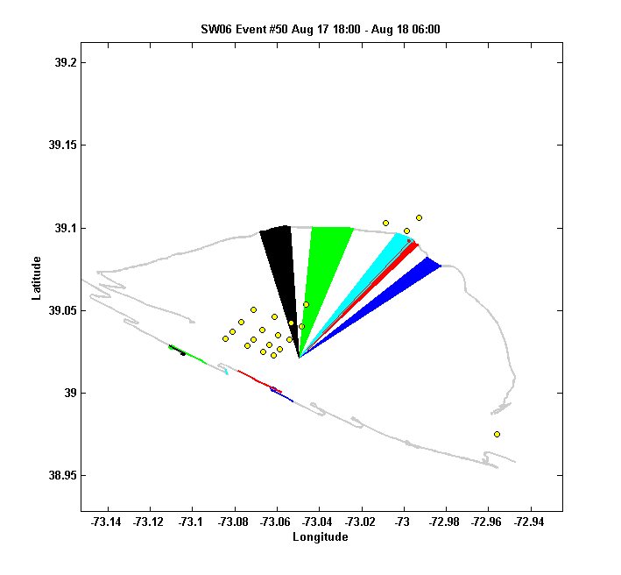
m5
m4
m3
m2
m1
shark
R/V Shark
R/V Oceanus

Slide 8
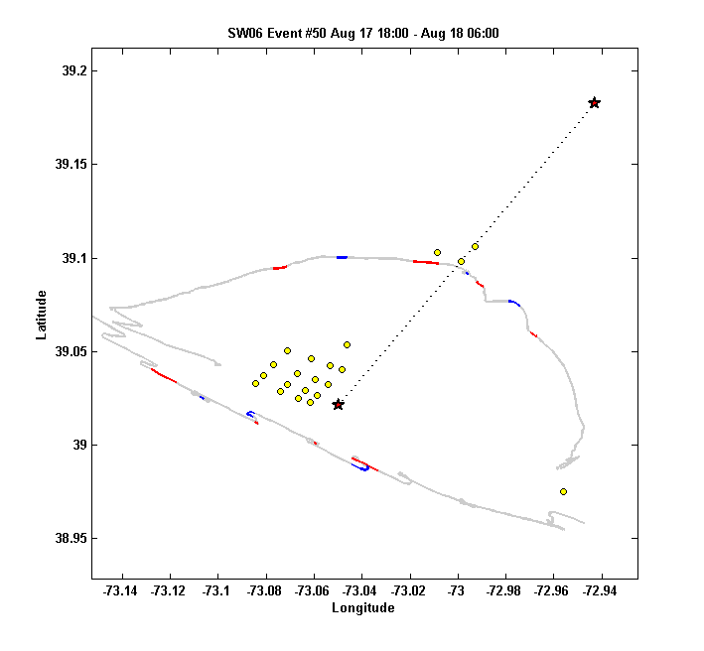
NRL300
f7
f6
f5
f4
f3
f2
shark
f1
R/V Shark
R/V Oceanus

Slide 9
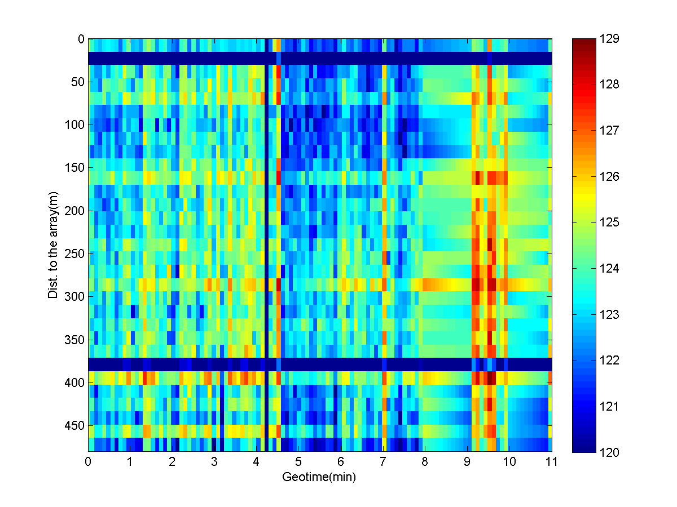
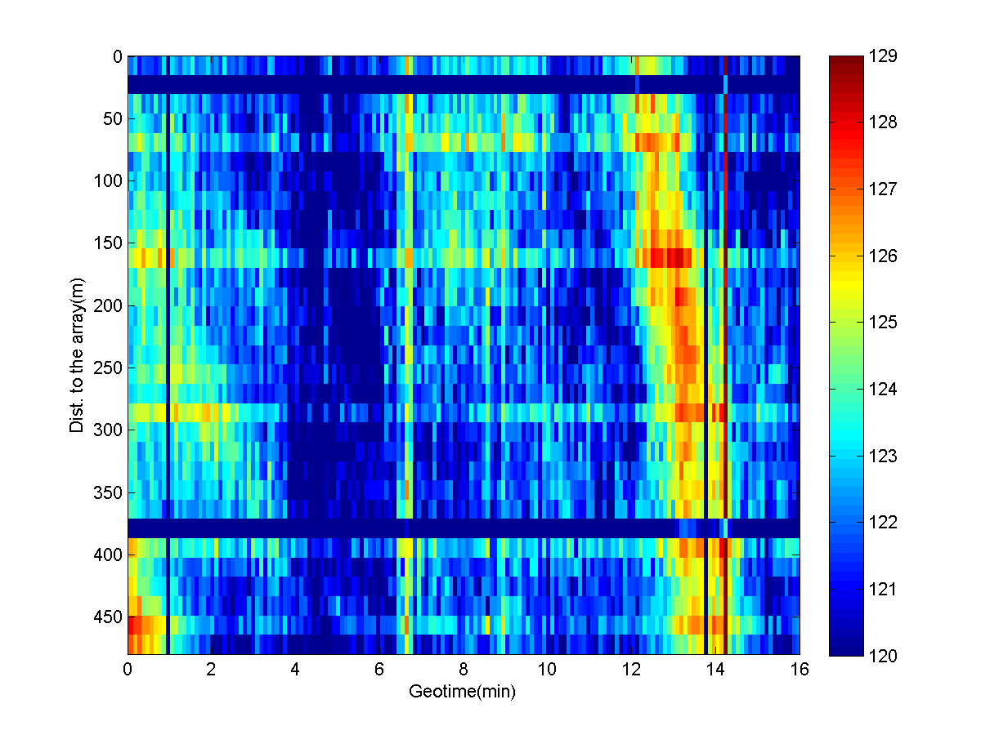
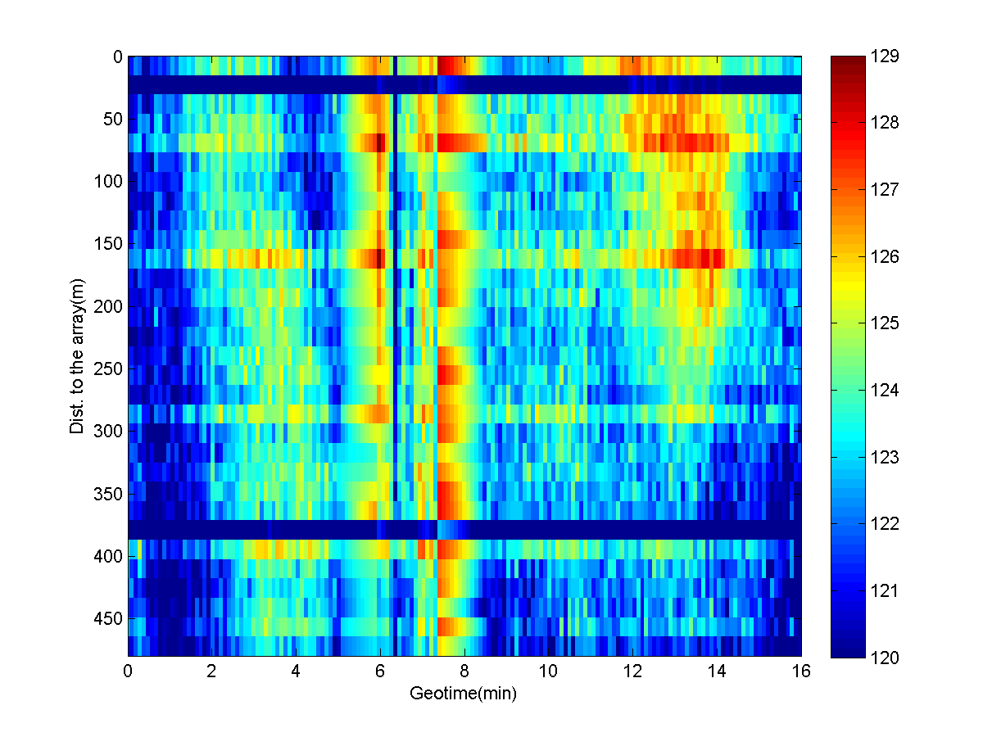
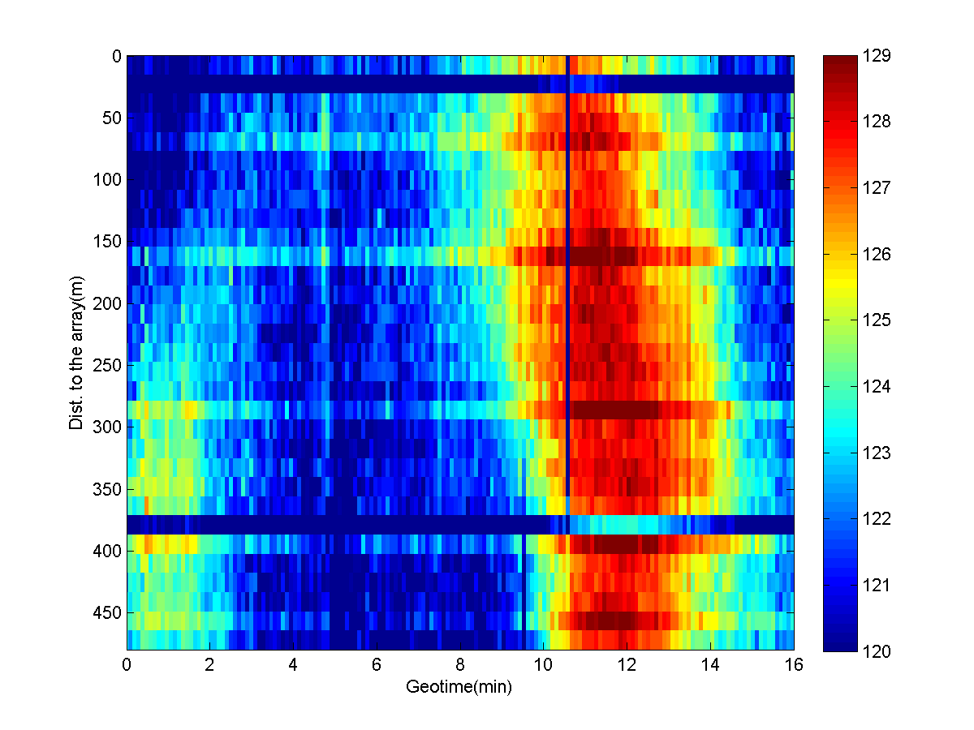
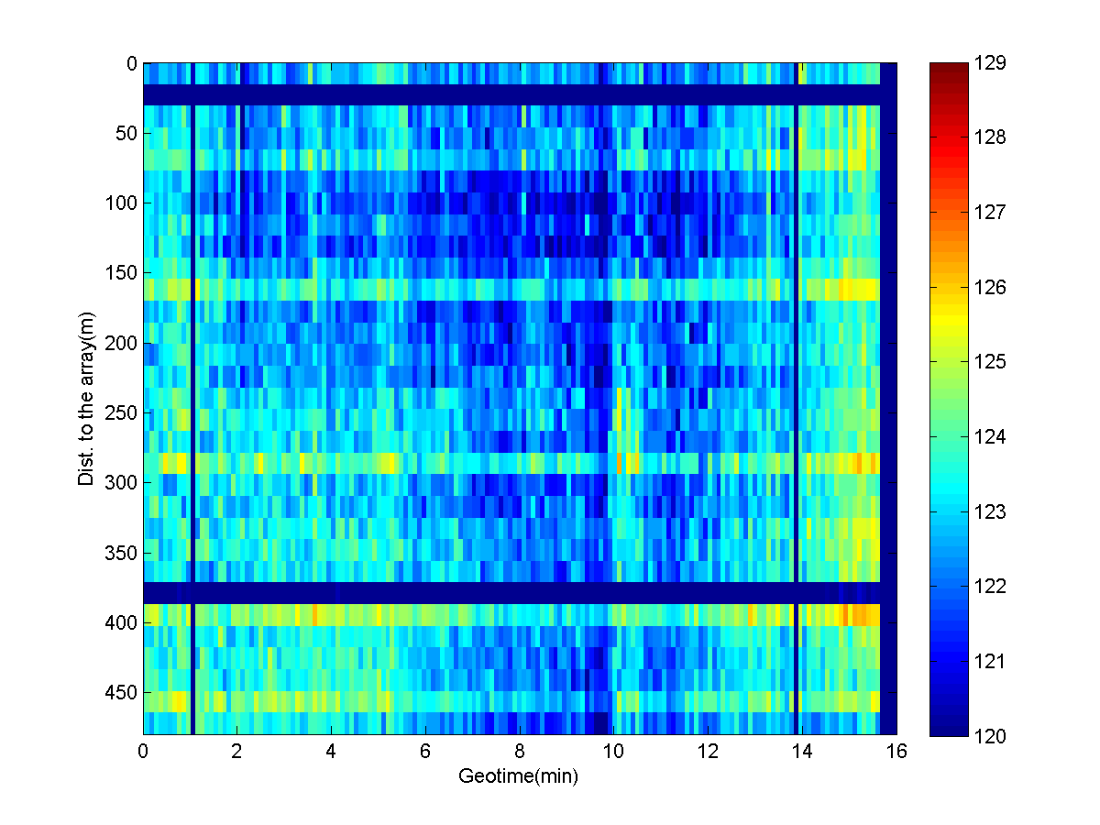
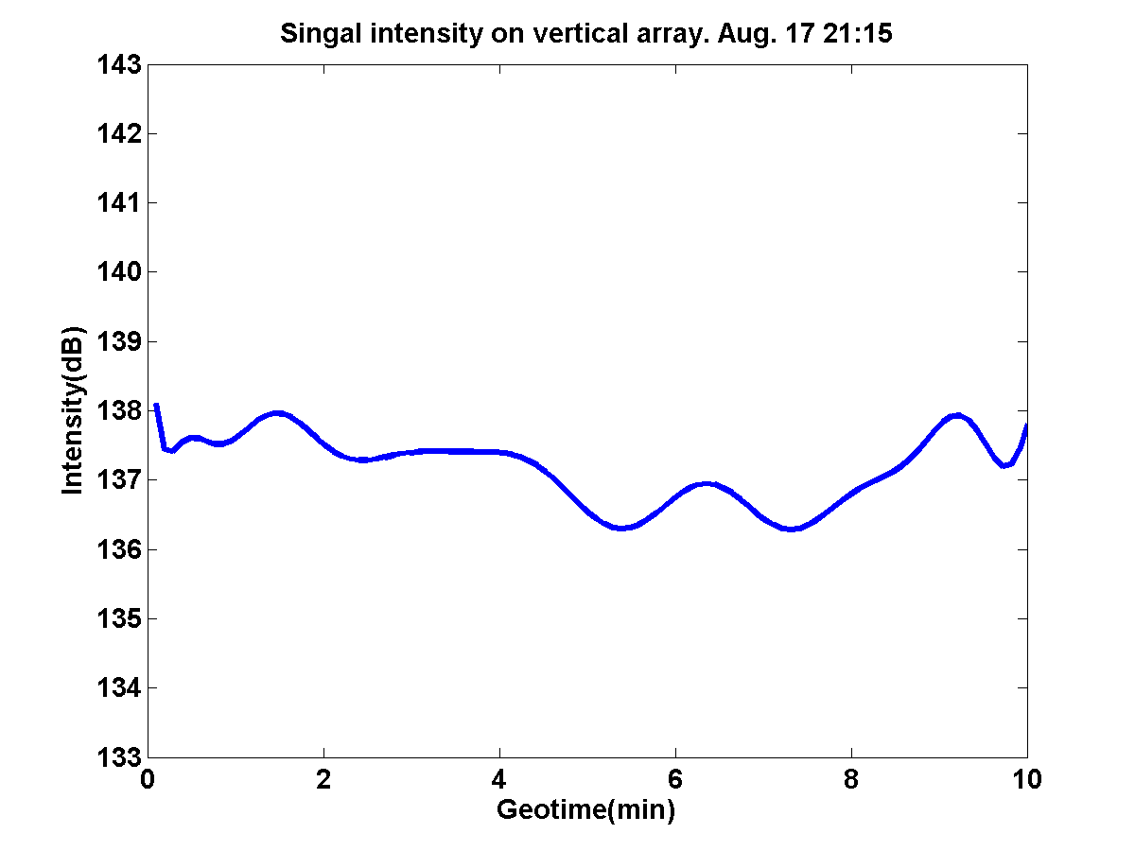
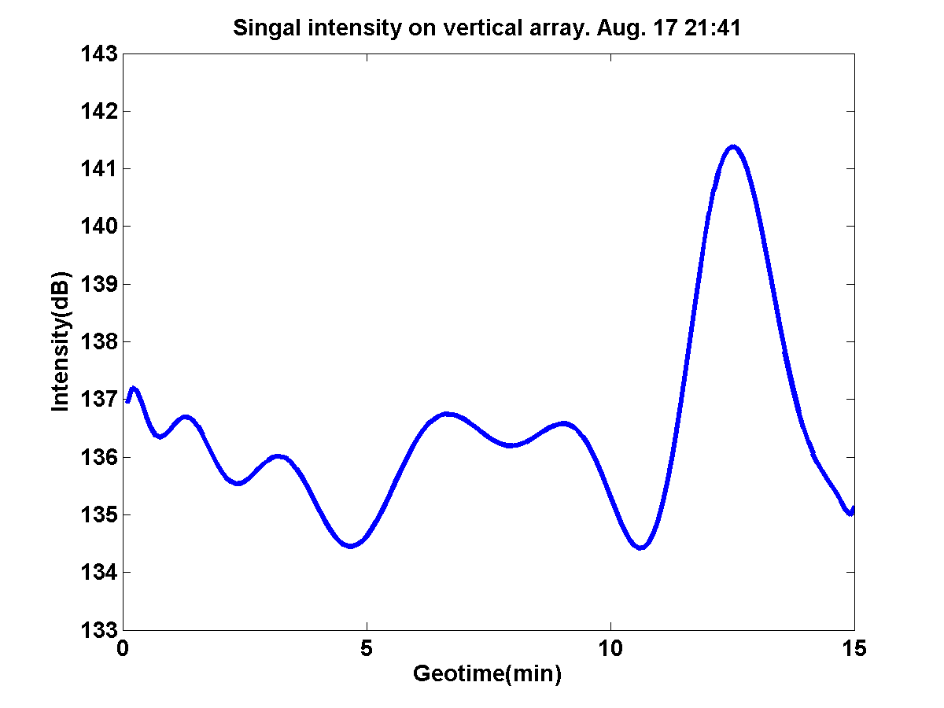
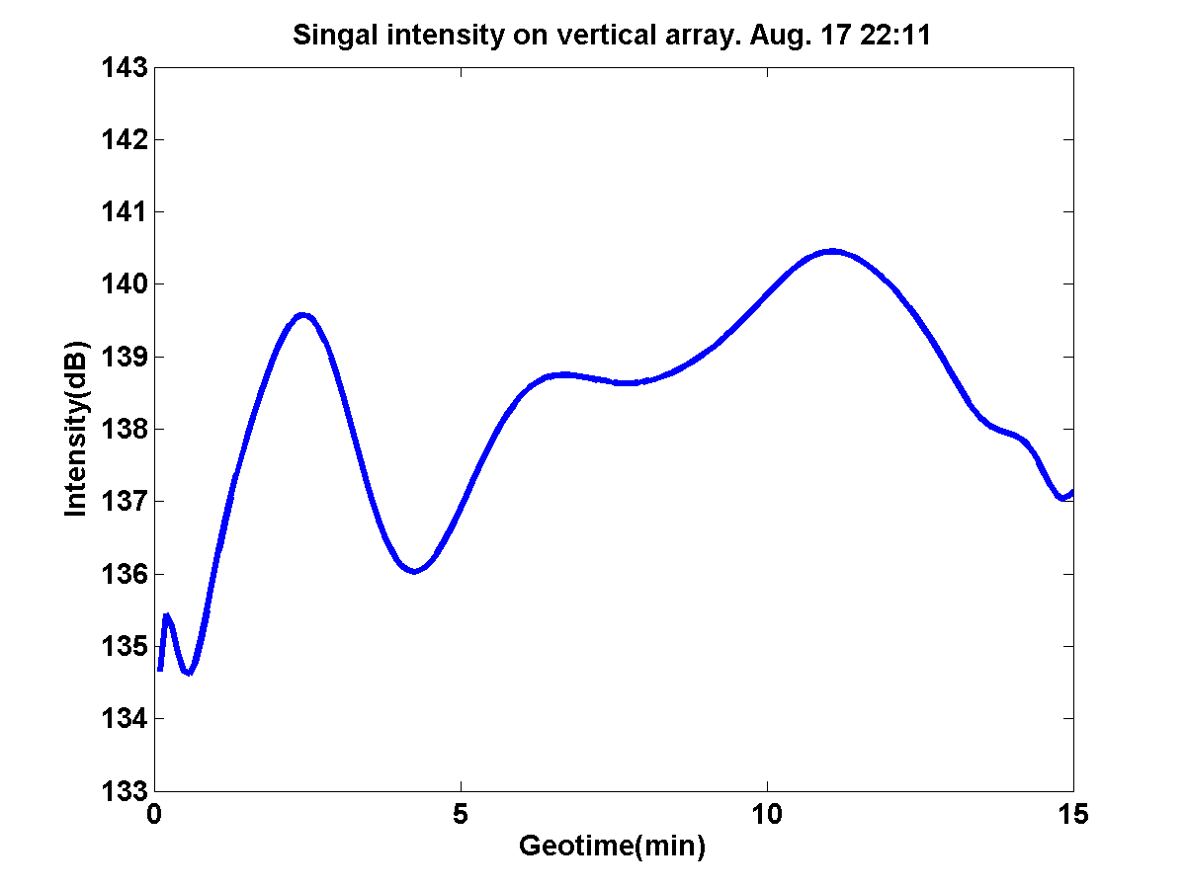
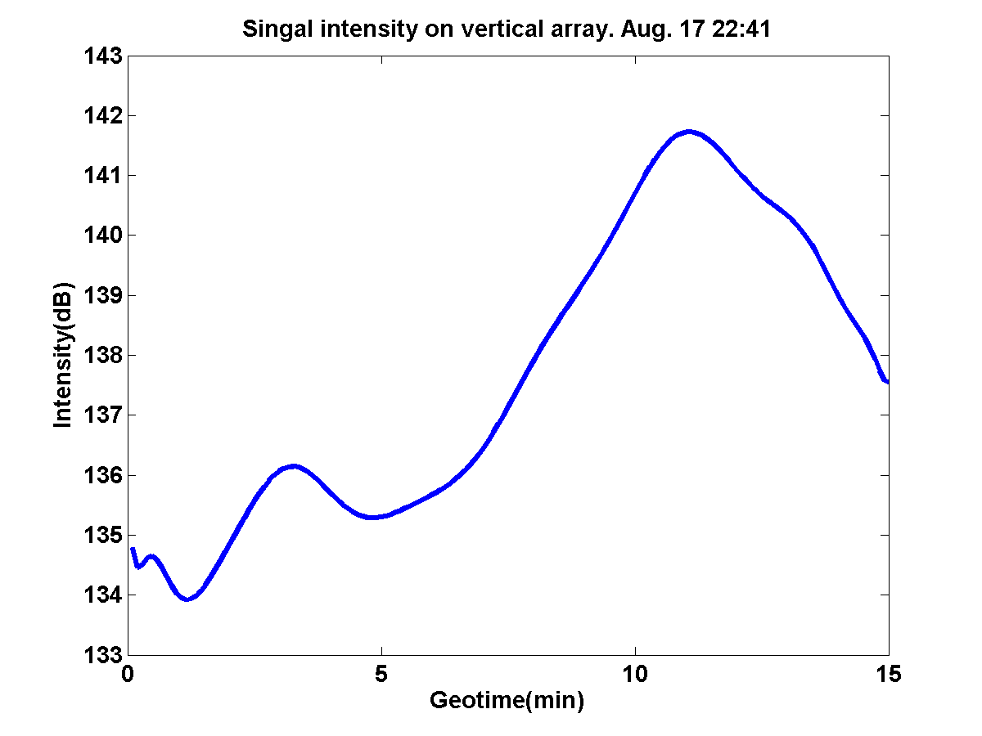
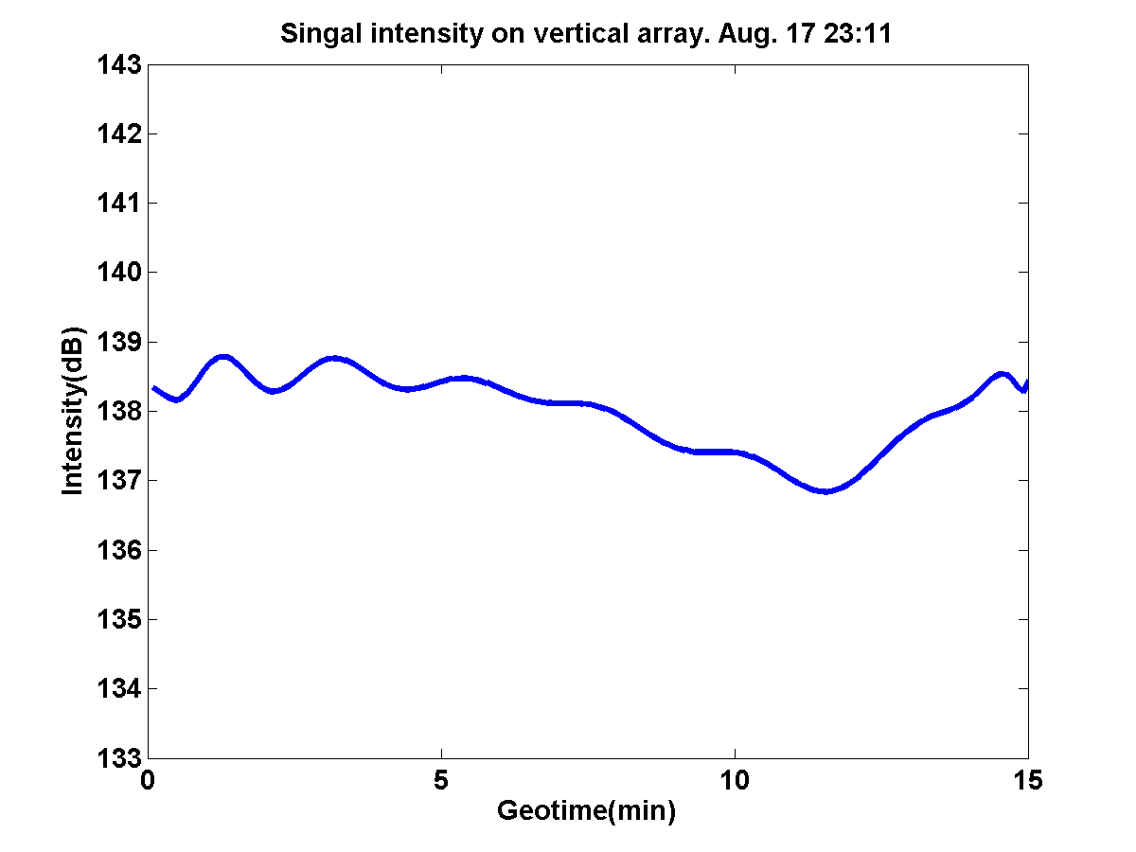
zone 1
zone 2
zone 3
zone 4
zone 5

