Slide 1
Research about ECG dataset
Chuankai_Luo

Slide 2
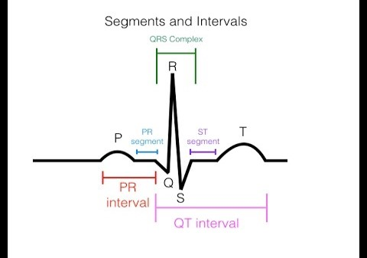
Brief introduce about ecg data

Slide 3
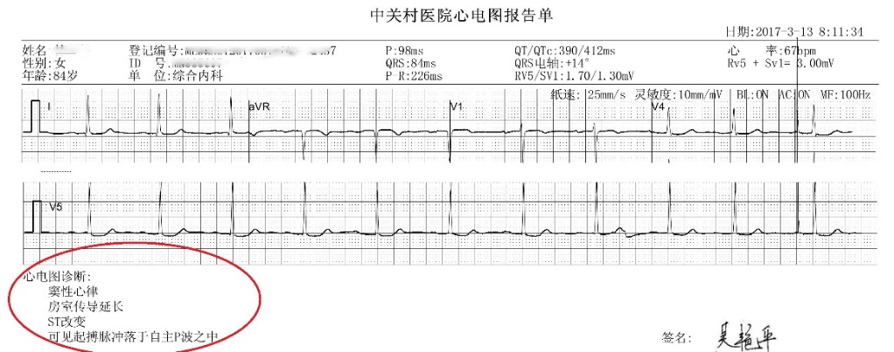
Brief introduce about ecg data

Slide 4
Brief introduce about ecg data
China ECG AI Contest (CEAC) 2019
.xml
.pickle
.mat
15,357 records
.json
.pdf
.ECG

Slide 5
Question 1
label distribution in this dataset
Question 2
Correlation between various diseases and gender and age
Question 3
Correlation between various diseases and diseases
Question 4
Algorithm that suit for this dataset to make classification

Slide 6
Question 1 label distribution in this dataset
Full name | abbreviation | Amount
Normal | Normal | 9788
Early repolarization graphic change | ERGC | 584
Indoor differential conduction | IDC | 90
T wave change | TWC | 5676
FirstdegreeA-Vblock | I-AVB | 805
Atrial fibrillation | AFI | 772
Premature atrial contraction | PAC | 769
Complete right bundle branch block | CRBBB | 963
Ventricular premature beat | VPB | 844
Left anterior branch block | LAFB | 343
Atrial flutter | AFL | 163
Incomplete right bundle branch block | IRBBB | 639

Slide 7
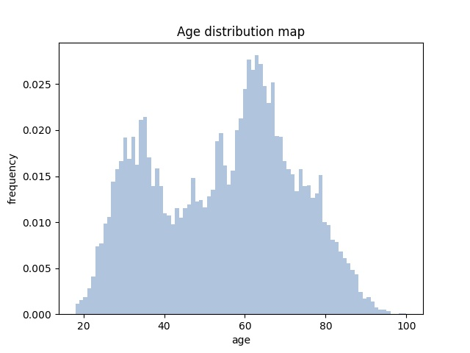
Question 1 label distribution in this dataset

Slide 8
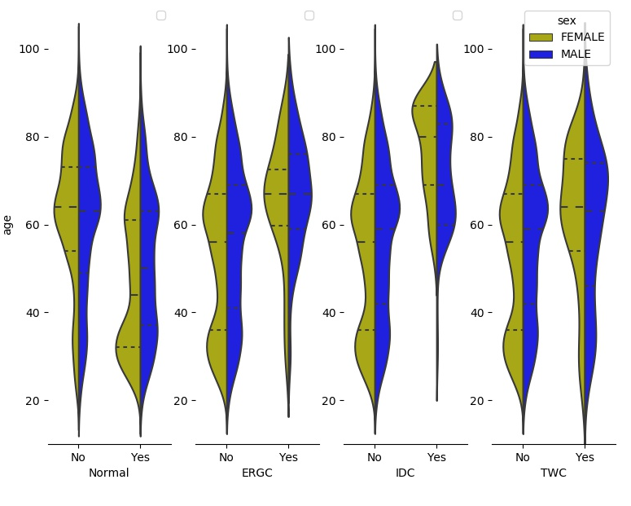
Question 2 Correlation between various diseases and gender and age
②
①

Slide 9
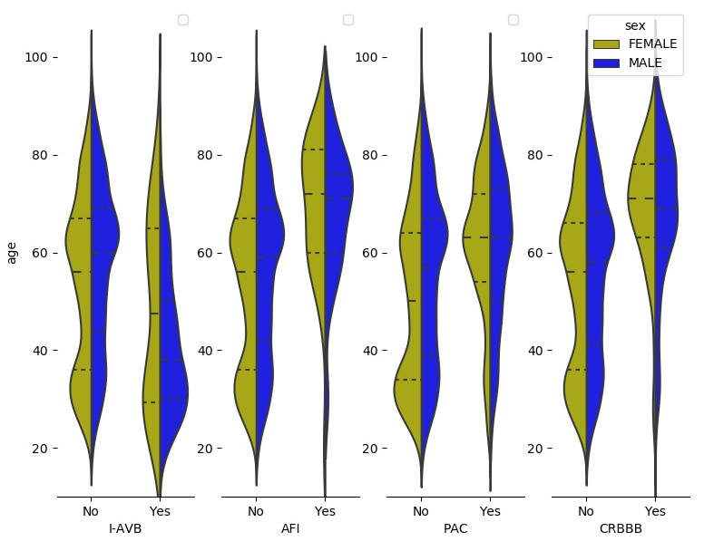
Question 2 Correlation between various diseases and gender and age
③

Slide 10
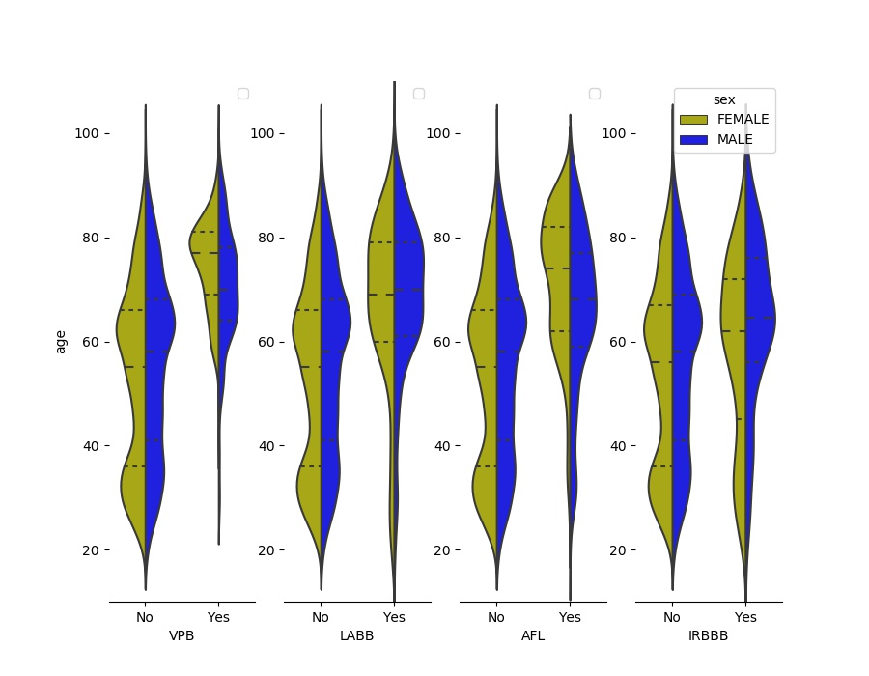
Question 2 Correlation between various diseases and gender and age
④

Slide 11
Question 3 Correlation between various diseases and diseases
 | age | Normal | ERGC | IDC | TWC | I-AVB | AFI | PAC | CRBBB | VPB | LABB | AFL | IRBBB
age | 1 | -0.3671 | 0.08809 | 0.09346 | 0.06186 | -0.12884 | 0.05298 | 0.23097 | 0.15809 | 0.20367 | 0.15112 | 0.16878 | 0.07699
Normal | -0.3671 | 1 | -0.13357 | -0.09165 | -0.18374 | -0.1754 | -0.06798 | -0.63919 | -0.20714 | -0.20267 | -0.20226 | -0.22751 | -0.21231
ERGC | 0.08809 | -0.13357 | 1 | 0.00918 | 0.02586 | -0.02342 | 0.01394 | -0.02357 | 0.02724 | 0.00894 | -0.00095 | 0.10824 | 0.0004
IDC | 0.09346 | -0.09165 | 0.00918 | 1 | 0.0148 | -0.01607 | 0.01039 | 0.03932 | -0.01898 | -0.01857 | -0.01853 | 0.03374 | -0.01392
TWC | 0.06186 | -0.18374 | 0.02586 | 0.0148 | 1 | -0.02884 | 0.00451 | -0.04074 | 0.00249 | 0.04401 | -0.00164 | -0.04179 | 0.00205
I-AVB | -0.12884 | -0.1754 | -0.02342 | -0.01607 | -0.02884 | 1 | -0.01192 | -0.10744 | -0.00608 | -0.03245 | -0.02619 | -0.03989 | -0.02836
AFI | 0.05298 | -0.06798 | 0.01394 | 0.01039 | 0.00451 | -0.01192 | 1 | -0.00183 | -0.01408 | 0.16082 | 0.11064 | -0.00499 | -0.01071
PAC | 0.23097 | -0.63919 | -0.02357 | 0.03932 | -0.04074 | -0.10744 | -0.00183 | 1 | -0.02463 | 0.06023 | -0.03883 | -0.05532 | -0.04088
CRBBB | 0.15809 | -0.20714 | 0.02724 | -0.01898 | 0.00249 | -0.00608 | -0.01408 | -0.02463 | 1 | -0.04197 | -0.00613 | 0.02307 | 0.00796
VPB | 0.20367 | -0.20267 | 0.00894 | -0.01857 | 0.04401 | -0.03245 | 0.16082 | 0.06023 | -0.04197 | 1 | -0.04098 | 0.03522 | 0.00092
LABB | 0.15112 | -0.20226 | -0.00095 | -0.01853 | -0.00164 | -0.02619 | 0.11064 | -0.03883 | -0.00613 | -0.04098 | 1 | 0.0233 | -0.00409
AFL | 0.16878 | -0.22751 | 0.10824 | 0.03374 | -0.04179 | -0.03989 | -0.00499 | -0.05532 | 0.02307 | 0.03522 | 0.0233 | 1 | -0.01457
IRBBB | 0.07699 | -0.21231 | 0.0004 | -0.01392 | 0.00205 | -0.02836 | -0.01071 | -0.04088 | 0.00796 | 0.00092 | -0.00409 | -0.01457 | 1
Spearman Correlation Coefficient

Slide 12
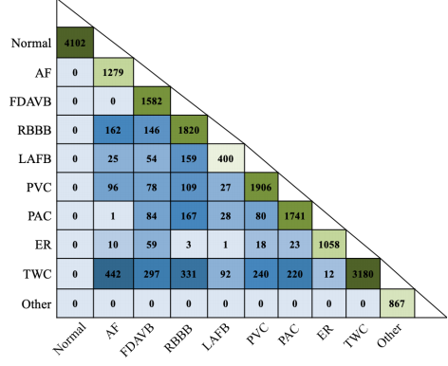
Question 3 Correlation between various diseases and diseases
②
①

Slide 13
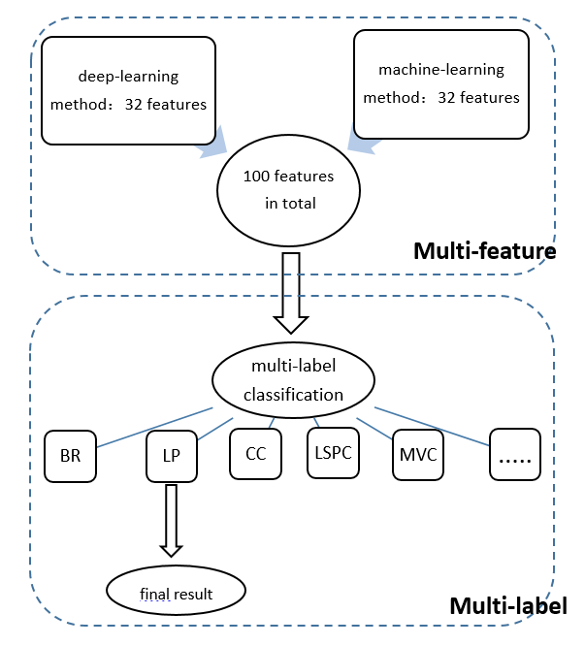
Question 4 algorithm that suit for this dataset to make classification
Multi-Feature Multi-Label algorithm
（MFML）
F1 score: 0.86
F1 = 2 * tp / (2 * tp + fp + fn)

Slide 14
Thank you!
Chuankai Luo

