Slide 1


Economy
罗浩

Slide 2
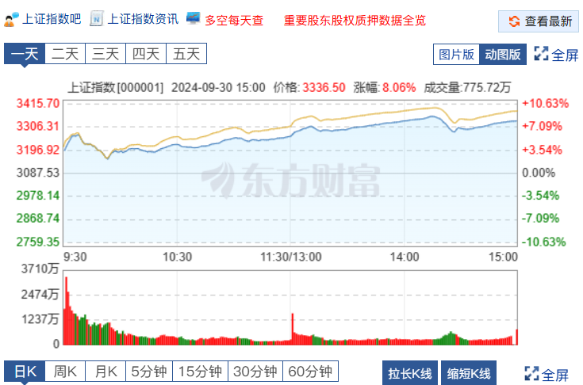
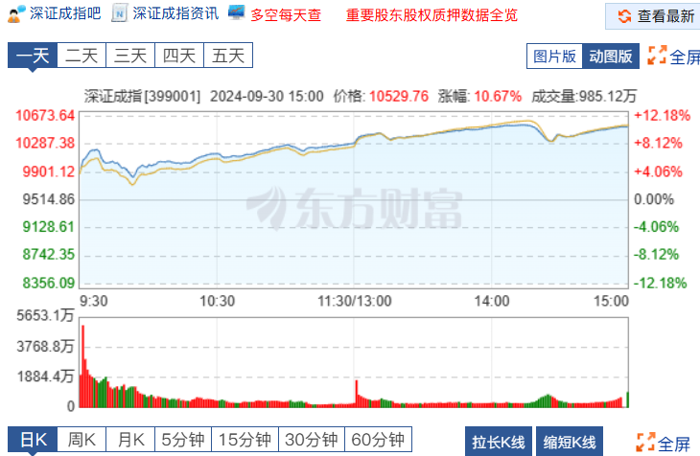
Shenzhen Component Index
Shanghai Composite Index

Slide 3




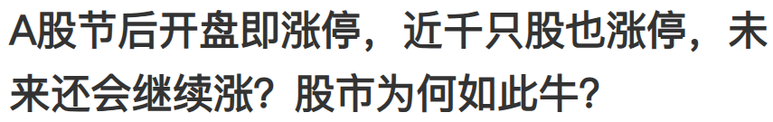
introduction of relevant stimulus policies
Reasons
high market expectations

Slide 4
Limiting up
Limiting up
Another bull
Topics
Staking all
Paying off
Paying off

Slide 5
Useful words and Expressions
Words of Extent of changing:
Up(mild->wild):
Climb/mount
To increase slowly
Surge
Soar
To describe a swift lift of one thing
Skyrocket
More profound than soar/surge
Down(mild->wild):
Decline/decrease
At a normal speed
Plunge
To jump
Collapse
More profound
…

Slide 6
Useful words and Expressions
Golden expressions
Stock prices for property firms surged following an announcement by China's central bank on Sunday evening, asking commercial banks to reduce interest rates on existing mortgages by Oct 31.
Following…,doing…
Substitute:
Subsequent to/in the wake of…doing
Eg.: Mudslide occurred following a tremendous storm, destroying everything getting in its way to the ground.

