Slide 1
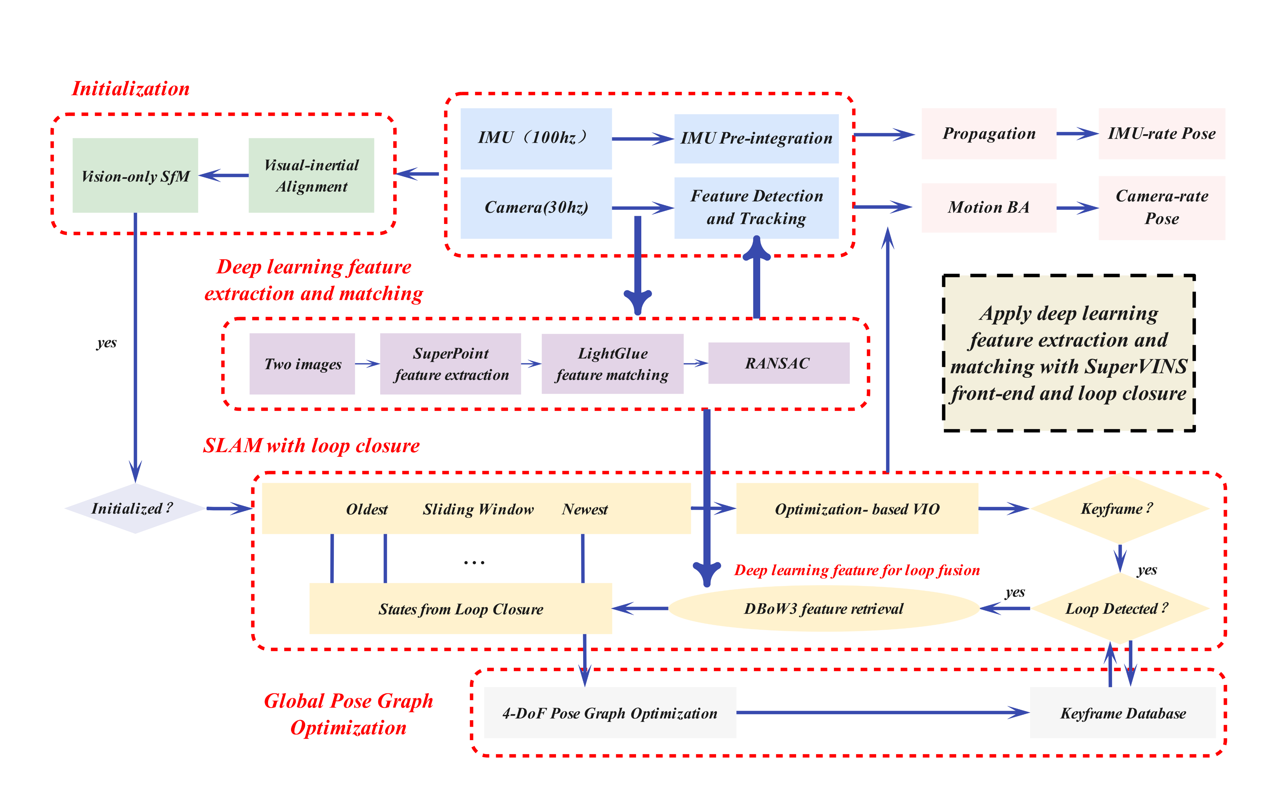

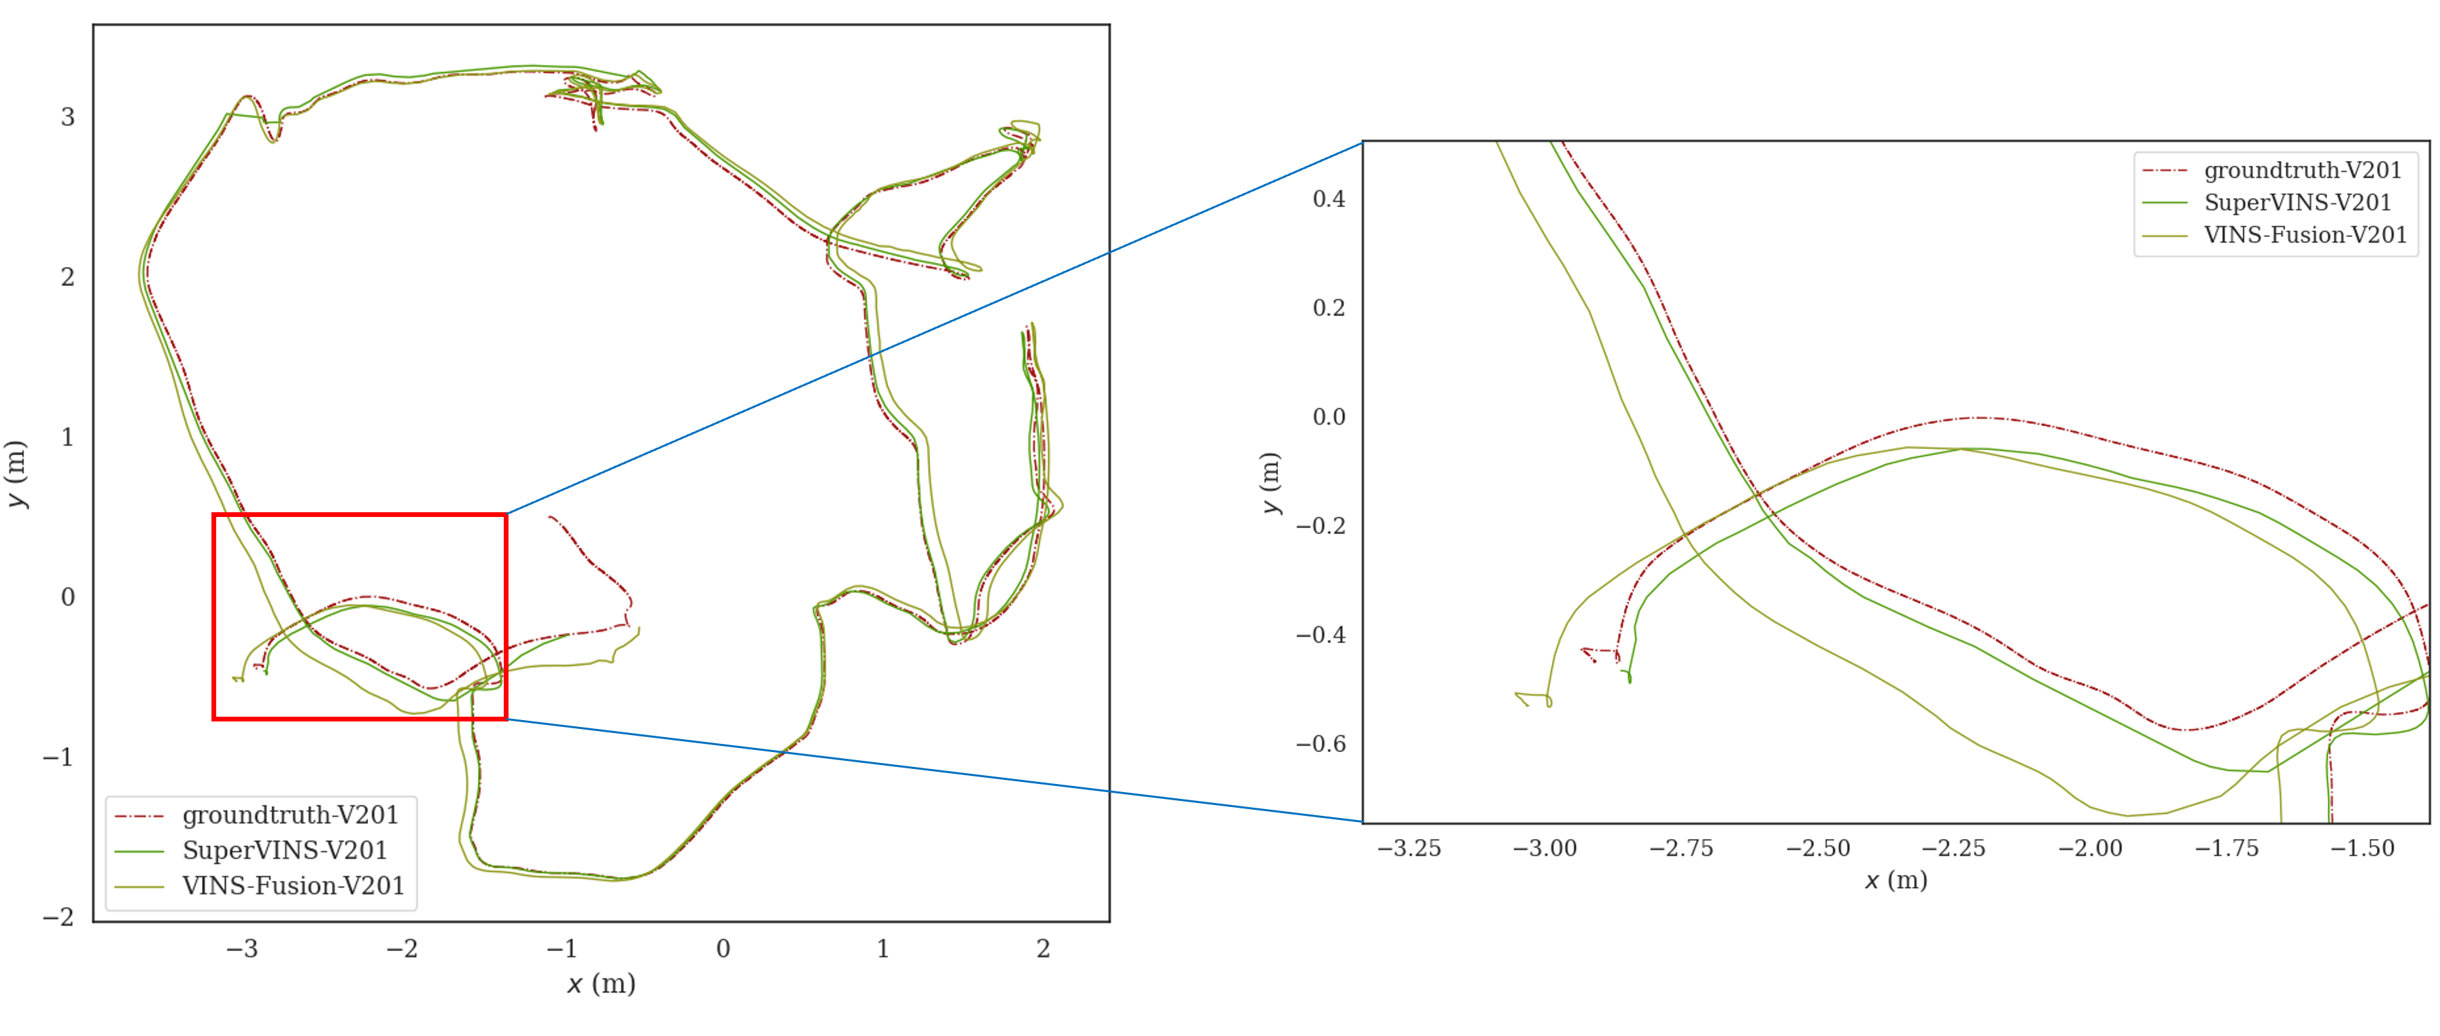
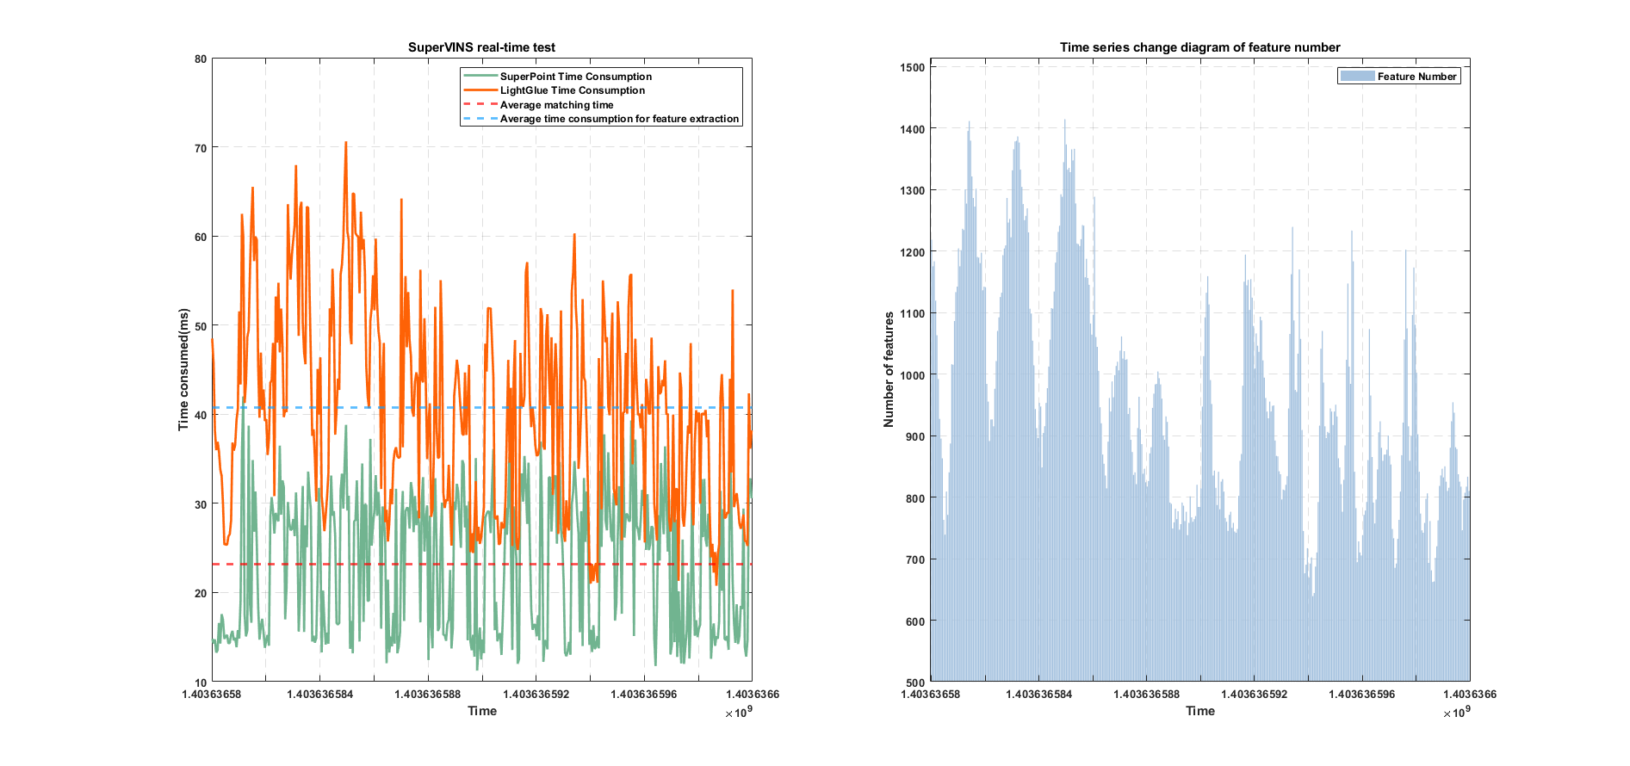
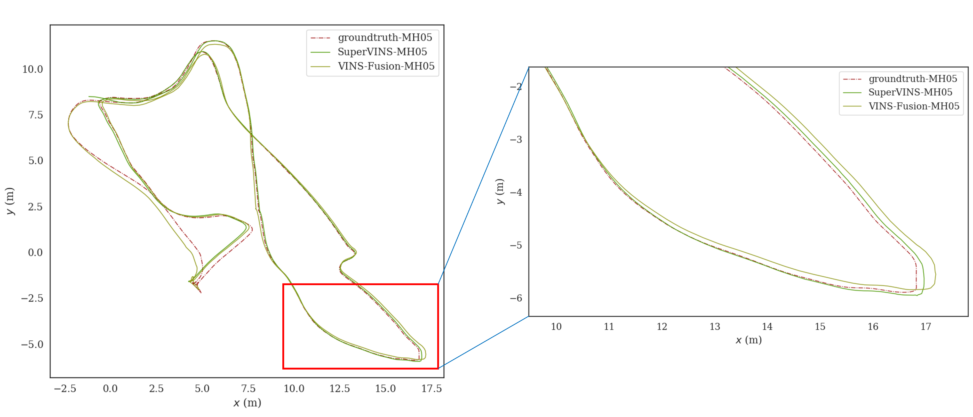

Slide 3


[PDF]

Slide 4

[Code]

Slide 5
[Code]

Slide 6
[PDF]

Slide 7
[PDF]

Slide 8
[Code]

Slide 9

[Project Page]

Slide 10

[Problem]

