Slide 1
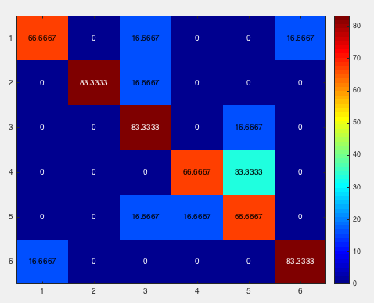
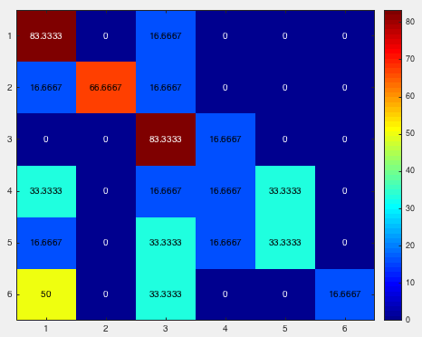
Irene1_18motionparameter_byrun_4masks
mask1
mask2

Slide 2
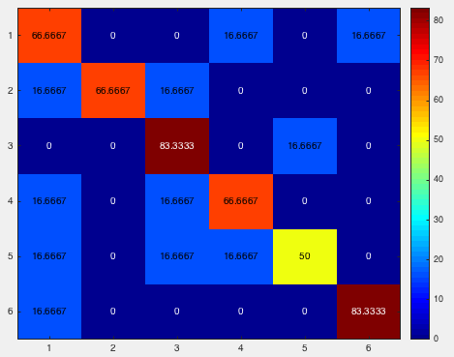
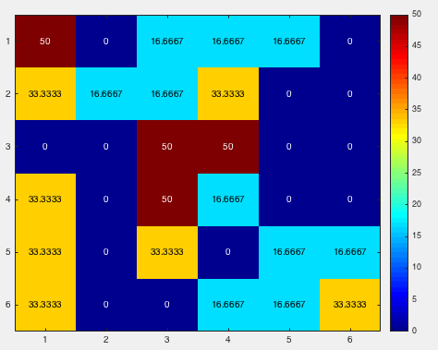
Irene1_18motionparameter_byrun_4masks
mask3
mask4

Slide 3
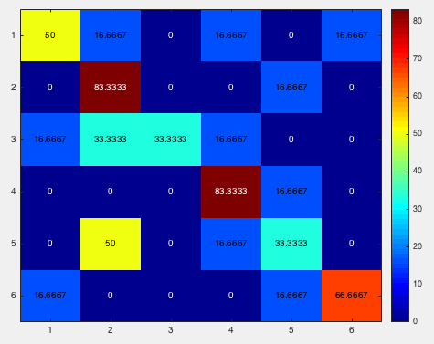
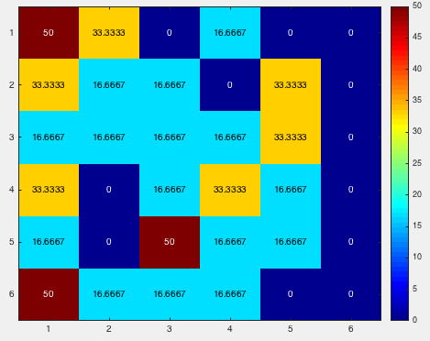
luo_18motionparameter_byrun_4masks
mask1
mask2

Slide 4
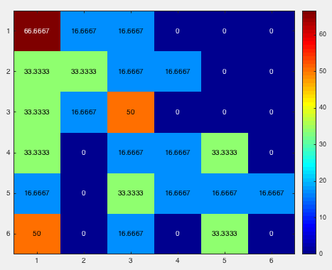
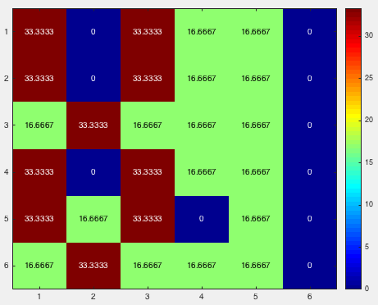
luo_18motionparameter_byrun_4masks
mask3
mask4

Slide 5
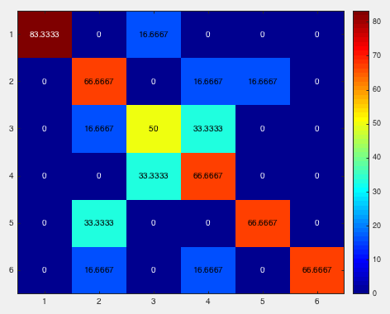
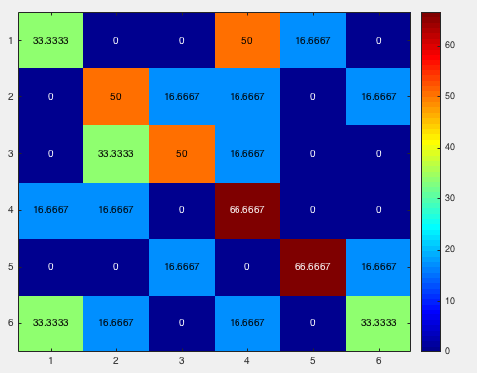
Irene2_18motionparameter_byrun_4masks
mask1
mask2

Slide 6
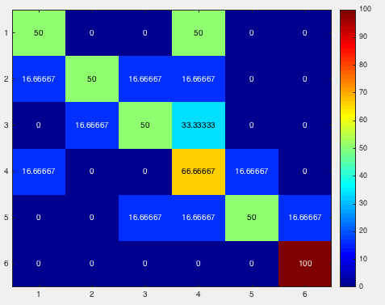
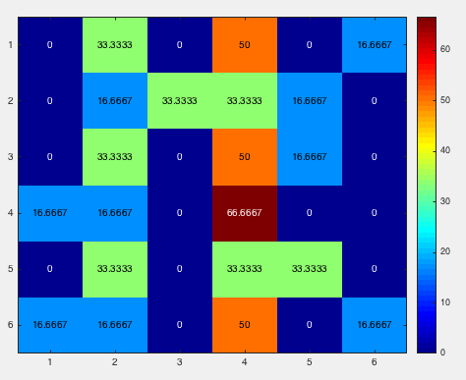
Irene2_18motionparameter_byrun_4masks
mask3
mask4

Slide 7
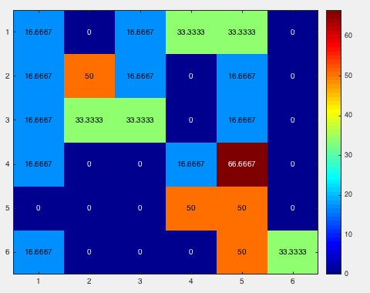
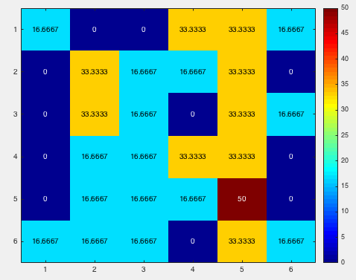
angela_18motionparameter_byrun_4masks
mask1
mask2

Slide 8
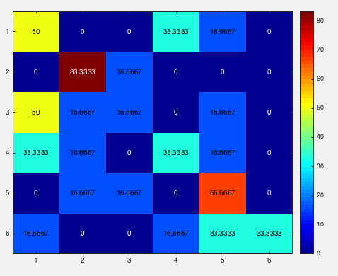
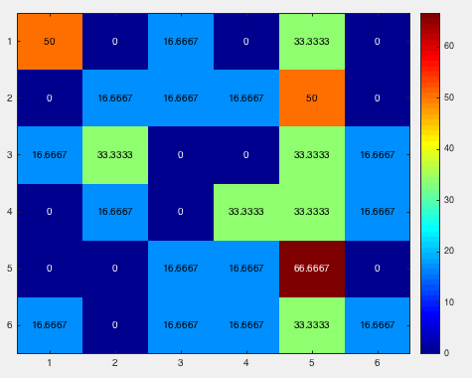
angela_18motionparameter_byrun_4masks
mask3
mask4

