Slide 1
LIFT LOG
Jesse Luo
CSS 475 A

Slide 2
LIFT LOG: What is it?
A database for fitness enthusiasts that stores different kinds of exercises and routines, as well as a user’s physical data.
User’s physical attributes (height, weight)
User’s weight history
Exercise routines
Exercises
Routine reviews

Slide 3
LIFT LOG: What can I do with it?
Create a User account
Track your weight over a period of time
Search for exercises or routine based on a muscle group
Build routines with existing exercises
Add new exercises (subject to approval)
Search for pre-existing routines
Review routines

Slide 4
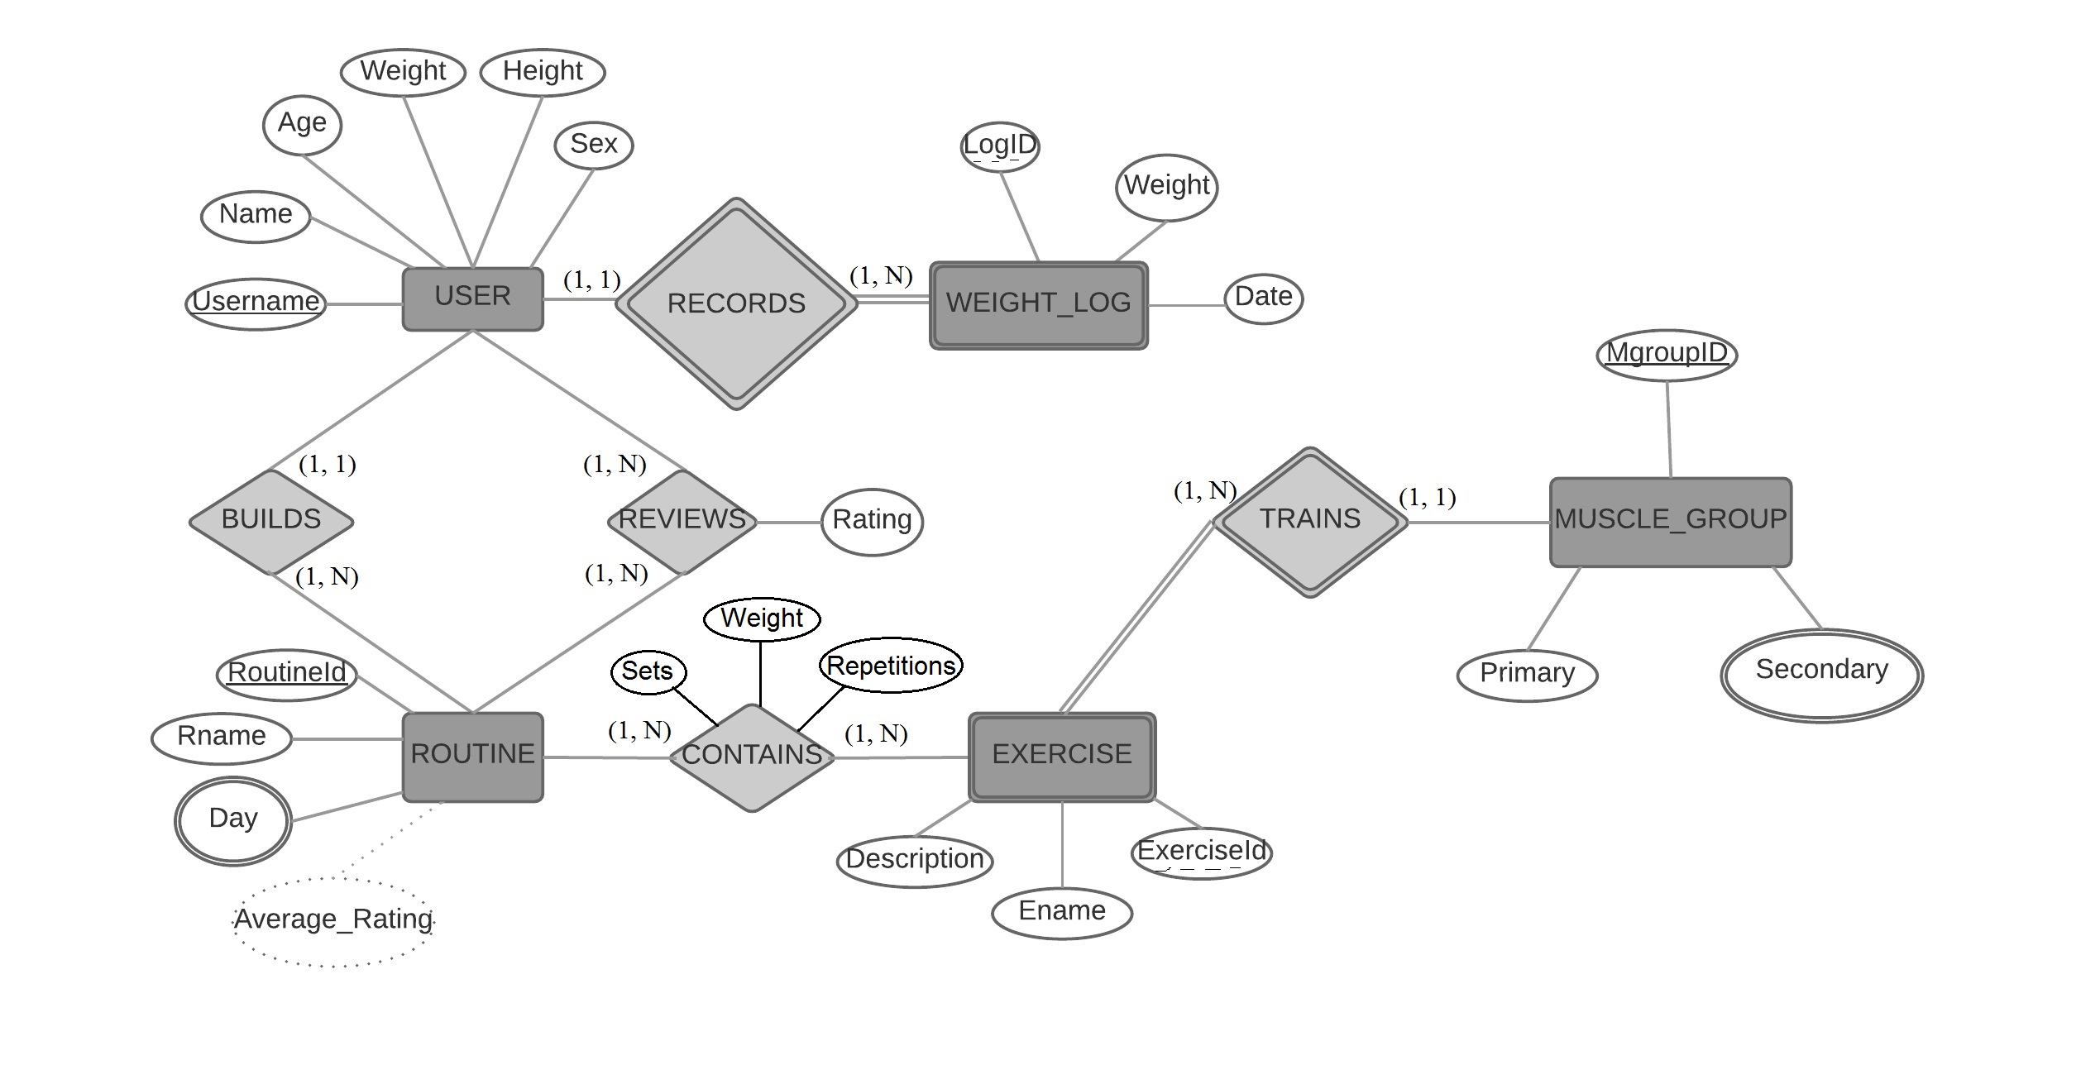
Entity-Relationship Diagram

Slide 5
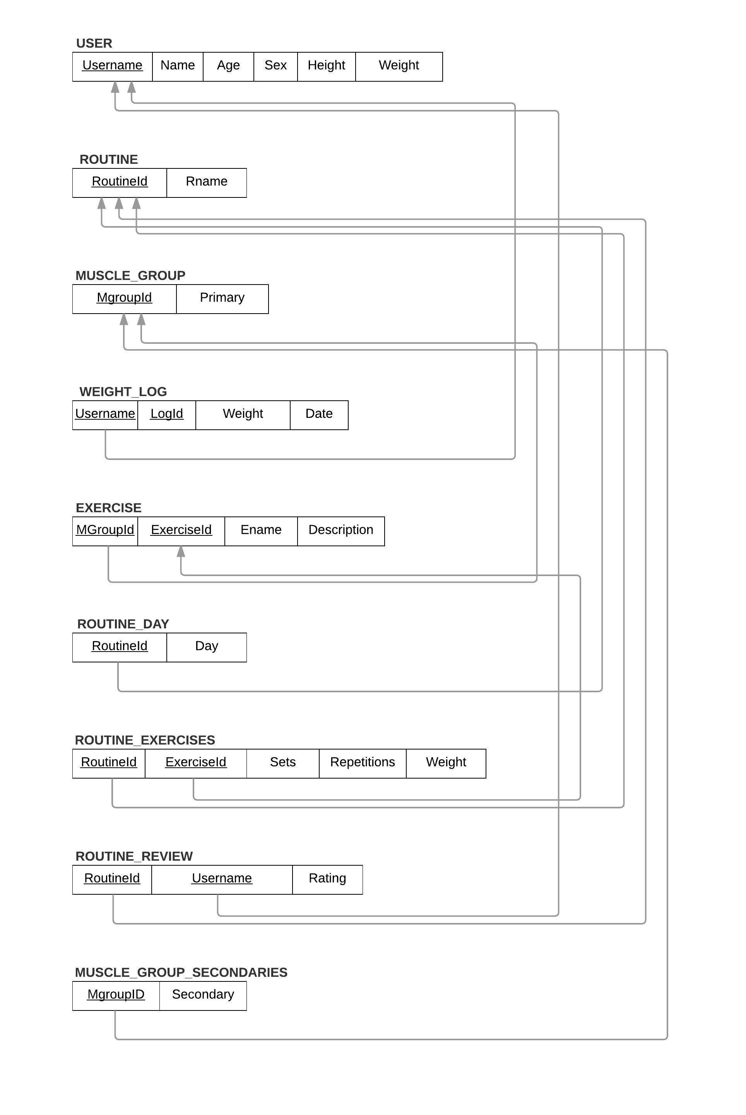
Relational Data Model
2NF:
User
Exercise
Weight_log
Muscle_group
Muscle_group_secondaries
Routine_day
3NF:
Routine_exercises
Routine_review
BCNF:
Routine

Slide 6
Queries
Retrieve a history of your weight changes over time.
Search for exercises that involve a specific primary mover.
Search for a routine that involves exercises that involve a specific primary mover.
Search for a list of all routines
Search for highest weight lifted in a specific exercise.
Search for routines with a certain rating or above.

Slide 7
Evaluation
How much effort was spent overall?
Brainstorming
Designing
Coding
What went right?
Coding was straightforward with what brainstorming and designing I had done
What went wrong?
Decreased size due to application, ET constraints
How would you do it differently if you have to do again?
More time brainstorming, designing

