Slide 1
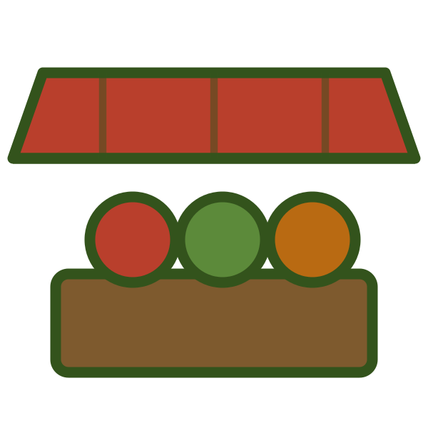

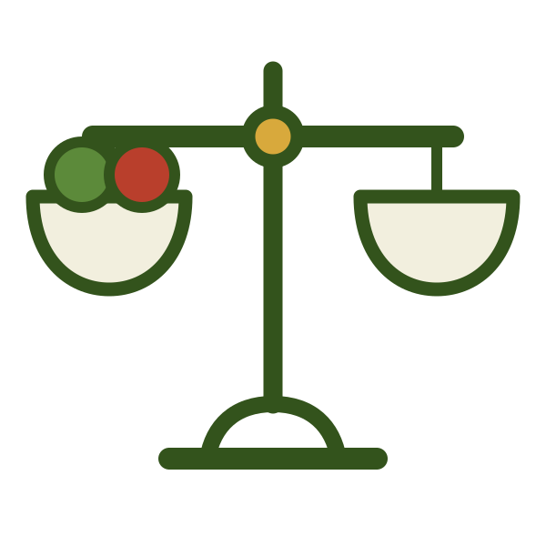
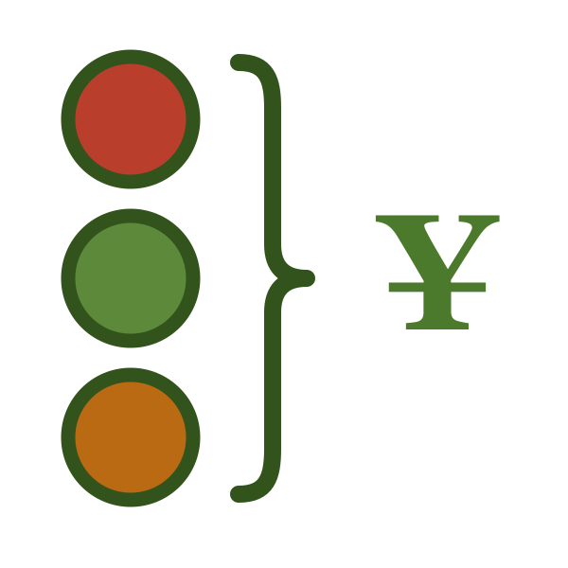

LESSON 2 OF 6
Y8 · Lesson 12
1 / 21
轻松学中文 2 · UNIT 4 · LESSON 12
怎么卖？
Asking the Price
Lesson 2 of 6 · 50 minutes · 课本 p.110、p.112

Slide 2
0–8 MIN · 复习
Review · Lesson 1
2 / 21
复习 · 钱 · MONEY RAPID FIRE
WHITEBOARDS · 4 MIN
Teacher says an amount → write the figure. Six of them.
Then teacher shows a figure → class says it chorally. Six more.
「二十块」用「元」怎么说？

Slide 3
0–8 MIN · 复习
Review · 练习册 p.130 Ex.6
3 / 21
复习 · 动词 + 名词 · 练习册 P.130 EX.6
PAIRS · 4 MIN
Sixteen verbs. Match each one to a noun from the box. Three minutes, one whiteboard per pair.
儿歌 汽车 外套 音乐 西餐 历史 钢琴 可乐
作业 衣服 小提琴 青菜 汉语 电影 篮球 水彩画儿
Highest count reads theirs out.
CONNECTION · 接上节课
买衣服、买青菜 —— today we find out how to ask what those cost before we buy them.

Slide 4
8–10 MIN
学习目标
4 / 21
LEARNING INTENTION · 学习目标
We are learning to ask how much something costs and to ask for a total.
SUCCESS CRITERIA · 我能……
1
I can say and write the four new words
买、卖、斤、一共
2
I can ask a price two ways
这些苹果怎么卖？／西瓜多少钱一斤？
3
I can ask for the total and answer it
一共多少钱？

Slide 5
10–20 MIN · I DO
生词 · Cycle 1 of 2
5 / 21
NEW WORDS · 跟我读两遍 · REPEAT AFTER ME, TWICE
mǎi
mài
买
卖
buy
sell
買
賣

Slide 6
10–20 MIN · I DO
生词 · Cycle 1 of 2
6 / 21
例句 · SEE THEM USED
Wǒ xiǎng mǎi yí ge xīguā.
我想买一个西瓜。
I want to buy a watermelon.
Tāmen mài shuǐguǒ.
他们卖水果。
They sell fruit.
Wǒ mǎi píngguǒ, tā mài píngguǒ.
我买苹果，他卖苹果。
I buy apples, he sells apples.

Slide 7
10–20 MIN · I DO
生词 · Cycle 1 of 2
7 / 21
写一句 · WRITE YOUR OWN
我想买 ______ 。
60 seconds. Mini whiteboards. One sentence.
EXTENSION · 加油题
One sentence using both words — a shop that sells it and you buying it.
这家店卖比萨饼，我想买一个。

Slide 8
10–20 MIN · I DO
生词 · Cycle 2 of 2
8 / 21
NEW WORDS · 跟我读两遍 · REPEAT AFTER ME, TWICE
jīn
yígòng
斤
一共
half a kilogram
altogether

Slide 9
10–20 MIN · I DO
生词 · Cycle 2 of 2
9 / 21
例句 · SEE THEM USED
Yì jīn píngguǒ shí kuài qián.
一斤苹果十块钱。
A jin of apples is ten yuan.
Wǒ mǎi liǎng jīn júzi.
我买两斤橘子。
I'll buy two jin of tangerines.
Liǎng jīn júzi hé yí ge xīguā, yígòng èrshí kuài.
两斤橘子和一个西瓜，一共二十块。
Two jin of tangerines and a watermelon — twenty yuan altogether.

Slide 10
10–20 MIN · I DO
生词 · Cycle 2 of 2
10 / 21
写一句 · WRITE YOUR OWN
我买 ______ 和 ______ ，一共 ______ 块。
90 seconds. Work the total out — in Chinese.
EXTENSION · 加油题
Three items and three prices, then the total. Add up in your head, not on paper.

Slide 11
10–20 MIN · I DO
Checkpoint · 买 vs 卖
11 / 21
认字 · READ THEM BACK. THEN: WHICH ONE IS BUY AND WHICH IS SELL?
买
卖
斤
一共

Slide 12
10–20 MIN · I DO
句型 · Asking a price
12 / 21
句型 · THREE QUESTIONS
这些苹果 怎么卖？
Loose goods — you don't yet know what the unit is
西瓜 多少钱一斤？
You name the unit yourself
一共多少钱？
The total — and the answer starts with 一共 too

Slide 13
10–20 MIN · I DO
句型 · Asking a price
13 / 21
模仿我说 · WATCH ME BUILD IT
1
这些橘子怎么卖？ —— 十块钱四个。
2
苹果多少钱一斤？ —— 五块五一斤。
3
菜花儿怎么卖？ —— 三块一个。
4
我买一个菜花儿和两斤土豆，一共多少钱？ —— 一共六块五。
List what you want first —— 我买 + 东西 + 和 + 东西 —— then ask 一共多少钱？

Slide 14
10–20 MIN · I DO
CFU · 检查理解
14 / 21
检查理解 · CHECK FOR UNDERSTANDING
WHITEBOARDS · NO ANSWERS ON SCREEN
1
「多少钱一斤」and「一斤多少钱」— are both all right?
2
Which do you use for a whole watermelon: 一个 or 一斤?
3
You are the customer. What is wrong with this?
我卖一个西瓜。
4
Translate: “How much altogether?”
5
十块钱四个 —— 一个多少钱？

Slide 15
10–20 MIN · I DO
课文一 · 课本 p.110
15 / 21
课文一 · TEXT 1 · CD 56
A
Zhè xiē píngguǒ zěnme mài?
这些苹果怎么卖？
B
Shí kuài (yuán) qián sì ge.
十块（元）钱四个。
A
Xīguā duōshao qián yì jīn?
西瓜多少钱一斤？
B
Liǎng kuài wǔ yì jīn.
两块五一斤。
A
Wǒ mǎi sì ge píngguǒ, yí ge xīguā, zài lái liǎng jīn júzi. Yígòng duōshao qián?
我买四个苹果、一个西瓜，再来两斤橘子。一共多少钱？
B
Yígòng sānshí kuài wǔ máo (jiǎo) wǔ (fēn).
一共三十块五毛（角）五（分）。

Slide 16
10–20 MIN · I DO
课文一 · 课本 p.110
16 / 21
听懂了吗 · COMPREHENSION —— 用中文回答
1
苹果多少钱一个？
2
她买了几个苹果？
3
「再来两斤橘子」是什么意思？
再来 = also give me —— 来 doing the work of 给我。

Slide 17
20–26 MIN · WE DO
Activity 1 · 课本 p.112 Ex.3
17 / 21
ACTIVITY 1 · 量词 · 课本 P.112 EX.3
PAIRS · 6 MIN
Twelve blanks. Fill them from the box, on one whiteboard per pair.
口 家 头 朵 个 位 台 条
三口人 一__花 一__电脑 一__学校 一__老师 一__裙子
一__白发 一__裤子 一__热狗 一__苹果 一__饭店 一__电视
Then add today's: 一斤土豆、两斤橘子 —— 斤 is a measure word too, the one for things that get weighed.
EXTENSION · 加油题
练习册 p.134 Ex.14 — the eighteen-item version, solo, against the clock. Then two sentences using a measure word that wasn't in the box.
一包土豆 · 一门课

Slide 18
26–38 MIN · YOU DO
Activity 2 · 课本 p.112 Ex.4
18 / 21
ACTIVITY 2 · 小摊 · 课本 P.112 EX.4
GROUPS OF 3–4 · 12 MIN
西红柿 ¥3.00/斤 · 菜花儿 ¥2.50/斤 · 苹果 ¥10.00/五个 · 比萨饼 ¥60.00/个
Half the groups keep the stall. The other half go shopping — then swap after five minutes.
At each stall: ask two prices using both question forms, buy at least two things, ask 一共多少钱？
The stallholder works the total out out loud.
EXTENSION · 加油题
You have 50 块 and must leave having spent between 45 and 50. Say aloud what you are not buying and why. Then report your total and your change — in Chinese.
我想买比萨饼，可是六十块，太贵了。我买两斤西红柿和一斤菜花儿。

Slide 19
26–38 MIN · YOU DO
Activity 2 · 示范
19 / 21
示范 · RUN IT LIKE THIS
A
Xīhóngshì zěnme mài?
西红柿怎么卖？
B
Sān kuài yì jīn.
三块一斤。
A
Bǐsàbǐng duōshao qián yí ge?
比萨饼多少钱一个？
B
Liùshí kuài.
六十块。
A
Wǒ mǎi liǎng jīn xīhóngshì hé yí ge bǐsàbǐng. Yígòng duōshao qián?
我买两斤西红柿和一个比萨饼。一共多少钱？
B
Yígòng liùshí liù kuài.
一共六十六块。
第二轮 · SECOND ROUND
Pinyin comes down for the second round. Same task, nothing on screen.

Slide 20
38–43 MIN · 游戏
Game · 排句子
20 / 21
GAME · 排句子 · SENTENCE JUMBLE
PAIRS · 5 MIN
One jumble at a time. Reorder it on a whiteboard, hold it up. First correct board scores.
① 怎么 / 这些 / 卖 / 苹果
② 一斤 / 多少 / 西瓜 / 钱
③ 多少 / 一共 / 钱
④ 两斤 / 我 / 橘子 / 买
⑤ 钱 / 一共 / 三十块 / 五毛
EXTENSION · 加油题
After reordering, say a second sentence that answers or follows on from yours — out loud, nothing written.

Slide 21



43–50 MIN · 小结
Plenary
21 / 21
小结 · PLENARY
SELF-ASSESSMENT · 自评
Write 1, 2, 3 on your whiteboard and put / / beside each.
EXIT TICKET · 出门条
Write the two ways of asking a price — 香蕉 in one, 土豆 in the other.
香蕉怎么卖？ 土豆多少钱一斤？
On a half-slip. Collected at the door.
下节课 · NEXT LESSON
We finish the market dialogue and learn to ask permission.
我可以用人民币吗？

