Slide 1




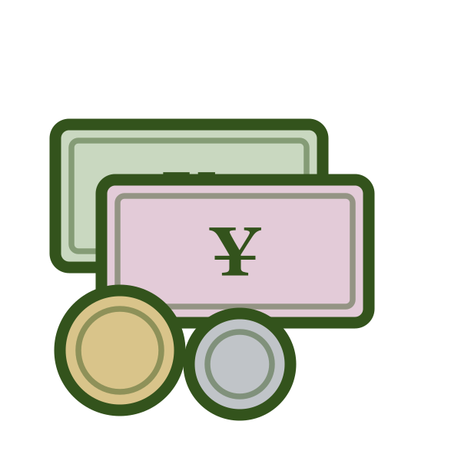
LESSON 3 OF 6
Y8 · Lesson 12
1 / 25
轻松学中文 2 · UNIT 4 · LESSON 12
我可以用人民币吗？
Asking Permission
Lesson 3 of 6 · 50 minutes · 课本 p.110、p.114

Slide 2
0–8 MIN · 复习
Review · Lesson 2
2 / 25
复习 · 课文一 · FROM MEMORY
PAIRS · 5 MIN
Rebuild the first half of Text 1 with only these English prompts on screen.
① how are these apples sold ② how much per jin for watermelon
③ I'll buy four apples, a watermelon and two jin of tangerines ④ how much altogether
Rehearse twice, swap roles. Two pairs perform.

Slide 3
0–8 MIN · 复习
Review · 改错
3 / 25
复习 · 改错 · CORRECT THE TEACHER
✗ 这句话错了
这些苹果卖怎么？
✗ 这句话错了
西瓜一斤多少？
✗ 这句话错了 —— 你是顾客
我卖两斤橘子。
CONNECTION · 接上节课
You've bought the fruit and you know the total. One thing left to settle at the till —— what you're allowed to pay with.

Slide 4
8–10 MIN
学习目标
4 / 25
LEARNING INTENTION · 学习目标
We are learning to ask whether we are allowed to do something, using 可以.
SUCCESS CRITERIA · 我能……
1
I can say and write the new words
用、人民币、可以
2
I can ask permission and answer it
我可以……吗？—— 可以。／不可以。
3
I can read the whole of Text 1 aloud with a partner
4
I can write the four simple characters
尸、户、革、丁

Slide 5
10–20 MIN · I DO
生词 · Cycle 1 of 3
5 / 25
NEW WORDS · 跟我读两遍 · REPEAT AFTER ME, TWICE
yòng
kěyǐ
用
可以
use
can; may

Slide 6
10–20 MIN · I DO
生词 · Cycle 1 of 3
6 / 25
例句 · SEE THEM USED
Wǒ yòng Hànyǔ shuō.
我用汉语说。
I'll say it in Chinese.
Wǒ kěyǐ chī ma?
我可以吃吗？
May I eat?
Wǒ kěyǐ yòng Yīngyǔ shuō ma?
我可以用英语说吗？
May I say it in English?

Slide 7
10–20 MIN · I DO
生词 · Cycle 1 of 3
7 / 25
写一句 · WRITE YOUR OWN
我可以 ______ 吗？
60 seconds. Something you would really ask.
EXTENSION · 加油题
Two questions — one to a teacher, one to a parent — both using 可以 and 用.
我可以用你的电脑吗？

Slide 8
10–20 MIN · I DO
生词 · Cycle 2 of 3
8 / 25
NEW WORDS · 跟我读两遍 · REPEAT AFTER ME, TWICE
rénmín
人民
bì
the people
币
currency
幣

Slide 9
10–20 MIN · I DO
生词 · Cycle 2 of 3
9 / 25
例句 · SEE THEM USED
Rénmín hěn duō.
人民很多。
There are a lot of people.
Zhè shì Zhōngguó de qiánbì.
这是中国的钱币。
This is Chinese currency.
Rénmín + bì = rénmínbì.
人民 ＋ 币 ＝ 人民币。
The people + currency = the people's currency.

Slide 10
10–20 MIN · I DO
生词 · Cycle 2 of 3
10 / 25
写一句 · WRITE YOUR OWN
中国的钱是 ______ 。
60 seconds. One sentence.
EXTENSION · 加油题
China uses 人民币. What does your country use? Write one sentence.

Slide 11
10–20 MIN · I DO
生词 · Cycle 3 of 3
11 / 25
NEW WORDS · 跟我读两遍 · REPEAT AFTER ME, TWICE
rénmínbì
人民币
RMB, Chinese currency

Slide 12
10–20 MIN · I DO
生词 · Cycle 3 of 3
12 / 25
例句 · SEE THEM USED
Wǒ yǒu yìbǎi kuài rénmínbì.
我有一百块人民币。
I have a hundred yuan of RMB.
Wǒ kěyǐ yòng rénmínbì ma?
我可以用人民币吗？
May I use RMB?
Zài Zhōngguó, wǒmen yòng rénmínbì.
在中国，我们用人民币。
In China we use RMB.

Slide 13
10–20 MIN · I DO
生词 · Cycle 3 of 3
13 / 25
写一句 · WRITE YOUR OWN
我可以用 ______ 吗？
60 seconds. Then read it to your partner and get an answer.
EXTENSION · 加油题
Write a two-line exchange: the question, then a refusal with a reason.
不可以，因为你还没有做作业。

Slide 14
10–20 MIN · I DO
Checkpoint · 五个词
14 / 25
认字 · READ THEM BACK — NO PINYIN, NO ENGLISH
用
可以
人民
币
人民币

Slide 15
10–20 MIN · I DO
句型 · Asking permission
15 / 25
句型 · THE PATTERN
我 可以 ＋ 动词 ＋ 吗？
可以 goes BEFORE the verb. ✗ 我用可以人民币吗
两种说法 · TWO SHAPES, ONE MEANING
The book uses both. The second is the one 练习册 p.132 drills.
我可以现在回家吗？ 我现在想回家，可以吗？

Slide 16
10–20 MIN · I DO
句型 · Asking permission
16 / 25
模仿我说 · WATCH ME BUILD IT
1
我可以吃吗？
2
我可以用人民币吗？
3
我现在可以听音乐吗？
4
我一边做作业一边听音乐，可以吗？
The tag form — whole sentence first, 可以吗 on the end.

Slide 17
10–20 MIN · I DO
CFU · 检查理解
17 / 25
检查理解 · CHECK FOR UNDERSTANDING
WHITEBOARDS · NO ANSWERS ON SCREEN
1
Does 可以 go before or after the verb?
2
Translate: “May I use Chinese?”
3
Answer this question.
我可以吃你的苹果吗？
4
Turn this into the tag form.
我可以现在回家吗？
5
Thumbs up if 币 means “currency”, down if it means money in general.

Slide 18
10–20 MIN · I DO
课文一 · 课本 p.110
18 / 25
课文一 · TEXT 1 · CD 56 —— 前半，齐读
A
Zhè xiē píngguǒ zěnme mài?
这些苹果怎么卖？
B
Shí kuài (yuán) qián sì ge.
十块（元）钱四个。
A
Xīguā duōshao qián yì jīn?
西瓜多少钱一斤？
B
Liǎng kuài wǔ yì jīn.
两块五一斤。

Slide 19
10–20 MIN · I DO
课文一 · 课本 p.110
19 / 25
课文一 · TEXT 1 · CD 56 —— 后半，然后两人一组
A
Wǒ mǎi sì ge píngguǒ, yí ge xīguā, zài lái liǎng jīn júzi. Yígòng duōshao qián?
我买四个苹果、一个西瓜，再来两斤橘子。一共多少钱？
B
Yígòng sānshí kuài wǔ máo (jiǎo) wǔ (fēn).
一共三十块五毛（角）五（分）。
A
Wǒ kěyǐ yòng rénmínbì ma?
我可以用人民币吗？
B
Kěyǐ.
可以。

Slide 20
10–20 MIN · I DO
课文一 · 课本 p.110
20 / 25
听懂了吗 · COMPREHENSION —— 用中文回答
1
她买了什么？
2
一共多少钱？
3
她用什么钱？

Slide 21
20–27 MIN · WE DO
Activity 1 · 练习册 p.132 Ex.9
21 / 25
ACTIVITY 1 · 可以吗？ · 练习册 P.132 EX.9
WHITEBOARDS · 7 MIN
Complete each one into a full 可以吗？question. One at a time, all held up together.
我用 英语说，可以吗？
我用 ______ 买这些衣服，可以吗？
我一边做作业 ______ ，可以吗？
我今天晚上想 ______ ，可以吗？
我再打一会儿 ______ ，可以吗？
______ ，可以吗？ —— entirely your own
EXTENSION · 加油题
Write the answer to each of your last three, and make one a refusal with a reason. Then 练习册 p.131 Ex.7 —— one sentence of your own for 要、不要、条、应该、可以、会.

Slide 22
27–33 MIN · YOU DO
Activity 2 · 课本 p.114 Ex.6
22 / 25
ACTIVITY 2 · 听一听，打勾 · 课本 P.114 EX.6 · CD 58
SOLO, THEN PAIRS · 6 MIN
Six items, three options each. Played twice. Tick in the book, then check in pairs.
The items reach back across the whole year —— weather, illness, 除了……以外, food, phone language.
Don't pre-teach. Working around an unknown word is exactly what the test's listening asks for.
EXTENSION · 加油题
Write the whole sentence you hear for items 3, 4 and 5 instead of ticking. Then rewrite item 5 about yourself.

Slide 23
33–38 MIN · YOU DO
Activity 3 · 课本 p.114 Ex.7
23 / 25
ACTIVITY 3 · 简单字 · 课本 P.114 EX.7 · 练习册 P.132 EX.10
尸
shī
corpse
3 strokes
户
hù
household
4 strokes
革
gé
leather
9 strokes
丁
dīng
man
2 strokes
这两个字最难分 · THE WHOLE DIFFICULTY
户 is 尸 with a dot on top. That is the only difference.
尸 · 户

Slide 24
38–43 MIN · 游戏
Game · 写字接力
24 / 25
GAME · 写字接力 · WRITING RELAY
TEAMS · 5 MIN
Teams line up. Teacher calls a character by its English meaning —— “household!”
First student runs up, writes it, runs back. Next student.
Wrong stroke order can be challenged by the other team for a bonus point.
EXTENSION · 加油题
Call by pinyin only, and the runner must write a word containing the character, not the bare character.
户 → 门户 · 革 → 皮革 · 足 → 足球

Slide 25



43–50 MIN · 小结
Plenary
25 / 25
小结 · PLENARY
SELF-ASSESSMENT · 自评
Thumbs on each of the four criteria —— / /
EXIT TICKET · 出门条
Write one 可以 question you would actually ask a teacher. One sentence.
On a half-slip. Collected at the door.
下节课 · NEXT LESSON
From the market to the restaurant —— and how to say the food is especially good.
他们的饭菜做得特别好吃。

