Slide 1
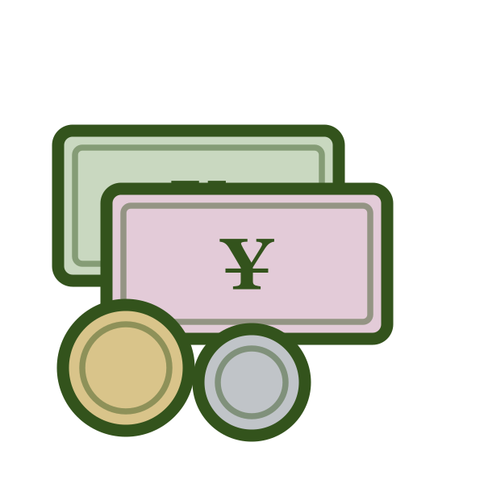


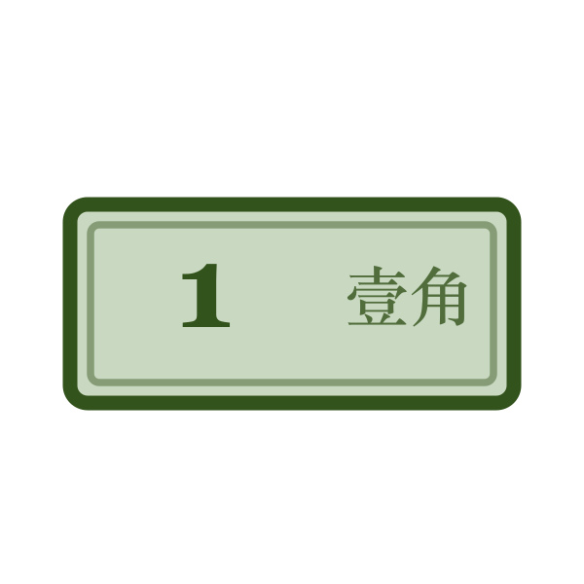

LESSON 1 OF 6
Y8 · Lesson 12
1 / 23
轻松学中文 2 · UNIT 4 · LESSON 12
人民币
Talking About Money
Lesson 1 of 6 · 50 minutes · 课本 p.110–111

Slide 2
0–8 MIN · 复习
Review · Lesson 11
2 / 23
复习 · FIVE ON WHITEBOARDS — HOLD THEM UP TOGETHER
复习 · 五题 · FROM LESSON 11
1
你午饭一般吃什么？
Answer in Chinese.
2
我晚饭吃米饭 ______ 面条。
One word in the gap.
3
你想吃中餐 ______ 西餐？
One word in the gap.
4
“It is likely to rain this afternoon.”
Translate into Chinese.
5
你们家常去饭店吃饭吗？
Answer in a full sentence.
CONNECTION · 接上节课
You can say where you eat and what you eat.
今天学的是最有用的一部分 —— 钱。
Today we add the part everybody actually needs at a market or a restaurant.

Slide 3
8–10 MIN
学习目标
3 / 23
LEARNING INTENTION · 学习目标
We are learning to read and say amounts of money in Chinese renminbi.
SUCCESS CRITERIA · 我能……
1
I can say the six money words
钱、块、元、毛、角、分
2
I can read an amount aloud and write it down
三十块五毛五分
3
I can explain when Chinese uses 块/毛 and when it uses 元/角

Slide 4
10–20 MIN · I DO
生词 · Cycle 1 of 3
4 / 23
NEW WORDS · 跟我读两遍 · REPEAT AFTER ME, TWICE
qián
kuài
钱
块
money
yuan （spoken）
錢
塊

Slide 5
10–20 MIN · I DO
生词 · Cycle 1 of 3
5 / 23
例句 · SEE THEM USED
Zhè shì shí kuài qián.
这是十块钱。
This is ten yuan.
Wǒ yǒu wǔ kuài qián.
我有五块钱。
I have five yuan.
Yí ge hànbǎobāo èrshí kuài qián.
一个汉堡包二十块钱。
A hamburger is twenty yuan.

Slide 6
10–20 MIN · I DO
生词 · Cycle 1 of 3
6 / 23
写一句 · WRITE YOUR OWN
我有 ______ 块钱。
60 seconds. Mini whiteboards. One sentence.
EXTENSION · 加油题
Write two questions with a price in each, using two different Lesson 11 foods.
一个热狗多少块钱？一个比萨饼呢？

Slide 7
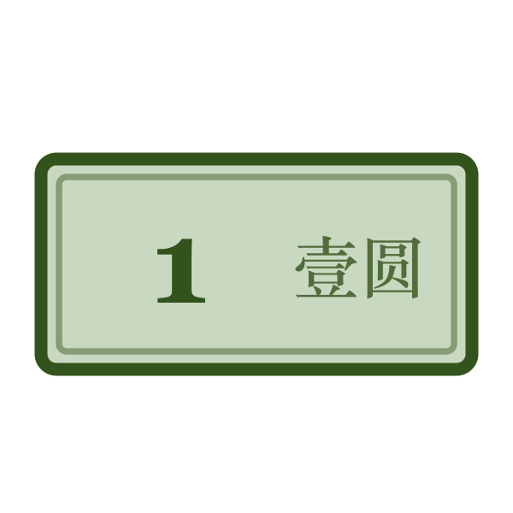
10–20 MIN · I DO
生词 · Cycle 2 of 3
7 / 23
NEW WORDS · 跟我读两遍 · REPEAT AFTER ME, TWICE
yuán
máo
元
毛
yuan （written）
1/10 yuan （spoken）

Slide 8
10–20 MIN · I DO
生词 · Cycle 2 of 3
8 / 23
例句 · SEE THEM USED
Wǔ kuài = wǔ yuán.
五块 = 五元。
Five kuai = five yuan.
Yí ge píngguǒ sān máo qián.
一个苹果三毛钱。
An apple is three mao.
Shí yuán wǔ máo.
十元五毛。
Ten yuan fifty.

Slide 9
10–20 MIN · I DO
生词 · Cycle 2 of 3
9 / 23
写一句 · WRITE YOUR OWN
______ 元 ______ 毛。
Write any amount — then read it aloud the spoken way.
EXTENSION · 加油题
Write three prices: one in 块毛, one in 元角, one written both ways.
十二块五毛 = 十二元五角

Slide 10
10–20 MIN · I DO
生词 · Cycle 3 of 3
10 / 23
NEW WORDS · 跟我读两遍 · REPEAT AFTER ME, TWICE
jiǎo
fēn
角
分
1/10 yuan （written）
1/100 yuan

Slide 11
10–20 MIN · I DO
生词 · Cycle 3 of 3
11 / 23
例句 · SEE THEM USED
Sān máo = sān jiǎo.
三毛 = 三角。
Three mao = three jiao.
Yì fēn qián.
一分钱。
One fen.
Yí kuài wǔ jiǎo wǔ fēn.
一块五角五分。
One yuan fifty-five.

Slide 12
10–20 MIN · I DO
生词 · Cycle 3 of 3
12 / 23
写一句 · WRITE YOUR OWN
______ 块 ______ 毛 ______ 分。
One amount. Then say it aloud to your partner.
EXTENSION · 加油题
Write the same amount again using 元角分, then say it once more the spoken way.
一块五毛五分 = 一元五角五分

Slide 13
10–20 MIN · I DO
Checkpoint · 六个字
13 / 23
认字 · READ THEM BACK — NO PINYIN, NO ENGLISH. THEN BACKWARDS.
钱
块
元
毛
角
分

Slide 14
10–20 MIN · I DO
句型 · Reading an amount
14 / 23
句型 · THE PATTERN
三十 块 五 毛 五 分
Largest unit first. No word for “and” — the units do that work.

Slide 15
10–20 MIN · I DO
句型 · Reading an amount
15 / 23
模仿我说 · WATCH ME BUILD IT
1
十块。
¥10.00
2
十块五毛。
¥10.50
3
三十块五毛五分。
¥30.55
4
一百二十块五毛 —— 用「元角」怎么说？
¥120.50 — now say it the written way.

Slide 16
10–20 MIN · I DO
课本 p.111 NOTE
16 / 23
课本 P.111 · NOTE
说 · Spoken
写 · Written
What people actually say
Price tags, receipts, the notes themselves
块 · 毛 · 分
元 · 角 · 分
五块 · 三毛
五元 · 三角
分 DOESN'T CHANGE
分 is the same in both. It is only the top two units that swap.
五块 = 五元 · 三毛 = 三角 · 五分 = 五分

Slide 17
10–20 MIN · I DO
CFU · 检查理解
17 / 23
检查理解 · CHECK FOR UNDERSTANDING
WHITEBOARDS · NO ANSWERS ON SCREEN
1
「三毛」= 几角？
2
Write ¥25.60 in characters — both ways.
3
Read this aloud: 一百零五块
Did you hear the 零?
4
What is wrong with this?
五钱块
5
一块 = 几毛？

Slide 18
20–27 MIN · WE DO
词汇总览
18 / 23
词汇总览 · STAYS ON SCREEN FOR THE WHOLE ACTIVITY
钱
块
元
毛
角
分

Slide 19

20–27 MIN · WE DO
Activity 1 · 课本 p.111 Ex.1
19 / 23
ACTIVITY 1 · 认一认 · 课本 P.111 EX.1 — SAY EACH ONE CHORALLY
一毛（角）
五毛（角）
一块（元）
一分
一百块
钱

Slide 20
20–27 MIN · WE DO
Activity 1 · 课本 p.111 Ex.1
20 / 23
ACTIVITY 1 · 卡片对练 · CARD PAIRS
PAIRS · 7 MIN
Shuffle your card set. One holds a card up, the other says it. 30 seconds each way.
Second round: put two or three cards down together — the partner says the total.
五十块 + 二十块 + 五毛 → 七十块五毛
EXTENSION · 加油题
Say each total twice — once as 块/毛, once as 元/角 — then say what it could buy.
七十块五毛。七十元五角。这些钱可以吃七个汉堡包。

Slide 21
27–37 MIN · YOU DO
Activity 2 · 练习册 p.129 Ex.2
21 / 23
ACTIVITY 2 · 听写价钱 · LISTEN AND WRITE THE AMOUNT
WHITEBOARDS · 10 MIN
Teacher reads an amount in Chinese. Write the figure. Hold it up.
Twice each for the first four, once after that.
五块 · 十二块 · 三毛 · 一块五毛 · 二十块八毛 · 九十九块
一百块 · 三十块五毛五分 · 六块二毛 · 四十五块 · 二百块 · 一百零八块五毛
Then flip it: 练习册 p.129 Ex.2 — seven pictures of notes. Write each amount in characters.
EXTENSION · 加油题
Write all seven both ways, then one sentence each for two of them saying what that money could buy.
一百块可以买十个热狗。

Slide 22
37–43 MIN · 游戏
Game · 拍价钱
22 / 23
GAME · 拍价钱 · SLAP THE BOARD
TWO AT THE BOARD · 6 MIN
Nine amounts written large on the board, in characters.
五毛 · 一块 · 五块 · 十块 · 二十块 · 五十块 · 一百块 · 三块五 · 十二块八毛
Teacher calls an amount — first to slap it scores. Winner stays on.
EXTENSION · 加油题
Call a sum instead of an amount （五块加五块 → slap 十块）, or call it in 元/角 so the student has to slap the 块/毛 version.

Slide 23



43–50 MIN · 小结
Plenary
23 / 23
小结 · PLENARY
SELF-ASSESSMENT · 自评
Thumbs on each success criterion — / /
Watch criterion 3 — the 块/元 split is the one that fades before next lesson.
EXIT TICKET · 出门条
Write ¥32.50 in Chinese characters — then write it again the other way.
三十二块五毛 / 三十二元五角
On a half-slip. Collected at the door.
下节课 · NEXT LESSON
How to ask the price.
这些苹果怎么卖？

