Slide 1


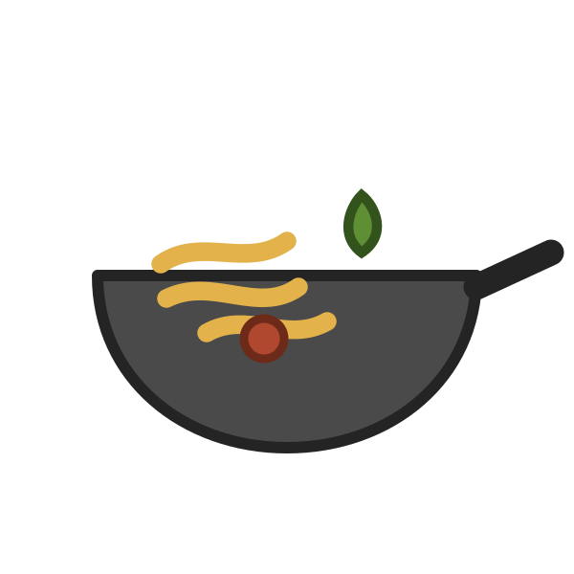


LESSON 4 OF 6
Y8 · Lesson 12
1 / 19
轻松学中文 2 · UNIT 4 · LESSON 12
做得特别好吃
How Well Something Is Done
Lesson 4 of 6 · 50 minutes · 课本 p.115–117

Slide 2
0–8 MIN · 复习
Review · Lesson 3
2 / 19
复习 · 可以 · FIVE ON WHITEBOARDS
WHITEBOARDS · 4 MIN
① Translate: “May I use RMB?”
② 我 ______ 用英语说吗？
③ 我用可以人民币吗？ —— 哪里错了？
④ Write the character for hù, household.
⑤ 一共多少钱？ —— 用中文回答

Slide 3
0–8 MIN · 复习
Review · 练习册 p.131 Ex.8
3 / 19
复习 · 阅读 · 练习册 P.131 EX.8
上个星期天我跟妈妈去市场买菜了。市场上人很多。妈妈先买了两条鱼和一斤猪肉。那天的苹果特别便宜，十块钱九个。妈妈买了二十块钱的苹果。我们还买了八个橙子，花了二十块钱。最后，我们又买了一些青菜。市场离我家很近，我们走路回家了。
对还是错 · TRUE OR FALSE — ON WHITEBOARDS
① 昨天她跟妈妈一起去市场买菜了。 ② 她妈妈买了十八个苹果。
③ 她妈妈没有买蔬菜。 ④ 她们走路回家了。
鱼、猪肉、橙子、便宜 are unknowns. Work around them — that is what the test's reading section asks for.

Slide 4
8–10 MIN
学习目标
4 / 19
LEARNING INTENTION · 学习目标
We are learning to say how well something is done, using 得 after the verb.
SUCCESS CRITERIA · 我能……
1
I can say and write the new words
好吃、特别
2
I can use the 好吃 scale
特别好吃 → 不好吃
3
I can build a sentence with 得
他钢琴弹得很好听

Slide 5
10–20 MIN · I DO
生词 · Cycle 1 of 1
5 / 19
NEW WORDS · 跟我读两遍 · REPEAT AFTER ME, TWICE
hǎochī
tèbié
好吃
特别
delicious
special; unusually

Slide 6
10–20 MIN · I DO
生词 · Cycle 1 of 1
6 / 19
例句 · SEE THEM USED
Zhè ge bāozi hěn hǎochī.
这个包子很好吃。
This bun is delicious.
Zhè jiā fàndiàn de chǎocài bú tài hǎochī.
这家饭店的炒菜不太好吃。
This restaurant's fried dishes aren't very nice.
Tāmen de bāozi tèbié hǎochī.
他们的包子特别好吃。
Their buns are especially delicious.

Slide 7
10–20 MIN · I DO
生词 · Cycle 1 of 1
7 / 19
写一句 · WRITE YOUR OWN
______ 特别好吃。
60 seconds. Name a real dish.
EXTENSION · 加油题
One sentence with 特别 and 可是 —— good and expensive at the same time.
这家的比萨饼特别好吃，可是特别贵。

Slide 8
10–20 MIN · I DO
写字 · 练习册 p.133 Ex.11
8 / 19
写一写 · 特别 是两个字 · 练习册 P.133 EX.11
特
tè
special
10 strokes · 牛字旁
别
bié
other
7 strokes
笔顺 · STROKE ORDER
别 is written 口 first, then 力 —— not the other way round.
Copy each three times. Books closed for the last one.

Slide 9
10–20 MIN · I DO
程度 · 课本 p.116
9 / 19
好吃的程度 · 课本 P.116 WORDS FOR REFERENCE
1
特别好吃
the strongest
2
非常好吃
3
很好吃
4
好吃 · 不错
5
不太好吃
6
不好吃
the weakest
Same shape as the 喜欢 ladder you already know. Read it down, then up.

Slide 10
10–20 MIN · I DO
句型 · The 得 complement
10 / 19
句型 · THE PATTERN
主语 ＋ 动词 ＋ 得 ＋ 很/特别/不太 ＋ 形容词
得 comes AFTER the verb. ✗ 他得跑很快
两种说法 · 课本 P.117 NOTE
Same meaning, two shapes. Both are in the book.
他说汉语说得很好。 他汉语说得很好。

Slide 11
10–20 MIN · I DO
句型 · The 得 complement
11 / 19
模仿我说 · WATCH ME BUILD IT
1
他跑得很快。
2
他跑步跑得很快。
3
他们的饭菜做得特别好吃。
4
姐姐的小提琴拉得不太好听，可是她钢琴弹得特别好。
Two clauses, two 得, and a contrast.

Slide 12
10–20 MIN · I DO
CFU · 检查理解
12 / 19
检查理解 · CHECK FOR UNDERSTANDING
WHITEBOARDS · NO ANSWERS ON SCREEN
1
Does 得 go before or after the verb?
2
Translate: “My dad plays basketball very well.”
3
What is wrong with this?
他跑得快很。
4
Give me the strongest way to say something is delicious.
5
Answer in a full sentence.
这家饭店的饭菜做得怎么样？

Slide 13
10–20 MIN · I DO
课文二 · 课本 p.115
13 / 19
课文二 · TEXT 2 · CD 59 —— 前两句
A
Nǐmen jiā cháng qù fàndiàn chīfàn ma?
你们家常去饭店吃饭吗？
B
Chàbuduō měi liǎng xīngqī qù yí cì.
差不多每两星期去一次。
A
Nǐmen jīngcháng qù nǎ jiā fàndiàn chīfàn?
你们经常去哪家饭店吃饭？
B
Wǒmen jīngcháng qù yì jiā Shànghǎi fàndiàn chīfàn. Tāmen de fàncài zuò de tèbié hǎochī.
我们经常去一家上海饭店吃饭。他们的饭菜做得特别好吃。
先别教 · LEAVE THESE FOR NEXT LESSON
次 and 差不多每两星期 are Lesson 5's business. Read them today — don't teach them.
听懂了吗：他们去哪家饭店？那家饭店的饭菜怎么样？

Slide 14

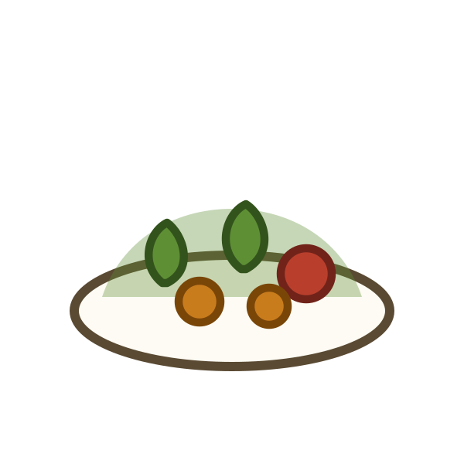



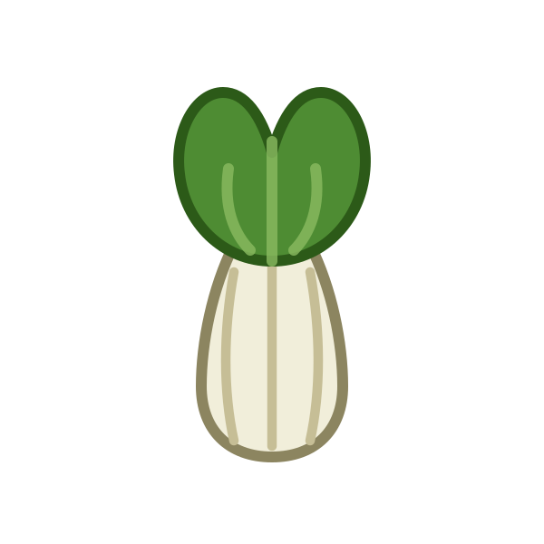
20–27 MIN · WE DO
Activity 1 · 课本 p.116 Ex.8
14 / 19
ACTIVITY 1 · 这……怎么样？ · 课本 P.116 EX.8 —— EIGHT DISHES, ALL OF THEM
炒面
比萨饼
香蕉
炒菜
汉堡包
西瓜
苹果
青菜

Slide 15
20–27 MIN · WE DO
Activity 1 · 课本 p.116 Ex.8
15 / 19
ACTIVITY 1 · 这炒面怎么样？
PAIRS · 7 MIN
A：这炒面怎么样？ B：非常好吃。
Work through all eight dishes.
The rule: no rung of the ladder twice by the same student. That forces all seven degrees into play.
Three pairs read theirs out at the end.
EXTENSION · 加油题
B justifies every answer with a second sentence using 因为 and something from an earlier lesson. Then A asks a follow-up —— and B answers without looking at the board.
不太好吃，因为我不喜欢吃青菜，我一般吃水果。

Slide 16
27–35 MIN · YOU DO
Activity 2 · 课本 p.117 Ex.10
16 / 19
ACTIVITY 2 · 用「得」造句 · 课本 P.117 EX.10
BOOKS · 8 MIN
Six pictures. One sentence each, with 得 and a different degree word every time.
游泳 · 打网球 · 弹钢琴 · 穿衣服 · 画画儿 · 跳舞
Pinyin stays up for two minutes, then comes down.
Then 练习册 p.137 Ex.21 as a fast check —— match the six sentence halves.
EXTENSION · 加油题
Write all six in both shapes, then a four-sentence paragraph about one real person in your family: what they do well, what they don't, what they cook. Every sentence with 得, joined with 可是 and 除了……以外. No word bank.

Slide 17
35–39 MIN · YOU DO
Activity 3 · 练习册 p.134 Ex.12
17 / 19
ACTIVITY 3 · 好 ＋ 动词 · 练习册 P.134 EX.12
WHITEBOARDS · 3 MIN
这条裙子很好看。 ______ 很好喝。 ______ 不好看。
______ 很好吃。 ______ 不好吃。 ______ 很好听。
All held up at once.
EXTENSION · 加油题
Add 好玩 and 好学 to the family, one sentence each —— then one sentence that uses three members of the family at once.
一家人 · ONE FAMILY OF WORDS
好 ＋ 动词 ＝ “good to do”.
好吃 · 好喝 · 好看 · 好听

Slide 18
39–43 MIN · 游戏
Game · 找不同
18 / 19
GAME · 找不同 · ODD ONE OUT
PAIRS · 3 MIN
Which word doesn't belong —— and why, in Chinese? The reason is the point.
① 特别好吃 / 非常好吃 / 不好吃 / 很好吃
② 炒面 / 包子 / 米饭 / 可乐
③ 得 / 很 / 特别 / 非常
④ 好吃 / 好喝 / 好看 / 好人
⑤ 苹果 / 西瓜 / 土豆 / 香蕉
EXTENSION · 加油题
Give a reason that works for a different word in the set too —— so there are two defensible answers —— then argue for yours in Chinese.

Slide 19



43–50 MIN · 小结
Plenary
19 / 19
小结 · PLENARY
SELF-ASSESSMENT · 自评
Traffic light on your whiteboard —— one per criterion. / /
EXIT TICKET · 出门条
Write one sentence with 得 about someone in your family.
On a half-slip. Collected at the door.
下节课 · NEXT LESSON
How often you eat out, and roughly how much it costs.
差不多每两星期去一次。

